Slide 1
Braille E-Reader
Samuel Kostousov
Grade 9
2021

Slide 2
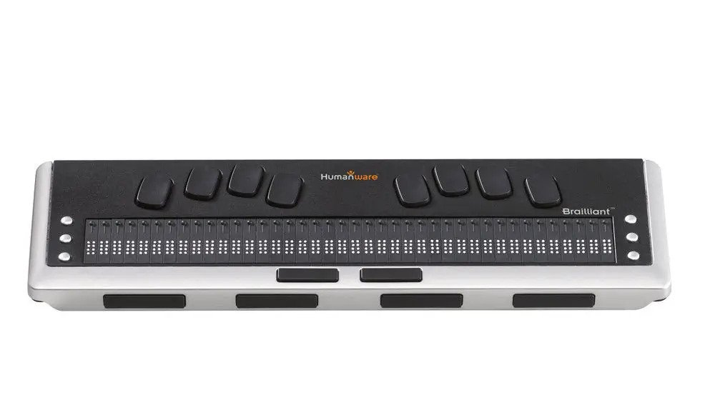
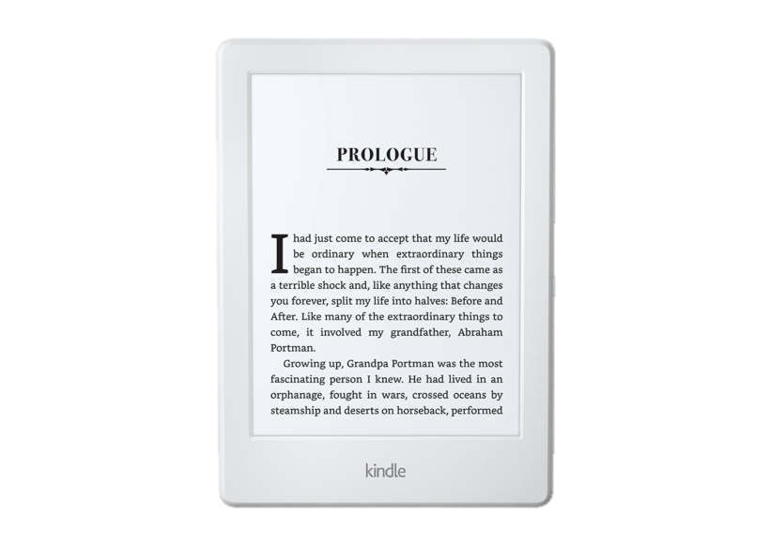
Modern Day Braille Displays
Image Credit: Amazon
Image Credit: Humanware
$3,775
Brailliant BI 40 Braille Display
27 Amazon Kindle Paperwhite E-Readers

Slide 3
Objectives
Create a Braille Display Technology that will be:
Cost affordable
Energy efficient

Slide 4
Side View (One Cell)
Braille Cell Raised
Braille Cell Down
Moving Platform
Braille Cell Raised
Braille Character
(Six-Cells)
Moving Platform
N
S
S
N
N
S
Rotating Platform
N
S
Rotating Platform
Braille Cell Down
Stepper Motor
Stepper Motor

Slide 6
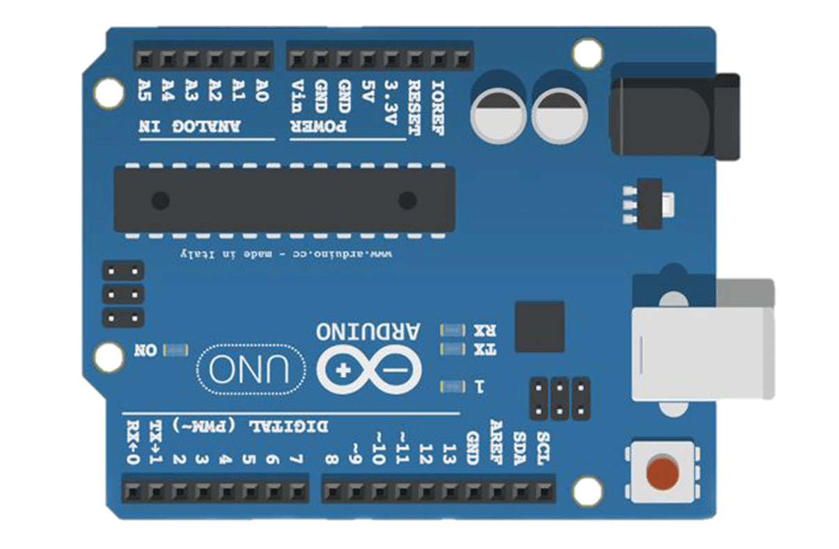
2H Microstep Driver
PUL+
PUL-
Arduino Uno Board
DIR+
DIR-
Power
ENBL+
ENBL-
SW8
ON
SW7
ON
SW6
ON
SW5
OFF
SW4
OFF
SW3
ON
SW2
ON
SW1
ON
Stepper Motor
+
-
DC-
A-
B-
A+
B+
DC+
A+
Power Bank
(Giving off 24V)
A-
B+
B-

Slide 7
Code
Includes the Arduino library
#include <Arduino.h>
#define PULSE_PIN 8
#define ENABLE_PIN 10
#define DIRECTION_PIN 9
void setup() {
pinMode(PULSE_PIN,OUTPUT);
pinMode(ENABLE_PIN,OUTPUT);
pinMode(DIRECTION_PIN,OUTPUT);
digitalWrite(ENABLE_PIN,HIGH);
}
void loop() {
digitalWrite(PULSE_PIN,LOW);
delay(10);
digitalWrite(PULSE_PIN,HIGH);
delay(10);
}
Defines the control pins
Moves one step (7.5°) and then repeats
Sets the previously defined pins to output pins
Sets the driver to ‘on’ (HIGH)

Slide 8
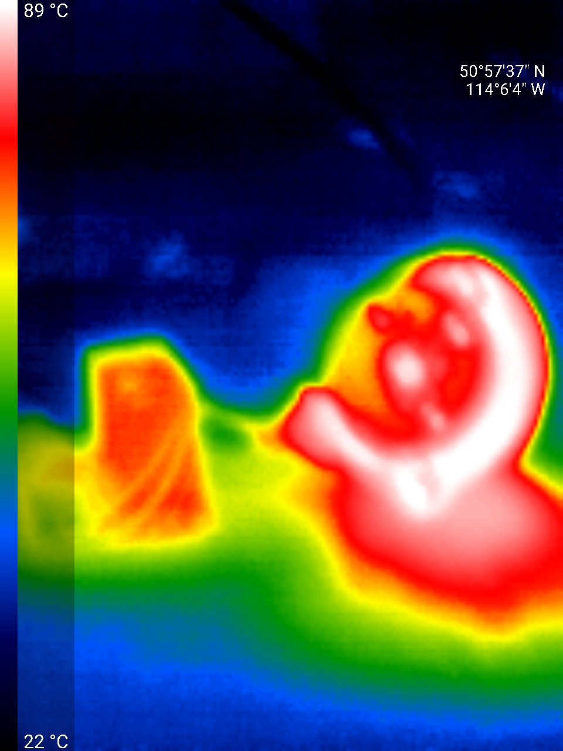
Problems
Problem: The micro stepper motor was too weak
Solution: I tested out the technology on a stronger & bigger stepper motor
P: The motor driver could not handle the required 24 volts and melted my apparatus (Fig.1)
S: I used a stepper motor driver
P: Instead of rising upwards, the moving platform rotated together with the bottom platform
S: I made grooves in the moving platform to allow it to only go upwards
140 C
Stepper Motor
22 C
Fig.1

Slide 9
Improvements
If I were to redo this project, I would:
Order motors from several different suppliers to make sure at least one would suit my needs.
Minimize the amount of area taken up by the tube surrounding the mechanism.
Wire the motor straight to the control board.

Slide 10
Prices
Material | Price
3D printing filament | Approx. $1-$2
12 mini magnets | $0.5
Stepper Motor | $0.75-$4.50
Overall Price of 1 cell: $2.25-$7.00
Overall Price of 1 Braille Character (6 cells): $13.50-$42
My New and Affordable Braille Technology (40 characters, bulk order): $500 - $1680
VS
Brailliant BI 40 Braille Display
My New and Affordable Braille Technology

Slide 11
Conclusion
Although the price is still high compared to regular e-readers, it’s definitely an improvement from the current e-readers available on the market.
The size isn’t ideal, but this can possibly be improved with the use of smaller stepper motors.
Using smaller stepper motors can also decrease the voltage needed, currently at 24v.

Slide 12
Extensions & Future Research
Scale down the size
Put together enough cells for at least one character
Lower the energy consumption
Have a blind person test out the technology
Program it to be able to display text files

Slide 13
Bibliography
Eldridge, A. (2019, Feb 11). Braille. Britannica. www.britannica.com/topic/Braille-writing-system
Eldridge, A. (2021, Jan 02). Louis Braille. Britannica. www.britannica.com/topic/Braille-writing-system
National Federation of the Blind. (2019, January). Blindness Statistics. NFB. www.nfb.org/resources/blindness-statistics
LastMinuteEngineers. (2021). Control Stepper Motor with L298N Motor Driver & Arduino. Last Minute Engineers. https://lastminuteengineers.com/stepper-motor-l298n-arduino-tutorial/
Amazon. (2021). Kindle Paperwhite –Now Waterproof with 2 times the Storage. Amazon. https://www.amazon.ca/All-new-Kindle-Paperwhite-Waterproof-Storage/dp/B07HKYZMQX/ref=sr_1_1?crid=1XCH46ZNYVISJ&dchild=1&keywords=kindle+paperwhite&qid=1615321963&sprefix=kindle+p%2Caps%2C231&sr=8-1
Bridges Canada. (2021). Brailliant BI 40 Braille Display. Bridges Canada. www.bridges-canada.com/products/brailliant-bi-40-braille-display

Slide 14
Image Credit: BrainPrick
Image Credit: Techaeris
Image Credit: Shutterstock
Notes:
Czxdf bmhfgdsa

