Slide 1
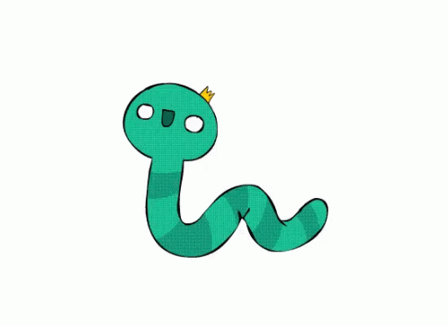
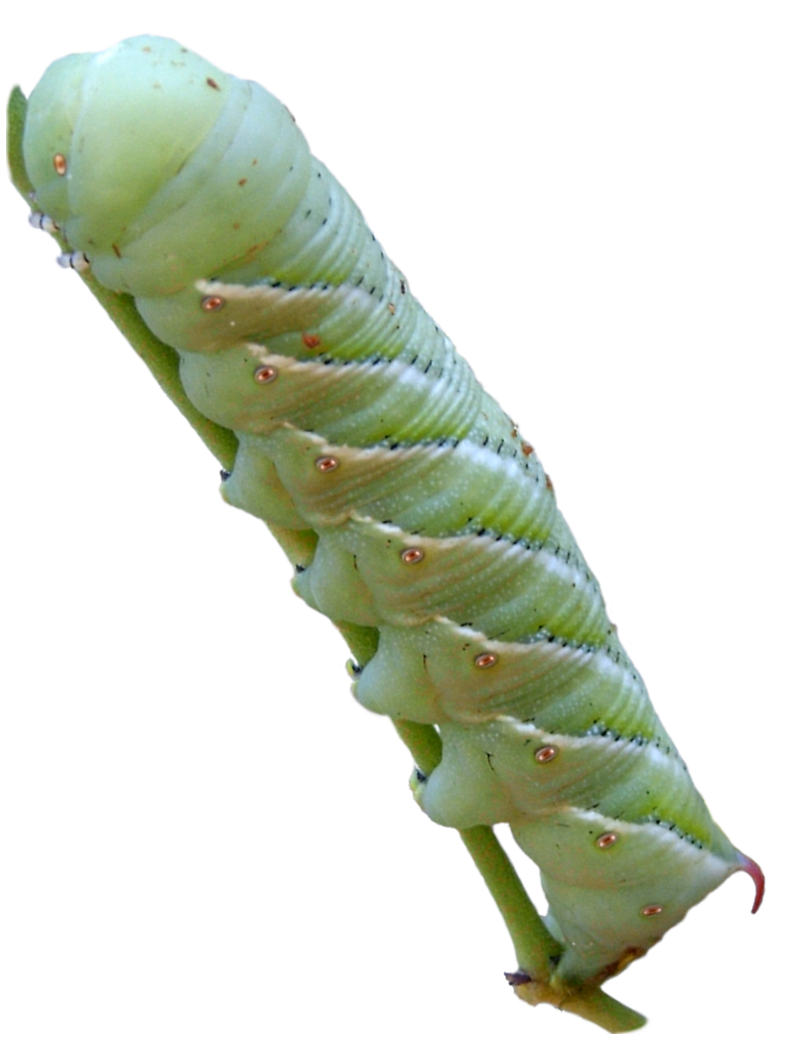
Hornworm help

Slide 2
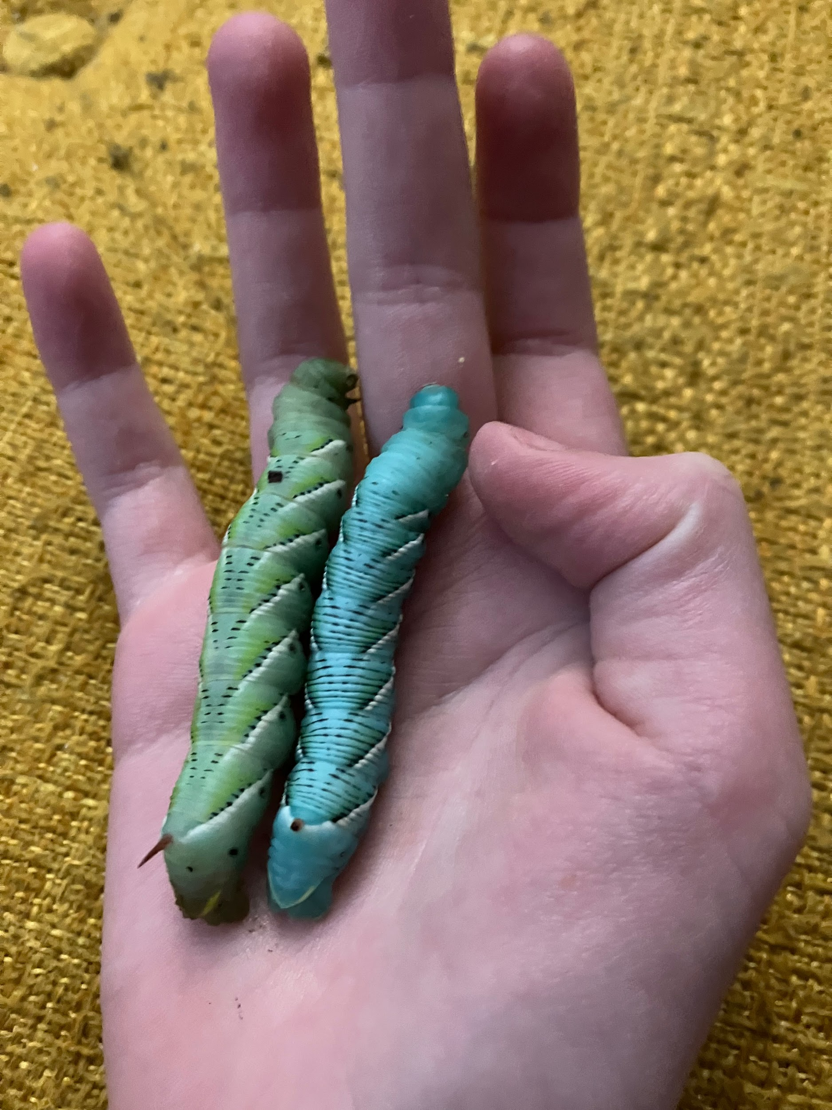
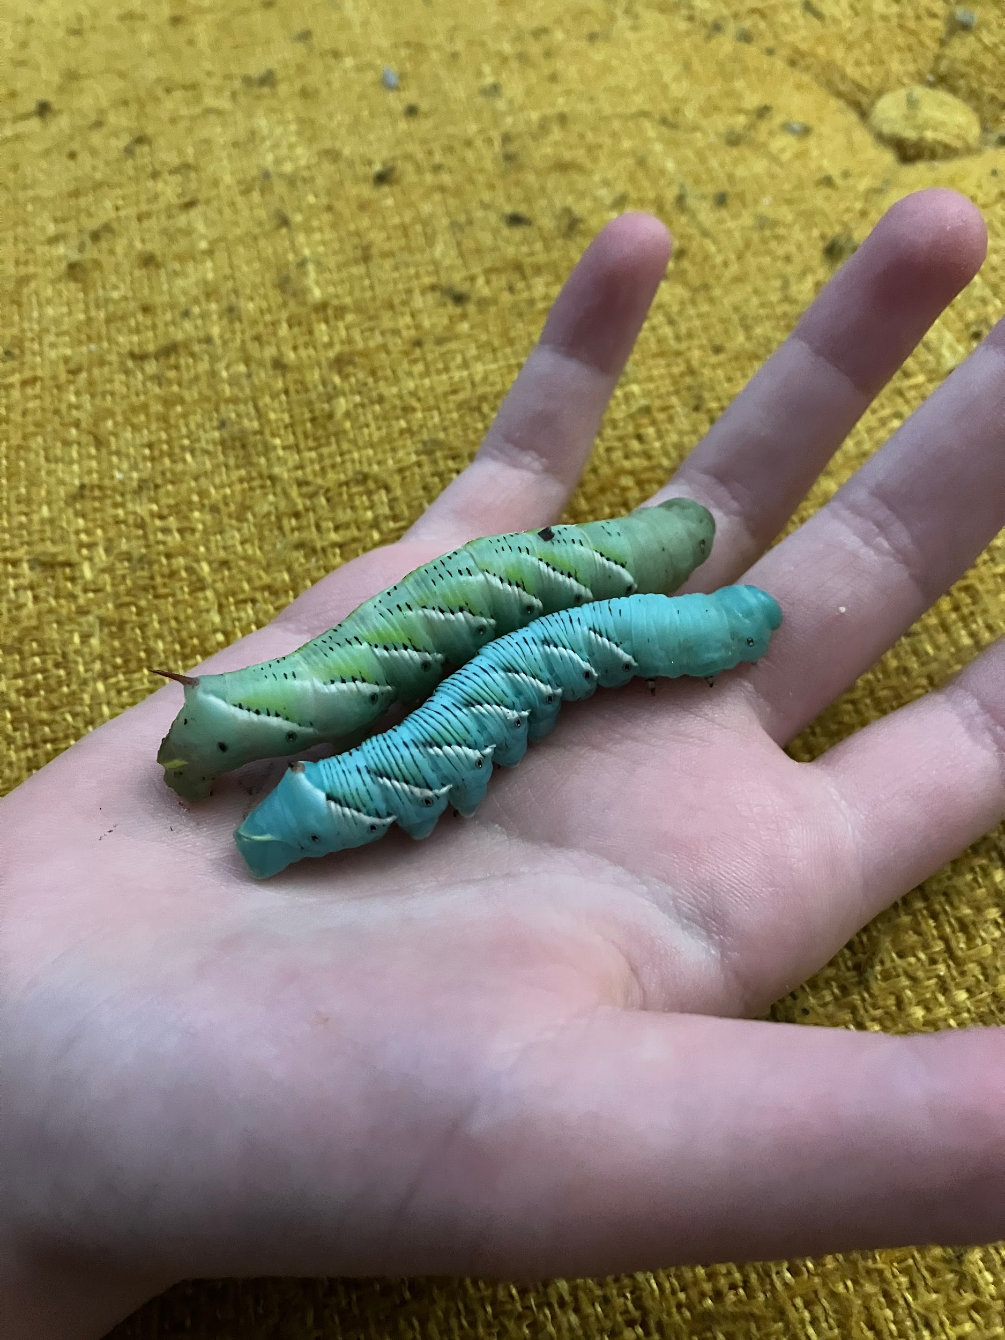
We experimented to see the difference between tomato eating only and hornworm food eating only! Heres the diffrinc
Tomato only
Tomato only
Hornworm paste only
h
Hornworm paste only

Slide 3
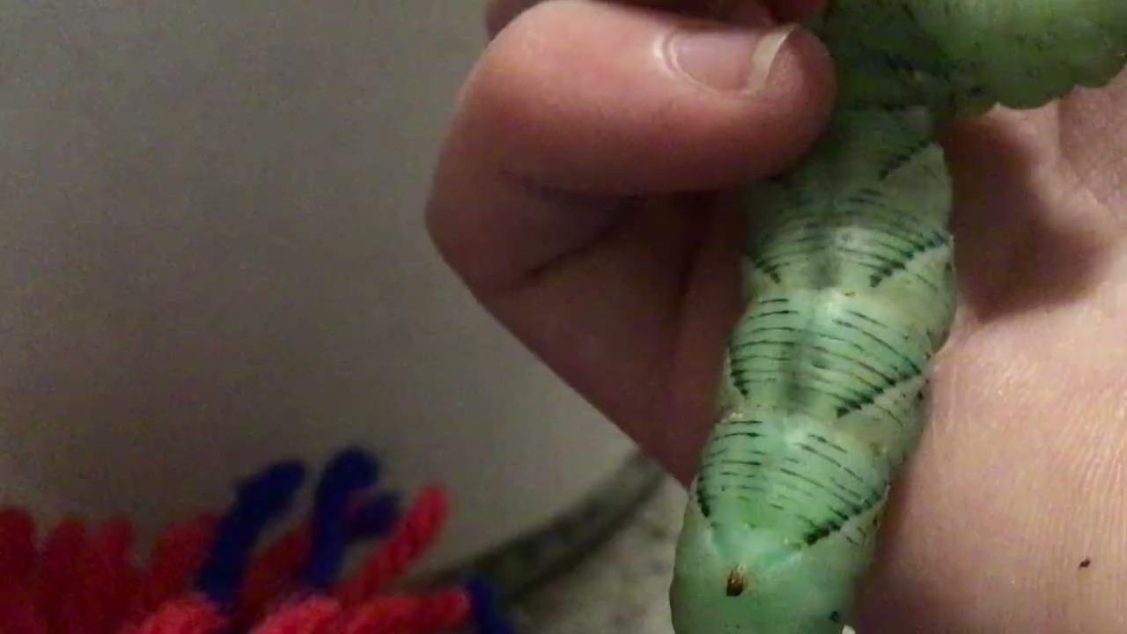
This is called pulsating it means the hornworm is ready to burrow!

Slide 4
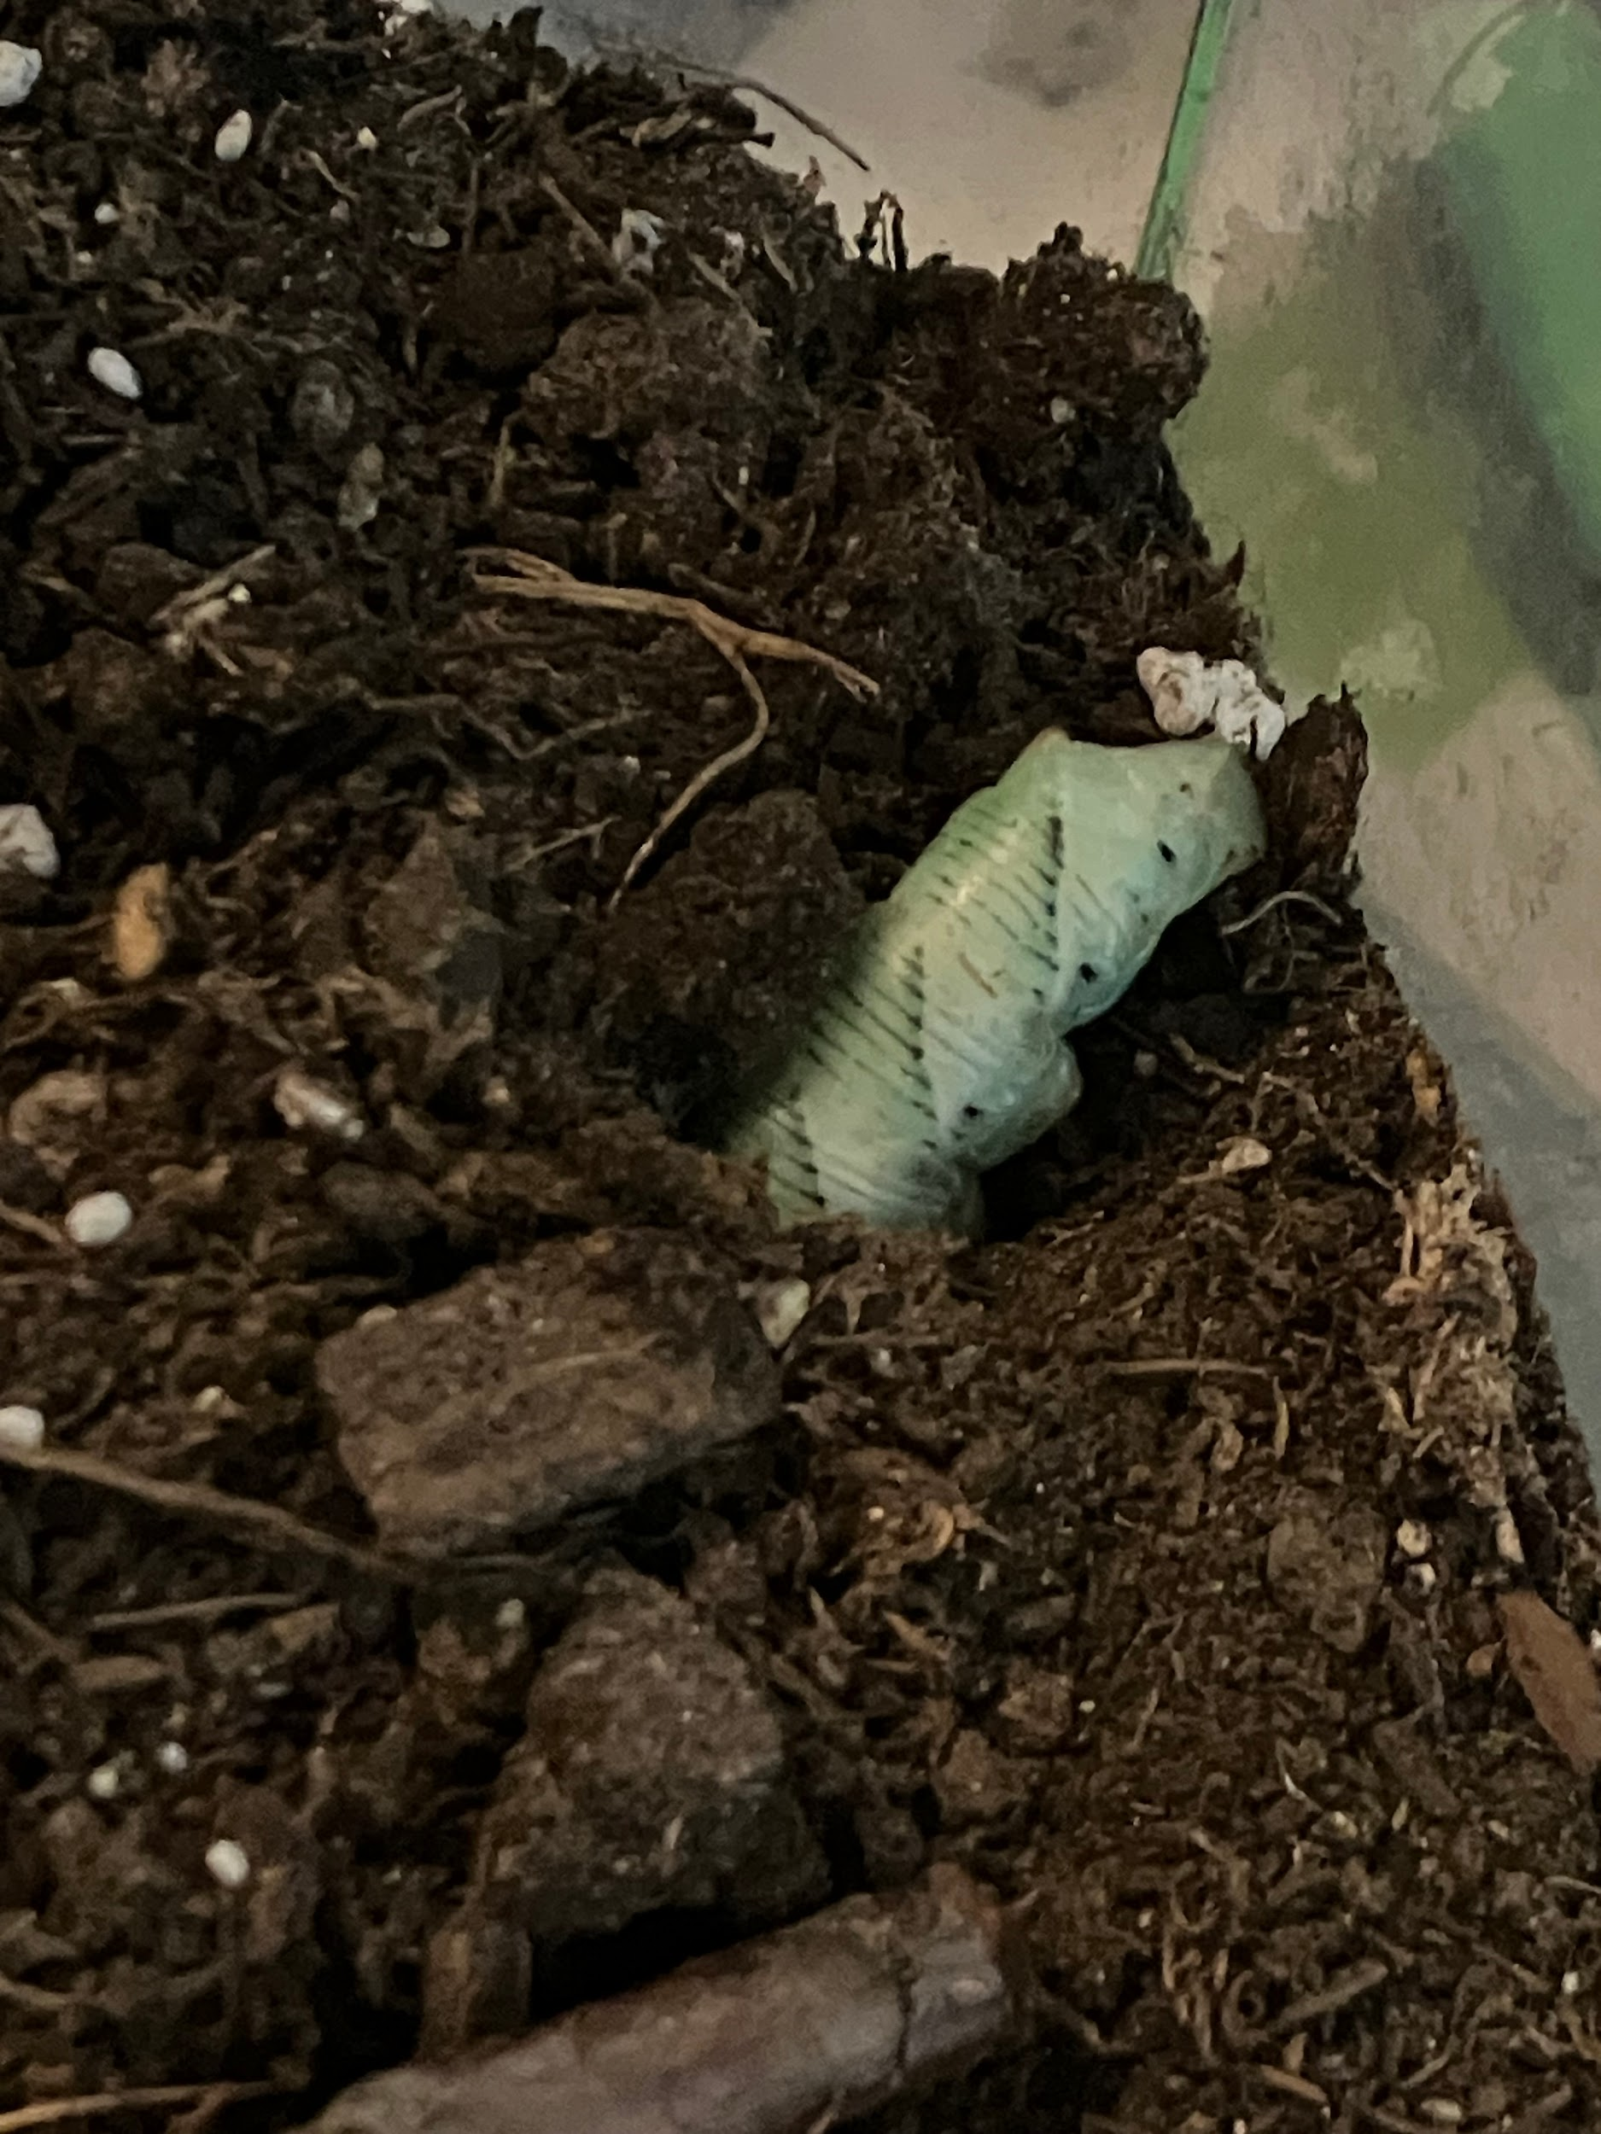
Heres a photo of our hornwormpaste eating hornworm burrowing!!!

Slide 5
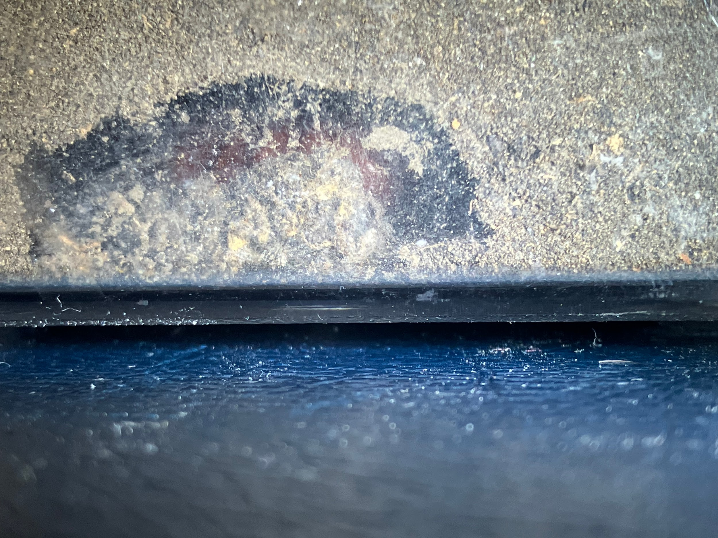
In this photo you can see a tiny bit of the pupa

Slide 6
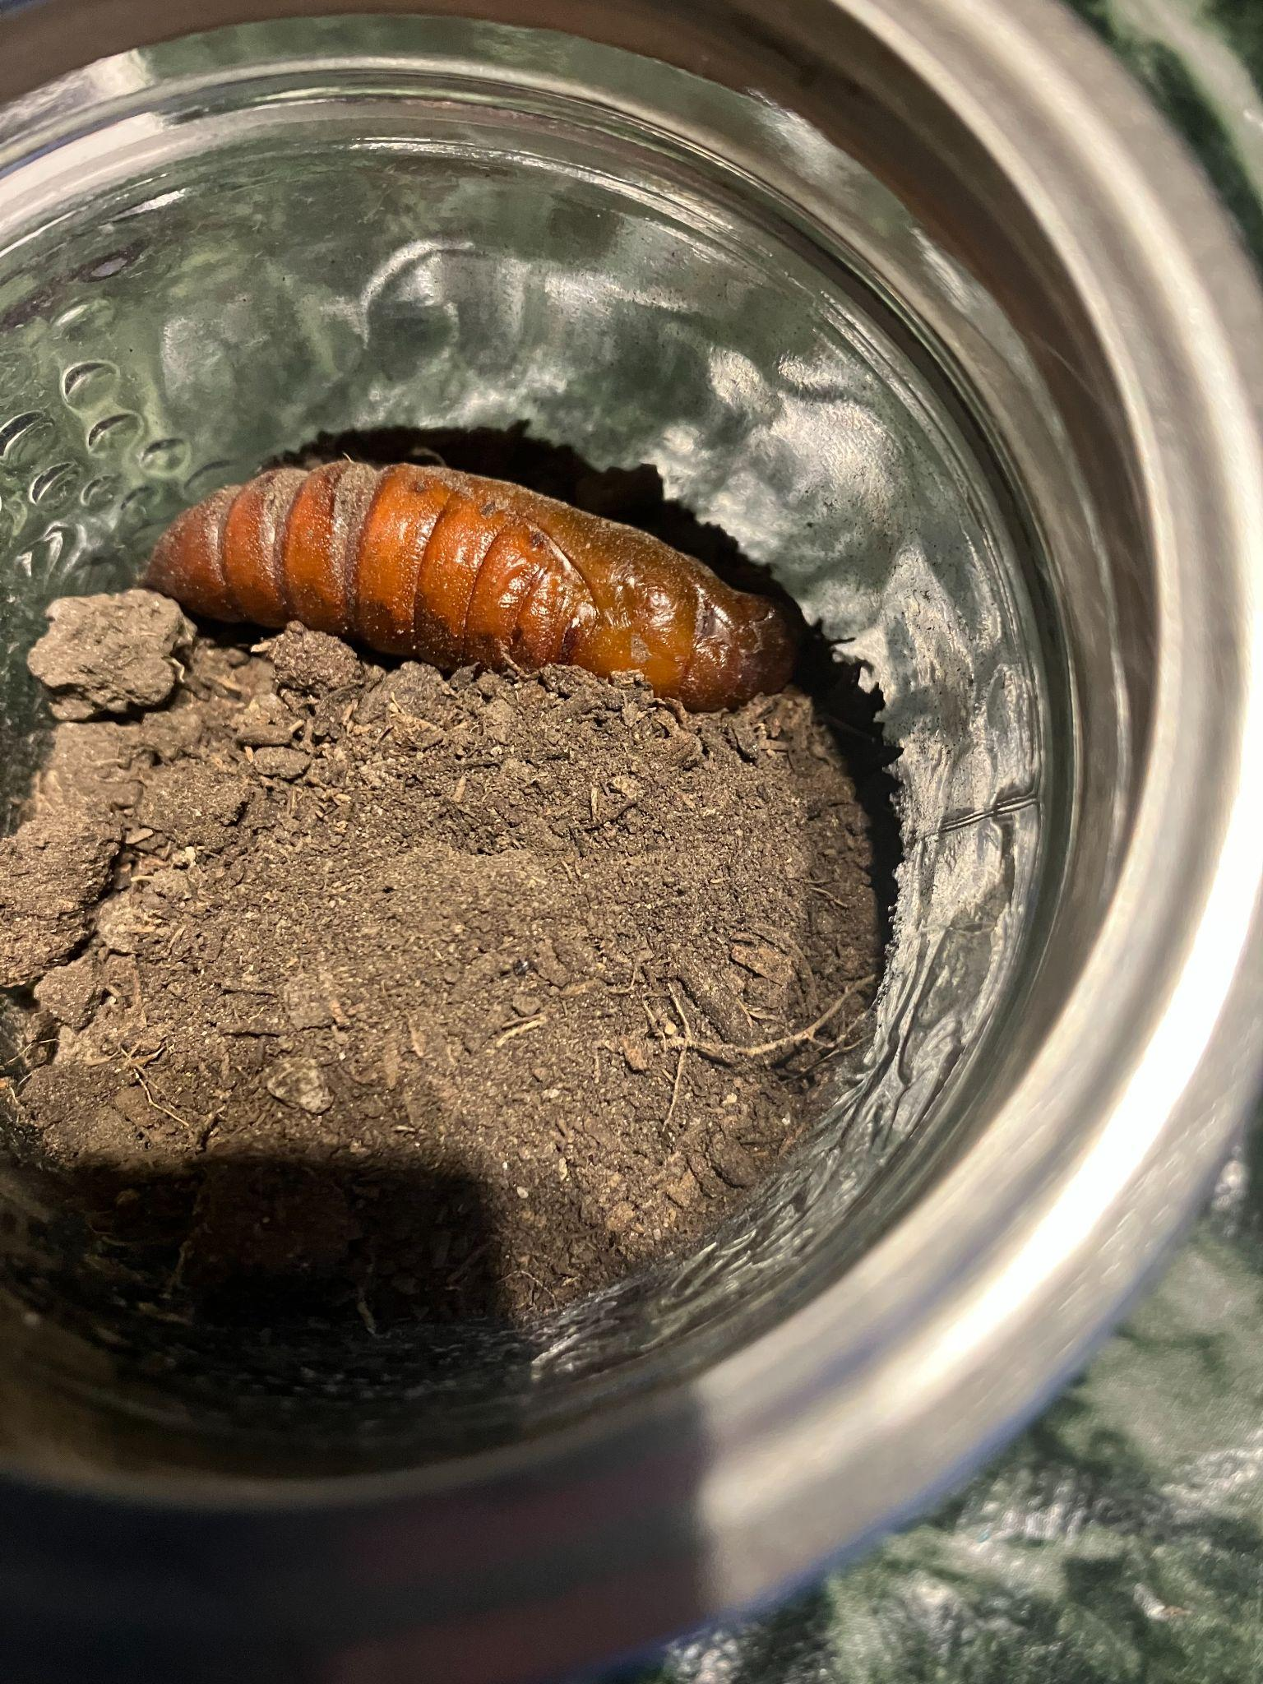
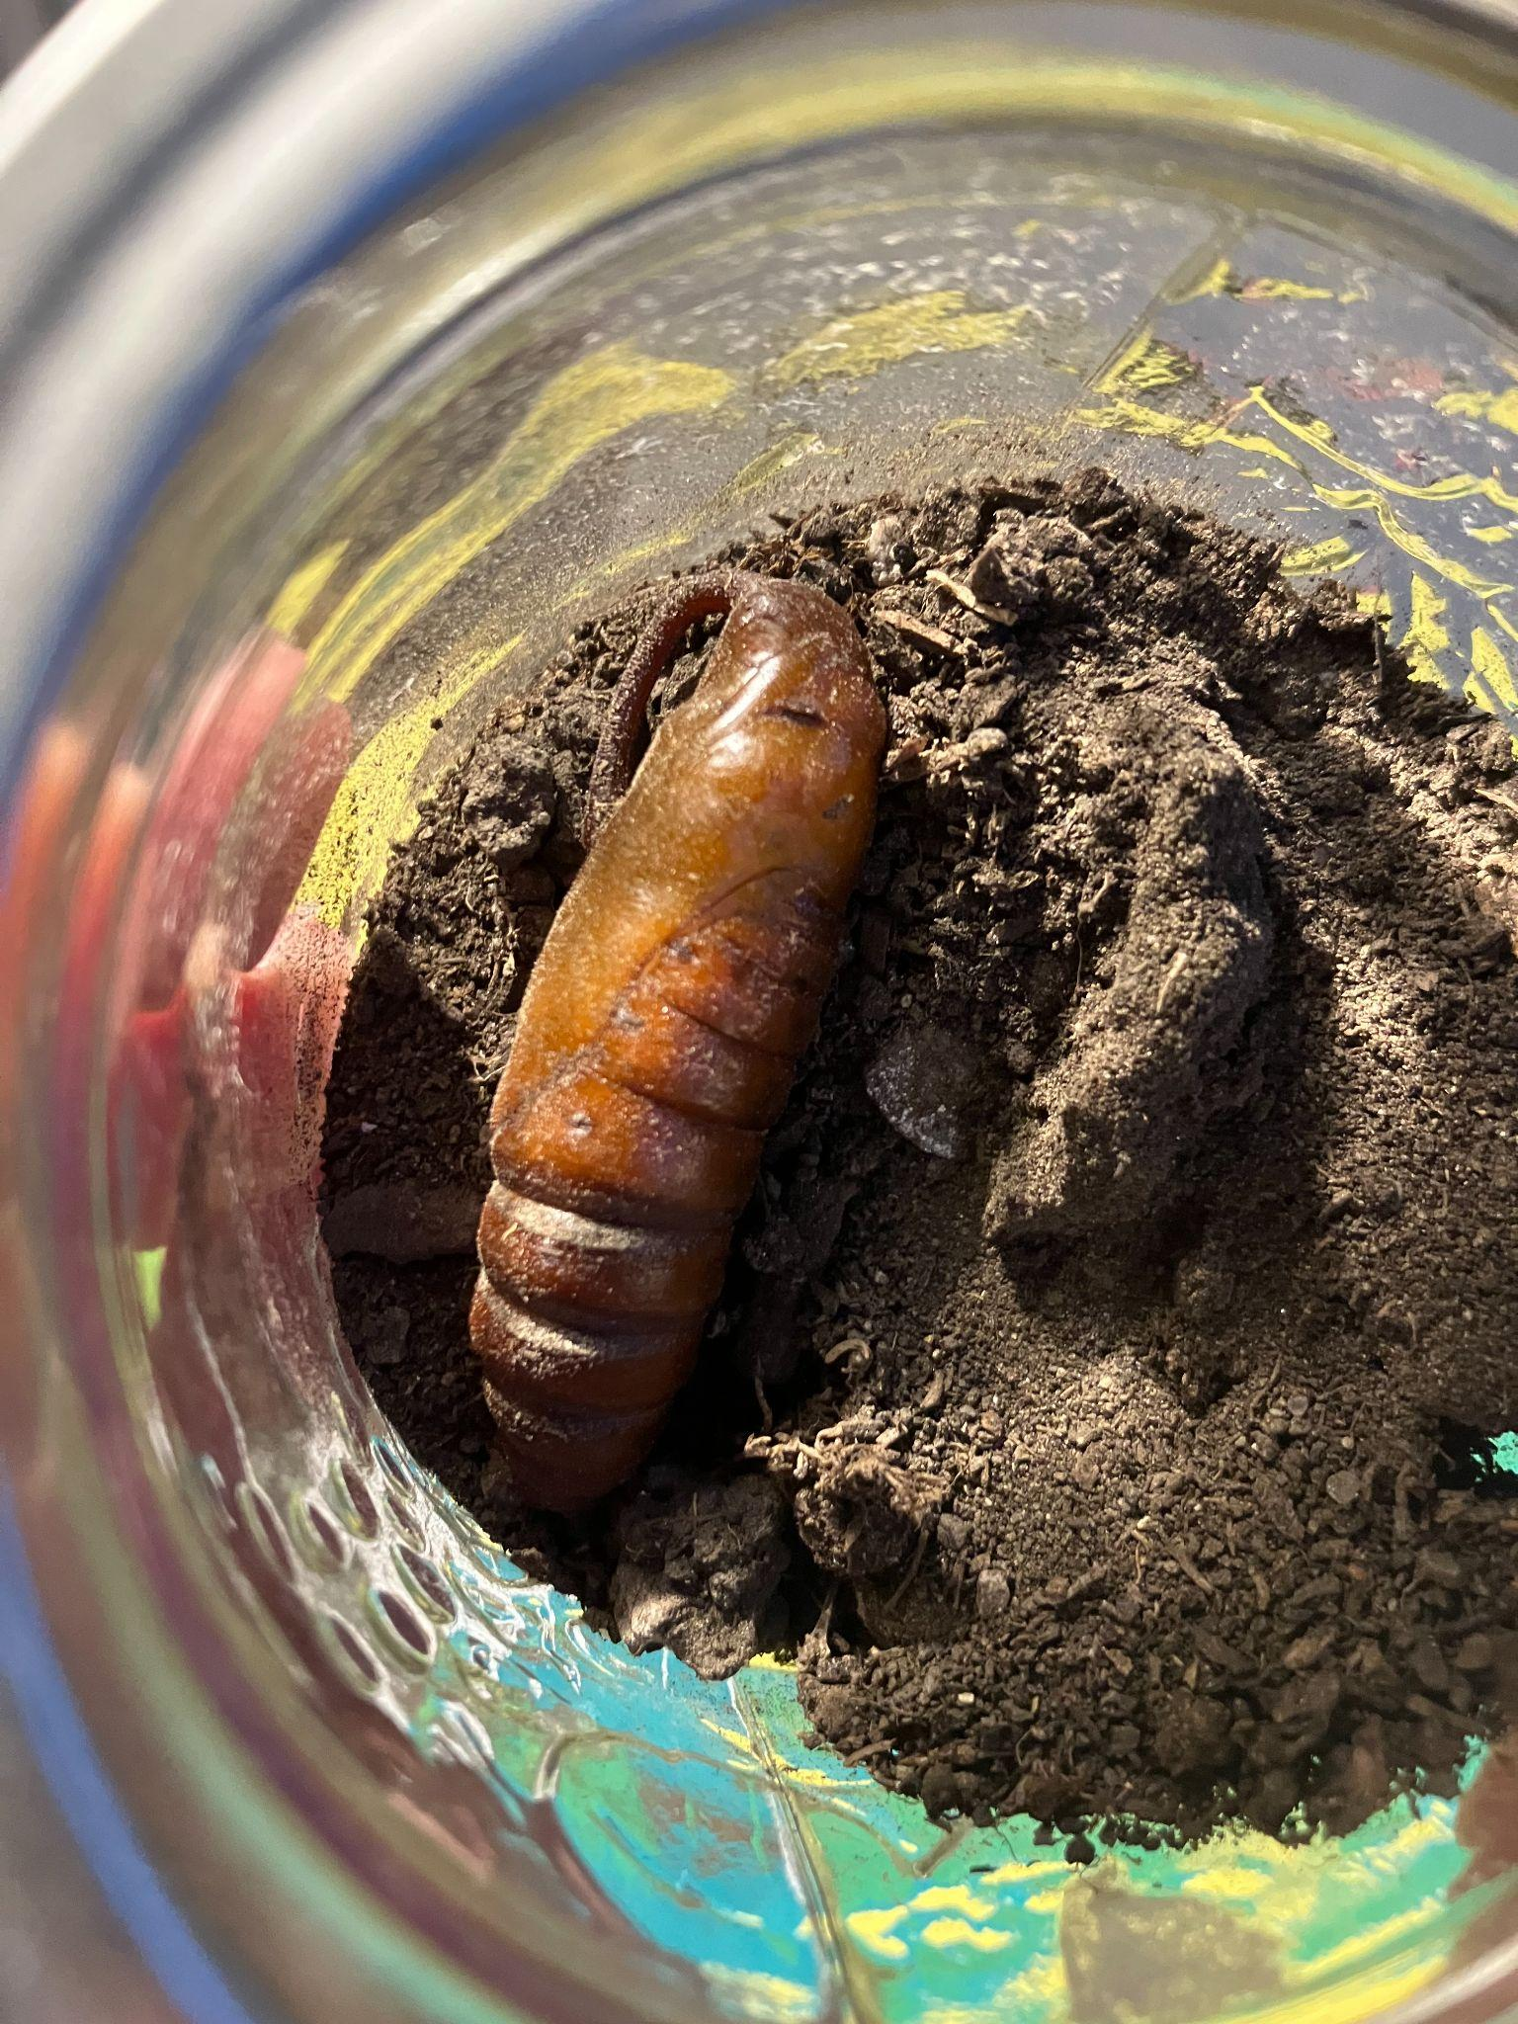
This is our hornworms pupa after we took it out of the soil!

Slide 7
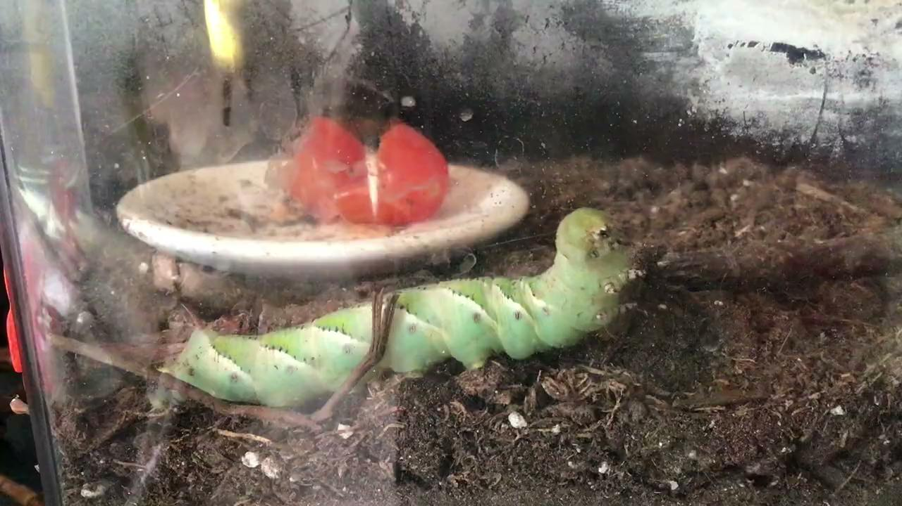
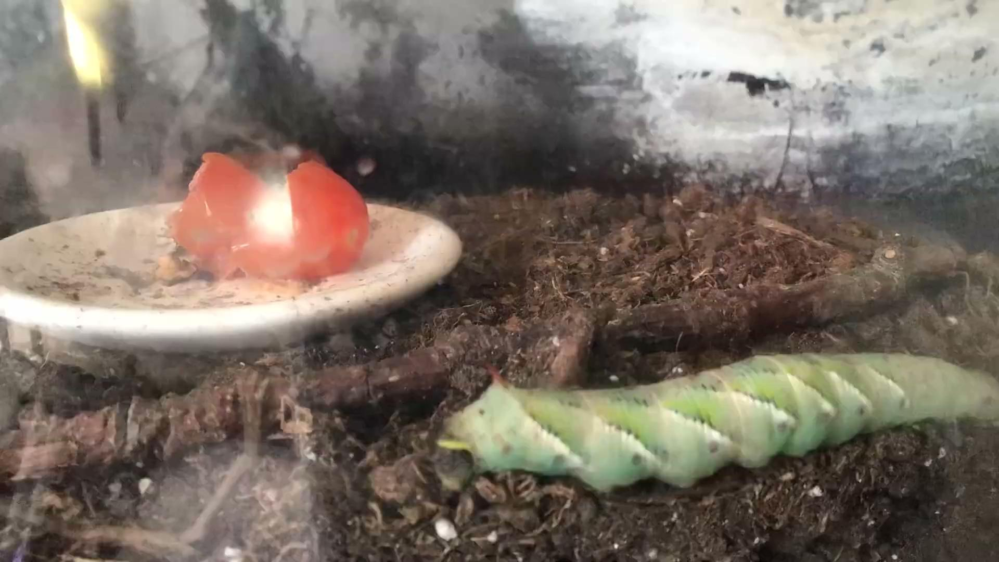
Heres some videos of our tomato eating hornworm crawling around, maby its looking for a spot to burrow?
Unfortunately it did not burrow and passed away.

Slide 8
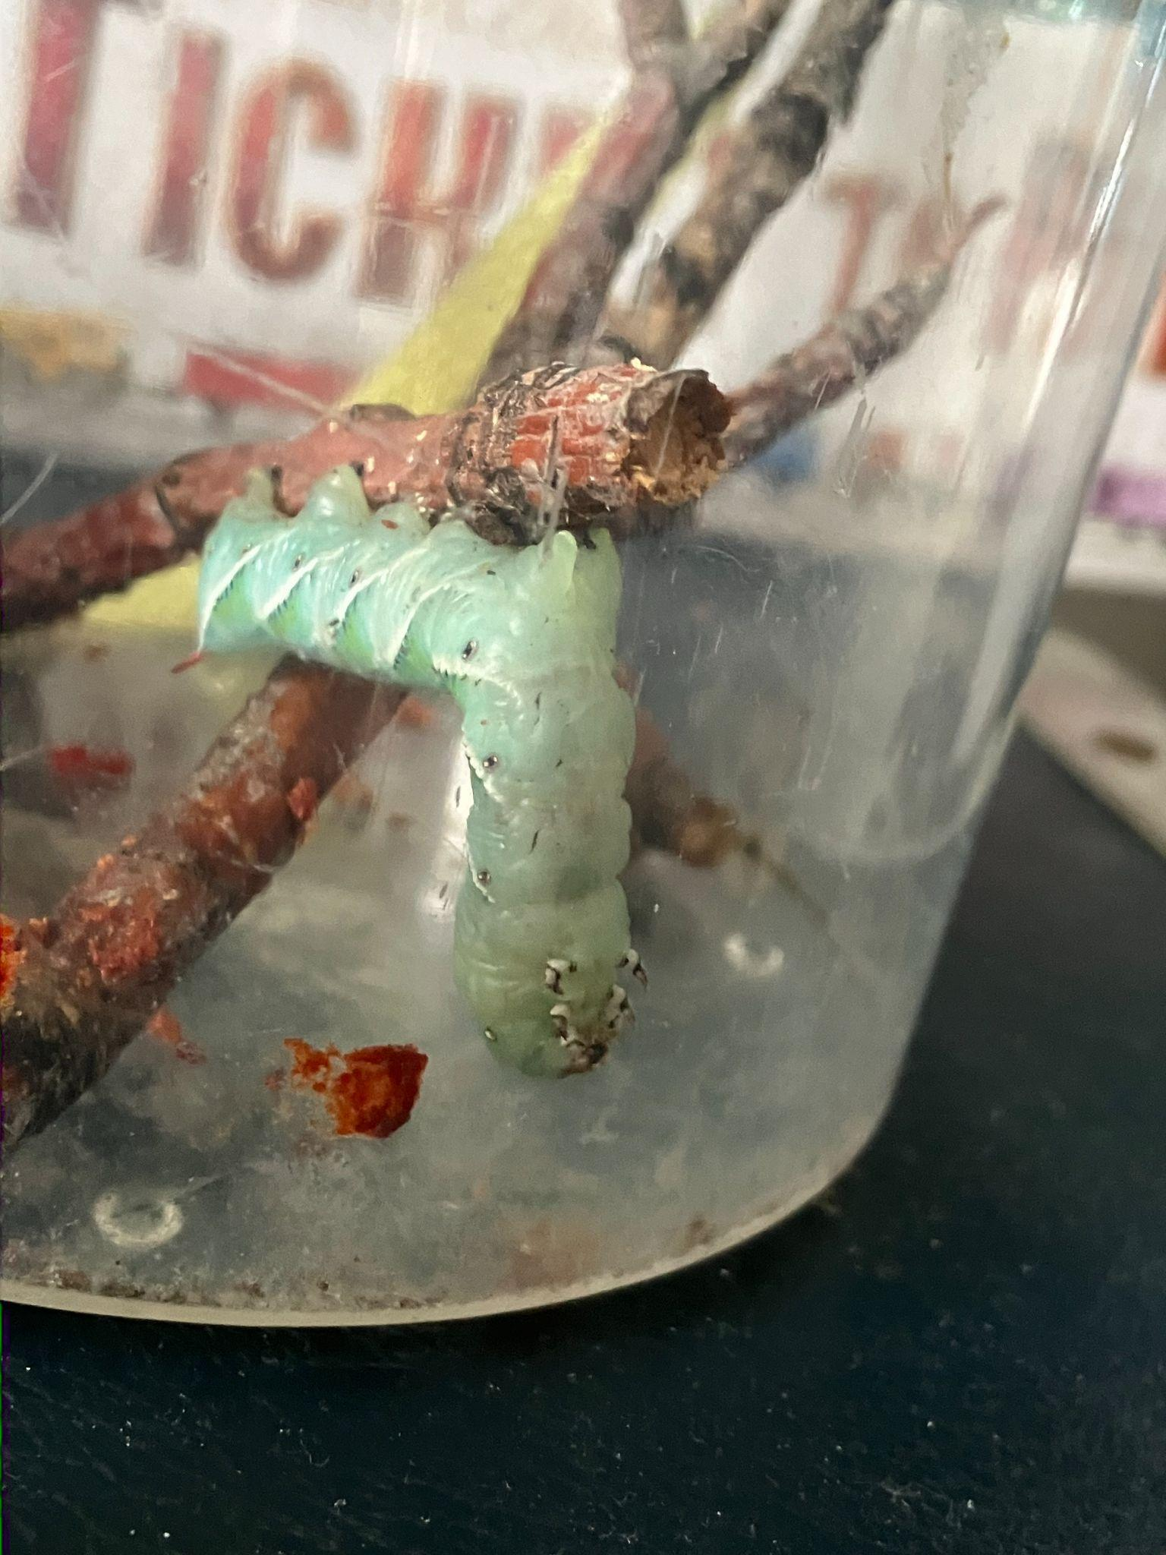
Hornworm yoga!

Slide 9
The end!

