Slide 1
Drugs And Genetics: The Genetic And Non Genetic Relation With Various Responses To Medications
By: Anay Shroff
Grade: 9
School: Fairview Jr. High

Slide 2
Table of Contents
Problem
Hypothesis
Research
Intro to research
General Medicines And Changes To Effectivity And Reactions
Prescription Medications And Changes To Effectivity And Reactions
Over the Counter Medicines And Changes To Effectivity And Reactions
Prevention of Reactions
Data
Conclusion

Slide 3
Problem

Slide 4
The Question I researched
Why do some people respond to medical drugs different than others and how is this related to genetics?

Slide 5
Hypothesis

Slide 6
My Educated Guess At The Beginning Of The Project
If I research about why some people respond to medical drugs differently than others, then, I think I will find that it is because of their genetic properties, because, the way you react to a medicine is based on the way that your body is built and the things that your body can and can not tolerate and these things are based on your genetic makeup.

Slide 7
Research

Slide 8
Intro to Research

Slide 9
Introduction
There are two different types of things that can happen if a medicine doesn’t work as intended
These are:
A change in the effectivity of the medicine
Adverse drug reaction occurring

Slide 10
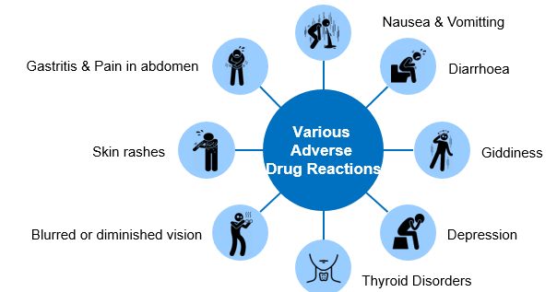
Adverse Drug Reactions (ADRs)
A type of reaction to medicines that can happen when taking a medicine
They are possible when there is a genetic mutation or when a certain patient related factor is causing the reaction

Slide 11
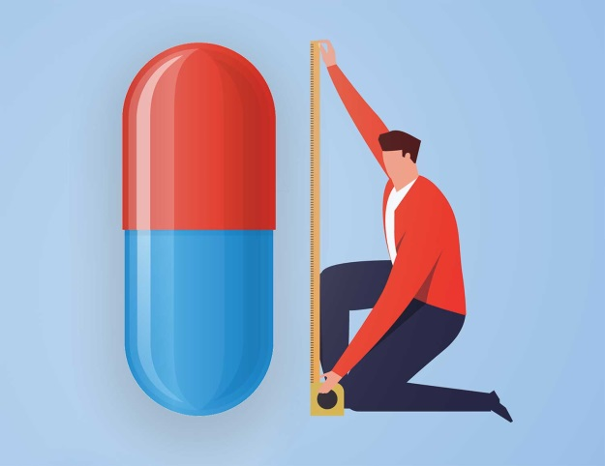
Change in Effectivity
When the medicine is either:
Less effective than intended
More effective than intended
Generally, problems occur when
the medicine is less effective than intended
There are two predominant reasons for this occurring:
Genetic related factors
Patient related factors

Slide 12
Part 1: General Medicines And Changes To Effectivity And Reactions

Slide 13
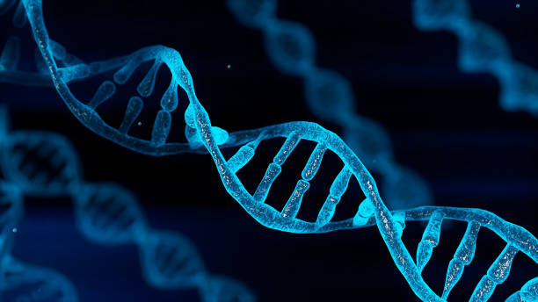
Genetic Factors Causing ADRs Or Changing Effectivity In General Medicine

Slide 14
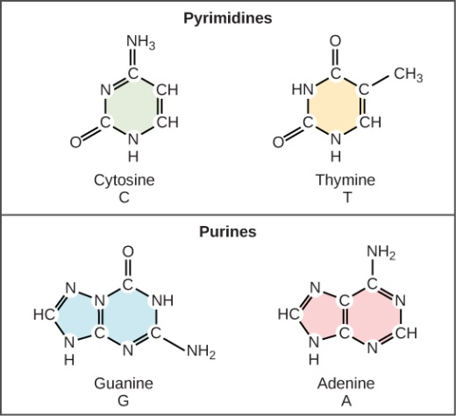
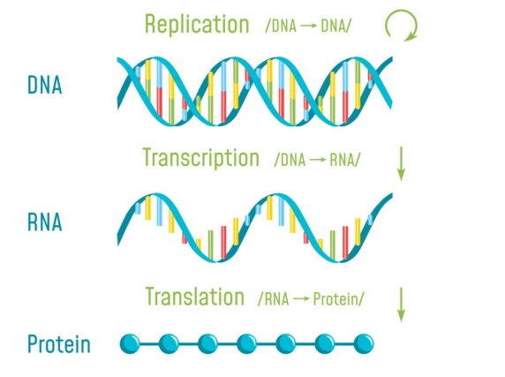
Genetic Mutations
There are 4 types of DNA nucleotides and they are shown in
the picture(top)
DNA is turned into mRNA through a process called
transcription which is then turned into proteins the process of
translation
Proteins are responsible for most of the functions of the cells in the body
Through the lengthy process, it is possible that a mutation in a
single DNA nucleotide called and SNP (Single-nucleotide Polymorphism) could
occur
If this occurs, it could cause the protein made in the end to be dysfunctional or completely useless
These differences are enough to be able to cause an effect on how our body handles a medicine
Drugs interact with signalling pathways called biochemical
pathways in very specific ways
These biochemical pathways use proteins to function properly
If the drug interacts with a protein that is dysfunctional,
the response to the drug and the effectivity of the drug
could drastically change

Slide 15
Differences In RGS Proteins
RGS proteins are responsible for regulating signals coming in from surface cell receptors of our body
There are commonly differences in these proteins that cause the same drug to have a different impact on the cell receptor (normally for medications used to stimulate cells)
RGS proteins provide a braking function for GPCR receptors
These receptors control hundreds of functions in our bodies and impact things like mood disorders, heart disease, and vision impairments
GPCRs are the main group of receptors targeted by medicines
A third of FDA approved medicines target GPCRs
GPCRs initiate cell signalling using G-proteins
RGS proteins help shut of the cell signalling (regulators of G proteins)
This shutoff device limits the G-protein signalling to only a brief amount of time
This allows the cells to reset and accept new signals
Without RGS proteins, the GPCR-initiated signal stays on for too long
This causes the cell to become dysfunctional
Genetic variation in the RGS proteins has the possibility to disrupt normal GPCR signalling
As a result of that, different individuals can have wildly different responses to the same GPCR targeting drugs

Slide 16
Patient Factors Causing ADRs Or Changing Effectivity In General Medicine

Slide 17
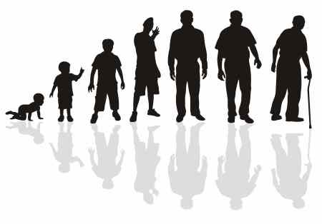
Age
All medicines can cause ADRs, but not all
patients develop the same level and/or the
same type of ADRs
Age is a very important factor which affects the
occurrence of ADRs
The risk of ADRs is elevated for:
For elderly patients who have multiple medical problems and are taking multiple drugs because there are more chances for two medicines to react with each other
Those who have a history of ADRs, and those with a reduced capacity to eliminate drugs from their body after the intended use is complete are also at high risk for ADRs
Elderly and young patients are also particularly vulnerable to ADRs because the drugs are less likely to be studied extensively in these extremes of age
Age can also be a factor because of dosage requirements and if the incorrect dose is given, an ADR can be caused or the effectivity of the medicine can be altered

Slide 18
Gender And Body Weight/Fat Distribution
Gender:
The biological differences of males and females can have an effect on the action of many drugs
There are several anatomical differences between males and females including body weight, body composition, gastrointestinal tract factors, liver and metabolism factors and these can all cause differences in whether ADRs occur
Body Weight and Fat Distribution:
Medicines are distributed to and from blood and various tissues in the body such as fat, muscle, and brain tissue
As the blood recirculates, the drug moves from the bloodstream into the body’s tissues
Once absorbed, most of the medicines do not spread evenly in the body
Some of them dissolve in water while others stay within the blood and the fluid that surrounds the cells
The drugs that dissolve in fat tend to concentrate in the fattiest tissues of the body
Some drugs leave the bloodstream slowly because they have bonded tightly with the proteins circulating in the blood and can act as reservoirs for the drug causing a reaction
Others leave the bloodstream very quickly, because they are less tightly bound to blood proteins and can cause the effectivity of the medicine to be reduced

Slide 19
Drug Related Factors Causing ADRs Or Changing Effectivity In General Medicine

Slide 20
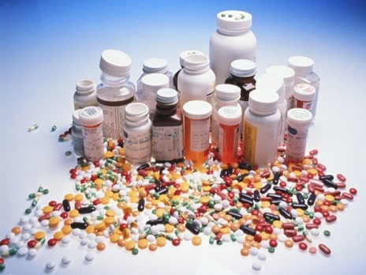
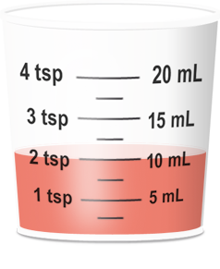
Polypharmacy and Drug Dosage/Frequency
Polypharmacy:
Taking several drugs, can add to the risk of having an ADR or the
the effectiveness of the drug dropping because the number and
severity of ADRs increases as the number of drugs taken increases
If there are more drugs being taken, it is also possible that they interact with each other and lower the effectivity of all the medicines involved
Dosage/frequency:
Drug dosing has an effect on the development of ADRs in many ways
some drugs need to be taken in the morning while others need to be taken in the evening
Some need to be taken at bedtime
Dosing and frequency can also have change the effectiveness of a
medicine
If a medicine is taken at the improper time it is possible that the
medicine will not be as effective
If the dosage is improper for the patient, the effectivity will
also change

Slide 21
Part 2: Prescription Medications And Changes To Effectivity And Reactions

Slide 22
Effectivity Of The Medicine

Slide 23
Effectivity
The main factor that influences prescription medicine effectiveness is resistance being built up to the medicine
This is a big issue for prescription medicines because they are often higher dose and are used for longer periods of time for treatment
If resistance is built to a certain medication then the medication will no longer work or will work but not very effectively
This could occur because of the body’s and the disease’s genetic make-up but happens most often because of using a medicine with certain ingredients repeatedly
For example, if the same antibiotic is given for every bacterial infection, the bacteria in the body can build resistance to that medicine which makes it useless after
The patient profile of past medical history and treatment comes into play more than genetics for the effectiveness of medicine on a patient
These issues tend to occur on prescription medicine more than others because of the prescription medicines being higher dose and containing ingredients that are stronger and have a bigger impact on the body

Slide 24
Normal Reactions To Medicine

Slide 25
Normal Reactions
Reactions to prescription medicines are more related to the genetics of the body and the type of body the medicine is given to
Patient profile doesn’t come into play as much
Reactions are more based on the patient’s body and are more based on genetics when it comes to ingredients of the medicine
Some body types and genetic makeups don’t allow for a certain medicine’s ingredients to be handled by the body so there is a reaction

Slide 26
Allergic Reactions To Medicine

Slide 27
Immunoglobulin E and T-Cell Expansion
Immunoglobulin E
One of the types of immune reactions is caused by the production of antibodies known as Immunoglobulin E or IgE
These antibodies travel to cells in the body that release hormones that trigger an immediate allergic reaction within the body
This reaction causes all the normal symptoms of allergic reactions
This reaction can occur in a matter of minutes or can take hours to occur which can lead to it being picked up fairly easily
T-Cell expansion
The more common type of allergic reaction to a drug is caused by the expansion of T-Cells(a type of white blood cell)
The T-Cells often detect the medicine and label it as an intruder or allergen which causes a full immune response
These responses caused by T-cells often take weeks to fully start so they are much tougher to pick up
It is also harder to figure out which drug caused the response because there is so much time between the drug being taken and the reaction

Slide 28
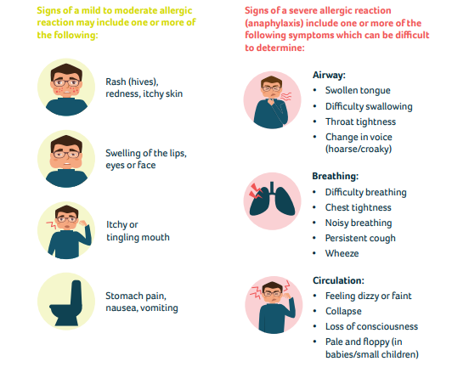
Anaphylaxis

Slide 29
Other Factors for Prescription Medicine Related to Effectiveness and Reactions

Slide 30
Genetic Differences
The liver has a collection of enzymes that break down many drugs so they can be removed from the body after their intended use is completed
The DNA or genetic material of cells contains the blueprint on how to create these enzymes that break down the drugs
Some people have small errors in their DNA called polymorphisms
These errors result in the enzymes not working as they are intended to
This is an issue with specifically prescription medicine because they are often harder to break down because they are stronger and more powerful causing the blood concentration to rapidly rise
If this rising blood concentration is more than the amount that can be tolerated by our bodies, serious reactions can occur
This can also reduce the effectivity of the medicine because the medicine can often end up in the wrong place which means that it won’t help treat the issue that the patient is having

Slide 31
Drug Interactions and Lack of Receptors to Bond With
Drug interactions
A big factor for prescription medicine is the interaction of several medicines taken together
This is a big factor because if different medicines with different can reduce each other’s effectiveness or cause reactions
This is a very important factor for prescription medications because they are often higher dose and contain more stronger and powerful ingredients
Lack of Receptors for the drug to bond with
Some people don’t have many receptors in the body that are capable with binding with the drug and helping with the drug’s effectiveness
Other people have the receptors but they are dysfunctional and don’t bond properly with the drug
This could be due to genetic mutations or other disease the patient has
As a result of this, the effectivity of the drug would be reduced because less receptors are able to bond with the drug so the drug is able to help with the issue less than it would be able to otherwise if the receptors were working

Slide 32
Part 3: Over the Counter Medicines And Changes To Effectivity And Reactions

Slide 33
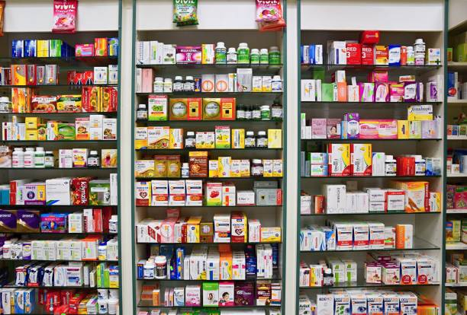
Intro to OTC(Over the Counter) Medicines
Medicines that don’t require a doctor’s
prescription are known as OTC medicines
These medicines help treat a variety of illnesses
The main factor that influences ADRs and
effectivity for OTC medicines is when they are used incorrectly
All of them do include usage instructions but not all people follow these instructions
OTC medicines are less powerful and stronger than prescription medicines
if used in the correct way, there is a very low possibility that an adverse drug reaction will occur or the effectivity will be reduced
There are reactions caused by OTC medicines are normally not serious and human error is their main cause
The effectiveness of the OTC drugs however depends much on the same factors as prescription medicine effectiveness
These are factors like age, dosage, and ingredients of the medicine

Slide 34
Examples of Human Errors Causing ADRs
DXM:
DXM (Dextromethorphan) is an opioid OTC medicine that is used for cough and cold treatment
This medicine does not have an effect on pain reduction and does not act on the opioid receptors in the body
In normal circumstances, the drug does not have an ability to cause ADRs
When taken in a dosage that is more than normal, DXM is able to cause a depressant effect and/or a hallucinogenic effect (an effect altering) a person’s view of reality
Repeatedly taking higher doses of DXM can cause an addiction to be formed
this can cause major damage to the body in places such as the brain
can even put the body in life threatening scenarios

Slide 35
Adverse Effects Caused by OTC Medicines
Sometimes OTC medicines can cause unpleasant effects called adverse effects
These effects are not adverse drug reactions and most of the time are not life threatening
These effects can also lead to a reduction if effectivity of the OTC medicine
These effects include side effects, drug interactions, and allergic reactions

Slide 36
Side Effects and Allergic Reactions
Side effects:
Side effects are effects on the body that OTC medicines have which don’t help the symptoms of the problem in the body
Side effects can also lead to decreased effectivity of the medicine if there are more side effects than good effects
A few examples of side effects are nausea, or dizziness
Side effects are different from drug allergies because side effects occur to most people who take the medicine while allergies only occur to a few
Allergic reactions:
Some people have allergies to certain OTC medicines
This is not very common because OTC Medicines generally have less powerful ingredients
Signs of an allergic reaction are itching, hives, or trouble breathing
Reactions to a medicine can occur at any point during the use of the medicine
For example, if you take a medicine and have no effect the day you take it, if you take the same medicine a month later, you might have an allergic reaction

Slide 37
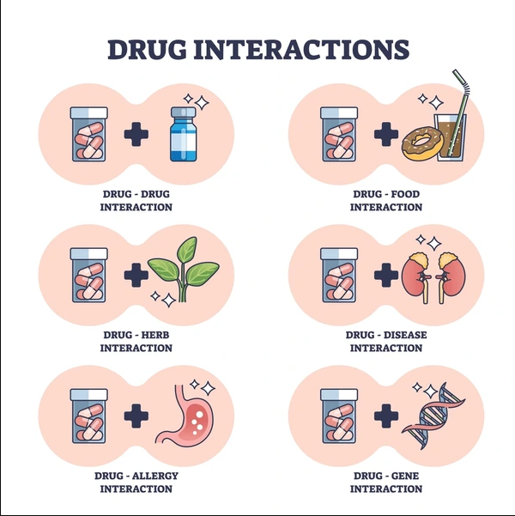
Drug Interactions

Slide 38
Part 4: Prevention of Reactions

Slide 39
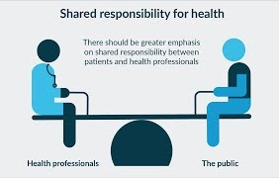
Prevention of Drug Reactions
Genetic factors:
SNP screening is used to screen for known SNPs or mutations which helps prevent reactions
Doctors are able to screen patients for SNPs
known to cause reactions
The prevention of major drug reactions is a shared responsibility of the doctor, the manufacturer, and the patient
Patient factors
Small things like taking the right pill at the right time make a difference
Following the instructions on the packaging is very important
Self prescribing is always dangerous and almost never results in proper benefits gained from the medicine

Slide 40
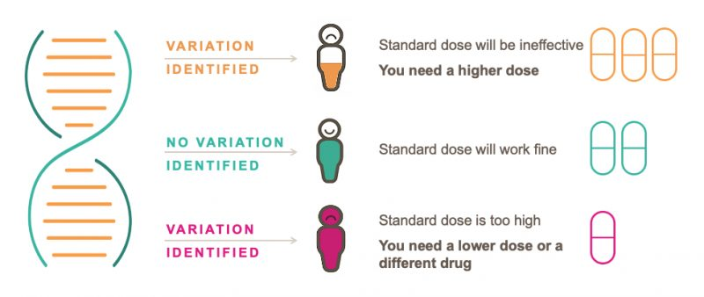
Pharmacogenetics
Pharmacogenetics is a cutting edge
technology which studies how genetics
has an impact on drug reactions
Differences in genes can be the reason why the effect of a medicine is different
Genes can also be the reason behind serious reactions
Pharmacogenetic testing is helps find information about your genes to help choose the medicine and dosage for you
This testing uses a sample of your blood, saliva, or cells
Pharmacogenetic testing is a type of precision medicine
Pharmacogenetics, pharmacogenomics, and pharmacogenomic testing are all other names

Slide 41
Data

Slide 42
Case Study 1: Effectivity of Antibiotics on a Bacterial Infection
The patient had used antibiotics several times in the past
This patient had undergone a knee surgery and had acquired a bacterial infection as a result of that surgery and improper care after the surgery
The bacteria’s name was Acinetobacter baumannii
The infection spread to the whole body and high dose antibiotic Colistin was started and was given for a long period of time
The patient was then switched to another antibiotic called Minocycline
After switching, the patient was moved to a different hospital where they tried Colistin again for a couple of days
After this proved ineffective they conducted an antibiotic resistivity test which involves trying several antibiotics and seeing which ones are effective
The one that ended up causing a benefit was the one that was a local antibiotic that wasn’t widely used yet and was a locally developed antibiotic that was called Doxycycline

Slide 43
Case Study 2: NIH National Library Of Medicine Case Study On Antibiotics Causing IBS
Patient is a 50 year old female experiencing symptoms of Gastroenteritis with a 20-year history of functional gastrointestinal symptoms(FGS), and reoccurring abdominal cramping
An evaluation in 2004 resulted in a diagnosis of Irritable bowel syndrome (IBS) in the patient
In august 2005, the patient's symptoms increased after experiencing acute viral gastroenteritis
She had a medical history of anxiety but no major health problems such as diabetes or any other problems
The patient used dicyclomine (anxiety medicine) 10 mg daily, which was started by 2004
Prior to that, the patient had been taking alprazolam (an antibiotic for intestinal and digestive system infections) but had later discontinued
Her response to dicyclomine was rated as 50% better than without any medicine and was very successful
The patient also received a trial of chlordiazepoxide (an anxiety medicine) 5 mg plus clidinium (a stomach and intestinal medicine) 2.5 mg twice daily with a 60% response from the medicine which was better than the other medicine
She later discontinued this medicine because of drowsiness which was one of the side effects she experienced
She was advised to contact a specialist who started the next part of her treatment

Slide 44
Conclusion

Slide 45
Conclusion
In conclusion, this project has shown many things that we can learn about effectiveness and reactions of medication and the genetic aspect to these things. Whether it was the case studies or the research, this project showed that genetics was not the only factor that is involved in determining the effectiveness of the medicine and whether or not reactions occur to the medicine. In the data shown in the project, we can also see that the patient profile and genetics of the patient play an equal role in determining the effectivity and whether or not a reaction will occur for a patient to a certain medicine. Genetics is a major factors but patient profile and other patient and drug related factors are just as important. This research also shows how if the right steps are taken, medicine effectivity can be kept as high as possible and reactions can be prevented.

