Slide 1
Auto-deploying EpiPen Which Reacts To Anaphylactic Symptoms
By Aaryan Praveen and Mrigank Pandey

Slide 2
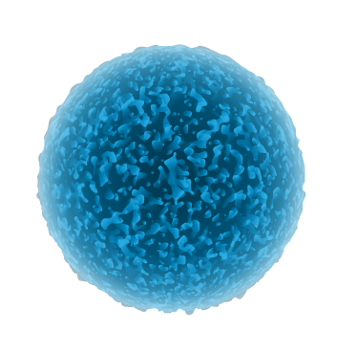
Table of contents
Project info
Introduction
What are allergies and what is anaphylaxis
How anaphylactic reactions can be oppressed
What is an Epipen and how does it work?
Problem and Solution
Designing and Planning
Design Idea
EpiPump explanation
Pump diagram
EpiPump functions and designs
How will it work
Bibliography
Materials required to build the EpiPump
Model showcase
Bibliography

Slide 3
Project: An auto-deploying EpiPen which reacts to anaphylactic symptoms (Innovation based)
Problem: Could an auto-deploying Epipen be created to use in emergency situations?
Hypothesis/Predicted outcome: An auto-deploying EpiPen would be feasible to create based on insulin pump technologies.
Idea: The main idea of the projects is to explain the design of an EpiPump that can be worn at all times to provide protection for people susceptible to anaphylactic shock.

Slide 4
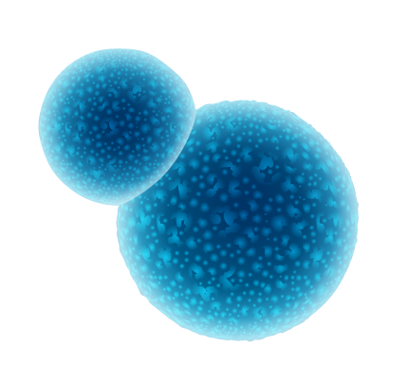
Introduction
Every year people of all ages and backgrounds are faced with allergies. Though most allergies aren’t very serious, some can be life threatening to people. When people are extremely allergic to some things, they are at risk of an anaphylactic reaction. If not treated right away, it can result in death. Fortunately we have a solution to the problem: a new design for an EpiPen, which we like to call the EpiPump!
This person has taken an allergy test, with the numbers in the picture showing different areas that the nurse testing them pricked and put suspect allergens on top of. Raised bumps can be seen, as a mild reaction.

Slide 5
What are allergies and what is anaphylaxis?
Allergies are a mistaken reaction your immune system makes when it thinks it needs to defend your body, even if the substance that it’s defending against is harmless. Though allergies can result in symptoms like rashes, hives, eyes watering and etc, it doesn’t always cause much harm to you. But, there is one exception. Anaphylaxis is a life-threatening reaction that occurs when an allergen comes into contact with a person. The allergen is usually the most common allergens such as shellfish, peanuts, milk, soy, eggs, etc. If not treated quickly, then the person can die.

Slide 6
Symptoms and signs of anaphylaxis
Mast cells are the origin of histamine release in the body. Histamines are the chemical hormones that cause the symptoms of anaphylaxis, and causes the body to react to non harmful things. Histamines cause redness and inflammation throughout the incident site, along with hives and rashes. These are all caused by one symptom, in which the histamines enter the blood while being ejected from the mast cells. The presence of these histamines within the bloodstream causes the arteries in proximity to the histamine release site to dilate. This means that the circulatory organ suddenly widen or “open up”, causing a sudden drop in blood pressure which can be deadly. As there is more blood flowing through the organ, the skin on the incident site appears red, thick, and more large.

Slide 7
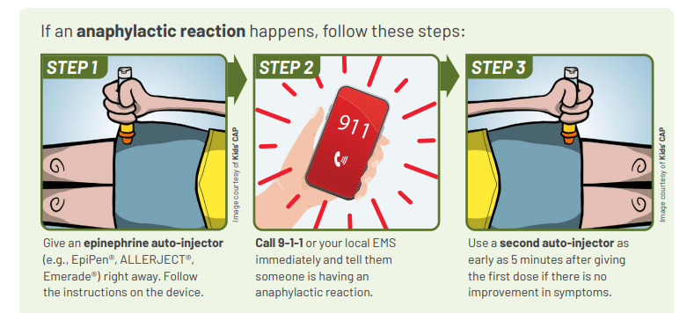
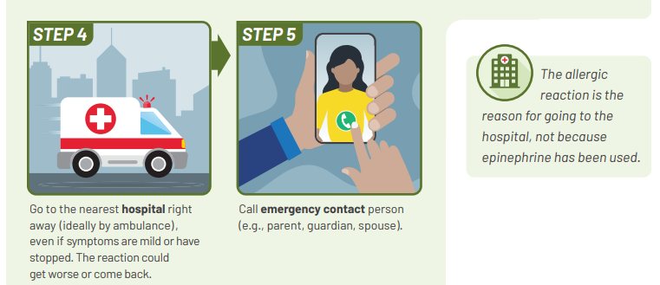
How can Anaphylactic reactions be oppressed?
When feeling like you have a anaphylactic reaction, you can quickly take a dose from an Epipen. It will help regulate reactions your body creates from the allergen when facing it. This will stabilize your condition as it lower histamine levels that increase in your body when you have an allergic reaction. After the dose from the Epipen, you should lie down as it helps your body have better blood flow and increase your blood pressure back to its original state.

Slide 8
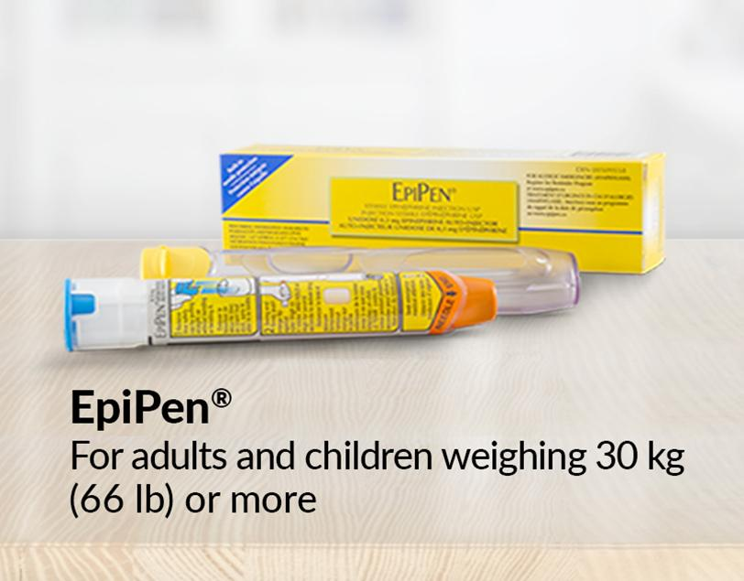
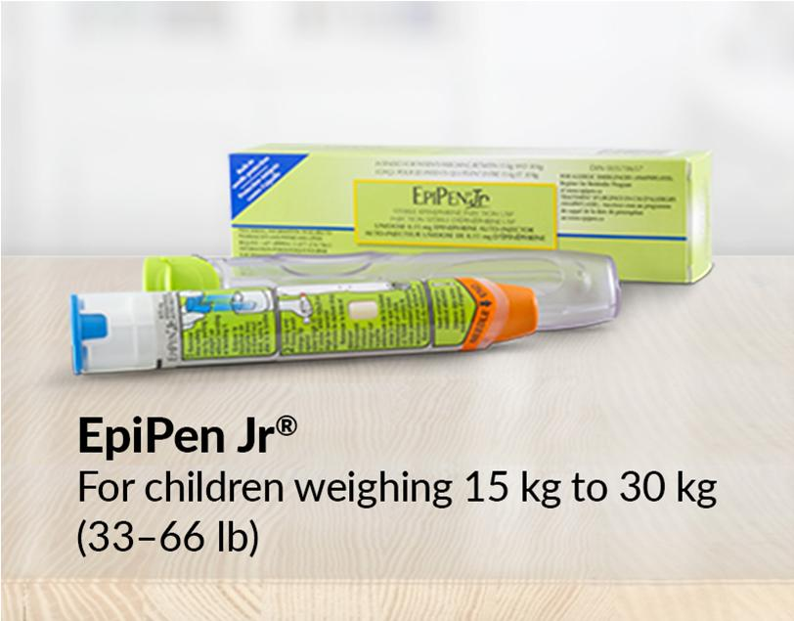
What is an EpiPen and how does it work?
An EpiPen is a medical device used to administer a dose of the chemical hormone epinephrine (also known as adrenaline), which is released by your body to counter the effects of the chemical histamine. Histamine is the chemical hormone that is released by your body’s mast cells to react when a mistaken allergen has come into contact with your body. Although your body will release epinephrine gradually, the EpiPen is a device administered to speed up the effects of epinephrine and help your body deal with the after reactions of the allergy.
The EpiPen comes in two different products: EpiPen and EpiPen Jr. EpiPen Jr contains a 0.15 mL dosage, while th EpiPen contains a 0.3 mL dosage. Weight also plays a part in which to use.

Slide 9
Problem and Solution
Problem: An epipen has to be used in an anaphylactic reaction. Sometimes when the reaction is too severe, you are not able to use the Epipen so someone near you has to insert the Epipen in your body for you. The problem is not a lot of people use Epipens or are educated on how to use them so people don’t know what to do if you are having an anaphylactic reaction.
Solution: To solve this problem we decided to design a device that inserts epinephrine when anaphylactic symptoms are detected.

Slide 10
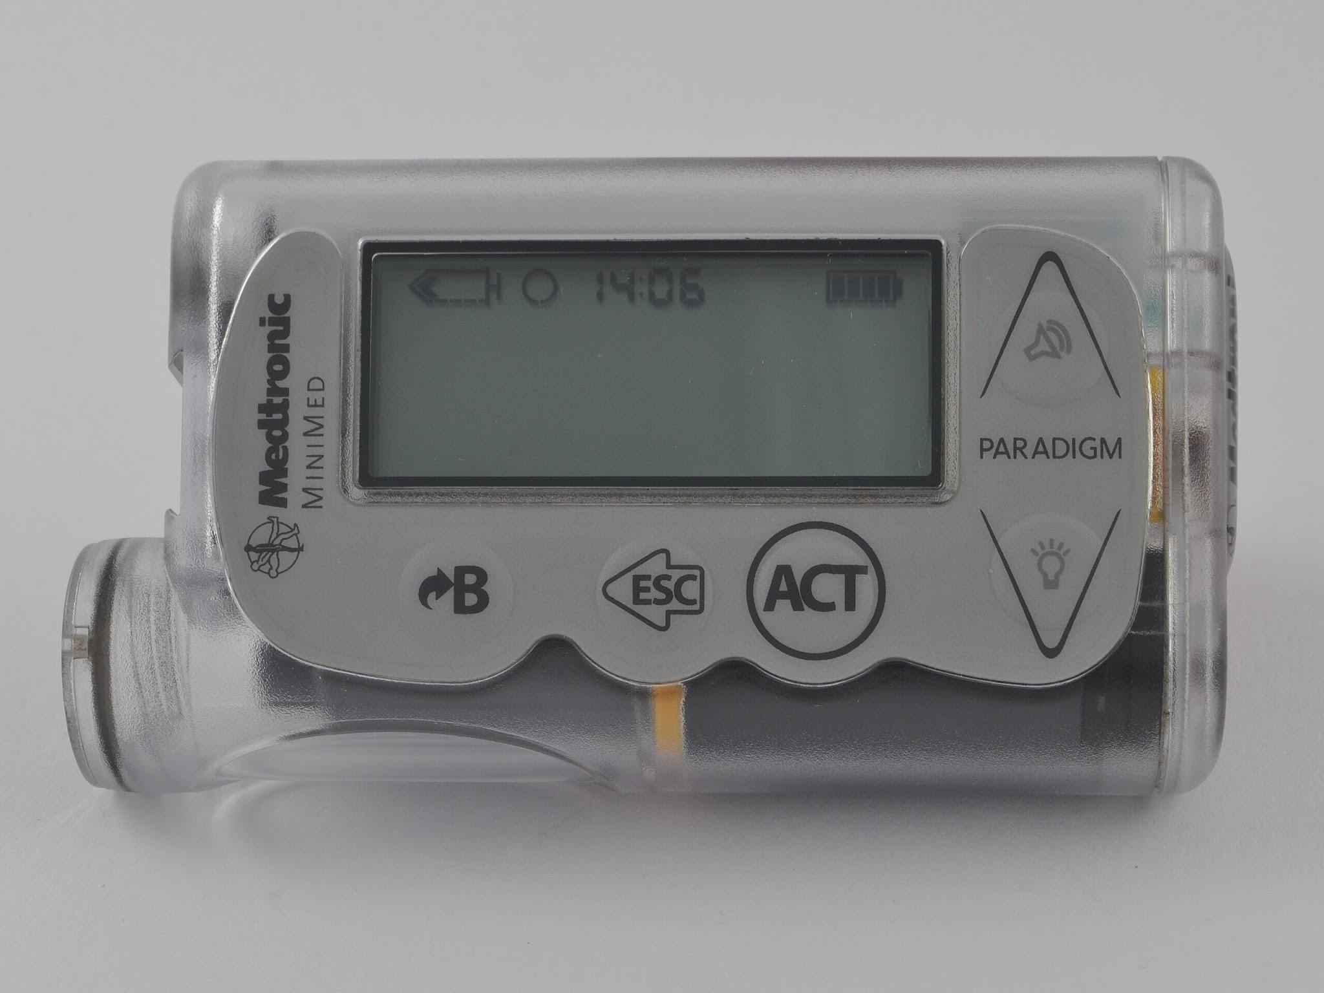
Design and Planning
Our design is similar to the function and appearance of an insulin pump. We had two designs, one of which we concluded could not function with our knowledge currently and the technology available to us for potential construction. Our final design was based off a tube insulin pump, with all the same features and functions, excluding two differences: our EpiPump would deliver a dose of epinephrine rather than a set rate of basal insulin, and sensors based off the insulin pump would rather be detecting symptoms of anaphylaxis instead of insulin decrease.
Our first design was based off of a tubeless insulin pump that looked like this.
But, we changed it to a tube insulin pump design that fitted our understanding more.

Slide 11
Why did we change our design?
We changed our design due to some shortcomings within it. As said before, our previous design was meant to look and function similar to a tubeless insulin pump, but the knowledge we had limited the design we could make. A tube insulin pump was much more feasible in our eyes due to its less compact and small design and the way the parts and functions are spread out. Another setback we mentioned was with the technology available to us. Since tubeless insulin pumps are much more smaller, their parts are laid out very densely and are not as spread out as tube insulin pumps. So, their parts would have to be much smaller. Since we have a smaller window of access to the parts we would require for that design, we dropped it and converted it into a tube insulin pump.
The tube insulin pump was much less compact, and its parts were spread out, opposing the tubeless insulin pump design.

Slide 12
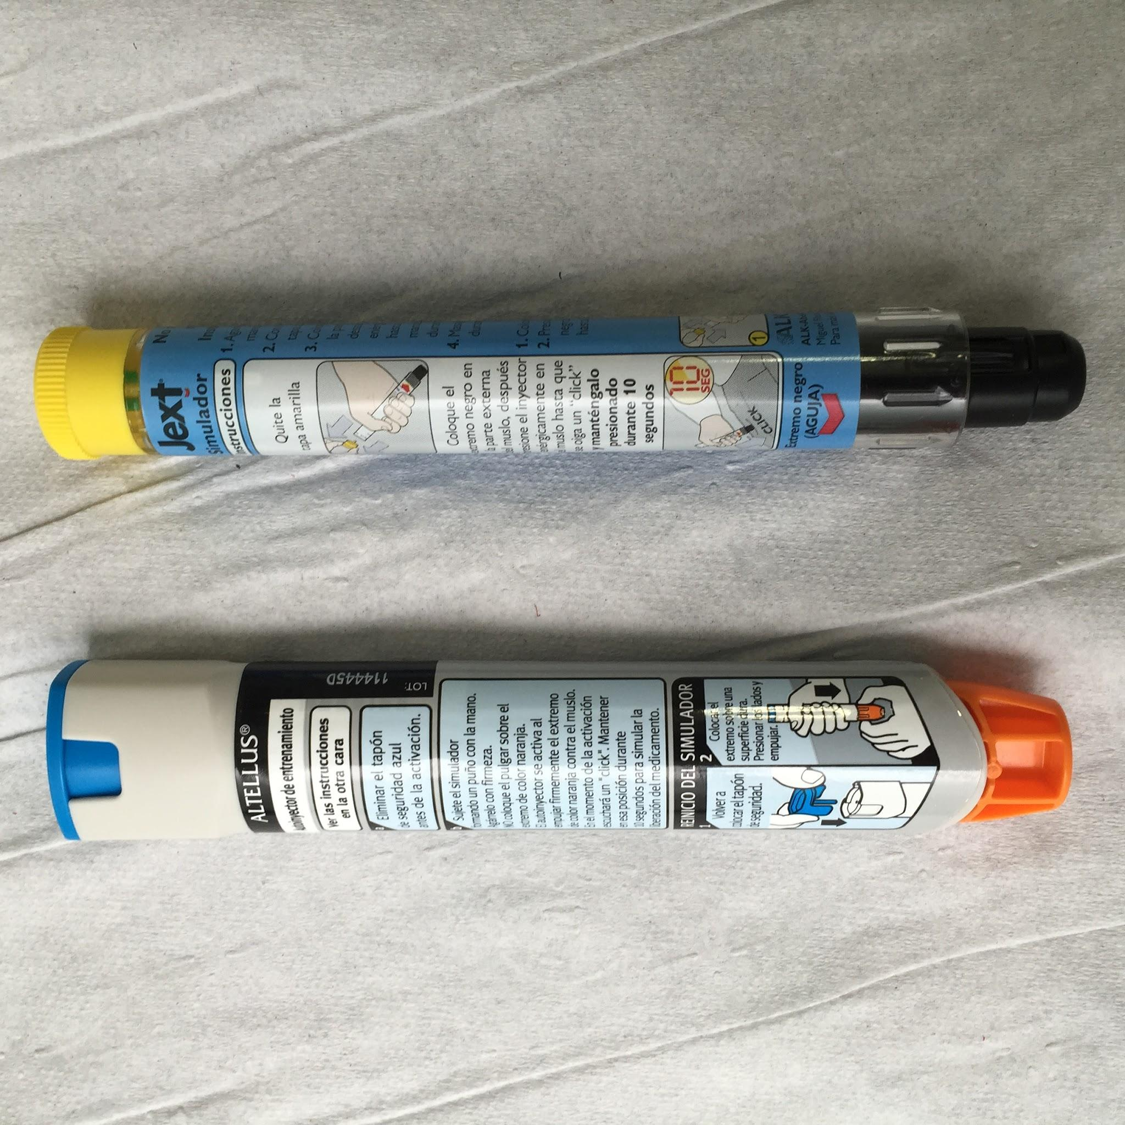
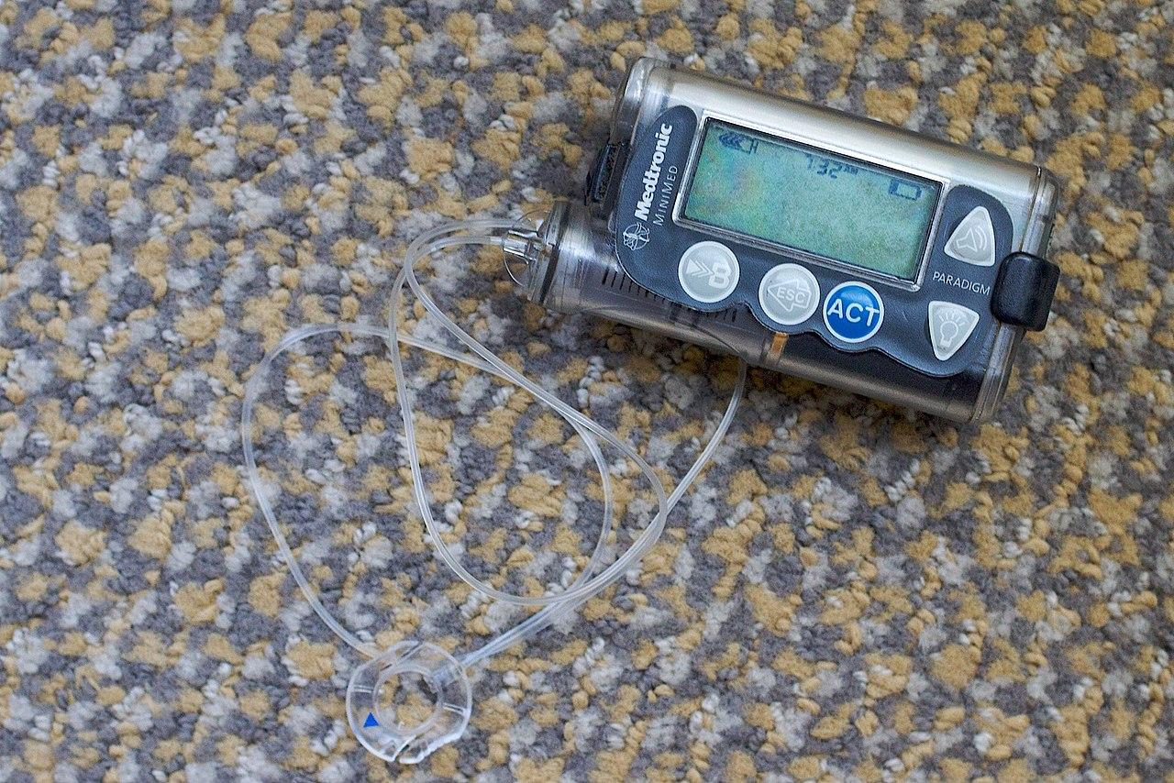
Design Idea
For the name of our innovation, we have decided to keep the name as EpiPump, which resembles the functions of the innovation. Our innovation project is based off the combination of an insulin pump and an Epipen. As said before in the previous slide, the Epi Pump will work as a normal insulin pump but meant for patients experiencing anaphylaxis.

Slide 13
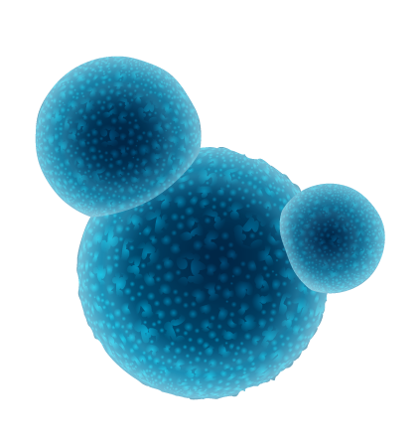
EpiPump Explanation and Warnings of Caution
The same steps should be taken if you were to use an Epipen. You should lie down after your dosage and call 911 after taking any life-saving medication. If one dosage doesn’t help, then IMMEDIATELY call 911 for help, as the condition could get worse and become fatal. Always have caution when dealing with any allergies, especially anaphylaxis, as they are unpredictable and can become fatal at any time. As the EpiPump would do most of the work, the only job the patient has to do (which the pump will alert them to do) is to lie down or sit with their legs open.
If symptoms of anaphylaxis are detected such as high histamine levels or low blood pressure, the monitor would give out a signal to both your pump and to your phone. As the signal is received, the pump would insert the prescribed amount of epinephrine into your body, which would should stabilize your condition.

Slide 14
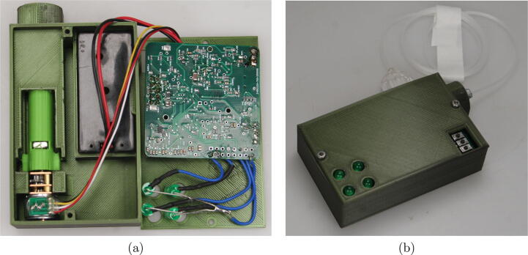
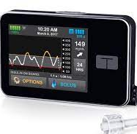
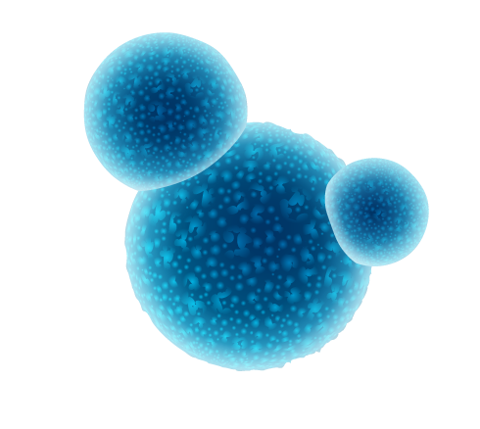
Insulin Pump diagram
As our Epi Pump is resembles an insulin pump, it will also have the most of the same internal parts as well. Most of the differences will come in the medicine and the dosage size, as well as the dosing container.
The EpiPump is based off of two main designs: the tandem diabetes insulin pump (bottom image) for the hardware design, and the Ultra Low-icost insulin pump created by NIH.gov (top image) for the internal components. The EpiPump will detect the symptoms of the heart rate and immediate drop in blood pressure, as well as the activation of mast cells.

Slide 15
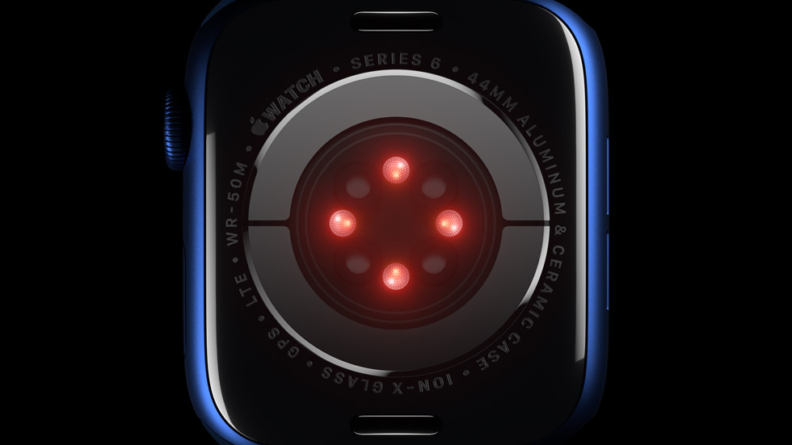
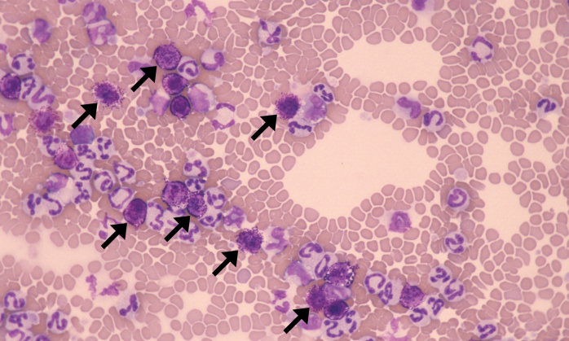
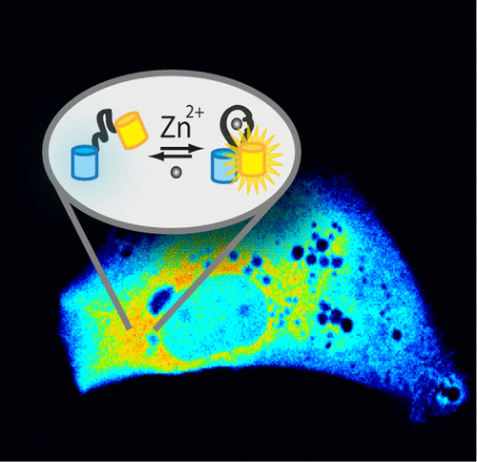
Sensor Functions
Infrared sensors
The EpiPump will have 3 main components: the cannula and the needle, the pump, and the monitors. The monitors used in the EpiPump will be an optical heart sensor (the same apple watch tech) and a chemical sensor to detect hormones that are released when anaphylaxis occurs (specifically histamines in the body). The optical heart sensor works by using green flashing LEDs that get absorbed by the blood inside of your body. When the heart beats and more blood flows, the absorption of the green light is greater, and the light sensitive photodiodes sensors measure the amount of the light reflected and absorbed. A chemical or fluorescent sensor would also be used to detect the amount of histamine or leukotriene neurotransmitters in the body. This could be done by either sensors detecting chemicals exclusive to mast cells, like proteoglycans and proteases. The fluorescent sensor can also detect bioactive amines within the bloodstream.
LED’s (green, but red in image)
Photodiode sensors
Fluorescent sensors can detect ions and chemicals in living systems.
The black arrows point to mast cells in loose connective tissue.

Slide 16
Monitor area
The monitor can be placed above major arteries (aorta artery for optimal histamine detection). The aorta artery is located in the middle of the chest.
The sensor is to be placed near the chest, outer thigh (far from your infusion set), or outer arm.

Slide 17
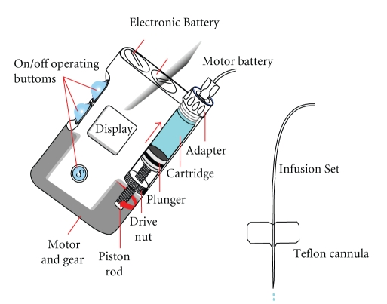
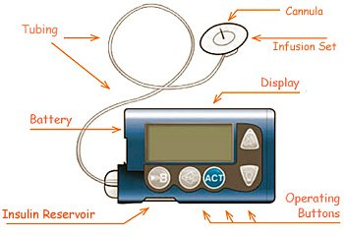
How the pump will work
For the functions of the pump, it will require a PCB and some level of coding that will make the pump function. But apart from that, it will be the size of a small iPhone or pager (normal insulin pump size) that has the insulated dosage container on the top left corner. A rechargeable AA battery will be enough to power the Epi Pump. Note: The video link below shows how the pump will work through the use of an intuitive circuit board. It is just a demonstration of how we expect it to work. It does not symbolize the function of the PCB within the pump.
Epipump Prototype.webm
Link to how the EpiPump will work video.
Epinephrine
Reservoir

Slide 18
How the pump will work continued
To start, the EpiPump will be monitoring at all times when it is on, so battery depletion is going to happen quicker if the pump is on at times where there is little to no risk factors in activities. The sensors located on the chest will collect data at a set time that you can change manually through the pump buttons and settings. They will also send this data to the pump which will analyze and give the data to the patient through the pump screen in an intuitive graph showing the presence of histamines and the different blood pressures and heart rates at different times of the day. But, once the sensors detect the first signs of anaphylaxis (which are rarely ever wrong) the sensor will send the information to the pump, which the pump will use to activate the motor powered by the battery to dose the patient with epinephrine. This will stabilize their condition and normally end the reaction. Then, the device will call 911 and hospital transportation of the location of the patient will be arranged to be taken to the hospital.
The motor will work through the use of a PCB, code, and a AA battery. The motor will turn a gear which, in turn, will make a worm screw turn and push a plunger into the cartridge through the use of a piston. Once the medicine has been fully pushed into the cannula, the plunger will retract and the tubing can be removed from the cannula.

Slide 19
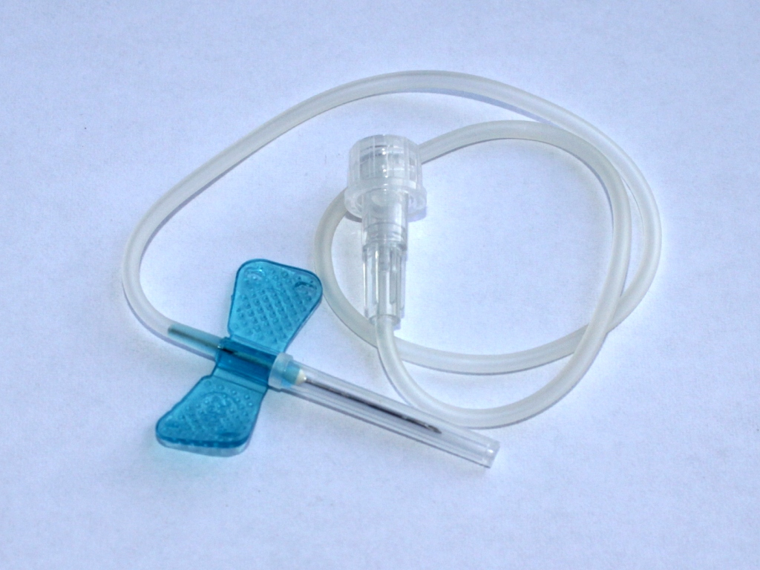
How the infusion set functions
The infusion set will the usual cannula and the tiny needle protruding into the subcutaneous layer of the skin (underneath the epidermis and dermis) that will stay in place for usually ten weeks. The patch that holds the cannula needle in place on the middle outer thigh will have an adhesive mixture of both acrylic and silicone adhesives to maximize strength and wear time of the cannula, while also ensuring that the cannula does not hurt the patient's skin when pulled out (time could range from 3-5 or 7 weeks based on the patients activities). As for the tube itself, it will be about 10 to 24 inches in length to allow comfort when standing or sitting to the patient. The tubing can come in sizes varying by 2 inches each. When the cannula is connected to the patch on the patient's leg, the same clicking connection that insulin pumps have will be applied. This ensures that the patient will get the medicine properly and they can detach the EpiPump when doing tasks like swimming, exercising, or cleansing themselves.
The cannula needle will be 2 cm long. But, different needle lengths can be chosen for obese patients with more subcutaneous tissue for their own health.
The same detaching cannula part will be incorporated for more convenience.

Slide 20
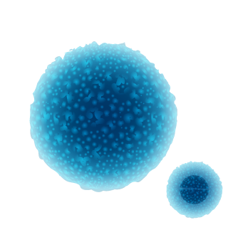
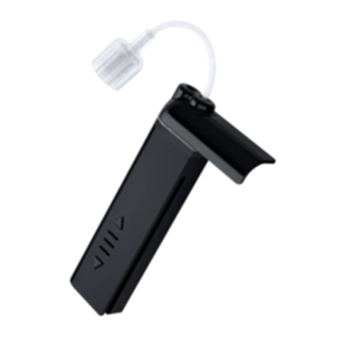
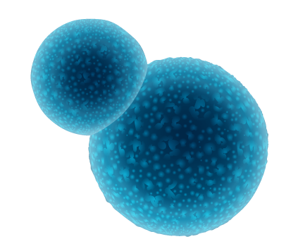
Procedure for changing Epinephrine cartridge
To change the cartridge of epinephrine after the dosage has been given, you must first remove the infusion set from the cannula to stop any accidental leaks in the tubing. You will require a new infusion set, new cartridge, syringe with needle, and 3 mL of epinephrine medication.
First, set the pump to load mode, so that a new cartridge can be loaded without epinephrine entering the tubing. After the tubing has been removed completely, remove the current cartridge of epinephrine.
Then, using the syringe, slowly and carefully pierce the container for the 5 mL of epinephrine on the top area meant for the needle.
Then, slowly draw the medicine up through the needle until it is completely taken within the needle Turn the needle upright and flick the needle 5-10 times for any air bubbles in the medicine to be pushed to the top or popped.

Slide 21
Procedure to change EpiPump cartridge
4. Very slowly press on the needle, to release the air bubbles within the needle. Stop when you see the epinephrine coming out of the needle.
5. Once this step is complete, pierce the syringe into the storage area and slowly push the needle into the new cartridge.
6. Once that step is complete, cautiously and slowly push the medicine into the cartridge until it is FULLY complete.
7. Lastly, push the cartridge into its space within the pump using the guard ridges to guide you. Remember to also log the expiration date on the epinephrine container to allow for a reminder to change the cartridge if not used by the expiration. This step is complete.

Slide 22
Procedure to change infusion set
If the Infusion set connected to your body falls off or gets damaged, it is a sign that it is time to replace it.
Step 1: You first have to remove the tubing from the cannula. Depending on when you last changed the cartridge, you can either replace the whole infusion set if your about to change your cartridge or change it in the next 12 hours. If you just changed your cartridge and the cannula falls off, you shouldn’t remove the whole infusion set, as epinephrine that was in the tubing would go to waste.
Step 2: So after the tubing is removed from the cannula, a new infusion set should be opened. The needle cover should be removed, and the cannula sticker should be removed. The infusion set tubing should also be onwinded and the infusion set should be popped back to be ready for placement.

Slide 23
Procedure to change the infusion set
Step 3: When you have cleaned and secured your new site, push the button on the capsule, which will attach your new infusion set to your body.
Step 4: If you just changed your cartridge, to help conserve epinephrine, remove the new tubing that came with the new infusion set and attach your old tubing filled with epinephrine to the new cannula. If your just changing your cartridge or changing it in the next twelve hours, remove your old tubing from the pump and attach the new tubing from infusion set that's on your body directly to the pump.

Slide 24
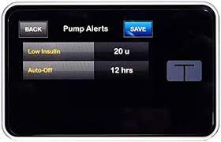
Materials required to create the EpiPump
Small gears to push the pump
Screen (full touchscreen)
Optical heart sensor and fluorescent sensor
Cannula, tube, and cannula inserter
A PCB and microcontroller unit. An ATSAMD21G18A MCU was chosen to make the EpiPump function. With code!
Small motor
EpiPump cartridge (this is rapid acting insulin picture)

Slide 25
References
https://www.researchgate.net/figure/Main-parts-of-an-insulin-pump_fig3_44853030
https://www.niddk.nih.gov/health-information/diabetes/overview/managing-diabetes/continuous-glucose-monitoring#:~:text=The%20second%20part%20of%20the,an%20app%20on%20a%20smartphone.
https://support.apple.com/en-ca/HT204666#:~:text=Apple%20Watch%20uses%20green%20LED,Between%20beats%2C%20it's%20less.
https://www.ncbi.nlm.nih.gov/pmc/articles/PMC3398748/#:~:text=Mast%20cell%20granules%20are%20rich,amines%2C%20proteoglycans%2C%20and%20proteases.&text=Clinically%2C%20the%20most%20important%20bioactive,human%20disease%20is%20well%20established.
https://pubs.acs.org/doi/10.1021/cr400546e
https://www.ncbi.nlm.nih.gov/books/NBK499904/#:~:text=Mast%20cells%20are%20oval%20or,body%20in%20loose%20connective%20tissue.
https://www.healthcentral.com/condition/diabetes/how-disconnect-pump-plus-tips-traveling-pump-using-pump-school
https://www.ncbi.nlm.nih.gov/pmc/articles/PMC9679028/
https://www.google.com/url?sa=i&url=https%3A%2F%2Ftopas.com%2Fcompany%2Fnews%2Ftandems-wearable-insulin-pumps-utilize-topas-coc%2F&psig=AOvVaw3HokxJGNjei4aaKGhmHSE7&ust=1705977883480000&source=images&cd=vfe&opi=89978449&ved=0CBQQ3YkBahcKEwjYs-2Q_e-DAxUAAAAAHQAAAAAQDQ
https://vetclinpathimages.com/2018/03/22/mast-cells/
https://www.epipen.ca/how-epipen-works
https://www.cbc.ca/news/canada/manitoba/manitoba-diabetic-insulin-pump-1.6541879
https://diabetesexpress.ca/products/tandem-t-lock-cartridge
https://www.mdpi.com/2218-1989/12/10/895
https://foodallergycanada.ca/wp-content/uploads/5-emergency-steps-for-treating-anaphylaxis.pdf
https://my.clevelandclinic.org/health/diseases/8619-anaphylaxis

