Slide 1
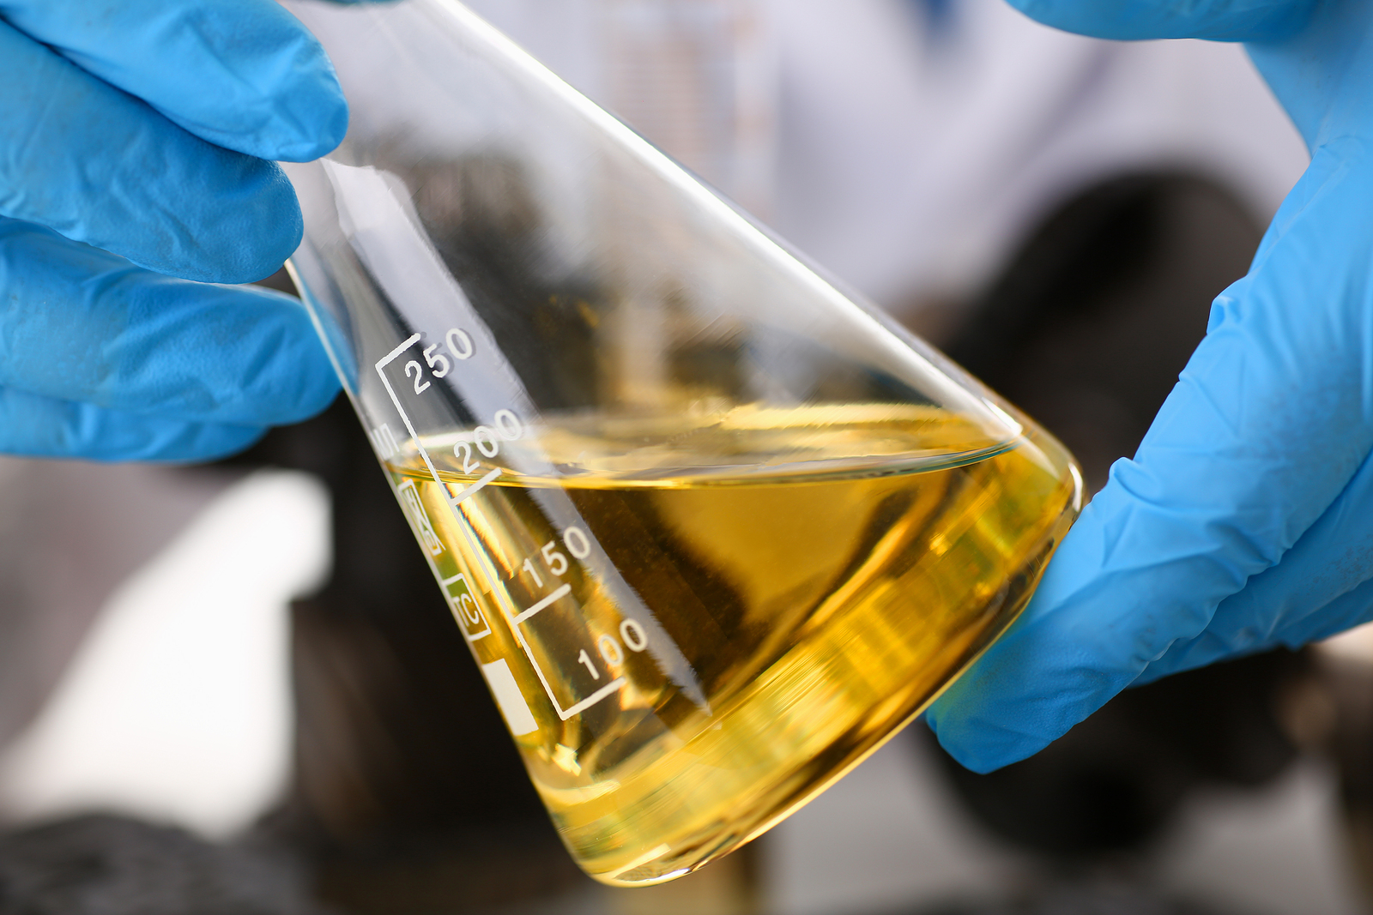
Food For Fuel
Food For Fuel
Food For Fuel
Food For Fuel

Slide 2
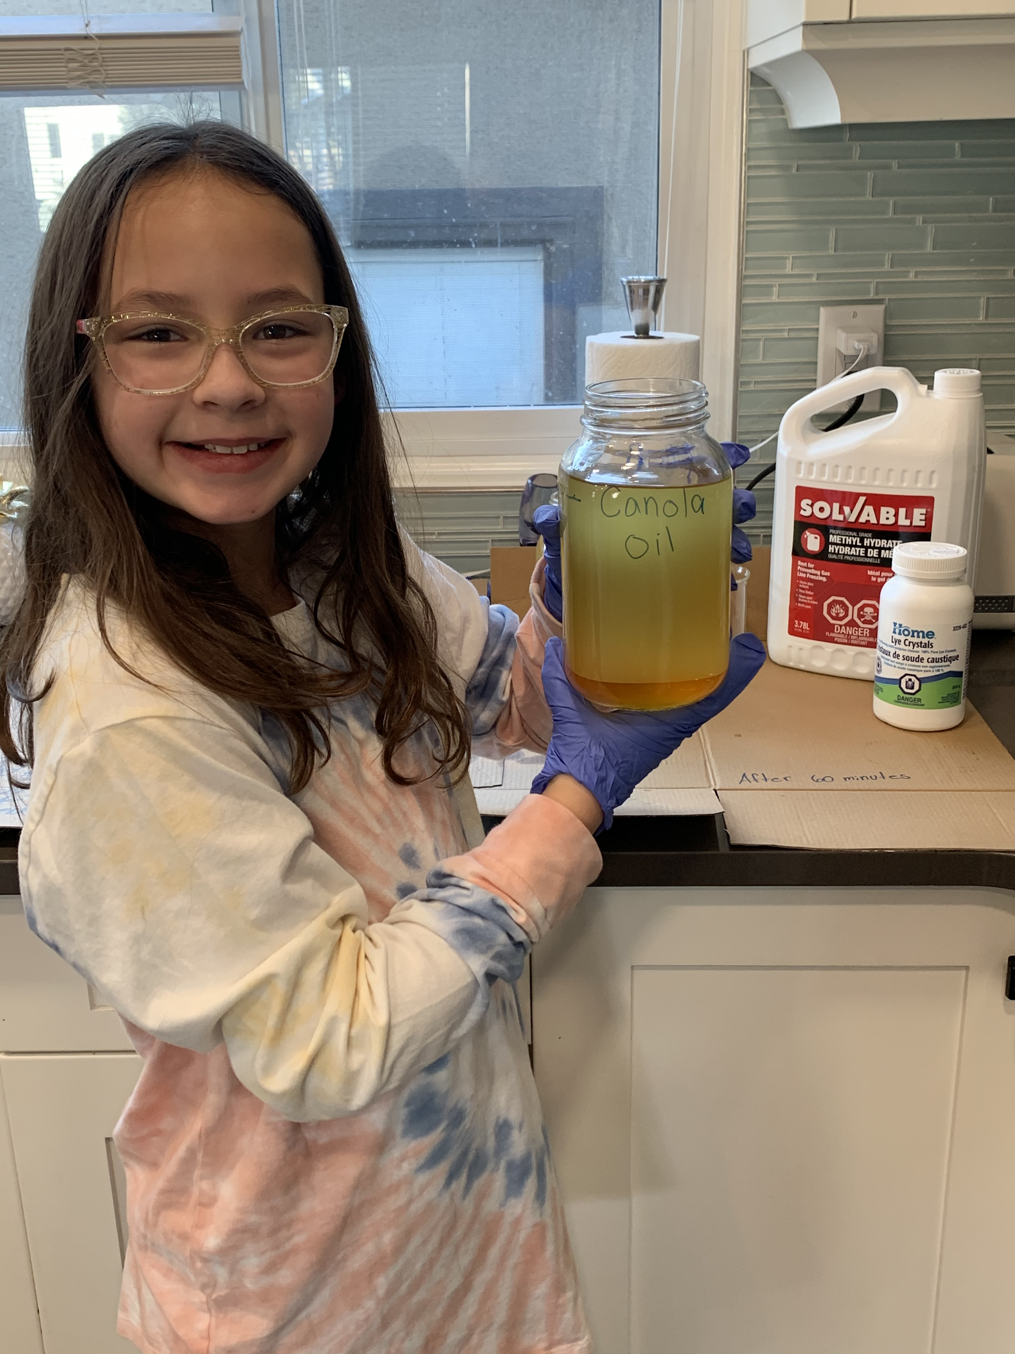
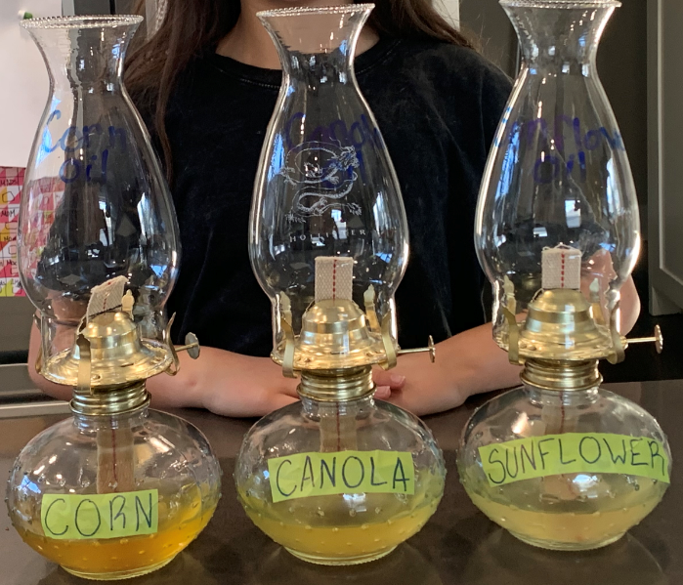
Background Research
Question:
Can I make homemade biodiesel from different types of cooking oils?
Hypothesis:
Yes, I will be able to make homemade biodiesel from different types of cooking oils. I will test the homemade biodiesel in kerosene lamps and evaluate which biodiesel is the most efficient and effective.

Slide 3
Background Research
Energy is a necessary part of our daily lives!
We use energy to heat and cool our homes, schools and businesses. We use energy for lights, appliances and even our
vehicles. About 90% of that energy comes from burning fossil fuels. Fossil fuels include oil, coal, and natural gas.
Since the late 1700s people have been using fossil fuels at a faster rate than ever before (https://ourworldindata.org/fossil-fuels).
But the planet’s supply of fossil fuels is limited because fossil fuels are non-renewable resources. The use of fossil fuels
harms the environment as well. When oil and coal burn, they release harmful gases. These gases react with moisture to
create acid rain, a dangerous form of pollution. Burning fossil fuels also increases the temperature of the Earth’s
atmosphere. The global average surface temperature rose 0.6 to 0.9 degrees Celsius between 1906 and 2005. This
warming, called the greenhouse effect, is harmful to living things. (https://earthobservatory.nasa.gov/features/GlobalWarming/page2.php)
This is why we need to develop new ways to make power without using fossil fuels.

Slide 4
Background Research continued
1. What is biodiesel?
Biodiesel is a renewable, biodegradable alternative fuel.
2. Why is biodiesel important?
Biodiesel is important because it is a cleaner-burning replacement for petroleum-based diesel fuel and it produces less toxic pollutants and greenhouse gases than petroleum diesel. Compared to diesel, biodiesel has the potential to reduce greenhouse gas emissions by over 80% on a lifecycle basis.
3. How is biodiesel made?
Biodiesel is made through a chemical process called transesterification. Transesterification is a reaction between the animal fat or oil with an alcohol (methanol) and a catalyst (lye). A catalyst increases the rate of the chemical reaction. The process leaves behind two products - methyl esters which is the chemical name for biodiesel and glycerin which is used in a variety of products, including soap and makeup.
4. What are renewable resources?
Renewable resources are made of natural resources that can be replenished, generation after generation. Wood-based products are renewable because trees “grow back” when forests are managed, and more trees are grown and replanted.
5. What are non-renewable resources?
Non-renewable resources are resources that have limited supply. There are four major types of non-renewable resources:
a. Oil
b. Natural Gas
c. Coal
d. Nuclear Energy
Oil, natural gas and coal are called fossil fuels.

Slide 5
Variables
Manipulated Variable
The different types of oil used for the experiment:
Canola oil
Corn oil
Sunflower oil
Constant Variables
The amount of oil
The amount of methanol
The amount of lye
The amount of time I blended each mixture - 30 minutes
The type of container I stored each mixture in
Responding Variable
Flame height
Flame colour
Flame presence
Flammability
The amount of smoke
How much wick was leftover
Notes:
Flammability is the ability of a chemical to burn or ignite, causing fire or combustion.

Slide 6
Materials
Safety Precautions
Methanol is a toxic alcohol. It is flammable and poisonous.
Lye crystals also known as sodium hydroxide is a powerful household cleaner that can be quite dangerous. It can cause burns, blindness or other serious injuries if mishandled.
Methanol (antifreeze)
Lye crystals
Sunflower oil
Canola oil
Corn oil
Blender (glass)
Mason jars (glass)
Beaker (glass)
Measuring cup (glass)
Camera
Gloves
Food scale
Funnel
Ruler
Felt pen
Whiteboard marker
Kerosene Lantern
Timer
Lighter
I had to make sure that all of the containers I used were glass because the methanol will eat through plastic.

Slide 7
Procedures
Measure out 200 milliliters of methanol in a glass beaker
Carefully pour the methanol into a glass pitcher and place it on the blender
Weigh out 3.5 grams of lye crystals using my food scale
Turn the blender on slow speed and slowly add the lye crystals to the methanol. This mixture is called sodium methoxide.
After the lye crystals completely dissolved in the methanol (about 2 minutes) I added 1 liter of Canola oil to the blender. I blended this mixture on low speed for 30 minutes.
Once the 30 minutes was complete I poured the mixture into a labelled mason jar.
After approximately 60 minutes I made my first observation. I observed the mixture starting to separate. There was a dark layer settling at the bottom of the mason jar which is glycerin and a lighter layer on top which is biodiesel.
To make sure that the mixture completely settled I waited another 24 hours.
In order to test the biodiesel, after 24 hours I carefully extracted 200 milliliters from each mason jar and placed it into a lantern. Then I evaluated each biodiesel for certain criteria. (see table 1.0)
I repeated steps 1-8 two more times for the Corn oil and Sunflower oil.

Slide 8
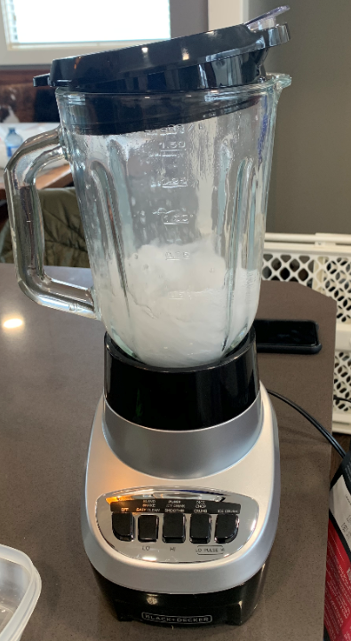
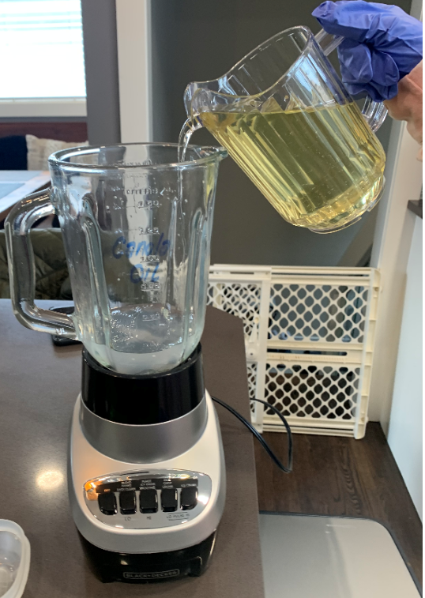
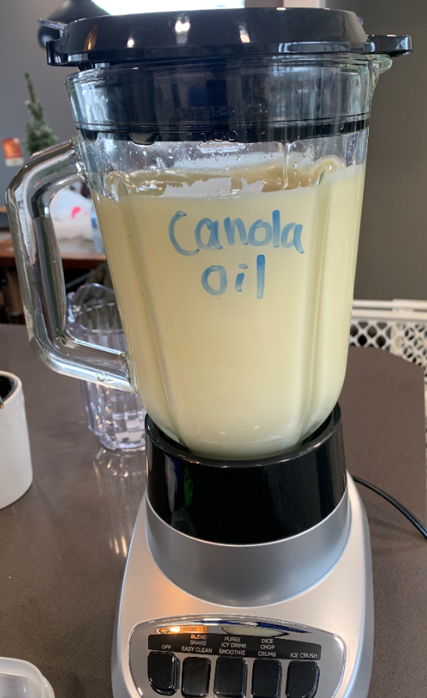
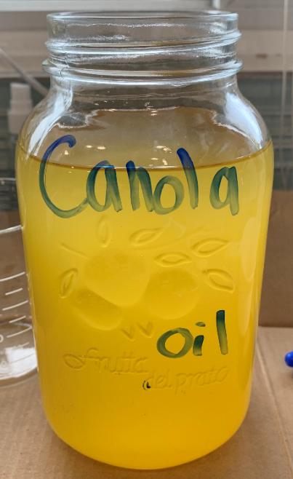
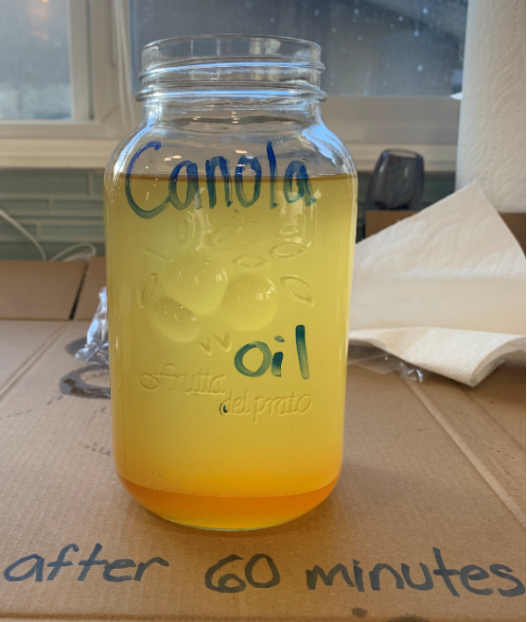
Procedures with pictures
Biodiesel forming
Blender on slow speed, mixing the lye crystals and the methanol. This mixture is called sodium methoxide.
Adding the Canola oil to the sodium methoxide. I blended this mixture on low speed for 30 minutes.
The mixture after blending for 30 minutes. This is the process of transesterification happening.
Once the 30 minutes was complete I poured the mixture into a labelled mason jar.
After 60 minutes I observed the mixture starting to separate.
Glycerin forming

Slide 9
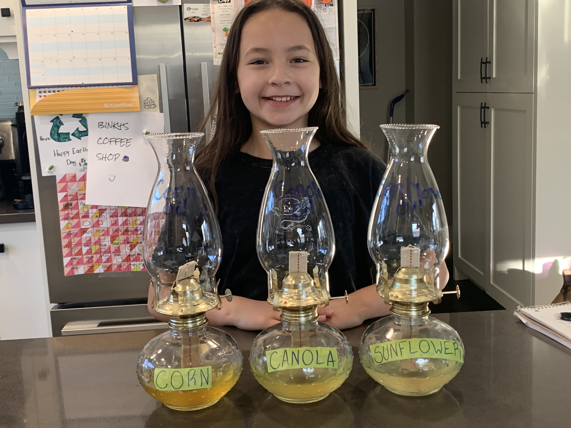
Procedures with pictures
Testing the Biodiesel
After 24 hours passed I carefully extracted 200 milliliters of each of the biodiesels from the mason jar and placed it into the lanterns.
Then I evaluated each biodiesel for certain criteria. (see table 1.0)

Slide 10
Observations - Table 1.0
I started with 9 cm of wick and 200 ml of biodiesel in each lantern
Type of oil | Length of wick at 30 minutes (cm) | Length of wick at 60 minutes (cm) | Amount of biodiesel after 60 minutes (ml) | Flame Colour | Flammability | The amount of smoke/colour of smoke | Odor | Price (for a 1.42L bottle/Western Family brand from Save-On)
Canola | 7.9 | 5.6 | 174 ml | orange | immediate | Canola oil had the most smoke and it was grey and black | Fish odor | $4.99 for 1.42L
Corn | 6.4 | 3.0 | 157 ml | orange | immediate | Corn oil had less smoke than Canola oil and the smoke was white | Burnt odor | $4.99 for 1.42L
Sunflower | 8.1 | 6.4 | 188 ml | orange | immediate | Sunflower oil had no smoke | Odorless | $4.99 for 1.42 L

Slide 11
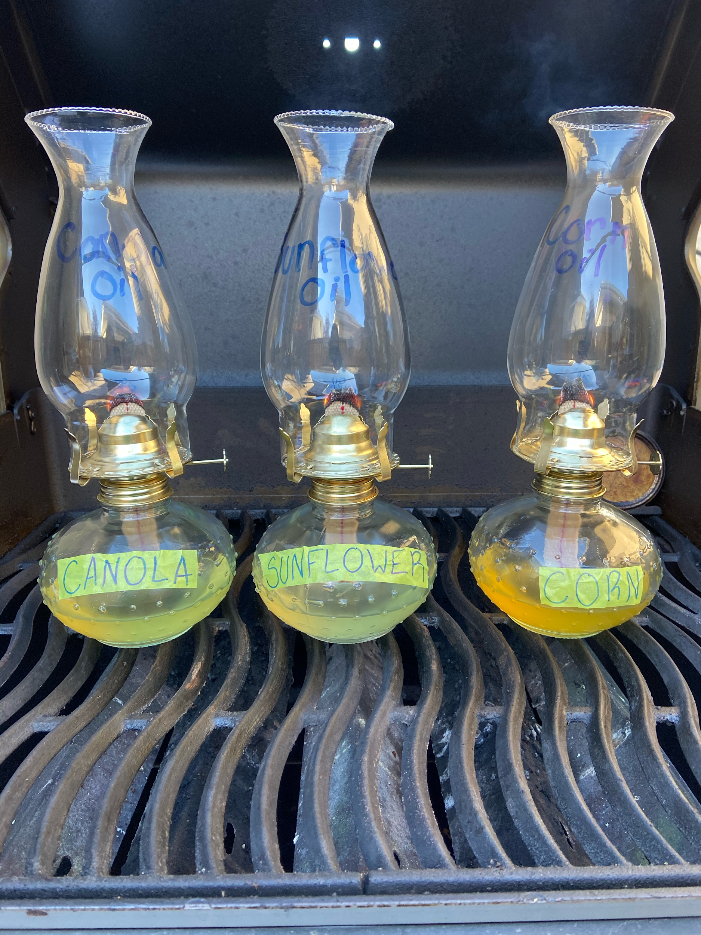
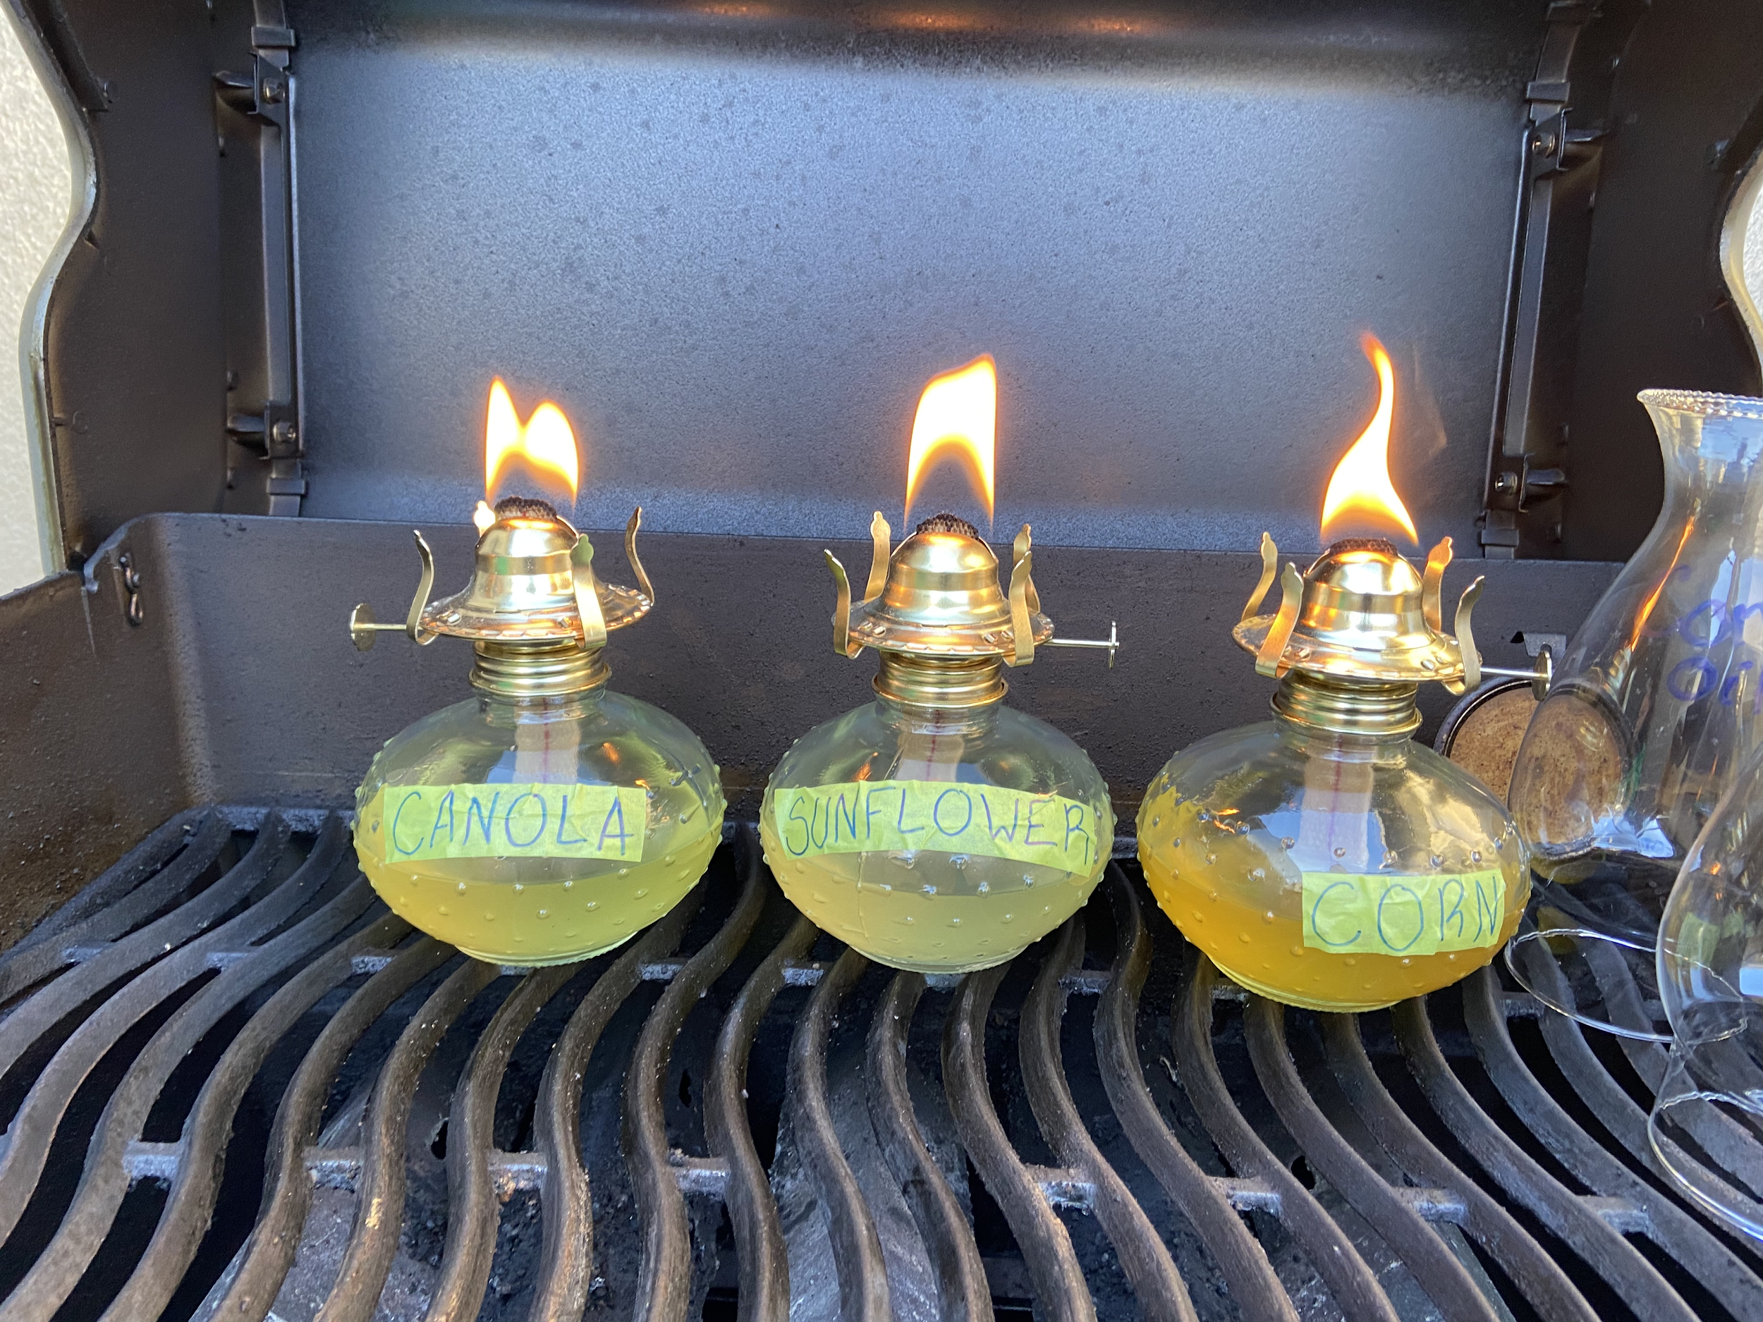
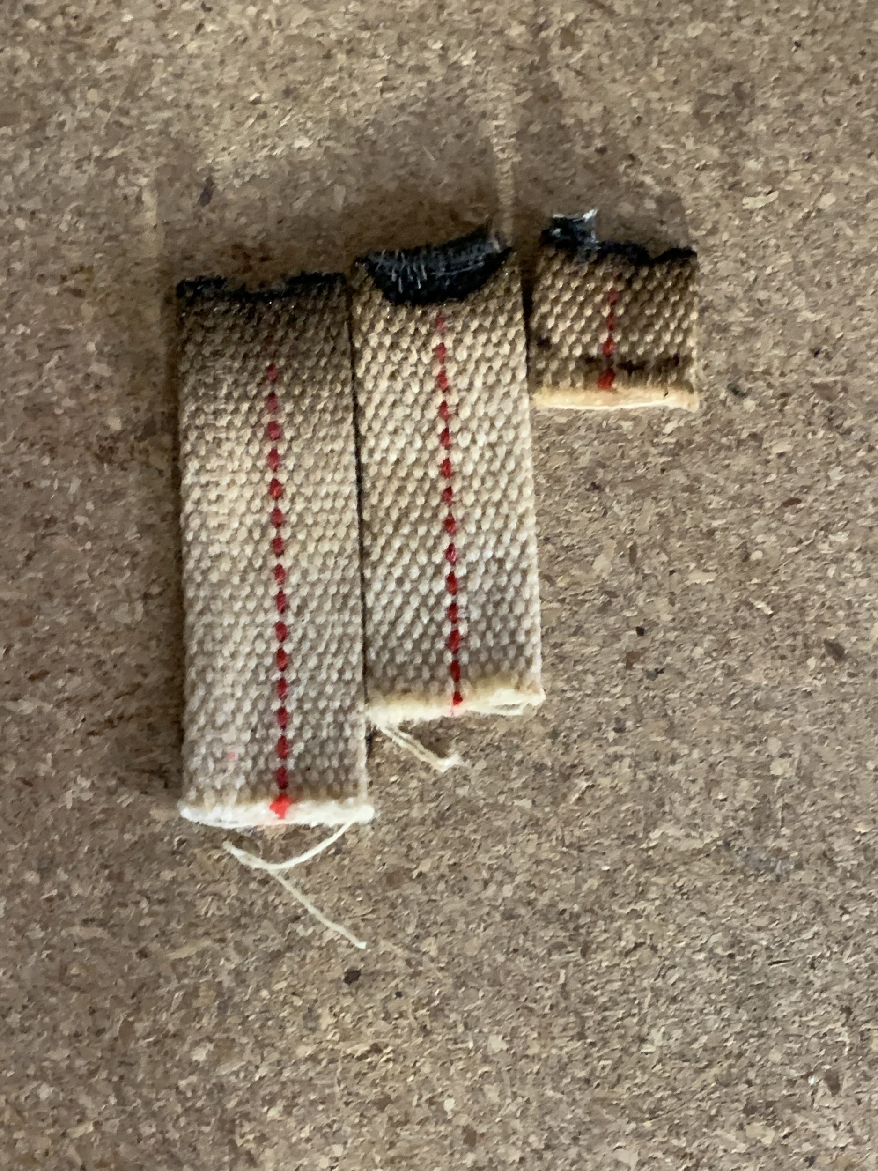
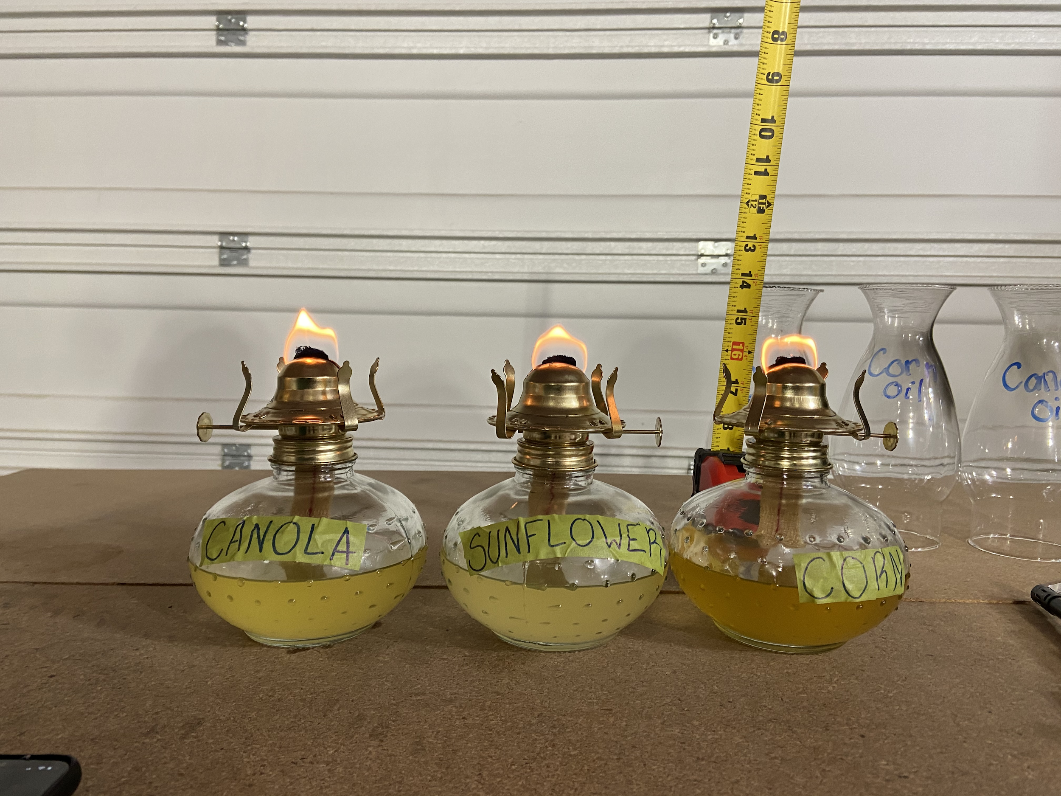
Pictures
sunflower
canola
corn
Wicks after 60 minutes

Slide 12
Analysis
I decided to do my science fair project on biodiesel because I wanted to see if I could actually make biodiesel out of renewable resources that I had sitting in my kitchen. As our non-renewable resources continue to deplete it’s important that we continue to be creative and find alternative forms of energy. At first I wasn't sure if I would actually be able to make it, but after I mixed all of the materials together and watched the glycerin and biodiesel start separating out-I knew I had done it. The next step was to actually test the biodiesel in my kerosene lamps. The fact that all of the oils burned at a different pace, had a different smell and a different look was so cool. I could actually compare the three biodiesels against criteria to determine how effective each one was.
Why is Biodiesel important?
Biodiesel is important because as our non-renewable resources deplete we need to find alternative forms of energy.
Biodiesel is a renewable resource making it better for our environment, biodiesel also produces less pollutants such as carbon monoxide, Hydrocarbons and other air toxins. (https://www.eia.gov/energyexplained/biofuels/biodiesel-and-the-environment.php).
Why did I use cooking oils? What are the benefits?
Canada is a major supplier of vegetable based oils so if we convert more of our crops to Biodiesel that will benefit not only Canada, but the entire world.
Cool Fact: Canada is the world’s largest exporter of Canola oil. We export 94% of our domestic product, a whole 2.9 million tonnes! (https://www.canolacouncil.org/biofuels/)
The reason I used cooking oils was because most restaurants use them and it becomes a waste product so I wanted to see if they could be converted into biodiesel.

Slide 13
Conclusion
Concluding my presentation, my hypothesis was correct. I was able to make homemade biodiesel with renewable resources. If I were to pick a biodiesel to put in my car I would choose the sunflower oil because it has no thick, dark smoke, it’s odorless and the lamp consumed the least amount of oil (or the oil lasted the longest). However, I recommend using the cheapest and most readily available oil as my experiment proved that all of the renewable resources can be converted into biodiesel.
If I were to do this experiment again I would test the biodiesel in an actual small diesel engine to determine if the biodiesel is more efficient than regular diesel.

Slide 14
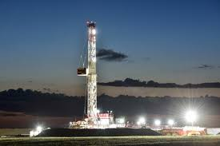
Applications
Biodiesel has a wide range of applications including all combustion engines. A combustion engine is an engine where the burning of fuel occurs.
Automobiles
Ships
Construction sites
Drilling rigs
Portable lighting systems

Slide 15
Sources of Error
Instrumental: An instrumental error may have occurred when I was weighing out the lye using my food scale. I had to reset the scale to zero each time but I did notice that the scale kept shifting between 0 and 0.1grams.
Environmental: An environmental error may have occurred when I was burning each biodiesel in the kerosene lantern because it was windy outside and the wind may have affected the way the biodiesel burned and the flame height.
Human: A human error may have occurred when I was reading the tape measure to measure the height of the flame or the length of the wick.

Slide 16
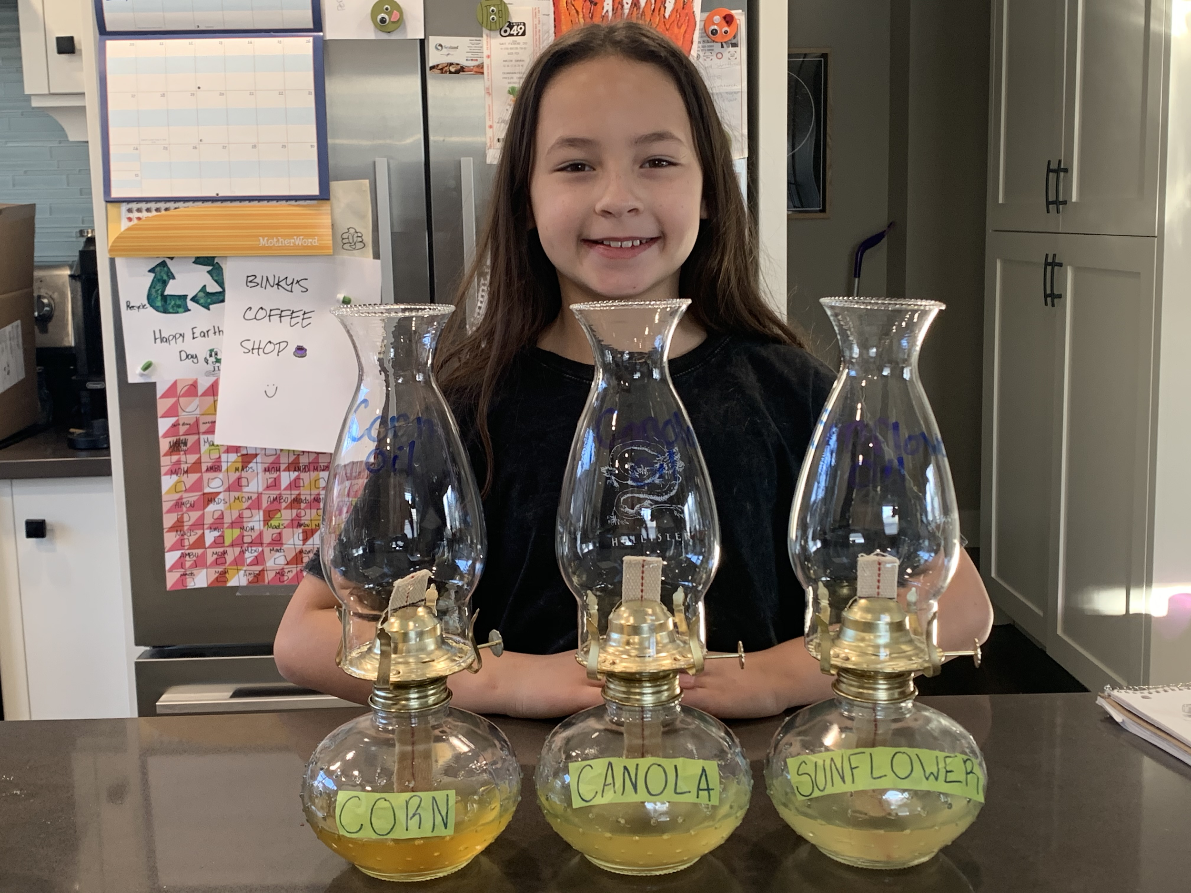
Thank you!

Slide 17
Sources
2020 Biofuels in Canada
https://www.naviusresearch.com/publications/2020-biofuels-in-canada/
Government of Canada
https://www.nrcan.gc.ca/energy-efficiency/energy-efficiency-transportation/alternative-fuels/biofuels/biodiesel/3509
Biodiesel Benefits - Why Use Biodiesel
https://www.biodiesel.com/biodiesel-benefits/
Biodiesel
https://www.dangerouslaboratories.org/
Biofuels Explained
https://www.eia.gov/energyexplained/biofuels/biodiesel-and-the-environment.php
Brilliant Biodiesel Benefits: 5 Unique Uses of Biofuels That Can Help the Environment
https://smartalternativefuels.com/blog/brilliant-biodiesel-benefits-5-unique-uses-of-biofuels-that-can-help-the-environment
Canola: Canada’s ideal resource for clean, renewable fuels
https://www.canolacouncil.org/biofuels/
Global Warming
https://earthobservatory.nasa.gov/features/GlobalWarming/page2.php

