Slide 1

Hydroponic Lettuce Growing
Grade 5 Science Project
John Costello Catholic School
By Kyle & Mark Wicentovich

Slide 2
Why we chose Hydroponics
Our family has been interested in gardening for many years, but how do you garden in the winter in Canada? Is the answer HYDROPONICS?
Growing food at home can save money and help the environment so we wanted to give it a try.
Our Problem Statement
What is the best way to grow lettuce at home?
LET’S FIND OUT!
Notes:
uyhhh

Slide 3

Hypothesis
Our hypothesis is that lettuce grown with sunlight as its light source will work better than using artificial light because the sun is more powerful and has more energy than a lightbulb.
VERSUS

Slide 4
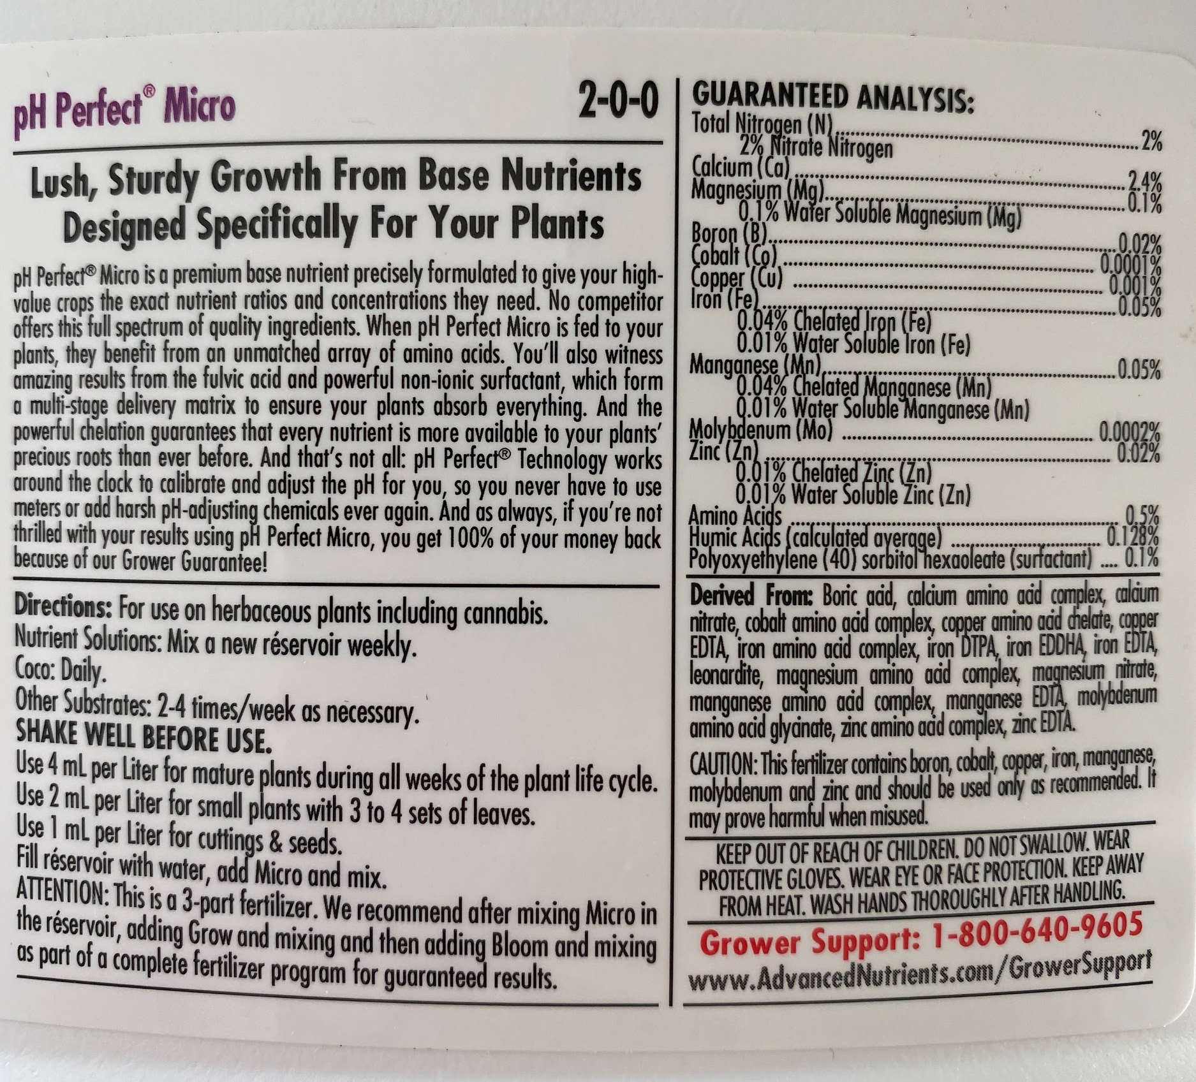
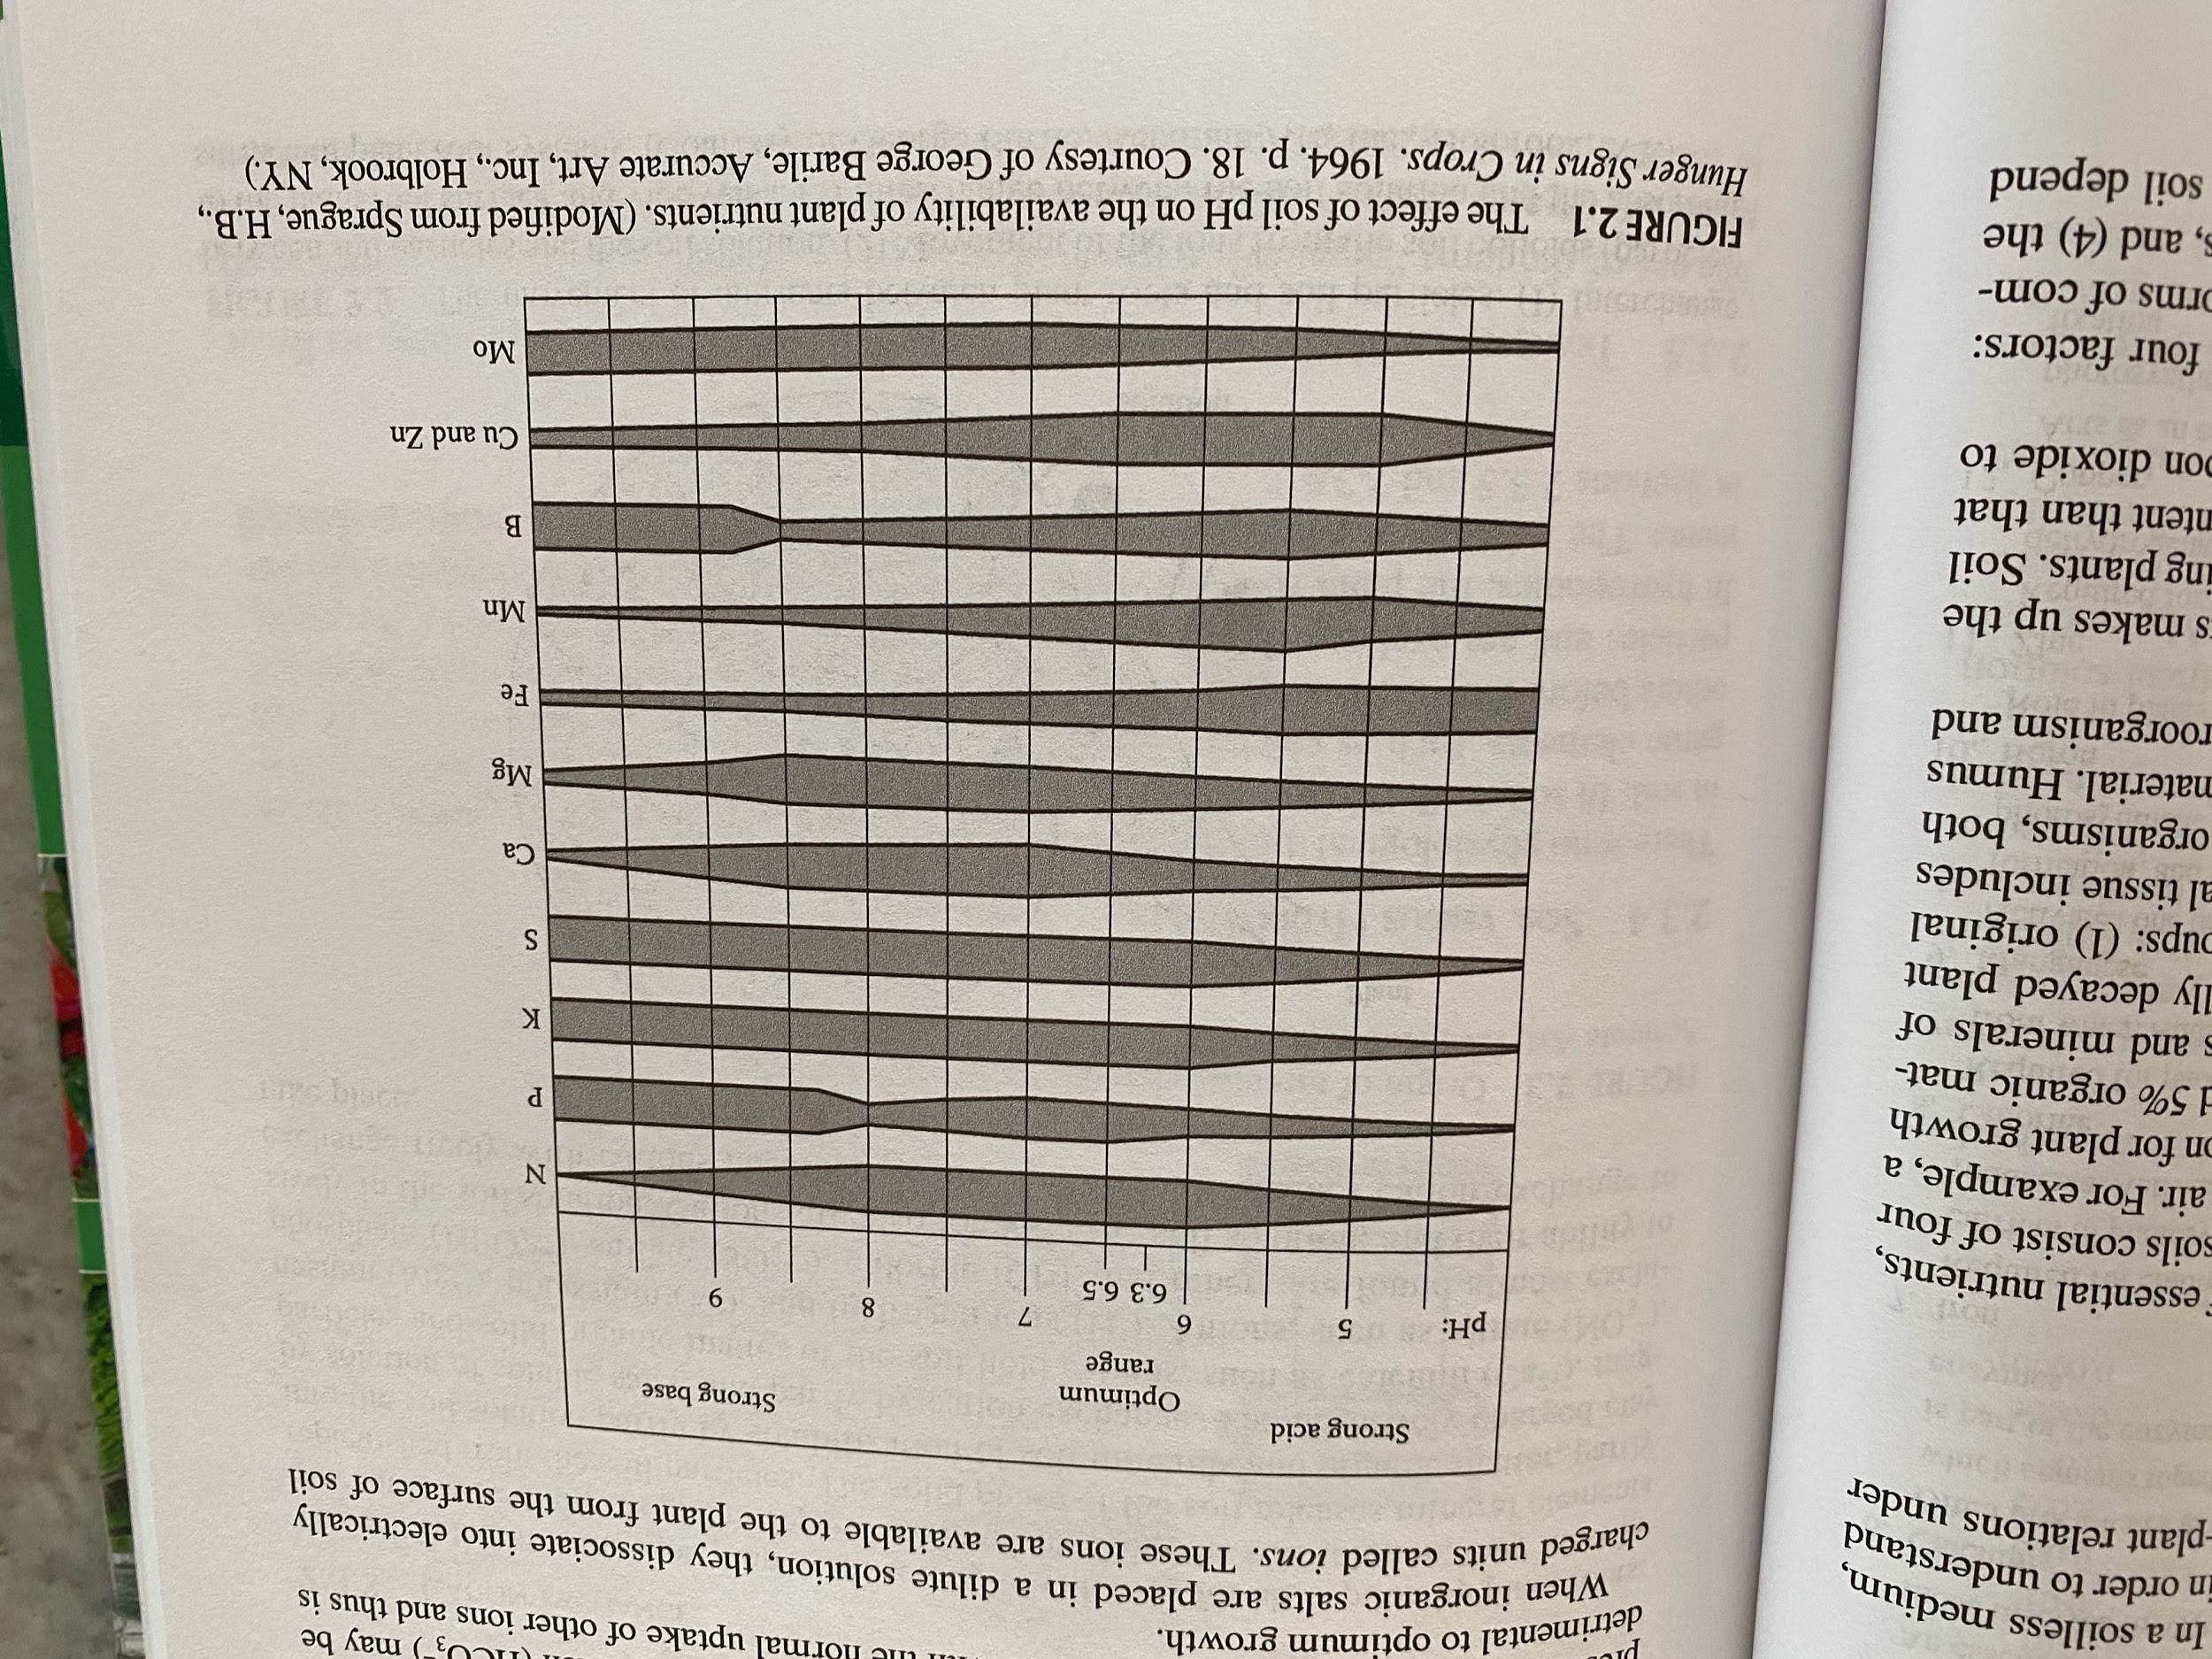
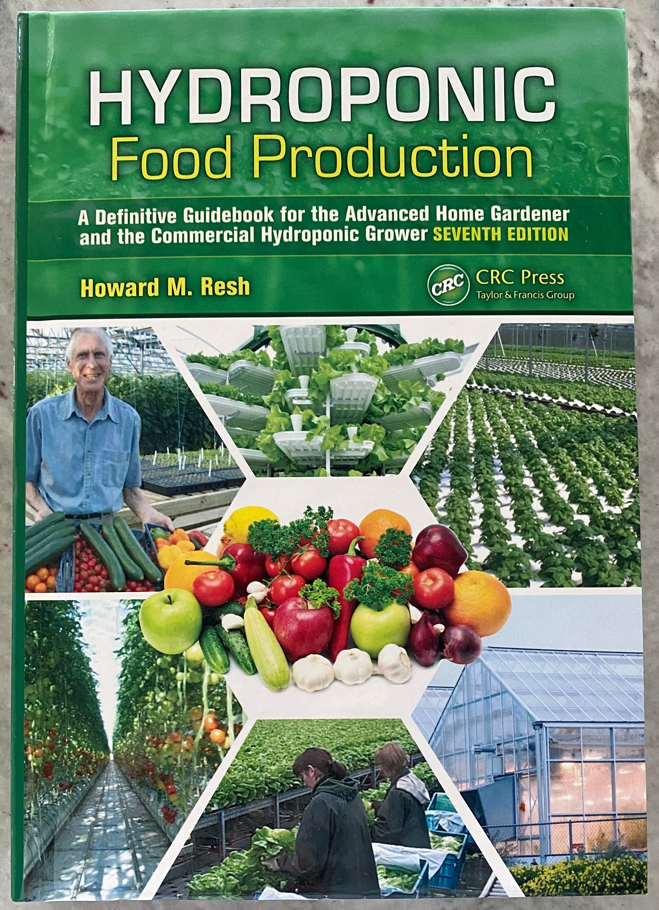
Research
Findings
We conducted research using the book
“Hydroponic Food Production”
The questions we wanted to answer in our research were:
What do the plants need to grow best besides the basics (Oxygen, water, light)
What is pH?
When can we transplant?
We also looked for clues on what light would be best in Canada but we found it was based on so many factors. Like direction of window, time of year, type of artificial light, etc.
We found good information from “Advanced Nutrients” who make nutrients for hydroponic growing. We followed these directions for our plant nutrient concentrations.
We also talked to our mom. She is a water treatment engineer and she took a course taught by American Hydroponics in Feb 2020 in California. But she had no planting experience so we were all learning together.
Plants need Nitrogen, Phosphorus, Potassium, Sulfur and other elements to grow best. These are naturally present in soil but not in water so they have to be added.
pH is a measure of H+ ions and OH- ions in a liquid. Lettuce absorbs nutrients best at pH of 5.75 to 6.5. Calgary water is pH 7 so we had to lower the pH.
We learned that we had to wait until the plants had good roots before we could transplant into the hydroponic system.
We learned that our hydroponic system is called a “cascade” type.

Slide 5
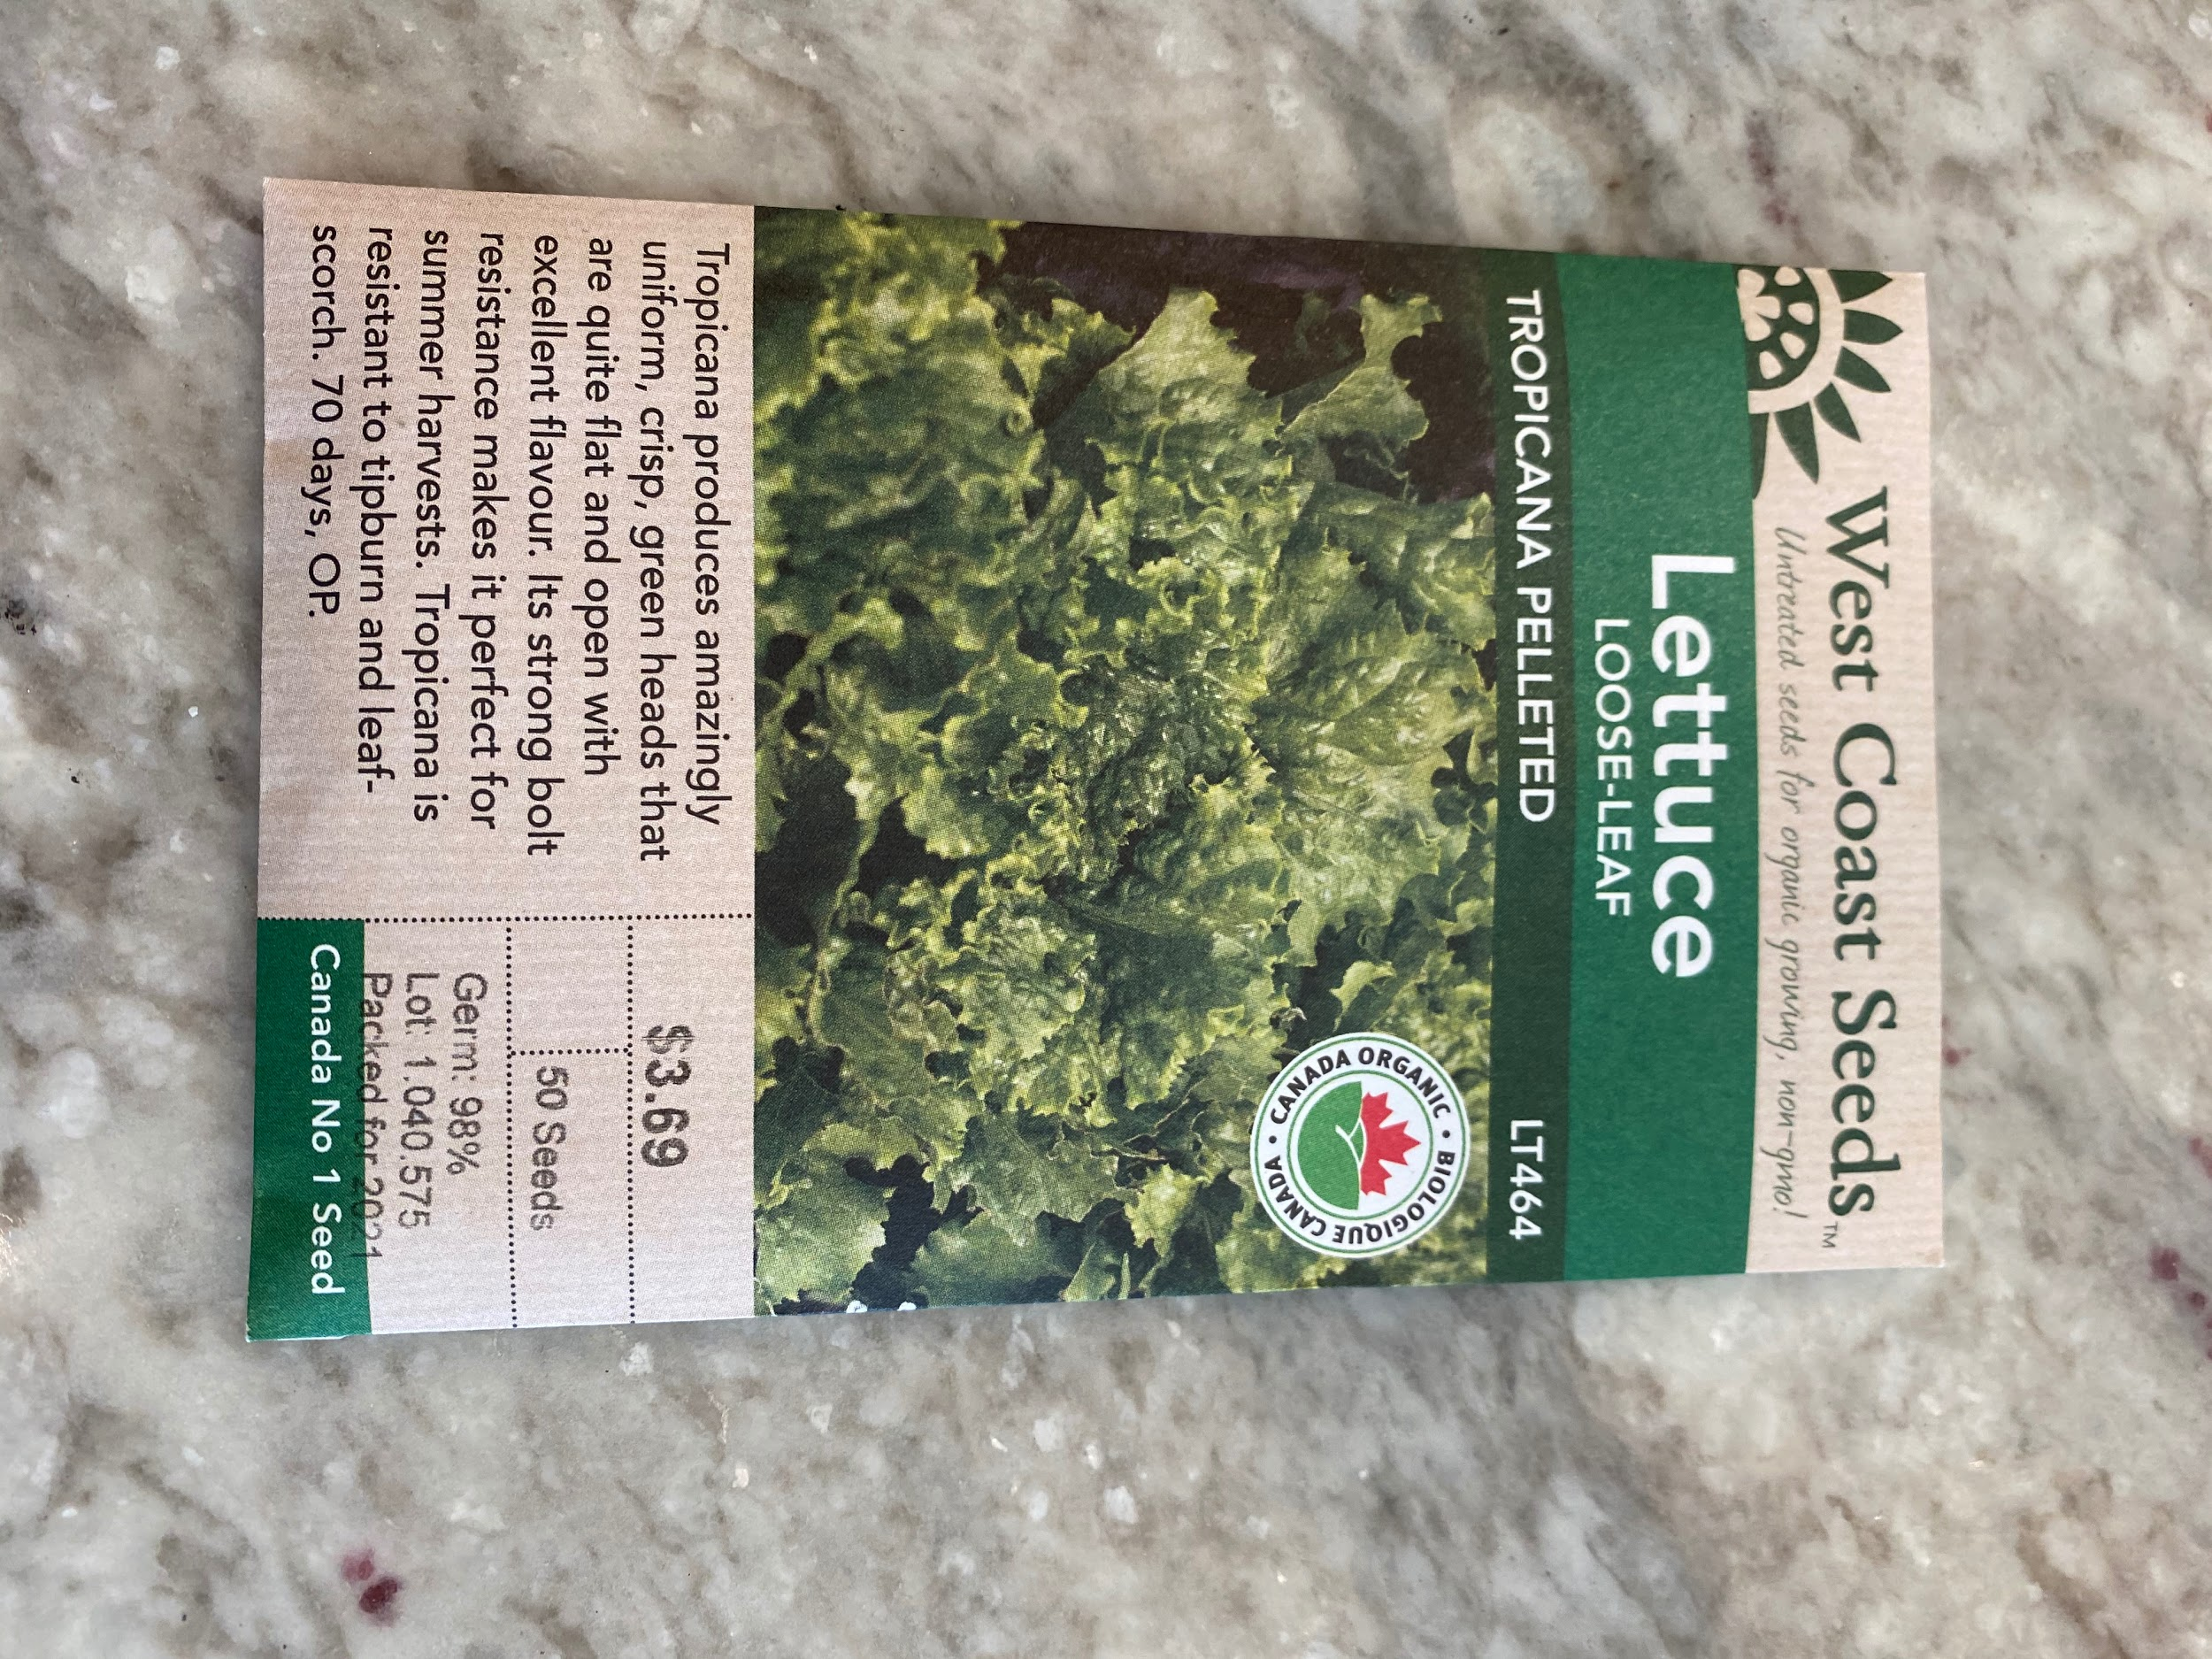
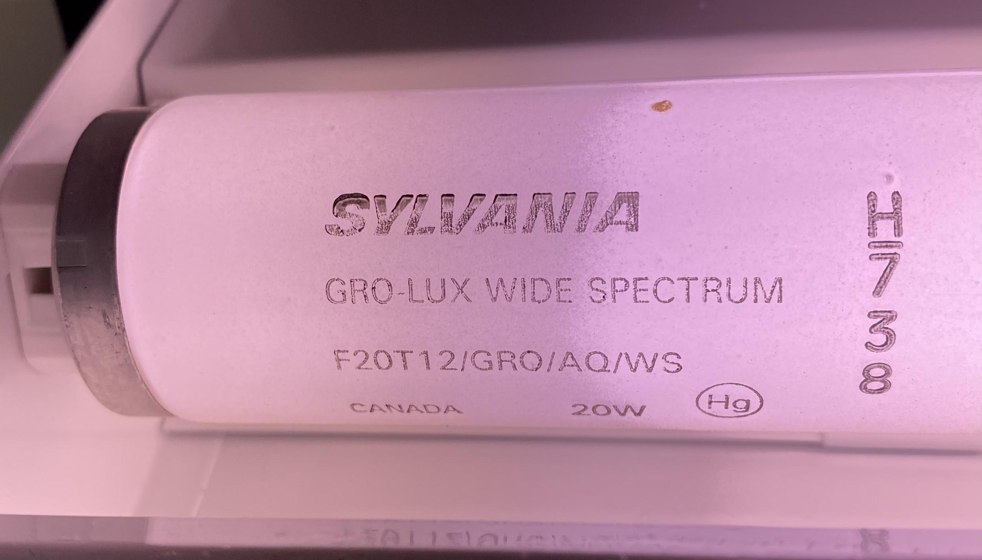
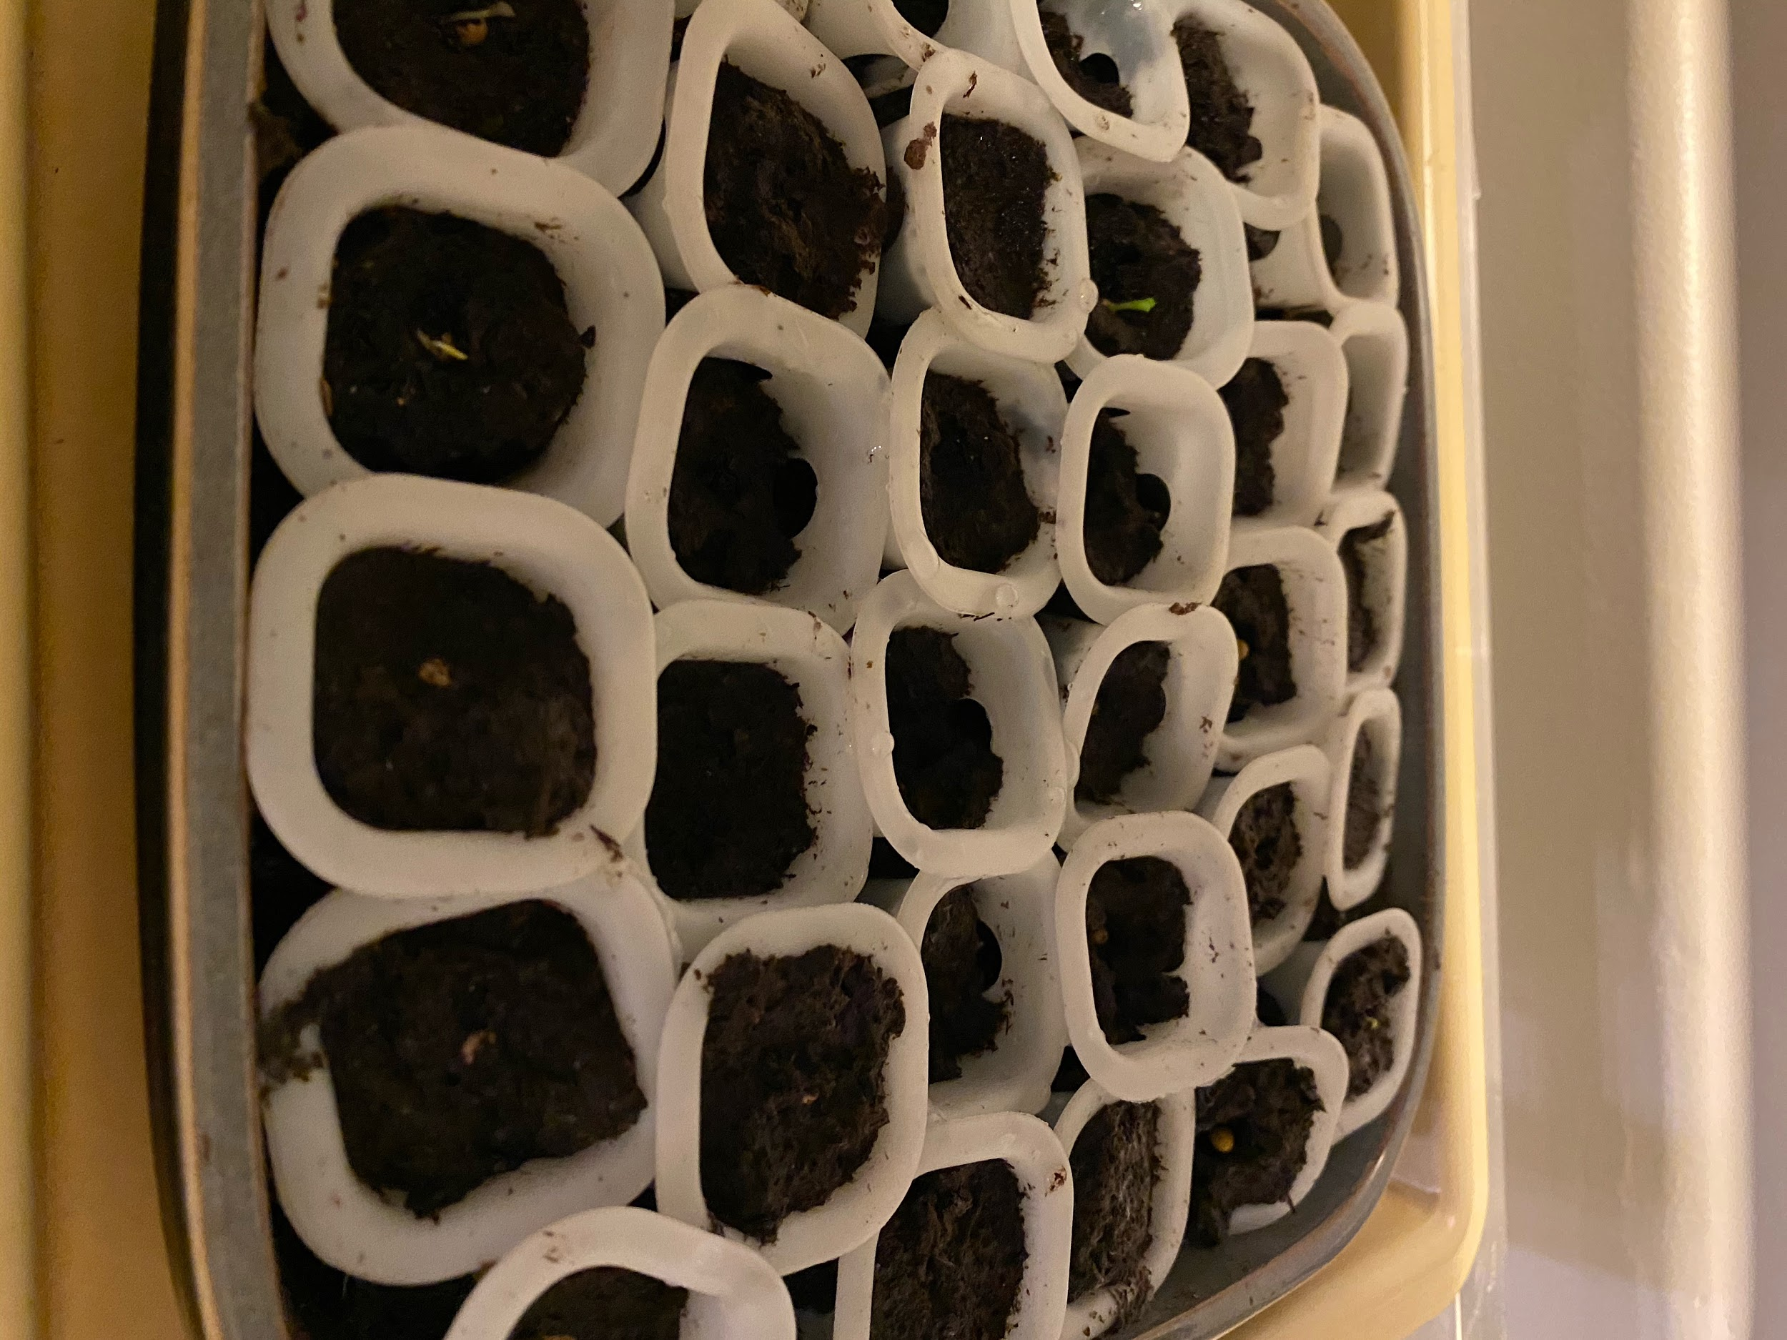
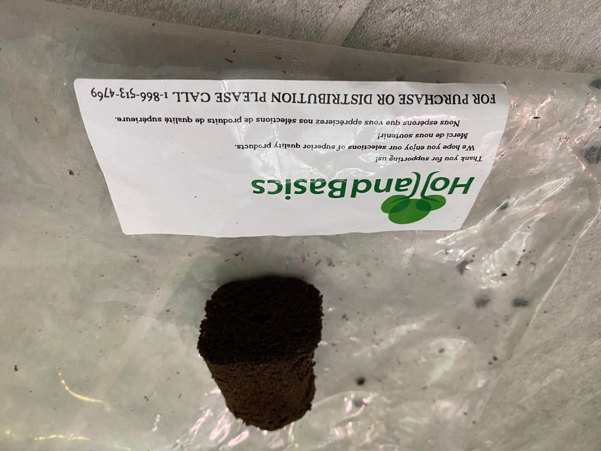
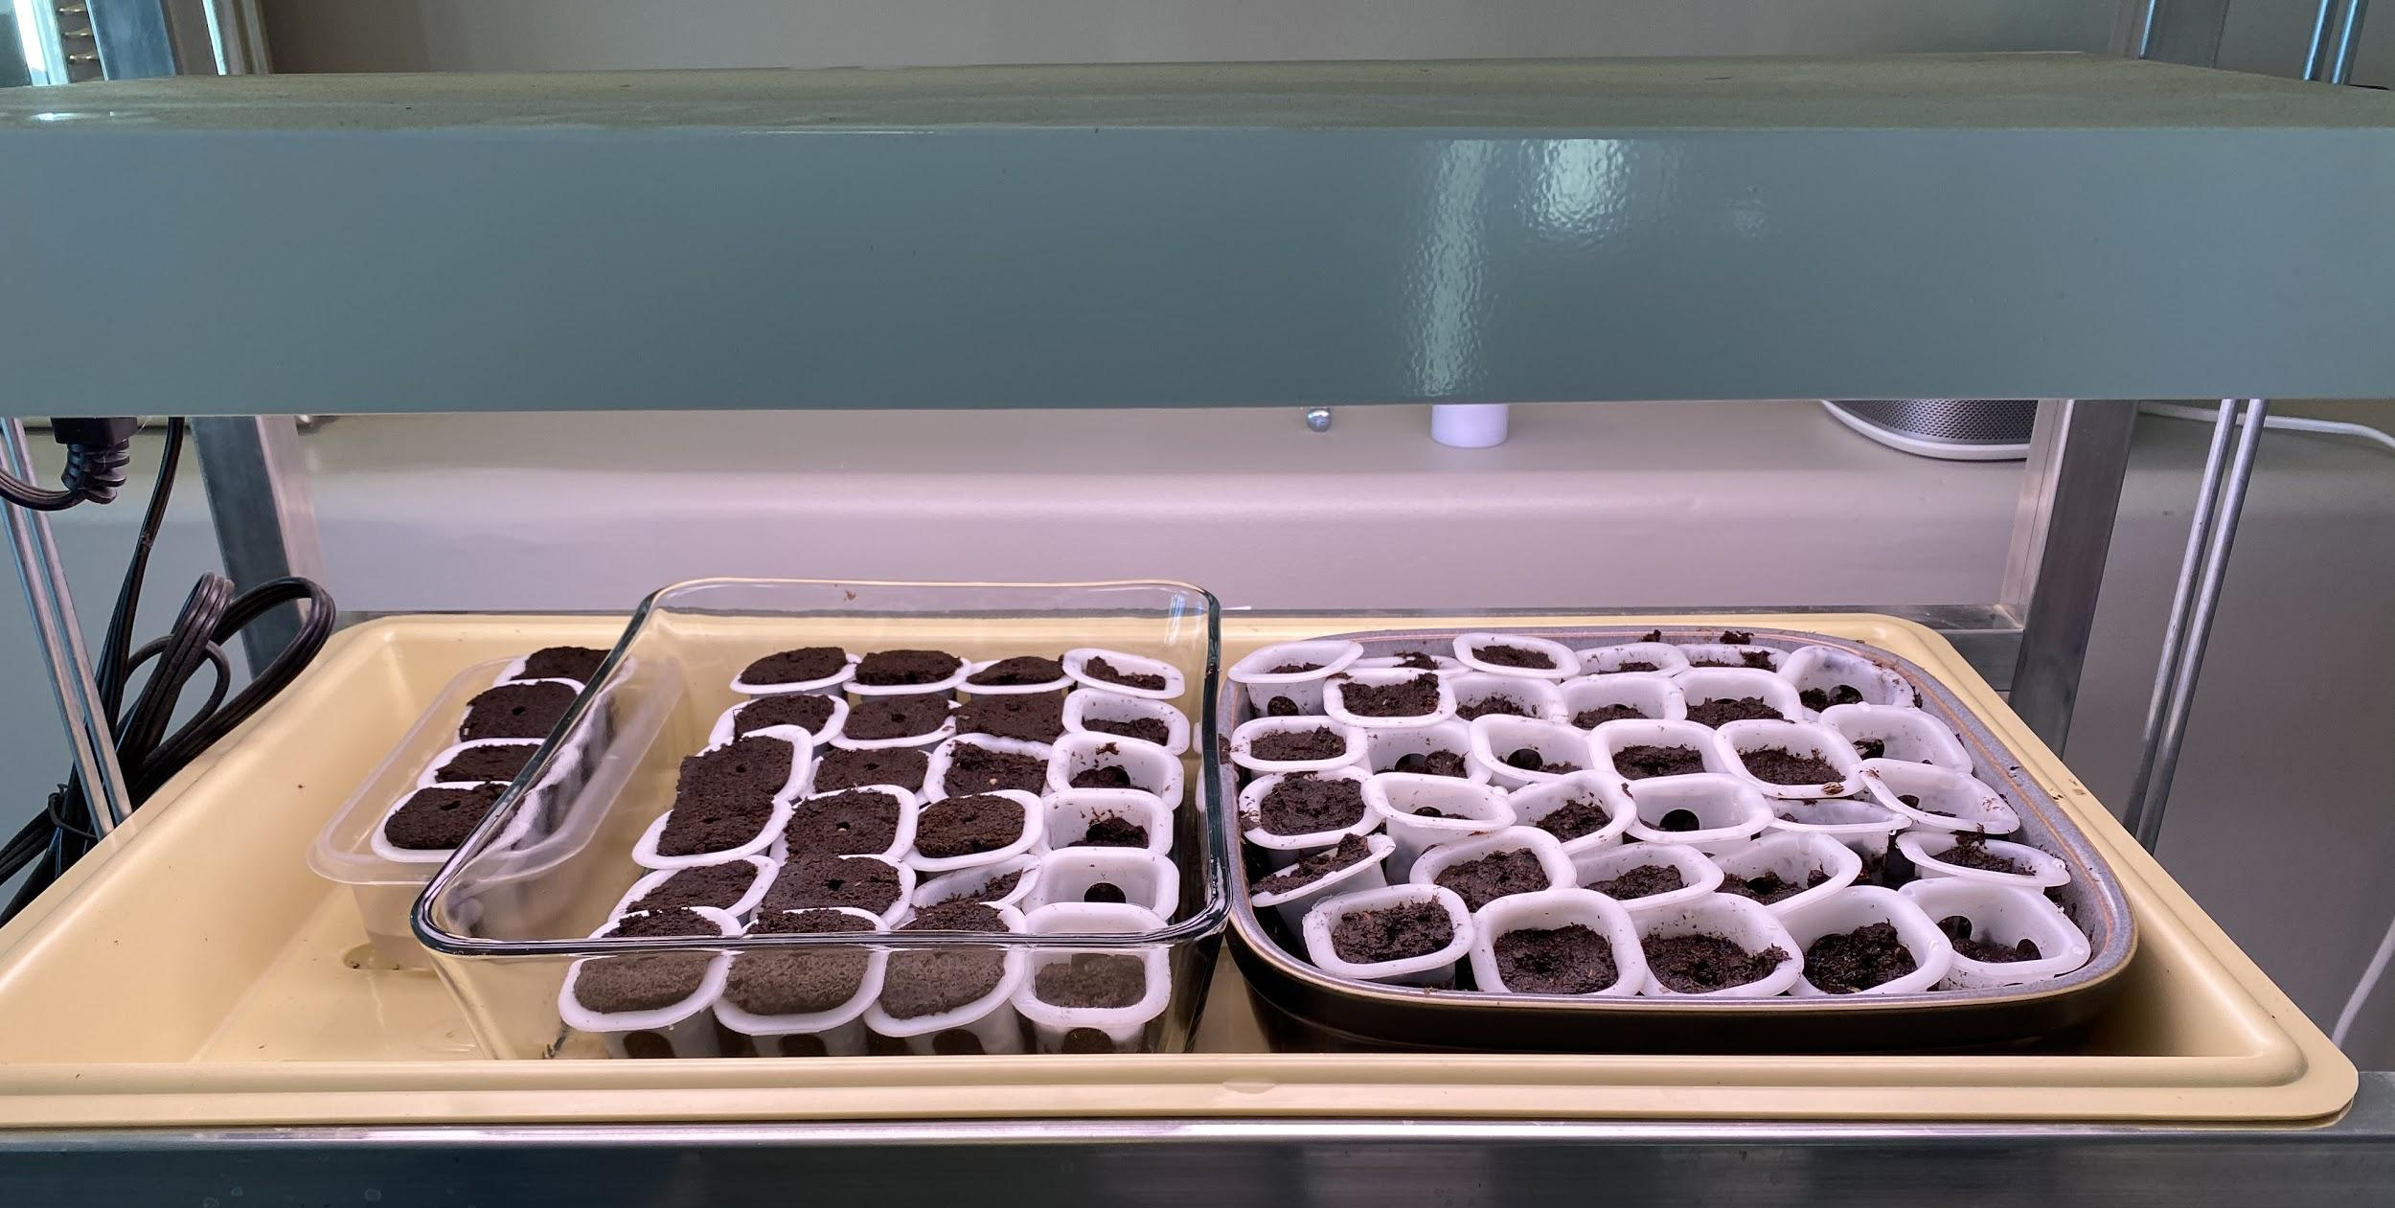
The Materials
Seeds
Peat pellets
Seedling containers
Seedling trays
Artificial lights

Slide 6
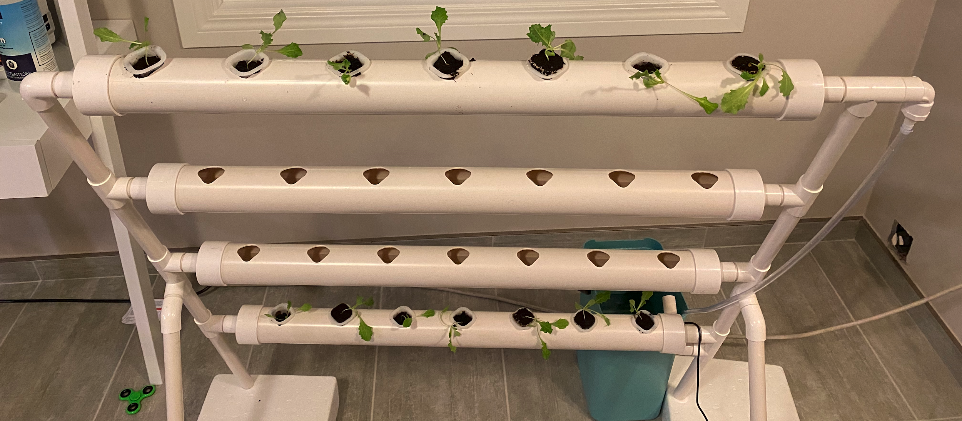
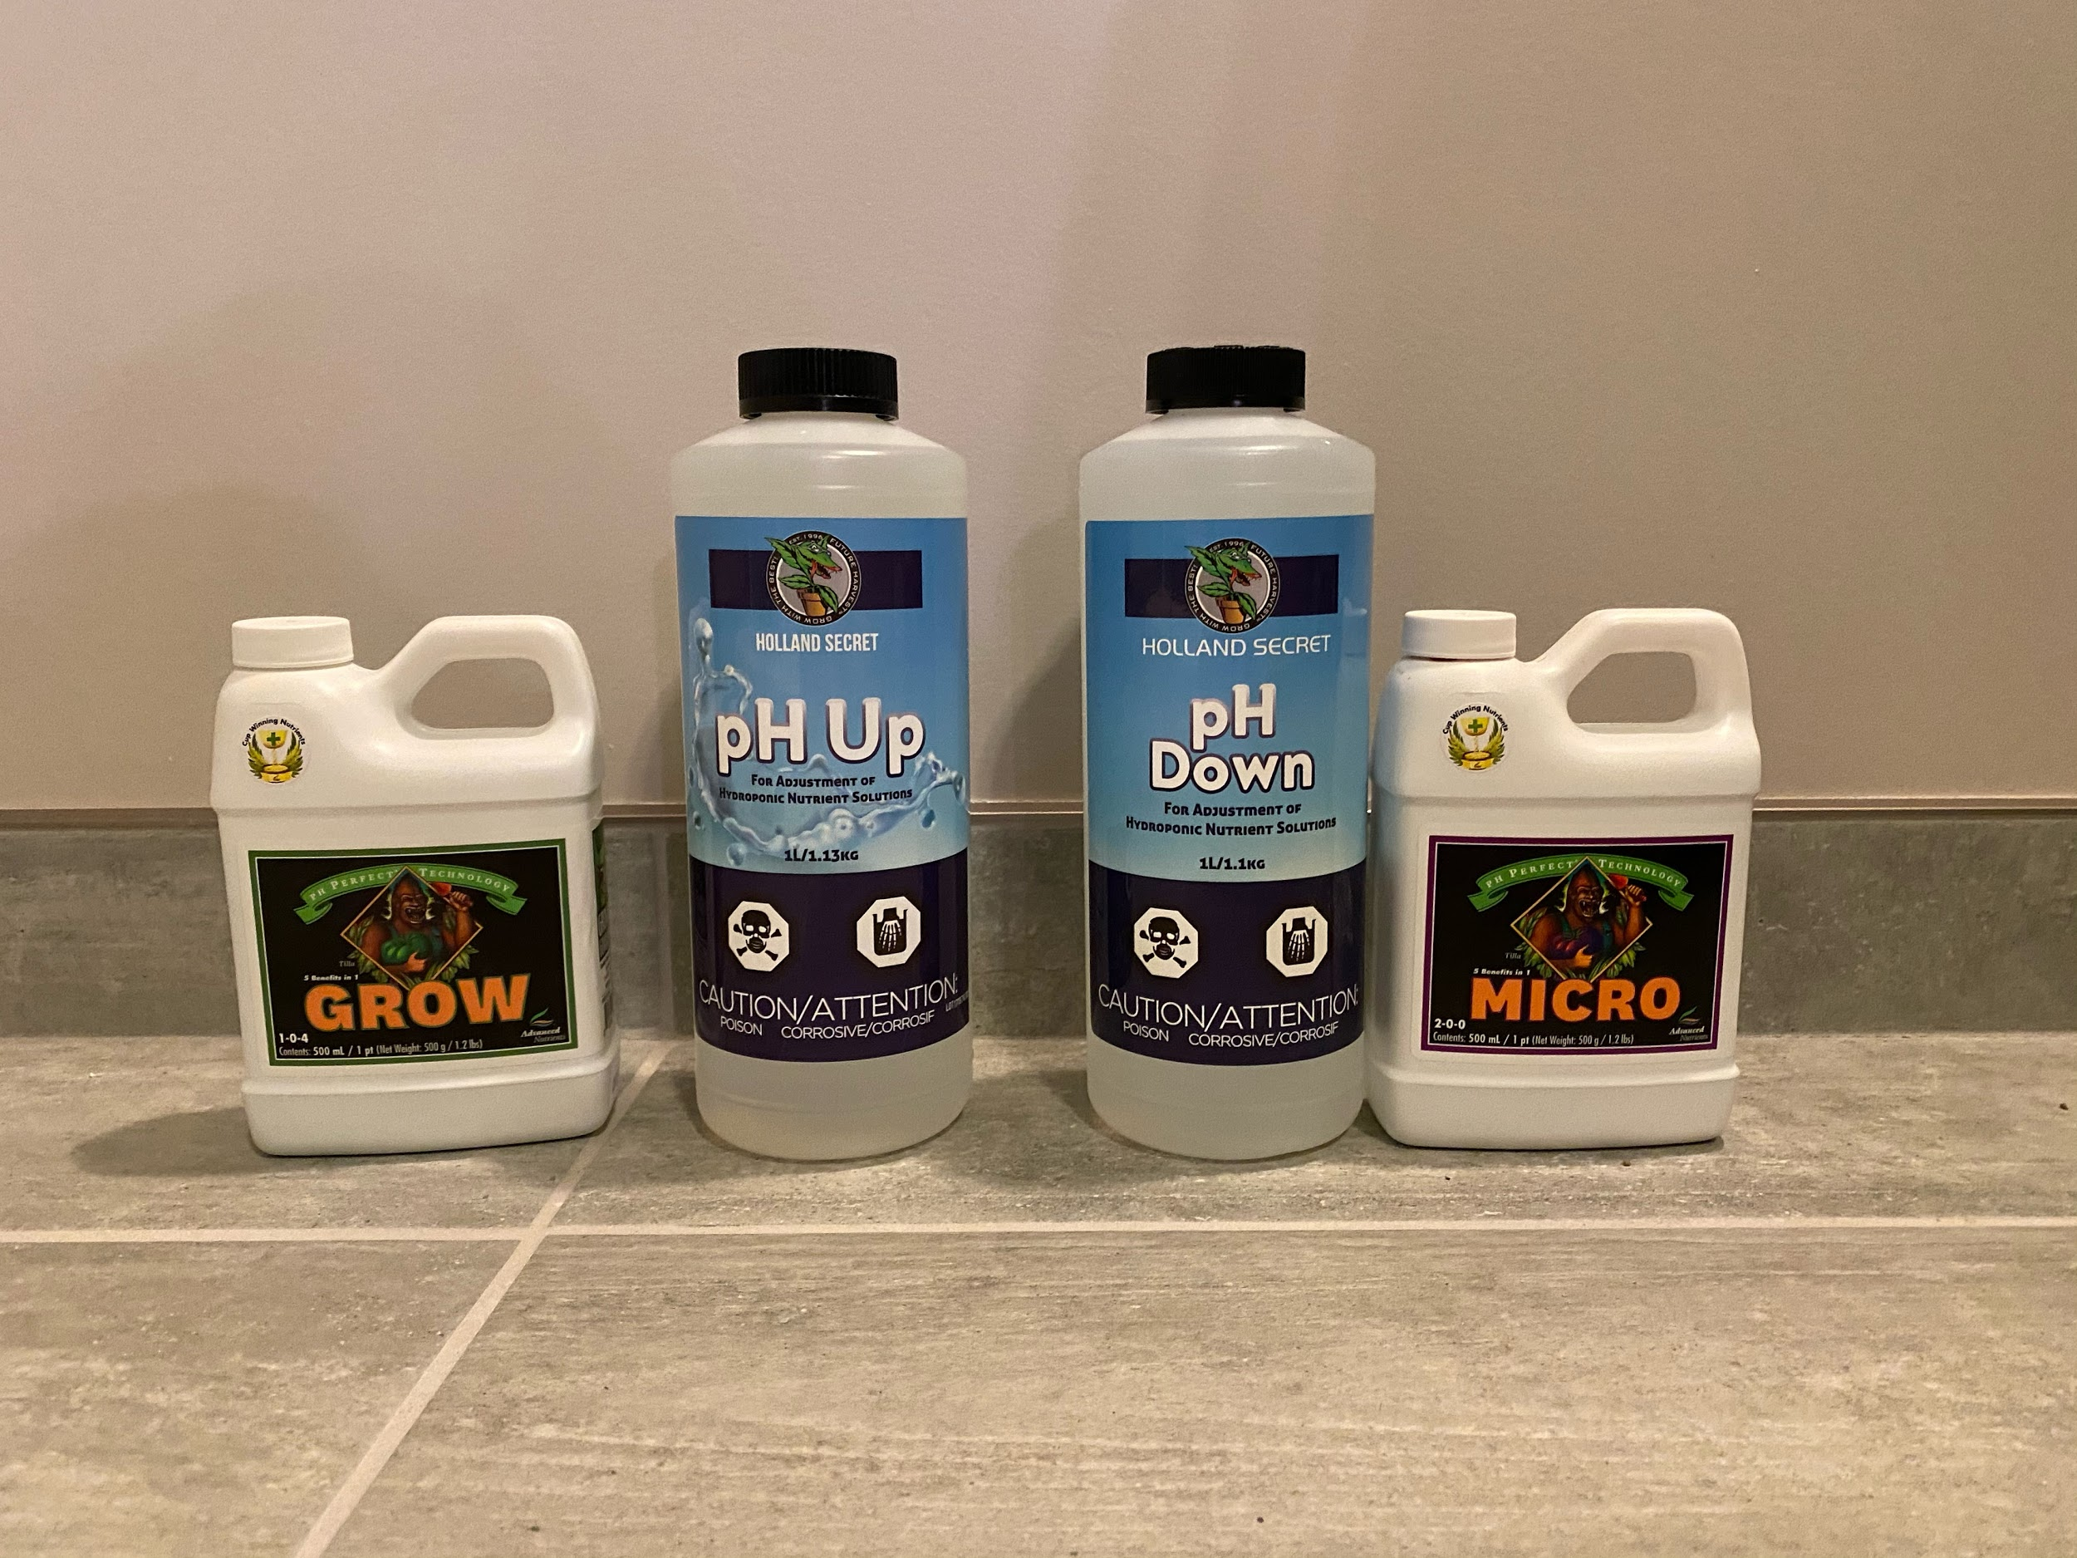
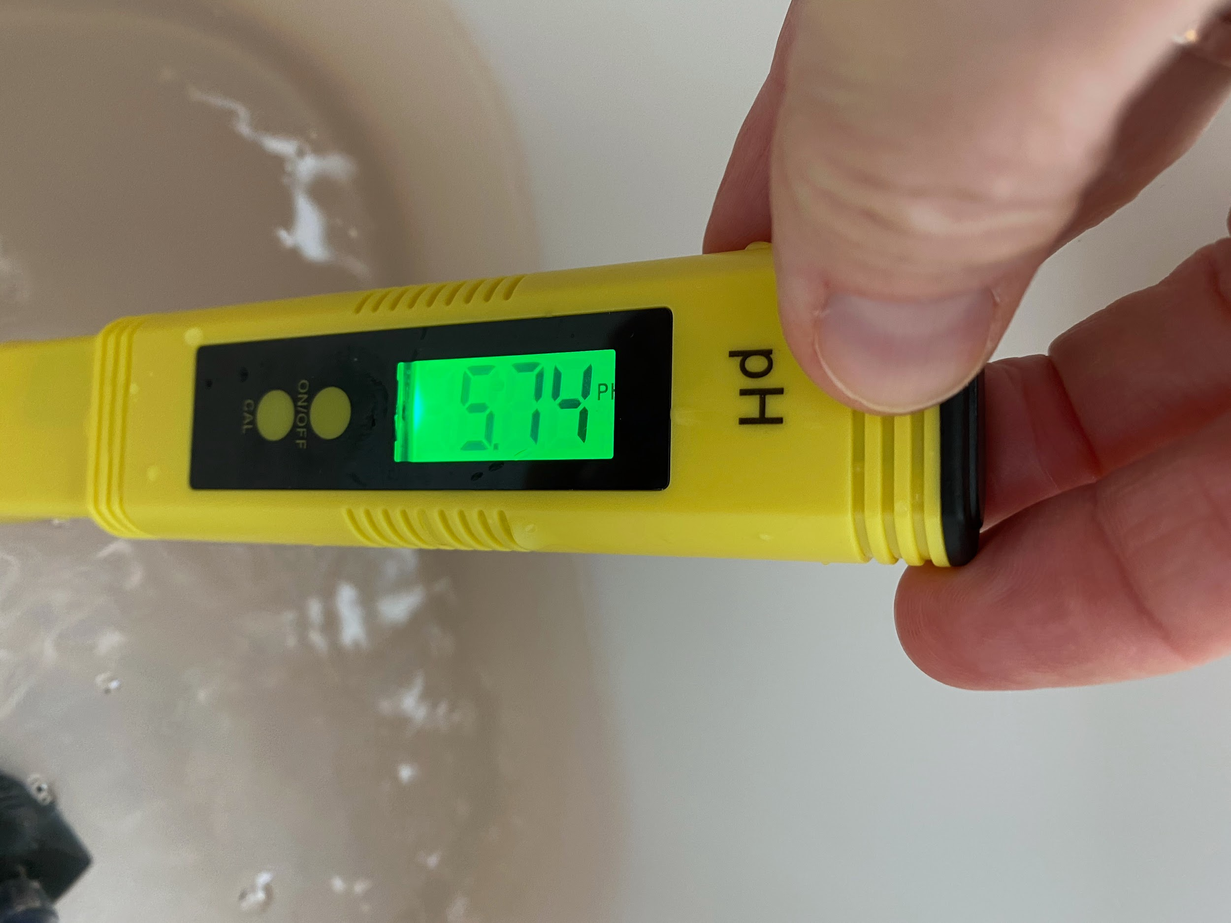
The Materials
(continued)
Two hydroponic systems (one for sunlight, one for artificial light
Nutrients
pH Control Solutions
pH meter
Water and Nutrient Solution Reservoirs
Water pumps
Sunny Window
Ruler/measuring tape

Slide 7
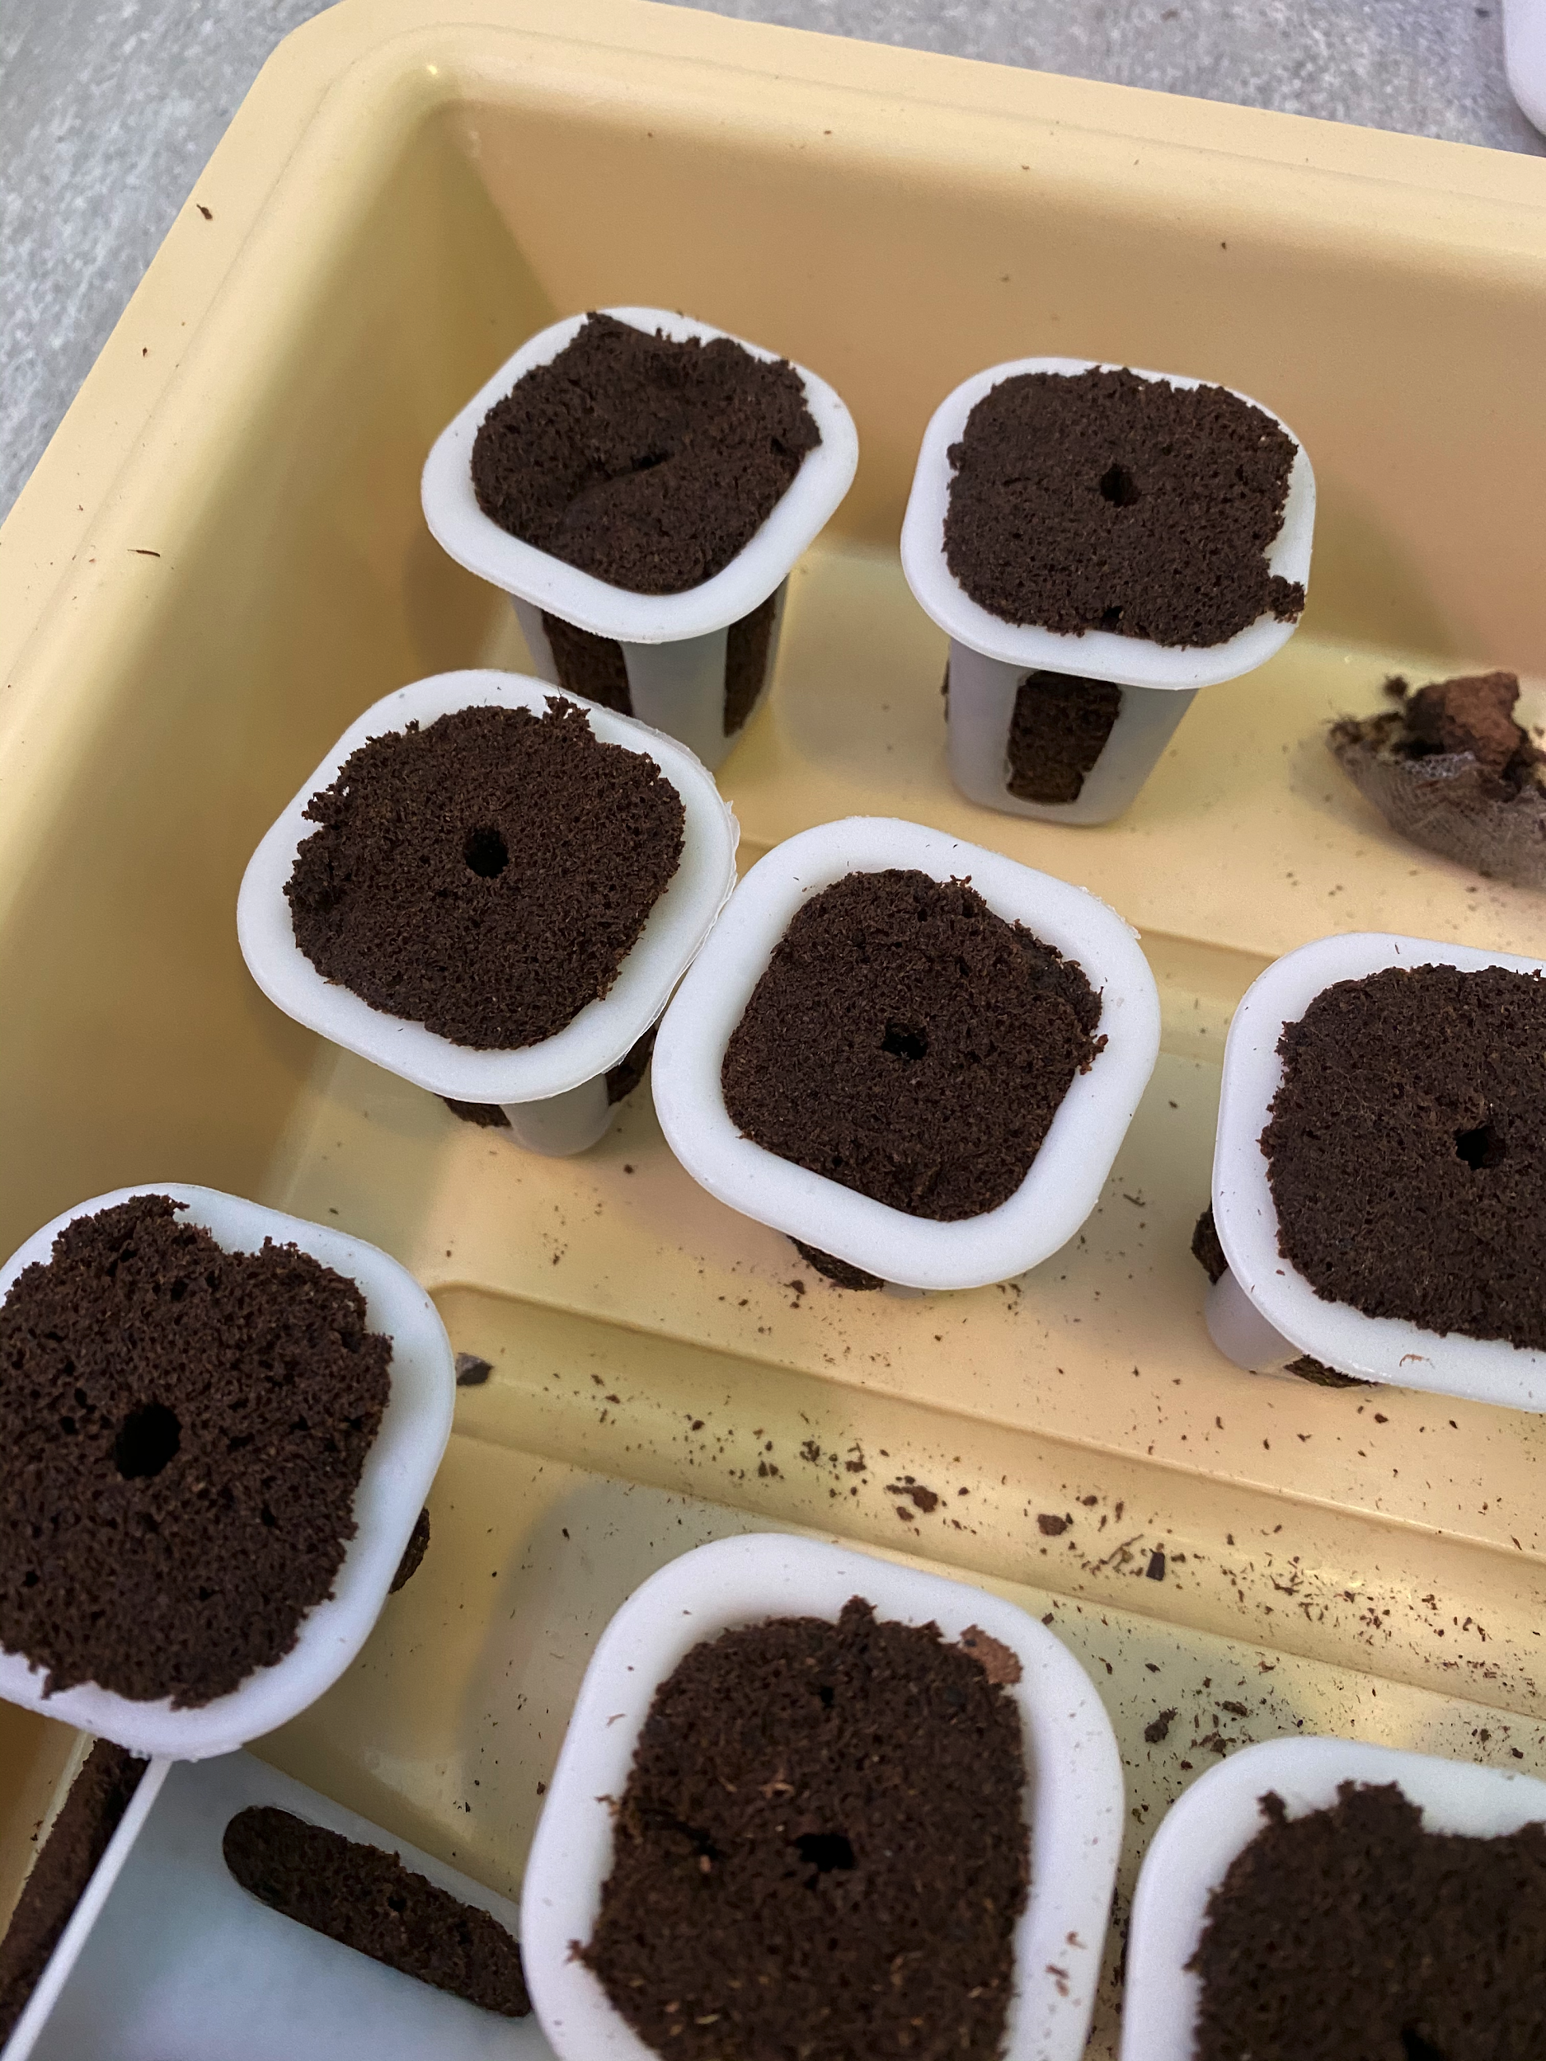
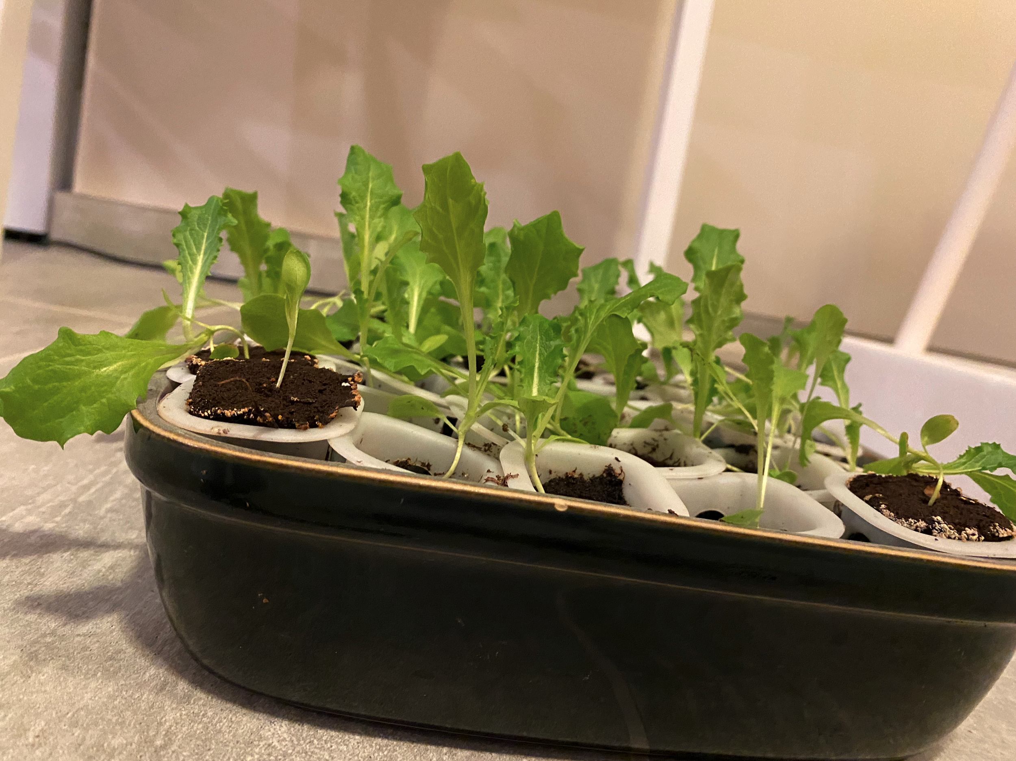
Planting and early growth
On the right side of the slide is the seed pods that are made out of peat which is naturally spongy and has room for the roots to poke out. We planted the seeds by placing them in the tiny holes. We had to make sure that they stayed moist so we put them in trays and kept a little bit of water at the bottom of the tray. The picture on the left shows what the plants look like just before we transplanted them into the hydroponic system.
Notes:
Starting

Slide 8
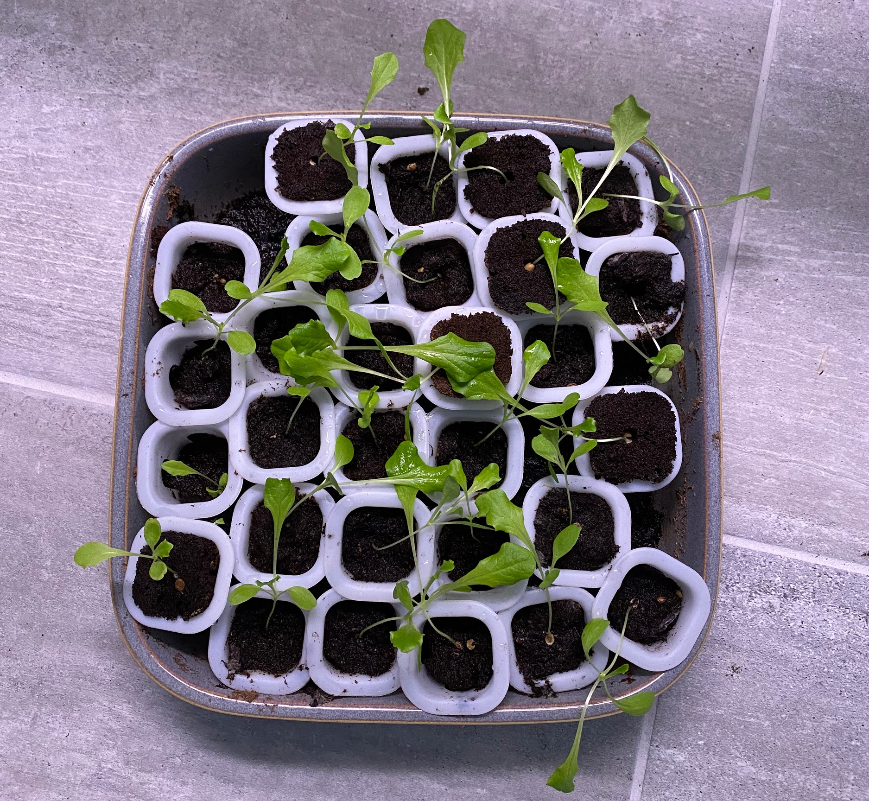
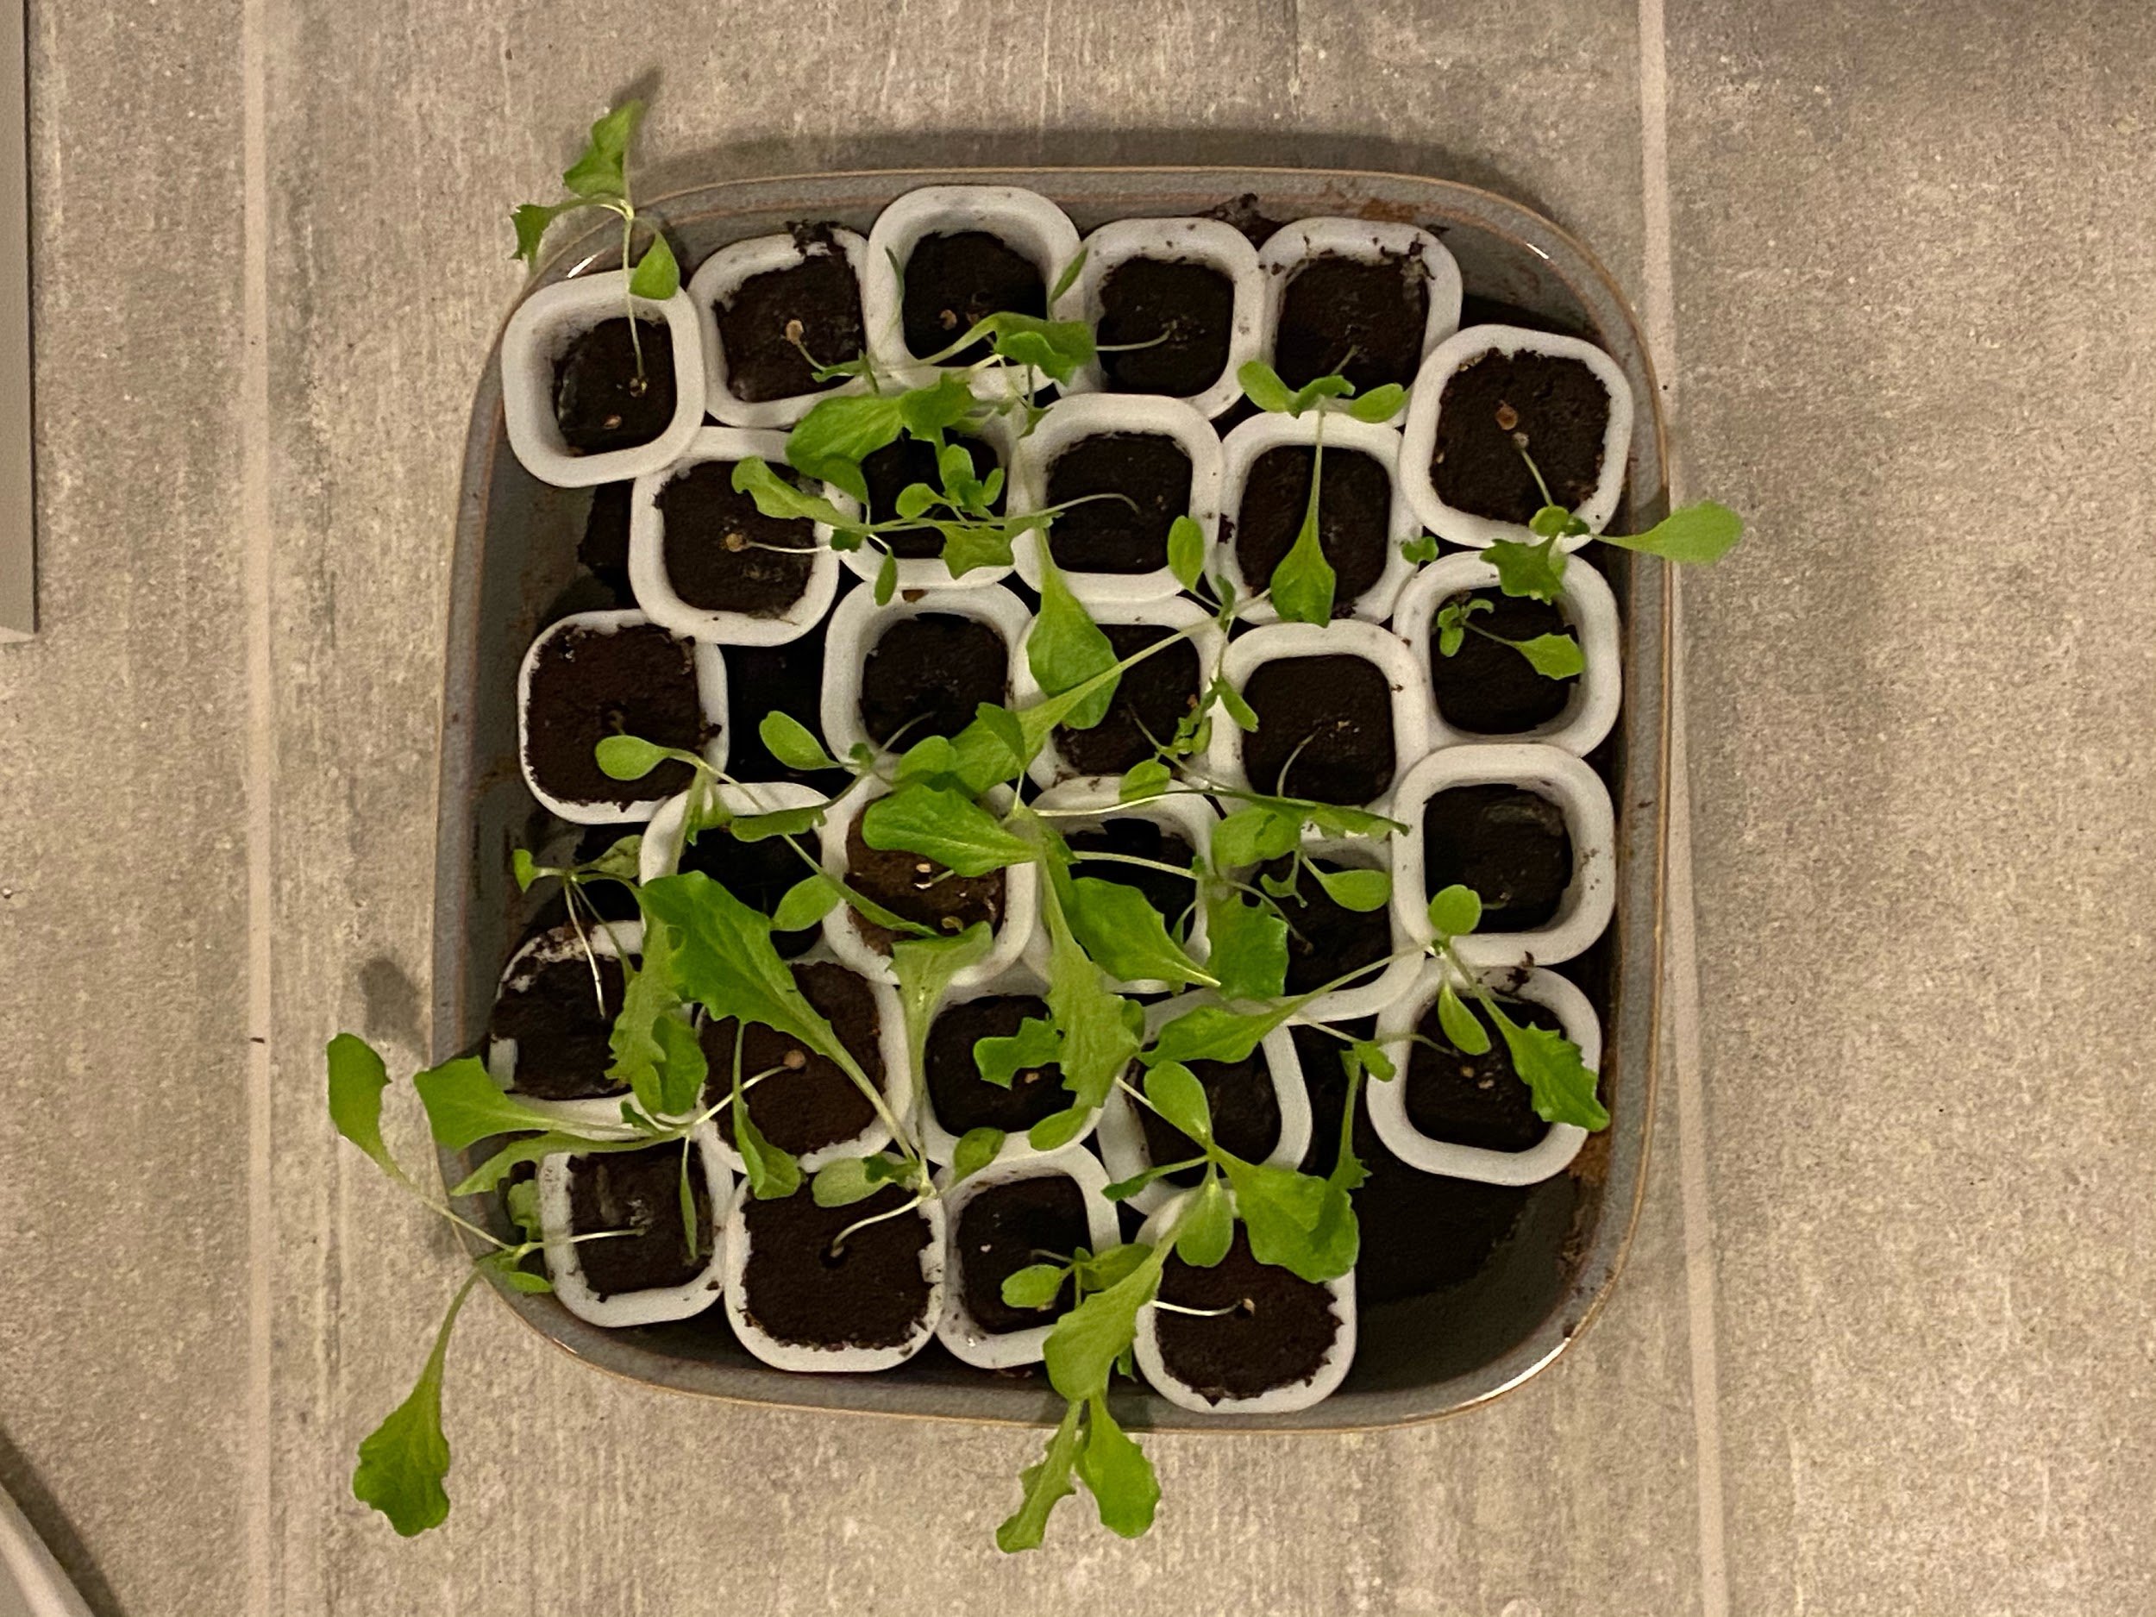
Seedling Growing Timeline and Observations
We planted the seeds on Dec 28th 2020
We placed them under the artificial lights to help them sprout
  We placed ALL seeds under lights, even the ones that later would be placed in sunlight
We watered them regularly with nutrient solution
We had a timer on the artificial lights set to 8 hours of light per day
On Jan 2, 2021 (6 days after planting) we already had some seeds sprouting
Some seeds did not sprout at all
Jan 2
Jan 8
Jan 21

Slide 9
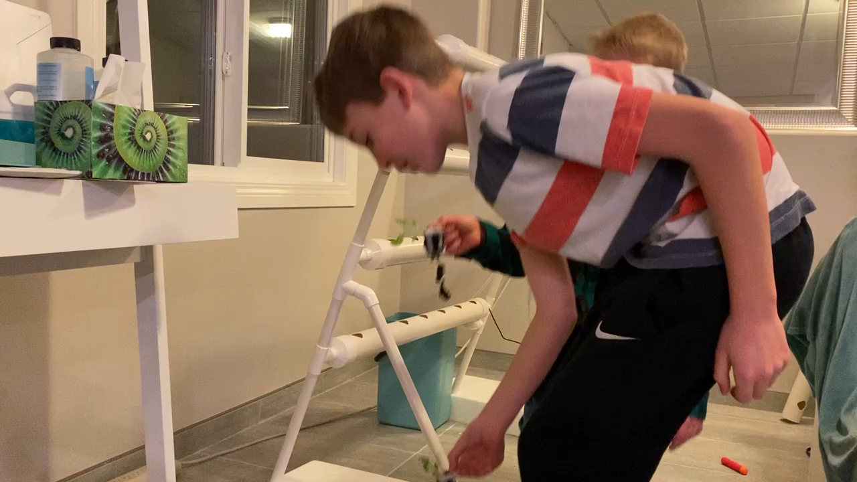
Transplanting
We planted 28 lettuce plants on January 30th
14 for sunshine and 14 for artificial light

Slide 10
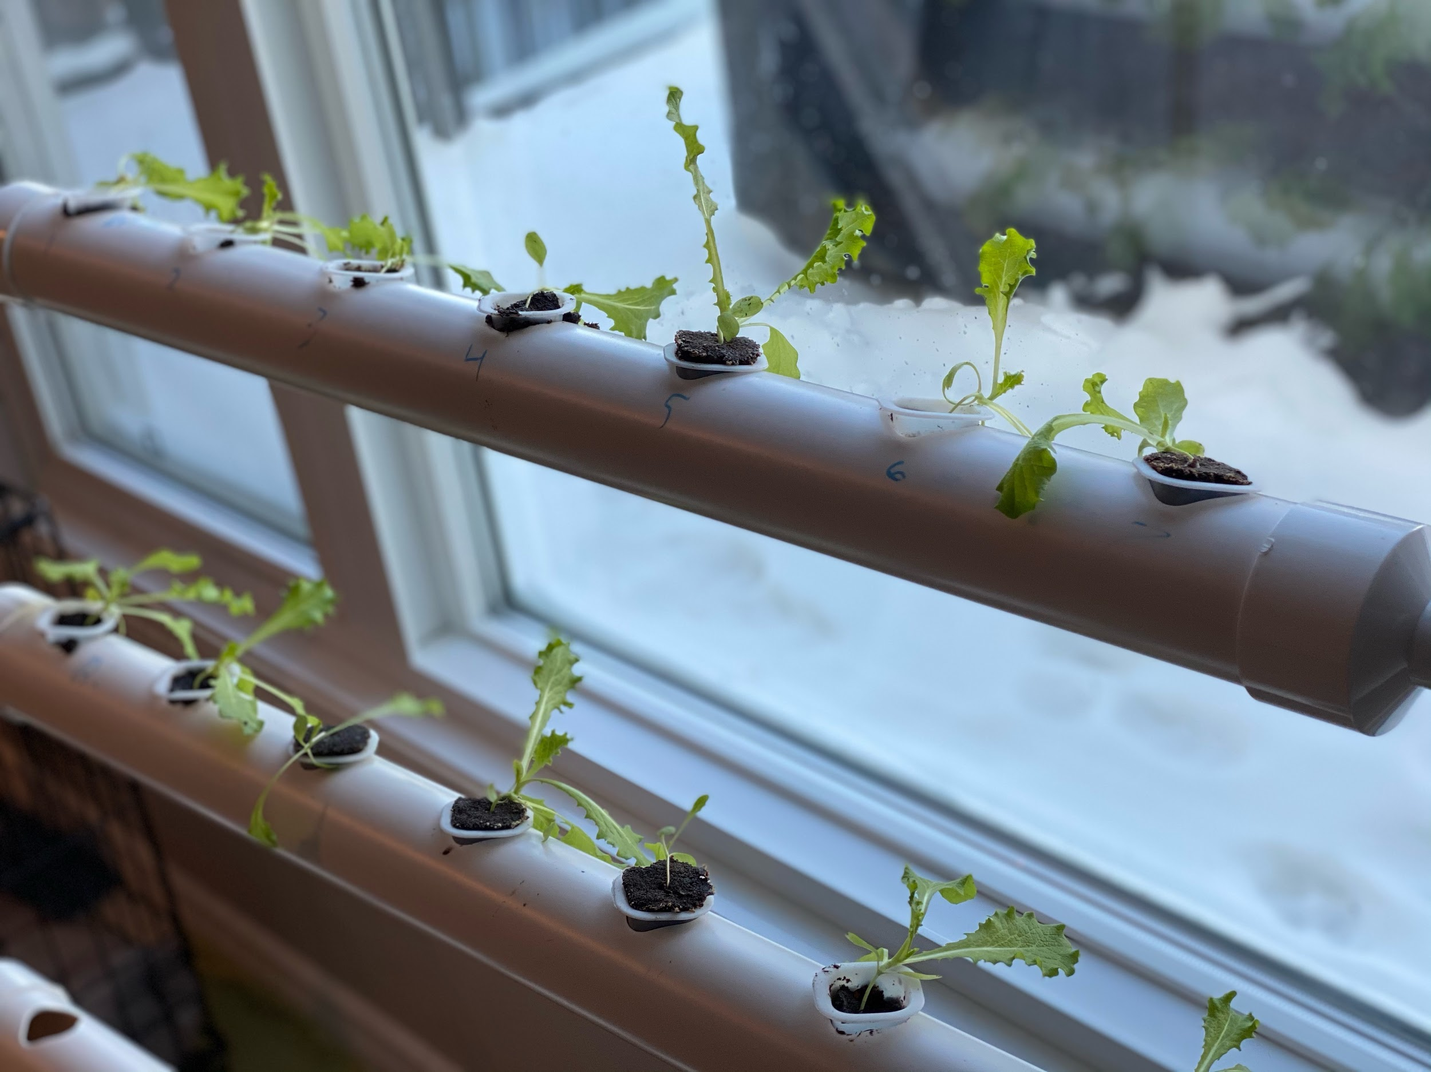
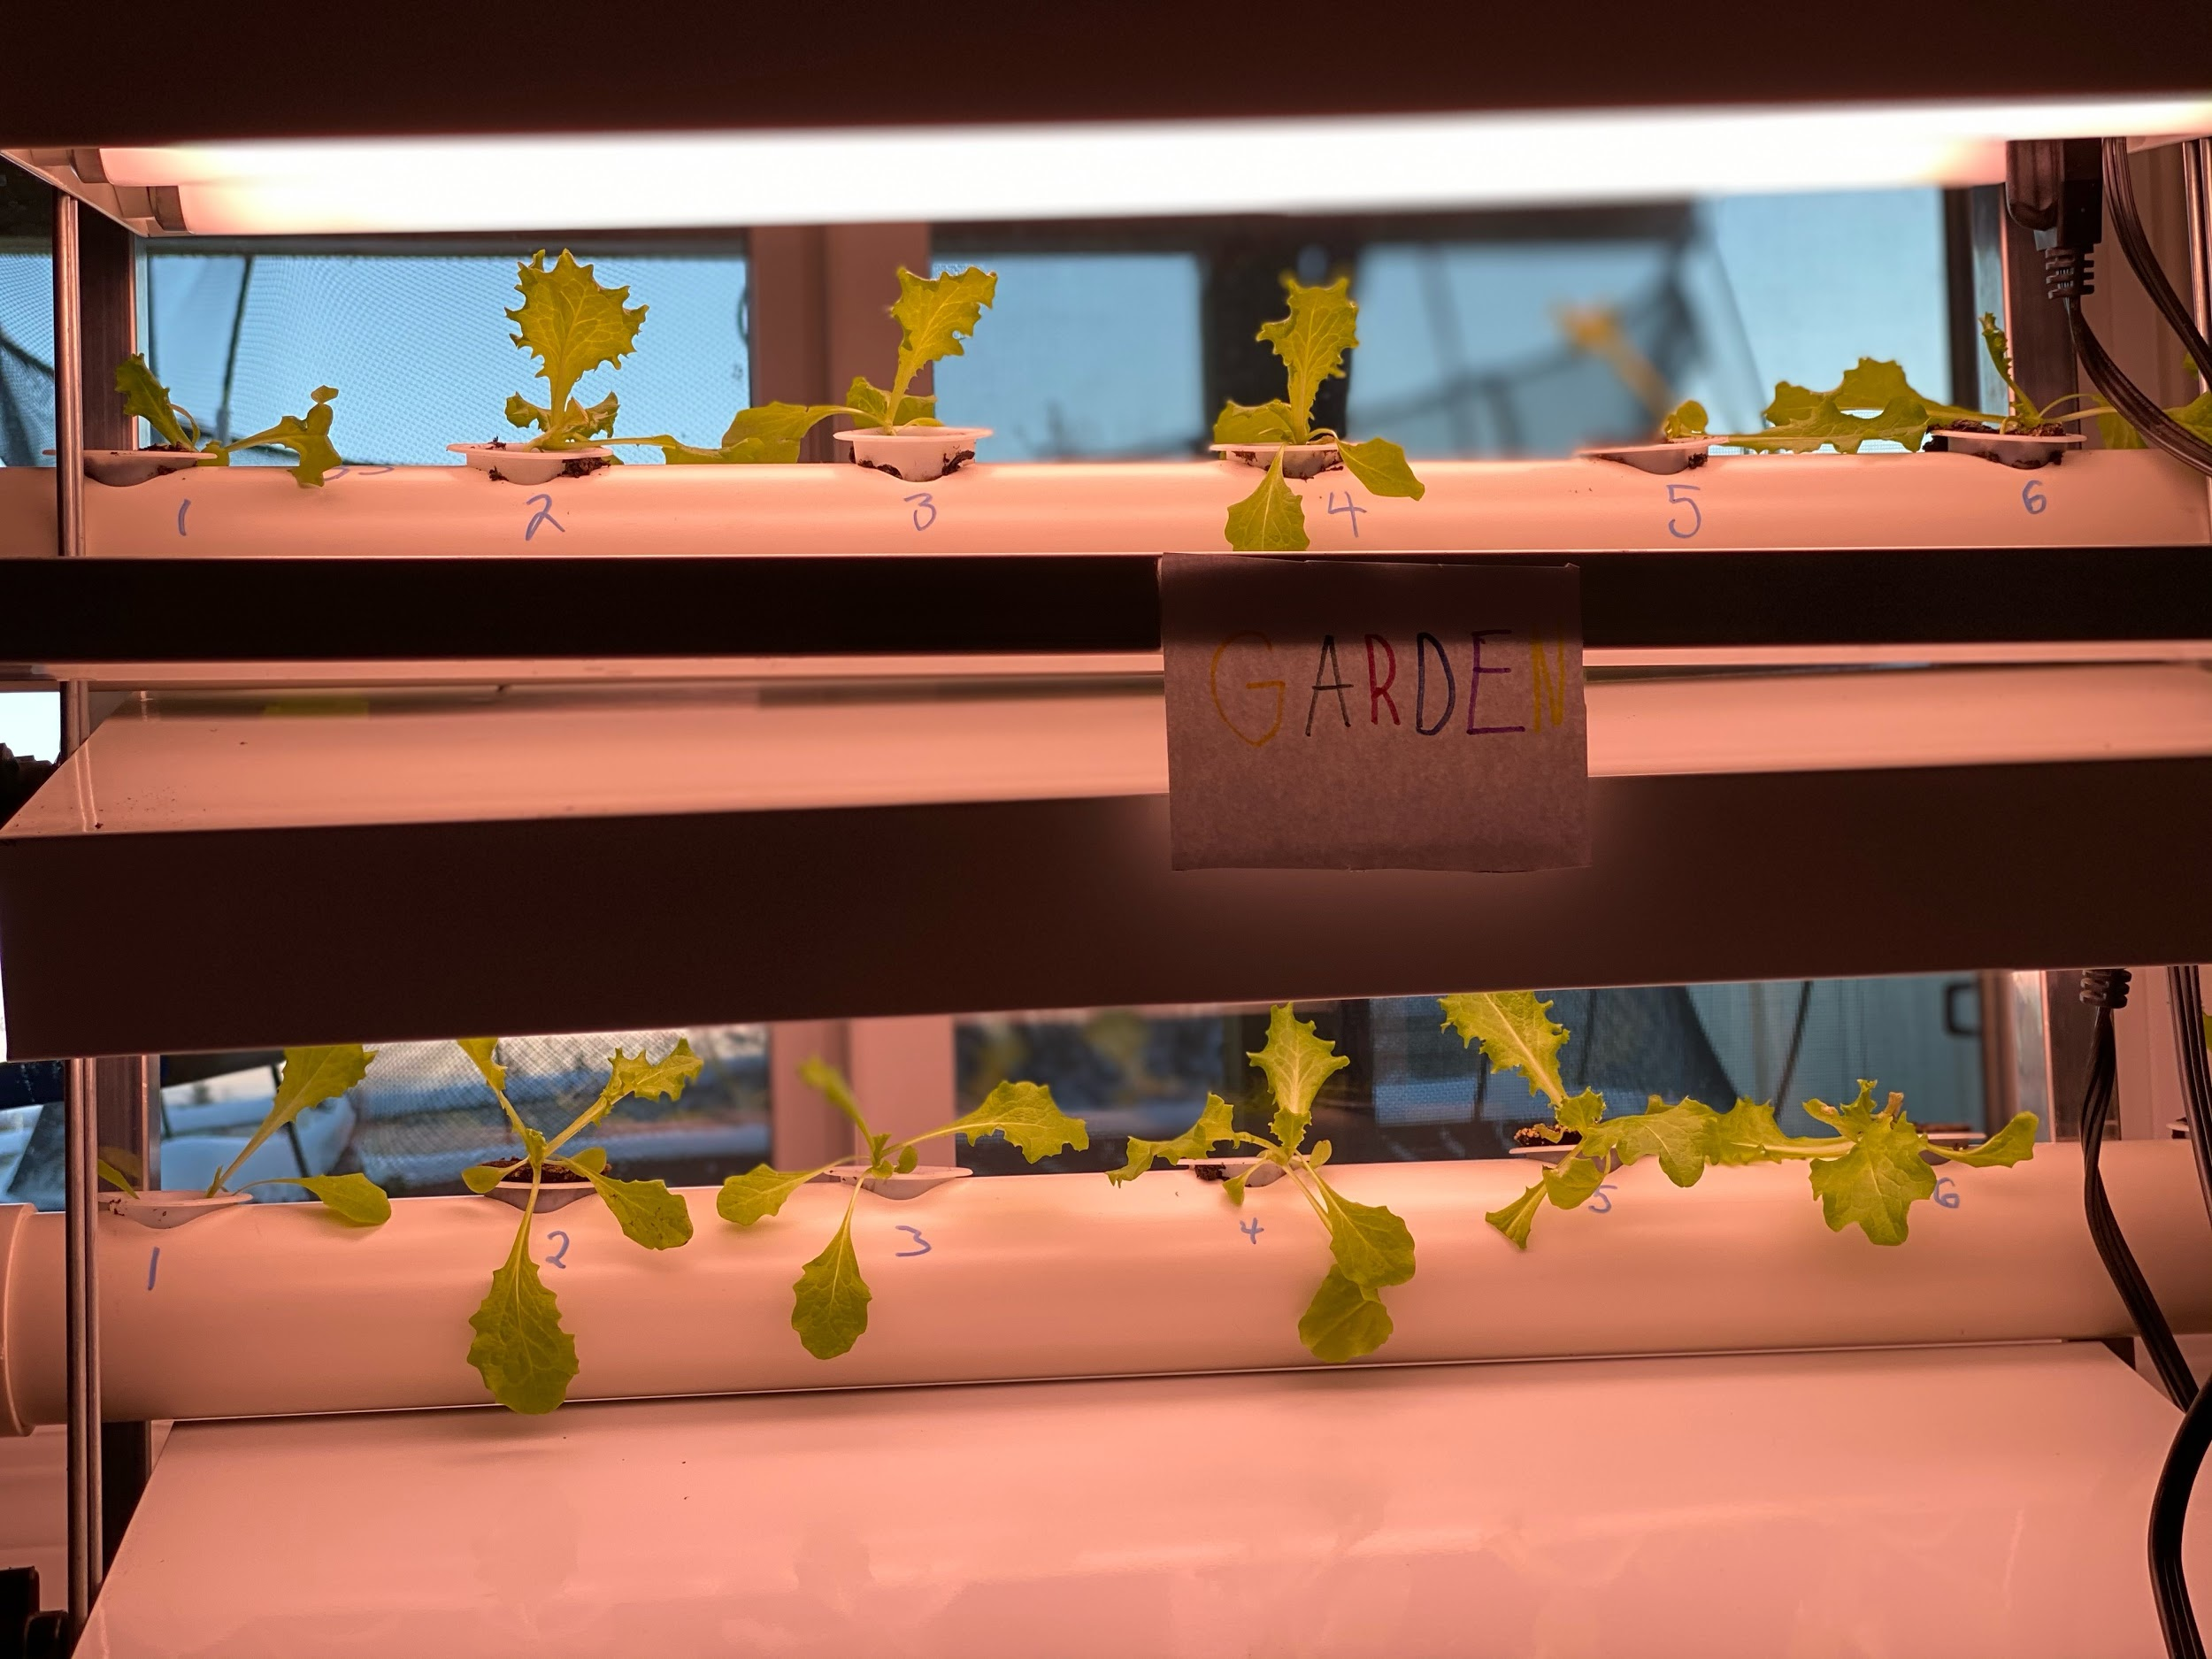
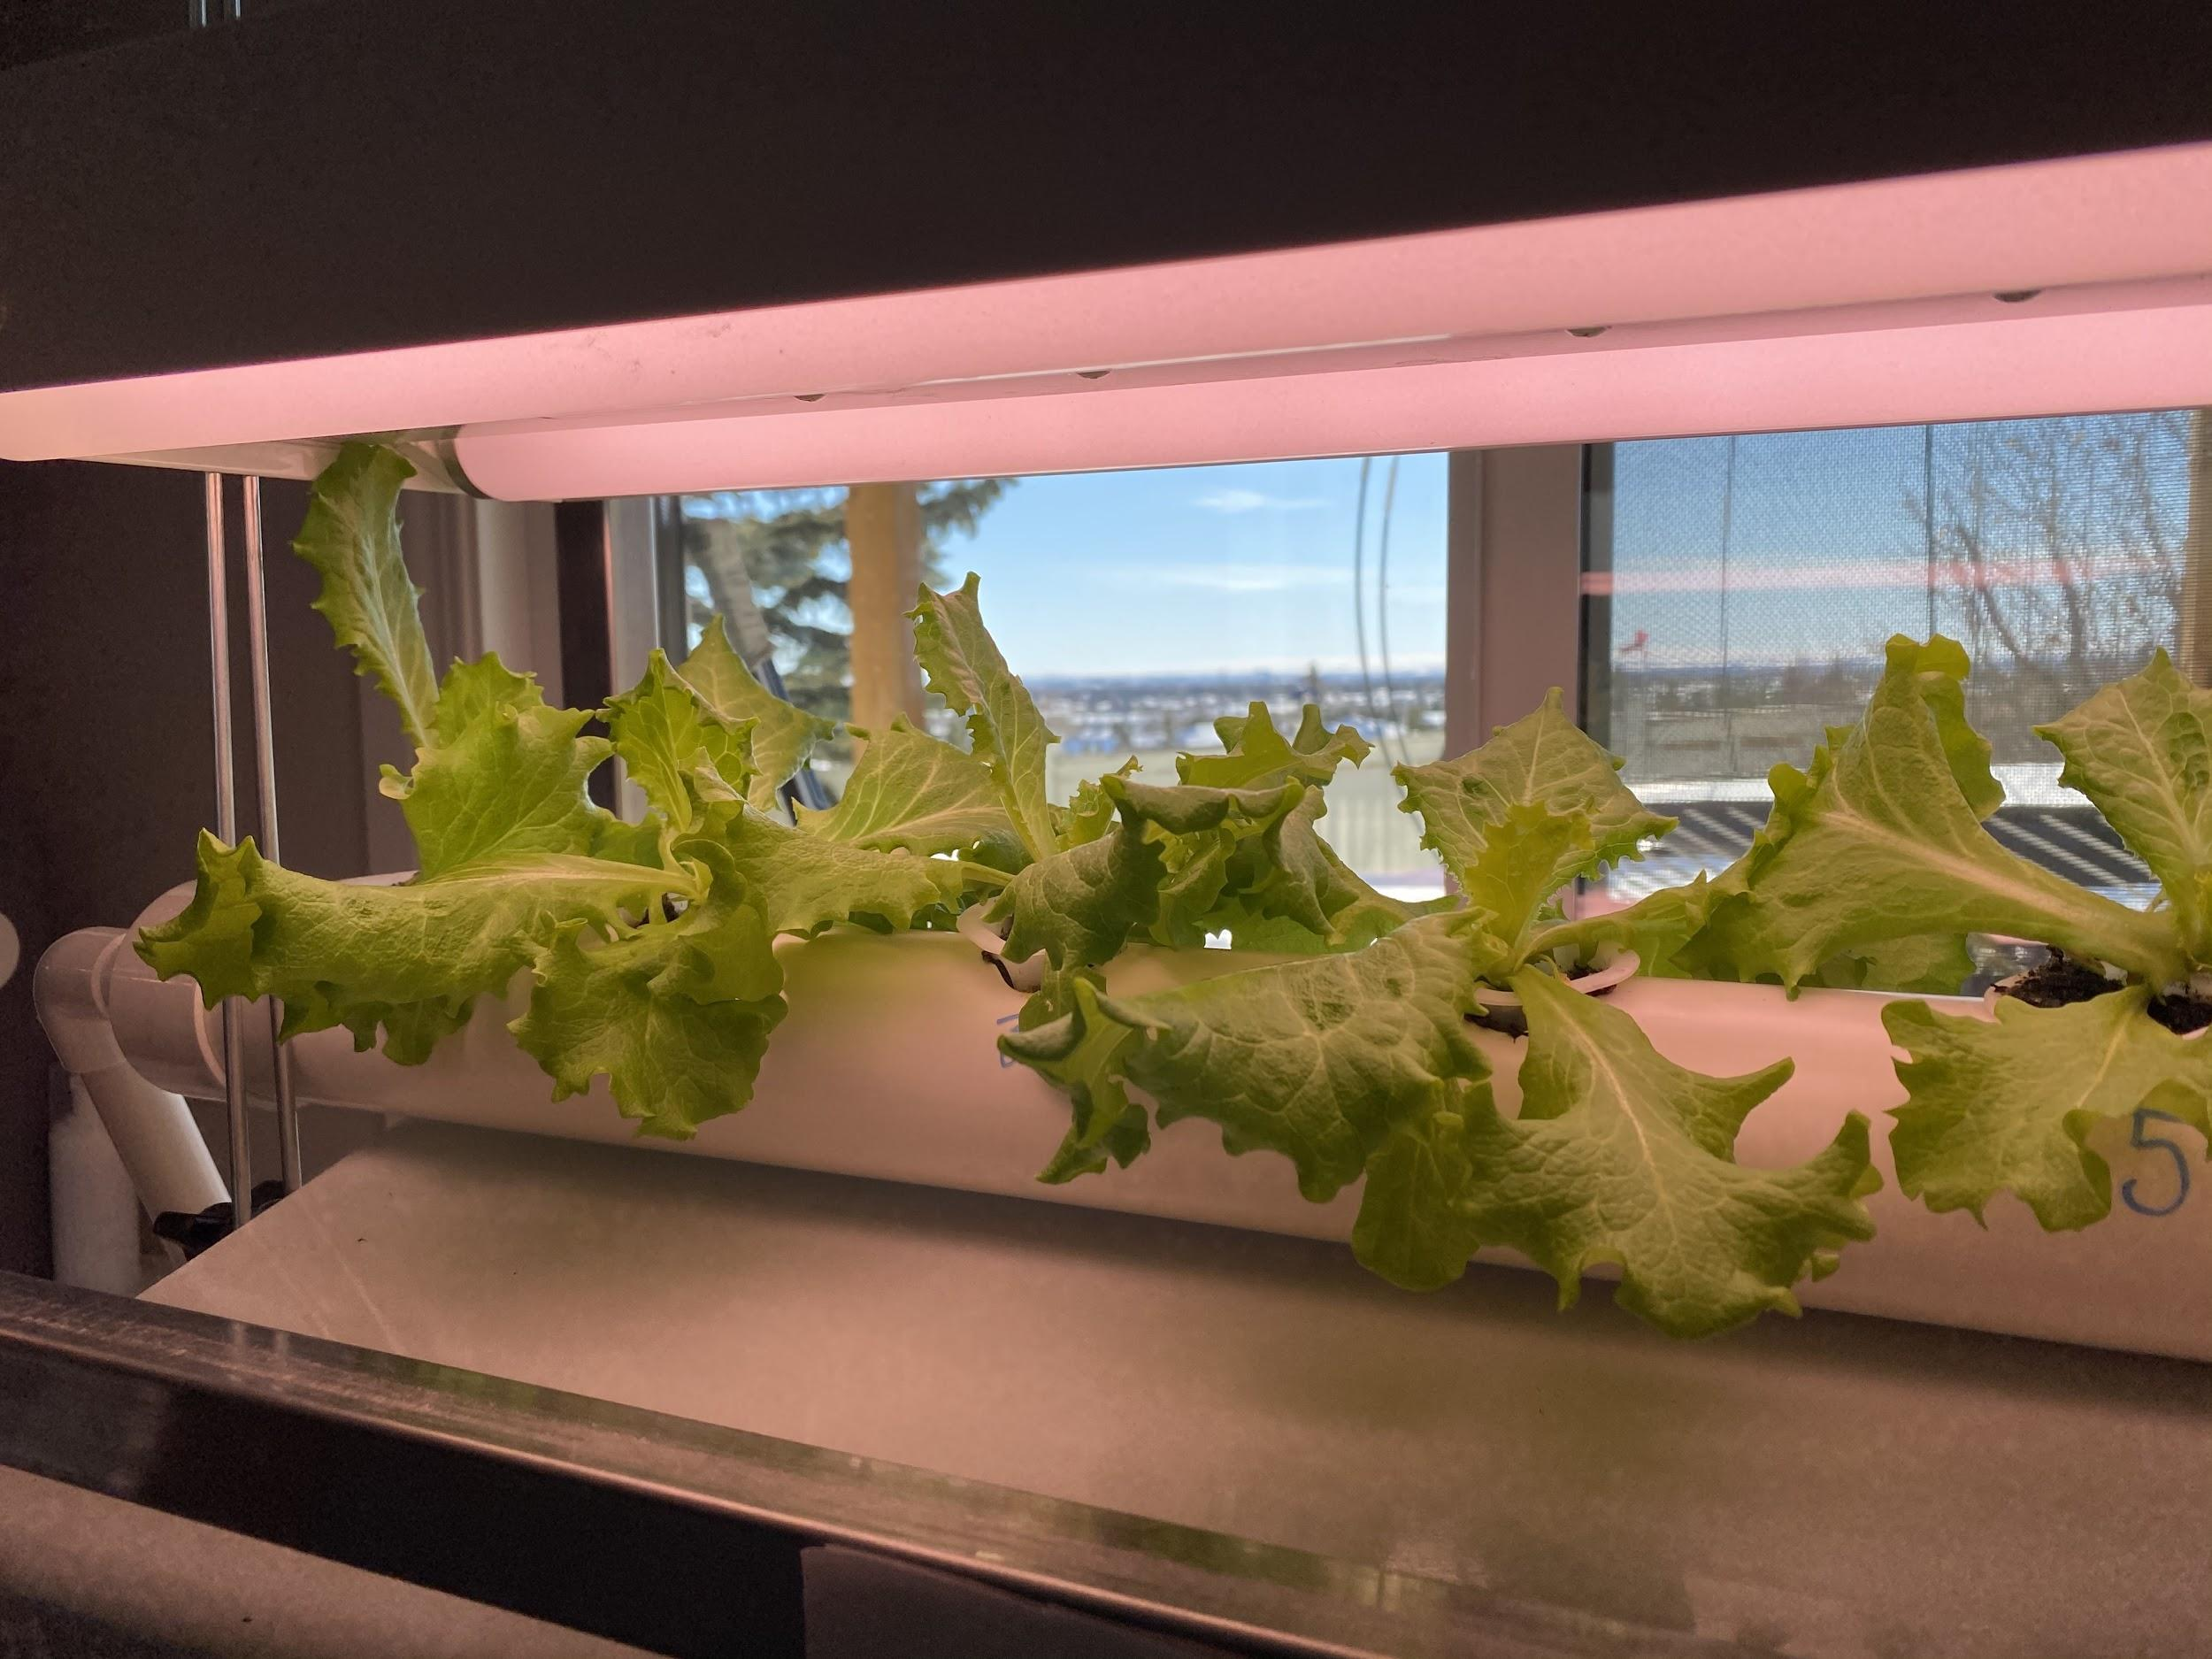
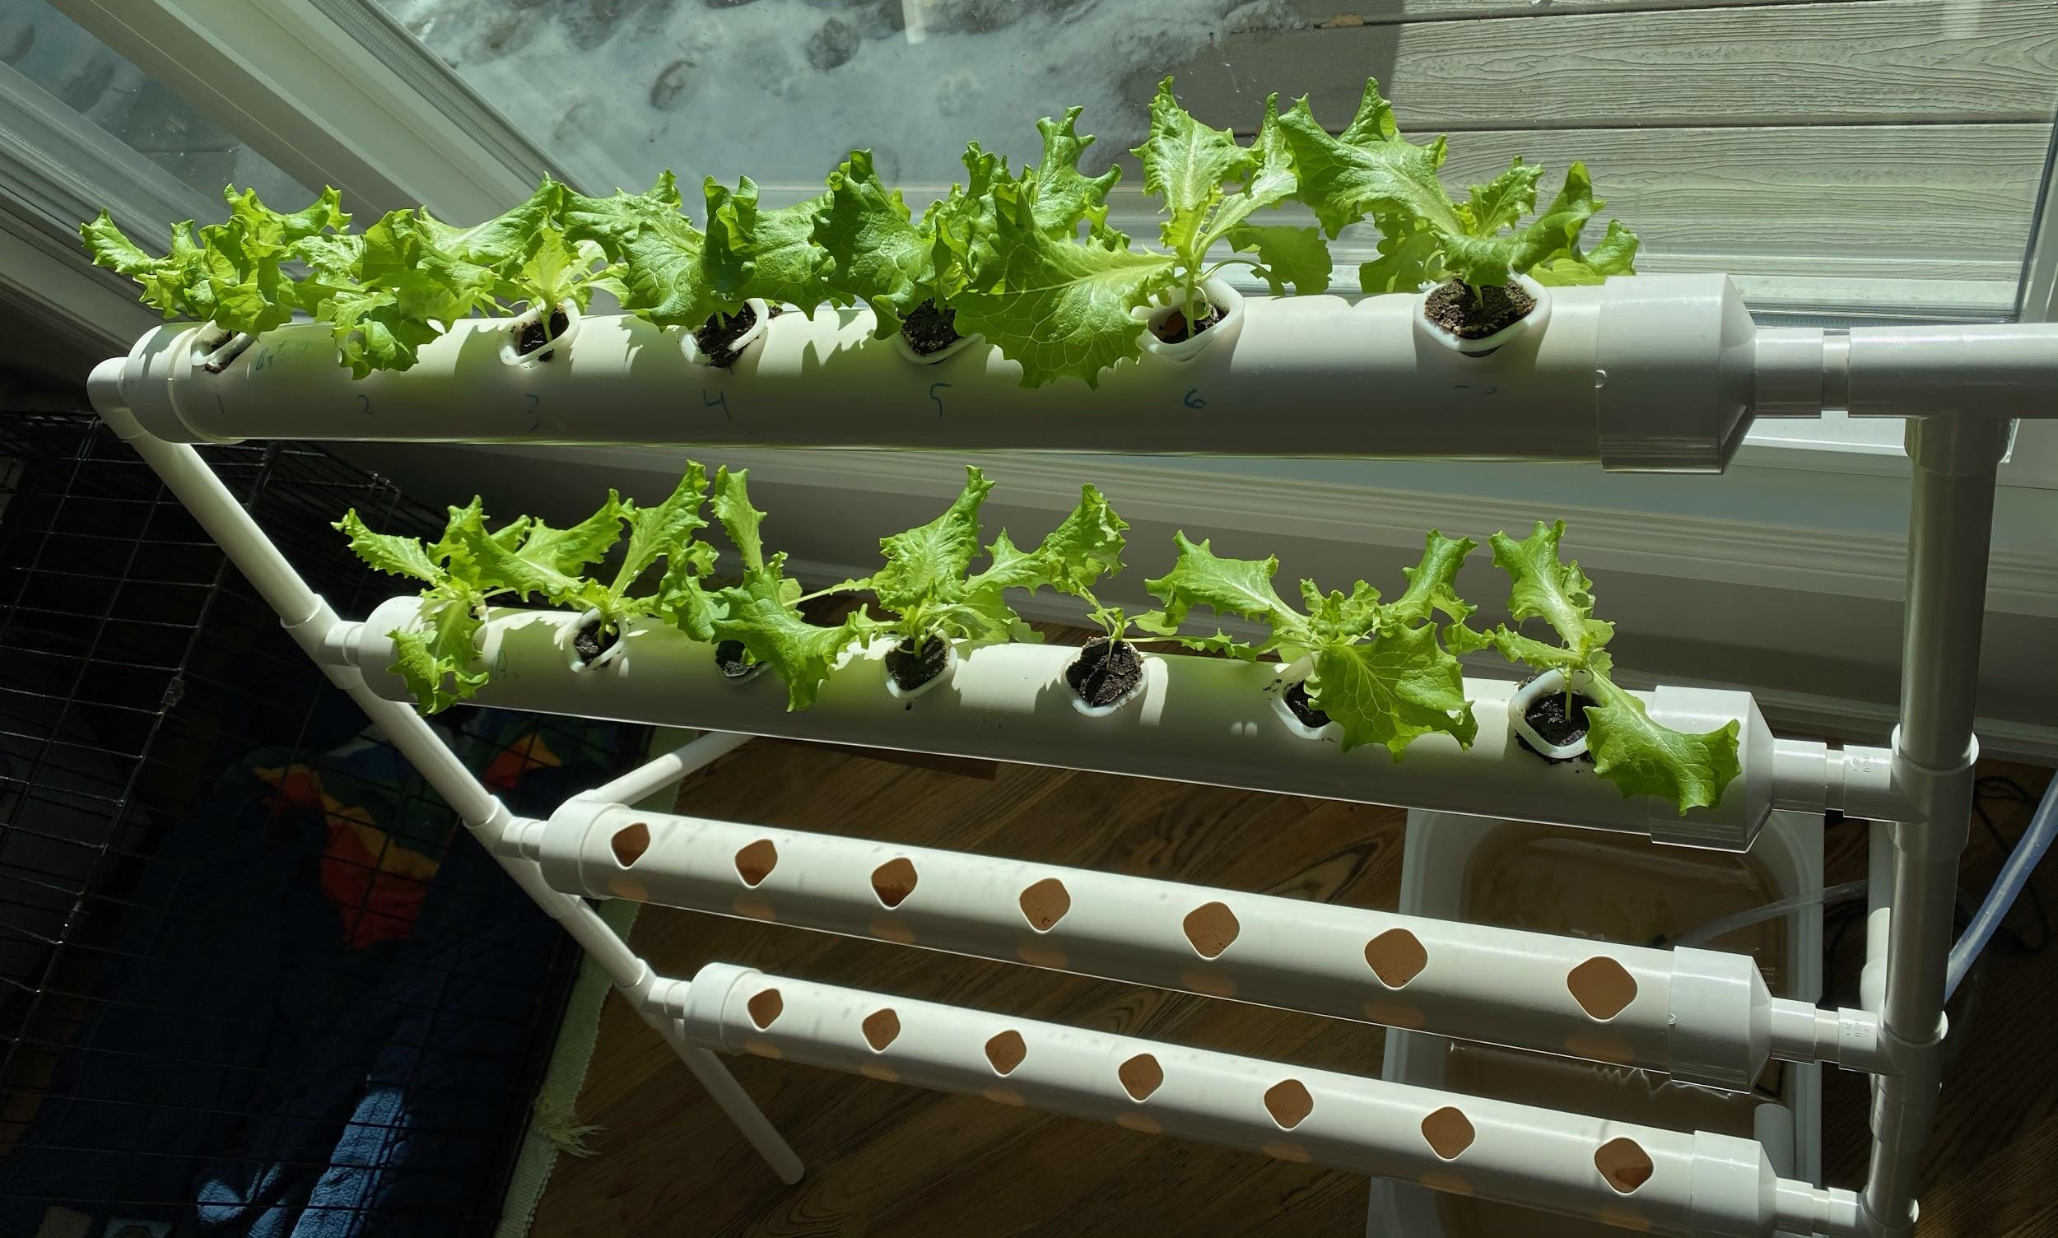
Variables
South Facing Window
Artificial Lights
We had:
7 sunny days
4 fully cloudy days
5 partly cloudy days
4 unrecorded days because we were not home.
Lights were on 8 hours per day
Batch 1 and 2 were placed in sunlight.
Batch 3 and 4 were placed under artificial lights.
Plants 7 in Batch 3 and 4 would not fit under the lights so these plants are a good experimental “control”.
Feb 8, 2021
Feb 8, 2021
Feb 20, 2021
Feb 20, 2021

Slide 11
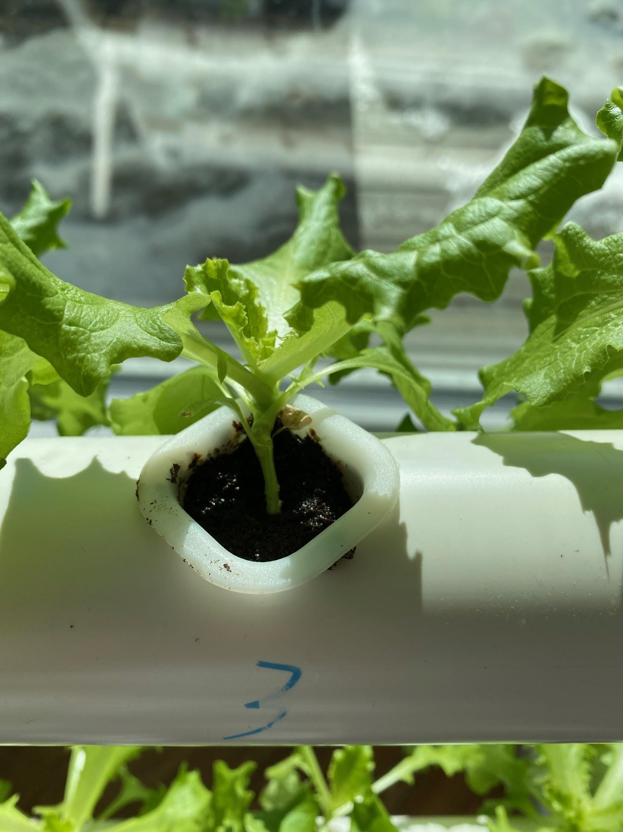
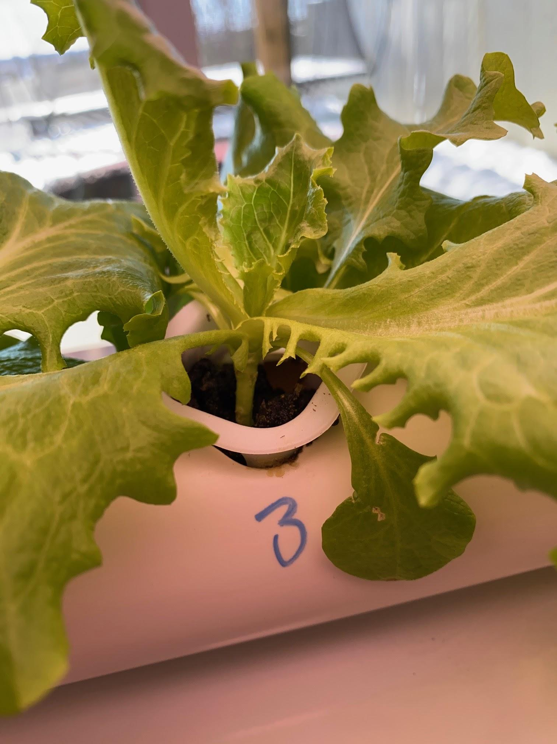
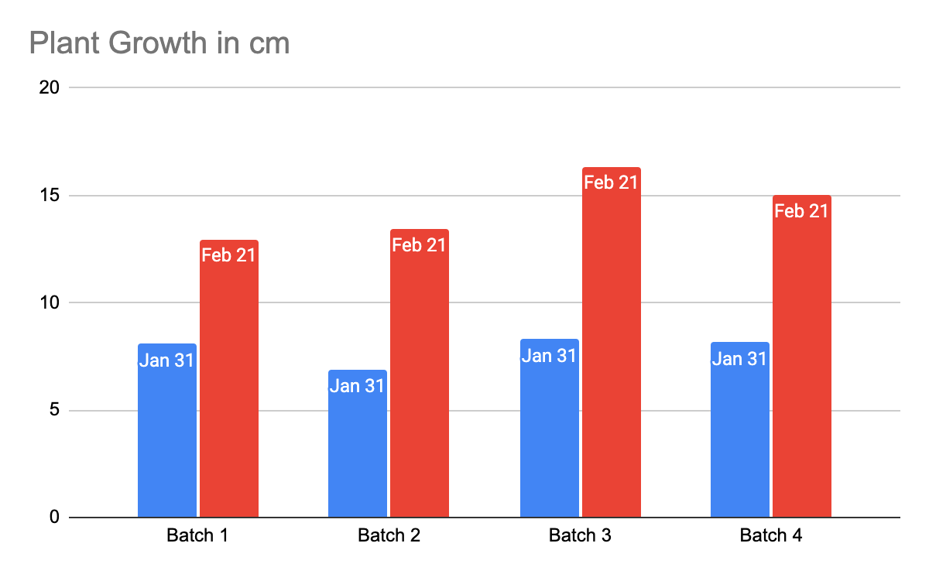
Results
Batch 1
Batch 3
Sunlight
Artificial Light
The average height increase for Batch 1&2 was 5.7 cm. The average height increase for Batch 3&4 was 7.4 cm.
This showed us that artificial light worked better than sunlight.
Notes:
Chart

Slide 12
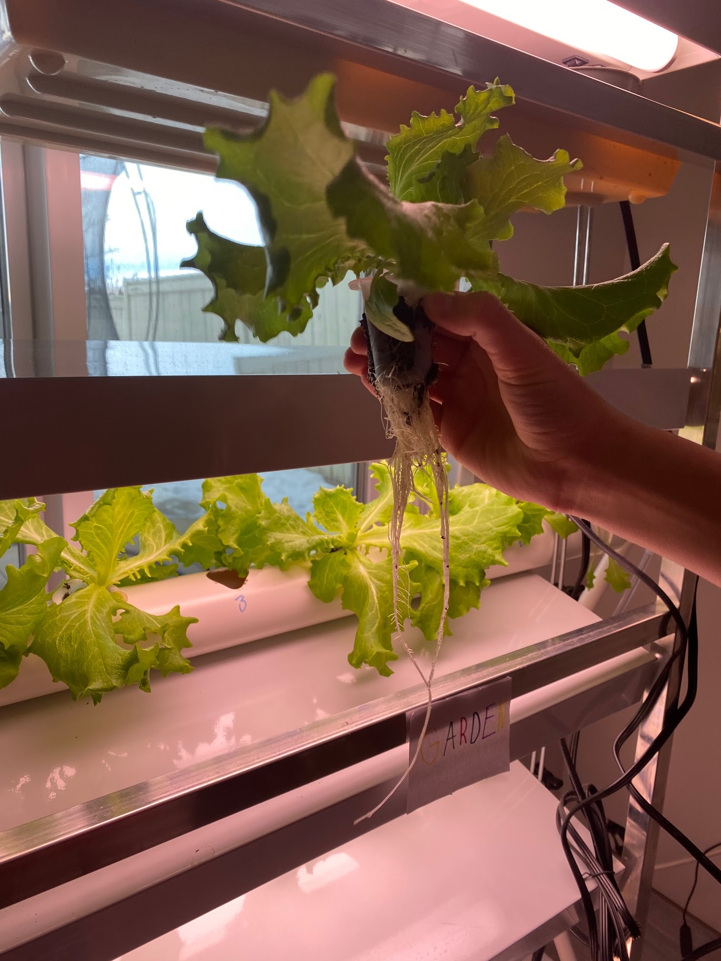
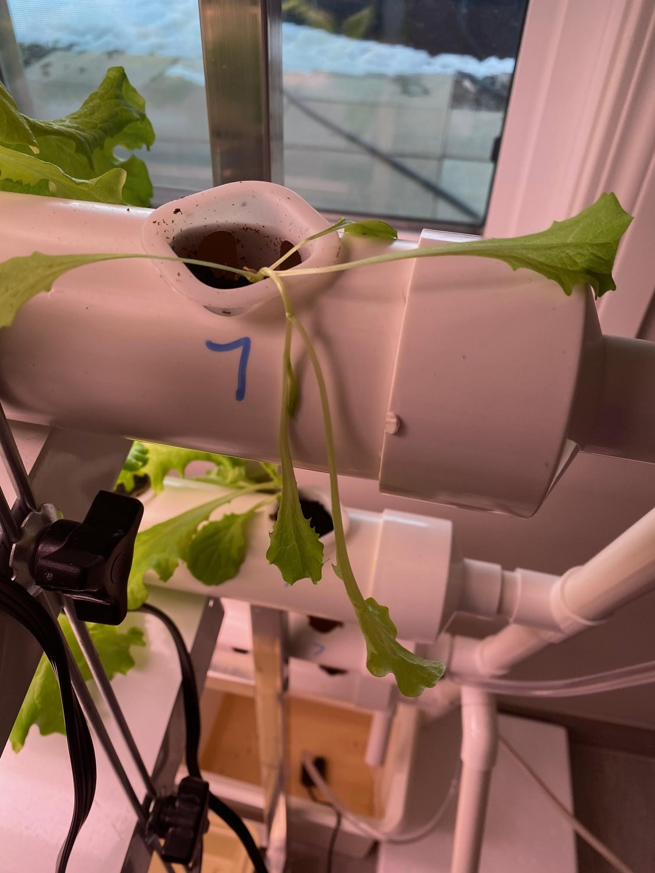
Analysis
Observations (Feb 21) Artificial Light
Plants had 8 to 9 leaves each.
The leaves of the plants that were growing under artificial light were larger than the plants growing in sunlight.
The roots were also larger on the plants growing under artificial light
During the growth phase these plants used more water.
Leaves were bright green.
The stalks of the plants were thicker
Plant 7 (in batch 3&4) did not receive any artificial light and the plants hardly grew. The leaves were a pale, light green.
Observations (Feb 21) Sunlight
Plants had 8 to 9 leaves each.
The leaves in sunlight were smaller than artificial light.
The roots were thinner and shorter than the plants growing under artificial light.
During the growth phase these plants used less water.
Leaves were bright green
The stalks of the plants were thinner.
All plants fit in the window so they all grew about the same.
Long roots on
plants growing in artificial light
Notes:
Credit: Kyle W.

Slide 13
Analysis (continued)
Why did artificial light work better than sunlight?
The artificial light was closer to the plants so they would get more light.
In the winter, Canada is farther from the sun so the sunlight is not that strong.
We had cloudy days while the artificial lights came on everyday.
Interesting Fact
The sun produces 3.86 x 10²⁶ Watts of energy (source: Siri)
38,600,000,000,000,000,000,000,000,000 W
Our artificial lights produced 20W per bulb
The sun is very weak in our living room in the winter!

Slide 14
Conclusion
What we learned is that artificial light works better than sunlight. Our hypothesis was incorrect.
Sunlight still worked well, even in winter. It would be interesting to do this project in the summer. Would our results be different? Maybe…
We hope you enjoyed our presentation. Thanks for watching.

Slide 15
