Slide 1
Does The Shape Of The Blades Affect The Wind Turbines Performance?
By: Rajveer and Khushi 6A

Slide 2
Project Question
Does the shape of the blades affect the wind turbines performance?

Slide 3
Key Words
1
2
3
Surface Area
Wind Turbine
Mechanical Energy
The amount of space covered by a shape.
A wind turbine is a device that converts the kinetic energy of wind into electrical energy
A form of energy that is generated by motion.
4
5
Rotary Motion
Renewable energy
The act of rotating on its axis.
Energy that does not run out ( wind for wind turbines).

Slide 4
Background Research
Wind power is one of the best and most sustainable forms of renewable energy and we use wind turbines to harvest the energy from the wind to power our homes. Wind turbines are machines that convert the wind's mechanical energy into electrical energy.
Wind turbines rely on two main principles. Newton's third law states that “for every action, there is an equal and opposite reaction”. This is true for the wind turbine’s blade. The action is the wind which projects air towards the blade and the reaction is the blade being pushed causing the wind turbine to spin.
Bernoulli's principle and Newton's third law. Bernoulli’s principle states that “faster-moving air has lower pressure”. This is true for the wind turbine blade because the blade is an “airfoil shape” (cont…)

Slide 5
Background Research Cont….
Wind turbines usually have a curved airfoil-shaped blade. This causes the wind to move faster over the curved side increasing the overall speed of the wind turbine.
Wind turbines work on a principle, instead of using electricity like a house fan, wind turbines use the wind moving through it to make electricity. The motor will turn the blades that also spin a strong generator, producing electrical energy. This is called renewable energy, renewable energy is energy that does not run out. The first ever electricity-generating wind turbine was made in 1887 by a Scottish professor James Blyth in Glasgow, Scotland.
We researched different types of blades of the wind turbine and that's how our project will work with the help and power of the fan, winds will travel through the turbine resulting in it spinning like you would see in the countryside.

Slide 6
Hypothesis
We believe that the rectangular blades will spin the fastest because of large surface area. We think the surface area of the rectangular blades will capture more air/wind leading to the weight to be lifted faster as the air will act as a strong force lifting it.

Slide 7
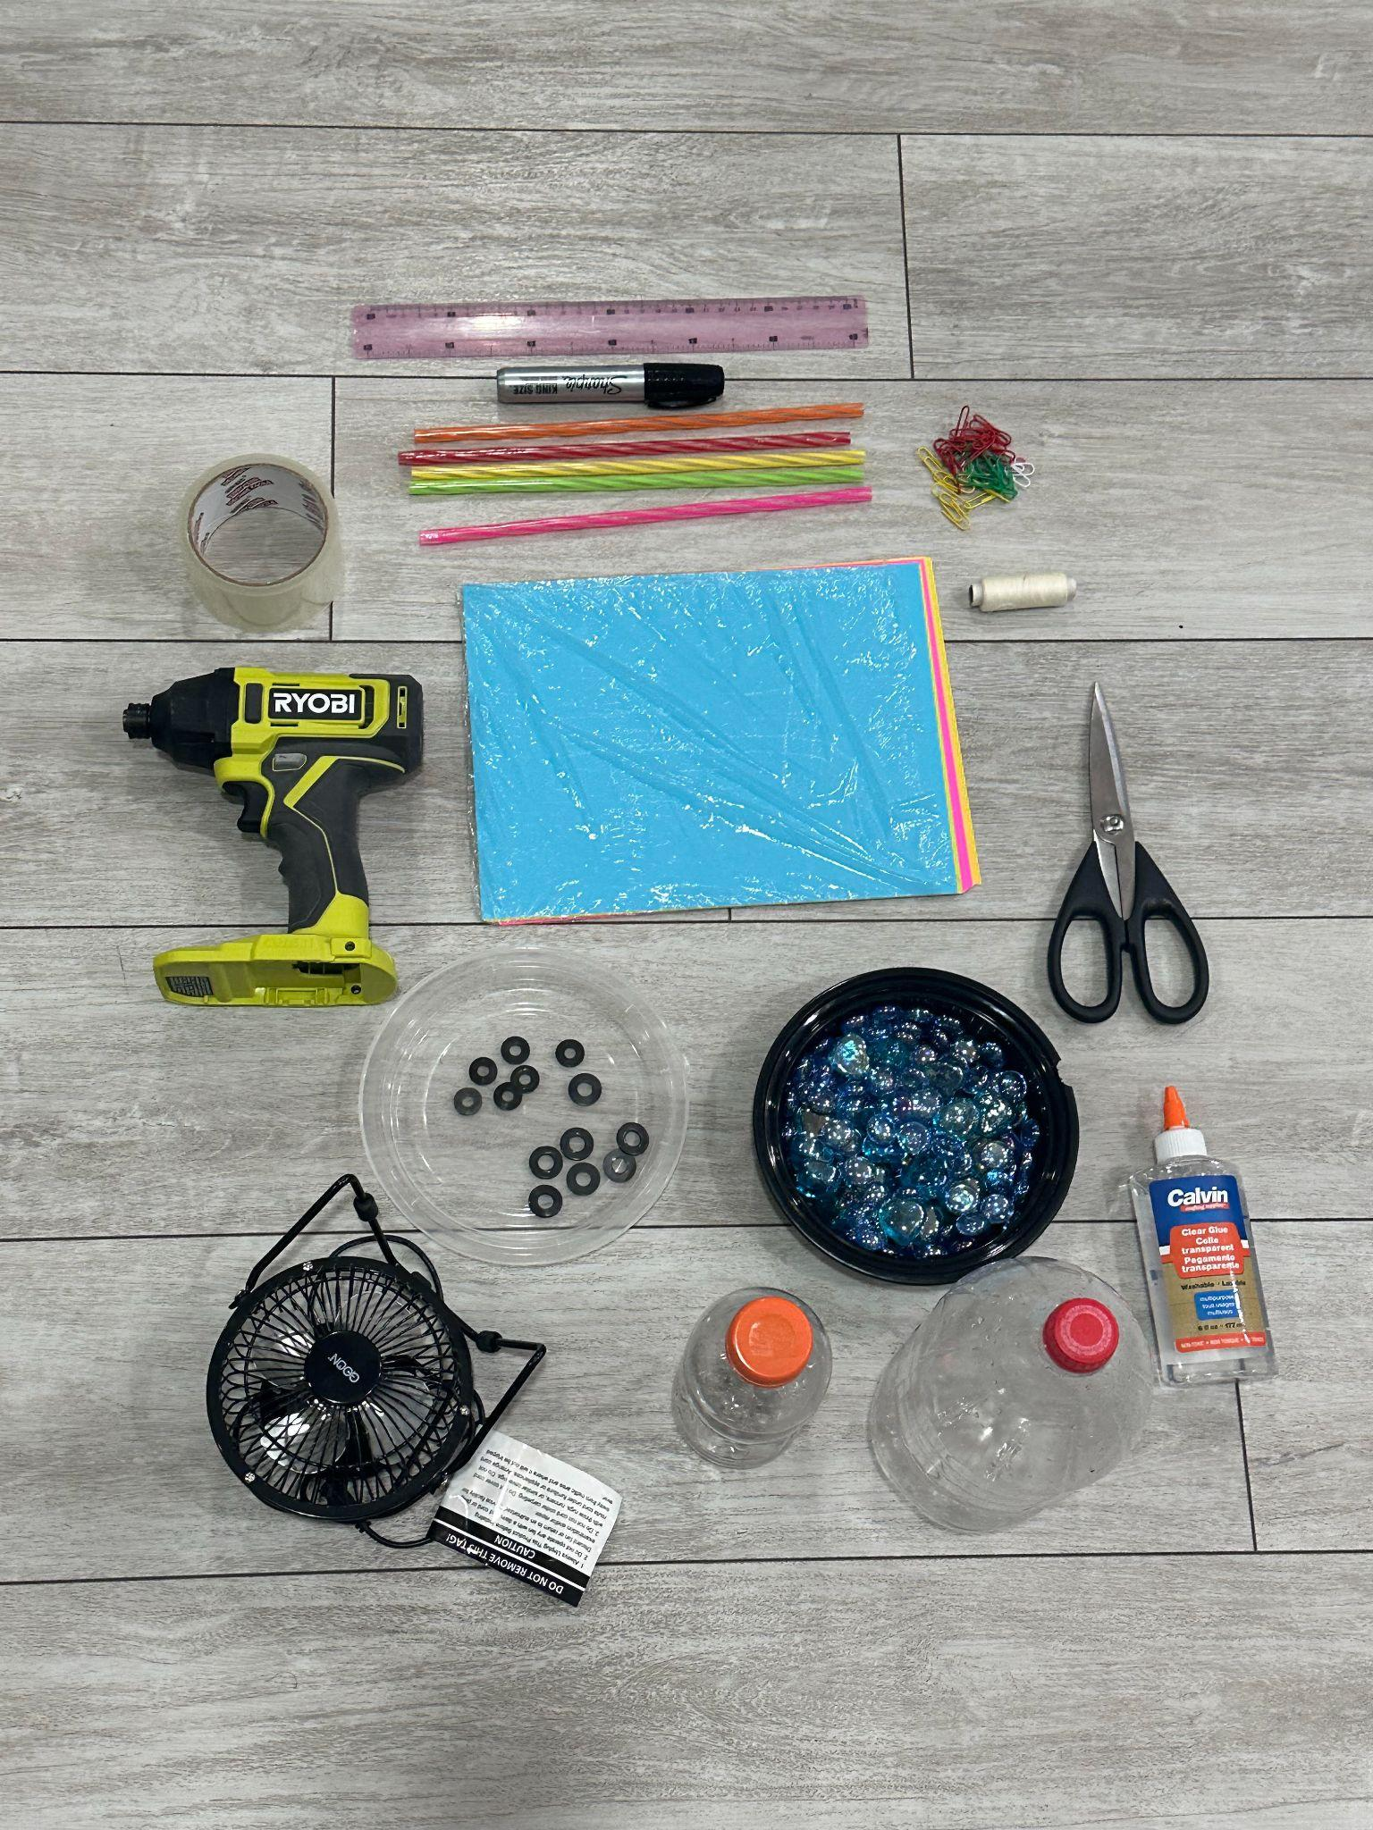
Materials
Ruler
Drill
Flat Washers
Tape
X5 straws
25-40 Marbles
Glue
Paper
Paper Clips
Mini Fan
Thread
1 liter bottle
500 ML bottle
Scissors

Slide 8
Variables
1
2
Dependent
Controlled
The time the different blade types takes to spin around.
The amount of weight
The speed of the fan
The distance of the fan from the bottle
2 blades for each shape
3
4
Responding
Independent
The time taken by different blades to rotate.
The shape of the blades

Slide 9
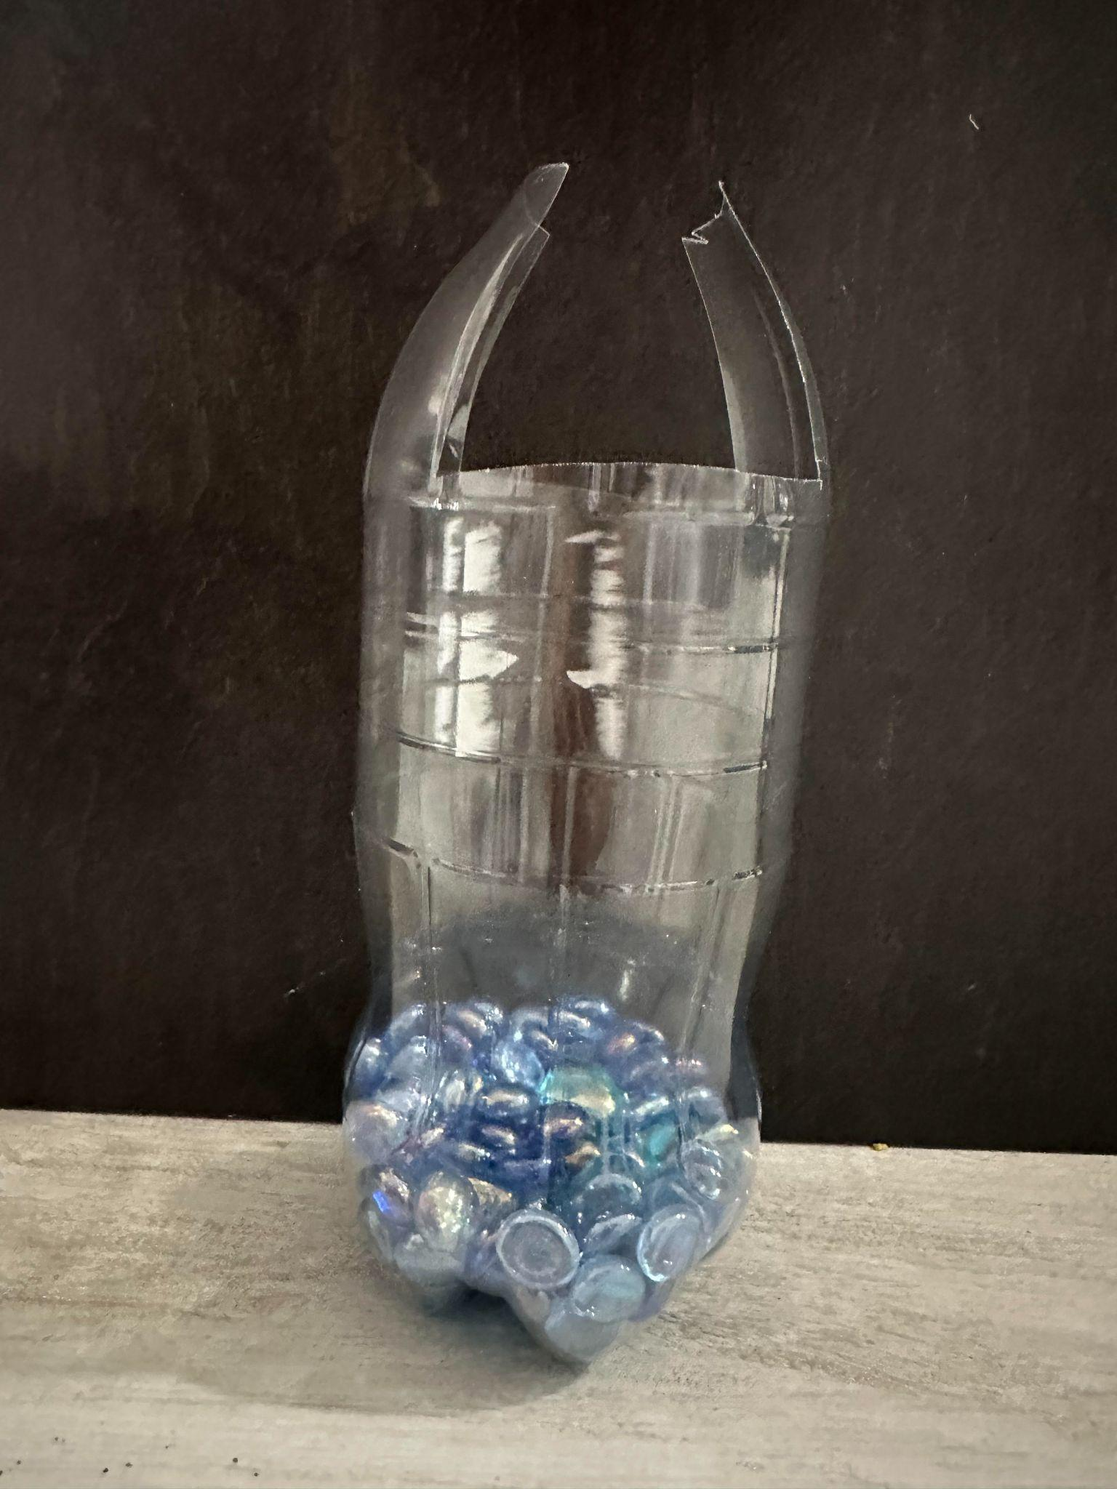
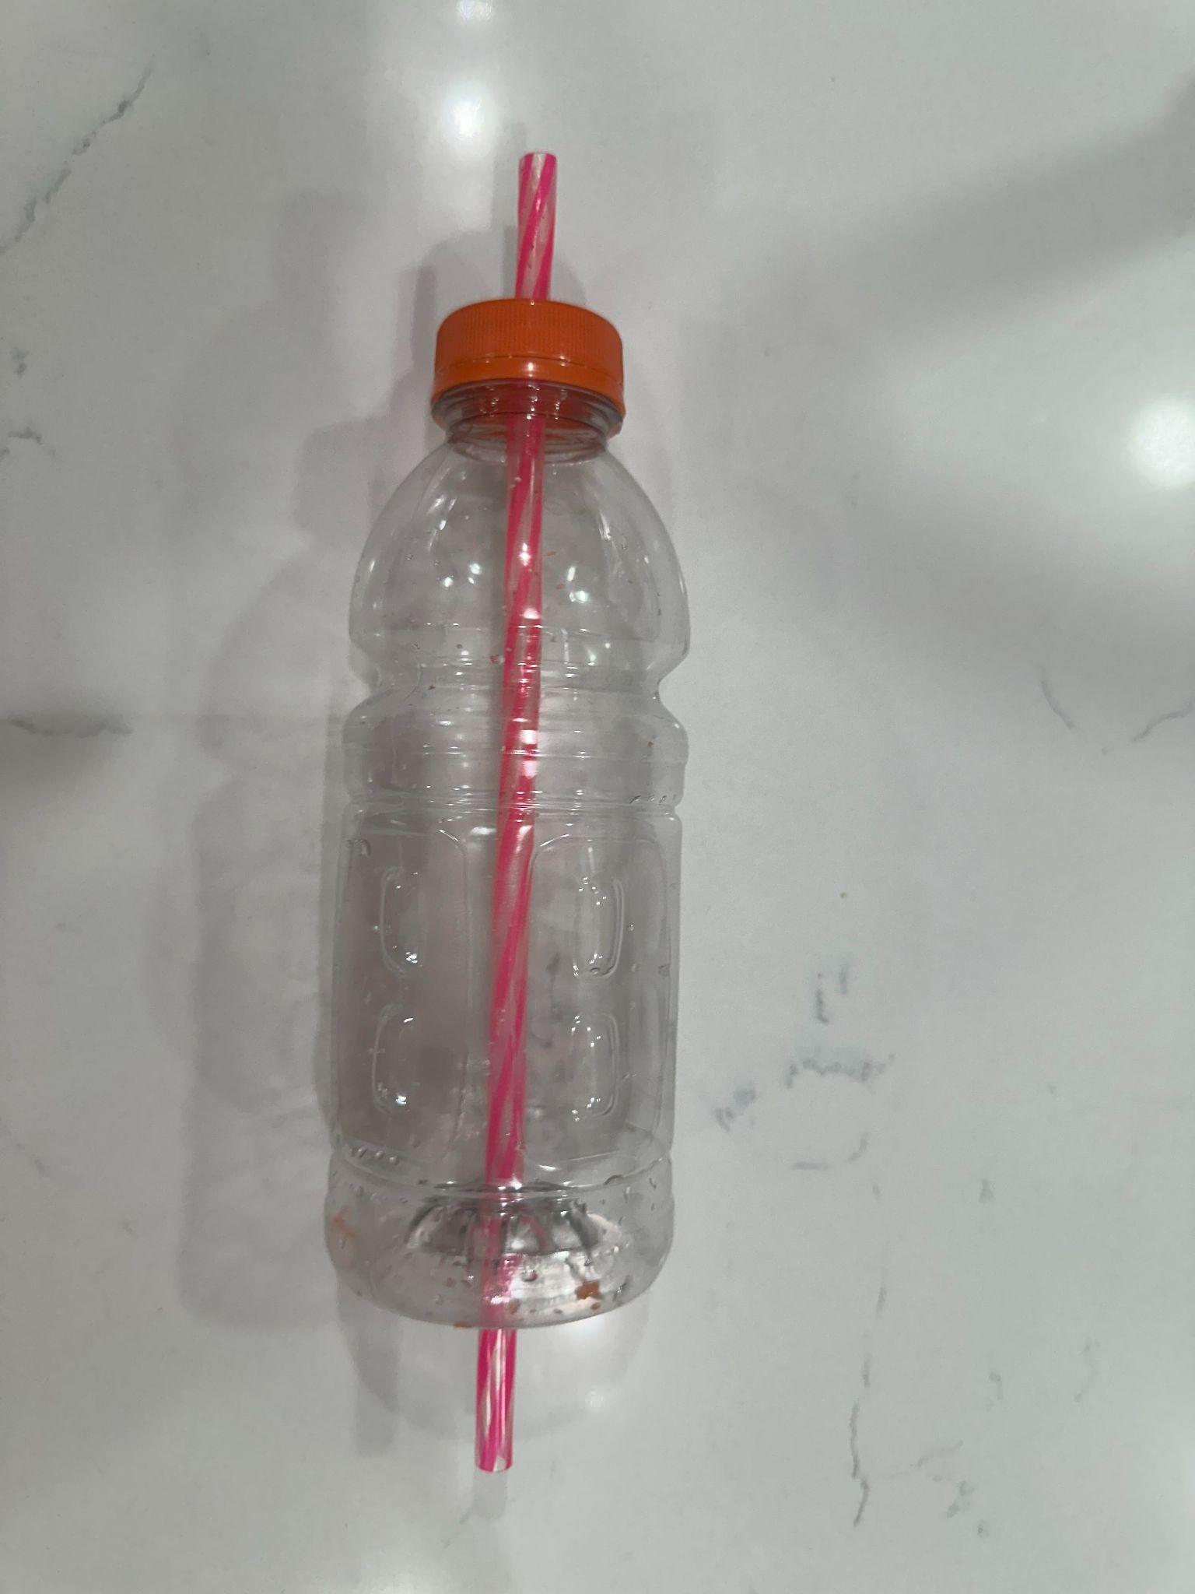
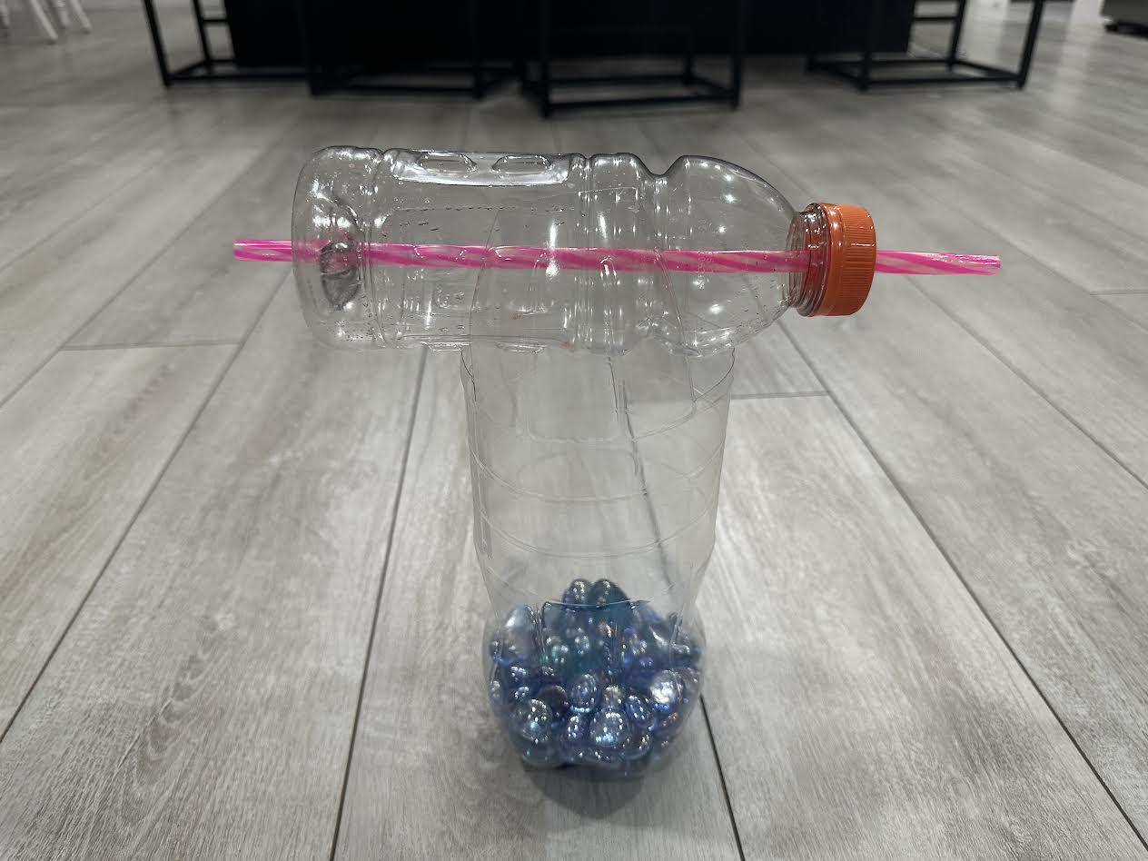
Procedure
1. Gather the materials.
2. Cut the top of the 1-liter bottle and create flaps on either side of the bottle. Fill the bottom of the bottle with marbles.
3. With the help of an adult we drilled a hole on each side of the 500-ml bottle and inserted a straw through it.
4. Attach the 500-ml bottle between the flaps of the 1-liter bottle as shown.
5. Then we cut the paper into 3 different shapes. We made rectangle, square,and triangle. We then folded each paper in half and taped the two longer edges forming a teardrop shape and curved them in the opposite direction.
1
2
3
4
5

Slide 10
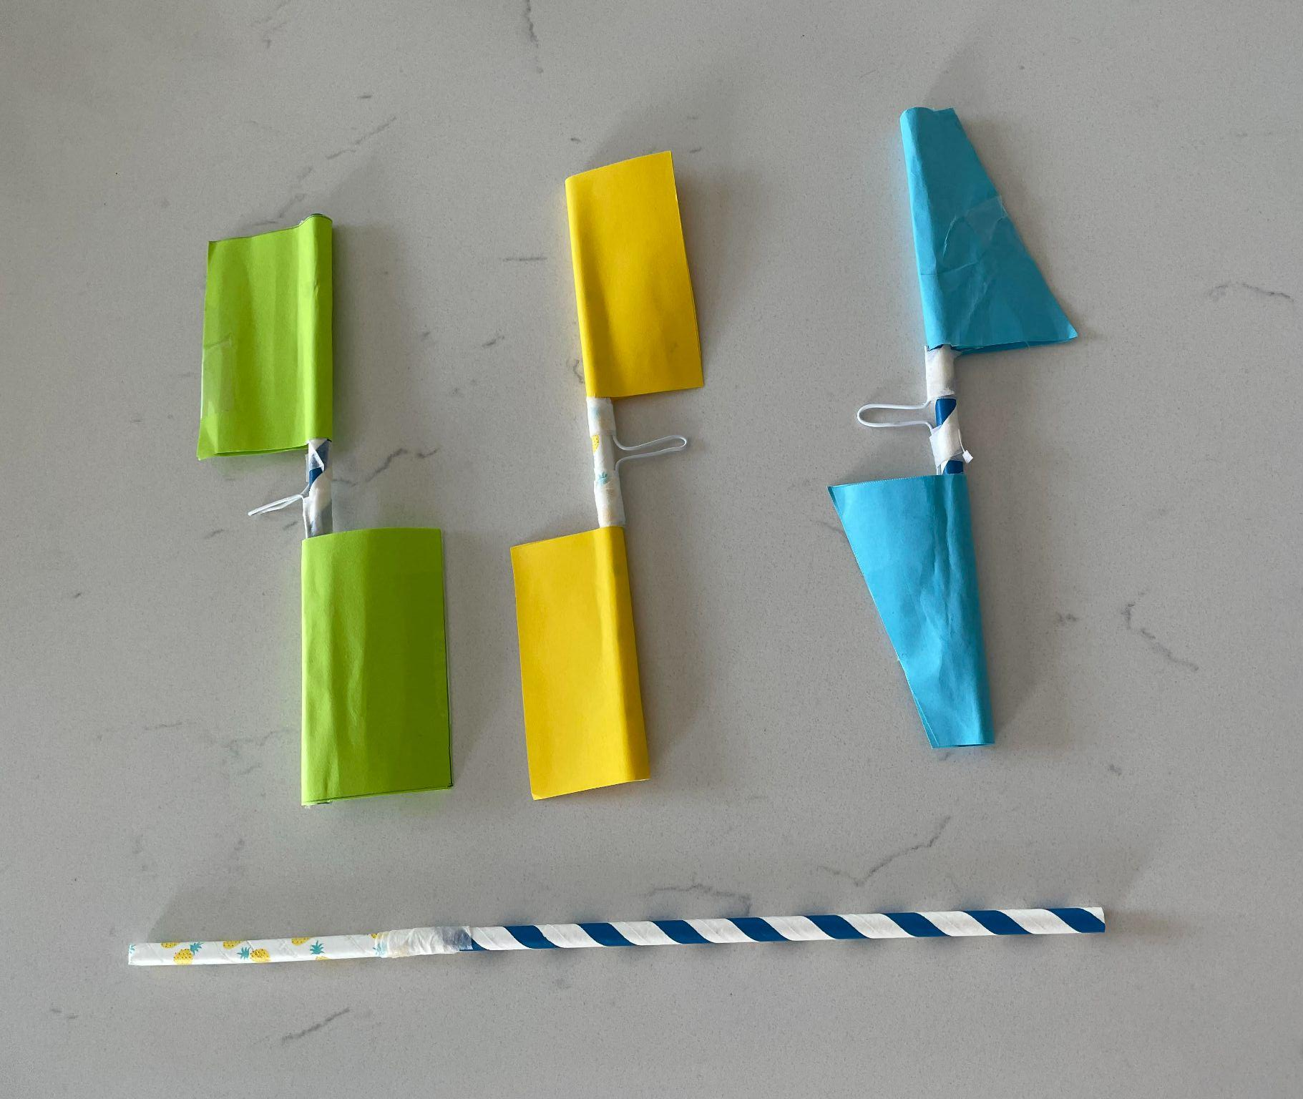
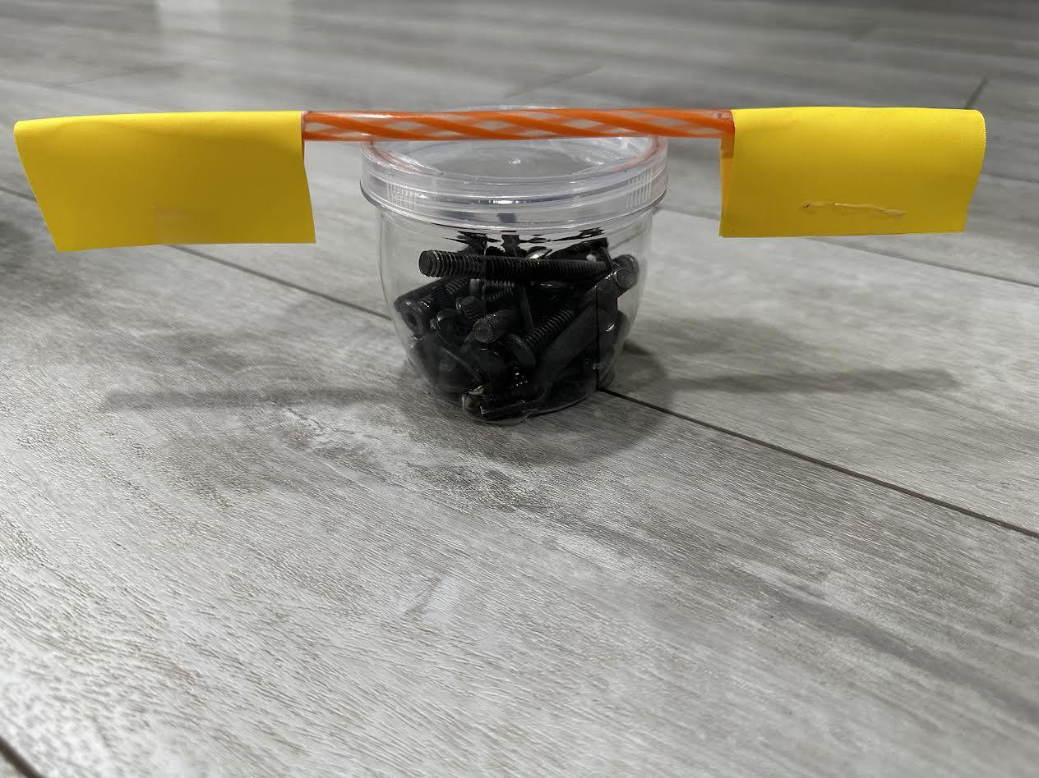
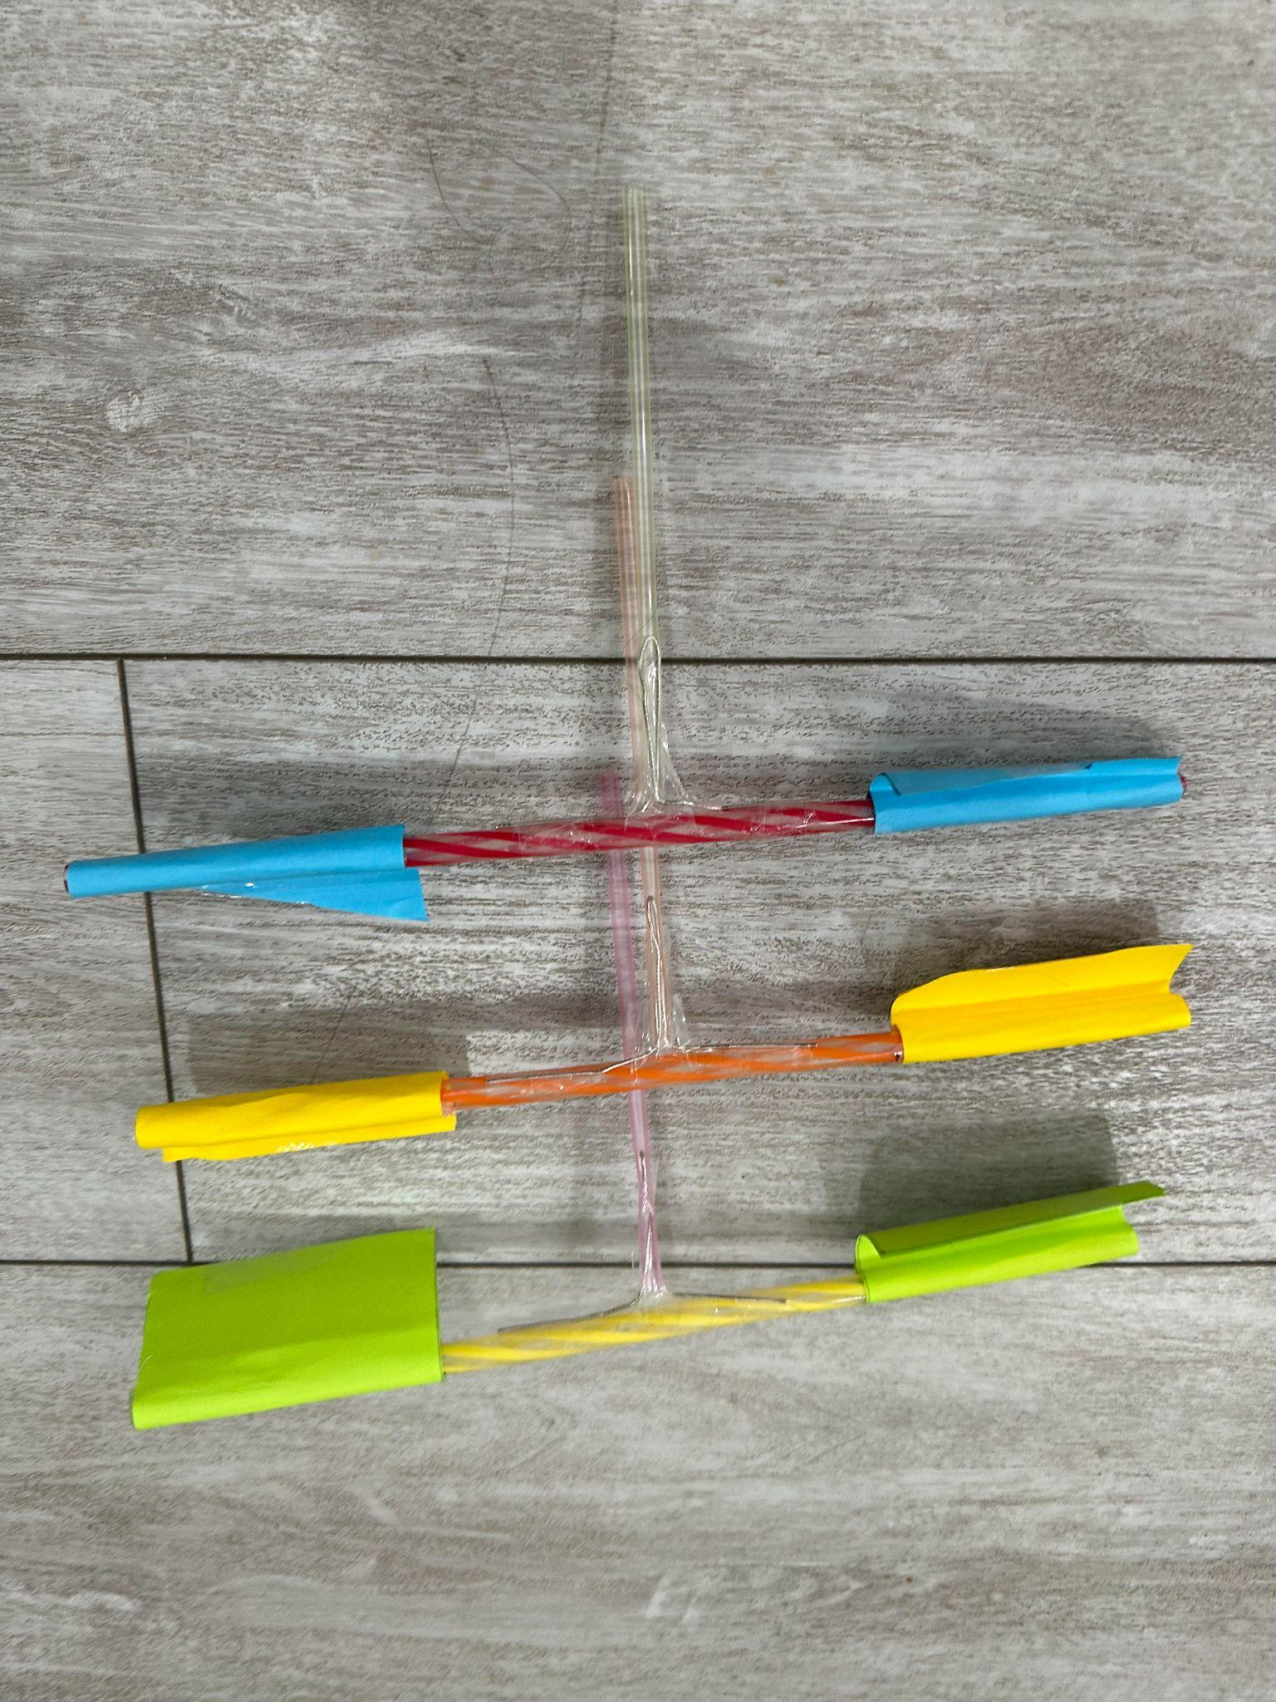
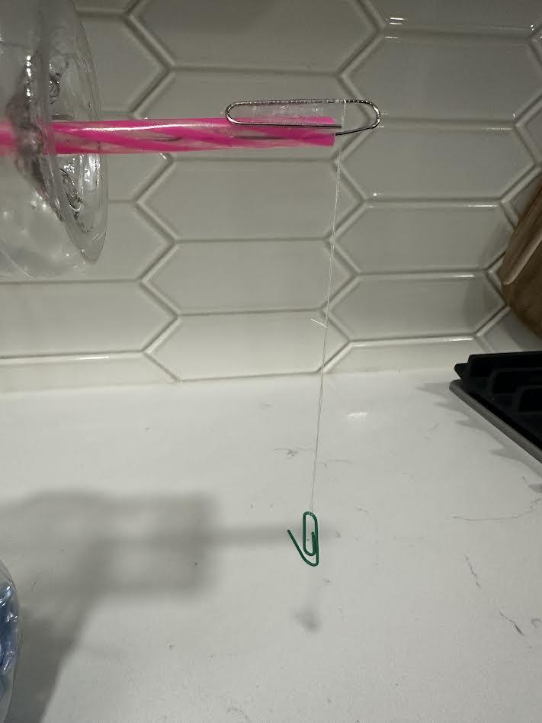
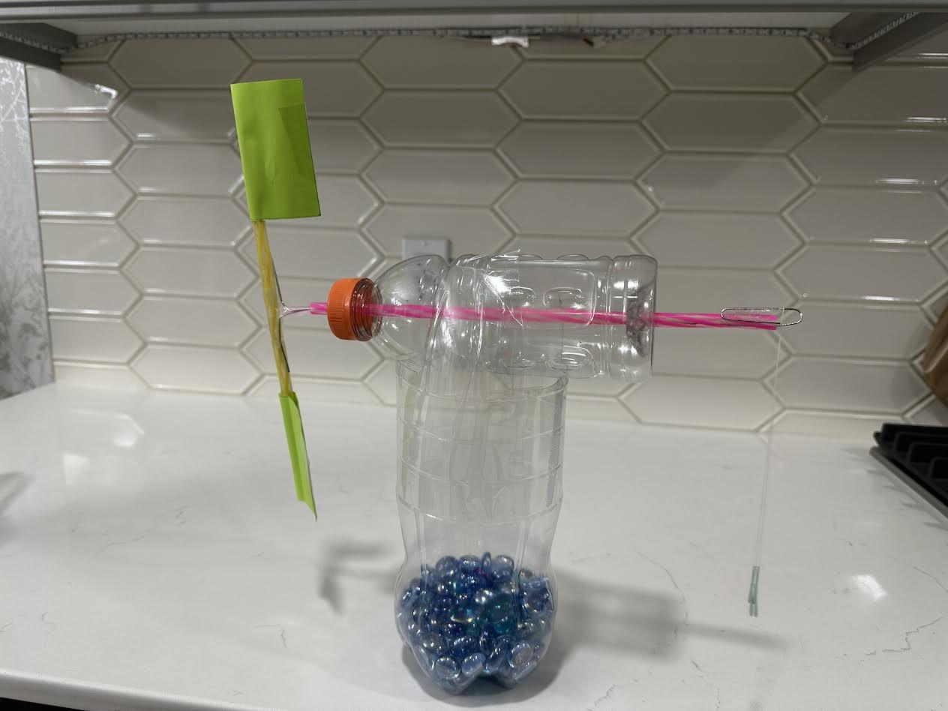
Procedure
7
6. We glued each paper on the ends of a straw just enough for a blade to be secured. Glue a blade on either side of the straw as show in the picture 6.
7. Repeat step six with the other blades.
8. Grab some paper clips and straighten them out. Twist the paperclip in the middle to form a “T” shape.
9. Put the “T” shape paperclip in between the blades. Creating something that looks like a handle. Add a straw to the bottom of the paperclip.
10. Take another paperclip and hang it from a string. Then attach the string to the end of the straw and put one flat washer for weight.
11. Put it all together and you have got yourself a wind turbine.
6
8
9
10
11

Slide 11
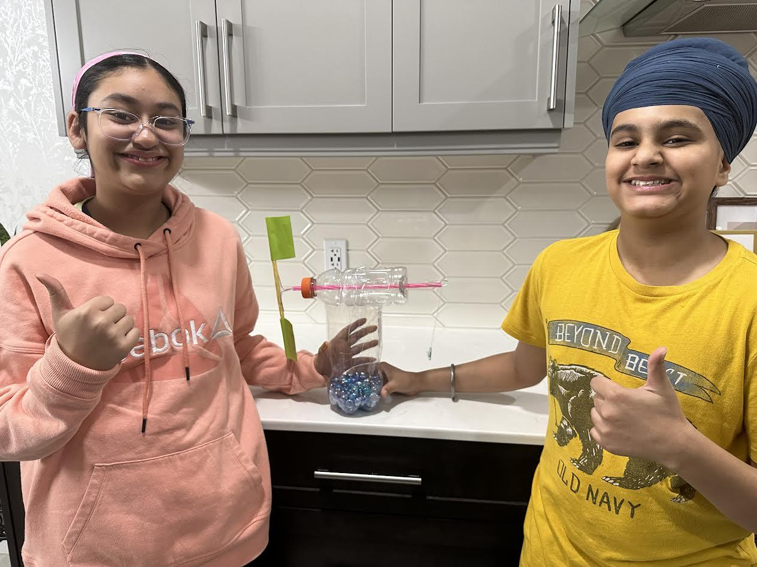
Now You Got A Wind Turbine!

Slide 12
Trial with Blue (triangular) blades

Slide 13
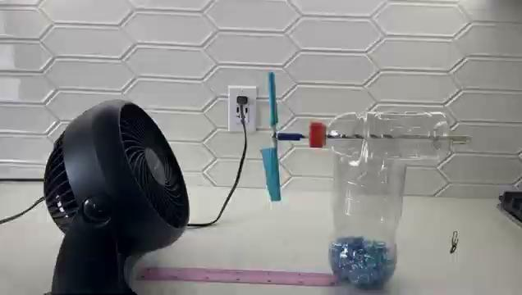

Slide 14
Blue Blade (Triangular) | Trials
 | 1 | 2 | 3 | Average
Time in seconds | 3.45 | 3.63 | 3.68 | 3.59
First we experimented with our Triangular blades. In the first trial with the Triangular blades (Blue) the time it took to lift the flat washer up to the top, as shown in the video, was 3.45 seconds. In the second trial the time was 3.63 seconds, and in the last trial the time was 3.68 seconds. Meaning the average time for the triangular blades to rotate around the straw and reach up to the top was 3.59 sec.

Slide 15
Trial with yellow (square) blades

Slide 16
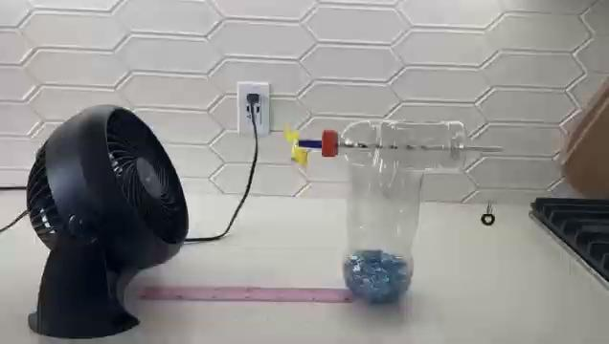

Slide 17
Yellow Blade (Squared) | Trials
 | 1 | 2 | 3 | Average
Time in seconds | 2.64 | 2.26 | 2.34 | 2.41
Next we have our Squared (Yellow) blades. In the first trial the time it took to lift the flat washer up to the top was 2.64 seconds. The second trial the time was 2.26 seconds. Finally in the third trial we noted the time was 2.34 seconds. Meaning the time in average concludes to 2.41 seconds.

Slide 18
Trial with Green (rectangular) blades

Slide 19
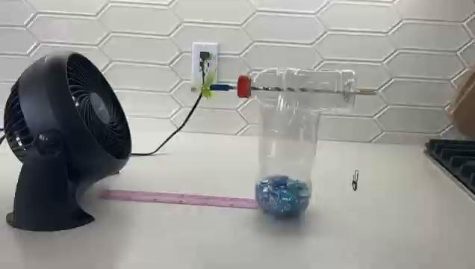

Slide 20
Green Blade (Rectangular) | Trials
 | 1 | 2 | 3 | Average
Time in seconds | 2.28 | 2.41 | 2.36 | 2.35
Lastly we have our Rectangular (Green) blades. In the first trial the time it took to lift one washer up to the top was 2.28 seconds. The second trial we noted the time of 2.41 seconds. And finally the third trial had a time of 2.36 seconds. The average would be 2.35 seconds.

Slide 21
Final Values
Blade Shape | Trials (seconds and milliseconds)
 | 1 | 2 | 3 | Average
Green (Rectangular) | 2.28 | 2.41 | 2.36 | 2.35
Yellow (Square) | 2.64 | 2.26 | 2.34 | 2.41
Blue (Triangular) | 3.45 | 3.63 | 3.68 | 3.59

Slide 22
Results
The question was ‘’Does the shape of the blades affect the wind turbines performance?’’, with us making a whole wind turbine and testing it out. We found that the Green Rectangular blades rotates fast by pulling up the weight up to the top in a record setting time of 2.35 seconds as it smoothly ran with the fast wind coming from the fan. We did find out that the shape of the wind turbines blades do affect the performance.

Slide 23
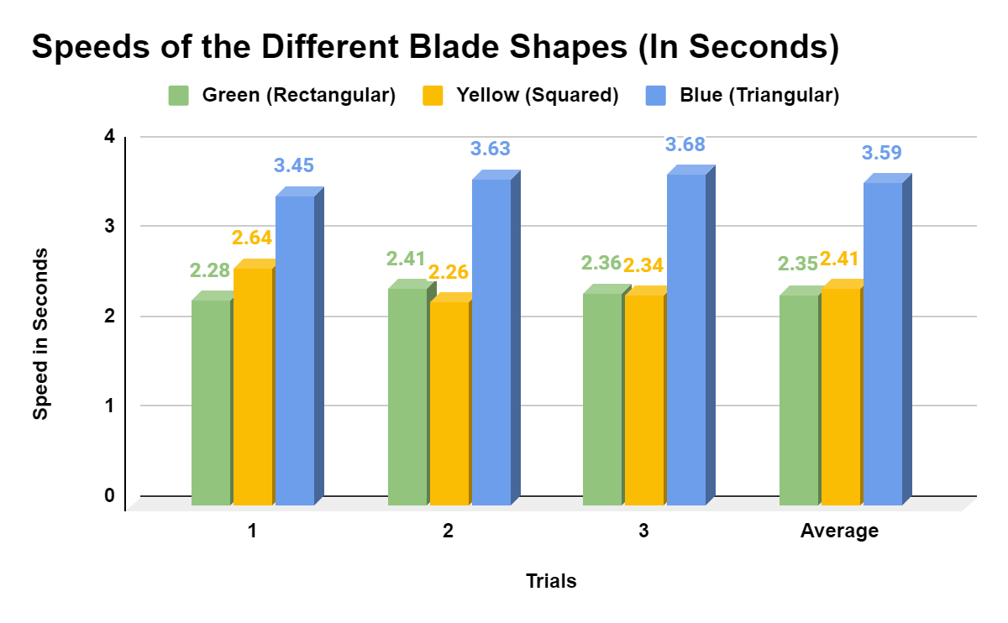
Final Values Graph
From this graph you can see that the rectangular blades (green) did the best with an average of 2.35 seconds. In second place was the squared blade (yellow) with an average of 2.41 seconds. The blades with the longest time was the triangular blade (blue) with an average of 3.59 seconds.

Slide 24
Conclusion
We hypothesized that the Rectangular blade (Green) would spin the fastest. After doing the experiment we found that our hypothesis was correct because the Rectangular blades (Green) took the least time to rotate and took on average 2.35 seconds.

Slide 25
Who Will This Be Useful For?
Wind turbines are found in rural communities and areas so the best example of “who would use this information’’, is farmers, as they usually live in large fields away from the urban cities and towns. Since farmers live in rural communities they would need electricity from somewhere. So one of the most popular ways are wind turbines to generate electricity. Wind turbines principal is very simple.”instead of using electricity like a house fan, wind turbines use the wind moving through it to make electricity. They generate electricity with using” 2 or 3 blades connecting to the rotor and forming a propeller. The rotor is also connected to the main shaft. The main shaft is a device that transfers the revolution from the rotor into the gearbox with a typical rotation of 20 rpm (revolution per minutes). The main shaft creates electricity by spinning a generator.

Slide 26
Sources Of Error And How Will We Prevent This In The Future?
The blades got stuck on the tap of the 500-ml bottle
we made sure that the hole in the bottle is smooth and big enough for a straw to spin freely.
The size of the fan, first we experimented with the smaller fan but it did not work due to less speed to pull the flat washer up.
We used a bigger fan with adjustable speed for our experiment.
The straws
The plastic straws we used before were too light weight and were not working so we switched to paper straws to give strength to our fan.

Slide 27
Abstract
The question of this project “Does the shape of the blades affect the wind turbines performance?,“ using three different curved blades on a home made structure of a wind turbine. The reason of this experiment was that we learned about the types of wings that a airplane has, so we thought about a wind turbine as it also works with curved and long blades, we wondered does the shape of the blades affect the performance of the wind turbine. (continued..)

Slide 28
Abstract (continued)
We did the experiment by setting up a mini fan at the highest setting and set up the wind turbine 30 cm away from the fan. We kept the speed and distance constant in all the trials. Then we use the stopwatch to record the time of each of the blades to get the weight (flat washer) to touch the top of the straw. We did three trials with each shape and found that the Rectangular blades (Green blades) took the least time with an average time of 2.35 seconds. The Yellow (Square blades) recorded an average 2.41 seconds and the Blue (Triangular blades) with a recording of average 3.59 seconds. (continued..)

Slide 29
Abstract (continued)
So we concluded that the Rectangular blades with the largest surface area that could hold enough air makes the blades spin more faster. We also found that the square blades were very close to the rectangular blades with the difference of only 0.06 seconds. While the triangular blades were spinning slow because of the shape and capturing less air and took 1.24 more seconds to rotate as compared to green blades. We also concluded that the shape of the blades does affect the performance of the wind turbine.

Slide 30
Application
After doing this experiment, we started to wonder if we are to change anything else on the wind turbine to make spin faster. We noticed that wind turbines only have three blades. We want to know if wind turbines will spin faster or slower if they have more blades.
Future Question: Does The Number of Blades a Wind Turbine Has Affect its Speed?

Slide 31
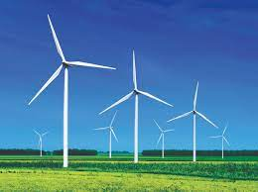
The usual wind turbine is as tall as the Statue Of Liberty.
China is the biggest wind electricity user and producer.
Wind energy is one of the fastest growing and one of the most popular sources of renewable energy.
Facts!

Slide 32
References
https://www.sciencebuddies.org/science-fair-projects/project-ideas/Aero_p040/aerodynamics-hydrodynamics/wind-turbine-design
https://science.howstuffworks.com/environmental/green-science/wind-power.htm#pt3
https://www.msichicago.org/support/donate/annual-fund/curiosity-society/curiosity-brief/can-renewable-energy-power-the-world/
https://www.iberdrola.com/sustainability/wind-turbines-blades
https://www.energy.gov/eere/wind/how-do-wind-turbines-work
https://www.opusenergy.com/blog/13-little-known-facts-about-wind-energy/
https://www.energy.gov/eere/wind/advantages-and-challenges-wind-energy#:~:text=Wind%20 turbines%20 harness%20energy%20 from,fuel%20 or%20 polluting%20the%20 air.
chrome-extension://efaidnbmnnnibpcajpcglclefindmkaj/https://www.nmmesa.org/wp-content/uploads/2019/10/Aerodynamics-of-Wind-Turbine-Blades.pdf

Slide 33
THANK YOU!

