Slide 1
POTATO POWER
BY SAIF SHARIFF-RAMJI
BRENTWOOD SCHOOL
Notes:
Hi my name is Saif Shariff-Ramji. I am in grade 5 at Brentwood School in Mrs. Ghosh’s class.
My science project is on Potato Power

Slide 2
Potato power
Potatoes can produce electricity
How does temperature impact voltage?
Can potatoes power the world?

Slide 3
hypothesis
When a potato battery is heated, it will produce more electricity because heat will reduce resistance and allow electrons to flow more freely producing more power.

Slide 4
research
What is Electricity?
How does a battery work?
How does a potato battery work?
Can boiling the potato increase the voltage?

Slide 5
Controlled variables
Potatoes of similar weight
Electrode material
Voltmeter settings
Distance between the electrodes and depth
Notes:
Controlled Variables
Type of fruit or vegetable - I will only use potatoes.
Size of fruit or vegetable - I will use potatoes of the same weight.
The metals used to build the battery - I will use the same kind of metals to make the battery for each potato.
Voltmeter - I will use the same voltmeter to measure the voltage.
Time - I will measure the voltmeter for the same amount of time for each potato
Distance between copper and nickel - I will use a ruler to measure the distance between them which should be the same for each potato
Depth of the copper and nickel - measure a line on each so that they go in the same depth on each potato.

Slide 6
variables
Dependent Variables
Voltage
Independent Variable
Temperature

Slide 7
Buy Supplies
Boil potato for 4 minutes and then 8 minutes
Measure and mark the distance for the eletrodes
Take the temperature of the potatoes
Place the electrodes into the potato
Take the voltmeter
Record in logbook
Repeat trial
Put one potato in the freezer, fridge, outside, basement and kitchen
Weigh Potatoes and pick ones that have similar weight
Set the voltmeter dial to measure at the 2V range
Plug the red and black voltmeter probe
.

Slide 8
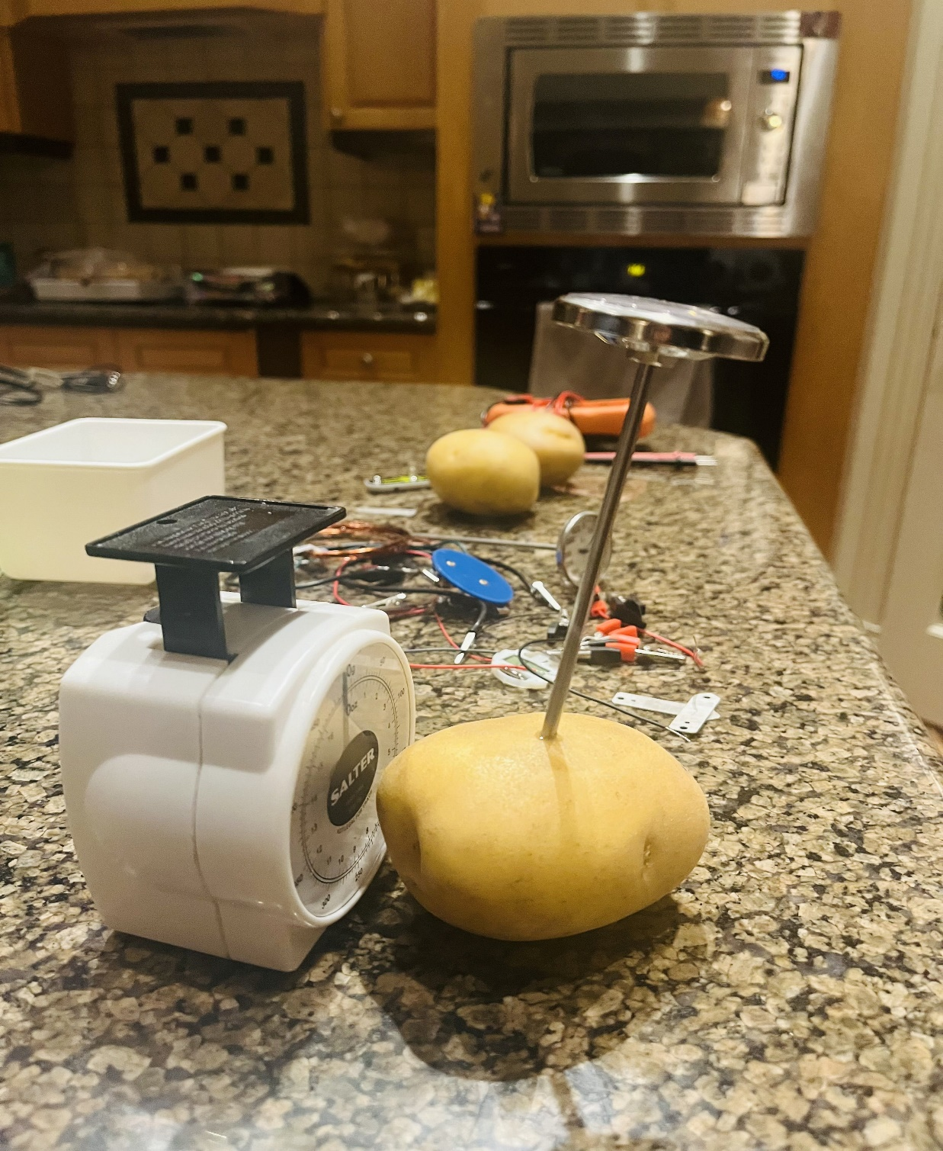

Slide 9
The trials
I ran trials on five days
I kept re-trying to see if my hypothesis would be true and tried different variations
In the end I found that there was a slight increase in voltage when the temperature of the potato was higher.

Slide 10
OBSERVTATIONS

Slide 11
Results #1

Slide 12
Results #2

Slide 13
Results #3

Slide 14
analysis

Slide 15
conclusion
My hypothesis that the voltage of a potato battery would increase for boiled potatoes was partly correct as the voltage did increase when connected in series.
My conclusion is that the voltage depends on the reaction between the phosphoric acid in the potato and the electrodes, which reaction increases when boiled.

Slide 16
Application
Picture from BBC Article

