Slide 1
School science fair logbook
By: Vivian,and Morgan

Slide 2
What dish soaps cleans the best?
(we will be swabing plates)

Slide 3
Plan
Our plan is to get most advertised dish soaps and least advertised dish soaps and see which one cleans the best with bacteria swab kits. And logging it into our logbook, so then we have lots of info for our tryfold.

Slide 4
Hypotheses
Vivian’s hypotheses: my hypothesis is the least advertised dish soap will clean the best and some people dont like expensive soaps so they go for the cheap soaps because the expensive soaps cost more money to advertise.
Morgan’s hypotheses: my hypothesis is the least advertised dish soaps will clean the best because most people just choose a dishsoap with cute or modern packeding or just choose one because there in a rush or they just dont care.

Slide 5
What is agar?
Agar is a liquid that either comes in the petri dishes before hand or you ave to put the agar in the petri dishes yourself in this case me and vivian had to do it ourselves agar is also used to thicken foods kinda like cornstarch but in this case we are using agar to show the bacteria.

Slide 6
How does agar collect mold?
Well agar is a liquid that sets and then you can swab almost anything and find out how much bacteria it holds. So the way it collects mold is when you swab something, in this case we are swabing plates before being cleaned and after so once we swab the plates we wait a few days for the bacteria to show on the petri dish. But the way the bacteria shows is the agar after a few days the agar gets tired of holding the bacteria. then the agar kicks out the bacteria and then the bacteria is lost without a home and then for us in human world we see the bacteria that all the dish soaps hold.

Slide 7
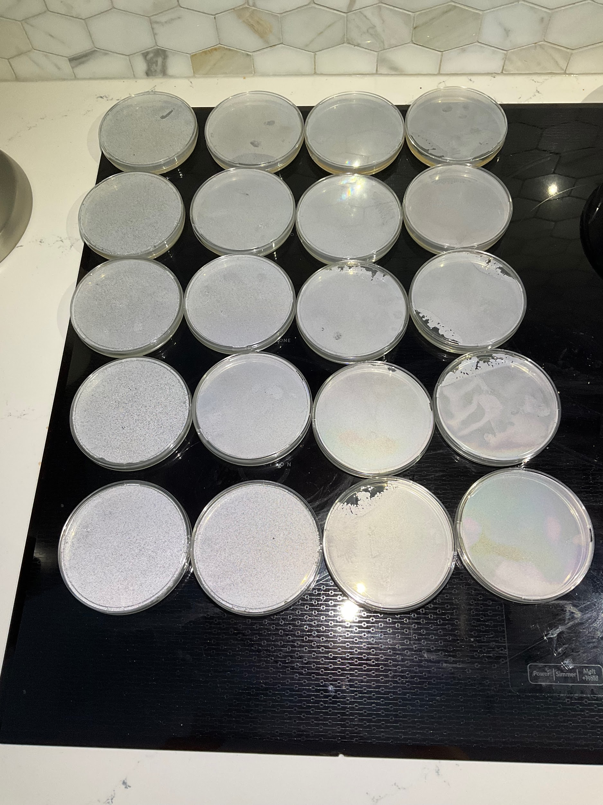

Slide 8
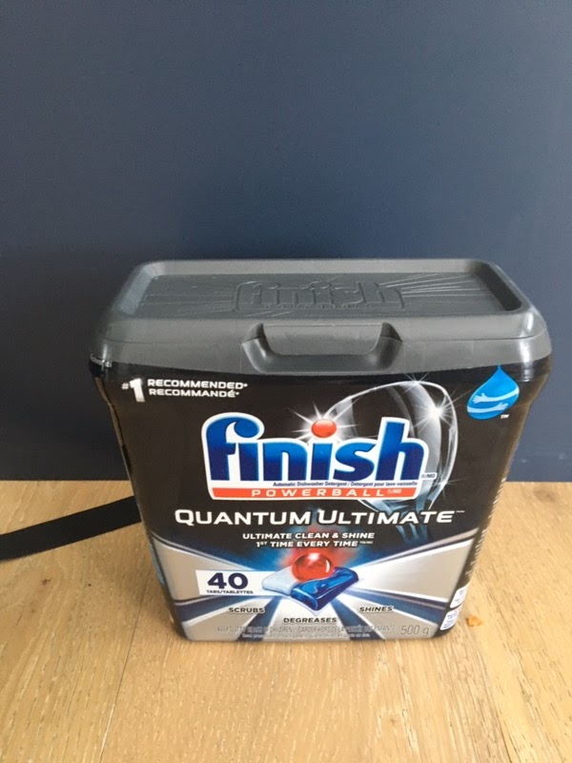

Slide 9
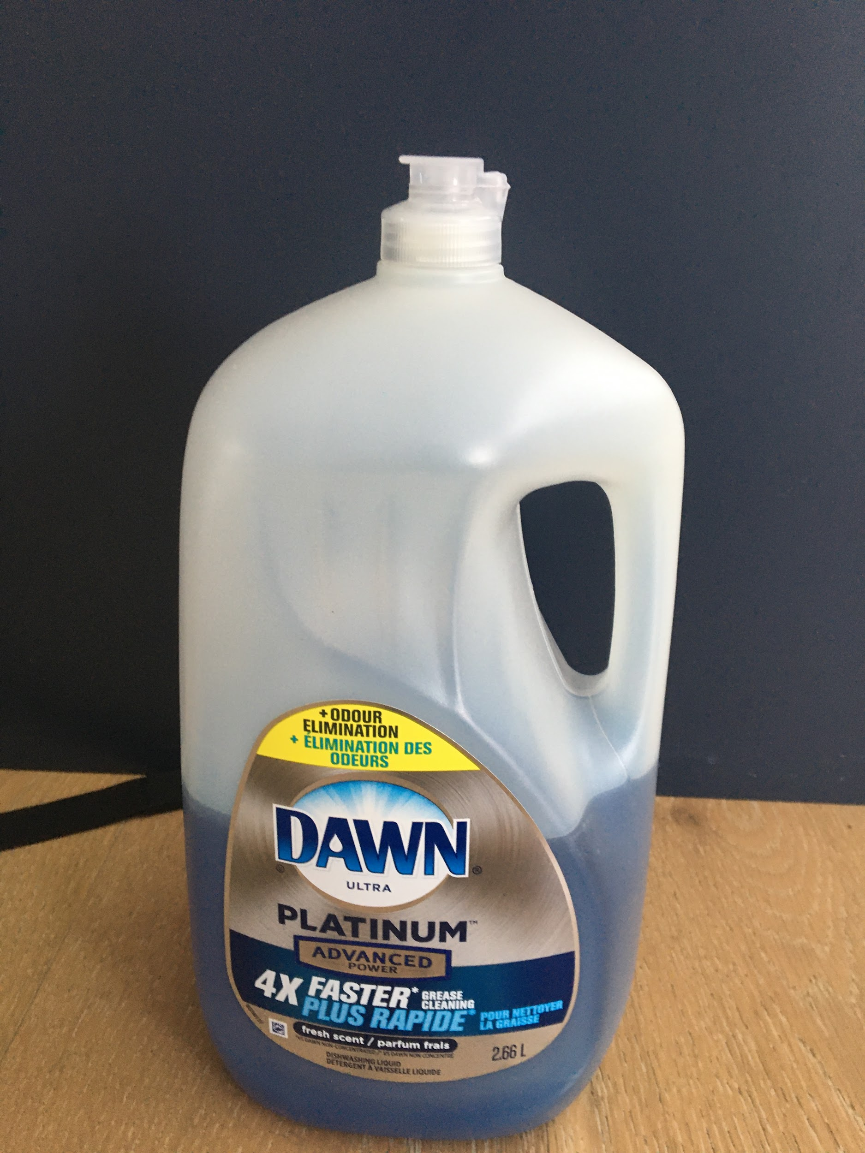

Slide 10
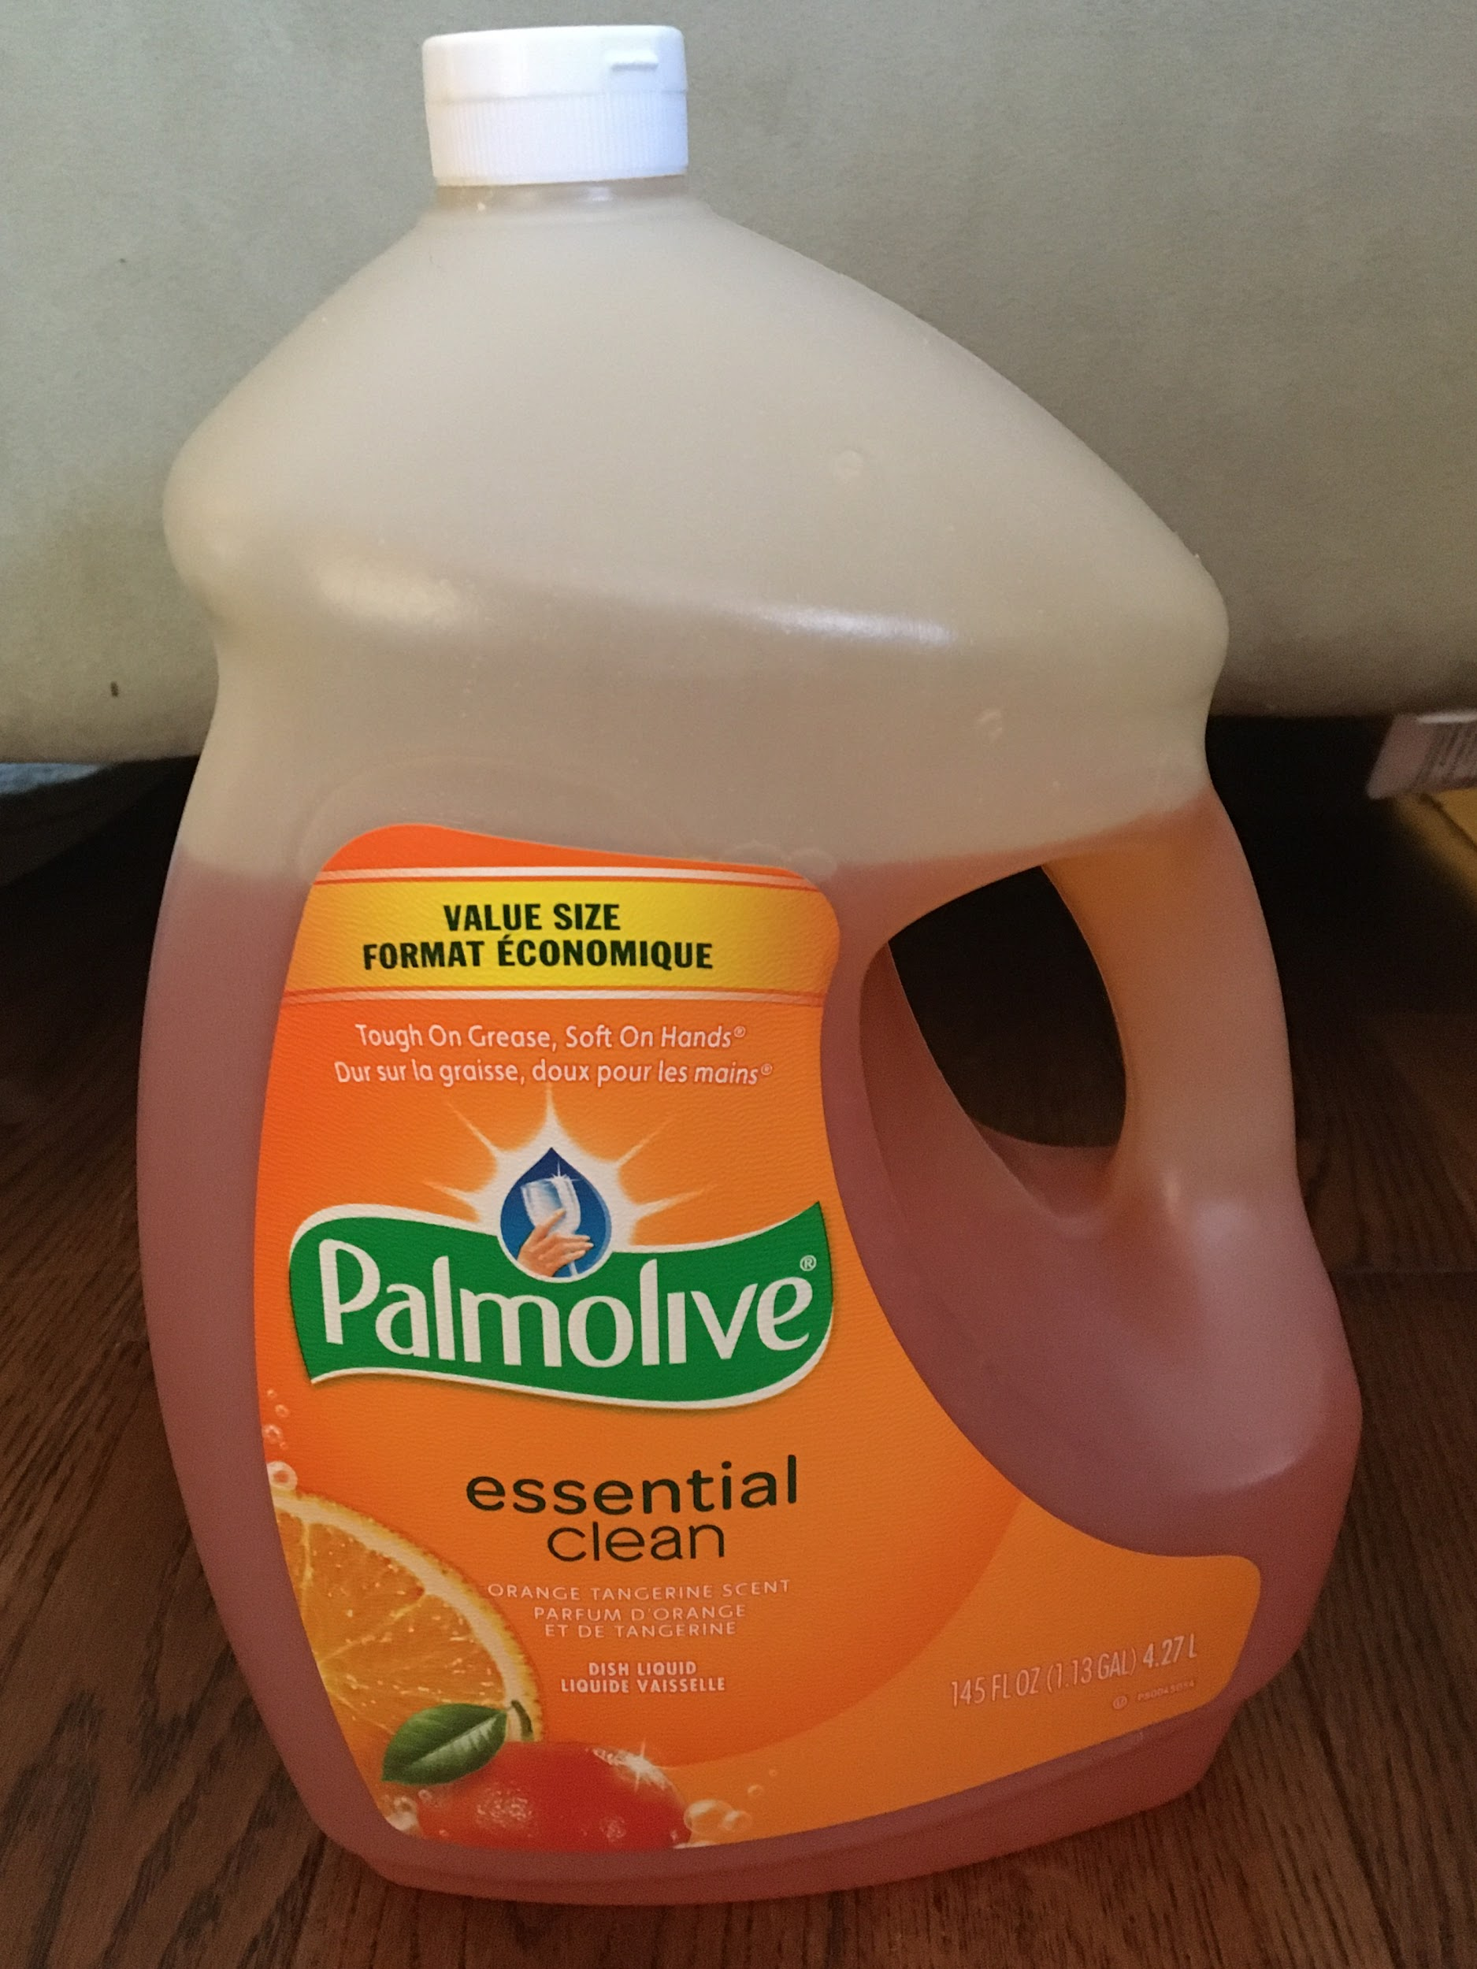

Slide 11
