Slide 1
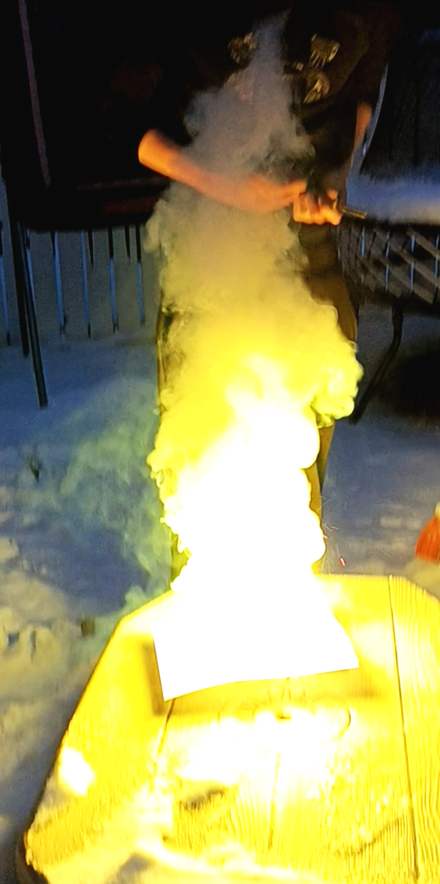
Zinc Flash Powder
This is Zinc Flash powder which is made with a combination of 1 part sulfur, 3 parts zinc powder and 1 part KNO3 (optional).
To the left is ½ of a teaspoon of this flash powder when its ignited. Even in low quantities this flash powder is very powerful, and this is why it’s sometimes used as a rocket fuel.

Slide 2
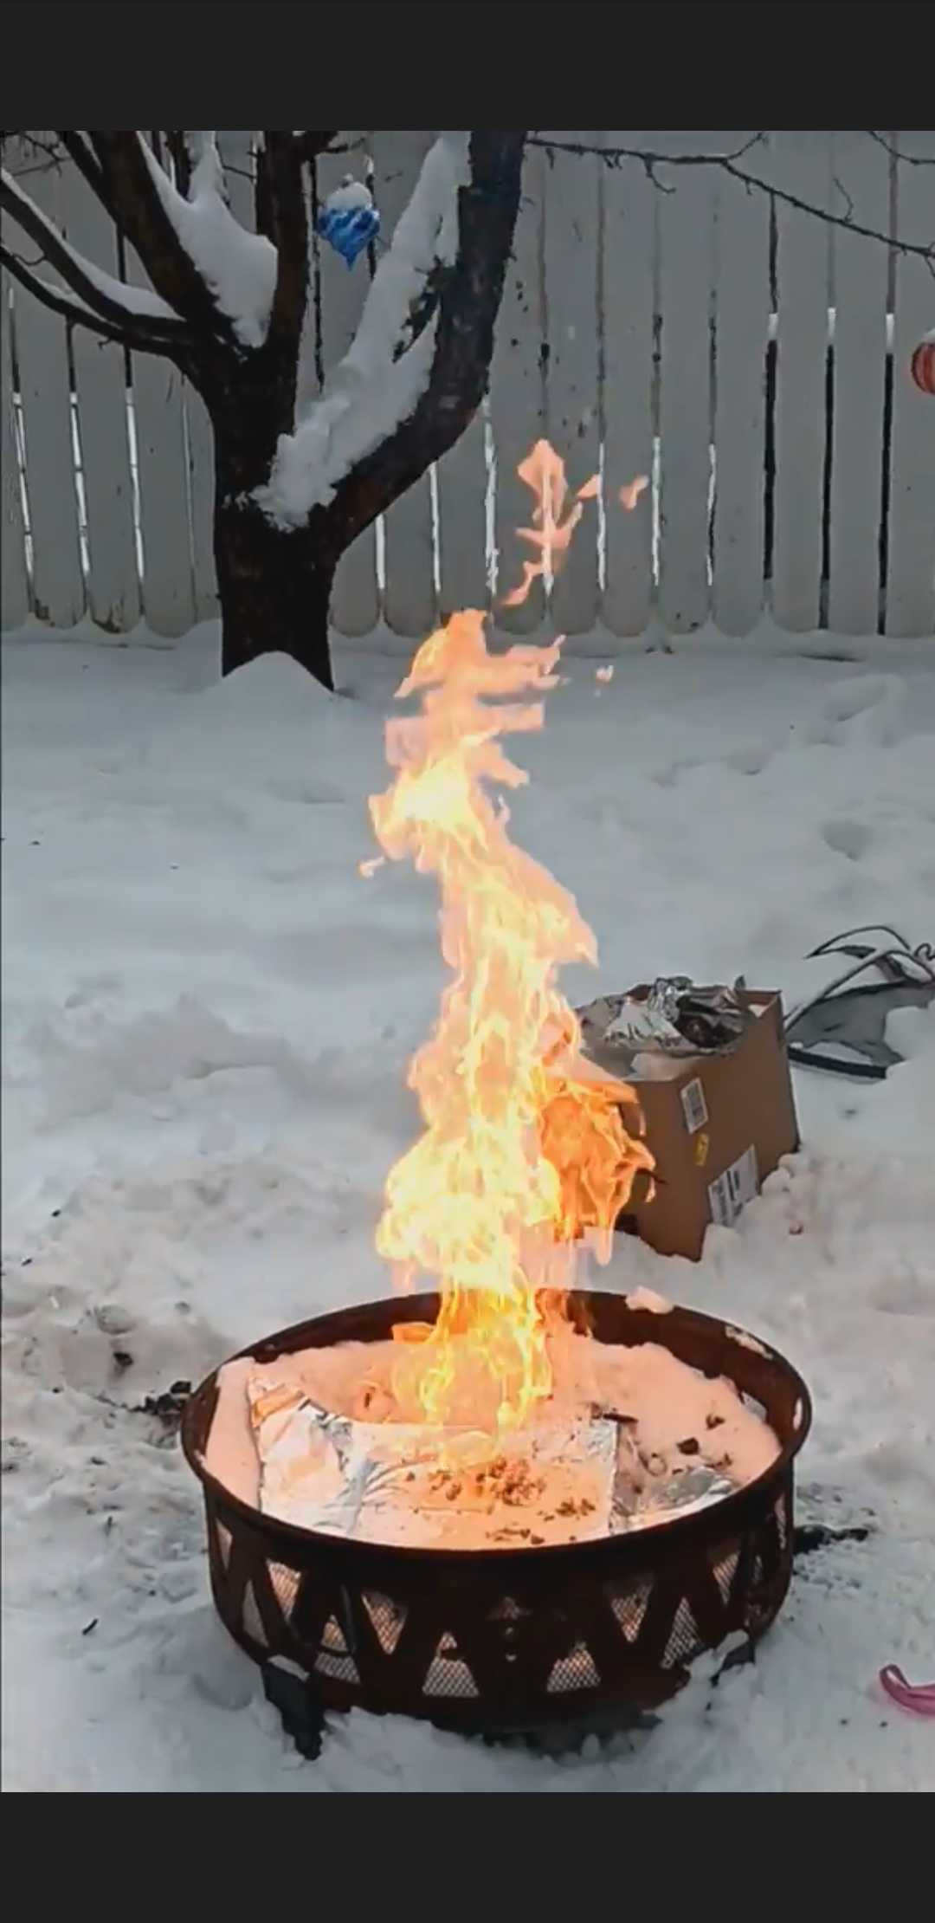
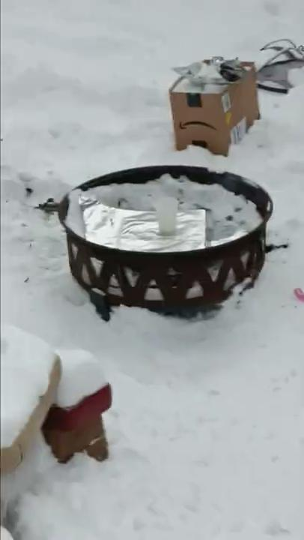
Pool Chlorine And Brake Fluid
To the right is an image and video of what happens when you mix pool chlorine with brake fluid.
Ratio used 1:1 tablespoons

Slide 3
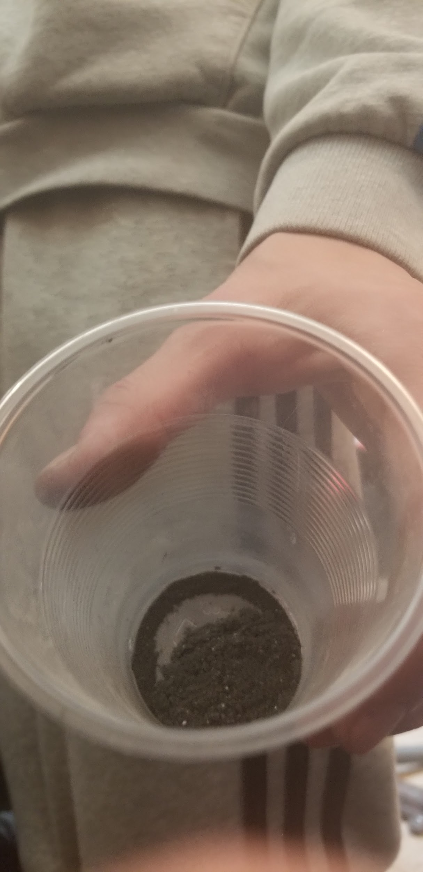
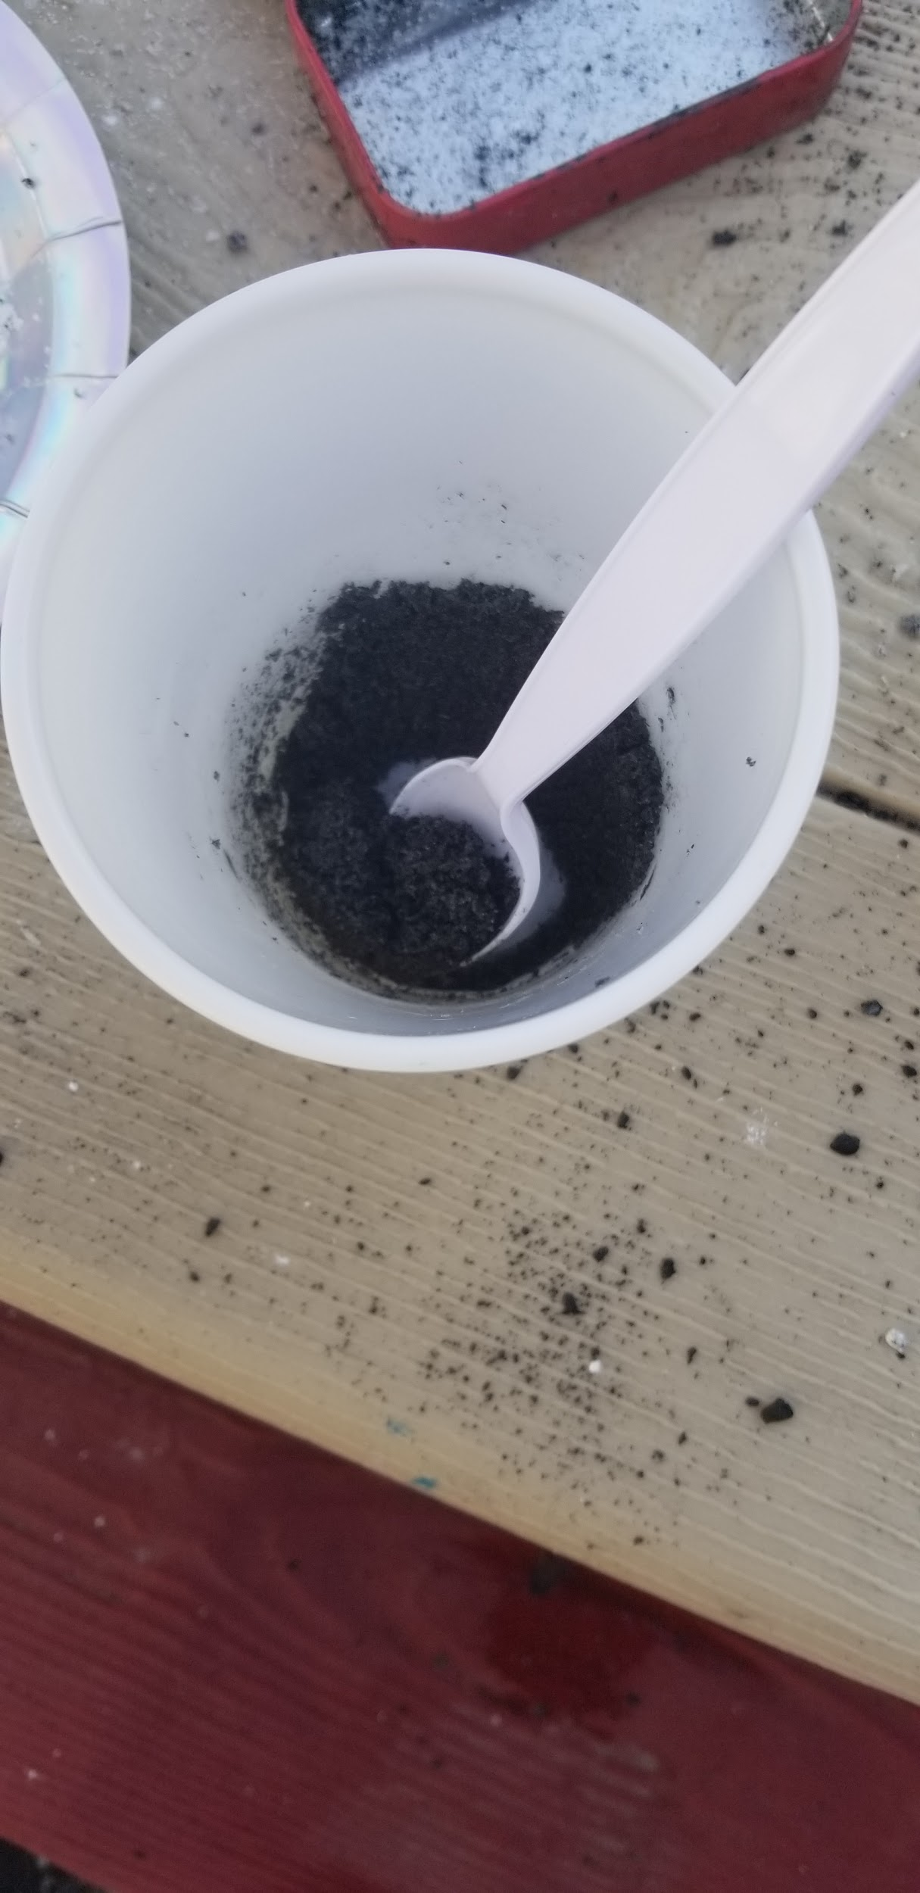
Black Powder
Black powder is a composition of 75% KNO3, 15% charcoal and 10% sulfur.

Slide 4
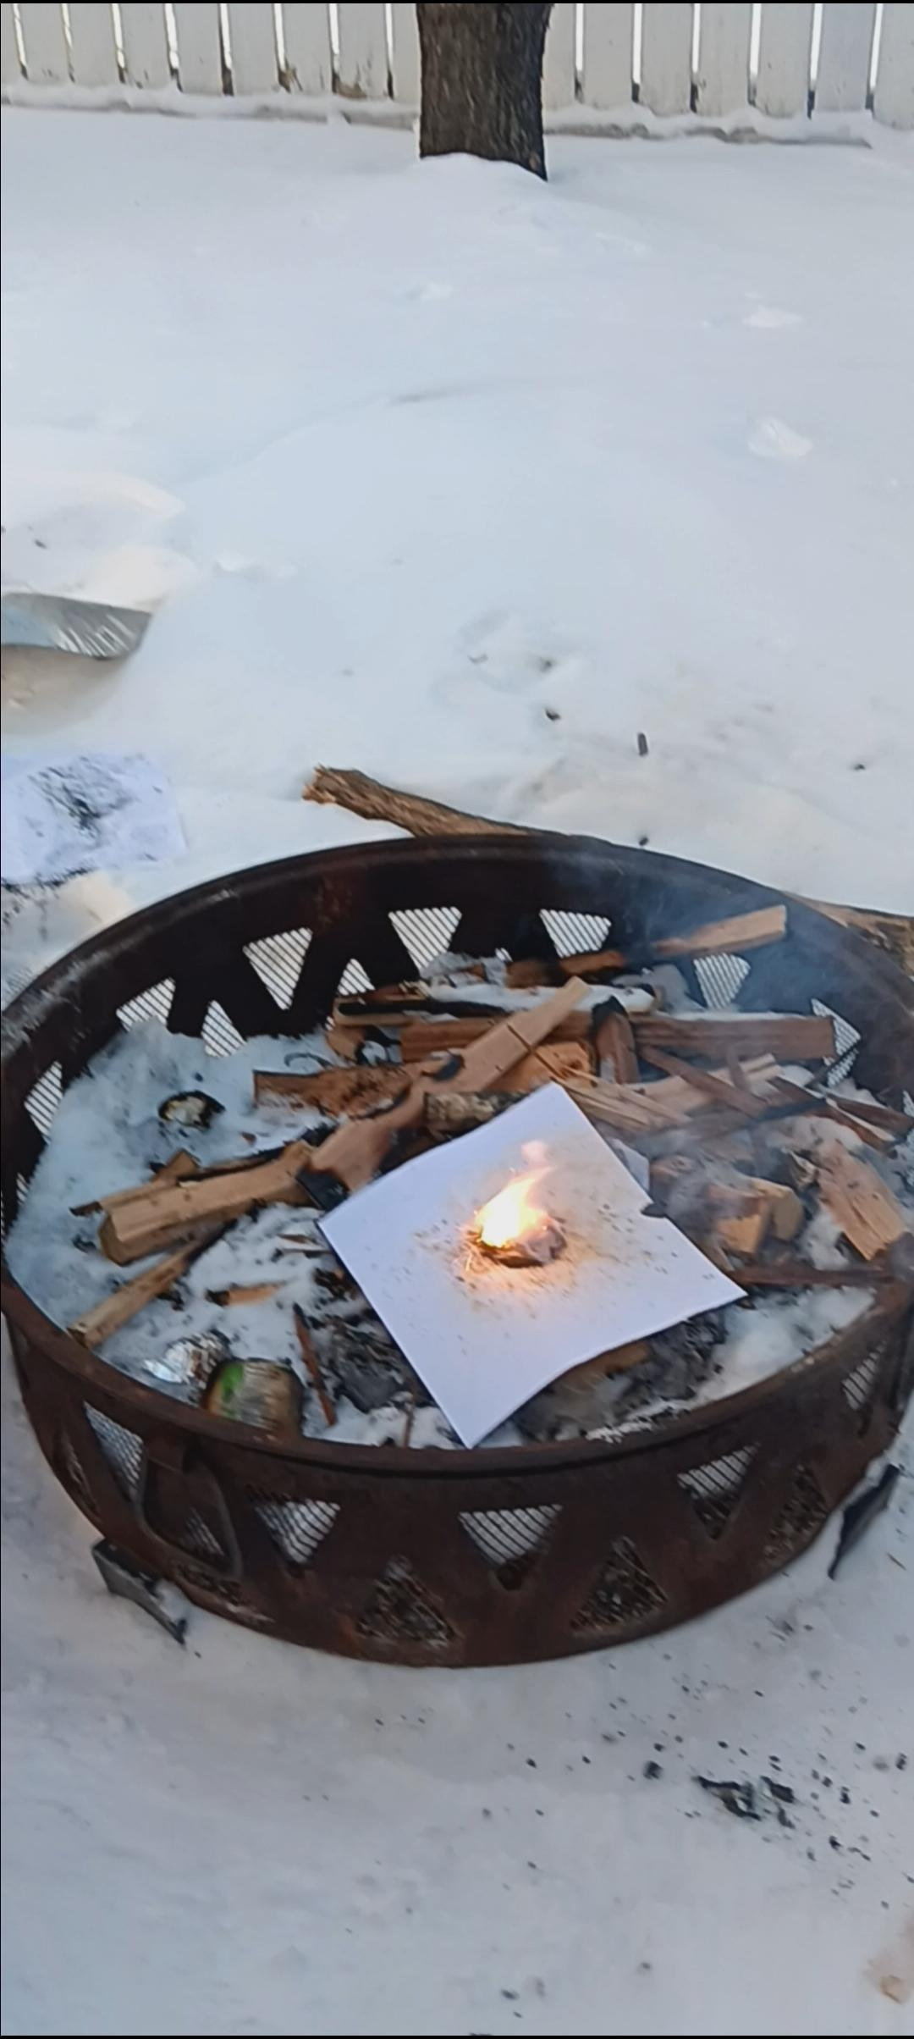
Aluminum Flash Powder
To the right is aluminum flash powder, which is 5 parts KNO3, 3 parts aluminum powder and 2 parts sulfur.
This flash powder also produces hot sparks and burned a dark orange color.

Slide 5
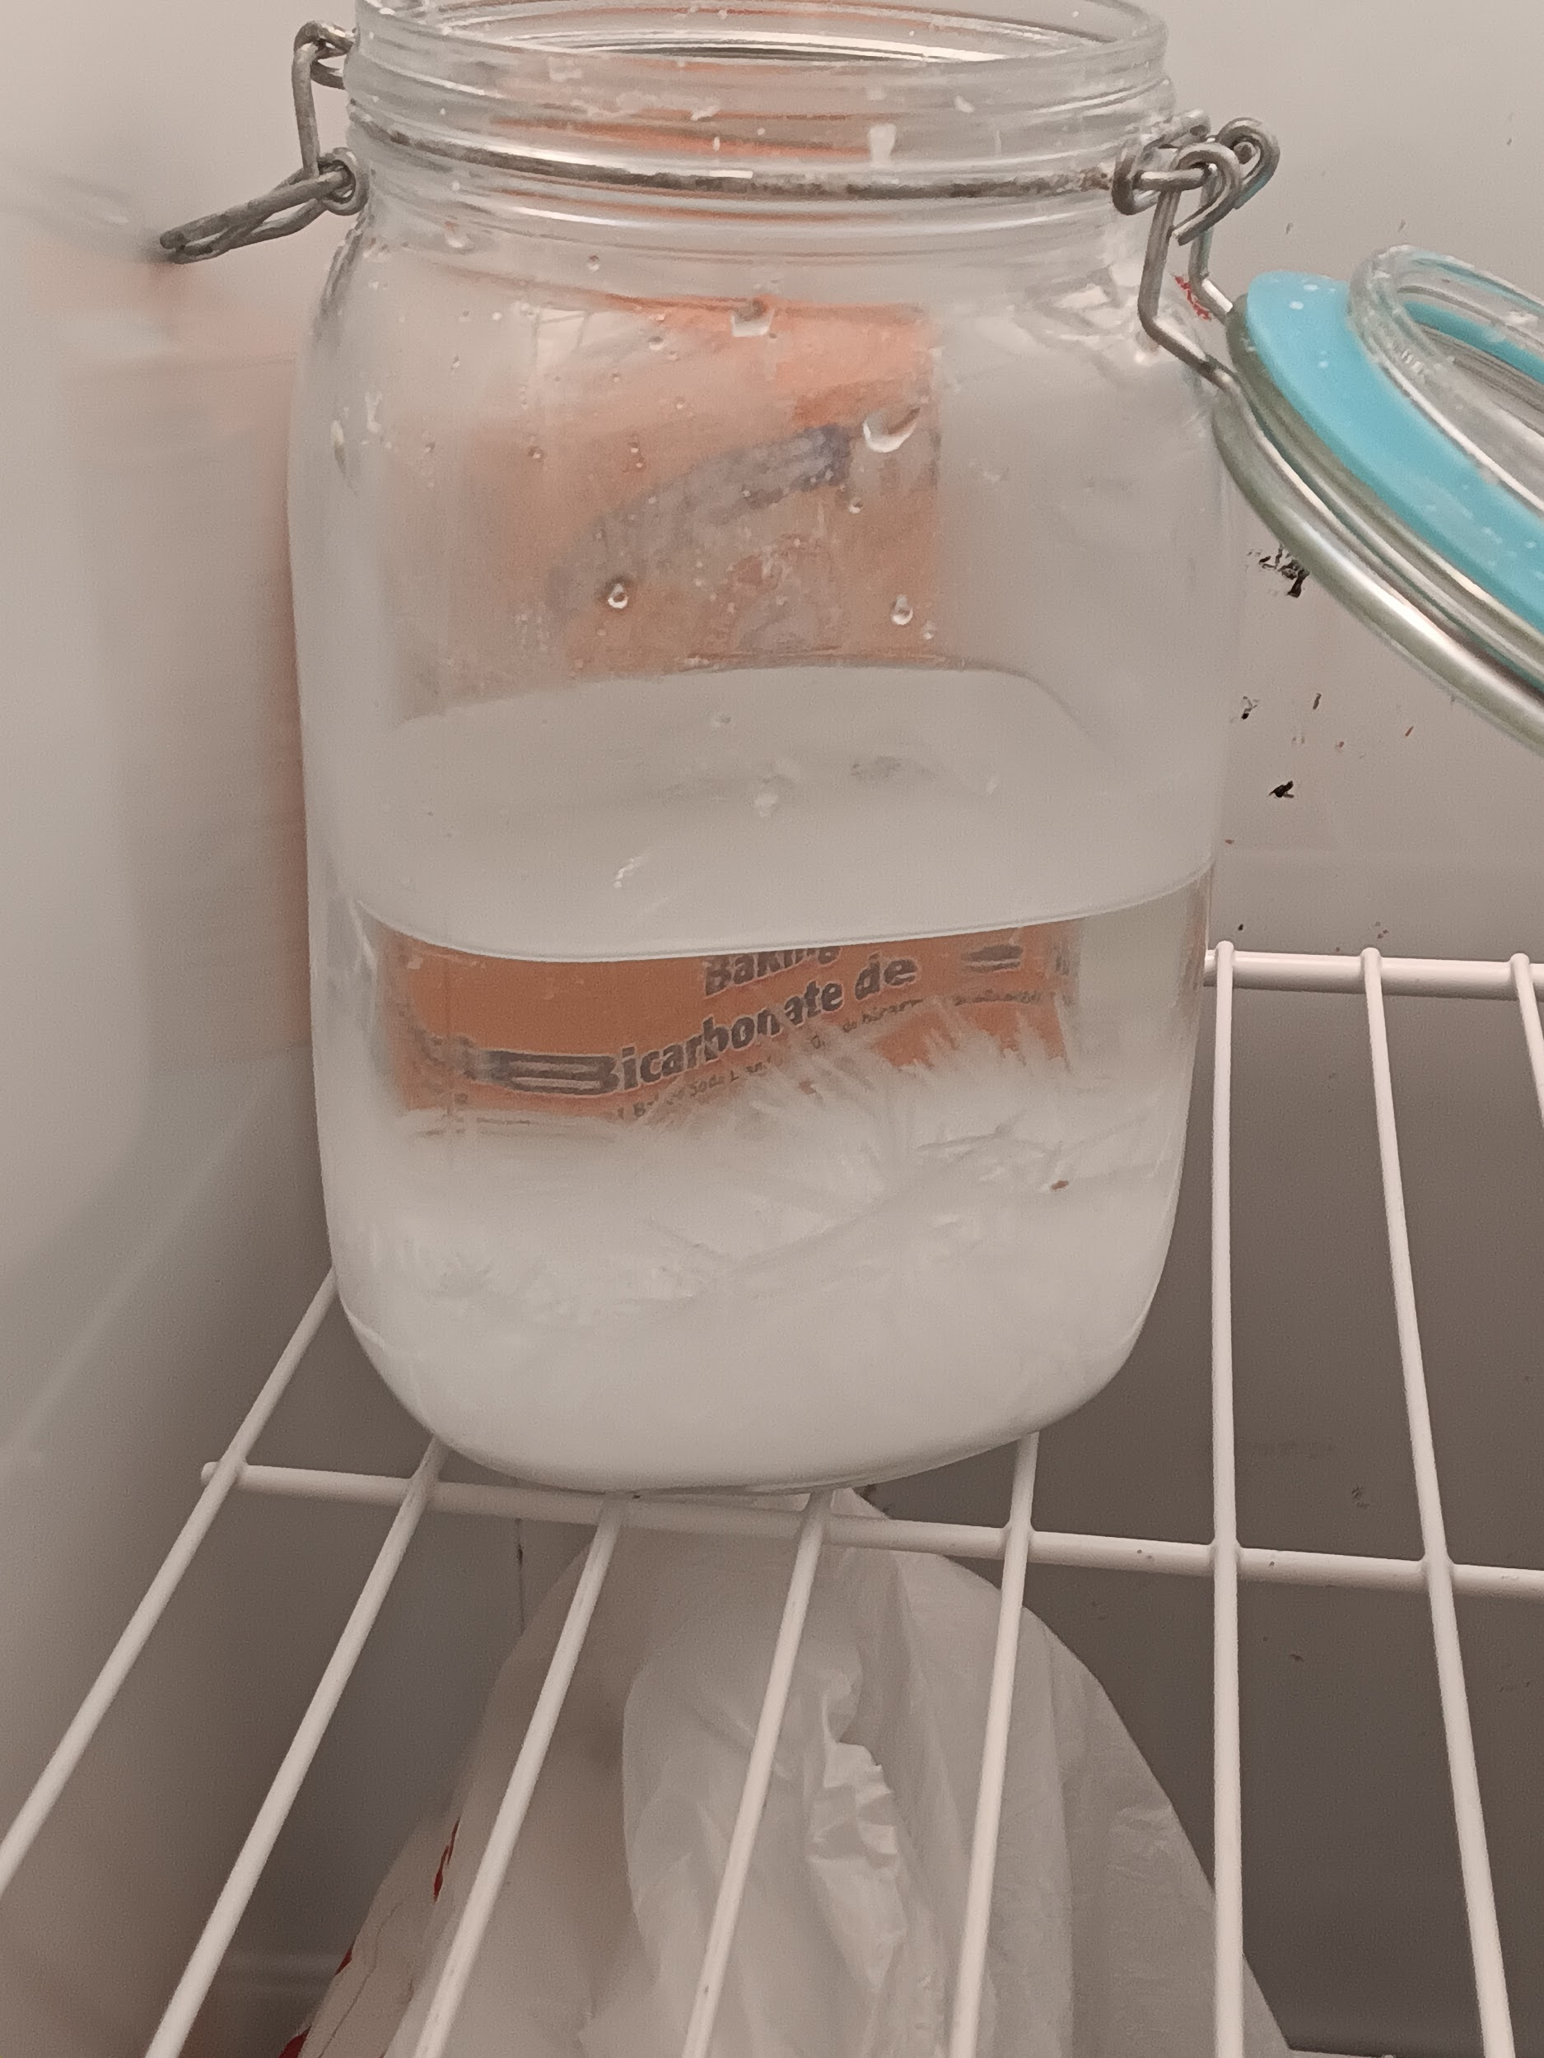
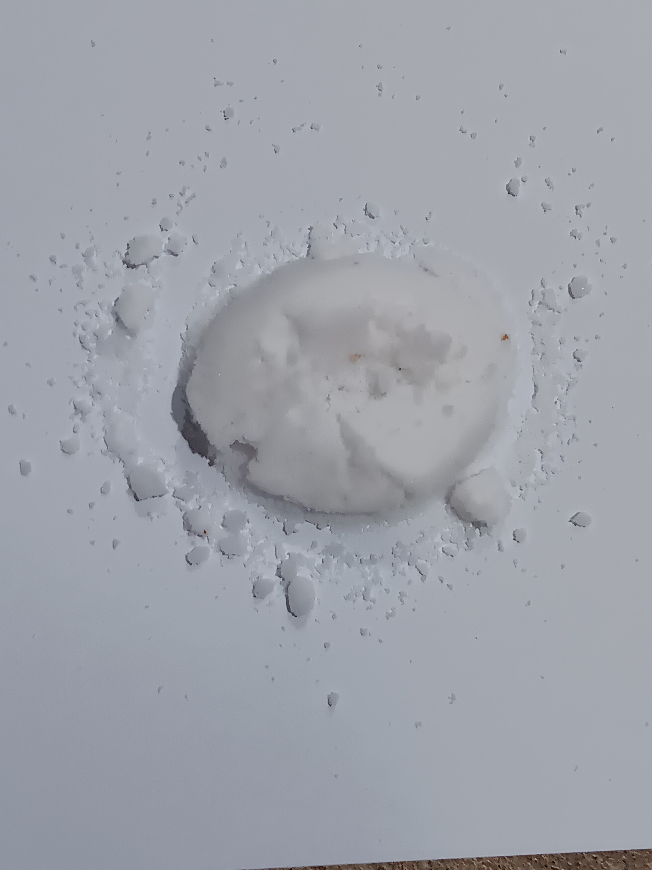
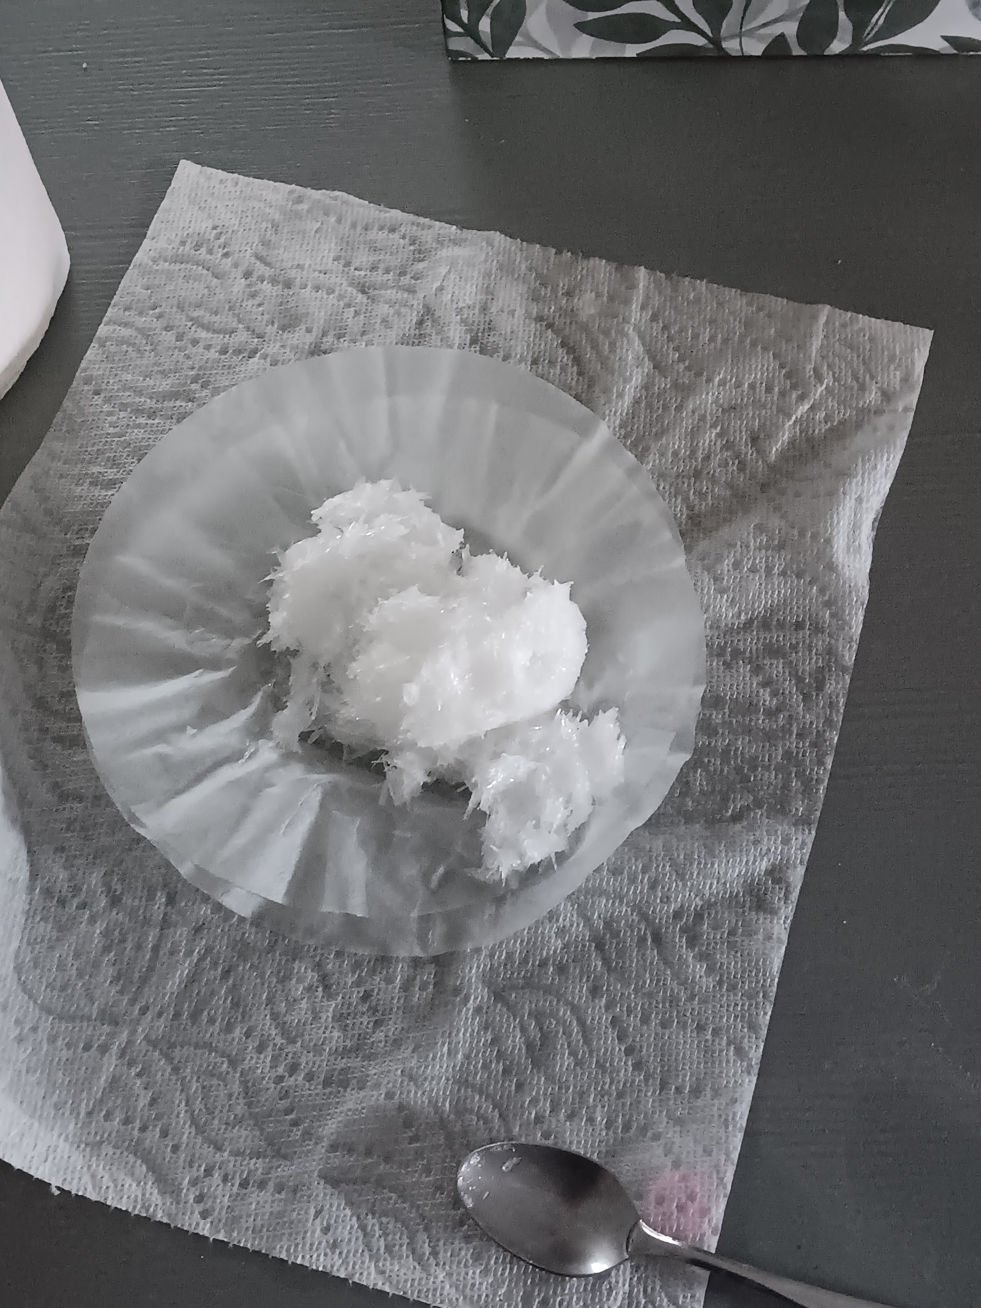
Potassium nitrate
KNO 3 or potassium nitrate is a alkali metal nitrate that has a sharp salty taste. KNO3 is also an oxidizing agent.
KNO 3 Crystals

