Slide 1
Catching the Waves of Inflation
By: Hassan Kurwa
With the Assistance of: Jamil A. Shariff, PhD, Astrophysicist, Member of Technical Staff in Systems Design at MDA

Slide 2
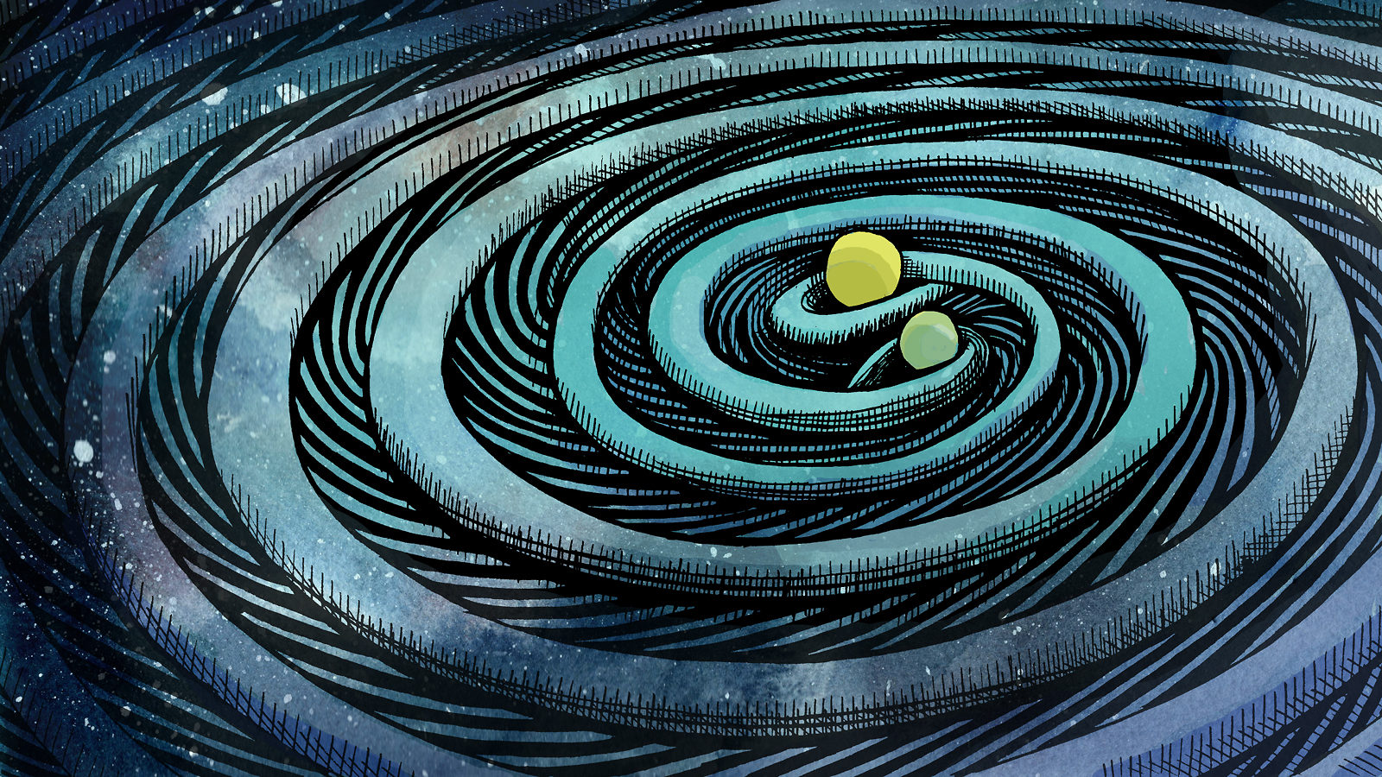
Inquiry Question
How can we find evidence for Primordial Gravitational Waves through observations of the Cosmic Microwave Background?
Artwork by Sandbox Studio, Chicago with Corinne Mucha

Slide 3
Hypothesis
If Primordial Gravitational Waves exist, then we should be able to find evidence of them in the Cosmic Microwave Background, because gravitational waves stretch and squeeze spacetime.

Slide 4
Sub Questions
What are Primordial Gravitational Waves?
What is the Cosmic Microwave Background?
What effect does the stretching and squeezing of space time due to gravitational waves have on the Cosmic Microwave Background?
How can we tell the difference between polarization from Primordial Gravitational Waves and Density Waves?
What can these observations tell us?
What is the Value of r/ Tensor-Scalar Ratio?

Slide 5
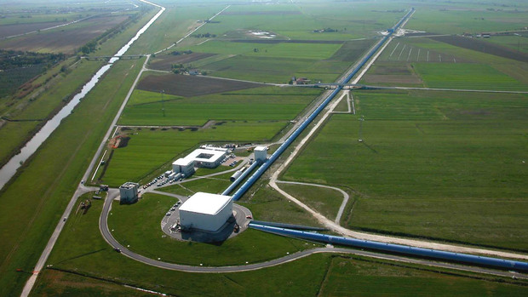
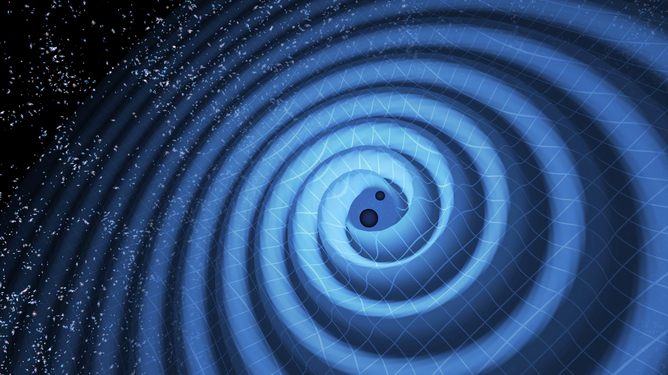
What are Primordial Gravitational Waves?
The Virgo Collaboration/CCO 1.0
An artist's impression of gravitational waves generated by binary neutron stars.
Credits: R. Hurt/Caltech-JPL
Notes:
Primordial Gravitational Waves are Gravitational Waves from the early universe. Gravitational Waves are ripples in Spacetime. They can be any size; it depends on the size of the disturbance. For example, if I were to wave my hand, I would produce very small Gravitational Waves. Very large Gravitational Waves are produced by very large amounts of energy being pushed around, for example, stars colliding. Gravitational Waves from Astrophysical Objects stretch and squeeze spacetime and can thus be measured by LIGO where they use the ever constant speed of light to measure Gravitational Waves have stretched and squeezed the surrounding area.
The difference between Primordial Gravitational Waves and Astrophysical Gravitational Waves is that Primordial Gravitational Waves are predicted to have an equal strength of signal from every direction as they were first emitted at the beginning of the universe, whereas Astrophysical Gravitational Waves have a weaker signal when measured from one direction, and a stronger signal when measured from another. This is because the Astrophysical Gravitational Waves come from a specific source such as Black Holes or Neutron Stars, whereas Primordial Gravitational Waves come from the beginning of the universe, which is a far more general source. However, as Primordial Gravitational Waves came from the beginning of the universe, the frequency is so low that LIGO cannot detect them.

Slide 6
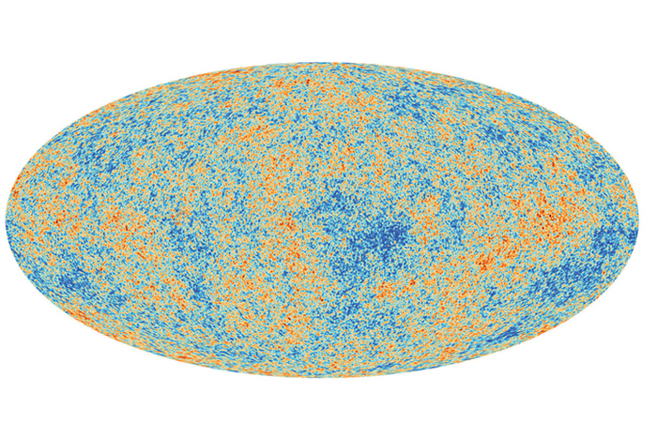
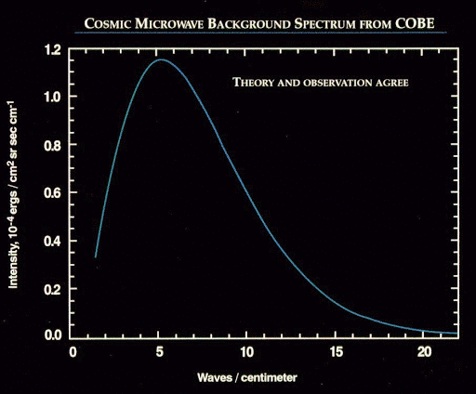
What is the Cosmic Microwave Background?
European Space Agency, Planck Collaboration
Untitled, the Stephen Hawking Center for Theoretical Cosmology
http://www.ctc.cam.ac.uk/outreach/origins/cmb.php
Notes:
The CMB is leftover radiation from the Big Bang. To explain exactly what the Cosmic Microwave Background is, and how it was made, we must understand the first minutes after the Big Bang. The Universe was very hot, and was very dense. All of the electrons were being scattered around and bumping into each other as well as into photons. Because of this, the photons couldn’t go far without being scattered again. This mean that if someone were in the midst of this situation, all they would see would be a thick fog. 400 000 years after the Big Bang, however, the electrons combined with positive particles, creating atoms and thus, the fog cleared. This is because the universe was cooling down, and the photons didn’t have enough energy to knock the electrons out of atoms. The photons stopped scattering and were able to escape this fog. They then started to move outwards in a straight line. Their starting point was called the surface of last scattering. When we observe the Cosmic Microwave Background, we see an image of this surface.
If they ask why the electrons stop scattering: it’s because the nucleus cancels out the positive charge of the electron

Slide 7
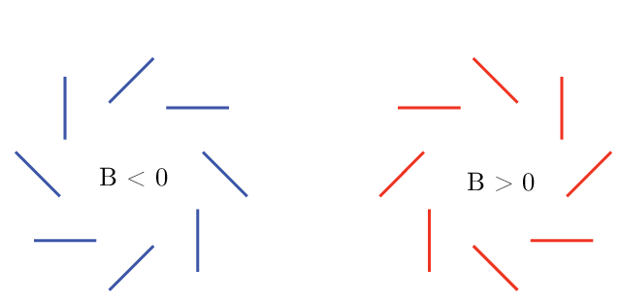
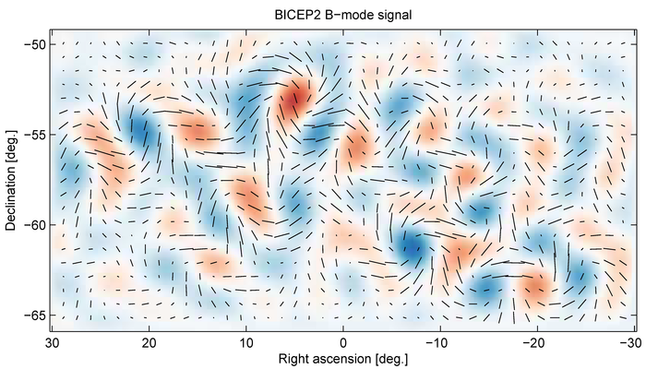
What effect does the stretching and squeezing of space time due to gravitational waves have on the Cosmic Microwave Background?
Verde L. nd. Untitled Researchgate https://www.researchgate.net/figure/Examples-of-E-mode-and-B-mode-patterns-of-polarization-Note-that-if-reflected-across-a_fig2_279420332
BICEP2 B-Mode Signal, nd. BICEP2 Visuals http://bicepkeck.org/media/b_over_b_rect_BICEP2.png
Notes:
The Cosmic Microwave Background is affected by Primordial Gravitational Waves through something called B-Mode Polarization. This is because the Gravitational Waves stretch and squeeze space-time. B-Mode polarization is a pattern of polarization directions on the sky. A B-Mode around a hot or cold spot in a CMB looks like fig. 1, and causes the Cosmic Microwave Background to look like fig. 2.

Slide 8
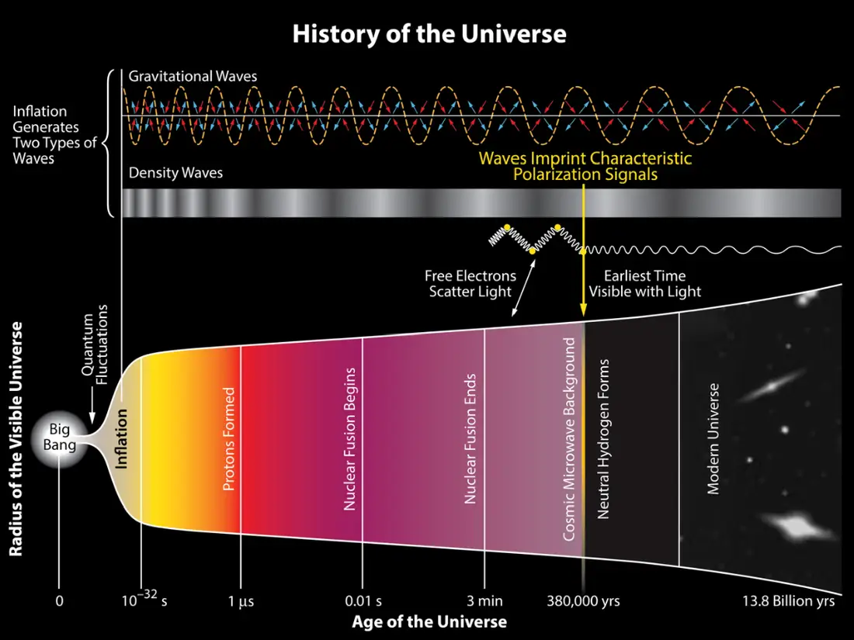
How can we tell the difference Between CMB Polarization from Primordial Gravitational Waves and Density Waves?
History of the Universe, nd. BICEP2 Visuals http://bicepkeck.org/media/History-of-the-Universe-BICEP2.jpg
Notes:
The Difference between the polarization from Density waves and Primordial Gravitational Waves is that one (Density Waves) produces E-Modes of CMB polarization, and one (Gravitational Waves) can produce both E-Modes and B-Modes of CMB polarization. The reason that experiments such as BICEP-2 and SPIDER have had difficulty clearly identifying B-Mode polarization from Primordial Gravitational Waves is because Interstellar Dust can also emit polarized microwave light that has a similar polarization to B-Modes, and the emission is much stronger than that of Primordial Gravitational Waves. Scientists don’t actually know the strength of the Primordial Gravitational Waves.
If they ask where the dust is situated: it’s in our own galaxy,

Slide 9
What are Density Fluctuations?
History of the Universe, nd. BICEP2 Visuals http://bicepkeck.org/media/History-of-the-Universe-BICEP2.jpg
Notes:
Density Fluctuations affect the Plasma. Density Fluctuations existed in the Primordial Plasma. These fluctuations are random, and can be described mathematically as a combination of different Density Waves of many different frequencies, an example of which being the one on screen.

Slide 10
What is the Value of r/ Tensor-Scalar Ratio?
Notes:
The Value of r is actually a ratio. This ratio is between the fluctuations of primordial Gravitational Waves (Tensor) and fluctuations in spacetime due to Density Variations (Scalar). This value indirectly conveys the strength of Primordial Gravitational Waves. Knowing the value of r can help us know the energy level of the event that occured at the beginning of the universe. Nevertheless, scientists have found it difficult to find the true value of r. We know roughly the maximum value of r, but have not been able to pin down the exact value. However, we do know that the value of r is not very large because if it were, we would have been able to detect evidence for Primordial Gravitational Waves by now. If we can measure B-Modes in an accurate fashion, then we can get a calculation of the value of r alongside a uncertainty measurement . Like I mentioned previously, this will massively help with understanding more about the details of the Big Bang. The most up to date value of r is r < 0.044 at 95% CL.

Slide 11
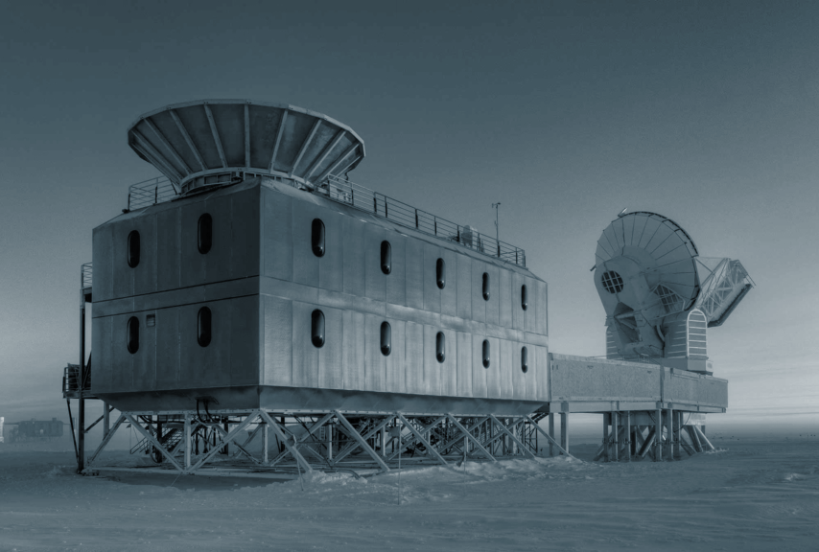
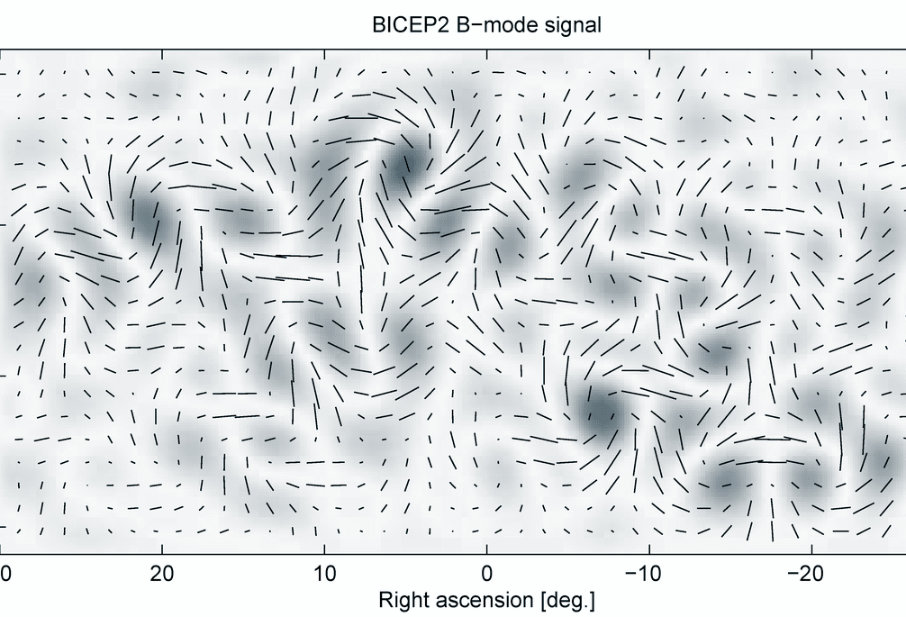
Analysis
Richter, S. (2018) Untitled, Harvard University https://physicsworld.com/a/from-dust-to-dust/
Untitled, nd. Stratocat.com https://stratocat.com.ar/fichas-e/2015/MCM-20150101.htm
BICEP2 B-Mode Signal, nd. BICEP2 Visuals http://bicepkeck.org/media/b_over_b_rect_BICEP2.png
Notes:
So now we know the importance of primordial gravitational waves, what the CMB is, and how Primordial Gravitational Waves impact the CMB. So now to answer the question: How can we find evidence for Primordial Gravitational Waves through observations of the Cosmic Microwave Background? Well, the answer is that if we are able to distinguish polarization from Primordial Gravitational Waves from Dust and Density Fluctuations, then we will be able to find evidence for Primordial Gravitational Waves. However, finding this distinguishability is the barrier to finding evidence. Luckily, with further research and more accurate models of Primordial Gravitational Waves, we should be able to get there.

Slide 12
Conclusion
In Conclusion, this hypothesis should be theoretically true. We have not found concrete evidence for Primordial Gravitational waves yet, but scientists are using progressively more accurate methods in order to identify if the CMB is polarized by Primordial Gravitational Waves.

Slide 13
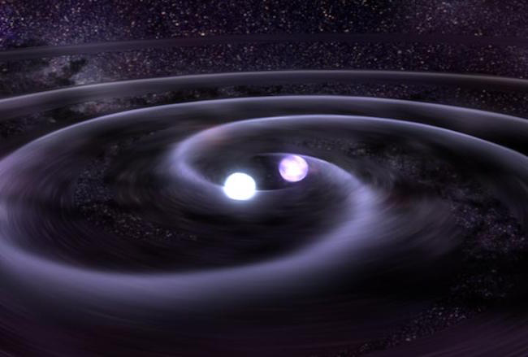
Application
Credit: NASA/Goddard Space Flight Center)
Knowing whether Primordial Gravitational Waves exist or not is crucial to learning about the beginning of the universe. If we can provide evidence for Primordial Gravitational Waves, then it can be proved that Inflation is the true beginning of the universe. Knowing about this will let us learn about mysteries such as Dark Matter and Dark Energy, as having an accurate imprint and story of where the Cosmic Microwave Background has been from the beginning of the universe can tell us so much about how the Universe works.

Slide 14
References
BICEP2 visuals. (n.d.). The BICEP and Keck Array CMB Experiments. https://bicepkeck.org/visuals.html
Chu, J. (2020, December 9). A technique to sift out the universe’s first gravitational waves. MIT News | Massachusetts Institute of Technology. https://news.mit.edu/2020/universe-first-gravitational-waves-1209
CMB polarization. (n.d.). www.cfa.harvard.edu/ |. https://www.cfa.harvard.edu/~cbischoff/cmb/
De Bernardis, P., & Masi, S. (2012). The cosmic microwave background: Observing directly the early universe. Space Telescopes and Instrumentation 2012: Optical, Infrared, and Millimeter Wave, 23. https://doi.org/10.1117/12.979916
Density wave model | COSMOS. (n.d.). https://astronomy.swin.edu.au/cosmos/D/Density+Wave+Model
ESA science & technology - What are baryonic acoustic oscillations? (n.d.). ESA Science & Technology - Science & Technology. https://sci.esa.int/web/euclid/-/what-are-baryonic-acoustic-oscillations-
Gravitational Lensing. (2019, 30). HubbleSite.org. https://hubblesite.org/contents/articles/gravitational-lensing
Howell, E. (2018, August 24). Cosmic microwave background: Remnant of the Big Bang. Space.com. https://www.space.com/33892-cosmic-microwave-background.html
Hu, W. (n.d.). Electric and Magnetic Modes. Wayne Hu's Tutorials. https://background.uchicago.edu/~whu/polar/webversion/node8.html
Hu, W., & White, M. (2004). The cosmic symphony. Scientific American, 290(2), 44-53. https://doi.org/10.1038/scientificamerican0204-44
Keating, B. (2018). Losing the Nobel prize: A story of cosmology, ambition, and the perils of science's highest honor. W. W. Norton & Company.

Slide 15
Kurzgesagt – In a Nutshell. (2014, March 3). The beginning of everything -- The Big Bang [Video]. YouTube. https://youtu.be/wNDGgL73ihY
Moskowitz, C. (2014, March 17). Gravity waves from Big Bang detected. Scientific American. https://www.scientificamerican.com/article/gravity-waves-cmb-b-mode-polarization/
Nave, R. (n.d.). Classification of polarization. https://hyperphysics.phy-astr.gsu.edu/hbase/phyopt/polclas.html
Observatories across the electromagnetic spectrum. (n.d.). nasa.com. https://imagine.gsfc.nasa.gov/science/toolbox/emspectrum_observatories1.html
Polarization of light, linear and circular (video). (n.d.). Khan Academy. https://www.khanacademy.org/science/physics/light-waves/introduction-to-light-waves/v/polarization-of-light-linear-and-circular
Sample size calculator. (n.d.). Calculator.net: Free Online Calculators - Math, Fitness, Finance, Science. https://www.calculator.net/sample-size-calculator.html
Tristram, M., Banday, A., Gorski, K., Keskitalo, R., Lawrence, C., Andersen, K., Barreiro, R., Borrill, J., Eriksen, H., Fernandez-Cobos, R., Kisner, T., Martinez-Gonzalez, E., Partridge, B., Scott, D., Svalheim, T., Thommesen, H., & Wehus, I. (2020). Planck constraints on the tensor-to-scalar ratio. Astronomy & Astrophysics, 19. https://doi.org/10.1051/0004-6361/202039585
WMAP Big Bang CMB test. (2016, May 9). Wilkinson Microwave Anisotropy Probe (WMAP). https://wmap.gsfc.nasa.gov/universe/bb_tests_cmb.html
WMAP CMB fluctuations. (2014, August 20). Wilkinson Microwave Anisotropy Probe (WMAP). https://wmap.gsfc.nasa.gov/universe/bb_cosmo_fluct.html

