Slide 1
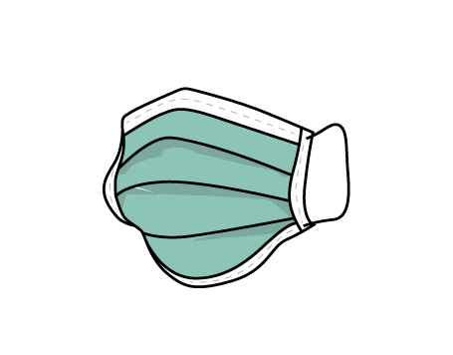
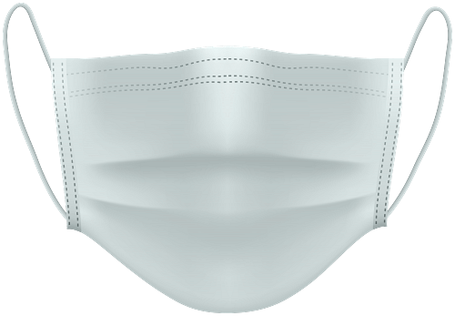
So Many Masks - What to Wear?
Science Fair 2020-21
Cooper Choi - Grade 8 - Webber Academy
Notes:
Complete

Slide 2
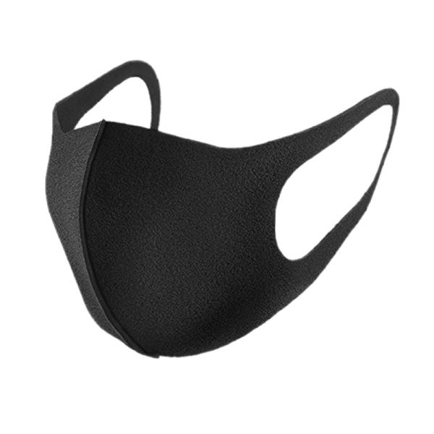
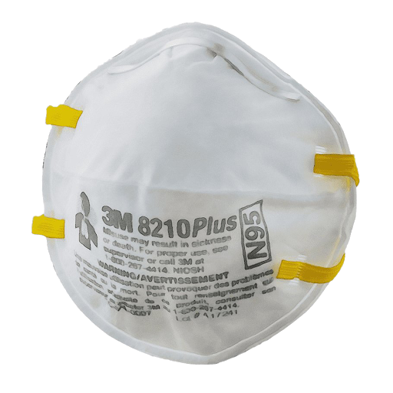
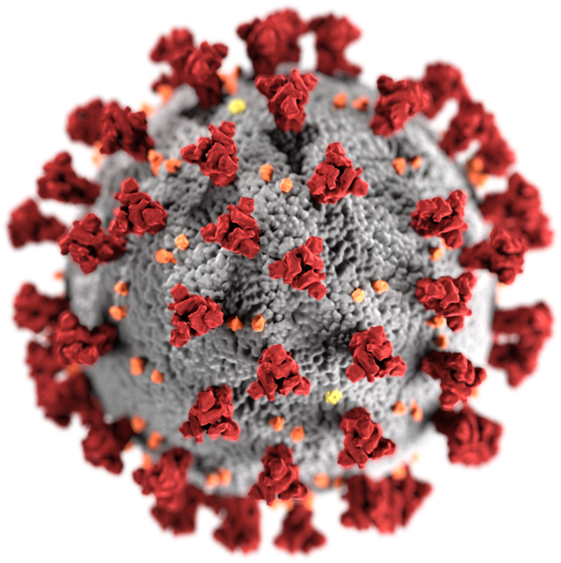
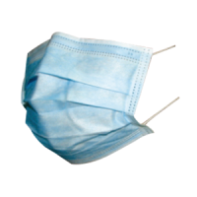
Introduction
Throughout the pandemic, what masks to wear and what materials are best for them have been an ongoing issue. There are countless studies on this, but they often contradict.
Objectives:
What is the best mask?
What would the most ideal mask look like?
Notes:
Complete

Slide 3
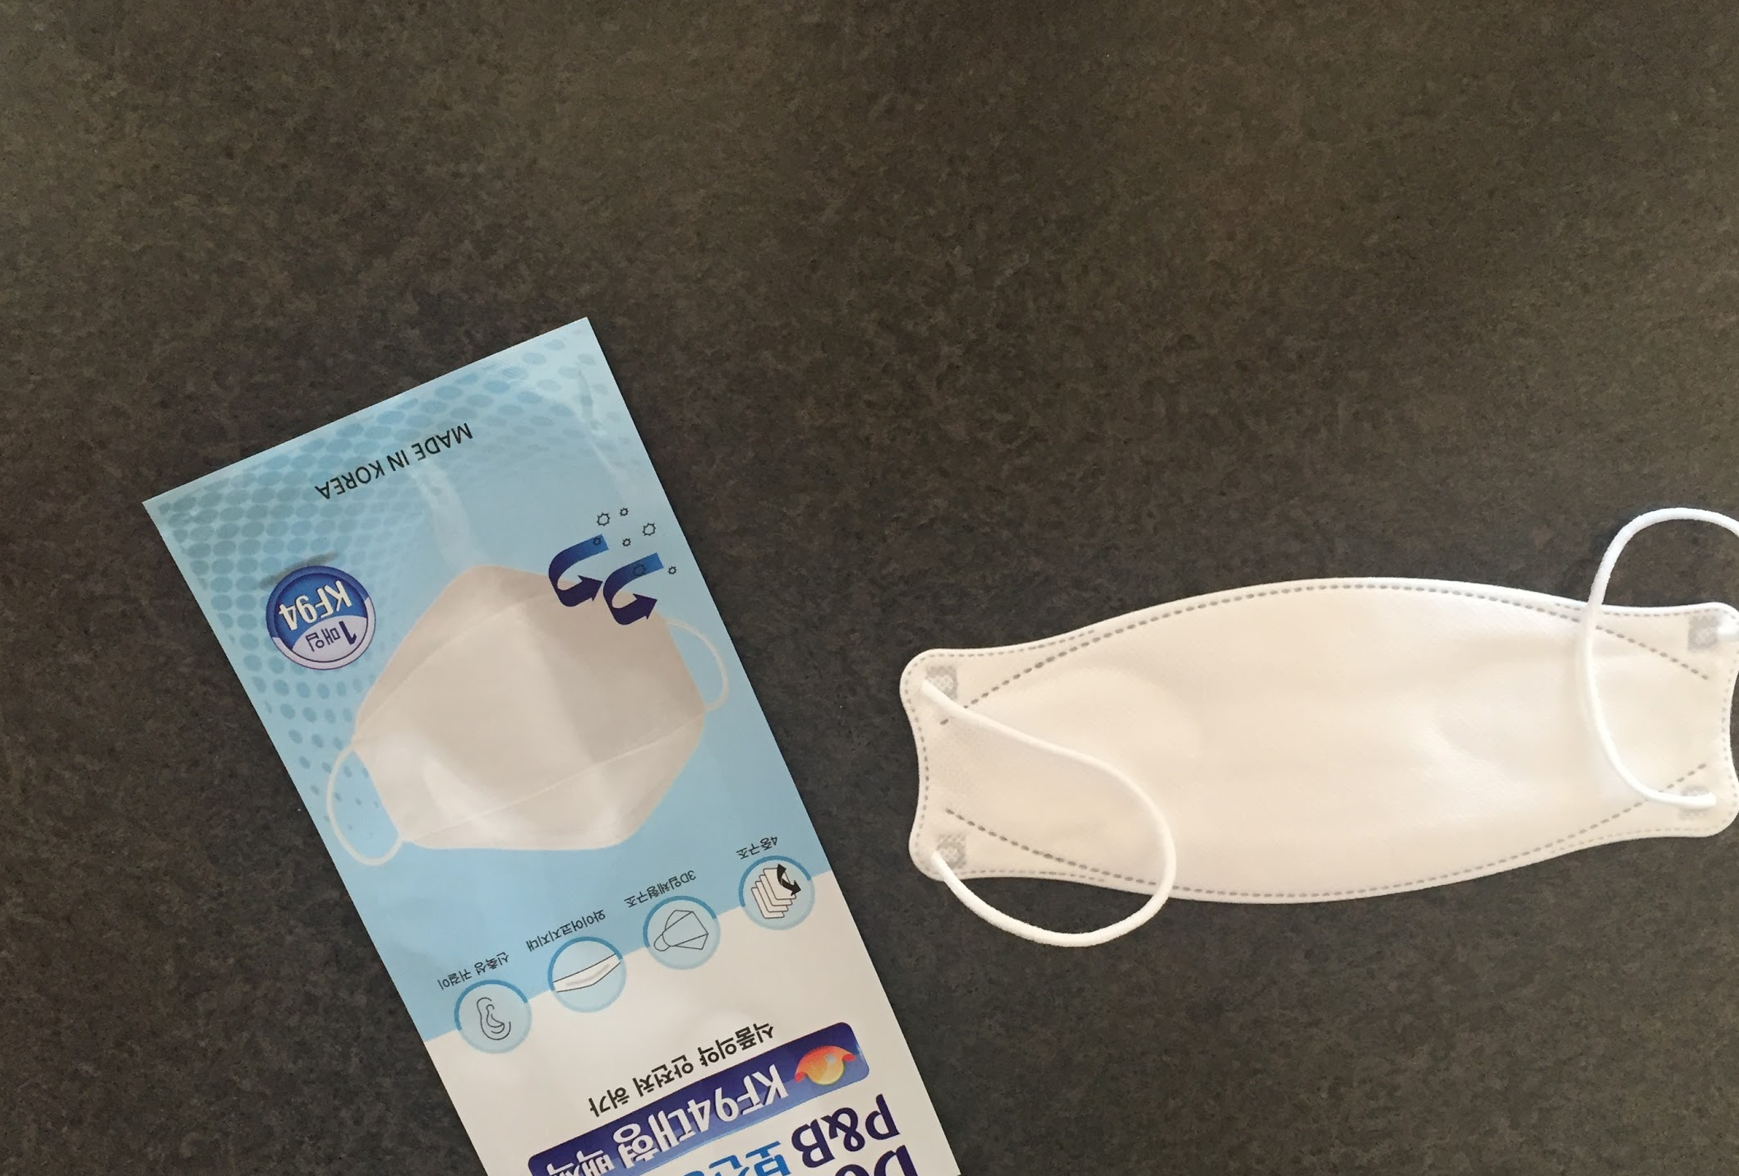
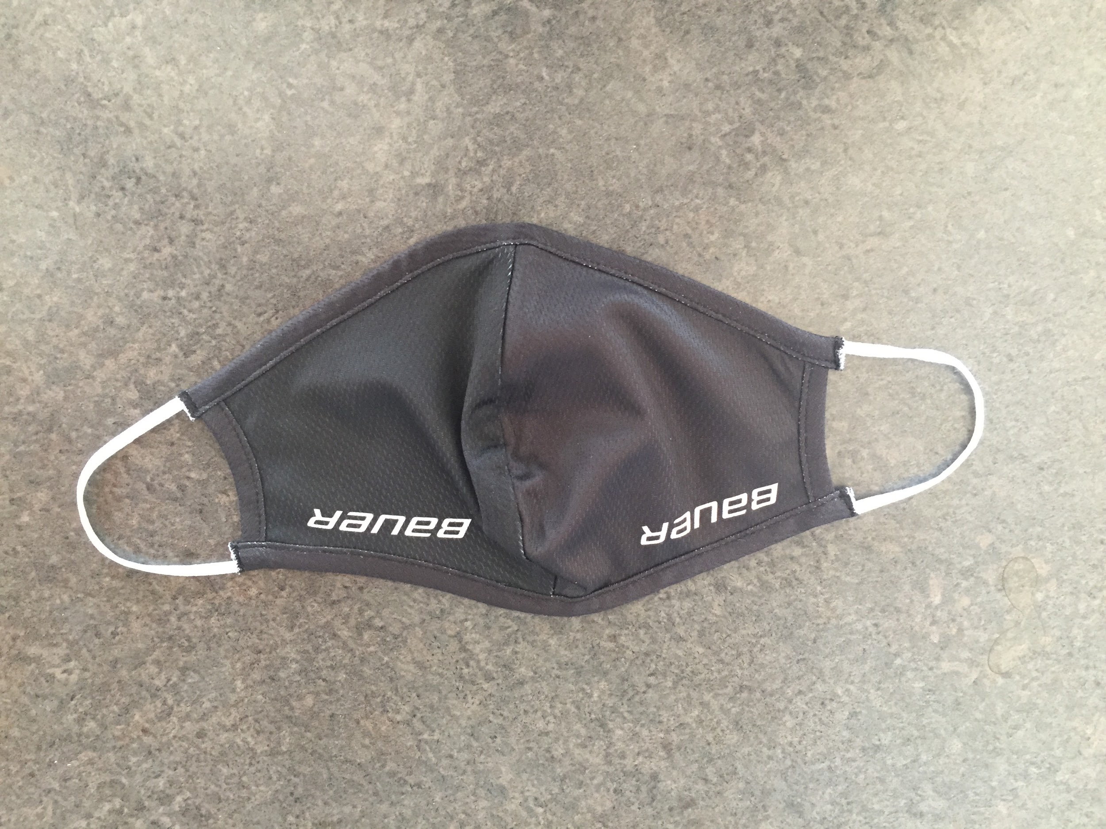
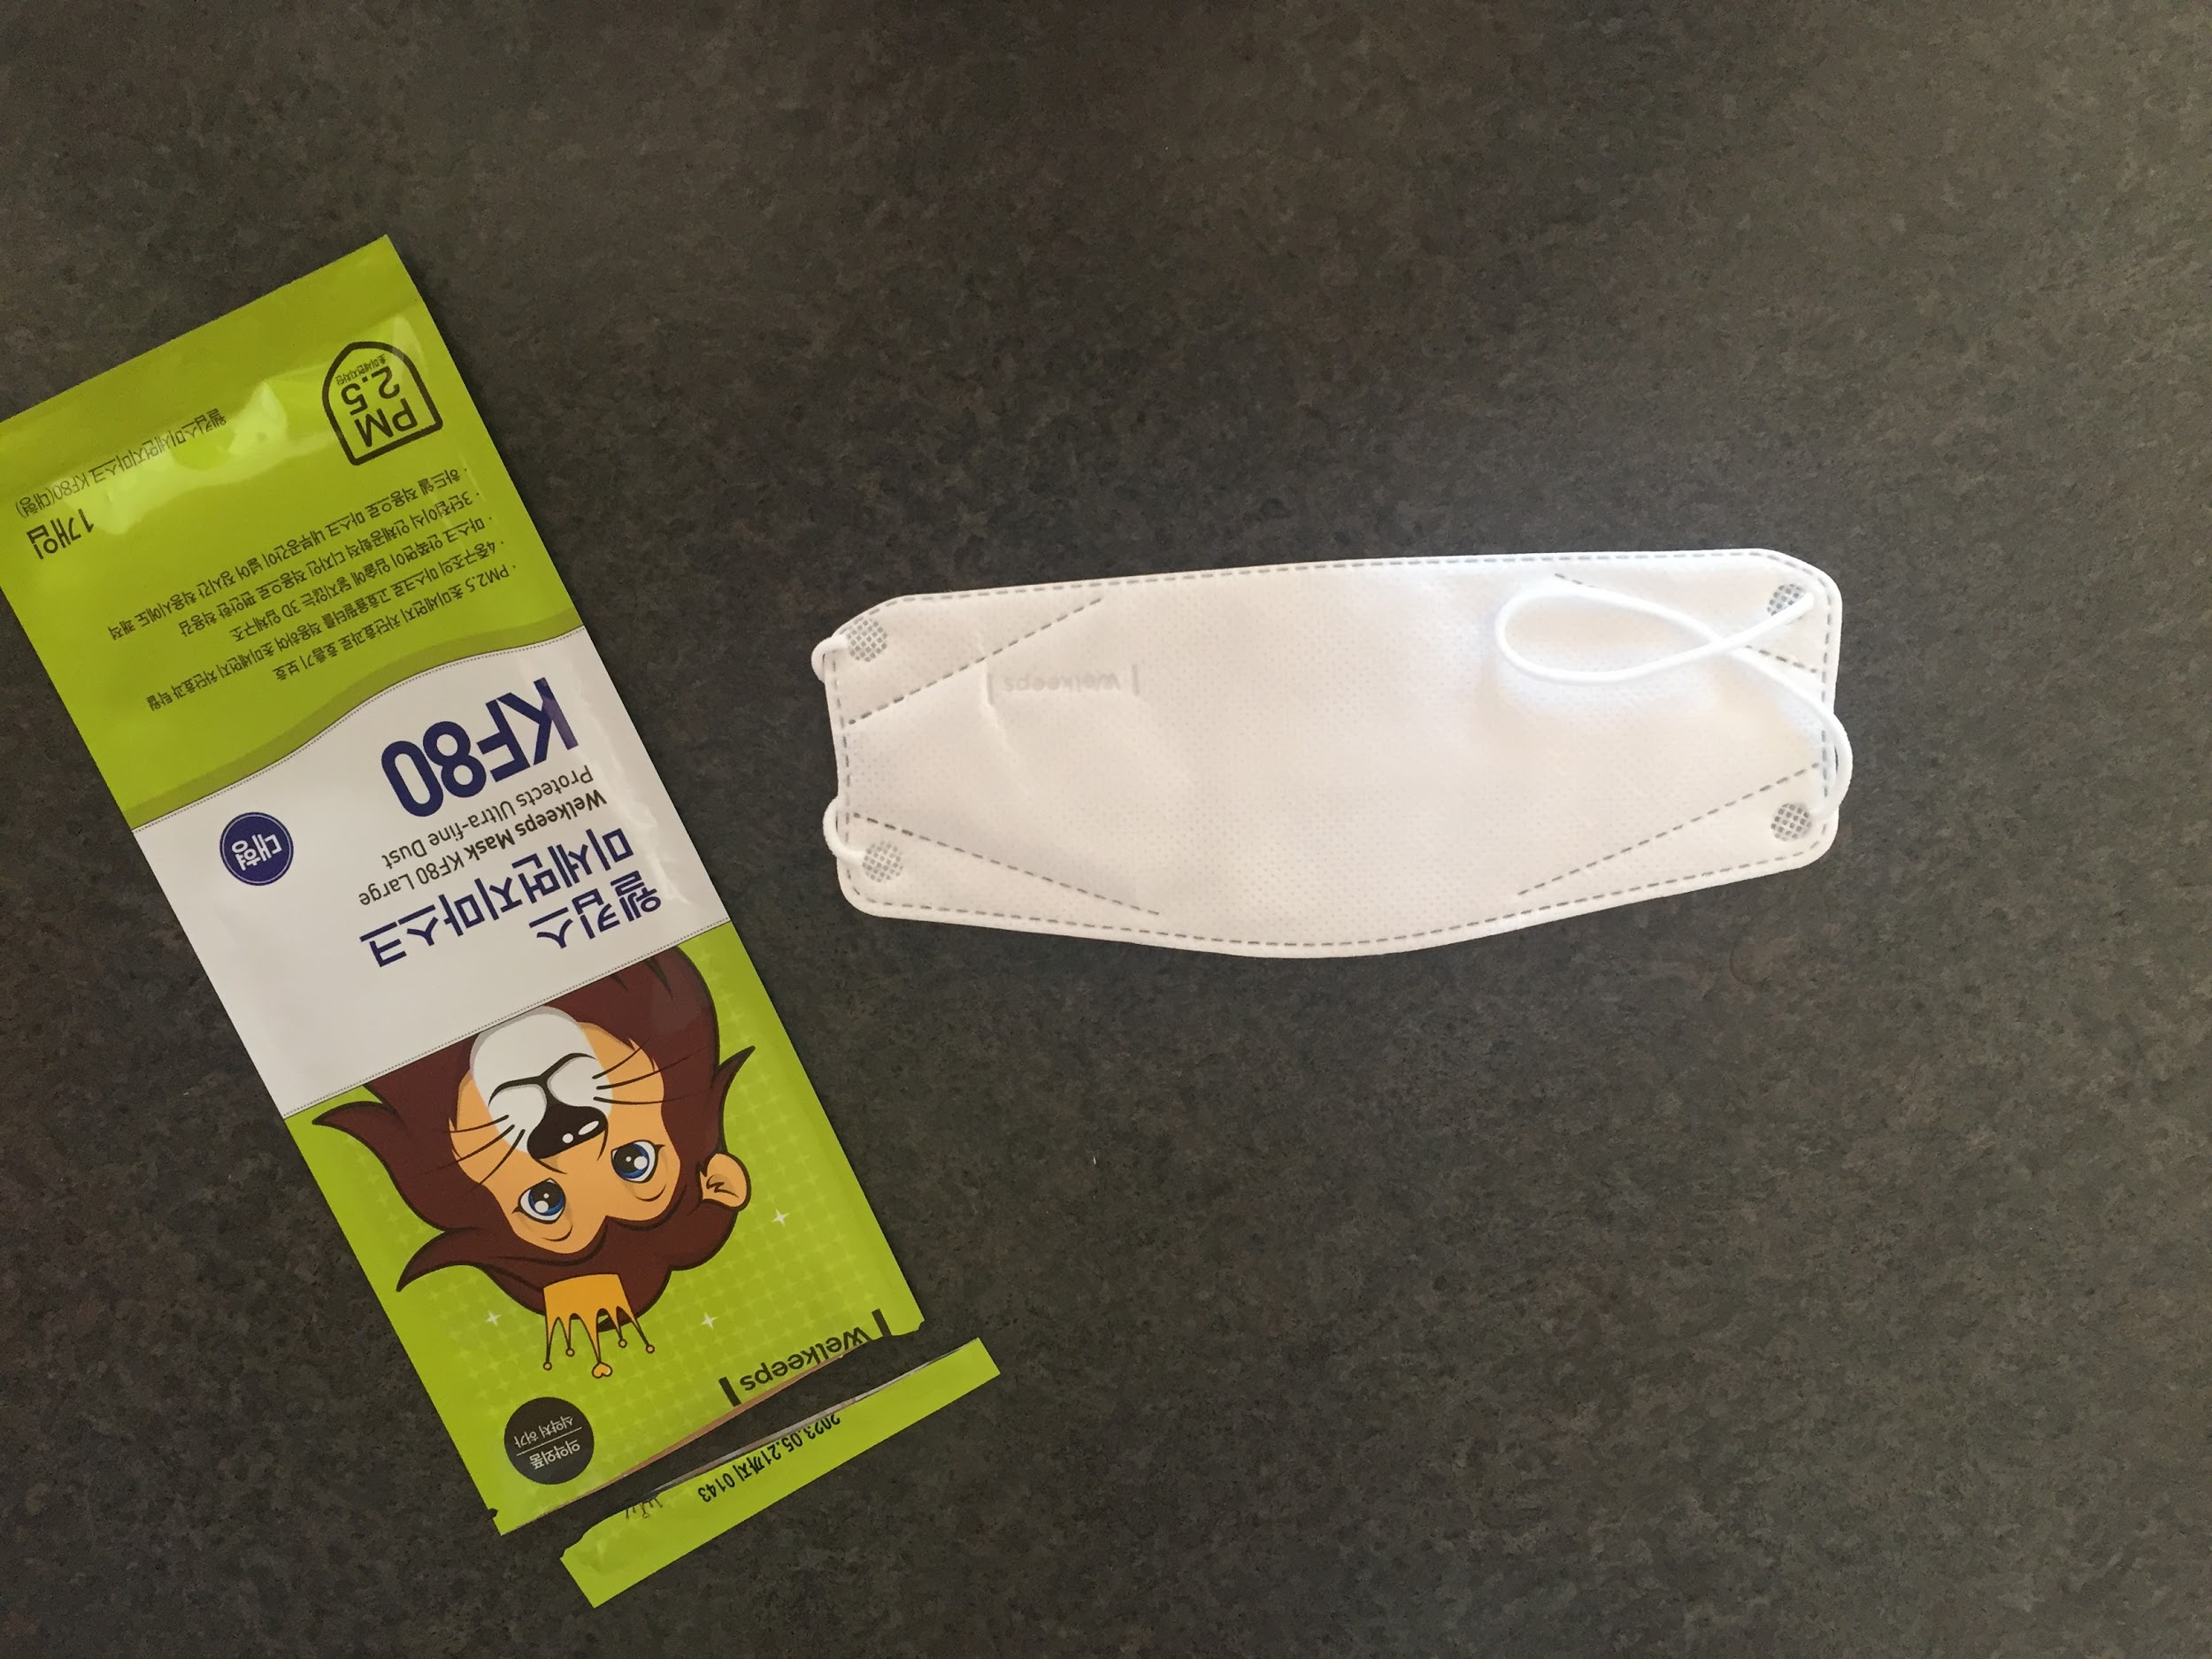
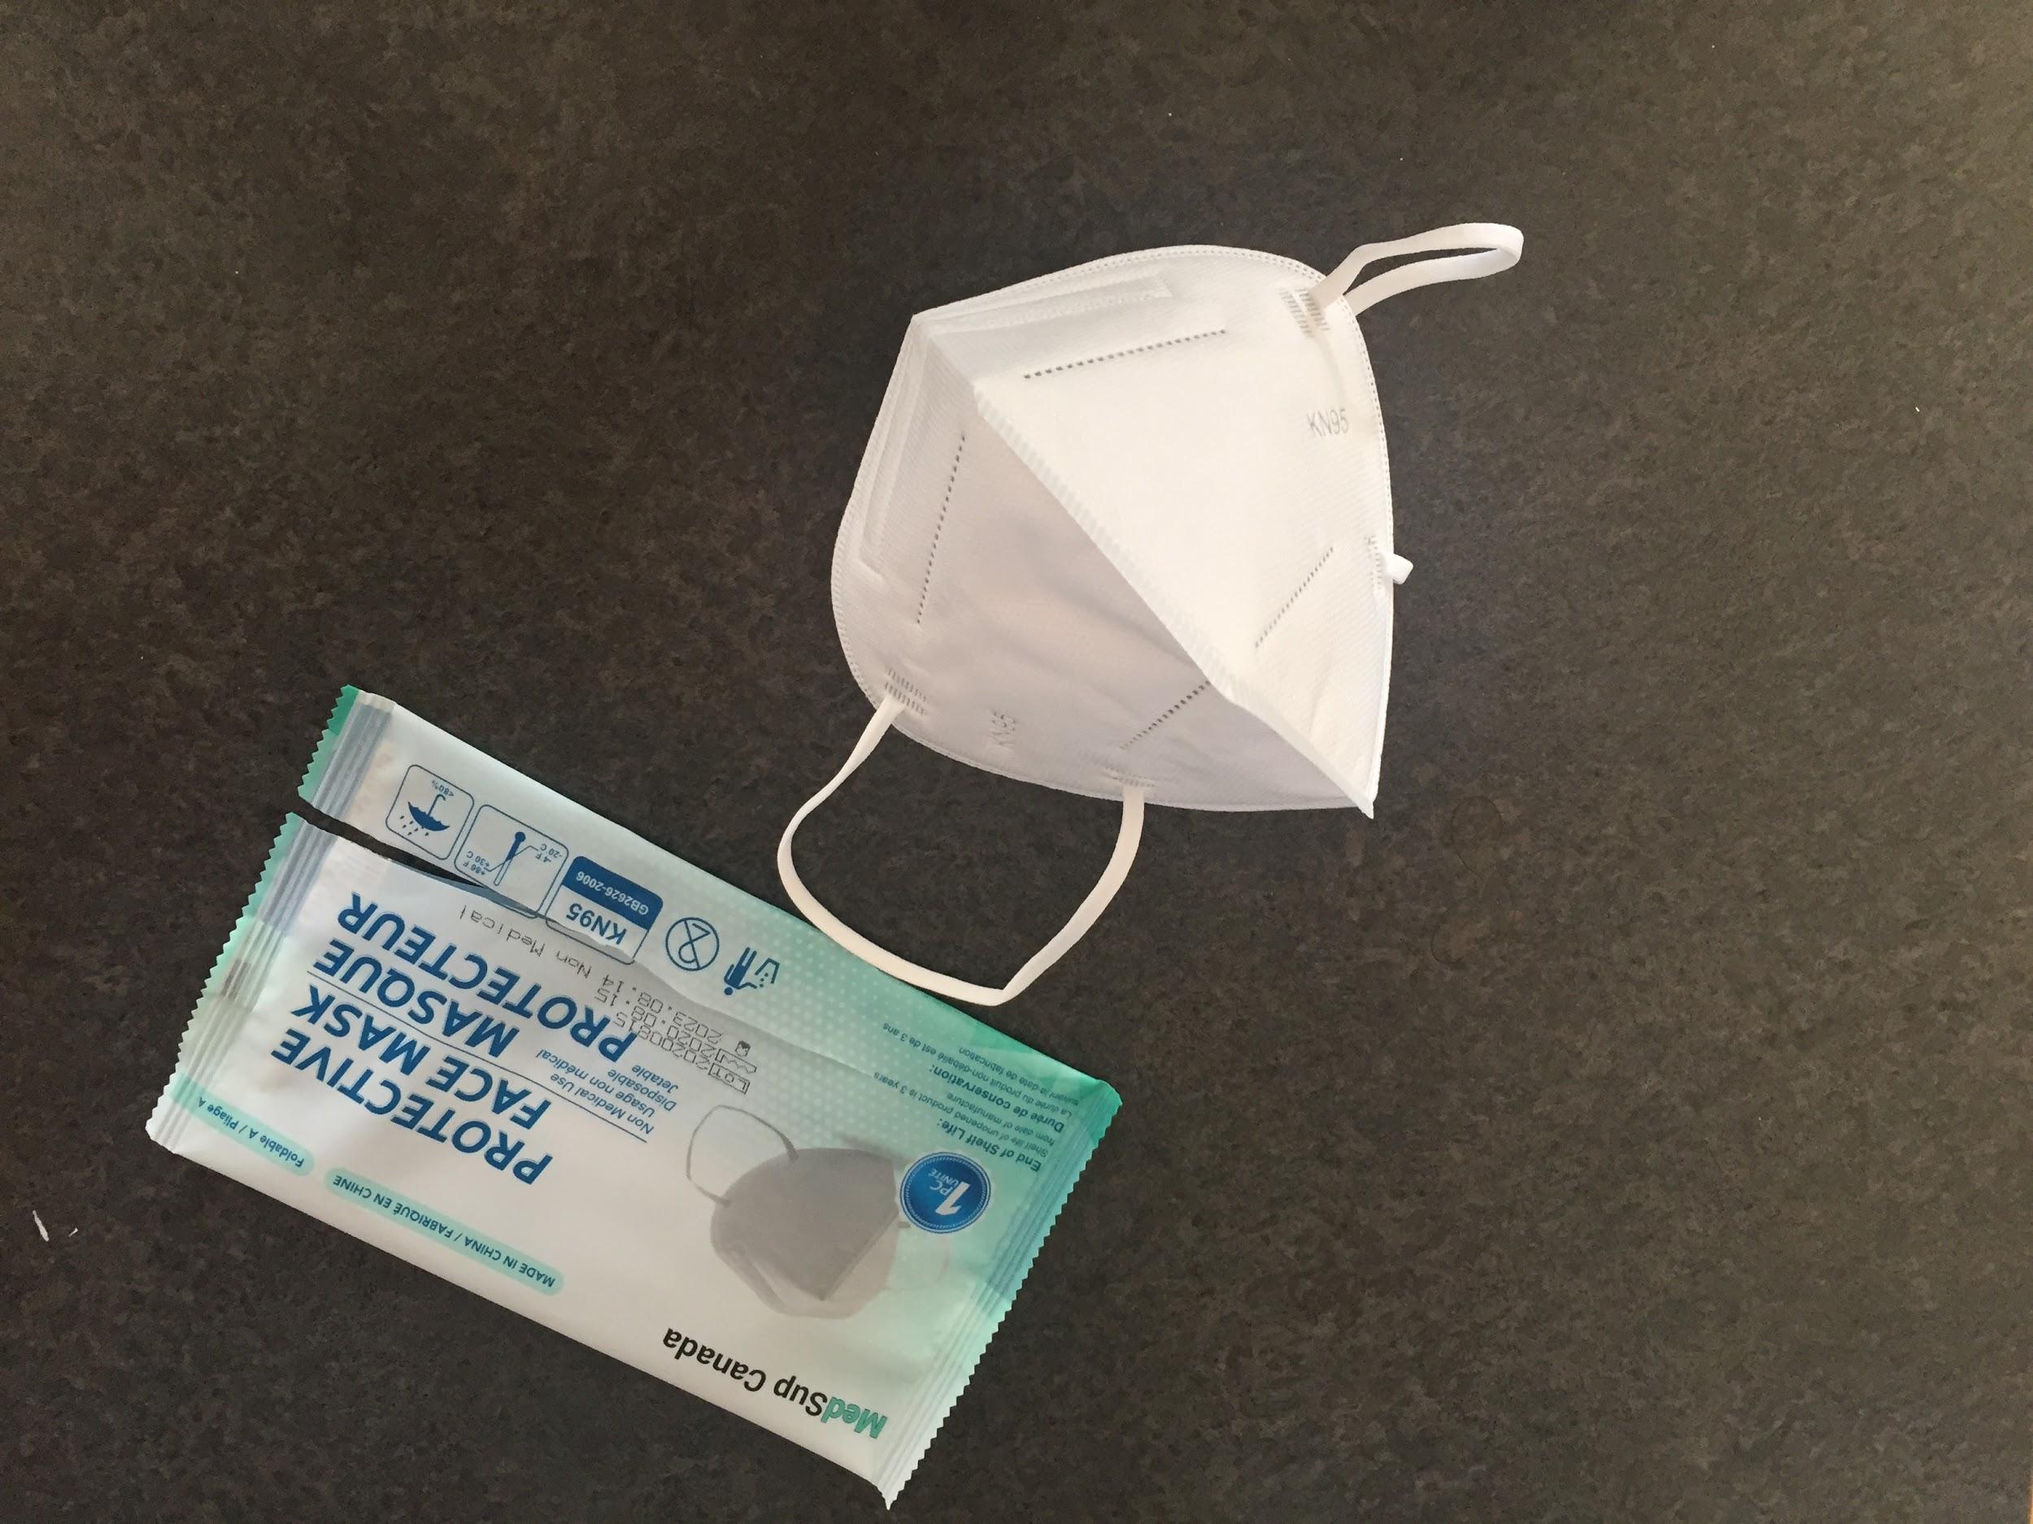
Masks - Background Information
Masks Used in my Experiments:
Dental Mask (Brand: Boomcare)
Cloth Mask (Brand: Bauer)
KF94 Mask (Brand: P&B)
KF80 Mask (Brand: Welkeeps)
KN95 Mask (Brand: Medsup Canada)
Country Designed by
% of Particles Filtered
KN=China
KF=South Korea
Notes:
Complete

Slide 4
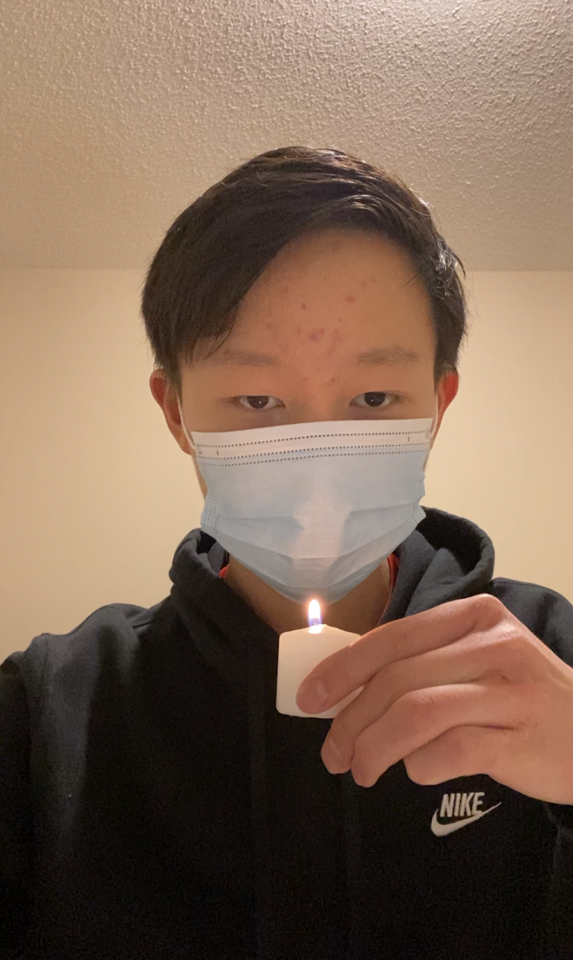
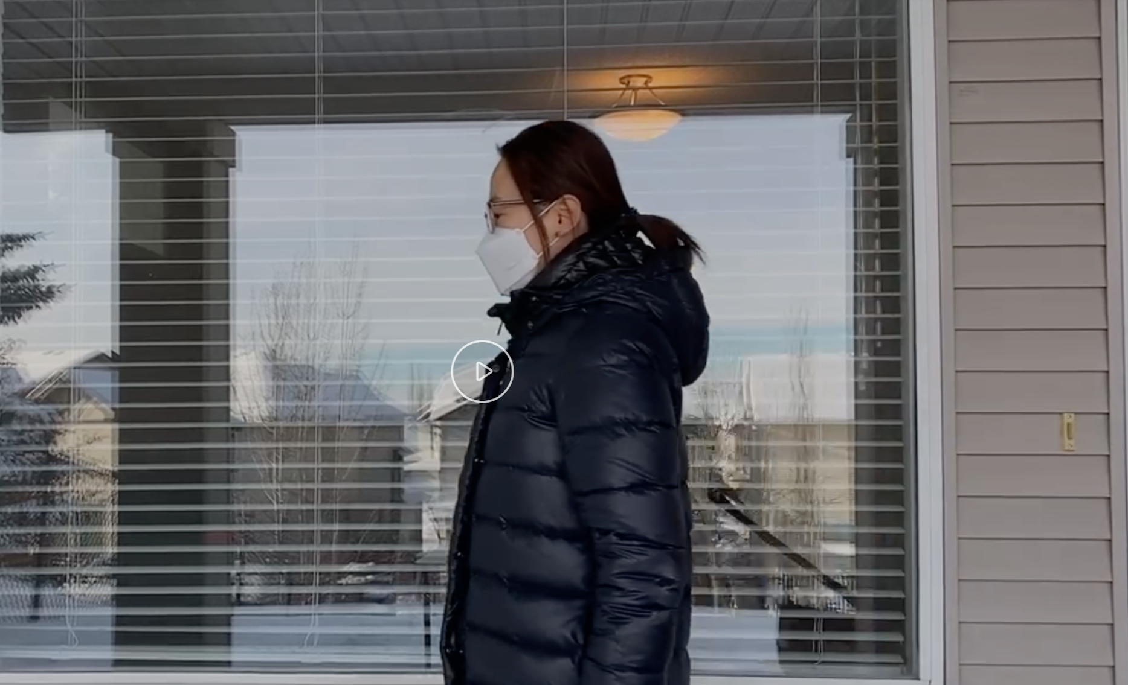
Experiments
Experiment 1 - Safety - Blowing a candle out while wearing mask
Experiment 2 - Safety - Using mask to filter water
Experiment 3 - Comfort - The fogging on glasses caused by wearing a mask
Research
Notes:
Complete

Slide 5
Overall Scientific Question and Hypothesis
Scientific Question: How does the type and design of a mask that is worn affect the wearer’s safety, comfort, and financial choice of masks?
Hypothesis:
- KF94 will perform the best
- Cloth mask will perform the poorest
Notes:
Complete

Slide 6
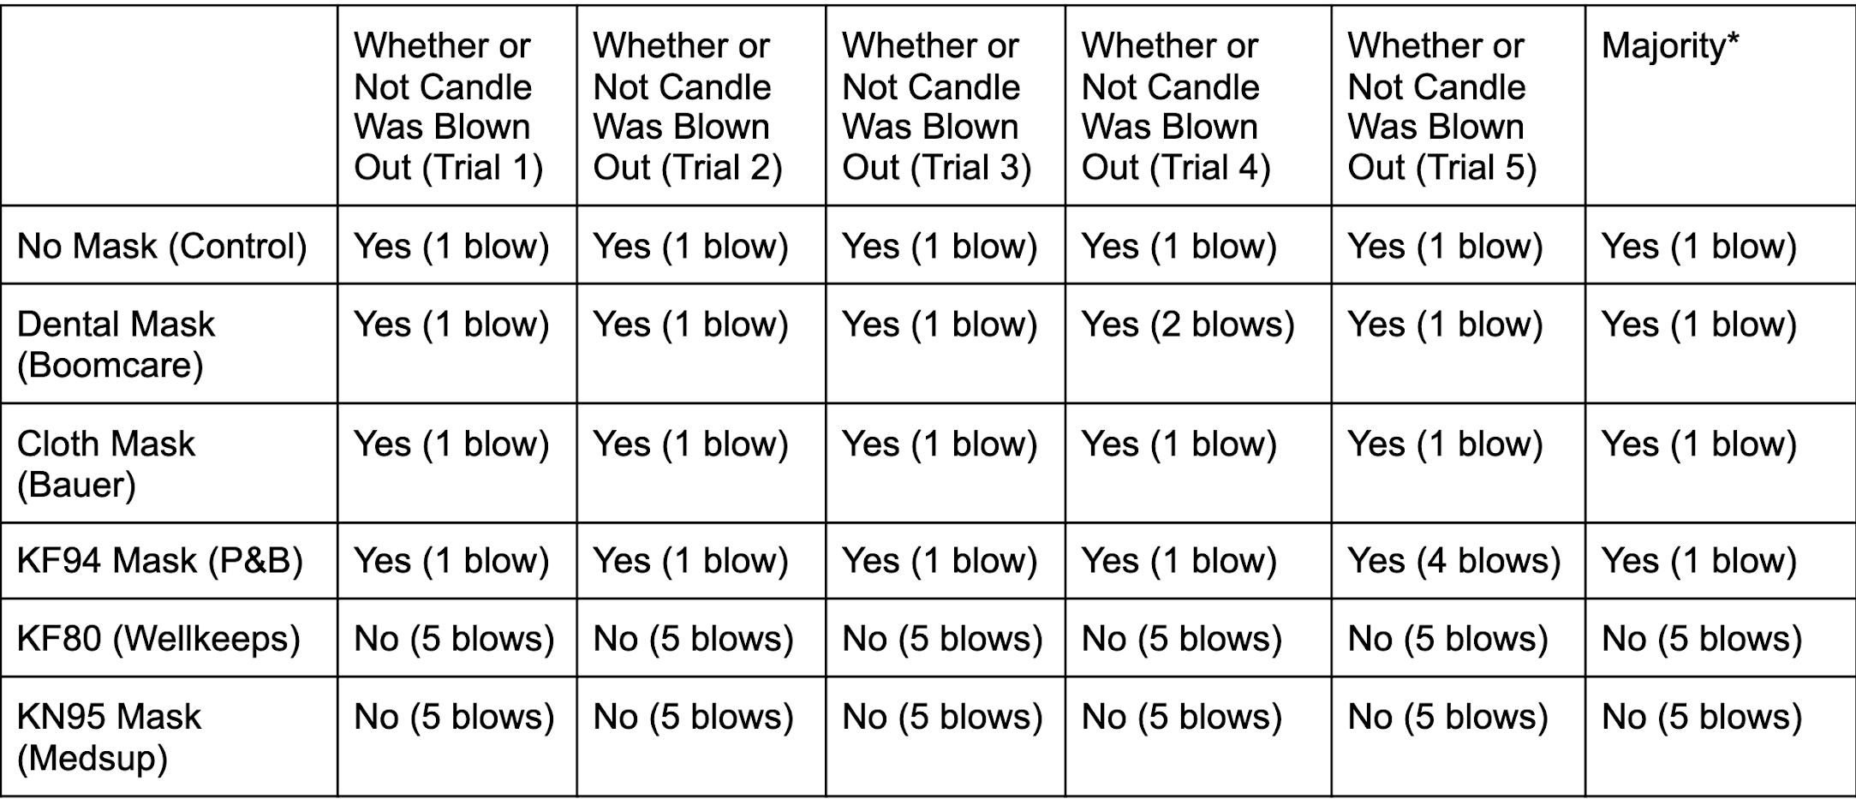
Experiment 1
Ranked
KF80 and KN95
KF94
Dental
Cloth
Notes:
Complete

Slide 7
Experiment 2
Outside Facing Up
Inside Facing Up
Ranked:
Dental and KF94 and KF80 and KN95
Cloth

Slide 8
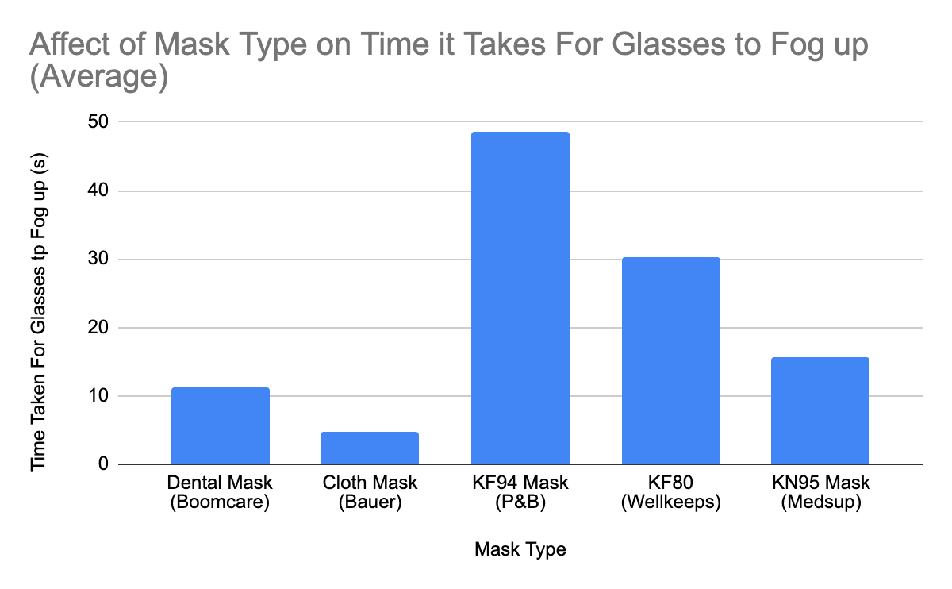
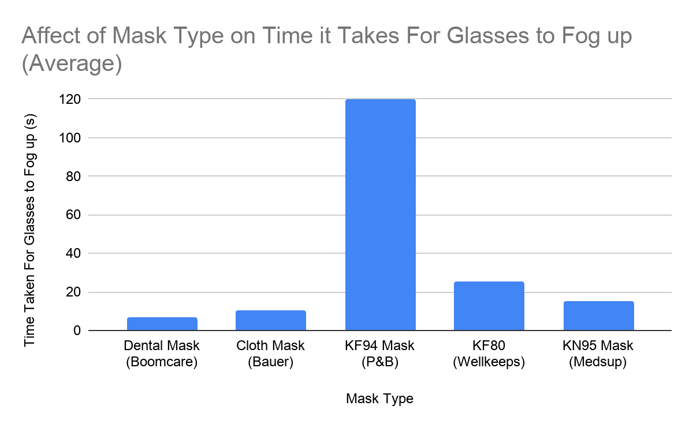
Experiment 3
-17°C
0°C
Ranked
KF94
KF80
KN95
Dental
Cloth

Slide 9
Overall Conclusion
Best Mask: KF80 Mask
Least Successful Mask: Cloth Mask
Overall Ranking:
KF80 Mask, KN95 Mask, KF94 Mask, Dental Mask, Cloth Mask
Most Ideal Mask Design:
Comparison with Other Studies:

Slide 10
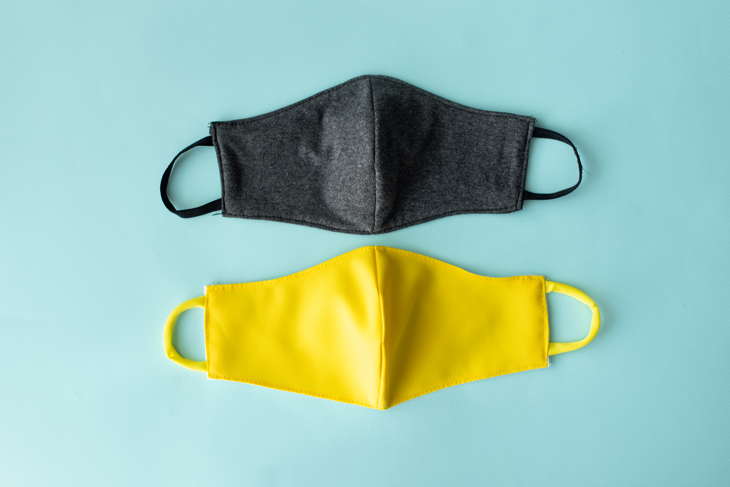
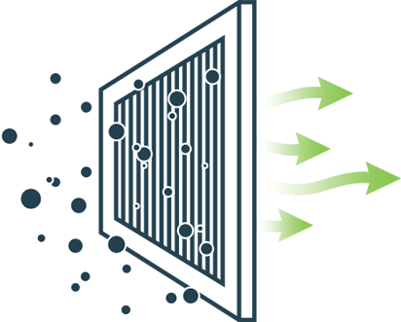
Real World Application
“What mask should I wear?”
Many rely on cloth masks - debunks this belief
New mask development for future diseases
Filter Development
Support for other studies

Slide 11
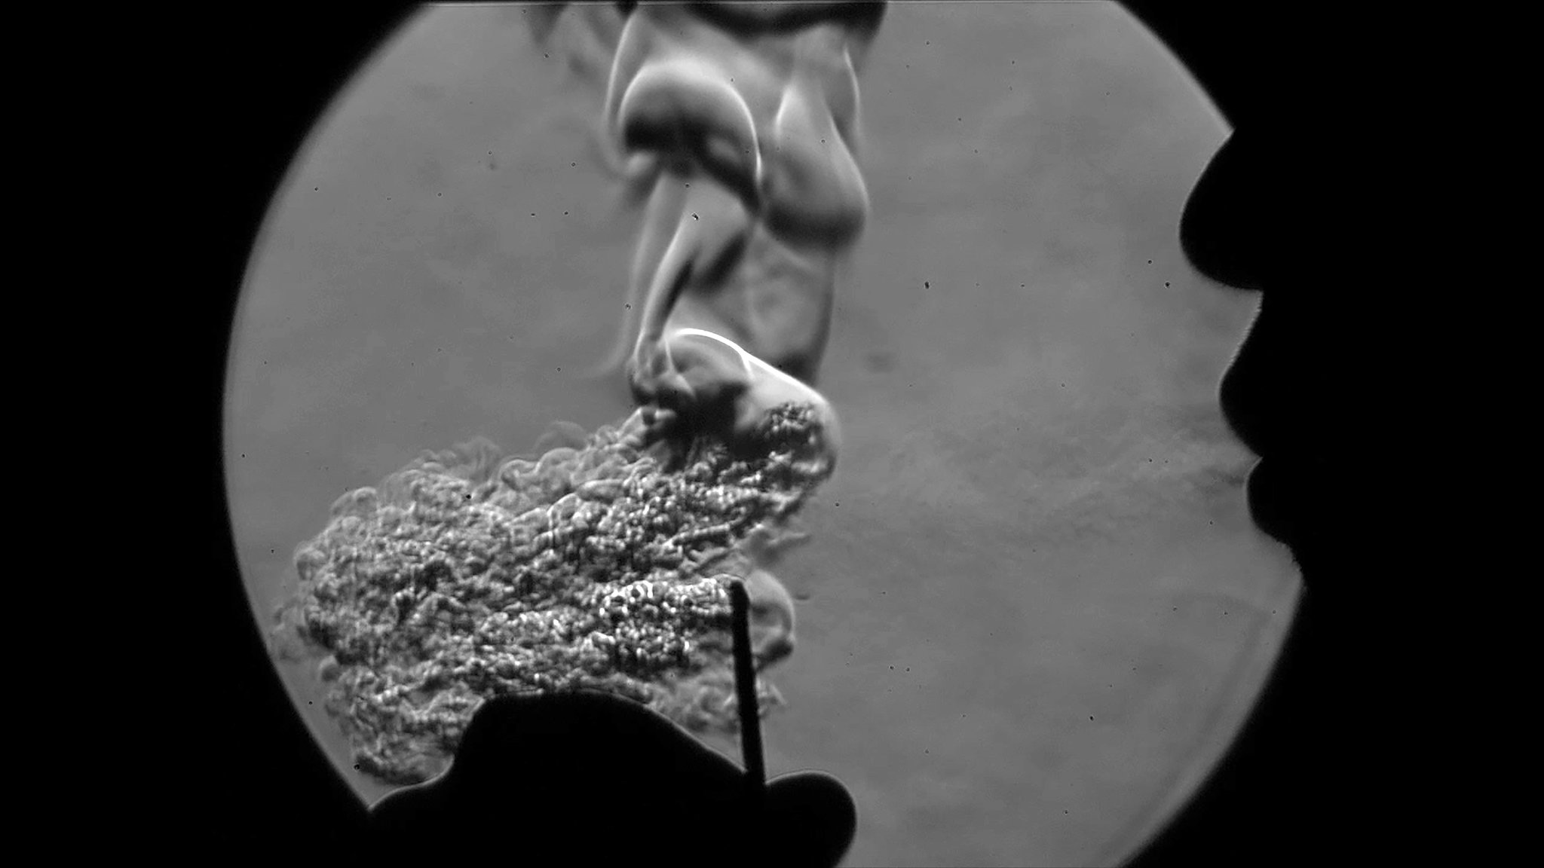
Improvements
Expanding the types of masks tested
Expanding factors of mask design
Adjusting and creating experiments to have more specific data

Slide 12
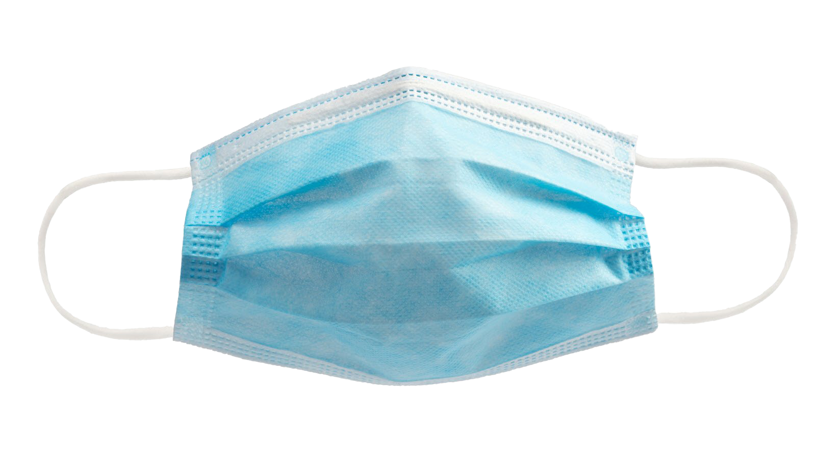
Thank You For Listening
Thank You to Webber Academy for Providing Me With This Opportunity

