Slide 1
How did

Slide 2
Water

Slide 3
Get on

Slide 4
Earth

Slide 5
By: Kean Nguyen

Slide 6
Introduction

Slide 7
Introduction
When you drink water, do you ever think where water comes from?
Do you ever wonder if the water you drink comes from space?
My science fair project is:
How did water get on Earth?

Slide 8
What is water?
Water is a molecule composed of hydrogen and oxygen. Water is chemically called H₂O. This means there are two hydrogen molecules (H₂) and one oxygen molecule (O). Water is a very special molecule because all life needs it. However, where did water come from? There are a few theories on how water got on Earth.

Slide 9
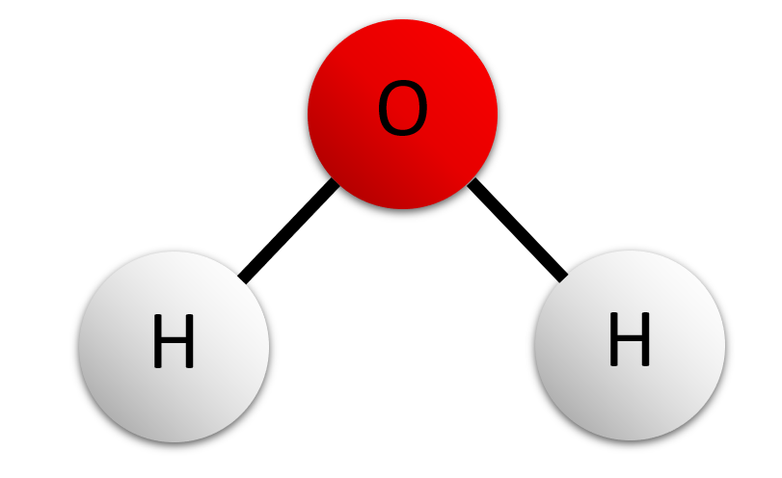
Short term memory!
Coffee

Slide 10
Why does life need water?
Life needs water because water helps dissolve important nutrients and move them to your cells. It can dissolve more compounds than any other liquid. This means it is a universal solvent. It is like this because the hydrogen side of water is a positive electrical charge and the oxygen side is a negative charge. This means that positive or negative atoms can still be attracted atoms with a charge (some atoms called neutral atoms don’t have charges). It also helps remove toxins from your body.

Slide 11
Purpose
Scientists have been thinking about this question for a while but still do not know the answer. I am researching this topic because it is fascinating and cool to research. I will also learn a lot. It is also important to research because then people will know how water got on exoplanets. I want to see how some planets have water. I also have some experience on this topic because I know why water is important for life.

Slide 12
Hypothesis
My hypothesis is that water got on Earth from asteroids that had water. This is because most asteroids are composed of ice that could have melted on the impact. The asteroids also crashed a lot a long time ago. Because this happened, I think the theory is a very likely one.

Slide 13
Research

Slide 14
Water on exoplanets
Scientists know how water is on other planets by using a technique called spectroscopy. Spectroscopy works by seeing what wavelengths molecules absorb. A wavelength is the distance between a crest and the next nearest one. The next step in spectroscopy is to see if there is a strong absorption of that specific wavelength.
E.g.: To see if water is on an exoplanet, we check if there is a strong absorption of infrared wavelengths; which water absorbs.

Slide 15
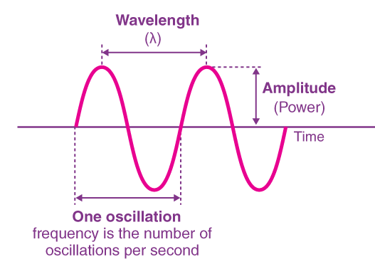

Slide 16
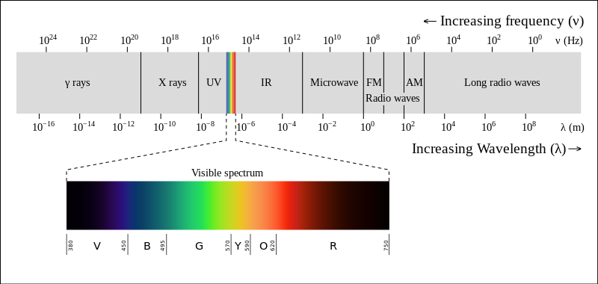

Slide 17
Research
Habitable zone
Another reason why we have water on Earth is because we are in the habitable zone. If we were in the back of the solar system and watery asteroids crashed into the planet, the water would just freeze and would be useless. If the watery asteroids crashed into Mercury, it would melt and that would not help life. We are in a special spot in the solar system where water is a liquid, which is useful for life. We also are in a special type of habitable zone. The CHZ is a continuously habitable zone. It is a place where water can exist for long periods of time.

Slide 18
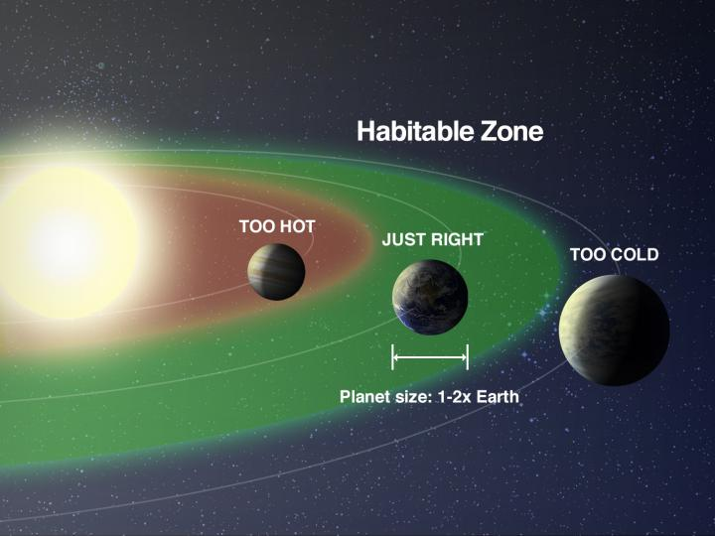

Slide 19
Research
Theia
Theia was the planetoid that crashed into the Earth to form the moon. The pieces that got off the planetoid formed the moon. When it crashed, it could have given the Earth some of its water if it had some. There is another piece of evidence too. The composition of the mantle and the crust come from the outer solar system. People know this because they check it with where the element molybdenum came from.

Slide 20
Research
Theia cont.
The molybdenum from the mantle came from the collision with Theia. The results also showed that the elements came from the outer solar system. This means Theia came from there. Everything that comes from the Kuiper belt has ice on it. When Theia crashed into the Earth, the ice could have melted and given Earth water.

Slide 21
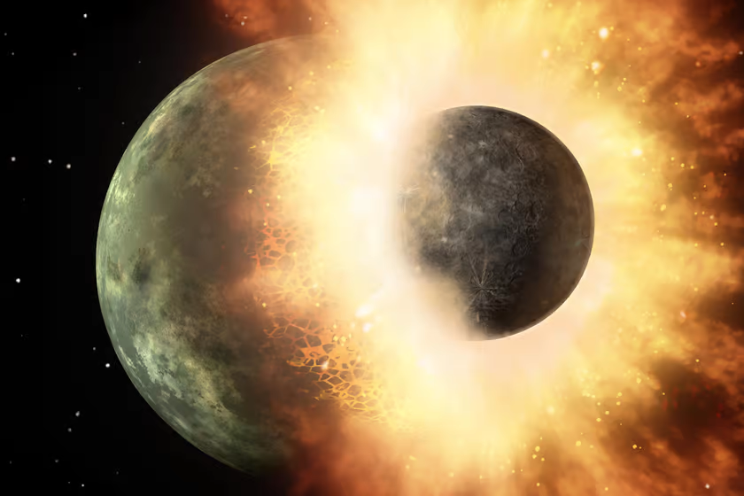

Slide 22
Research
Planetesimals
Another way water could have gotten on Earth is from planetesimals. Planetesimals are water-rich objects. These objects could have been asteroids or comets. They could have been made in the outer solar nebula of the early solar system where there was a lot of water ice. Then they could have crashed into the Earth. The heat of the crash would have melted the ice resulting in water.

Slide 23
Research
Planetesimals cont.
Comets:
The possibility of comets bringing water to us was later ruled out because comets had a different amount of deuterium in them than the oceans. Scientists now say that comets did not bring water to the Earth because of this. There is a small exception though. Water from certain types of comets DO have the same amount of deuterium as the Earth’s ocean. These comets would have to travel very far to get to Earth. Even if they could get here, simulations show that these comets would only have made up 6% of Earth’s water.

Slide 24
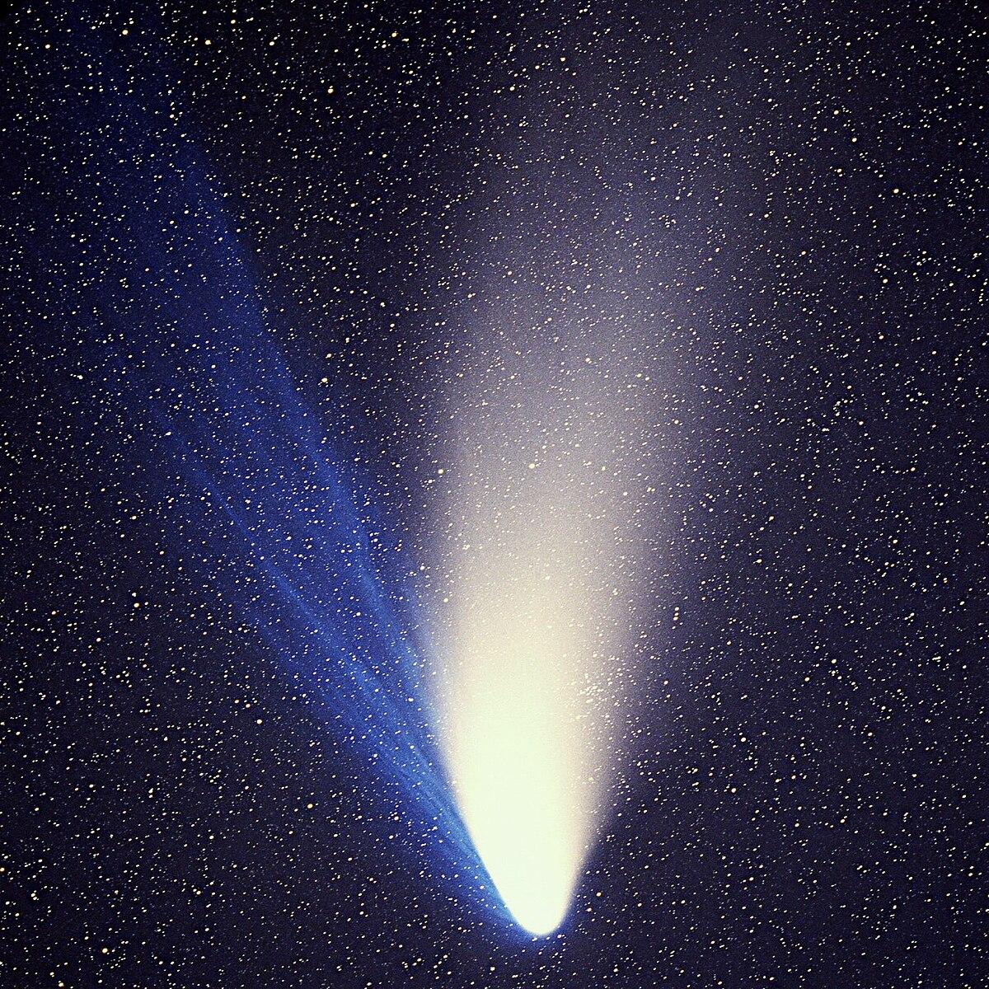

Slide 25
Research
Planetesimals cont.
Asteroids:
There have been at least 190 asteroid/comet impacts that have hit the Earth. The scientists found this number by scanning all the craters in the world. There is very likely to be more because the Earth’s surface is changing all the time and the craters would have disappeared. All or most of them could have carried water to the Earth. There also could have been smaller asteroids that could have given water to the Earth.
The evidence for the asteroid theory is that the amount of deuterium in our water is the same as the asteroids.

Slide 26
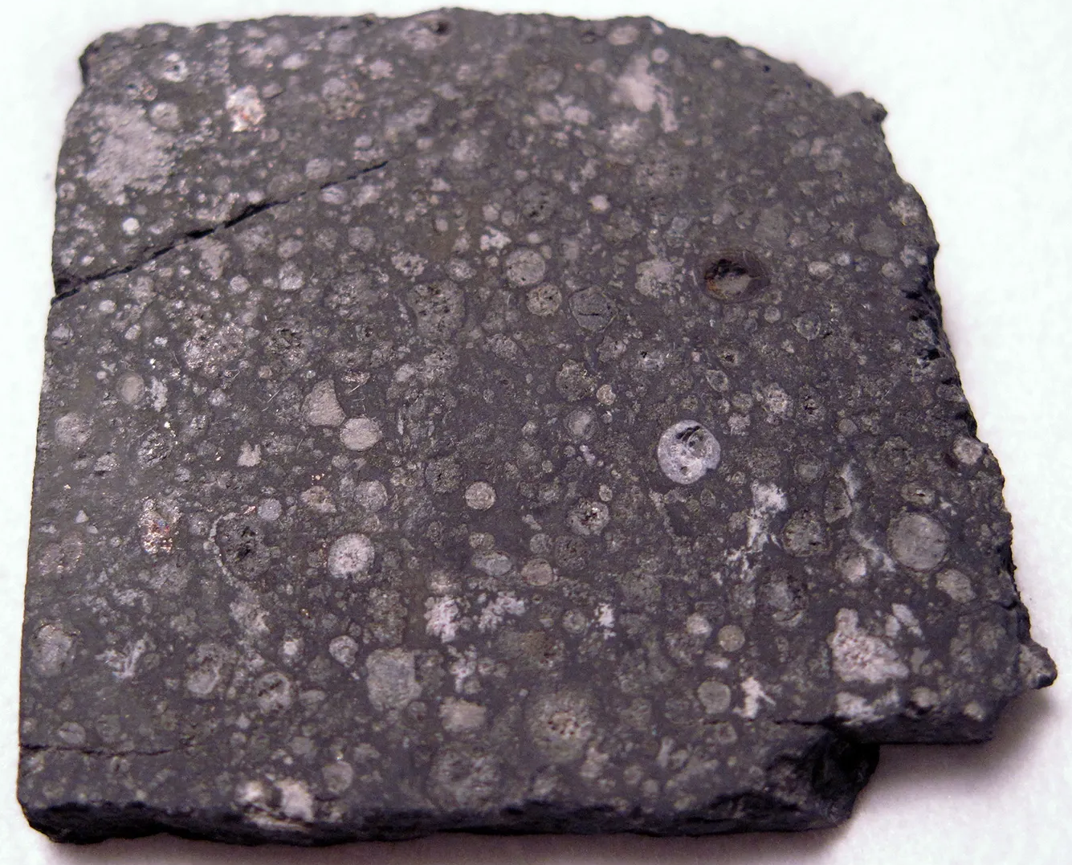

Slide 27
Research
Stars
A way water could have been made is from stars. Inside stars, a reaction called nucleosynthesis of nuclear fusion happens. This means making heavier elements from lighter ones. The two elements needed for water, hydrogen and oxygen are made in nucleosynthesis. When the stars explode, they release all the elements. When the oxygen and hydrogen react, they can become water or hydrogen peroxide. Hydrogen peroxide is the thing you have in your first aid kit to disinfect wounds. It can become oxygen and water if it is heated because it is very unstable.

Slide 28
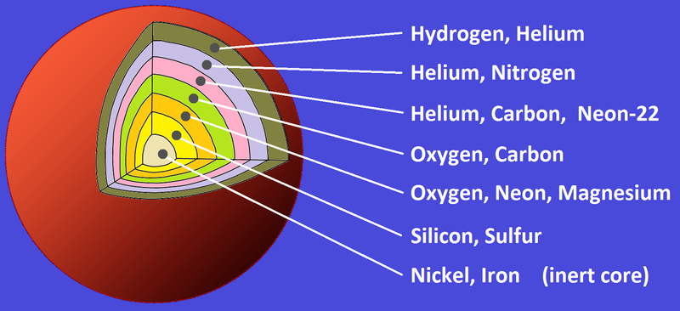

Slide 29
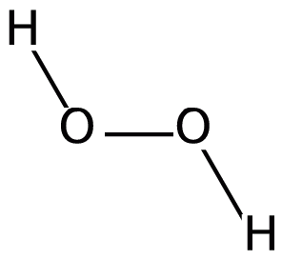

Slide 30
Research
Stars cont.
How water from stars gets to the Earth:
The water that came from the star would get to Earth through asteroids. The water could have gone to the asteroid and taken a ride on it. Another way water molecules could have gotten to the Earth is by floating through space. The molecules could have bombarded the Earth and given it water. This is different from asteroids and comets because they also have deliver water much more slowly. The water molecules would have to this for billions of years to get some water.This is basically comets because comets are balls of snow.

Slide 31
Research
Volcanic outgassing
One way water could have gotten out of the Earth is that the rocks that made up the Earth might have had water in them. The water might have gone up by volcanoes along with the magma. The water vapor could have gone into the atmosphere condensing then raining down as rain.

Slide 32
Conclusion

Slide 33
Findings
The different ways water got on Earth are:
Volcanic outgassing from the water inside the Earth.
Planetesimals that crashed into the Earth and gave it water.
Stars that exploded gave new elements that made water; some went to the Earth
Theia gave water to the Earth.
Any combination of the theories might have given the Earth water.

Slide 34
Conclusion
In conclusion, stars, volcanic outgassing, planetesimals, and Theia might have given us water, or any combination of them might have given the Earth water. My hypothesis was included in the results and I still think that it is the most likely way water could have gotten on the Earth because there were many asteroid bombardments in Earth’s history. I also think this is the theory because we know a lot about it and a lot of the evidence is pointing toward this theory.
This topic was very fun to research. I learned many new things doing this.

Slide 35
Future Research
The next topic I want to research would be where oxygen came from. I read in a book that water made oxygen because there were special bacteria which do photosynthesis to make oxygen. Photosynthesis requires water to produce oxygen.

Slide 36
Glossary
Molecules: A substance that is made from atoms.
Planetesimals: A water-rich celestial object.
Planetoid: A small body like a planet.
Asteroid: A rocky celestial body made of rock or metal that orbits the sun.
Carbonaceous chondrite meteorites: A rich carbon meteoric stone with spheroidal mineral grains.

Slide 37
References
Davis, J. (2023). How did Earth get its water?. The Planetary Society. https://www.planetary.org/articles/how-did-earth-get-its-water#:~:text=There%20are%20numerous%20theories%20about,here%20after%20the%20planet's%20formation.
Kershner, K. (n.d.). Can we detect water on water on exoplanets?. HowStuffWorks. Retrieved: Jan 15, 2024, from https://science.howstuffworks.com/detect-water-exoplanets.htm
Remple, A. (2022). How many asteroids have hit the Earth?. WorldAtlas. https://www.worldatlas.com/space/how-many-asteroids-have-hit-earth.html
Alexander, C. (2021). Where did Earth’s water come from?. Carnegie Science. https://epl.carnegiescience.edu/news/where-did-earths-water-come
Angelich, A. (n.d.). Animation of Stellar Nucleosynthesis Inside A Red Giant. [Photograph]. National Radio Astronomy Observation. Retrieved Jan 3, 2024, from https://public.nrao.edu/gallery/animation-of-stellar-nucleosynthesis-inside-a-red-giant/
Where did Earth’s water come from?. (2016). Where did Earth’s water come from?. [Video]. TED-Ed. https://www.youtube.com/watch?v=RwtO04EXgUE
How Did Earth Get Its Water?. (2017). How Did Earth Get Its Water?. [Video]. SciShow Space. https://www.youtube.com/watch?v=_Y-XUAKTAkE

Slide 38
References
Did Earth’s First Water Come from Comets, Volcanoes or Asteroids?. (2023). EarthHow. https://earthhow.com/origin-of-water-comets-volcanoes-outgassing/#:~:text=The%203%20main%20theories%20for,ice%20transported%20water%20to%20Earth.
Dinh, K. (2022). Ball and stick model of water molecule labelled with element symbol. [Photograph]. Wikipedia. https://commons.wikimedia.org/wiki/File:Water_Molecule_Ball_and_Stick.png
Merriam-Webster. (n.d.). Retrieved: Dec 29, 2023, from https://www.merriam-webster.com/
Alexander, C. M.O'D. (2013, August 6). chondrite. Encyclopedia Britannica. https://www.britannica.com/science/chondrite
Thirsty? Have a comet!. (2019). NASA SpacePlace. https://spaceplace.nasa.gov/comet-ocean/en/
Cutaway diagram of massive star pre-collapse based on a tracing of Public Domain NASA diagram Nucleosynthesis in a star.gif pinned key version. (2011). [Photograph]. Wikipedia. https://en.wikipedia.org/wiki/File:Massive_star_cutaway_pre-collapse_(pinned).png
Where Did Earth’s Water Come From?. (2023). Wonderopolis. https://www.wonderopolis.org/wonder/Where-Did-Earth%E2%80%99s-Water-Come-From#:~:text=In%20the%20early%20years%20of,give%20Earth%20so%20much%20water.
Hydrogen Peroxide Found in Space. (2011). Retrieved: Jan 5, 2024, from https://www.eso.org/public/news/eso1123/

Slide 39
References
High mass star. (n.d.). Retrieved: Jan 2, 2024, from https://lco.global/spacebook/stars/high-mass-star/#:~:text=Then%20unlike%20low%20mass%20stars,oxygen%20into%20silicon%2C%20then%20iron.
Atteberry, J. (2010). Why is water vital to life?. Howstuffworks. https://science.howstuffworks.com/environmental/earth/geophysics/water-vital-to-life.htm
Tillman, N. (2017). The Late Heavy Bombardment: A Violent Assault on Young Earth. SPACE.com. https://www.space.com/36661-late-heavy-bombardment.htm
Nelson, A. (n.d.). Picture of hydrogen peroxide. [Photograph]. LAB ALLEY. Retrieved: Feb 8, 2024, from https://www.laballey.com/pages/industrial-uses-of-hydrogen-peroxide
Choi, C. (2022). How did Earth get its water?. Moon rock suggest is might have been here all along. SPACE.com. https://www.space.com/earth-water-origins-studied-moon-rocks
A NASA graphic showing an Earth-sized planet inside, within, and outside of the habitable zone around a star. (n.d.). Retrieved: Feb 12, 2024, from https://www.eurekalert.org/multimedia/540386
Szondy, D. (2015). Artist's impression of Theia colliding with Earth. [Photograph]. News Atlas. https://newatlas.com/moon-origin-umd/37065/
Szondy, D. (2019). Most of Earth's water came from a cosmic collision that formed the Moon. NEWS ATLAS. https://newatlas.com/earth-water-moon-collision/59782/

Slide 40
References
Delsemme, Armand H. and Weissman, Paul. (2024). comet. Encyclopedia Britannica, https://www.britannica.com/science/comet-astronomy.
Ghose, T. (2015). Why Is Water So Essential for Life?. LIVESCIENCE.
https://www.livescience.com/52332-why-is-water-needed-for-life.html
Water Science School. (2018). Water, the Universal Solvent. USGS. https://www.usgs.gov/special-topics/water-science-school/science/water-universal-solvent#:~:text=Water%20is%20called%20the%20%22universal,chemicals%2C%20minerals%2C%20and%20nutrients.
David, J. E. (2013). COMETS! VISITORS FROM DEEP SPACE. Comets. Google Books. https://www.google.ca/books/edition/COMETS/Ud2aAAAAQBAJ?hl=en&gbpv=1&dq=origin,+water,+asteroid,+comet+asteroid+-clean+-purifying&pg=PA139&printsec=frontcover
Wave. (n.d.). [Photograph]. Byjus. Retrieved: Feb 12, 2024, from https://byjus.com/physics/waves/
Alexander C. (2017). Piece of the Allende meteorite, which is classified as a carbonaceous chondrite. [Photograph]. Encyclopedia Britannica. https://www.britannica.com/science/carbonaceous-chondrite
Hand, K. (2020). Alien Oceans: A Search for Life in the Depths of Space. Princeton University Press.

Slide 41
Figure 1. A water molecule composing of hydrogen and oxygen.
Figure 2. A wave
Figure 3. A light scale; water absorbs microwave really well.
Figure 4. A habitable zone
Figure 5. Artist impression of Theia.
Figure 6. A comet
Figure 7. A carbonaceous chondrite meteorite.
Figure 8. Nucleosynthesis
Figure 9. A hydrogen peroxide molecule. It is made of hydrogen & oxygen. The H₂O could have broken off and left the oxygen, the two most important elements needed for life.

