Slide 1
Structural Stability & Soil Liquefaction during Earthquakes
Experiment with different structures and surfaces
Presented By:
Yugam Bansal (5th Grade - Mrs.Rushton’s Class)

Slide 2
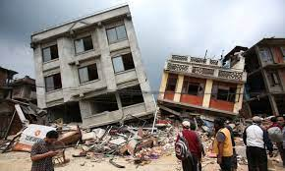
Problem - Why am I doing this project?
Earthquakes happen all around the world. A lot of people survive but many die due to collapsing and sinking buildings.
People are terrified of this deadly phenomenon and moved to countries which are less prone to earthquakes.
A good building structure and foundation can result in less damage to buildings during an earthquake.
I have experimented with different building structures and ground material to understand their impact during an earthquake.
This image is a picture of a building collapsing and sinking due to an earthquake

Slide 3
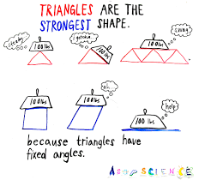
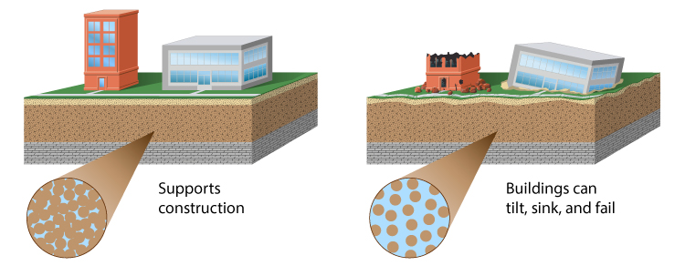
Background Research
Triangles are the strongest shape in geometry because when an earthquake occurs and the ground moves one way, the force gets pushed on one of the four triangular sides (like a pyramid) of the building.
For rectangles, the force of the earthquake makes the ground move in one direction causing the force to bend the building in the opposite direction.
In soil liquefaction when an earthquake occurs the ground gets loosened up and due to the large amount of water underneath the surface, it causes the building to sink.
If the ground has less water, a firm surface has a better chance of the building not sinking during an earthquake.

Slide 4
Hypothesis
Based on my background research If I use a triangular building then I think it will withstand an earthquake better than a rectangular building because triangles are the strongest shape in geometry and the force will be easily exerted out of the building.
Based on my understanding I think that if I use a hard surface such as gravel with lesser water content then I think the building (the wooden model house) will have the least amount of chance to sink during an earthquake. On the other hand if I use a softer surface like soil/sand with more water content then there are a higher chances that the earthquake will make the building to sink because soil liquefaction will make the higher content of water rise up in the soft surface making the building to easily sink.

Slide 5
Experimental Variable
STRUCTURAL STABILITY
SOIL LIQUEFACTION
Manipulated variables
Structure shape
Structure base
Responding variable
Which structure withstands an earthquake for a longer period of time
Controlled variables
Same shaker table
Same material that we place the shaker table on
Same bowl and ball on the building
Same stopwatch down to the millisecond
Buildings were built with same material
Manipulated variables
Material put into the container for the ground/foundation
Responding variable
Which type of ground/foundation is best to withstand soil liquefaction during an earthquake
Controlled variables
Same container that I tested in
I used the same model house
I used the same shaker table
Same material we placed the shaker table on
Same amount of time on the timer

Slide 6
Procedure - Structural Stability
First I made the shaker table (representing an earthquake) by putting 2 rubber bands around both sides of 2 cardboard sheets. And I also placed 4-6 balls (harder and bigger makes the earthquake more intense) in between the center of the cardboard sheets.
Then I made three buildings, one was the small base rectangular building, second was the big base rectangular building and third was the big base triangular building. These buildings were made out of plastic straws and connecter pieces.
I placed the small base rectangular building on the shaker table.
For the stability of the building base, I had to put the rubber bands on the shaker table over the base connectors.
Then I put a bowl with a ball in it at the top of the building (representing weight of the building).
After that I set a stopwatch and immediately started shaking the shaker table.
Finally I stopped the stopwatch when the ball fell down from the top of the building and analyzed how long it took.
I repeated steps 3-7 for the other buildings.

Slide 7
Procedure - Soil Liquefaction
First I took the shaker table from the structural stability experiment.
Next I took a plastic box/container and filled it halfway with sand.
After that I poured 1 glass of water in the plastic box and waited till the water sunk in.
Then I got a small wooden model house and placed it on the sand in the box/container.
Next I placed the box/container on top of the shaker table, started a timer for 30 seconds and started shaking the shaker table.
Finally when the 30 second timer rung I measured how deep the model house sunk in if it sank at all and recorded it.
I repeated steps 2-6 for soil and gravel.

Slide 8
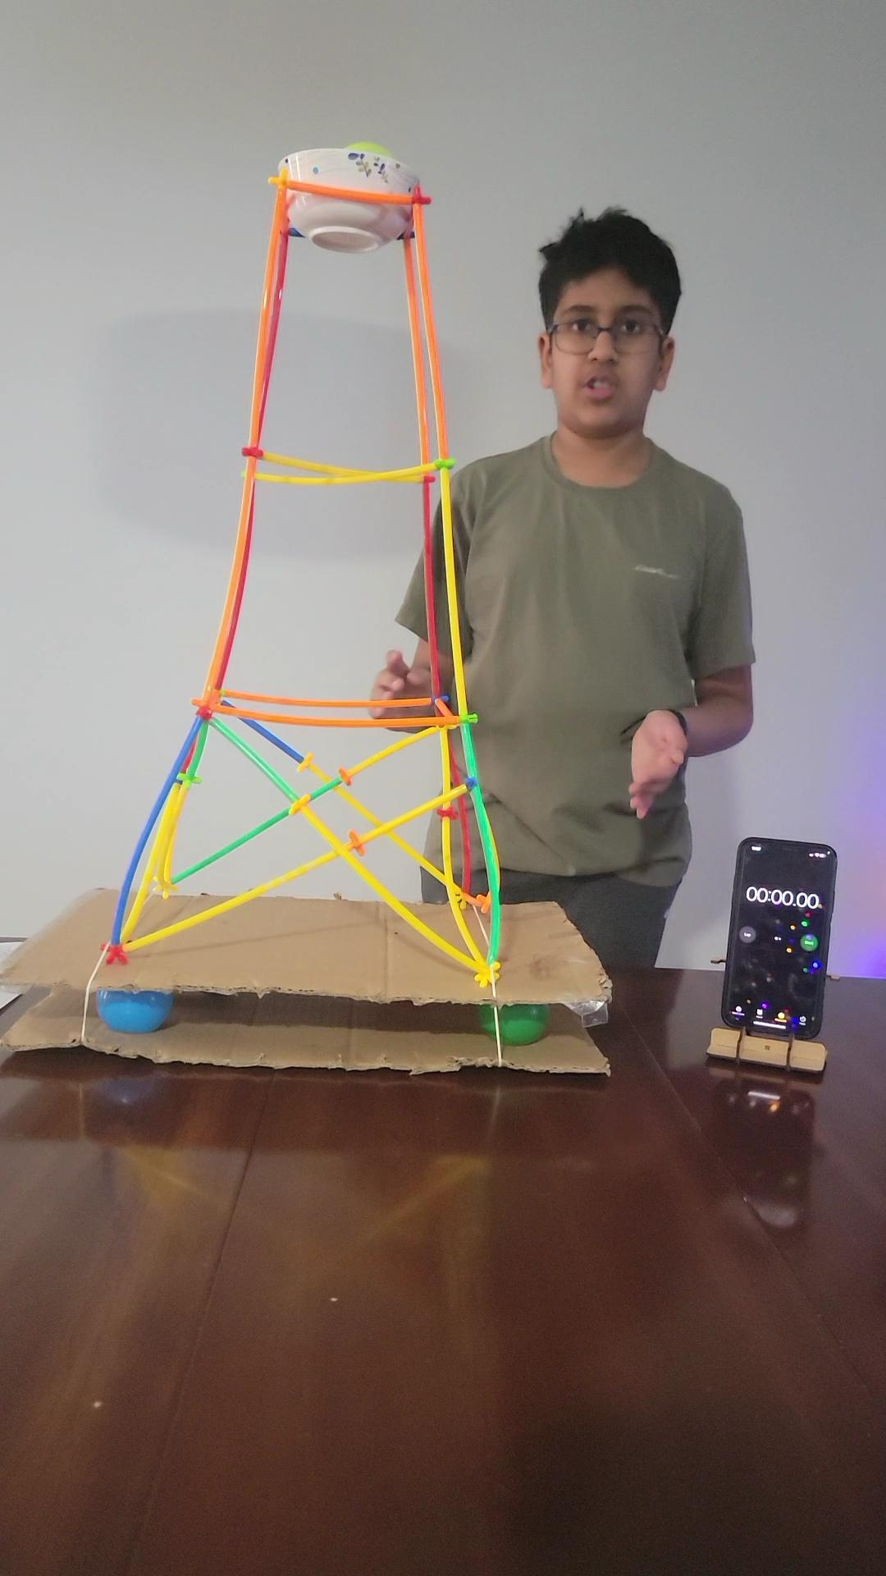
Results/Analysis - Structure Stability
Based on my experimentation the averaged results were:
The big base triangular building was the most stable among all the three buildings even though there was some structural damage. The average time it took for the ball to fall off was about 44 seconds.
The average time it took for the big base rectangular building’s ball to fall off was about 27 seconds.
The average time it took for the small base rectangular building’s ball to fall off was about 17 seconds.
The average time it took for the small base rectangular building’s ball to fall off was about 17 seconds.
Time (sec) Building Structure | Trial # 1 | Trial # 2 | Trial # 3
Big Base Triangular | 44 | 45 | 19
Big Base Rectangular | 27 | 17 | 28
Small Base Rectangular | 20 | 17 | 15

Slide 9
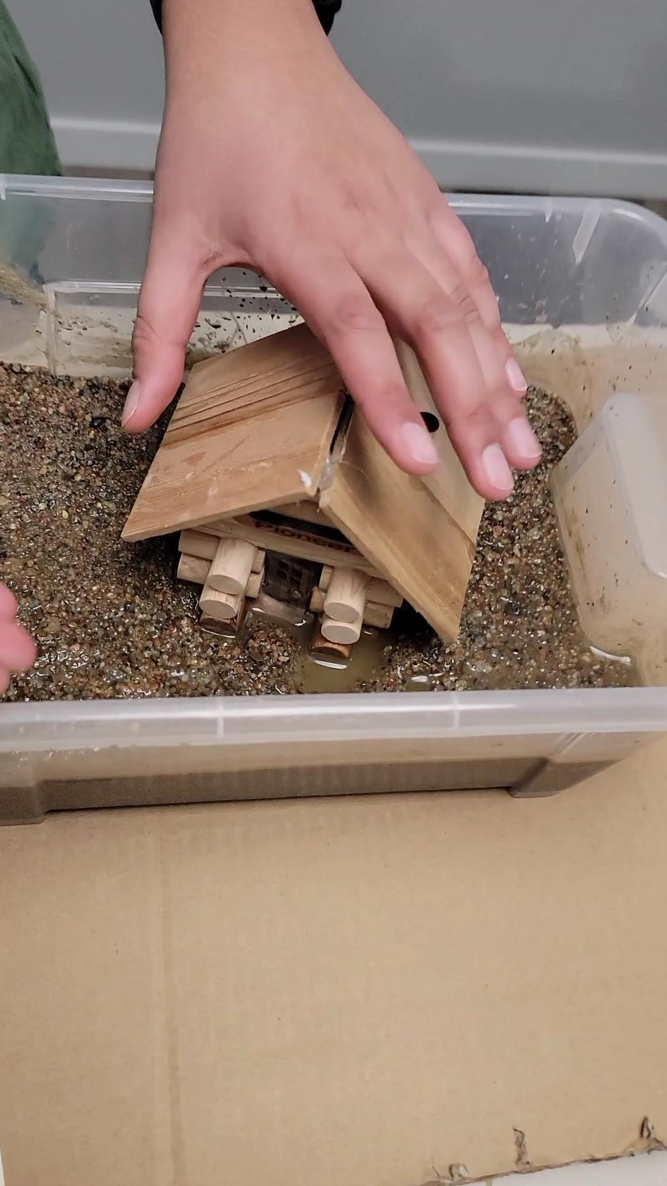
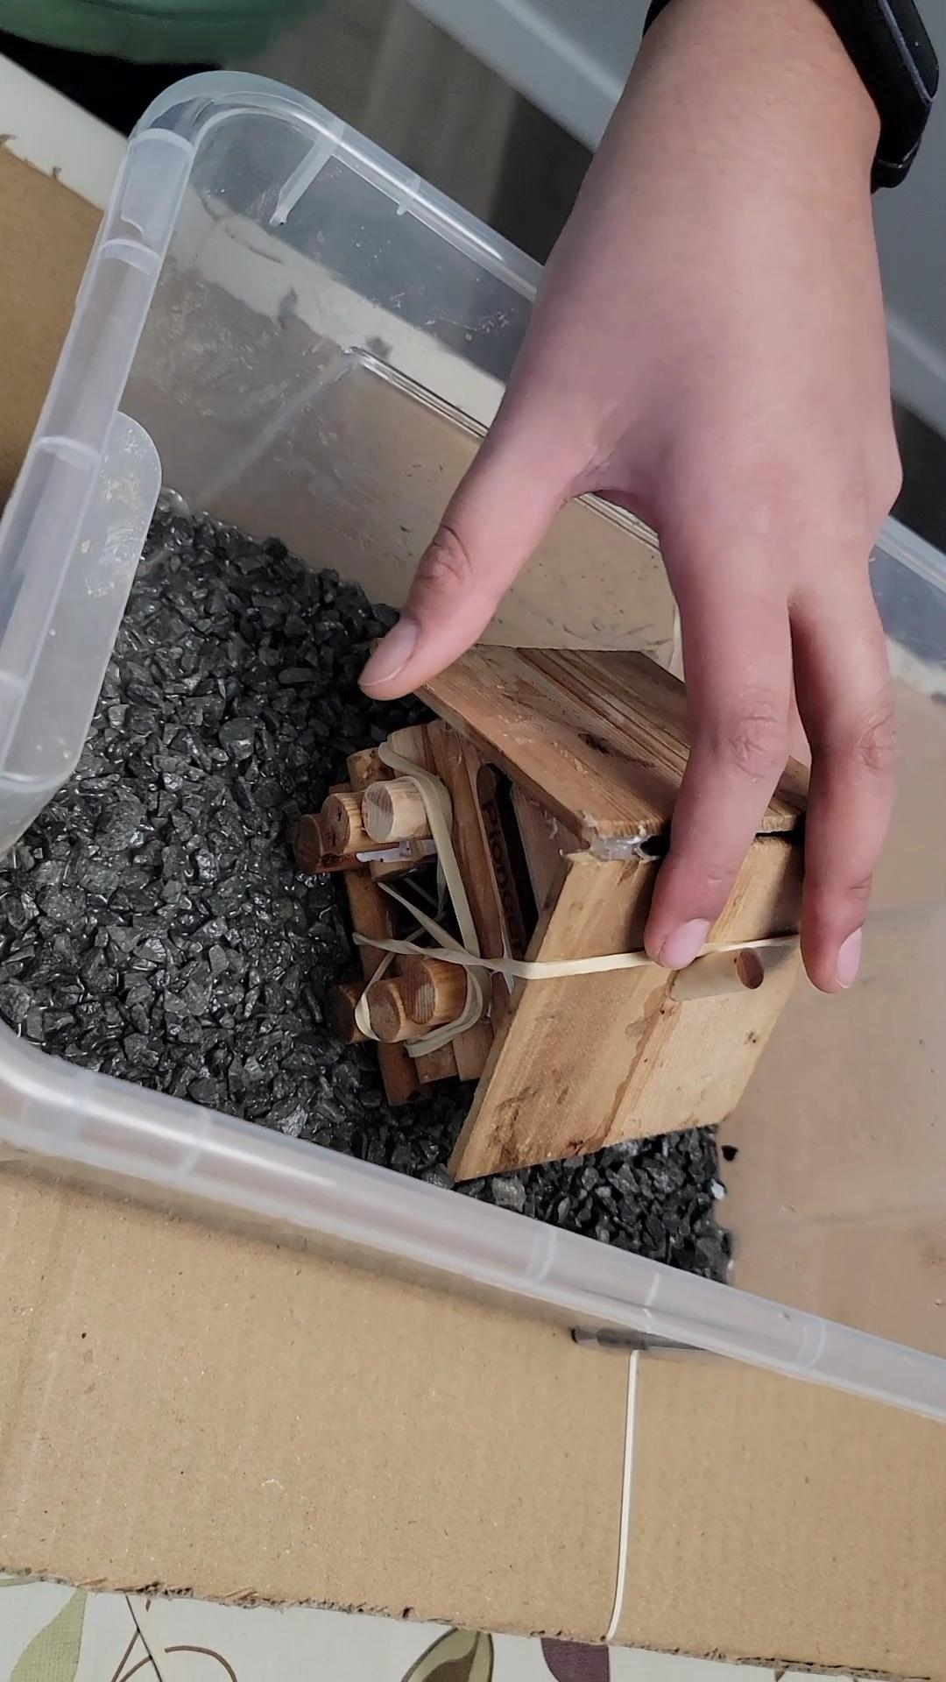
Results/Analysis - Soil Liquefaction
The average results of my experimentation are as follows:
A hard and rocky ground surface seems to be the best option for foundation/ground with lesser water content, the model house did not sink at all.
Soil with more water content sank around 5.3 cm.
With sand, the average depth the house sank was about 0.89 cm.
Depth (cm) Material | Test # 1 | Test # 2 | Test # 3
Sand | 0.89 | 0.8 | 0.9
Soil | 5.3 | 5.3 | 5.3
Gravel | 0.1 | 0 | 0

Slide 10
Conclusion
Based on my experimentation both of my hypothesis about Structural Stability and the Soil Liquefaction matched my experiment’s results.
My conclusion for the Structural Stability experiment was that the big base triangular building will stand up the longest because triangles are the strongest shape in geometry.
And my conclusion for the Soil Liquefaction experiment was that with less water content and with a hard foundation such as gravel, the wooden house will stay up.

Slide 11
Application/Extension
Who Cares:
An Architect (a person who designs houses) can use the information from my project to apply on real life buildings. You might be thinking, people already know that triangular buildings are earthquake resistant since people have already done this experiment before but haven’t applied it on real life buildings (I was just proving the facts). The reason people don’t build triangular buildings is because of cost, cost is why people are not making triangular buildings because the triangular buildings do not have a lot of space in them.
Improve:
One way I could have improved was using different materials so that way people knew what materials they can use and I can make the small base triangular building. If anyone in the future wants to do a project like the one I did, I would recommend doing something related to earthquakes that isn’t about structural stability or soil liquefaction and that can also improve buildings in different ways.

Slide 12
Extra Info - What is a seismometer and how does it work?
A seismometer is something that is made to check the direction of the earthquake. The seismometer I made works when the ball gets balanced on a pencil that is stuck to clay and when you push the table (to represent an earthquake) the ball goes where the push was, landing in one of the six cups. Most people know seismometers as something that records the intensity of an earthquake and this is also true.

Slide 13
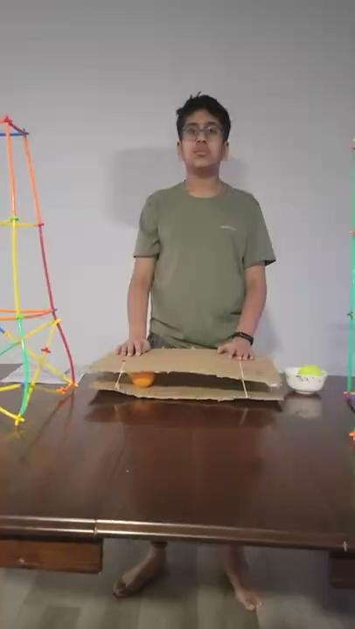
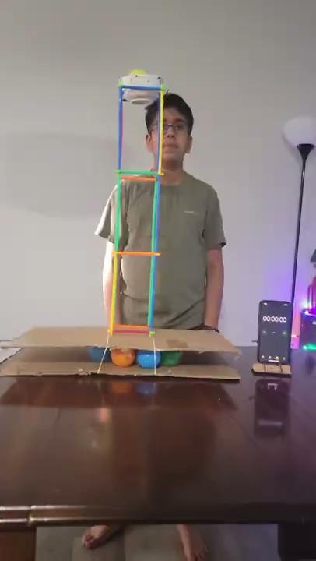
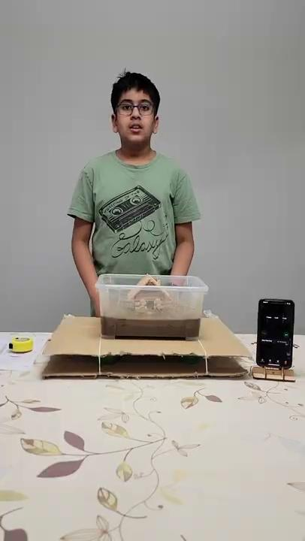
Thank You
Q & A
Here are some videos about my project:
Project Overview Structure Stability Soil Liquefaction

