Slide 1
Solar Oven
By: Matthew B.

Slide 2
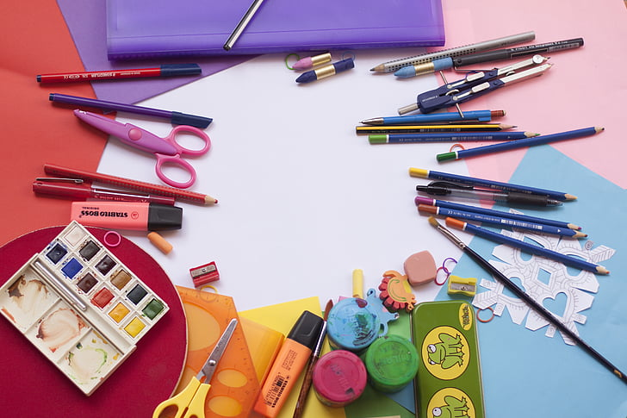
What are the materials and what purpose do they serve?
There is a transparent sheet covering the opening of the solar oven, creating a greenhouse effect. The greenhouse effect is when glass lets the sunlight in but traps in the heat, warming up the greenery inside. The aluminum foil serves as a mirror in a concave shape, focusing the sunlight into a certain area, AKA the marshmallow. The black paper serves as a heat amplifier, absorbing all the sunlight, converting it to heat and emitting the heat.

Slide 3
Upsides…
&
Downsides…
Solar ovens can reach up to 350 degrees fahrenheit!! But that is not hot enough to cook chicken or bake a cake. Not even hot enough to cook a pizza!!! Also, solar ovens are weather reliant. If there is cloud cover or it is at night, you cannot use a solar oven. But on the bright side, solar ovens are friendly to the environment and do not pollute.

Slide 4
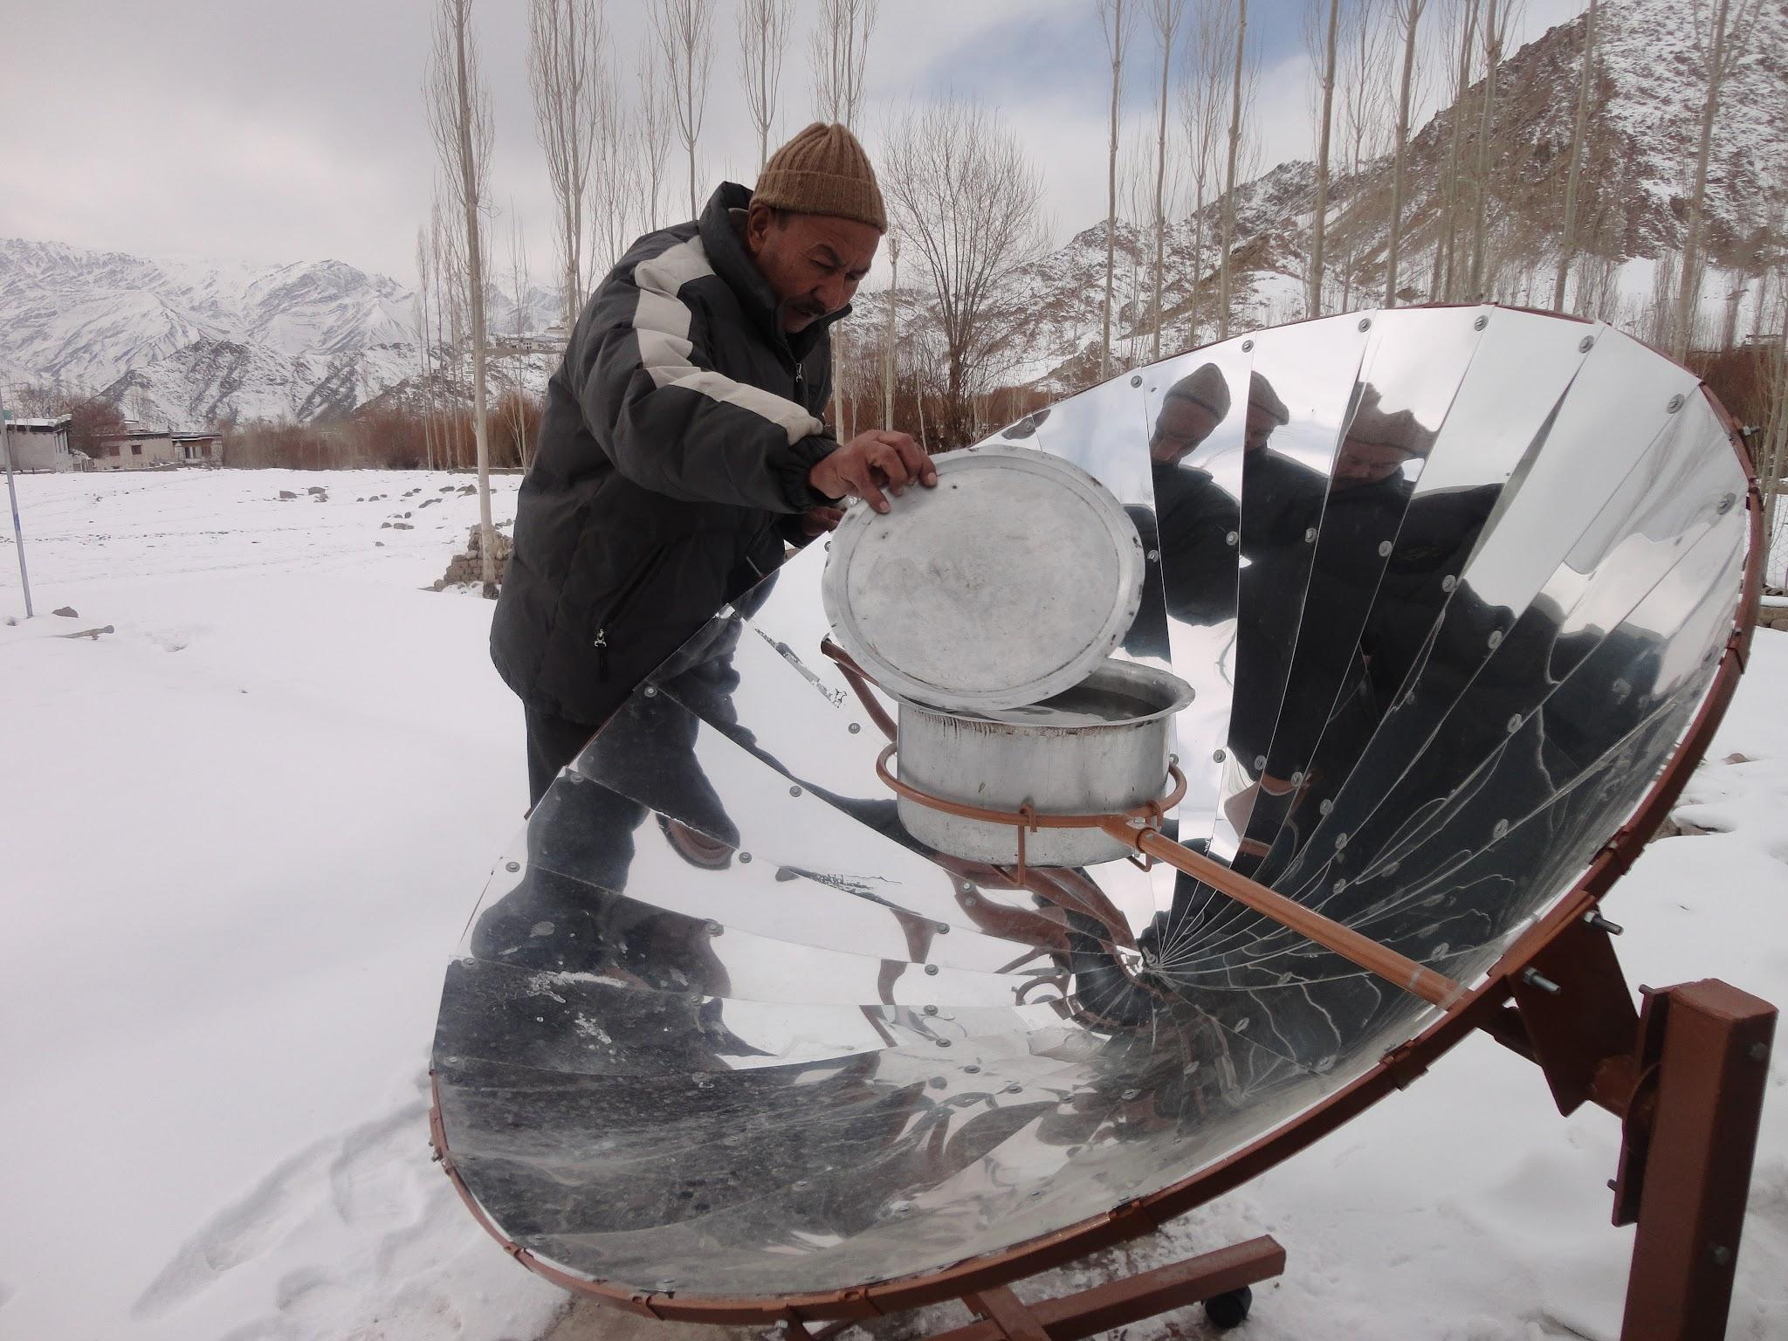
Fun Facts
More solar energy hits the earth in one day than the whole human race can use in 27 years!!!
Solar ovens can clean food, equipment, water and many other items! It even kills bacteria with the temperatures it reaches
A solar oven is shaped like a jet engine!! The shape is to concentrate the sunlight into a specially shaped pot holder therefore warming up the sunlight.

Slide 5
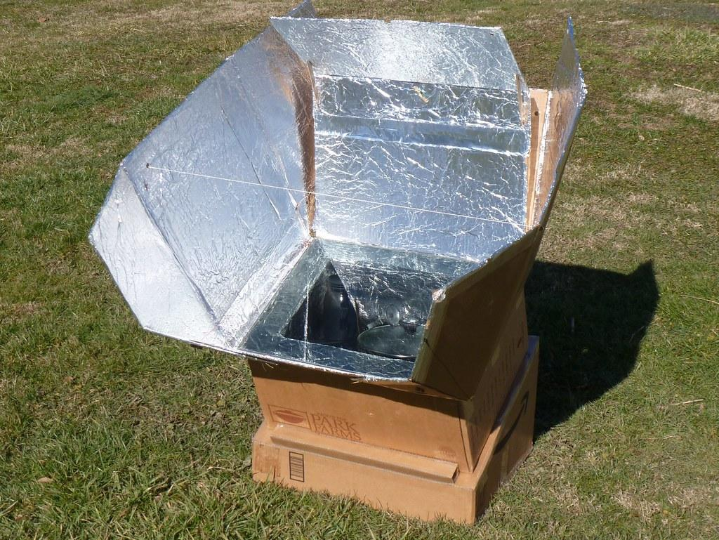
How to create your very own solar oven
Step 1: take a box (preferably a clean pizza box) and cut 3 sides of a square in the center leaving a 2 inch space on the side. That one side will be your hinge.
Step 2: cover the flap you just made in aluminum foil. This will be the concave mirror.
Step 3: cover the bottom of the box in black paper. This will be the heating enhancement I talked about in the first slide.
Step 4: cover the hole with cling wrap. This will be for the greenhouse effect.
Step 5: prop open the box with a piece of cardboard. Leave there for 30 min with a marshmallow on a cracker or cookie inside.
You have successfully created your very own solar oven. Pop a thermometer in there and measure the heat!!

