Slide 1
Which fabric holds heat the longest?
By: Stephanie 淑哇 Froese

Slide 2
Big Question
Which fabric will hold the most heat before going back to room temp at 24°C.

Slide 3
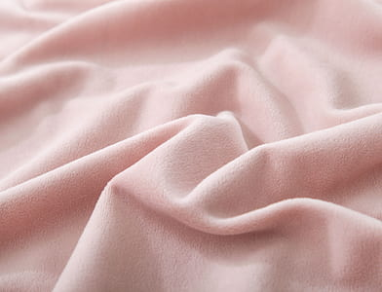
Hypothesis
If I heat up different types of fabric to a certain temp and then measure how long it takes to go back to room temp, then fleece will take the longest to cool, because fleece is thick and dense.
Fleece

Slide 4
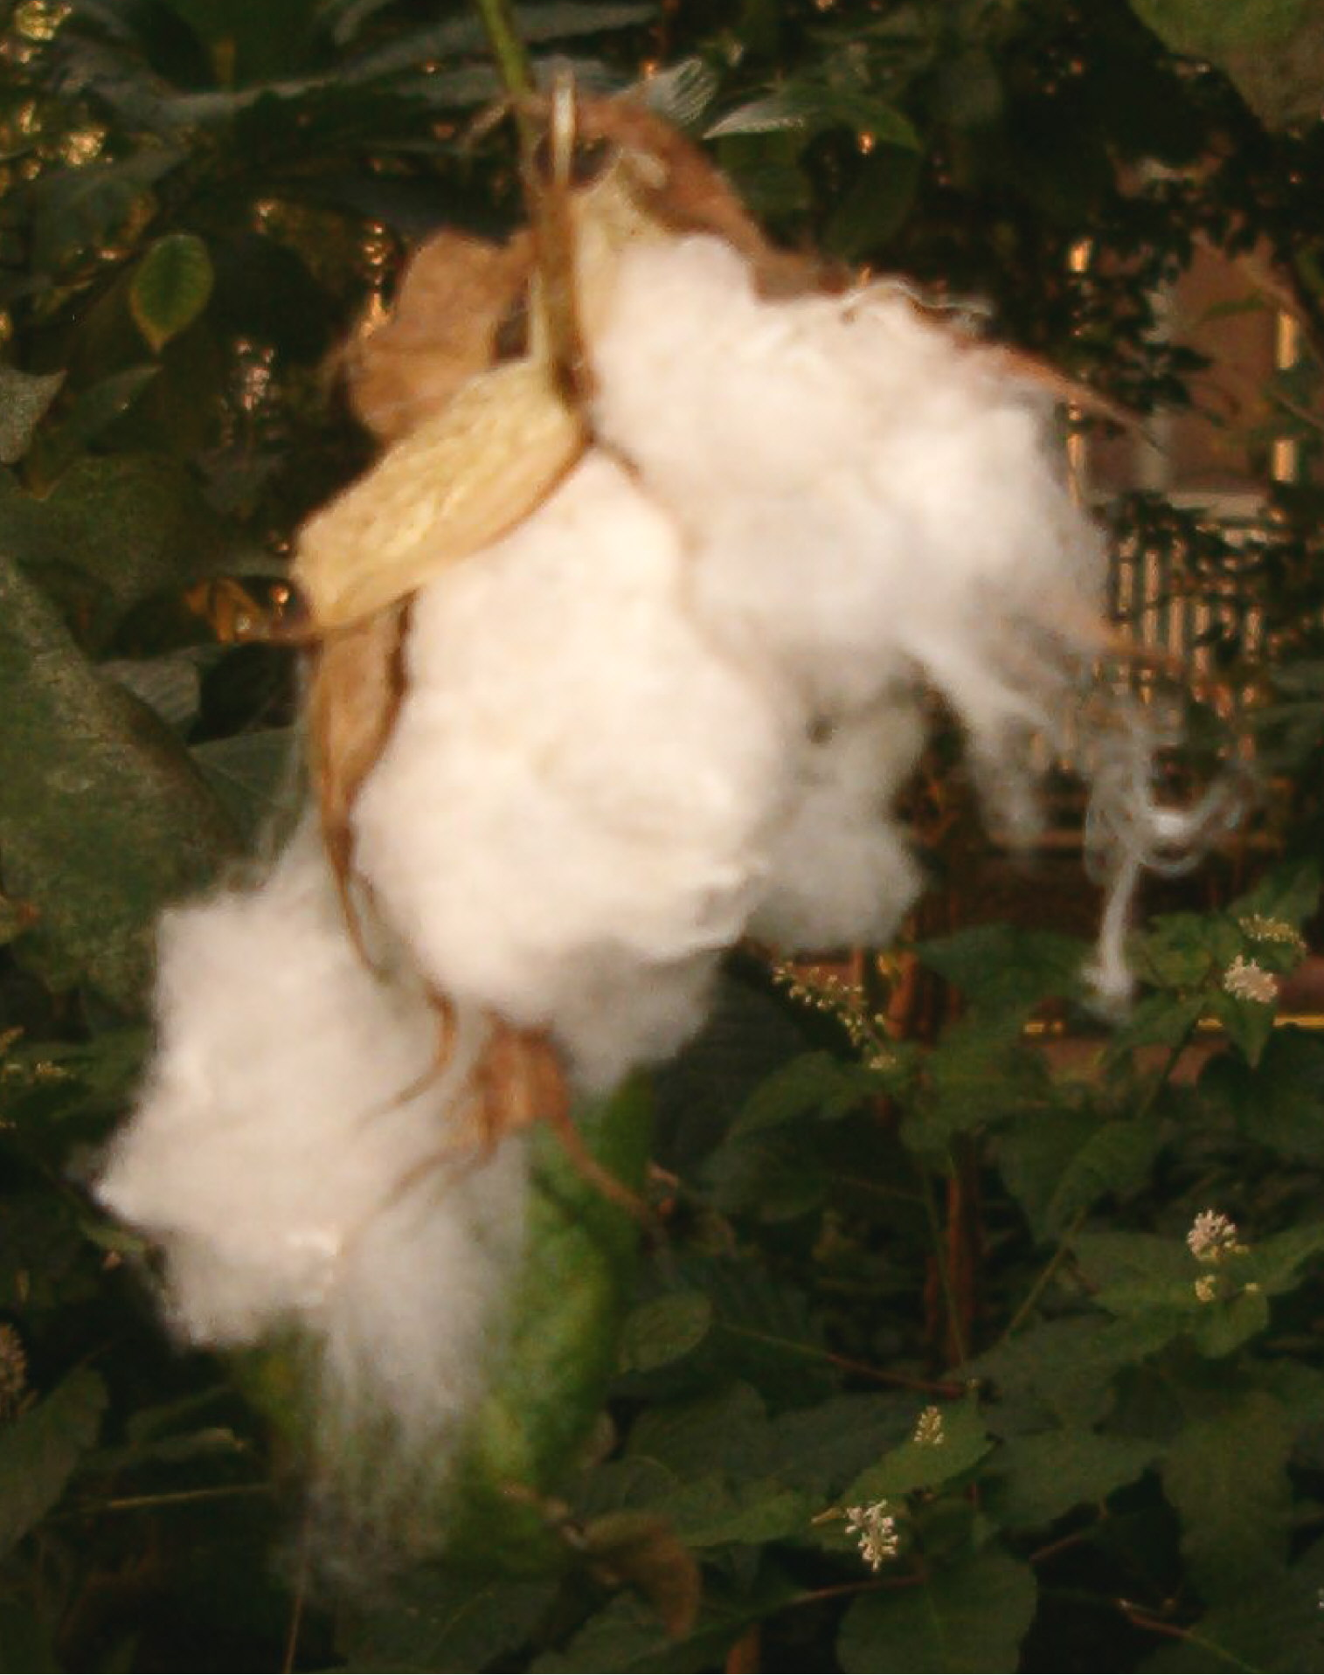
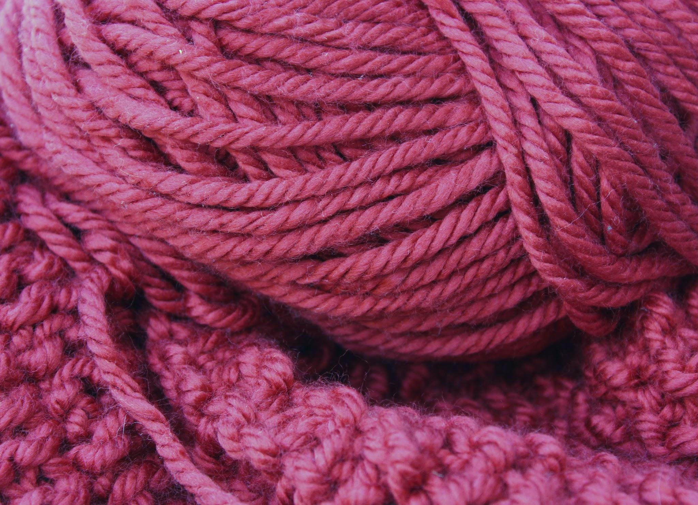
Background Research
Wool:
1. Wools density will depend on how tight you weve it.
2. Wool provides natural UV protection - for both humans and sheep alike! Because it is a naturl substens.
4. Wool helps reduse body oder
3. Wool is made manly of Sheep Wool.
4. Wool holds moisture without feeling wet!
5. Wool can get scratchy and from all the heat and moisture it can start to fray.
Cotton:
1. Cotton is made out of plants.
2. Cotton plants can grow to six feet tall
3. Cotton is made from the genus Gossypium plant.
4. Cotton is a natural fiber so it is biodegadebel.
5.Cotton fabrics are not verey strechy.

Slide 5
Fleece:
1. Fleece is a senthetic fabric.
2. Fleece is made out of the same polermer as yuor pop bottels.
3. Fleece will last longer then most fabrics and it will also stay in shape.
4. Fleece will light on fire easyer then most fabrics.
5. If your fleece sweter gets wet then it will dry fastr then wool.
6. Fleece is very easy to clean!

Slide 6
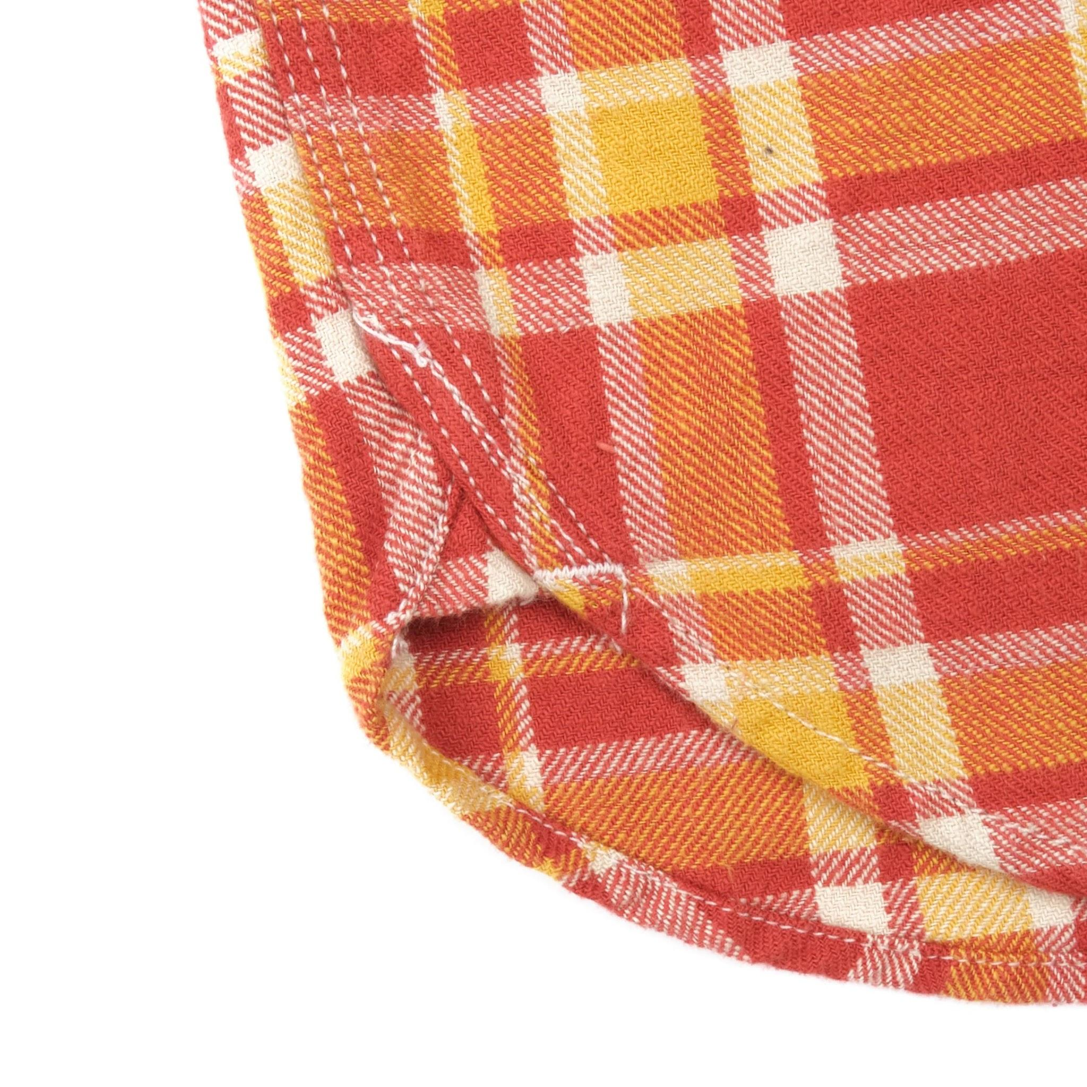
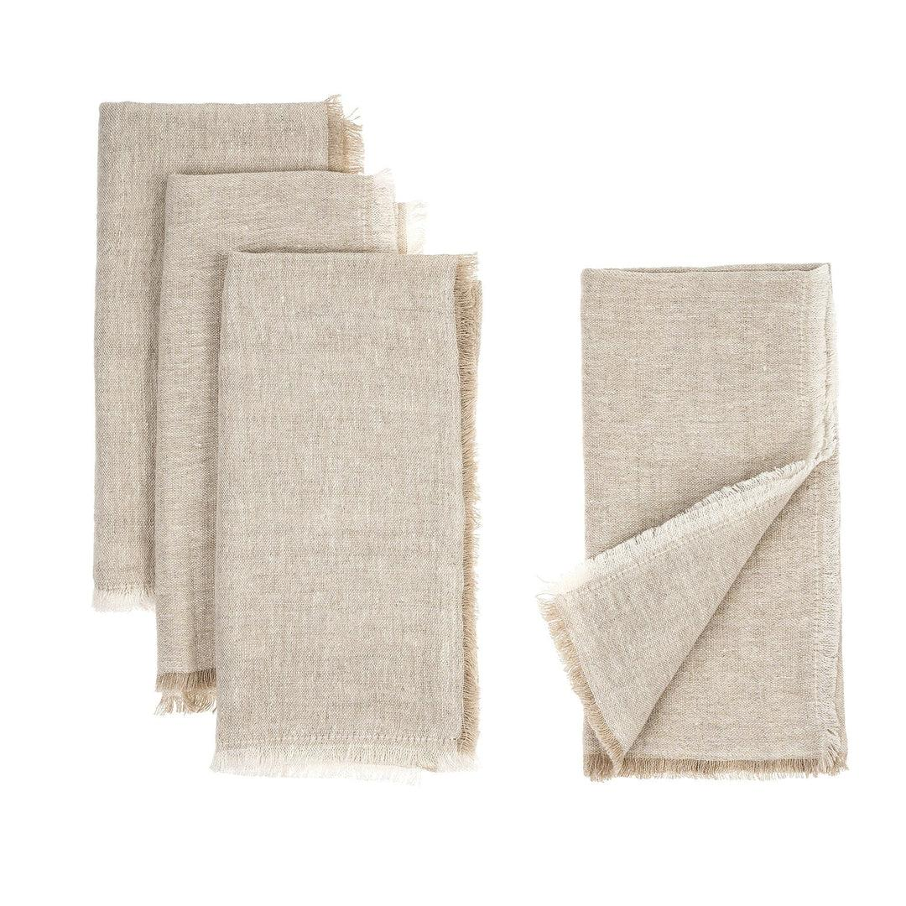
Linen:
1. Linen is is a verey old fabric. Mummies were wrapped up in it and it has lasted for centuries. There is no question about linen being durable.
2. 85% of the world’s linen comes from Europe.
Flannel:
1. Cozy fabric known as flannel has been in use for hundreds of years.
2. Flannel was made from worsted yarn.

Slide 7
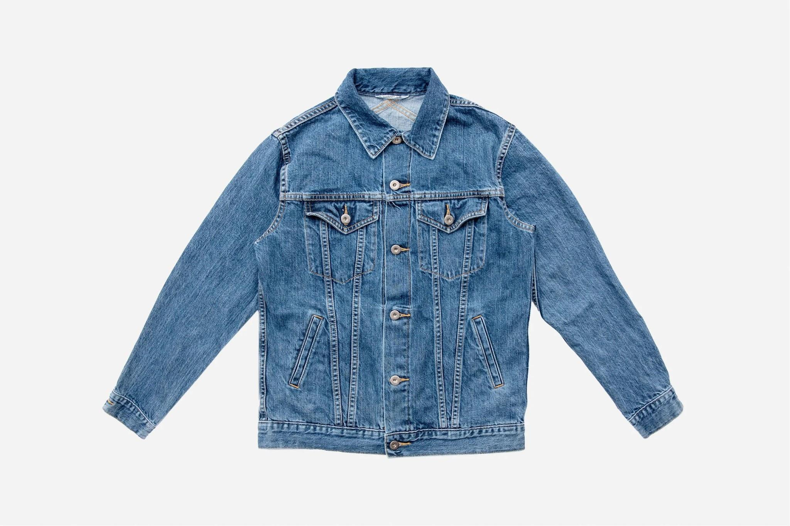
Denim:
1. Before we used the word jeans, they were called waist overalls.
2. After World War 2 in the 1950s, blue jeans were banned at several places like schools, theaters, and restaurants as they were seen as a form of rebellion against society.
3. Denim is made of cotton fabric!
rebellion= a sort of protesting

Slide 8
Variables
The types of fabric
How long it takes to cool
The starting and ending temp
How heat is measured and produced
Manipulated Variable (what you changed)
Responding Variable (what you watched for)
Controlled Variables (stayed the same)

Slide 9
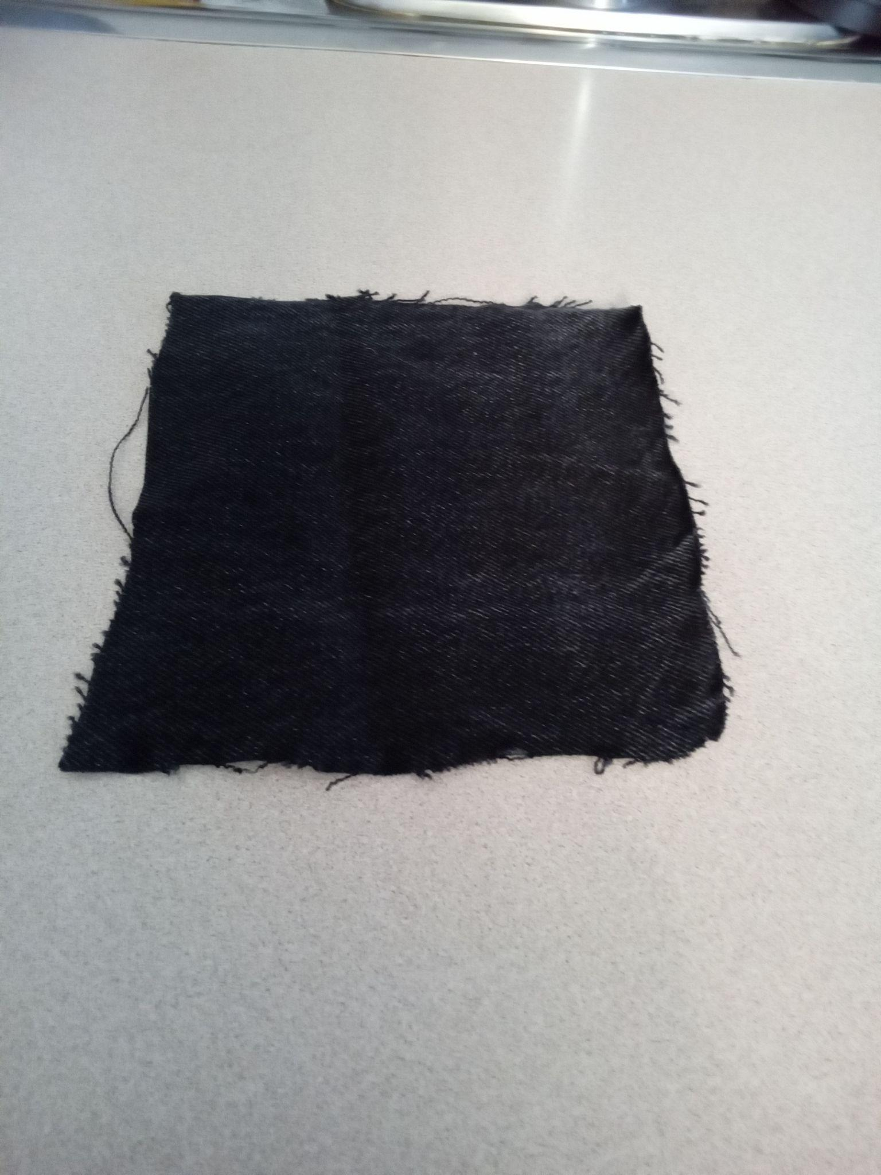
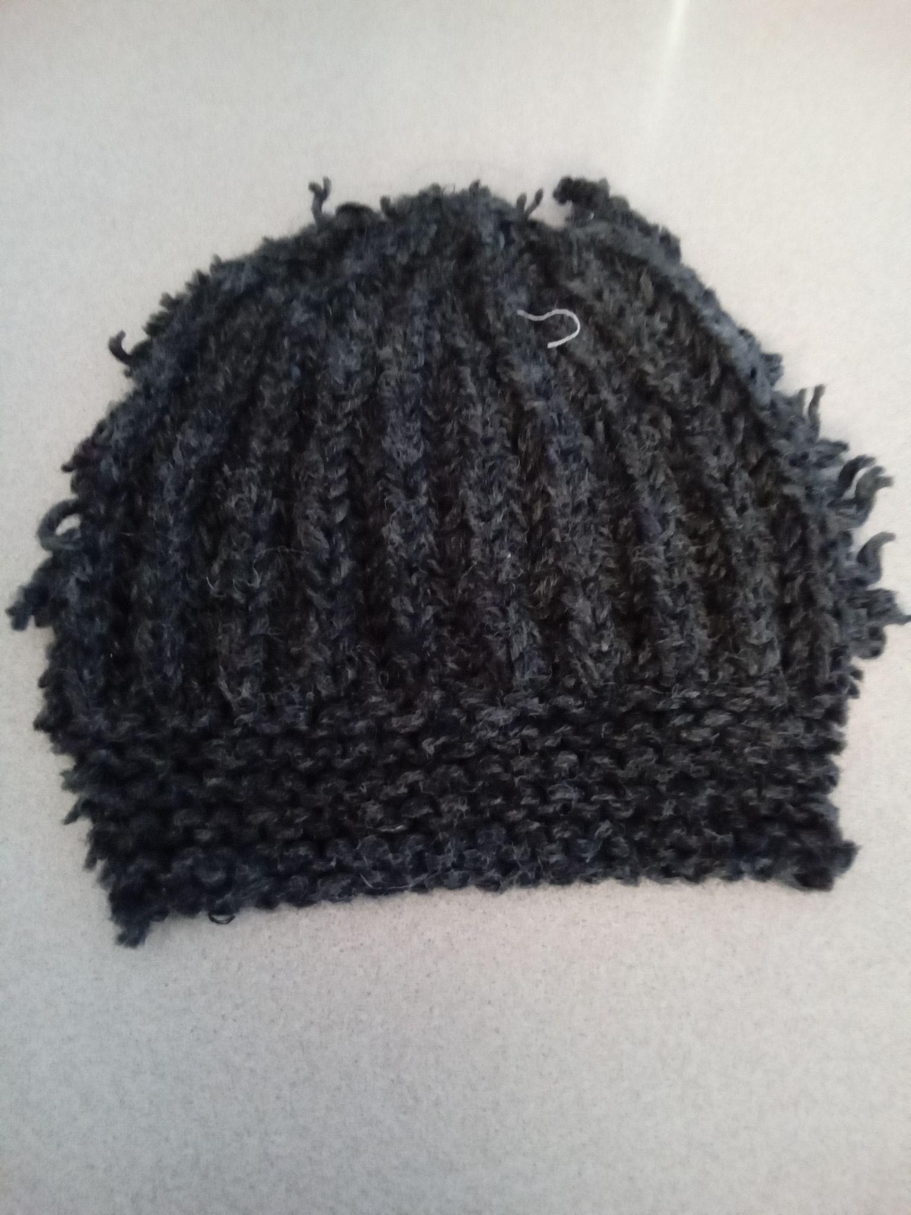
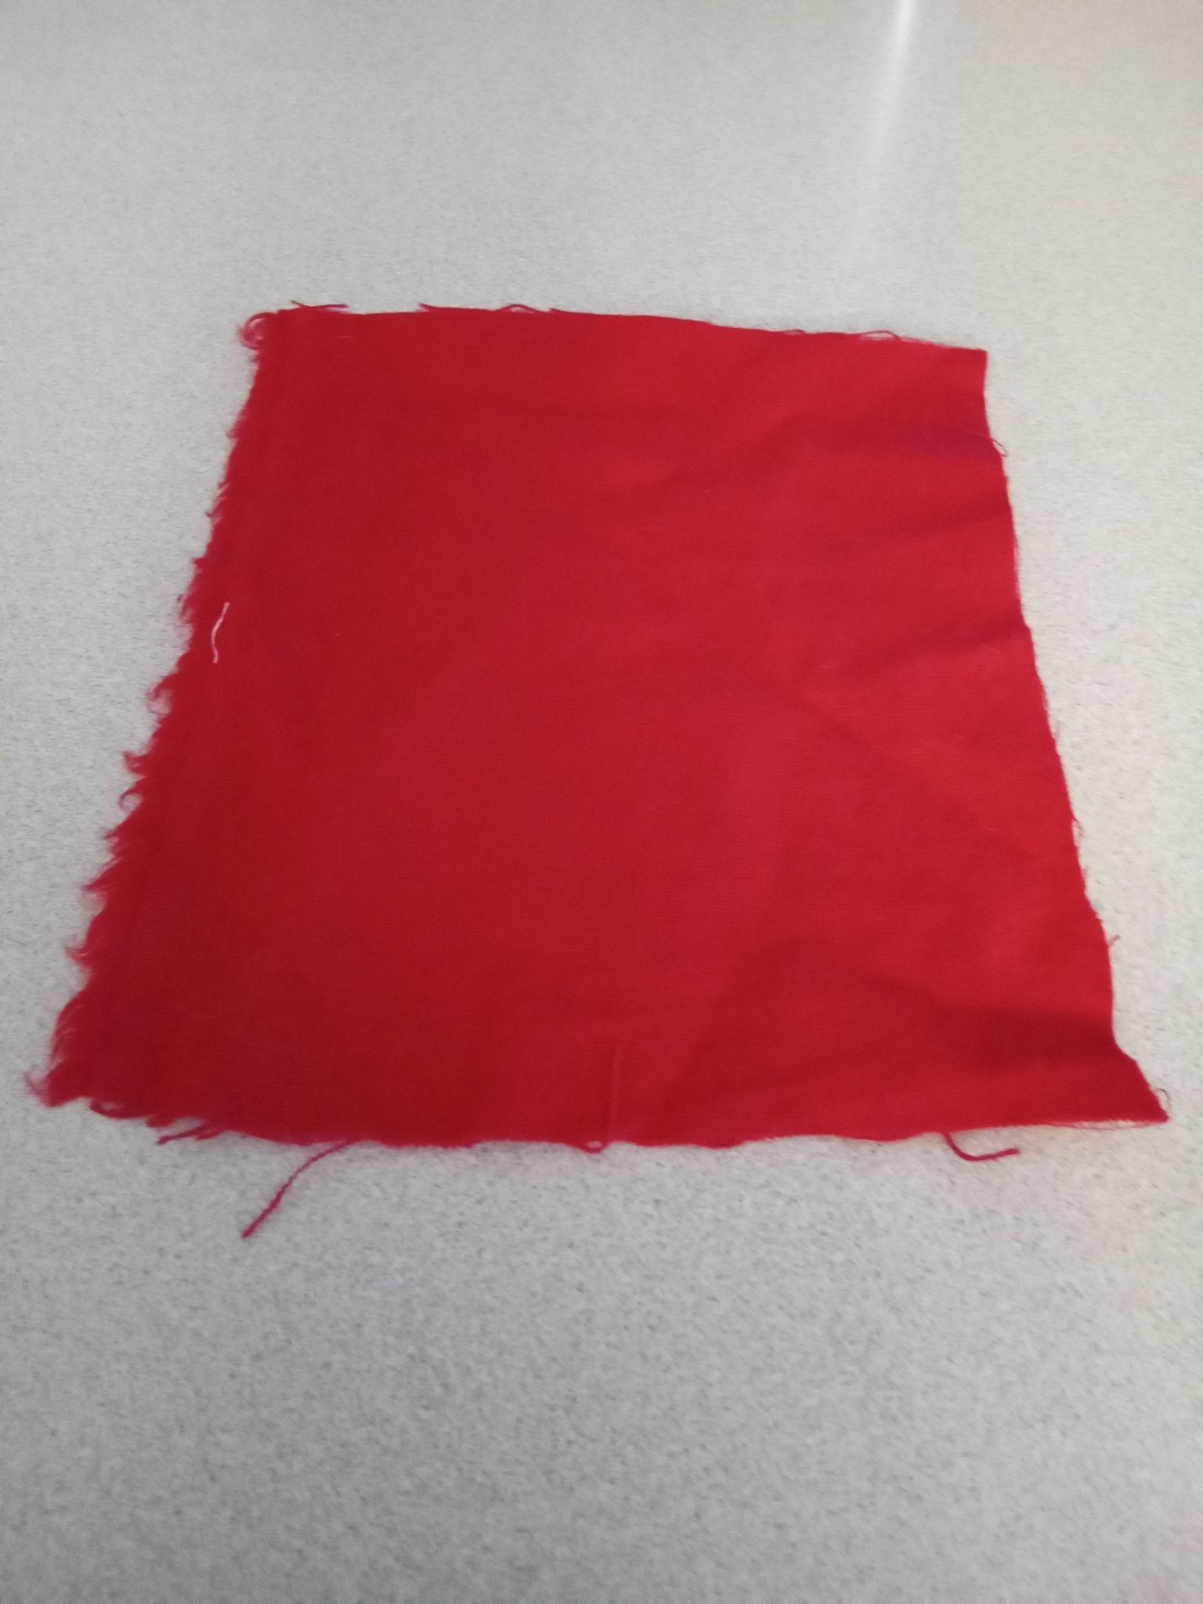
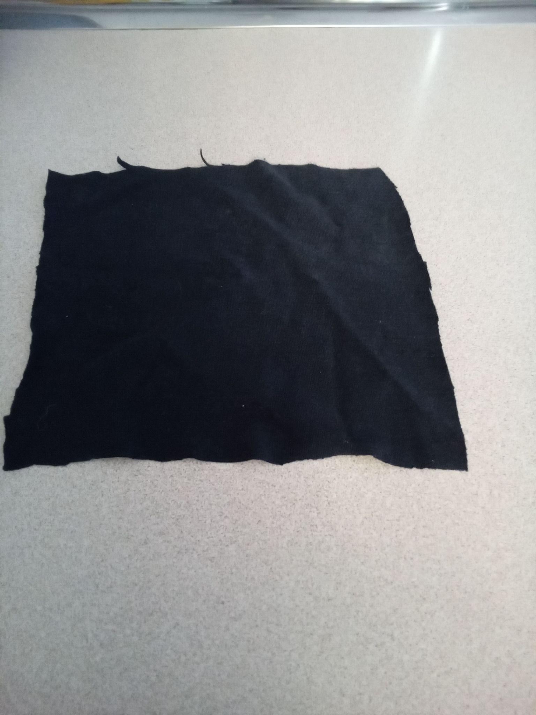
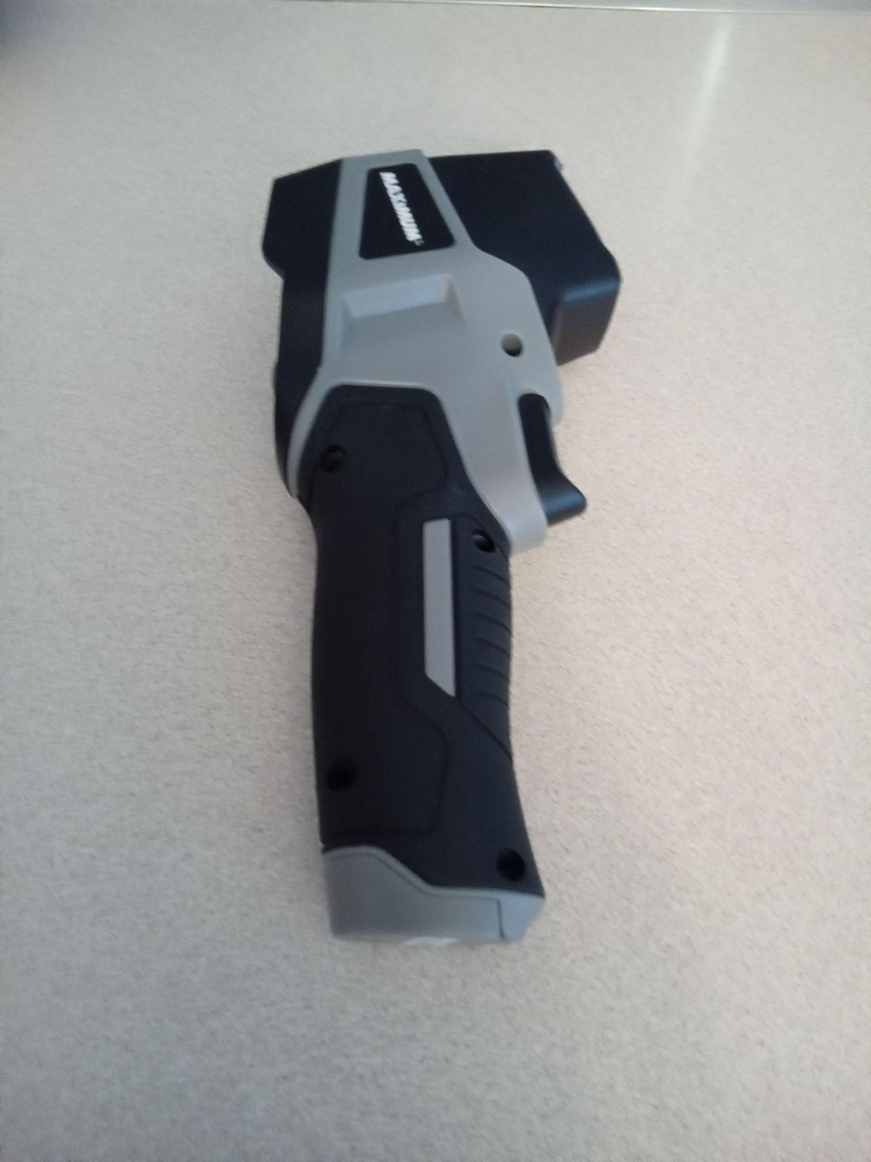
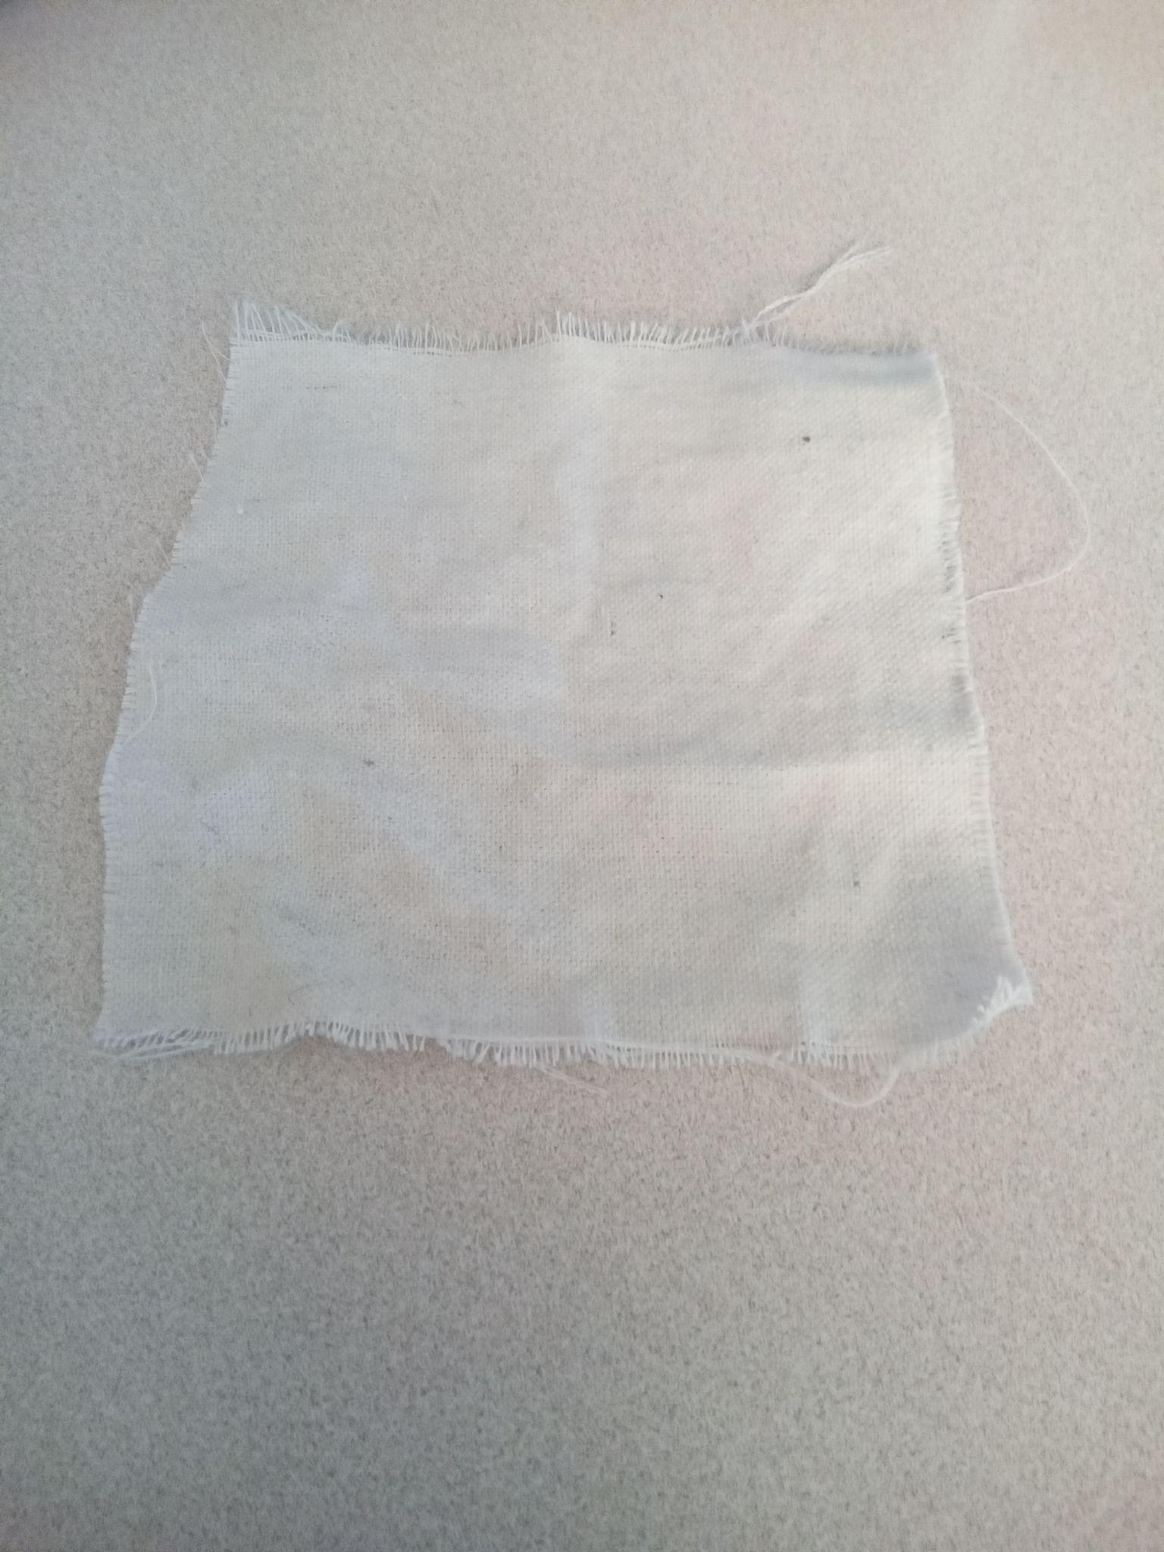
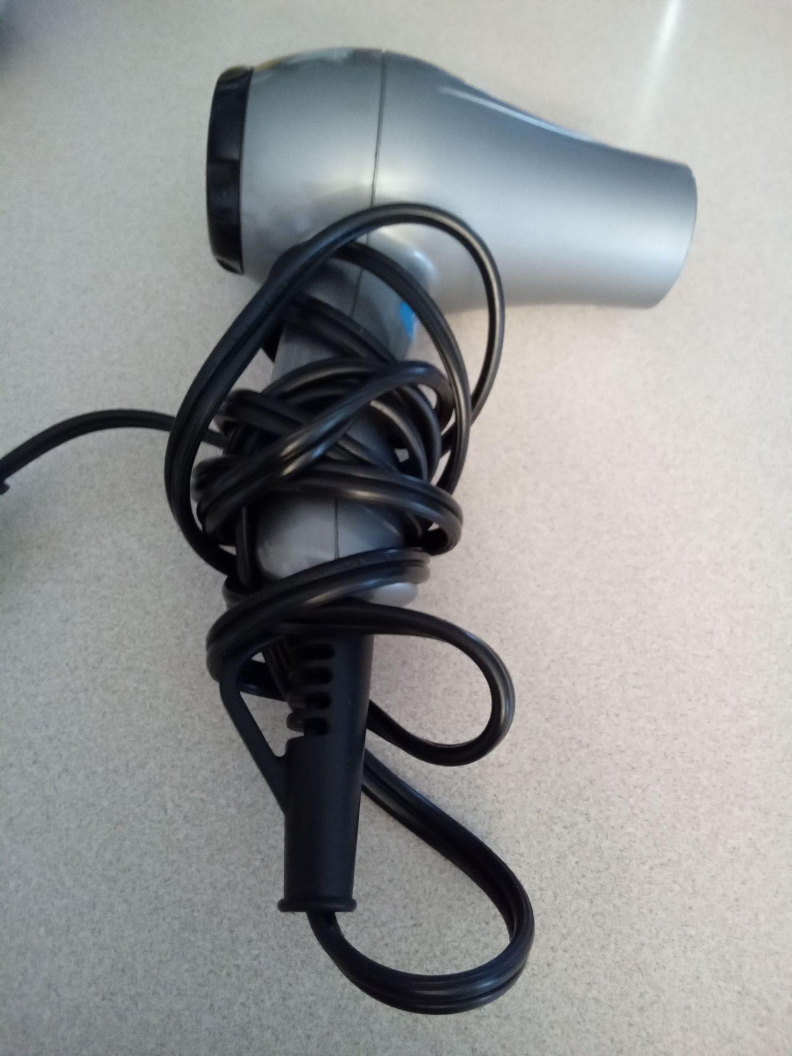
Materials
Fabrics
- Cotton
- Linen
- Flannel
- Denim
Denim
- Blow dryer
- Thermometer
- Wool
- Fleece
Wool
Flannel
Cotton
Fleece
Thermometer
And Blow dryer
Linen

Slide 10
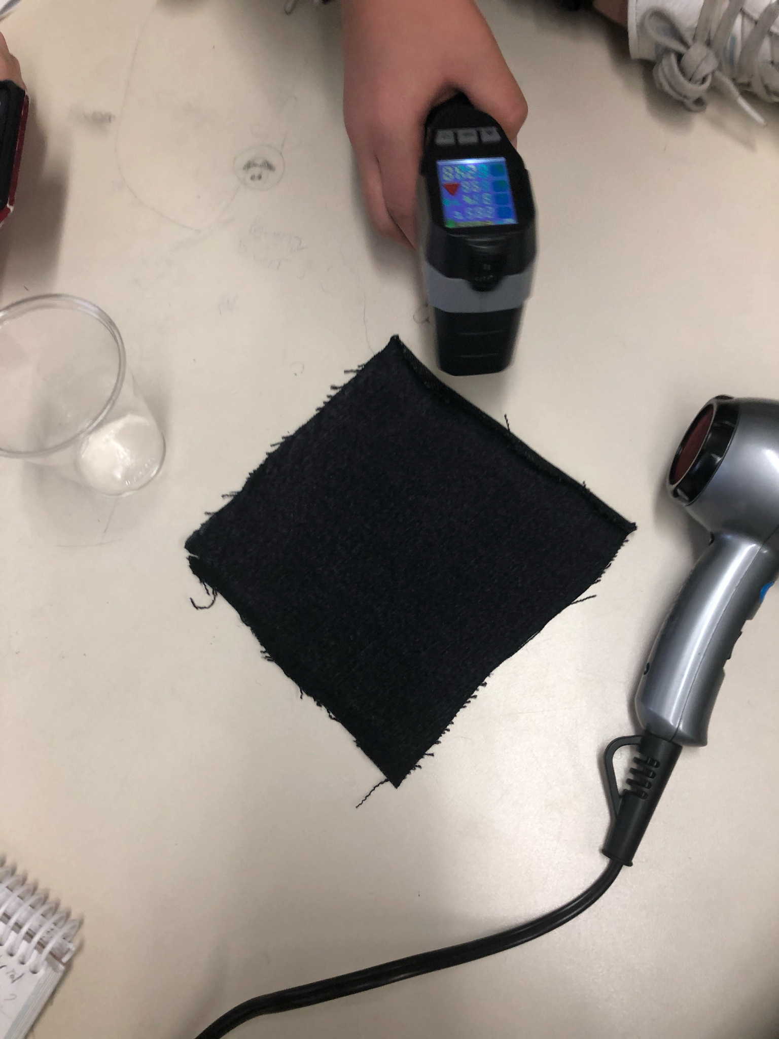
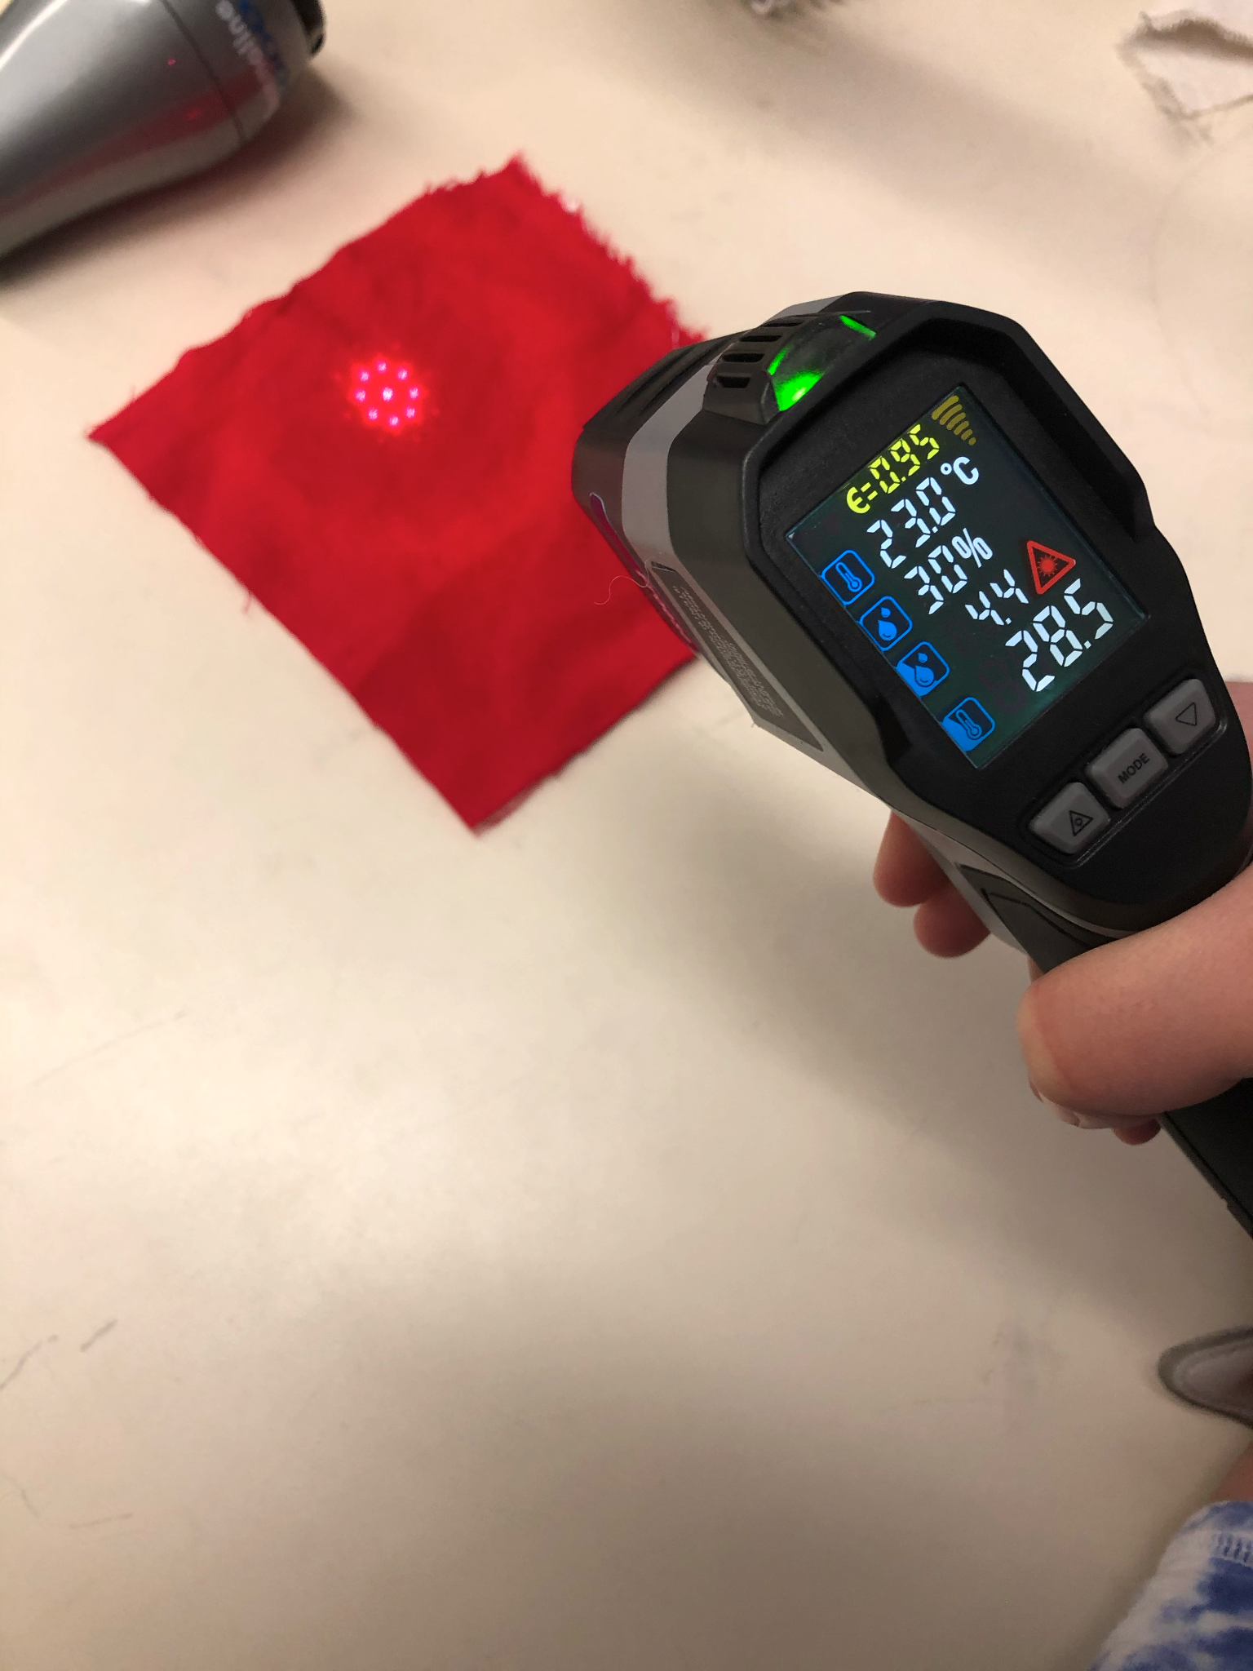
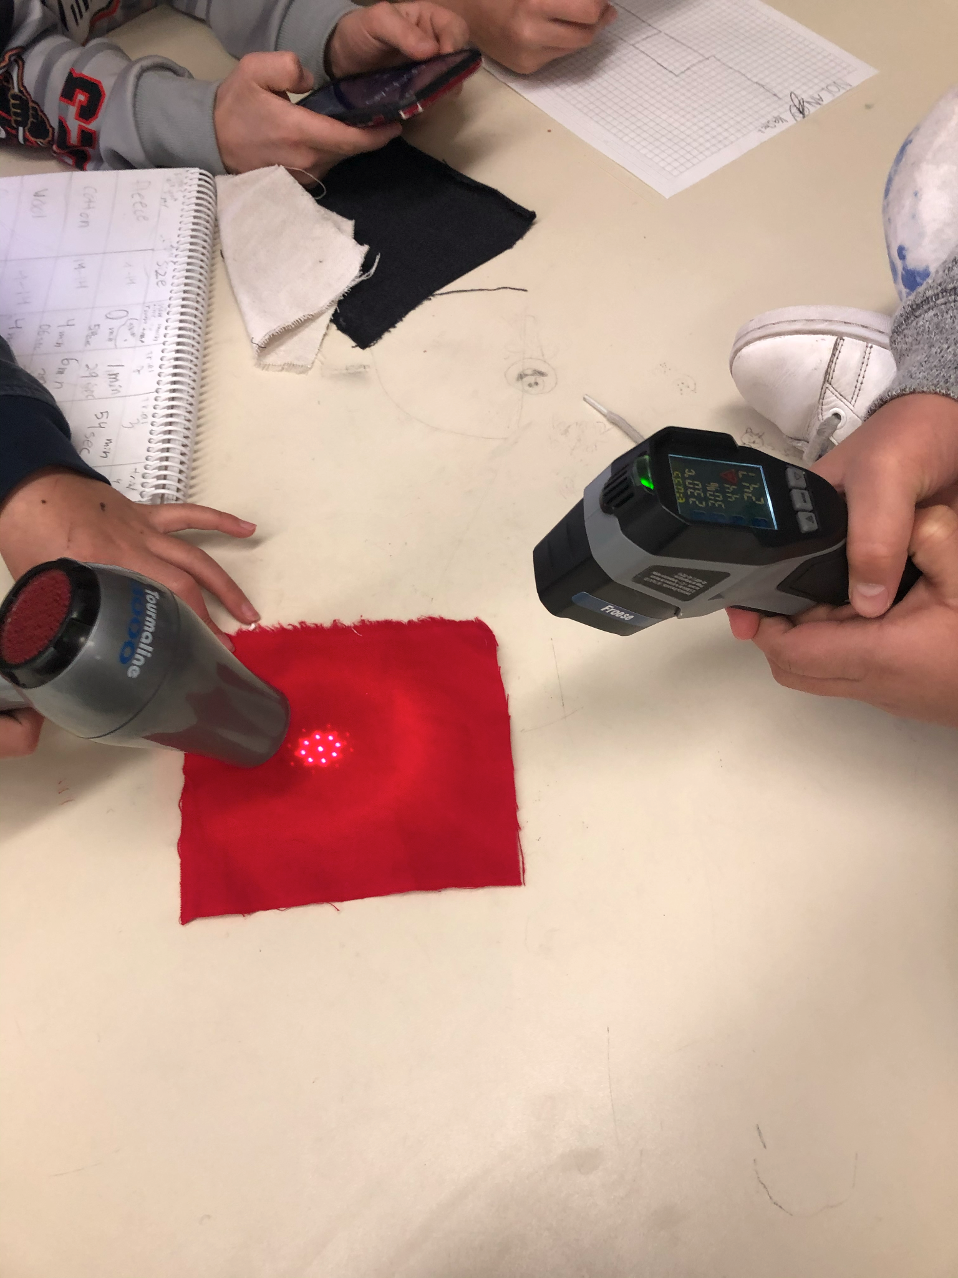
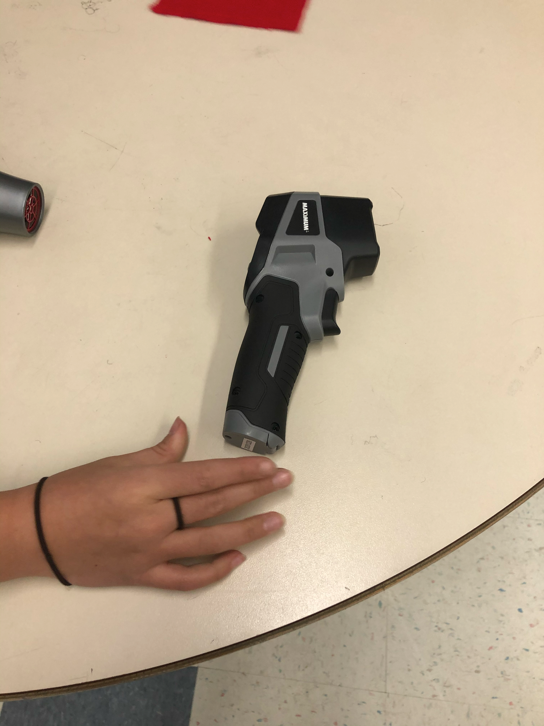
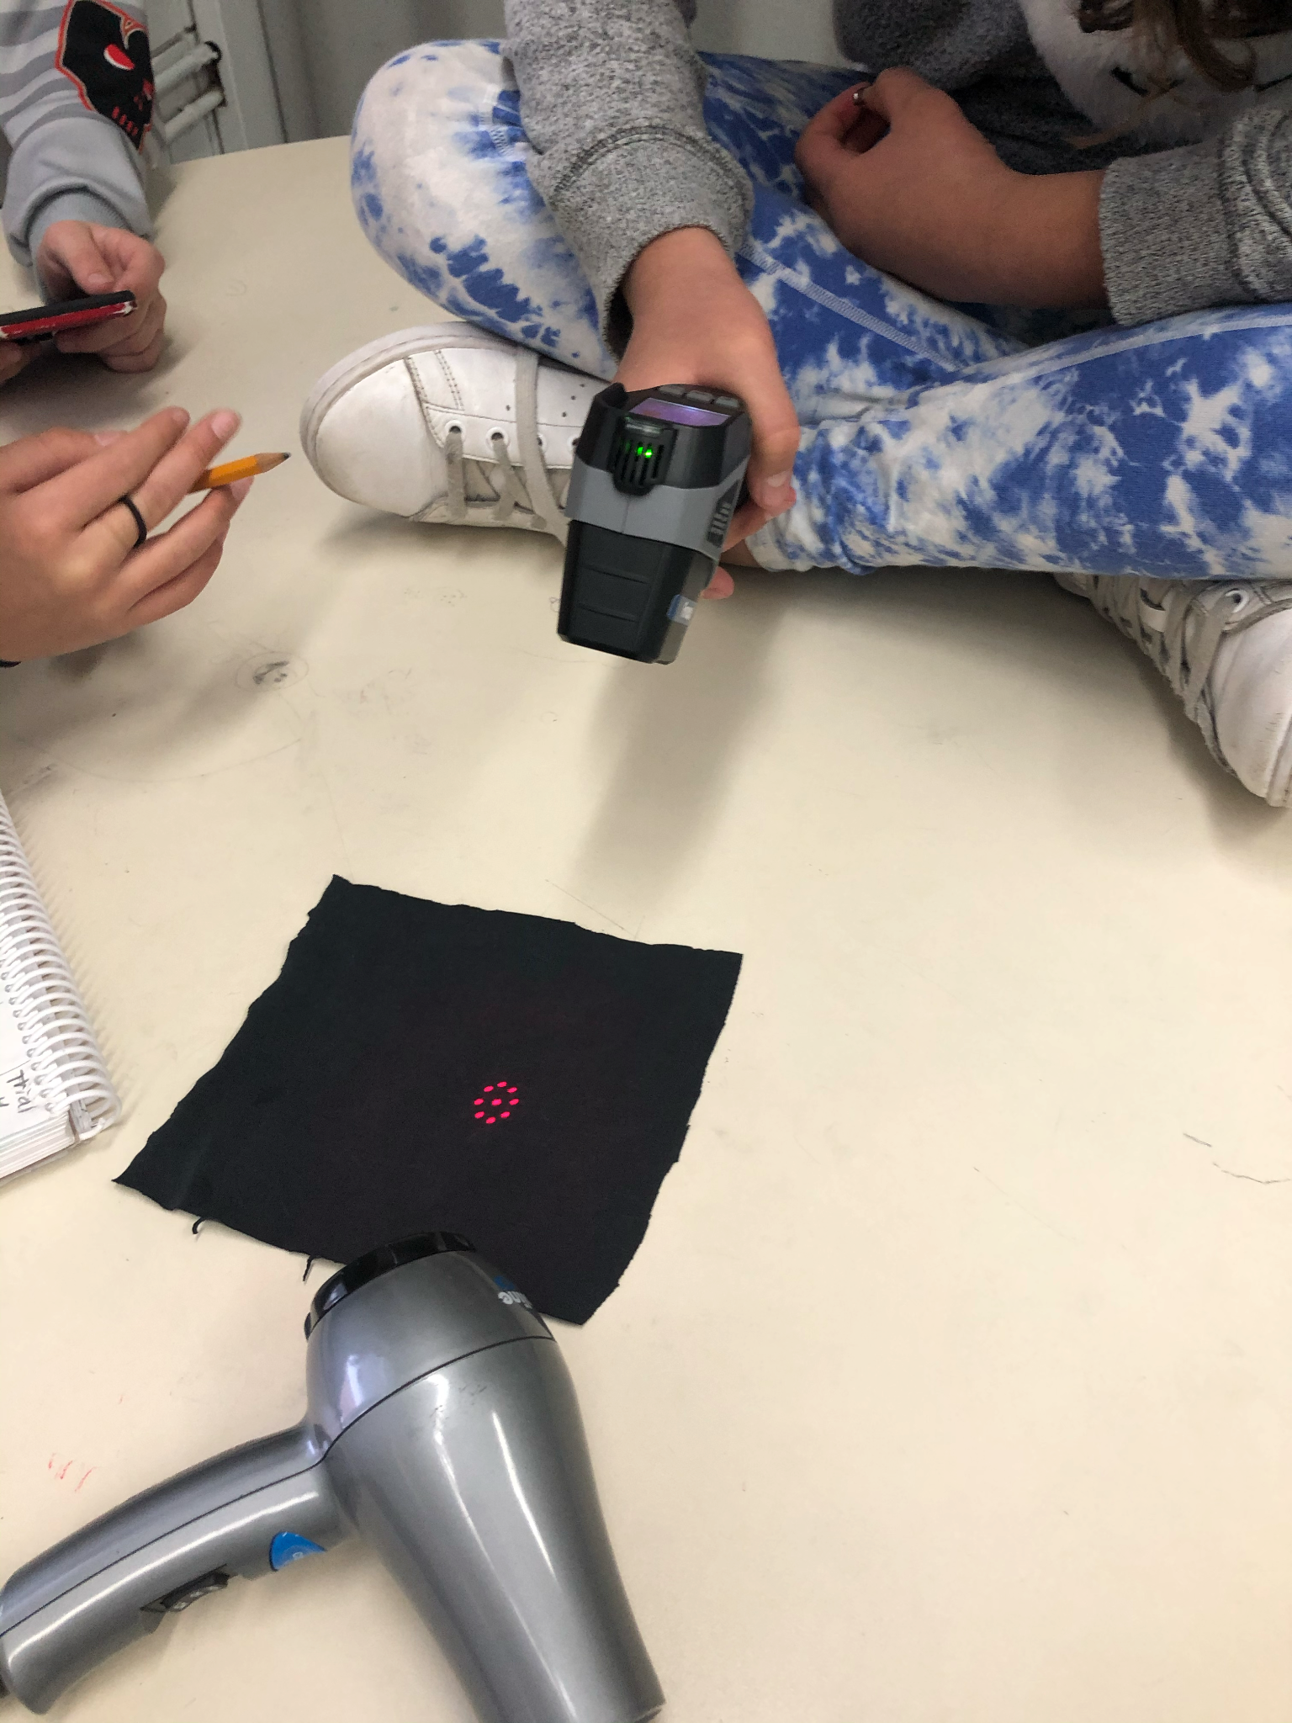
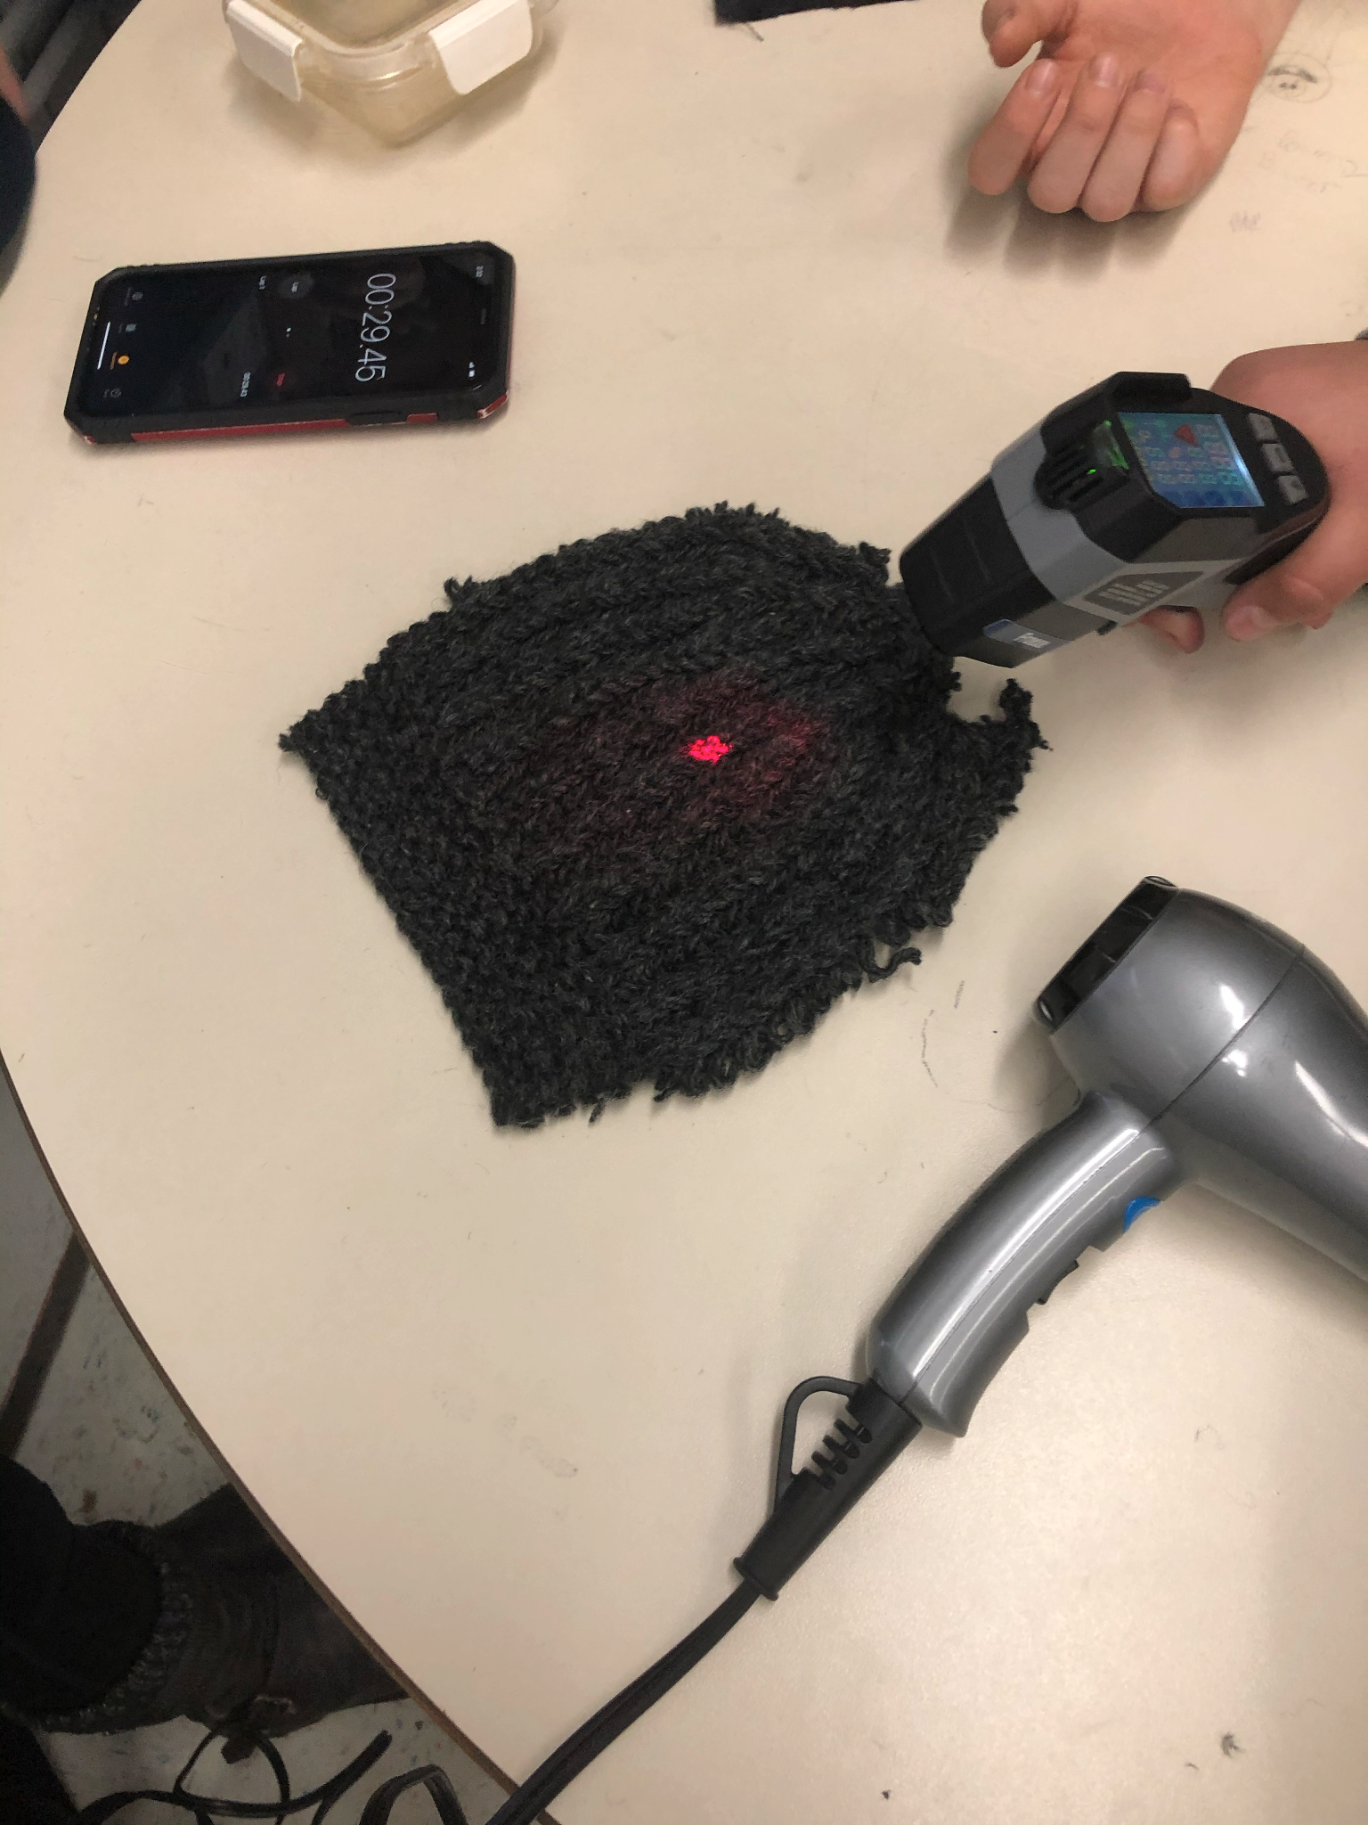
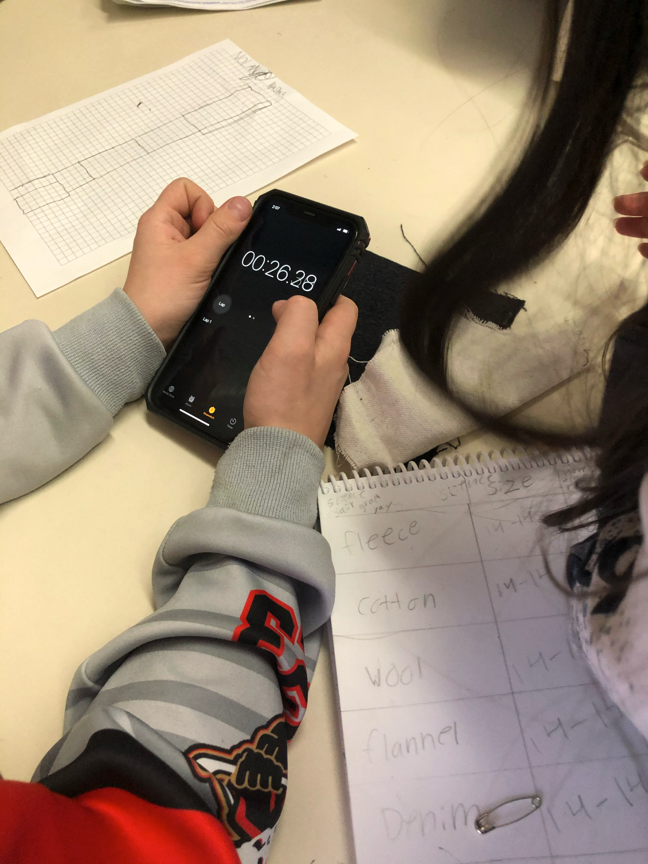
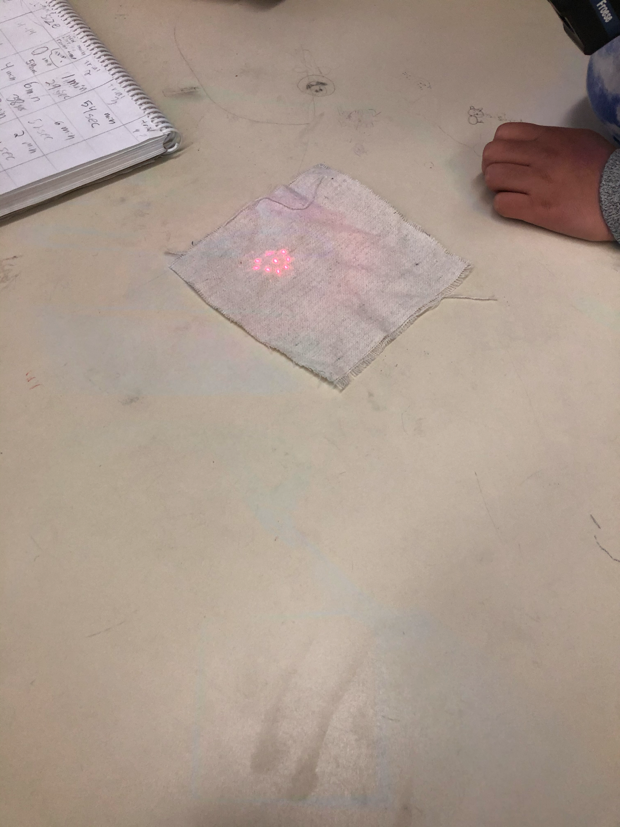
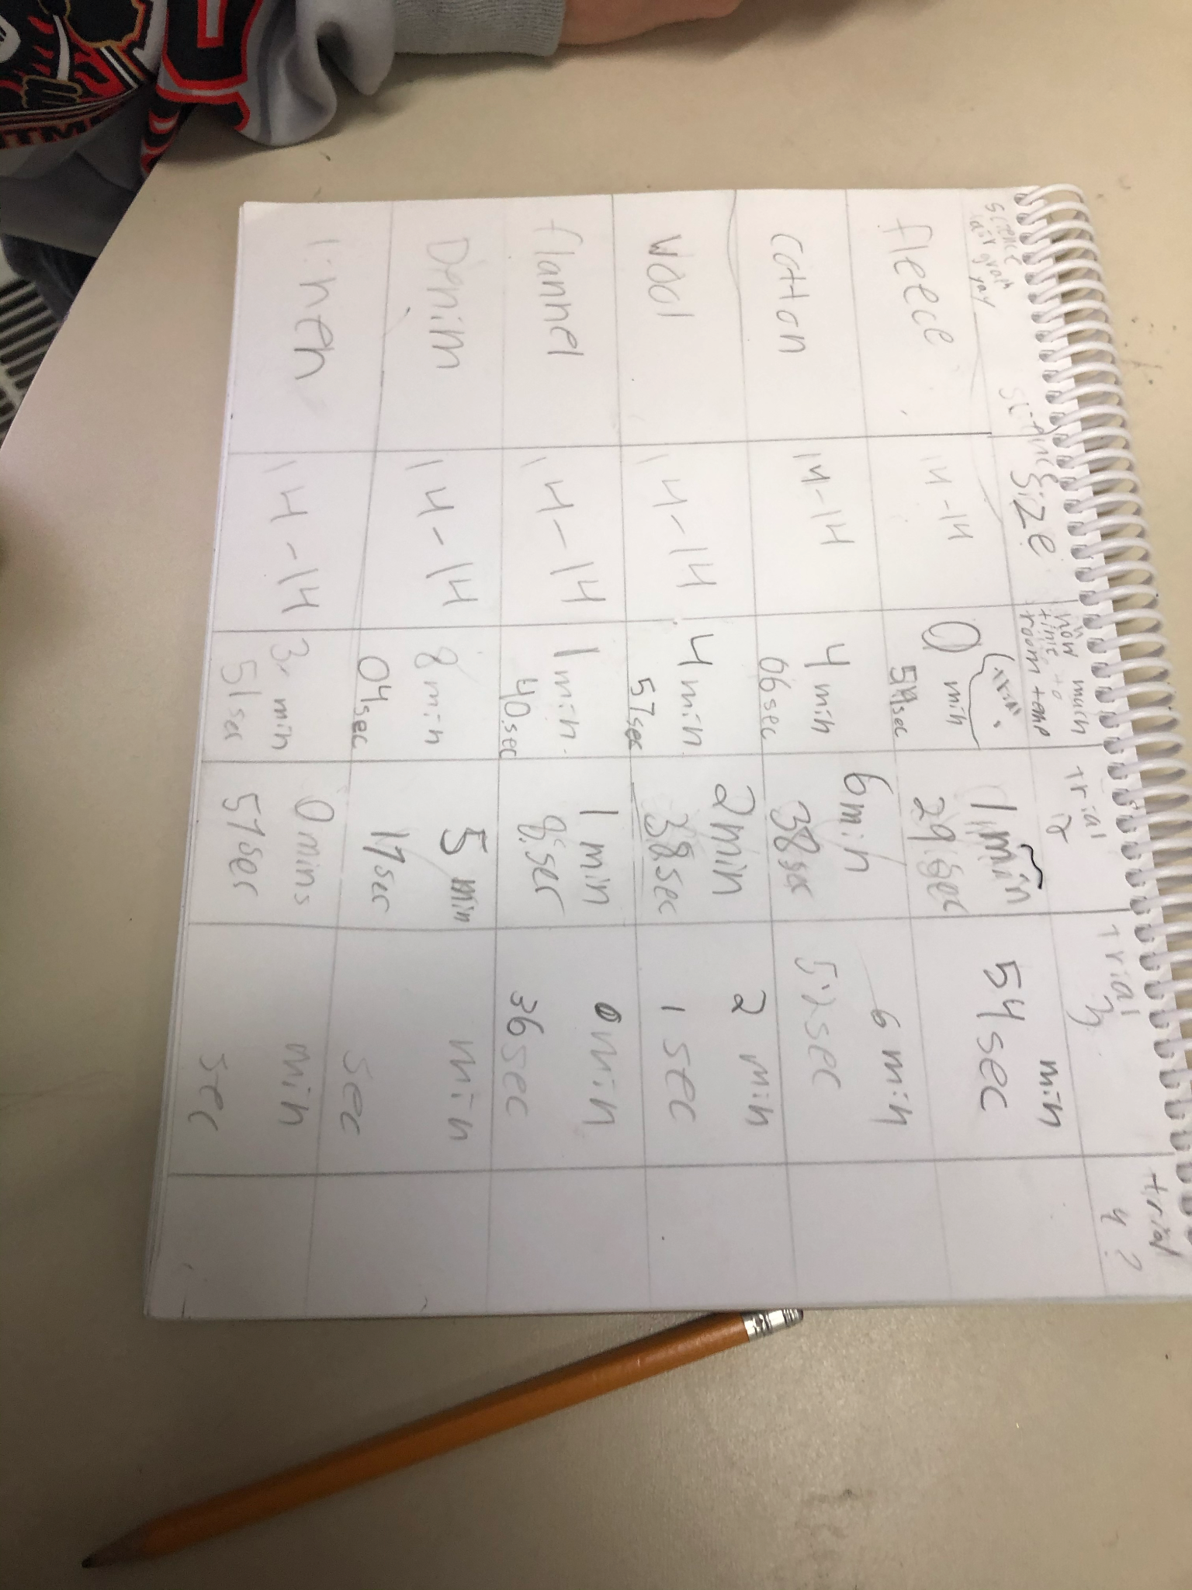
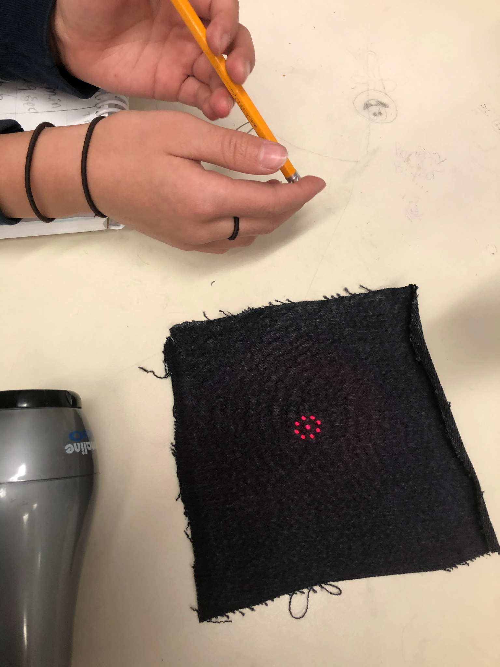
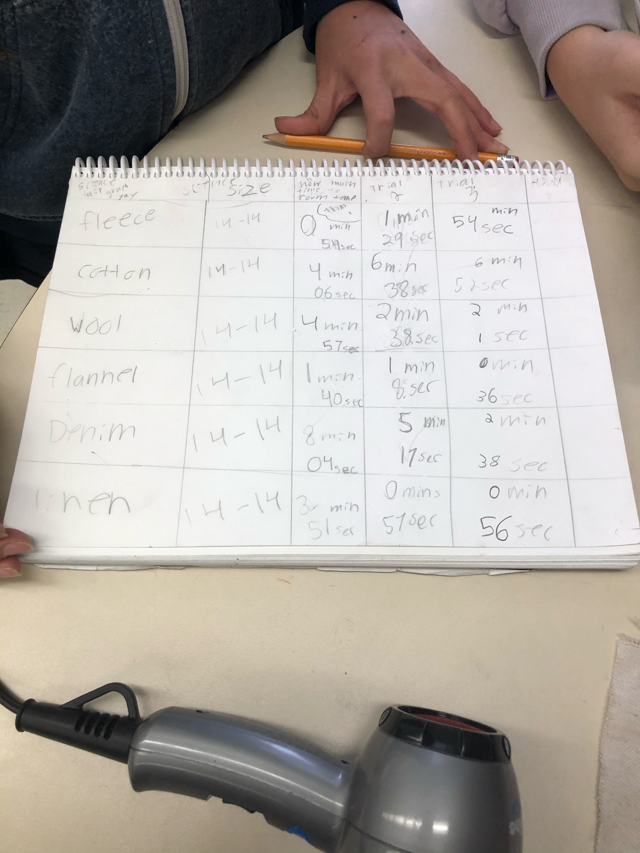
Pictures

Slide 11
Procedure
1. Get materials including fabric, thermometer, and blow dryer.
2. Heat one piece of fabric to 56°C.
3. Start timer and wait for fabric to cool.
4. Stop timer when fabric reaches 24°C.
5. Record time and fabric type.
6. Repeat with other fabrics.

Slide 12
Observations
Fabric | Size | Trial 1 | Trial 2 | Trial 3 | Trial 4
Fleece | 14cm-14cm | 54 sec | 1 min 29 sec | 54 sec | 20 sec
Cotton | 14cm-14cm | 4 min 6 sec | 6 min 38 sec | 6 min 52 sec | 2 min 54 sec
Wool | 14cm-14cm | 4 min 57 sec | 2 min 38 sec | 2 min 1 sec | 1 min 2 sec
Flannel | 14cm-14cm | 1 min 40 sec | 1 min 8 sec | 36 sec | 29 sec
Denim | 14cm-14cm | 8 min 4 sec | 5 min 17 sec | 2 min 38 sec | 46 sec
Linen | 14cm-14cm | 57 sec | 57 sec | 56 sec | 1 min 1 sec

Slide 13
Observations
What Happened to Denim!
Denim. Denim started off with a astonishing 8 minutes and 4 seconds! But after it started to decrease faster and in the last trial it took 46 seconds to get back to 24°C! The problem is likely that the timer didn't start on time.
Denim

Slide 14
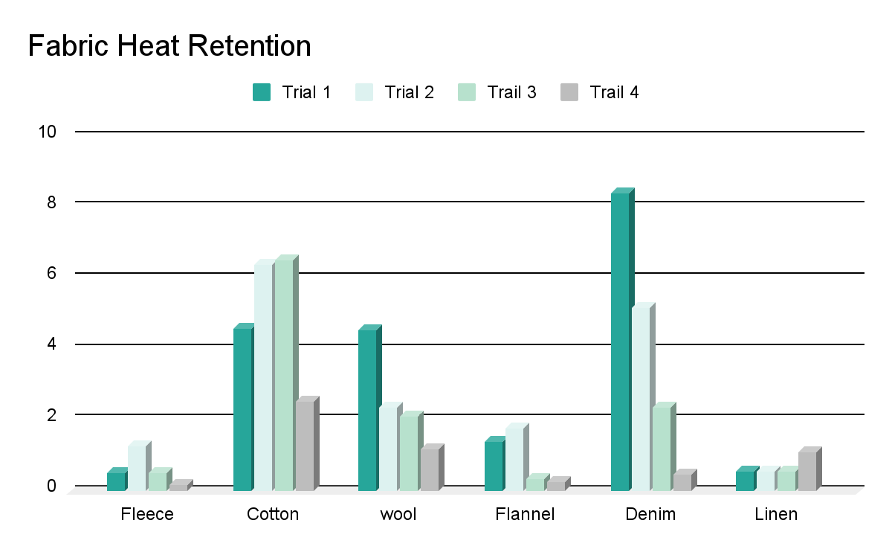
Graph

Slide 15
Analysis
My data told me that Denim holds heat the longest out of Fleece, Cotton, Wool, Flannel, and Linen.
I learned that if I want to dress warm I should wear Denim.
A connection I made is that my Dad wears jeans and he is always warm!

Slide 16
Conclusion
My hypothesis was incorrect because, denim tock the longest to go back to room temp, At a astonishing 8 min and 4 sec!
If I were to expaned on this progect I would test more fabric and if the do bester in more harsh envierments.

Slide 17
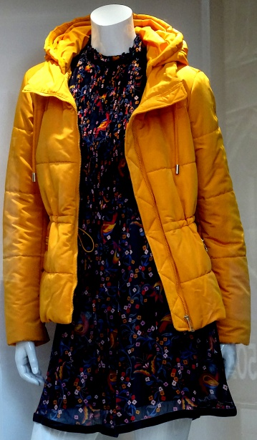
Real World Application
In real life this is good information to know because… We would know what to wear if it was cold outside.
If I was to expand on my project then I would test if they do better outside or inside. I could also see which of the fabrics stay cool.

Slide 18
Sources of Error
One of my sources of error is that my piece of wool that I had was thicker than all of the other fabrics because it came from a hat. It also was't the exact size that is was supposed to be it was to big. That would mean that it can hold more heat so it takes longer to cool down.
Wool

Slide 19
Real World Applications
- Denim is can be hard on the environment because…
Some cotton is produced in a sustainable way. It doesn't use pesticides and uses less water and energy.
Next steps:
1. How diffrent weaving paterns efect how much heat it holds.
2. How diffrent types of denim retain heat.
3. Testing diffrent blends of fabric.

Slide 20
Bibliography
agiboo. (no date). Retrieved from
https://www.agiboo.com/12-interesting-facts-about-cotton/
Britannica. (no date) Retrieved from
https://www.britannica.com/topic/cotton-fibre-and-plant
Candorthreads. (no date). Retrieved from
https://candorthreads.com/what-fabrics-are-tightly-woven/
eNZees. (no date). Retrieved from
https://enzeesfootsoother.com/blogs/news/10-cool-facts-about-woolv
FACTS.NET. (no date). Retrieved from
https://facts.net/lifestyle/food/17-unbelievable-facts-about-yard-of-flannel/
Good on you. (no date). Retrieved from
https://goodonyou.eco/how-sustainable-is-fleece/
Long Jhon. (no date.) Retrieved from
https://long-john.nl/10fun-facts-you-need-to-know-about-denim/
Madam de la Maison. (no date). Retrieved from
https://madamedelamaison.com/blogs/putting-it-all-on-the-table/why-should-you-love-linen
Sewport. (no date). Retrieved from
https://sewport.com/fabrics-directory/denim-fabric
Shirts in Bulk. (no date). Retrieved from
https://www.shirtsinbulk.com/blogs/articles/fun-facts-about-fleece
Tripel Pundit. Feb 2, 2016. Retrieved from
https://www.triplepundit.com/story/2016/low-down-sustainable-cotton/57221

