Slide 1
LCD and Potentiometer

Slide 2
HELLO!
I this is Zeb and Sabbir
And I'm here to do Our Science fair ueh fi8er f7u presentation

Slide 3
Let's Start Guys
Let’s start with the first set of slides

Slide 4
What is and LCD
A Liquid Crystal Display (LCD) is a type of output display that uses liquid crystals combined with polarizers. LCDs come in all sorts of shapes and sizes. They are also very flexible depending on their size. They were first invented in 1964 by Radio Corporation of America (RCA) and it was first mass-produced by Epson in 1982. LCDs have replaced the heavy, bulky, and less energy-efficient cathode ray tubes (CRT) displays. More so, CRTs were more prone to break due to them being mostly made out of glass.
There are six layers to an LCD screen:
The first layer consists of a polarizer filter film that has a vertical axis that allows light that enters through to be polarized
The second layer consists of a thin glass sheet that contains indium tin oxide (ITO) electrodes. The shape of these electrodes are embedded into the glass sheet, which determines what will be shown when the LCD is switched on
The third layer has a thin layer liquid crystals arranged in a way called the twisted nematic field effect
The fourth layer has another thin glass sheet that contains ITO electrodes but this layer has horizontal ridges that lines up with the horizontal polarizer film
The fifth layer has a another polarizer filter film but this one has a horizontal axis that either blocks or passes light
The sixth layer consists of a reflective surface that sends light back to the viewer. In a backlit LCD, the reflective surface is replaced by a light source
LCDs use much less power than the bulky CRT, which makes them produce less heat than its predecessor. LCDs produce no image bleeding nor smearing and produce high-quality images when displayed in a fixed resolution. Unlike CRTs, LCDs are not affected by any magnetic interference. LCDs can also display data from a Digital Visual Interface (DVI) or High-Definition Multimedia Interface (HDMI) connection without having the need to convert to analog data. But there can be downsides to having an LCD like limited viewing angles in older, cheaper displays. This is due to the viewer’s position on viewing the display, which affects the color, saturation, contrast, and brightness in certain angles. LCDs have a variety of applications such as TVs, monitors, digital watches, calculators, smartphones, and many more devices that require an output display.

Slide 5
What is a Potentiometer
A potentiometer is a type of resistor that has three-terminal ends with a sliding rotating contact that forms an adjustable potential divider. Potentiometers are mostly used to control electronics for example they are used to control the volume of audio equipment. It can also be used to control the speed of a fan. Potentiometers can also act as a position transducer, a type of mechanism that converts a signal from one type of energy to a signal in another type of energy, which is used in joysticks for example. Potentiometers consists of a resistive element (made from carbon or other highly resistive materials), a sliding contact that makes electrical contact with the element, two of the terminals are attached to the ends of the element and the other terminal is attached to the sliding contact, a shaft that moves the sliding contact from one part to the other and a housing to enclose the element and the wiper.
A trimpot is a type of potentiometer that is adjustable but it is really small in size. They are commonly used to initially calibrate equipment after the manufacturing process. They are usually mounted directly on a printed circuit board (PCB) due to them having three-terminal legs instead of the ones with holes in the terminals and their knob can be turned by a screwdriver. The name trimpot used to be a registered trademark from a company called Bourns, but later the name became generic. There are two main types of trimpots, a skeleton potentiometer, and a multi-turn potentiometer. A skeleton potentiometer works like a regular trimpot but it’s stripped from its enclosure and shaft. They also move less than a single full turn. A multi-turn potentiometer has a type of gearing arrangement inside the trimpot so it can do multiple turns, which makes it really precise to set the resistance.

Slide 6
Materials
16, breadboard jumper wires
1, 10k potentiometer
1, LCD screen
1, 9V battery
1, breadboard
1, USB cable
1, UNO R3 controller board

Slide 7
Hypothesis
If the knob of the potentiometer is turned anywhere to the right. Then the phrase on the LCD screen will become brighter.

Slide 8
Procedure
Connect jumper wires to a Breadboard and to the UNO R3 controller board to configure the LCD and potentiometer so that you can program.
Connect the USB cable to to the UNO R3 controller board.
Open Arduino coding app.
Program the LCD screen so it can start up and show a phrase (you don’t need to program the potentiometer). Like this:
// Import the Liquid Crystal library
#include <LiquidCrystal.h>;
//Initialise the LCD with the arduino. LiquidCrystal(rs, enable, d4, d5, d6, d7)
LiquidCrystal lcd(12, 11, 5, 4, 3, 2);
void setup() {
// Switch on the LCD screen
lcd.begin(16, 2);
// Print these words to my LCD screen
lcd.print("HELLO IM AN LCD!");
}
void loop() {
// put your main code here, to run repeatedly:
}
Start the program and see if it works, if i doesn’t then take a look at the wires and see were you go wrong.

Slide 9
Variables
Manipulated variable: The position of the knob on the potentiometer.
Responding variable: How bright or dim the phrase of the LCD screen is.
Controlled variables: the voltage of the battery, the UNO R3 controller board, and the size of the LCD screen.

Slide 10
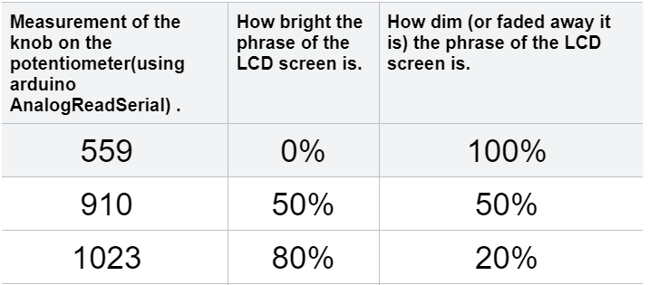
Qualitative and Quantitative
We analyzed that by turning the knob of the potentiometer to the middle, I saw the phrase disappear. This might be because the potentiometer doesn’t let any electrons go through. Then I turned the knob from the middle to a quarter to the right, the phrase wasn’t too dim nor too bright. This might be because the potentiometer is letting a steady flow of electrons through. Then I turned the knob all the way to the right, this made the phrase so bright you can barely see the phrase. This might be because the potentiometer is letting almost all the electrons go through. This is similar to a floodgate in where we control the flow of something and in this case we control the flow of electrons.

Slide 11
Conclusion
It was predicted in our hypothesis that turning the potentiometer anywhere to the right would make the phrase on the LCD screen brighter. That’s because the potentiometer is like a resistor. There are different types of resistors. Different resistors have different effects but with a potentiometer, it’s a three-way variable resistor that you can control.

Slide 12
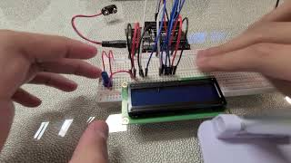
Video

Slide 13
Citations
Bojack 10K Ohm Breadboard Trim Potentiometer With Knob For Arduino P103 3 Termin. (n.d.). eBay. Retrieved February 19, 2024, from https://www.ebay.ca/itm/373153101301
Braza, J. (2020, May 21). How Variable Resistors Work. Circuit Basics. Retrieved February 19, 2024, from https://www.circuitbasics.com/variable-resistors/
Laptop - Free computer icons. (n.d.). Flaticon. Retrieved February 19, 2024, from https://www.flaticon.com/free-icon/laptop_5957235
Liquid-crystal display. (n.d.). Wikipedia. Retrieved February 19, 2024, from https://en.wikipedia.org/wiki/Liquid-crystal_display
Potentiometer. (n.d.). Wikipedia. Retrieved February 19, 2024, from https://en.wikipedia.org/wiki/Potentiometer
Smart Phone Icon PNG & SVG Design For T-Shirts. (n.d.). Vexels. Retrieved February 19, 2024, from https://www.vexels.com/png-svg/preview/128754/smart-phone-icon
"tablet" Icon - Download for free – Iconduck. (n.d.). Iconduck. Retrieved February 19, 2024, from https://iconduck.com/icons/22620/tablet
tv icon Vector Illustration 582064 Vector Art at Vecteezy. (n.d.). Vecteezy. Retrieved February 19, 2024, from https://www.vecteezy.com/vector-art/582064-tv-icon-vector-illustration

Slide 14
THANKS!
Any questions?

