Slide 1
Plants Vs Soil Erosion
Reyansh Chandra

Slide 2
Problem
Can plants reduce the amount of soil eroded on a sloping surface with water as the eroding agent?

Slide 3
Hypothesis
If I pour water on some sloping surfaces with plants and some without plants, then less soil will erode from the slope with plants. A plant’s roots are what stabilize the soil and keep it from flowing away in a runoff. Plants can also stop the erosion of soil by using their wide growth and branches to keep hard rainfall from damaging the soil, as well as other low-lying plants.

Slide 4
Issues of Soil Erosion
Soil erosion is the natural and sometimes human caused wearing away of soil and it is causing some major issues in our world today. One of the issues is the wearing away of topsoil, which is the layer of soil that contains all the nutrients and fertility and nurtures the growth of plants. The topsoil possesses minerals such as magnesium, potassium, phosphorus, and nitrogen, all essential for plant growth. It also helps in the absorption of nutrients from the soil. This is due to its pH level, which is between 5.5 and 7.5. That level is neither extremely acidic or extremely alkaline, as 7 is exactly neutral and 5 is slightly acidic. The pH level of the soil affects the plants availability to nutrients, as well as the way the nutrients react with one another. For example, if the soil is extremely alkaline, then specific nutrients will not be available, while others such as iron, manganese, and aluminium shall become toxic. Soil erosion can also deposit silt in low lying areas and expose subsoil, which is the soil layer directly beneath the visible top layer. Silt deposits can be bad for the environment because when silt flows away in a runoff, it can have a toxic effect on the environment where it is deposited, or moved. For example, silt that erodes, or runs off from areas that use chemical fertilizers can spread to water bodies and make them poisonous. This can harm all the living things that use that water, such as people, animals, and fish. Exposure of subsoil is also not the best because it might increase the chances of more soil erosion, as it has a poorer structure and lower organic matter. The subsoil also has reduced water infiltration and this means in can’t absorb the water in the chance of a runoff. This will increase the chances as it will have to stand its ground against a larger amount of water, increasing the chances of runoff. All of these effects are neither good for our environment nor us, as water is a necessity of life for all organisms and agriculture is a major part of our lives as it provides all of the food we eat to perform our daily activities. The issues of soil erosion threaten 2 of our necessities of life, food and water. It also hurts the environment as many animals and plants also use the water soil erosion contaminantes. This threatens life on planet earth itself. When soil erosion happens, our soil is lost. Soil is a very important resource on our planet and we should do everything to conserve it. Some ways we can reduce this is by planting plants, recycling our resources, and laying plant matter, such as mulch. Laying mulch helps because it helps in easing the absorption of water and improving erosion resistance. These are just some of the ways we can stop the effects of soil erosion.* *See pictures on following slide

Slide 5
Healthy Topsoil
Topsoil should have the right amount of nutrients, a ideal level of pH, as well as good texture and water absorbance. As mentioned before, topsoil is the layer of soil which contains the most nutrients and helps crop grow. To perform this task, a layer of healthy topsoil should contain the right proportions of sand, clay and organic matter. It should also provide nutrients to your landscape, as well as good drainage while still holding enough moisture for the plant roots to absorb. The topsoil should also contain nutrients such as, magnesium, phosphorus, potassium, and nitrogen. Each and every one of these nutrients has an important role to play in the growth of the plant. Nitrogen helps in the growth of healthy stems and leaves, while the potassium and magnesium help to photosynthesize and provide the plant with lush green leaves. Phosphorus helps in the production of the plant’s cells and DNA. Aside from the nutrients, the topsoil’s pH level also decides the quality of it. The topsoil should have a pH level which is neither extremely acidic, nor extremely alkaline. This level can be found between 5.5 and 7.5. The pH level of the soil can affect the growth of the plant in many ways. The level can affect the plant’s availability to nutrients, as well as how these varying nutrients react with one another. An example of this would be that if some topsoil was extremely alkaline, then some nutrients shall not be available, while other nutrients such as iron, manganese, and aluminium shall become toxic or be in such large quantity that they are not helpful to the plant anymore. Though many plants can cope with a wide range of pH levels, many problems can be caused with a level of pH respective to the plant. Topsoil also varies across regions with different textures and water absorbance. For example, clay can be found in many gardens, but it is hard to work with as it has a tendency to harden and traps the nutrients in the stick soi, though it has a good level of water absorbance. A more ideal kind of topsoil would be the loamy and sandy type. This soil has a dark and rich color, lightweight, and friable. A quick identification tst should be that the soil is hard to roll into a ball and then breaks apart easily. Topsoil si a important layer of soil and should be saved and protected from the process of soil erosion.

Slide 6
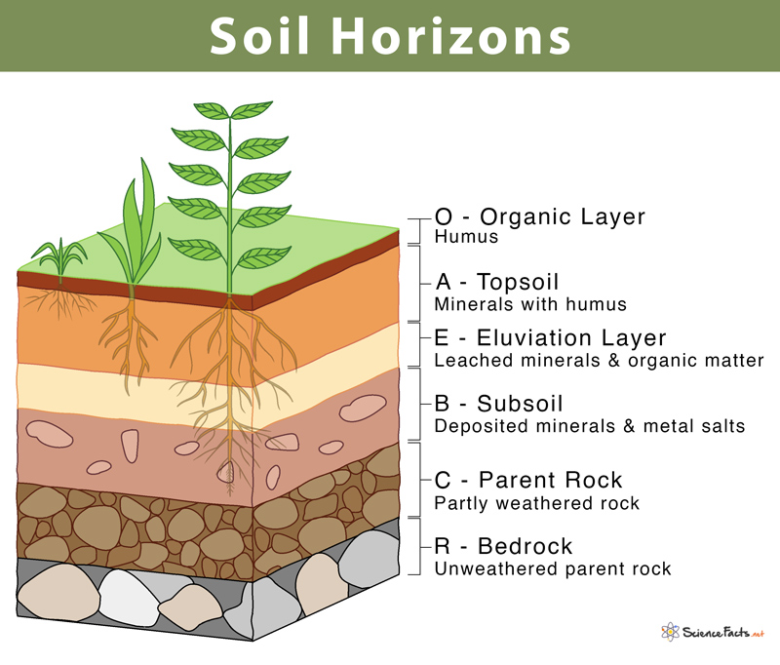
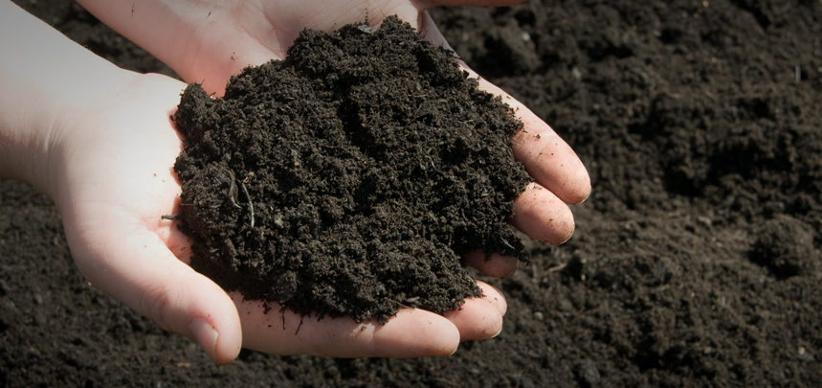
Topsoil
Topsoil Layer A

Slide 7
Types of Root Systems
Roots are a crucial underground part of vascular plants. The roots are mainly responsible for anchoring the plant into the ground and taking in all the necessary minerals, nutrients, and water which is present in the soil. The roots can also be used for the storage of food. These are some of the responsibilities that a plant’s roots overtake, but there are also different types of root systems, the 3 being taproot, fibrous, and adventitious. The taproot system primly consists of one main central root with small and lateral roots protruding out of it, known as tertiary or secondary roots. At the end of these, you shall find the thin hairlike structure known as a rootlet. These rootlets are essential for the absorption of water from the soil. The taproot system is strongly established and hard to remove. Some examples of plants with the taproot system are carrots, mustard, beetroot, and parsley. The second type of root system is known as the fibrous root system. It consists of a bushy system of roots with moderately sized branching roots protruding from the stem. Some plants which posses this root system are maize, rice, and marigold. The final type of root system is known as the adventitious root system. This is a unique system that does not grow from the radicle like the previous other 2 root systems. A primary root is present and this kind of root system is a characteristic of angiosperms, or flowering plants. It is modified for respiration, support, as well as food storage. Roots are essential for the survival of any plant and these types of roots systems are present for the plants specific needs, as well as necessary activities, such as anchoring, absorption, storage, reproduction, and ecological functions.

Slide 8
Soil Erosion Causing Natural Disasters
Among the many things that impact the rate and occurrence of natural disasters, soil erosion is a major one. Some examples of natural disasters being impacted by soil erosion are floods, landslides, and droughts. Floods are impacted greatly by the occurrence of soil erosion, and when this happens, great destruction is caused. This happens because soil erosion caused in a runoff can send soil laden water downstream, which can clog up and stop the flow of water in rivers and streams. These blockages can eventually result in the effect of flooding. Another natural disaster caused courtesy of soil erosion is drought. The reason for this is that the top layer of soil is most productive and absorbs precipitation best. When this layer of soil is removed due to soil erosion, the lower layers of soil are exposed. These layers aren’t nearly as productive, thereby making their ability to absorb water lesser than that of the topsoil, perpetuating the drought cycle. Landslides are also a major negative effect of soil erosion. The erosion can often drive landslides especially when the slope biomes uneven or unstable. They are also mainly caused by undercuts caused by soil erosion. All of these different natural disasters can have a negative impact on our lives. Therefore we should control soil erosion the best we can.

Slide 9
Plants Vs Soil Erosion
Many of the types of plants stop soil erosion through their different types of roots. Some roots are fibrous, while some maybe strong, but not as widespread. These all play a different role in stopping soil erosion as explained ahead. Groundcover plants stop soil erosion through their widespread roots. An example of a plant with this method is Ivy. Shrubs can use their strong roots. Aside from the roots, they also use their thick blooming leaves and branches to act as a physical barrier. These characteristics assist them in protecting the soil from harsh winds, downpours and extreme sunlight. An example of a shrub that does this is Buckwheat. Grass uses its fibrous roots to stop the occurrence of soil erosion and is extremely useful on hilly and sloping surfaces. Last but not least, trees also play a major role in stopping soil erosion from occurring. Their roots can help stabilize the soil and they make great usage of their branches that also stop hard rain which may hurt the soil and low lying plants. An example of this would be the Willow tree. All these plants use roots to stop the soil from eroding, flowing, or blowing way. *
*See diagram on following slide

Slide 10
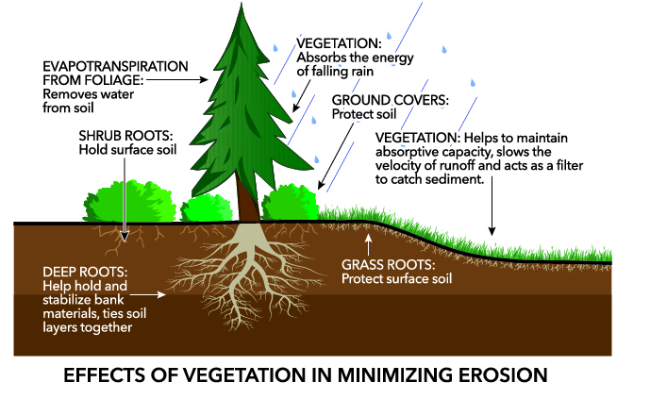

Slide 11
Importance of Soil
Sometimes we don’t realize that many of the things that we use today come from soil. Soil is the life giving earth in which crops can grow in. Soil provides 95% of the world’s food. Climate change is a global issue of the earth getting heated to quickly and soil, along with plants, can also play a role in the decrease of it. A plant extracts CO₂ from the air during during photosynthesis, hence reducing that amount of Carbon Dioxide present in the air. After doing so, the plant saves the Carbon Dioxide in the soil as fresh plant residues and highly decomposed material known as humus. Hence, there is also a large amount of CO₂ being stored in the soil and when that soil is eroded away or dug through by heavy machinery to build commercial items, even more Carbon Dioxide is released into the atmosphere. This is reversing all the plants work to rid of CO₂ when it was alive and living. Biodiversity is also essential to our food security, which is ultimately the amount of food produced in a certain area and we want that to be as high as possible, because if the amount of food security was minimal, survival would be difficult for all living beings. A large variety of biodiversity is present in soil and therefore many fungus and insects which provide nutrients to our food live in soil, as explained later on. Soil is one of the main global reservoirs to the extent that 25% of animal species live underground, while 40% of organisms live in terrestrial ecosystems and are associated with soil in some part of their life. Soil can aslo unearth medicines. Many of the life-saving drugs and vaccines that are used today were discovered in rich and biodiverse environments situated in soil. Some examples include penicillin and bleomycin, which can be used to cure cancer andamphotericen. This concludes the fact that soil is essential for our survival and we need to save our soil.*
*See diagram on following slide

Slide 12
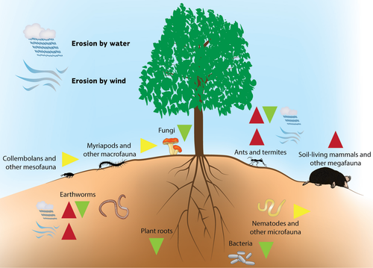

Slide 13
Types of Soil Erosion
Soil erosion can happen in different forms. The two major categories are wind erosion and water erosion.
Water Erosion is when the soil erodes through water in a runoff.
Sheet Erosion- when the soil is eroded in thin uniform layers or sheets.
Rill Erosion-when the soil is eroded in small strips of land a bit smaller than gully erosion.
Gully Erosion-when the soil is eroded in deep grooves on unprotected land.
Bank Erosion- the slumping, undercutting and scouring of the rivers and other water bodies due to fast flowing water.
Wind Erosion is when the soil is eroded by methods of wind
Crop damage- The airborne soil can sandblast delicate leaves and stems and can even bury plants and seeds cause a decrease in crop yield.
Dust storms- When the dry and loose soil particles are suspended in the air, they can cause harsh dust storms that may last several hours. These storms can damage crops, harm livestock, and cause a variety of serious human health problems, such as asthma attacks and dust pneumonia.

Slide 14
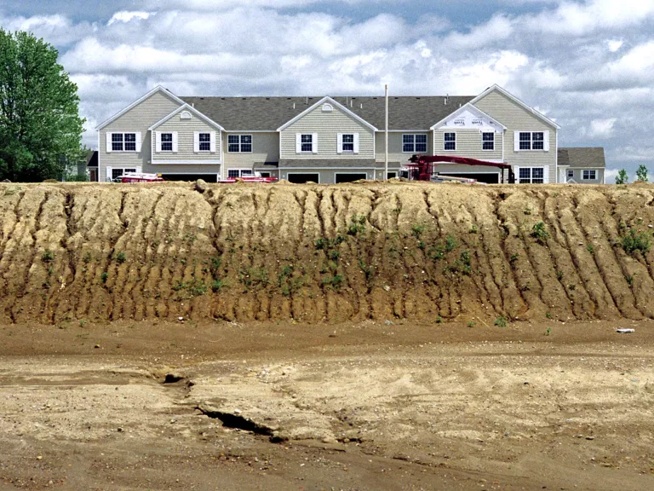
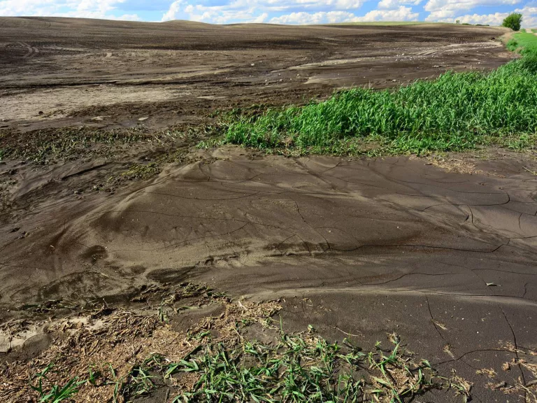
Sheet Erosion
Rill Erosion

Slide 15
Variables
Manipulated Variable- Plants or No Plants
Responding Variable- Amount of soil eroded by my experiential rainfall.
Controlled Variables- Amount of soil in each pan, angle of pan, type of pan, size of pan, amount of water, and the type of soil

Slide 16
Materials
Scissors/Knife
Aluminum bread pans (6) 21x14cm
Aluminum cake pans (3) 38x25cm
Ruler
Sticky Notes
Kitchen Scale
Soil
Chickpeas (42)
Permanent Marker
3-5 cm tall plastic container
Stopwatch
Rain spout watering can
Cotton cloth
Water

Slide 17
Procedure
How to sprout chickpeas:
Soak raw chickpeas in room temperature water for 12 hours.
Then wrap (soaked) chickpeas in a wet cloth for 24 hours.
Most will have sprouted and are ready to plant!
Experiment Procedure:
Take the 6 bread pans and fill them ⅔ of the way with soil so it does not overflow the pans.
Poke 3 holes along both of the long sides of each bread pan using scissors. The holes should be about the size of a dime.
Take the 3 cake pans and measure the weight of one of them using the kitchen scale.
Place 2 bread pans in each of the cake pans.
Plant the sprouted chickpeas in 3 of the bread pans. They should be about 2.5 cm apart.
Label each bread pan either “seeds” or “no seeds”.
Water your plants (and the no seeds) regularly for 7-10 days until they are 8-10 cm tall and ready for the experiment.
Make 2 vertical cuts down halfway down the short side of every bread pan. Fold the flap downwards.
Rinse all cake pans
10. Take a 3-5 cm tall container to prop the uncut side of the bread pan and the
cut side will be in the cake pan to create a slope.
11. Fill up your watering can fully and pour water on the slope created for 5 seconds. (Note: Hold your can high so the water flows to every part of the pan and fill up the can after every trial.)
12. The cake pan will now be a mix of soil and water.
13. Carefully drain the water out using a stringer and measure the weight of the cake pan with the soil. Subtract the weight of an empty pan from it. Use a kitchen scale.
14. Repeat steps 11-13 for all of your pans.
15. Analyze your results.

Slide 18
Observations
I had observed a few things during doing my experiment. One of them was that when the water flowed through the soil, it was taking many particles of soil with it into the cake pan. Many of these particles were so miniscule that they did not separate with the stringer. I think this means that the soil may have dissolved into the water. This might actually be similar to what happens to water bodies when silt is deposited in them. I had also had a few preliminary trials before my experiment in which I noticed that the more damp the soil was the less likely it was to erode. This was probably because the water automatically helps the soil particles bond with each other. One of the major things that I observed though, was that a lot of soil eroded of my slope. I had probably filled the pan just a little before the rim and after pouring water on it, it was like a whole layer of soil had been removed. This shows how much soil can possibly erode in real life.

Slide 19
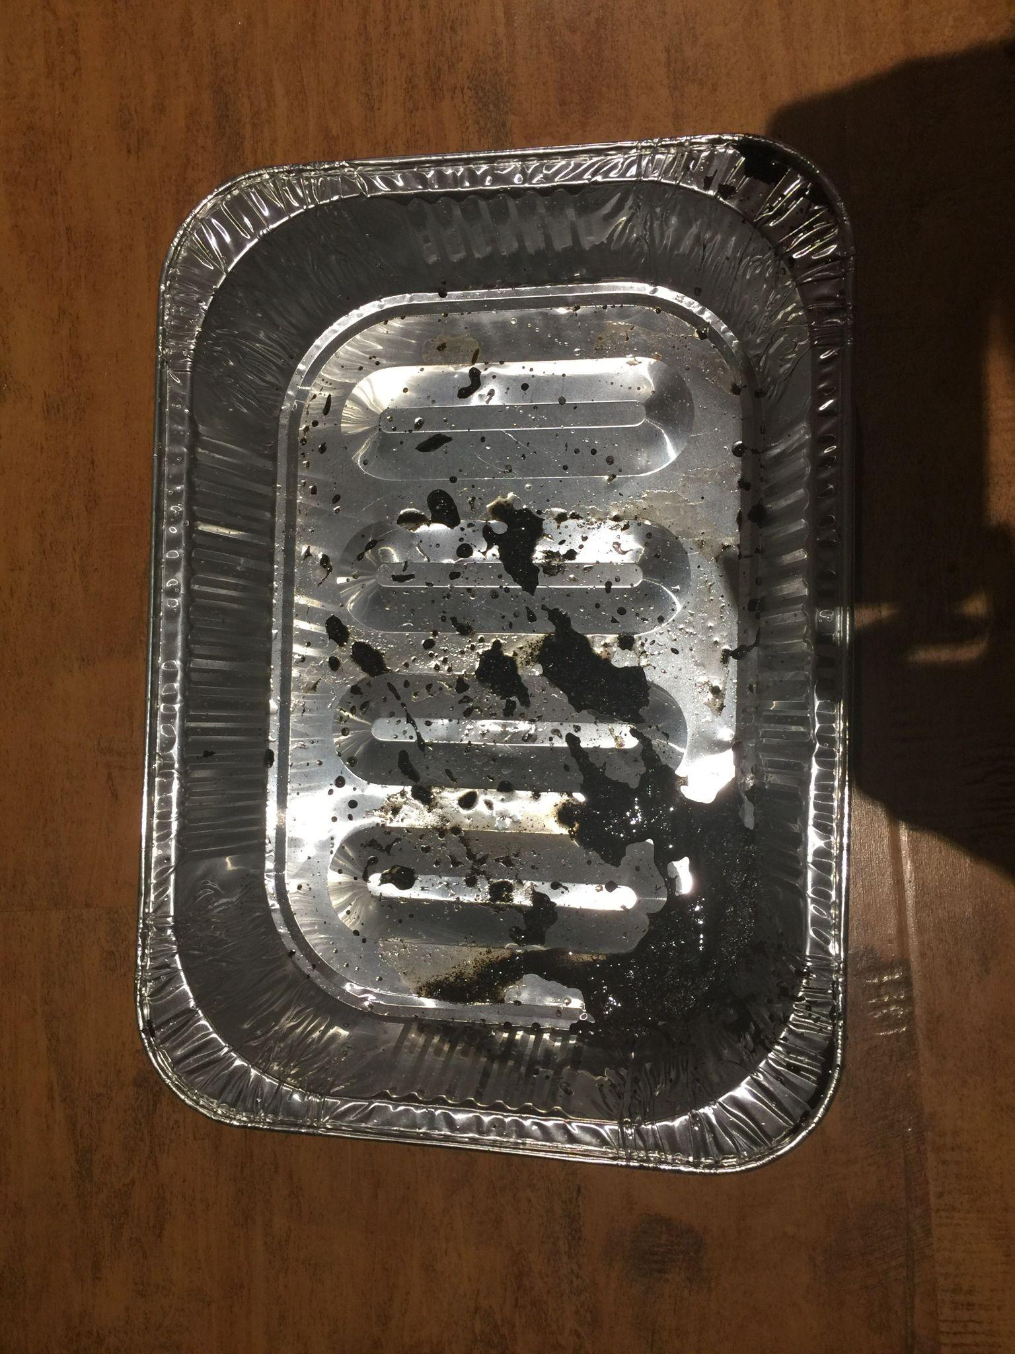
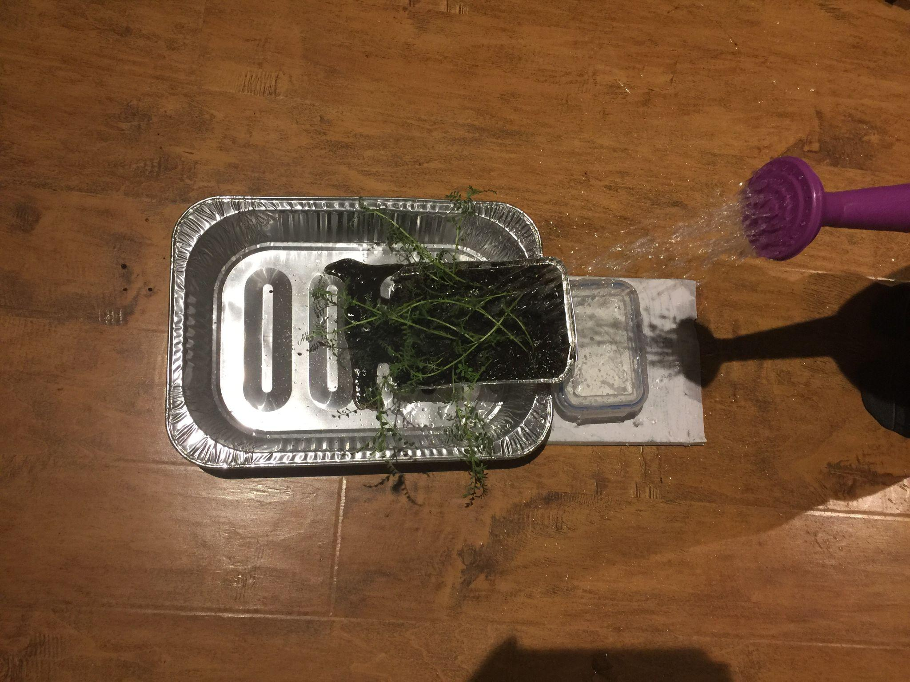

Slide 20
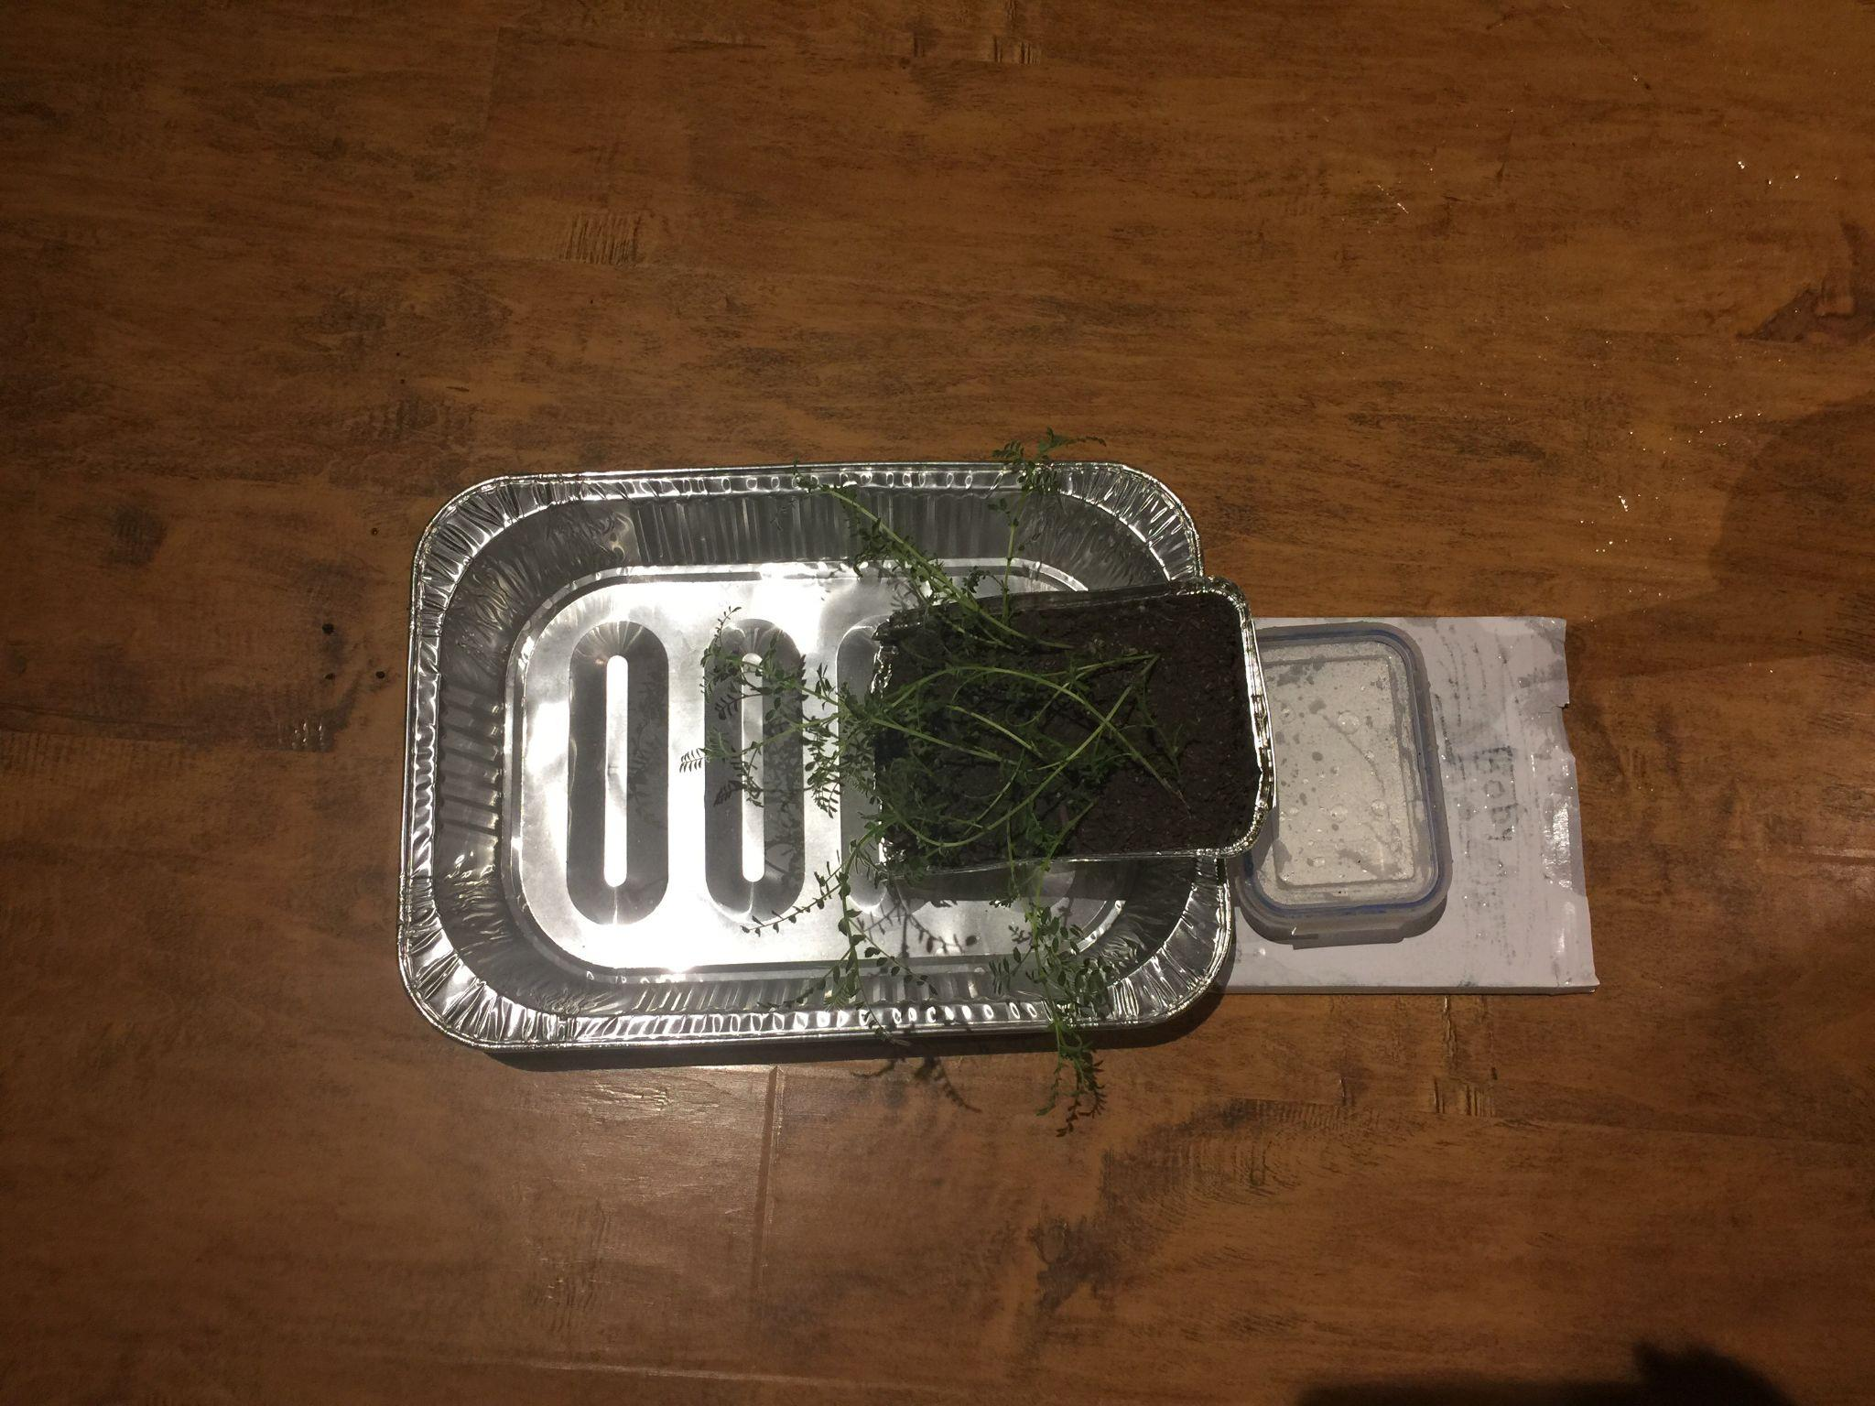
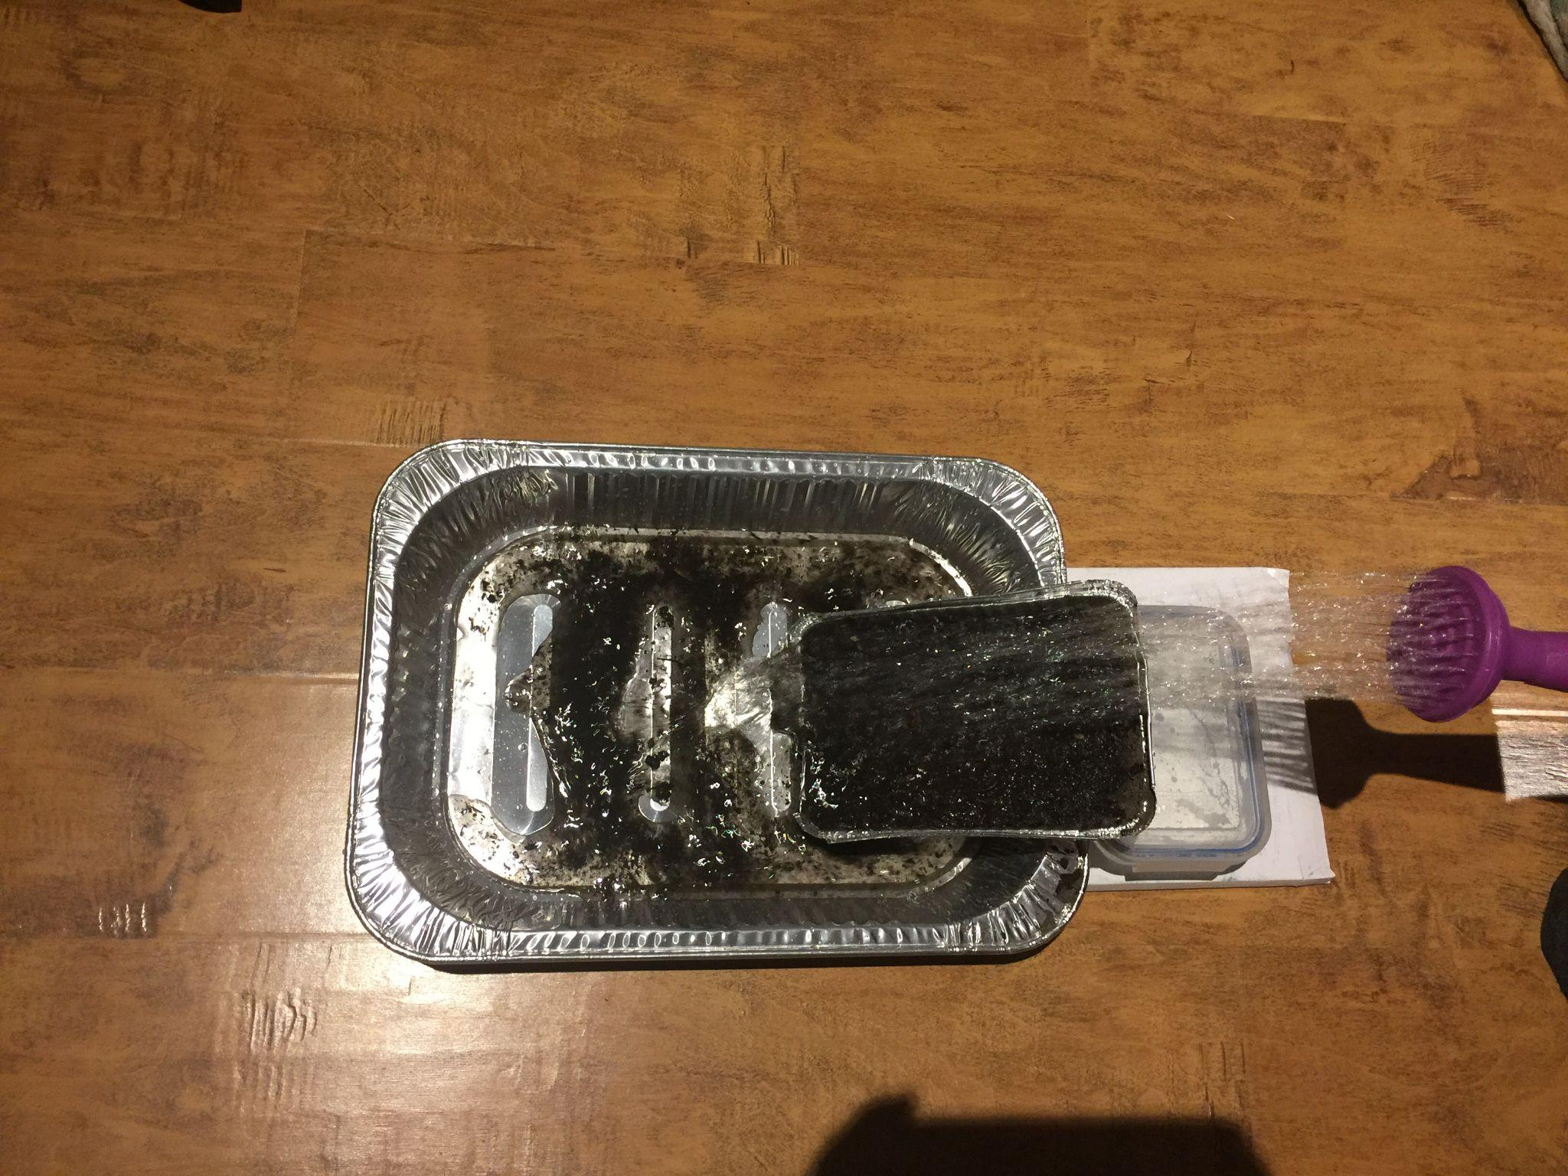

Slide 21
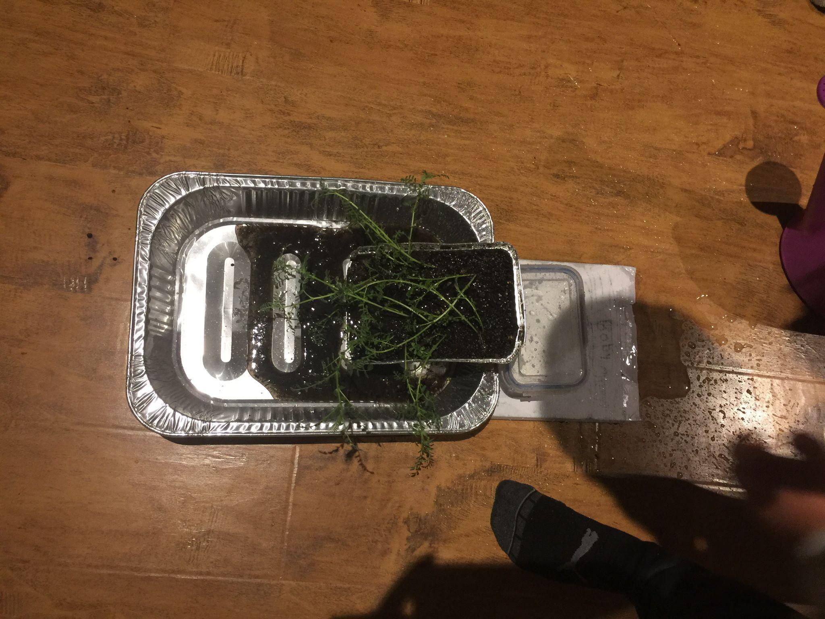
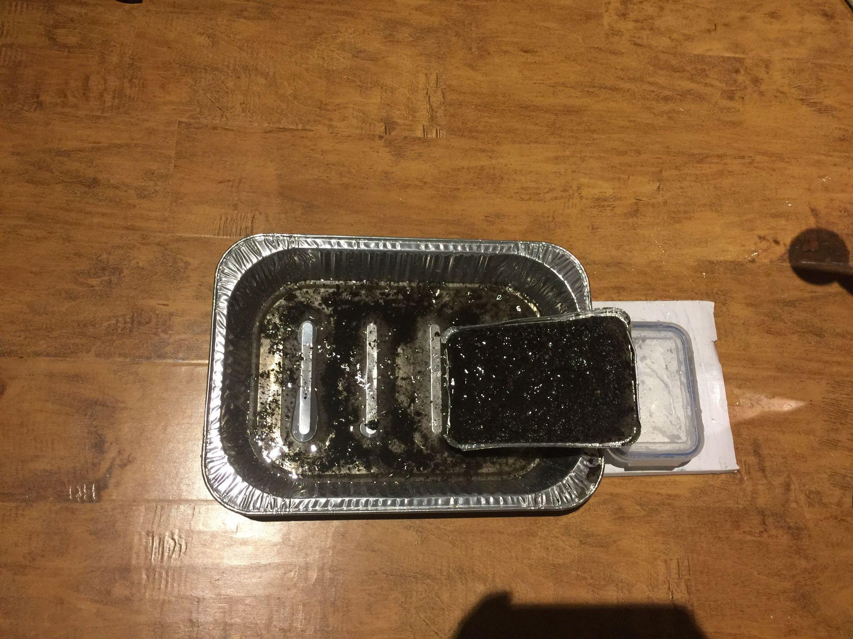

Slide 22
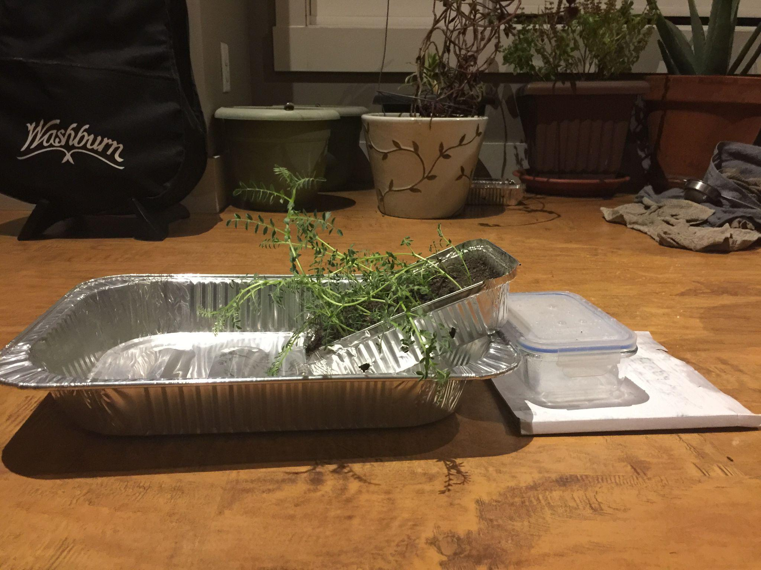

Slide 23
Data
 | Amount of Soil Eroded Without Plants (in grams) | Amount of Soil Eroded With Plants (in grams)
Trial1 | 100 | 74
Trial 2 | 84 | 60
Trial 3 | 60 | 50

Slide 24
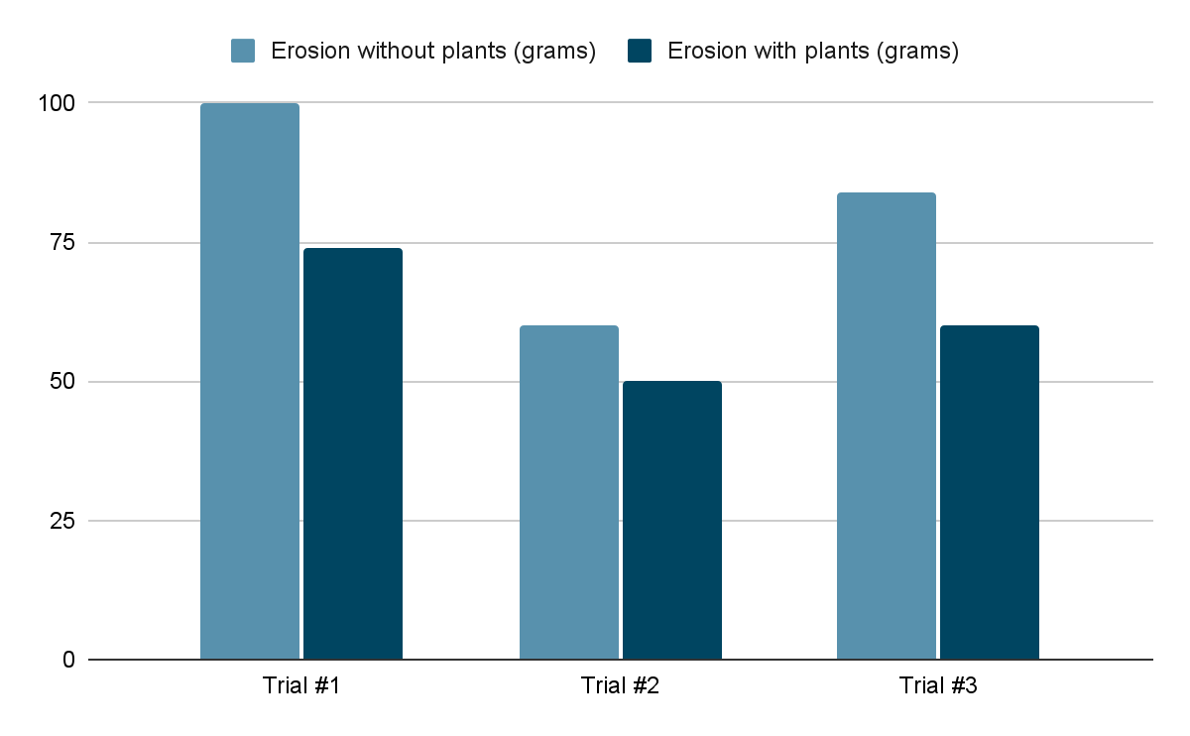
Soil Erosion - Trials

Slide 25
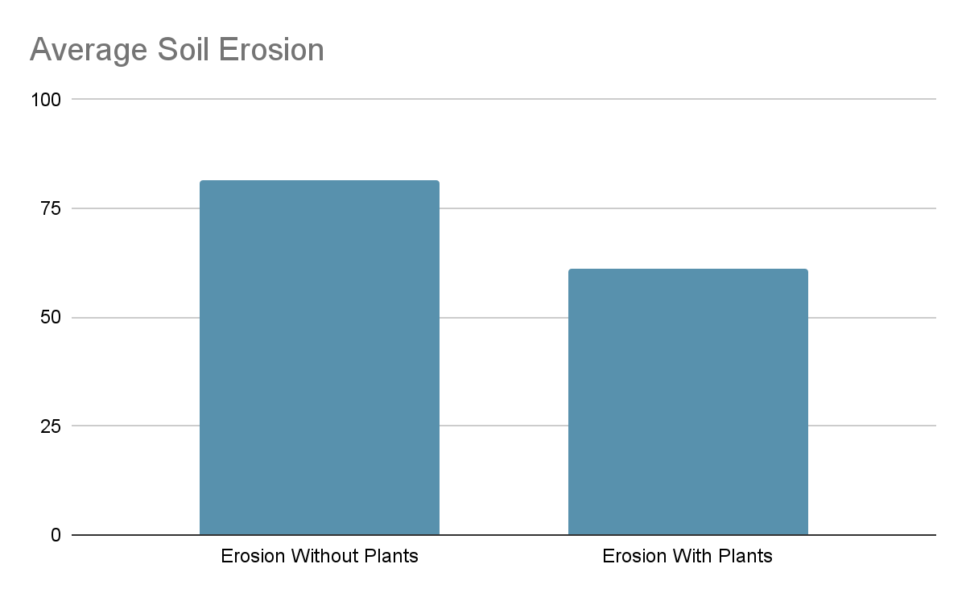
81.33
81.33
61.33
61.33
Notes:
I had 3 different results for the bread pan with plants and 3 results for the pans without plants. This graph shows the average of both of them results as shown in the table.

Slide 26
Analysis
My hypothesis of less soil eroding from the slope with plants was correct with connection to my experiment. One of the things that may have impacted my results was that some pans had less plants than the others, but they still proved to hold the soil together even with the amount of roots that they had. The weight of the soil that eroded from the plantless slope was always greater than the weight of the soil that flowed of the slope with plants. This means that we lost less soil, thus proving my hypothesis to be correct. We know that grass is the best type of plant to stop soil erosion on slopes due to their possession of fibrous roots. Though our plants were chickpeas, part of the leguminous shrub category. This means that the chickpeas if a leguminous plant, but grows like a shrub, in dense clumps that support each other. A legume is can be simply be defined as a member of the bean family. Some other common legumes would be lentils, peas, peanuts, and soybeans. Though our chickpea plants were not this dense, they still might have displayed some shrub qualities when preventing soil erosion. Another interesting fact to consider is that chickpea plants consist of a taproot system with a primary root and small secondary roots protruding out of it. These roots are strong and are difficult to remove. Therefore the chickpea plant is a shrub with a taproot system, with the ability to reduce the effects of soil erosion. The data concludes the fact that plants do stop soil erosion we can and should do everything we can to plant them and save our precious, life-giving earth, known as soil.

Slide 27
Conclusion
There a few things that could be taken away from this experiment. One of them is that plants reduce soil erosion with their roots. My experiment proved this because in every trial, I had 1 pan with plants and another without plants. My hypothesis was correct and I also would assume that the reason was also the same. The roots of the plants are what stopped the erosion from occurring. I also had a few preliminary trials to check for any errors before I did my final experiment. In these trials I observed that the damp soil is automatically compacted by the water, while the dry and crumbly soil erodes easily since the water molecules can easily separate the soil particles from each other. The big message to take away from my experiment is that soil is very important for survival and plants are one of the largest solutions to the problem of soil erosion.

Slide 28
Applications
There are many different ways that the reduction of soil erosion can impact humanity and make our world a better place. All of the flora and fauna that need a hearty amount of soil will thrive and our water bodies shall become pure due to the absence of chemically treated silt in them. Some of the next steps that can be taken to reduce this issue include joining clubs or contribute to organizations which help the environment and animals. People are encouraged to plant as much greenery as possible and save and recycle the resources that are provided to them. They are also encouraged to try and be eco-friendly with everything that they use. For example, instead of washing their car in their driveway with buckets of water, they take it to the car wash, which recycles the water. Another thing that is possible is not using chemical fertilizers when growing plants, because this can again hurt our environment by flowing into water bodies and hurting the insects in the soil. All of these tips to save our soil may seem small and miniscule compared to the problems that face us today, but every little step towards a healthier planet help.We have to be leaders and show others how to save our soil and along with that, our planet.

Slide 29
Next Steps
There are a few steps that we can possibly take to reduce soil erosion on commercial property, one of them being planting plants and grass. This will help as plants are one of the major stoppers of soil erosion, but plants can also improve beauty and naturality of an area if you are stopping soil erosion in a commercial manner. It will improve the look of your property as well as reduce the things that can deplete attractiveness. The newly added plants will also require the soil to be tilled and watered regularly, automatically improving soil health. Another thing that could possibly be done is leveling the landscape, as soil erosion occurs best on slopes and actually more than on a regular leveled landscape. Though most areas might have naturally sloping areas, leveling the land would be best. This will also help as irrigation systems may flow to quickly in some areas and drain poorly in others. The flat landscape will also provide plants with the opportunity to thrive throughout the year. The final activity possible to reduce soil erosion is to install barriers. These barriers can stop soil erosion as they can can reduce the soil erosion caused by excess runoff and winds over time, as well as provide additional privacy to your property. All of these ideas also reduce soil erosion, as well as provide additional benefits to your [property or the area where installed. If financial issues arise though, these benefits can easily be saved for as they have such benefits and are almost a part of business itself. If you also want to improve the health of the soil itself, then manure is a better idea than fertiliser, since fertilizer may be rich in certain nutrients, but can actually reduce soil fertility over time.

Slide 30
Sources of Error
There were few things that could have or did impact my results.
I was the one counting, since the use of a stopwatch seemed to fast and we needed some time for the water to actually flow and erode the soil.
The amount of sunlight may have made a difference in how wet or dry the soil was. As I observed in my preliminary trials before my actual experiment.
Another thing was that my results were rounded and not very exact so the data didn’t get to complex.
The final source of error was that I only completed my experiment once, as I did not have enough time to grow another set of plants. My results would have been more reliable if I was able to collect repeatable data.

Slide 31
Citations for Information
Queensland;, c=AU; o=The S. of. (2013, October 25). Impacts of erosion. Queensland Government. Date retrieved (Oct 25 and 26, 2023) from https://www.qld.gov.au/environment/land/management/soil/erosion/impacts
Mulvihill, K. (2021a, June 1). Soil erosion 101. Erosion 101: Everything You Need to Know About Soil Erosion. Date retrieved (Oct 25 and 26, 2023) from https://www.nrdc.org/stories/soil-erosion-101#water
Soil erosion: Why it happens and what we can do about it. Project Learning Tree. (2021, February 11). Date retrieved (Oct 25, 2023) from https://www.plt.org/educator-tips/how-prevent-soil-erosion/
What is topsoil?. Online Soil. (n.d.). Date retrieved (Oct 25 and 26, 2023) from https://www.onlinesoil.co.uk/knowledge-base/general-info/what-is-topsoil#:~:text=Topsoil%20is%20the%20upper%20layer,the%20ground’s%20nutrients%20and%20fertility
Roundy, D. (2023, October 26). Plants vs erosion: The power of erosion control plants. Granite Seed and Erosion Control. Date retrieved (Oct 31, 2023) from https://graniteseed.com/blog/how-do-plants-help-prevent-erosion/#:~:text=The%20plant’s%20roots%20also%20hold,This%20helps%20prevent%20soil%20runoff.

Slide 32
Citations for Information Con.
“Discovering the Subsoil : Programme: Horizon: Cordis: European Commission.” CORDIS, CORDIS, Date retrieved (Feb 28, 2024) from cordis.europa.eu/programme/id/HORIZON_HORIZON-MISS-2023-SOIL-01-01
“Soil Erosion: Causes and Effects.” Ontario.Ca, Date retrieved (Feb 26, 2024) www.ontario.ca/page/soil-erosion-causes-and-effects.
“Taproot.” Taproot - an Overview | ScienceDirect Topics, Date retrieved (Feb 14, 2024) from, www.sciencedirect.com/topics/agricultural-and-biological-sciences/taproot#:~:text=Chickpea%20has%20a%20typical%20taproot,composition%20(Gregory%2C%201988).
Akbari, Morteza, et al. “Assessing Impacts of Floods Disaster on Soil Erosion Risk Based on the Rusle-GLOSEM Approach in Western Iran - Natural Hazards.” SpringerLink, Springer Netherlands, 30 Mar. 2023, Date retrieved ( Feb 21, 2024) from, link.springer.com/article/10.1007/s11069-023-05925-y#:~:text=Floods%20can%20also%20cause%20damage,most%20critical%20(Lal%202008).
“Understanding Droughts.” Education, Education, Date retrieved (March 7, 2024) from, education.nationalgeographic.org/resource/understanding-droughts/.
Sulaeman, Dede, and Thomas Westhoff. “The Causes and Effects of Soil Erosion, and How to Prevent It.” World Resources Institute, World Resources Institute, 7 Feb. 2020, Date retrieved (March 9, 2024) from, www.wri.org/insights/causes-and-effects-soil-erosion-and-how-prevent-it#:~:text=Soil%20erosion%20decreases%20soil%20fertility,more%20likely%20to%20happen%20again.

Slide 33
Citations for Information Con.
Silt. Home - National Geographic Society. (n.d.).Date retrieved (Dec 7, 2023) from https://www.nationalgeographic.org/encyclopedia/silt/
U.S. Forest Service. Forest Service Shield. (n.d.). Date retrieved (Dec 7, 2023) from https://www.fs.usda.gov/wildflowers/ethnobotany/food/legumes.shtml
Zurich.com. (n.d.-b). Date retrieved (Oct 26, 2023) from https://www.zurich.com/en/media/magazine/2021/how-soil-supports-life-on-earth-and-could-help-win-the-fight-against-climate-change#:~:text=Soil%20helps%20produce%20our%20food,the%20carbon%20and%20nitrogen%20cycles.
How are chickpeas grown? is it a vine, Bush, tree? are chickpeas the seed or the fruit?. Quora. (n.d.). Date retrieved (Dec 7, 2023) from https://www.quora.com/How-are-chickpeas-grown-Is-it-a-vine-bush-tree-Are-chickpeas-the-seed-or-the-fruit#:~:text=Chick%20peas%20are%20legumes%20that,chickpea%20itself%20is%20the%20seed.

Slide 34
Citations for Information Con.
“Alberta Farmers Face Growing Risk of Soil Erosion in 2024 as Drought Persists | CBC News.” CBCnews, CBC/Radio Canada, 22 Jan. 2024, Date retrieved (Feb 10, 2024) from www.cbc.ca/news/canada/calgary/alberta-drought-farm-erosion-risk-2024-season-1.7090899#:~:text=The%20top%20layer%20of%20soil,thereby%20perpetuating%20the%20drought%20cycle.
Oregon State University Landslide Research Group: Landslide Information, Date retrieved, (Feb 15, 2024) landslides.oregonstate.edu/landslides.html#:~:text=Erosion%20can%20often%20drive%20landslides,the%20toe%20of%20a%20slope.
“Can Plants Stop Soil Erosion?: Science Project.” Science Buddies, Science Buddies, Date retrieved, (Oct 10, 2024), from, www.sciencebuddies.org/science-fair-projects/project-ideas/EnvEng_p037/environmental-engineering/can-plants-stop-soil-erosion.
c97078x1. “Three Ways to Reduce Soil Erosion on Your Commercial Property.” Lawn Management Company, Lawn Management Company, 2 Apr. 2020, Date Retrieved, (Feb 18, 2024) from, lmchouston.com/three-ways-to-reduce-soil-erosion-on-your-commercial-property.
Dsahathemes, and Grand River Natural Stone. “Steps to Choosing the Best Topsoil.” Grand River Stone, Grand River Stone, 24 May 2023, Date retrieved, (Feb 15, 2024) from, www.grandriverstone.com/blog/steps-choosing-best-topsoil/.
Admin. “Root System - Roots, Types of Roots and Functions of Roots.” BYJUS, BYJU’S, 6 Oct. 2023, Date retrieved, (Feb 17, 2024), from byjus.com/biology/root-system /.
“Soil Acidity.” Agriculture Victoria, Department of Jobs, Precincts and Regions, 5 Mar. 2024, Date retrieved (eb 27, 2024) from, agriculture.vic.gov.au/farm-management/soil/soil-acidity.

Slide 35
Citations for Pictures
How do plants prevent erosion?: Socratic. Socratic.org. (2017, June 4). Date retrieved (Oct 31, 2023) from https://socratic.org/questions/how-do-plants-prevent-erosion
Mukherjee, S. (2023, February 17). Soil horizons: De31ition, features, and diagram. Science Facts. Date retrieved (Oct 31, 2023) from https://www.sciencefacts.net/soil-horizons.html
Soil Biodiversity and soil erosion: It is time ... - wiley online library. Soil biodiversity and soil erosion. (n.d.). Date retrieved( Oct 31, 2023) from https://onlinelibrary.wiley.com/doi/full/10.1111/geb.12782
“A New Way to Farm Bioneers.” Bioneers, Bioneers, 2 Mar. 2021, Date retrieved (march 10, 2024) from, bioneers.org/soil-erosion-civilizations-and-a-new-way-to-farm-zmbz2006/

