Slide 1
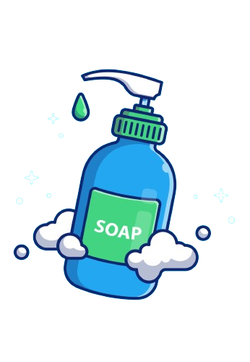
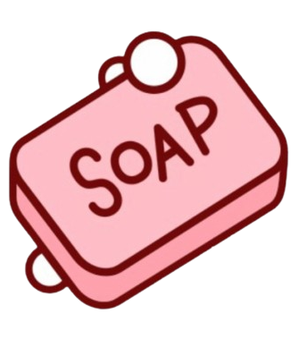
Which Soap Cleans Hands The Best?
By: Luka Dojcinovic

Slide 2
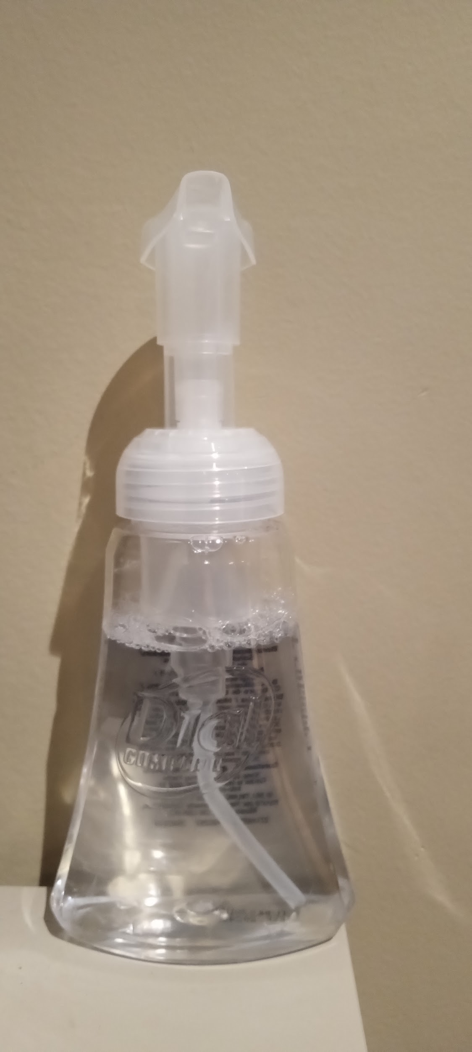
Testable Question
What type of soap takes the most bacteria off your hands?
Bar Soap
Liquid Soap
Foam Soap

Slide 3
Hypothesis
If three different types of soap are tested (Bar Soap, Liquid Soap and Foam Soap), then Liquid Soap will get the most bacteria off your hands because Liquid Soap is sticky so it can get stuck in the crevasses of your hands and reach all of the germs.

Slide 4
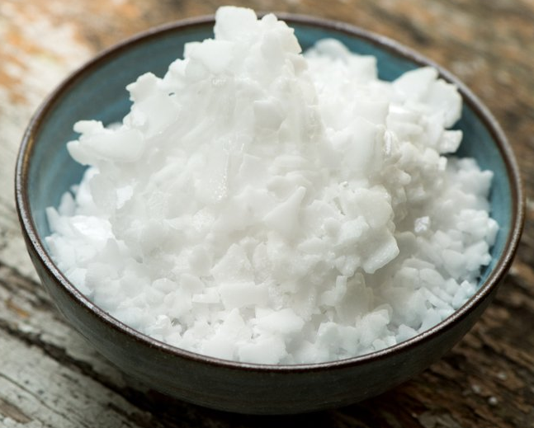
Background Research
Out of the three soaps I am testing, Liquid Soap is most common soap found in homes and businesses for handwashing. Different types of Liquid Soap are used for various purposes. One of the things found in Liquid Soap is potassium hydroxide. Potassium hydroxide is a chemical compound that has a strong base. To produce soap you need to mix together and heat up oil and lye. Lye is another alkaline hydroxide similar to potassium hydroxide. Some oils that are used are castor oil, almond oil, jojoba oil and most vegetable oils. If you wanted to add scent to your soap you can add essential oils or fragrances.
Potassium Hydroxide.
Potassium Hydroxide Chemical Structure

Slide 5
Background Research Continued
One problem with using Bar Soap is that germs can spread between people really easily because of all the people using it. Bar Soap is less commonly used for hand soap and more often seen as body soap for showers. After a few uses of Bar Soap it can get messy and slippery. The oils used for making Bar Soap are Coconut Oil, Avocado Oil, Palm Oil, and lastly Almond Oil. The reason Bar Soap is made with these oils is because these are harder oils then others. These are used in Bar Soap because Bar Soap is meant to be a solid. Just like Liquid Soap, Bar Soap is made with heated oil combined with lye, but the only difference is its pressed into molds.
Foam Soap is exactly like Liquid Soap but Foam Soap is pushed through a unique dispenser to give the Foam the texture. One benefit of Foam hand soap is that it provides more of a lather, making it easier to wash your hands. Because Foam Soap is almost exactly like Liquid Soap it has the same oils as Liquid Soap.

Slide 6
Background Research Continued
There are many infections and diseases that you can get from contaminated hands. Some common ones are Salmonella, E-Coli, Influenza, Colds and Covid-19. These happen when you don't wash your hands properly, and when you touch dirty surfaces and eat afterwards. The younger you are the more times you get colds in one year. Toddlers and preschool age children are most likely to get 8 to 12 colds each year because their immune system is still developing. School age children and pre teens are most likely to get 5 or 6 illnesses a year. Lastly, teens and adults may have 2 to 3 illnesses a year because their immune system is stronger. Another thing is that the older you get, the more you are used to washing your hands and are usually cleaner then young children. So you don’t get sick, always wash your hands before and after you eat, and when you get them dirty. This will help you and your peers stay healthy.

Slide 7
Variables
.
Manipulated Variable (what you can change) | The type of soap (Bar Soap, Liquid Soap, and, Foam Soap)
Responding Variable (what you are looking for) | Amount of bacteria that the soap takes off your hands
Controlled Variables (what stays the same) | The amount of time your hands are under water Amount of soap on your hands How long you rubbed your hands under water Temperature of water

Slide 8
Materials
1 Germ Tracker Kit (Glow Powder and Black Light)
1 Pears Bar Soap
1 Eco Max Liquid Soap
1 Dial Foam Soap
Tap Water
Sink
9 Pieces of Paper Towel

Slide 9
Procedure
Grab all of your materials
Put 1 shake of glow powder on your hand then rub them together
Go to a sink that can give water
Get both of your hands wet
Pick up one of the three soap’s
If you pick the bar soap rub it on your hand for 15 seconds if you pick one of the other ones squirt it once on one of your hands.
You put your hands under the sink then turn on the fossette then rub your hands under water for thirty seconds
Dry your hands with 1 piece of paper towel
Look at your hands with a black light
Record your data on a piece of paper, visually take note of % of bacteria left
Repeat steps 2-10 twice more for best data

Slide 10
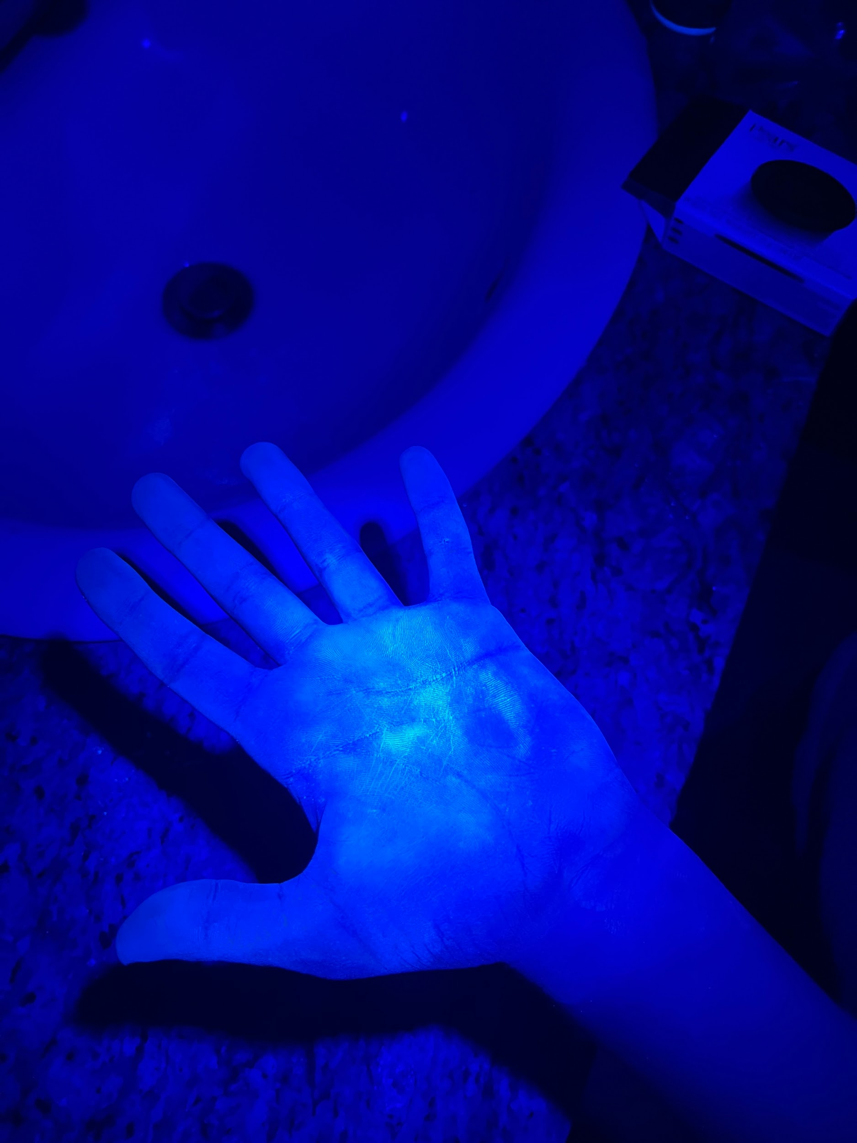
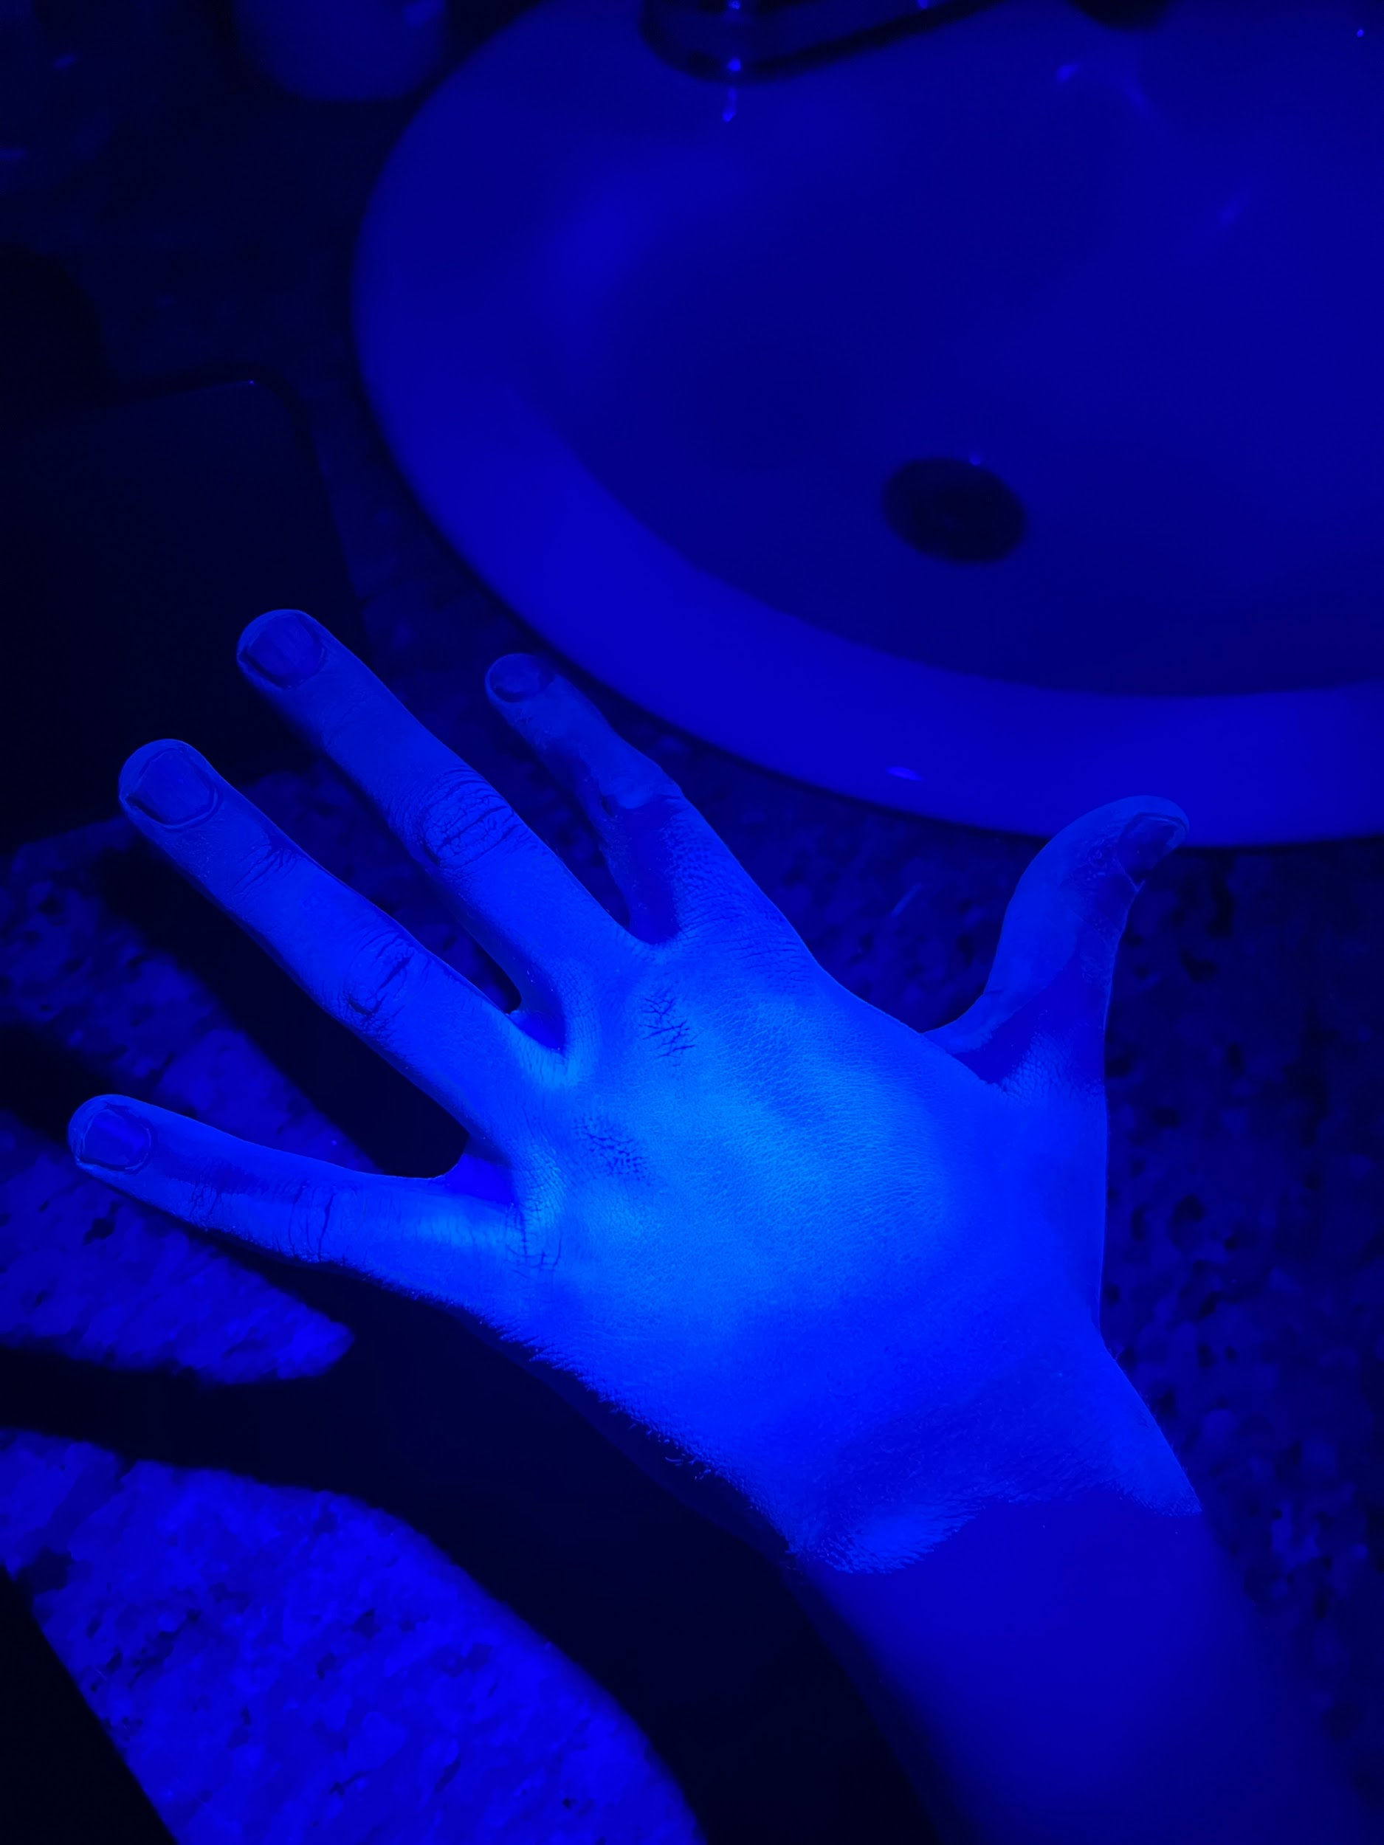
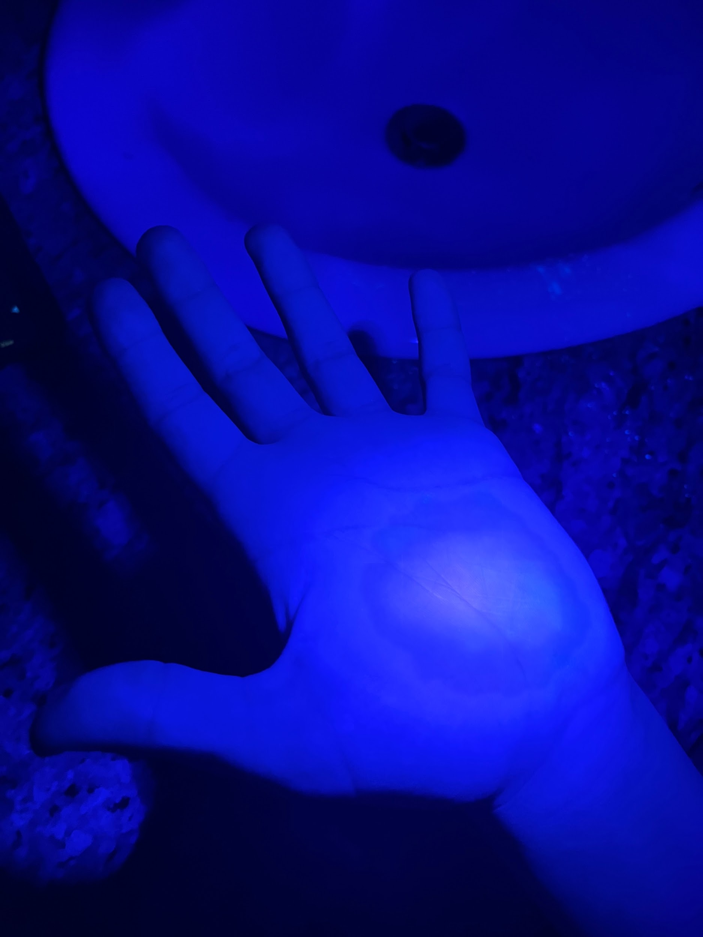
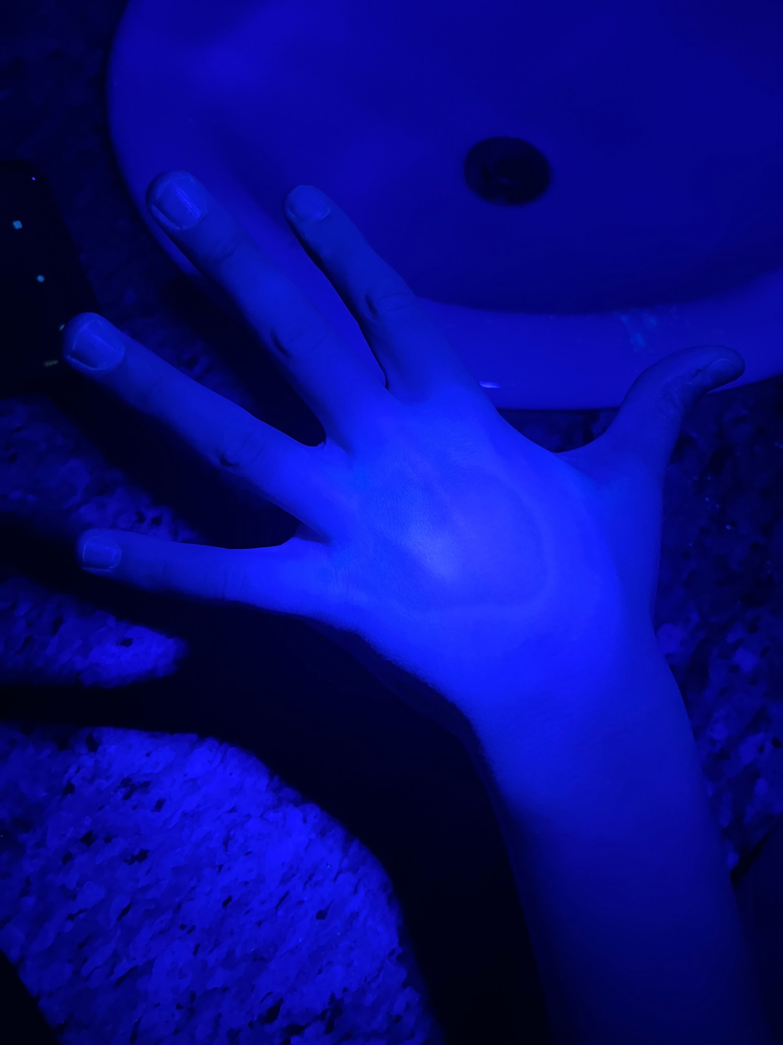
Observations Bar Soap (Test 1)
Palm before washing
Back of hand before washing
Palm after washing
Back of hand after washing

Slide 11
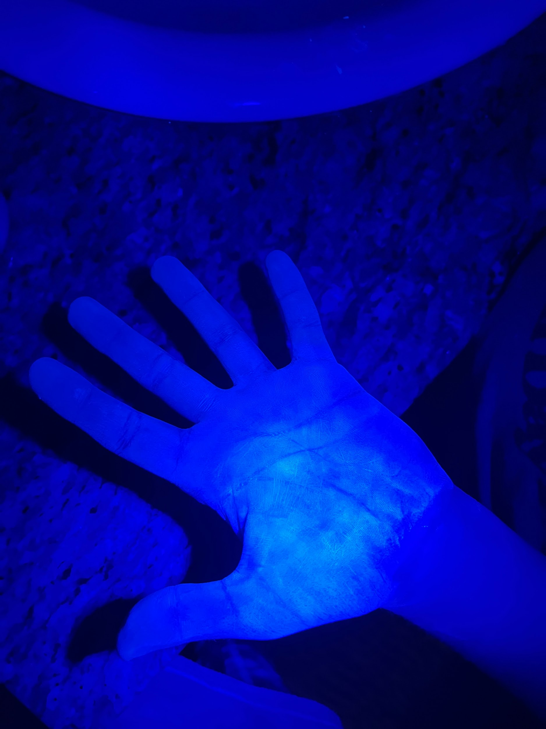
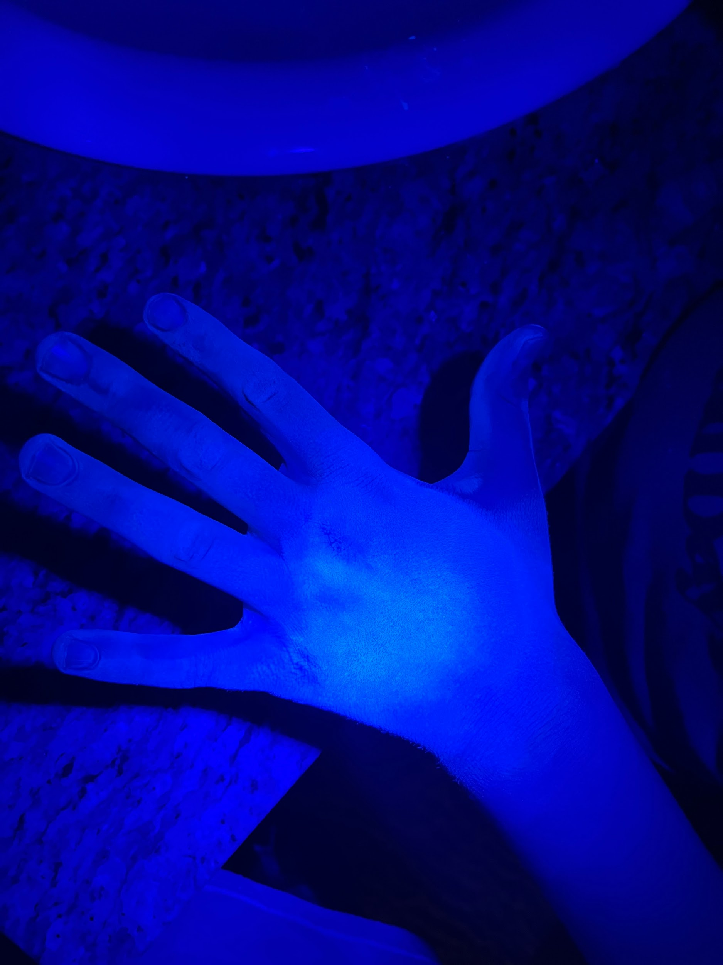
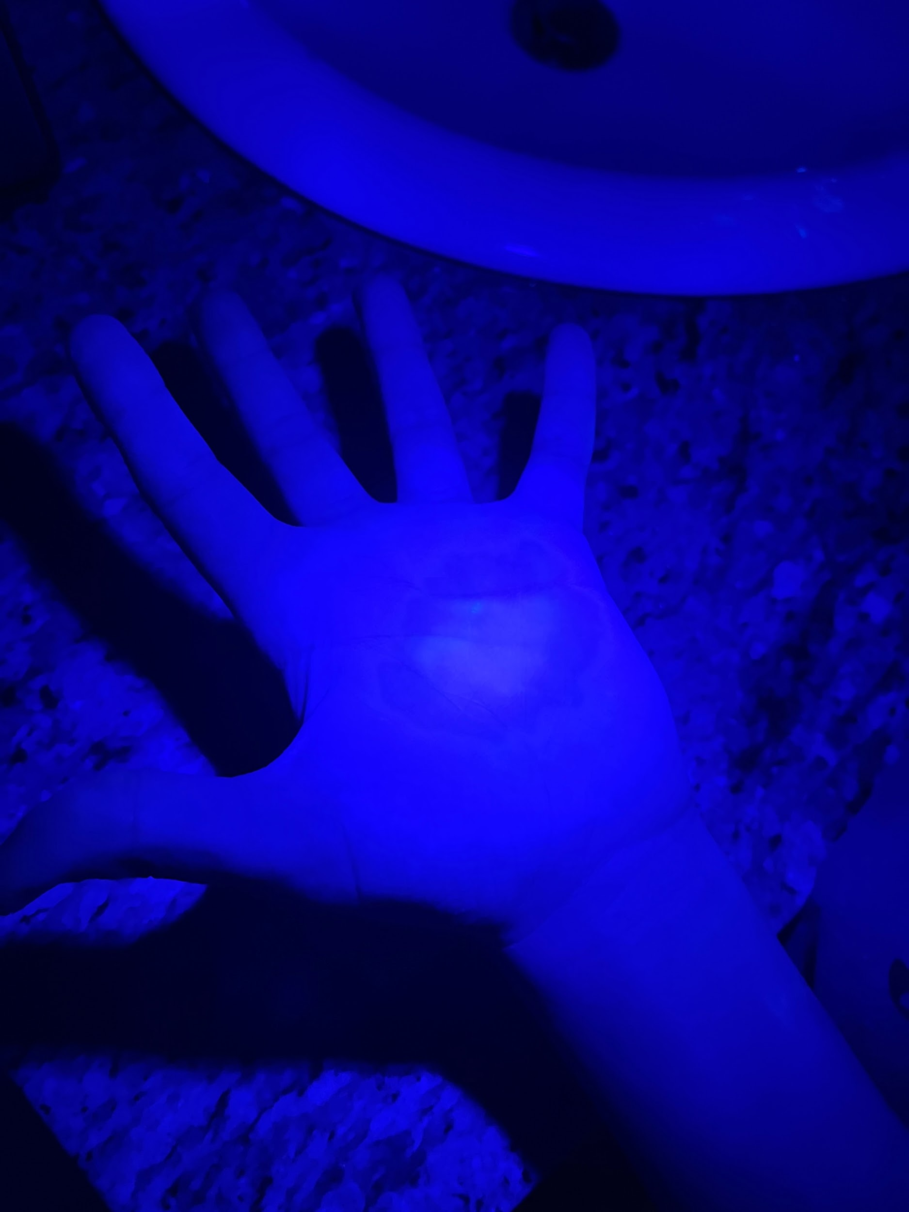
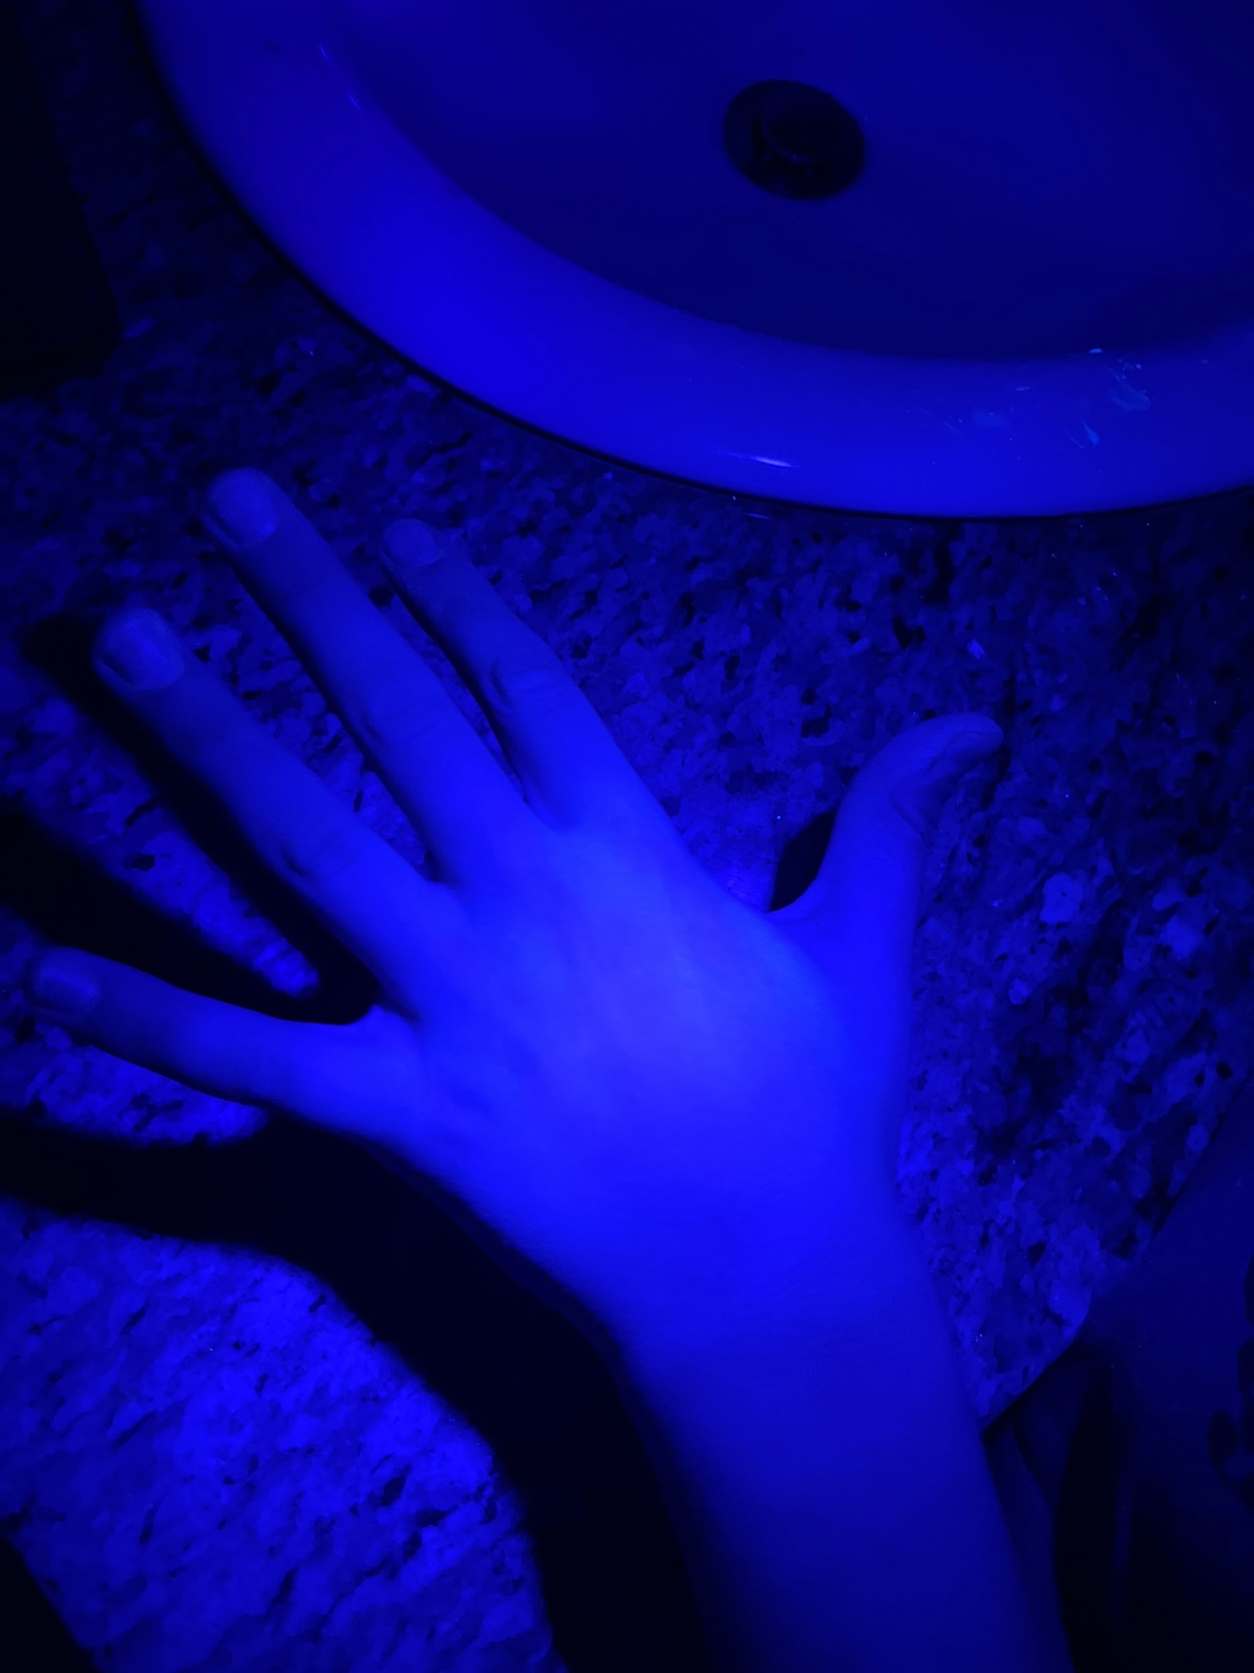
Observations Liquid Soap (Test 1)
Palm before washing
Back of hand before washing
Palm after washing
Back of hand after washing

Slide 12
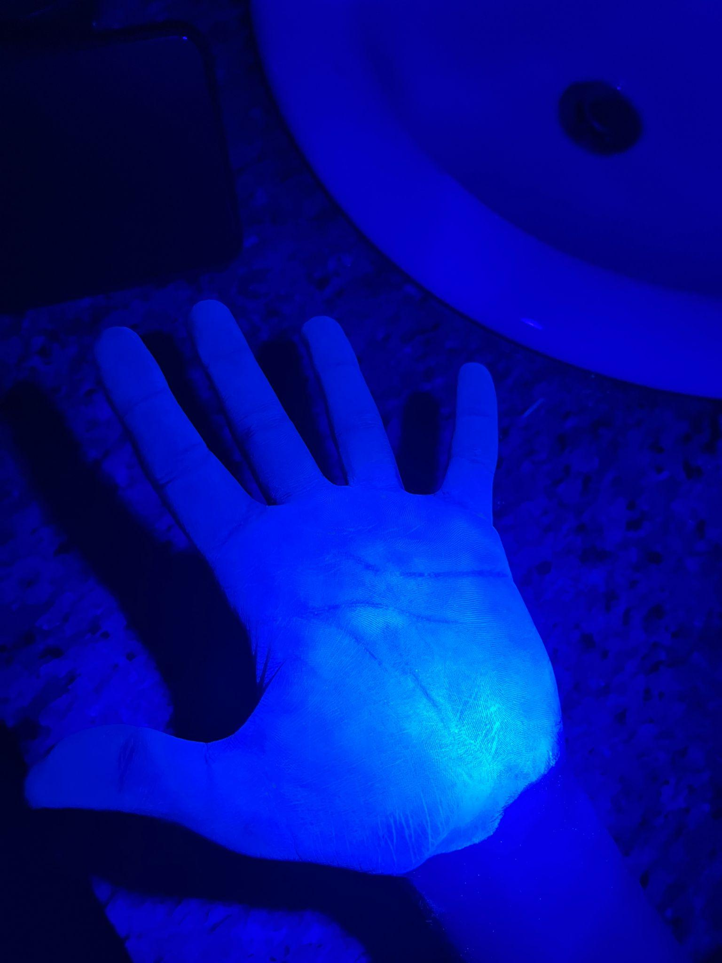
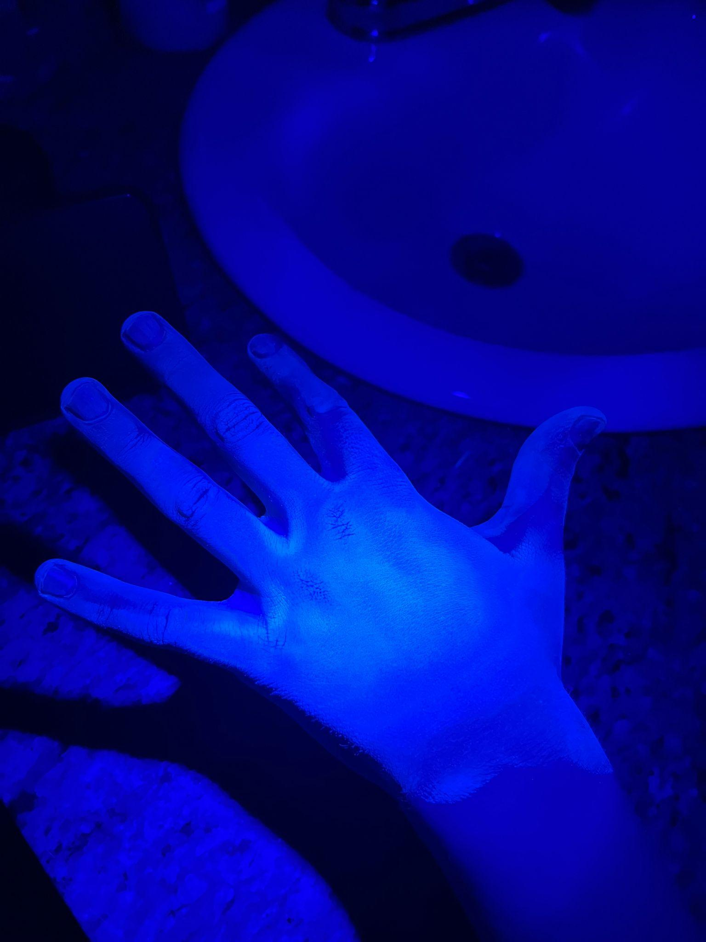
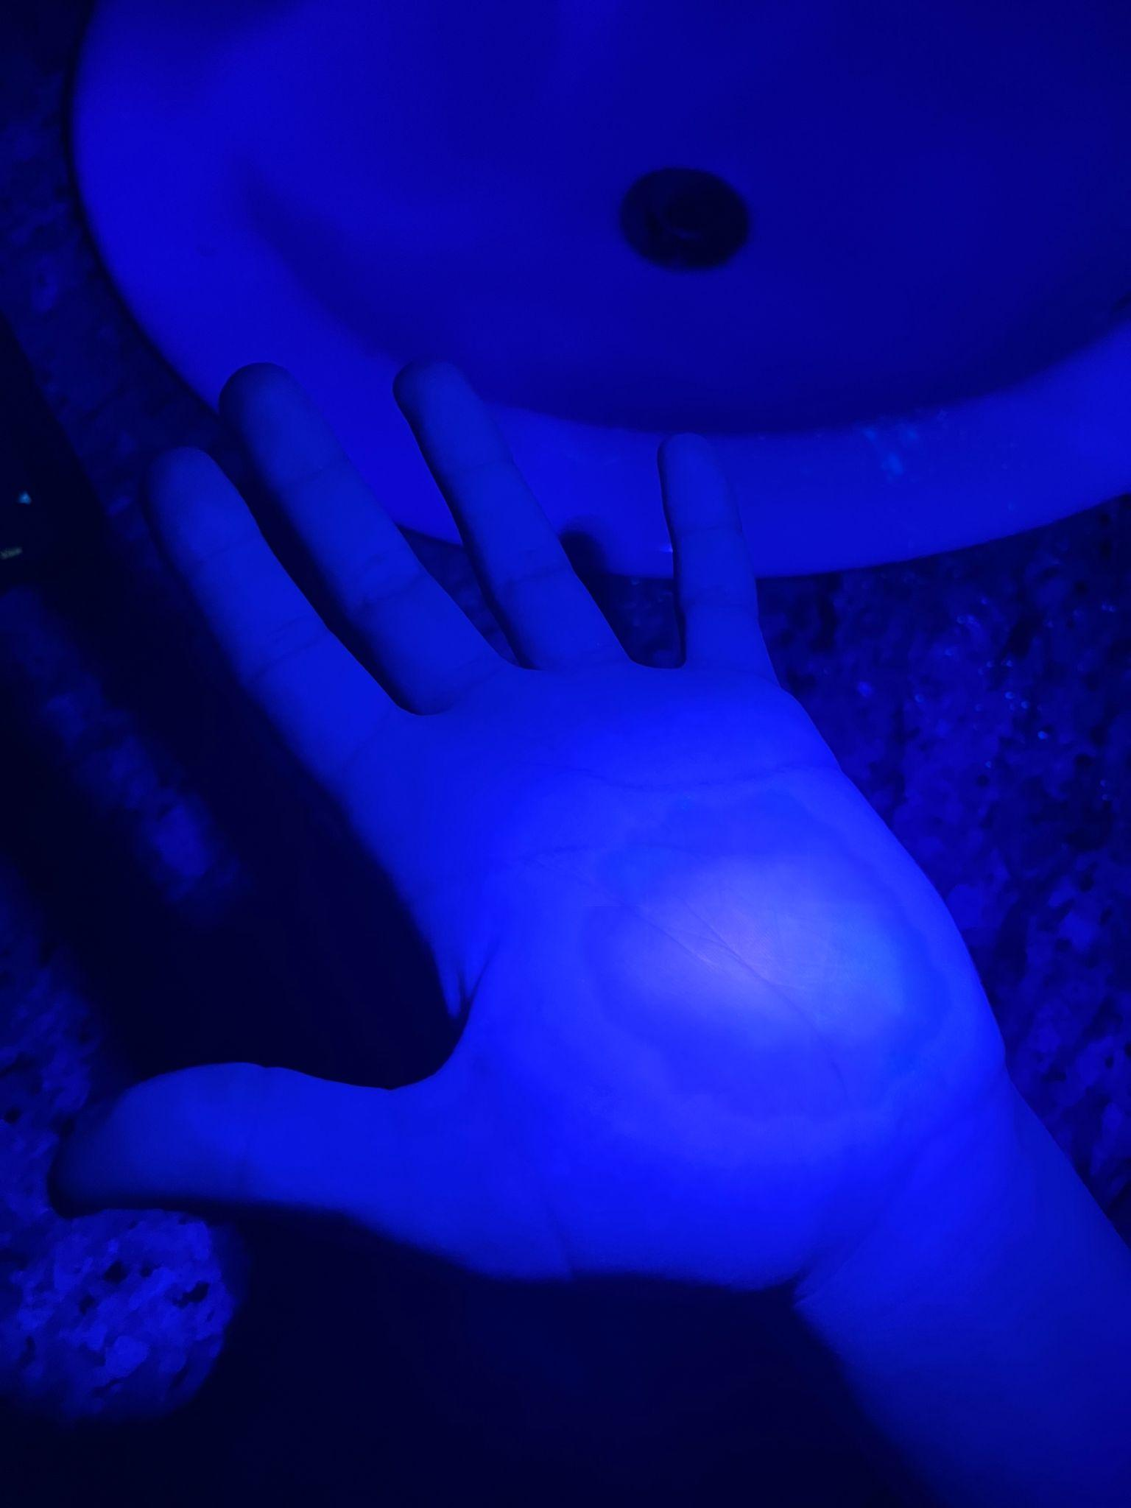
Observations Foam Soap (Test 1)
Palm before washing
Back of hand before washing
Palm after washing
Back of hand after washing

Slide 13
Observations Test 1
When I used bar soap, there was still some bacteria around my palm on the front of my hand. On the back of my hand there was some bacteria in between my pointer finger and my middle finger. There was also a really little bit on the centre of the back of my hand.
When I used liquid soap, there was almost no bacteria on both the back of my hand and my palm. But there was a tiny bit on the top of my thumb and nail.
When I used foam soap, there was a little bit of bacteria on the back of my hand near the bottom of my pinky finger. There was also some bacteria around the bottom right area of my palm. There was a little bit of bacteria at the top of the nail on my ring finger.

Slide 14
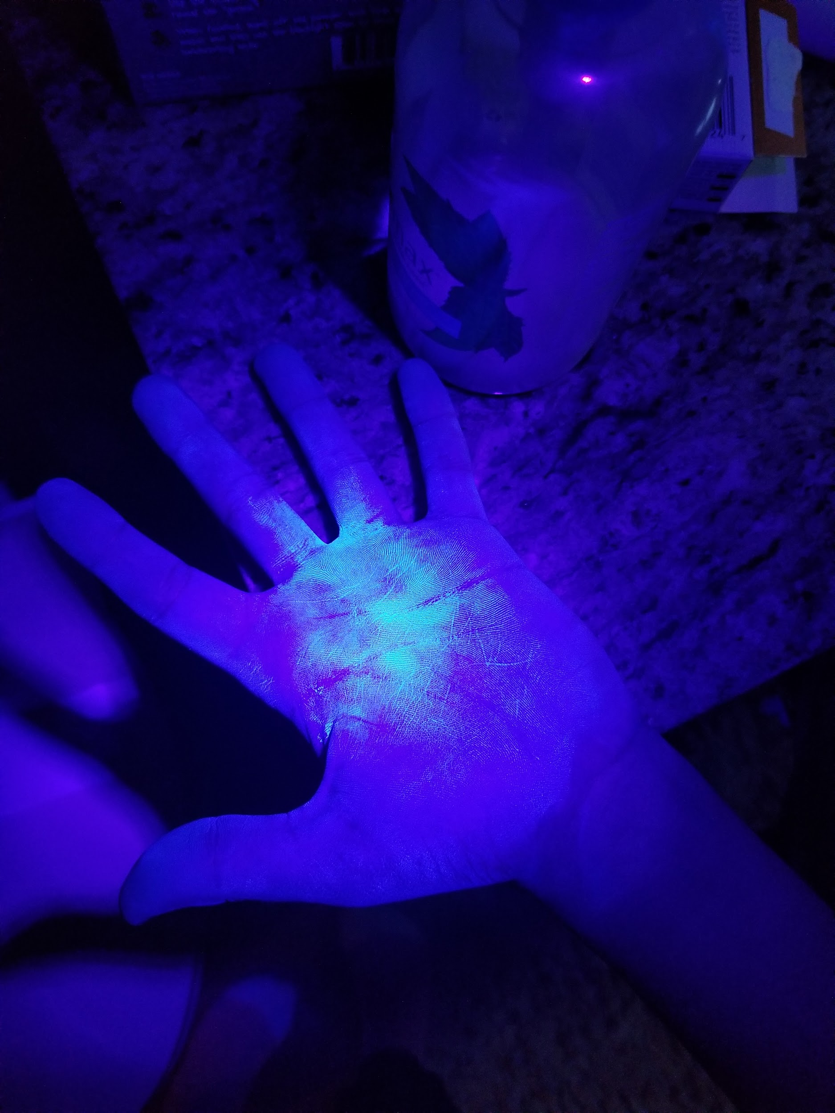
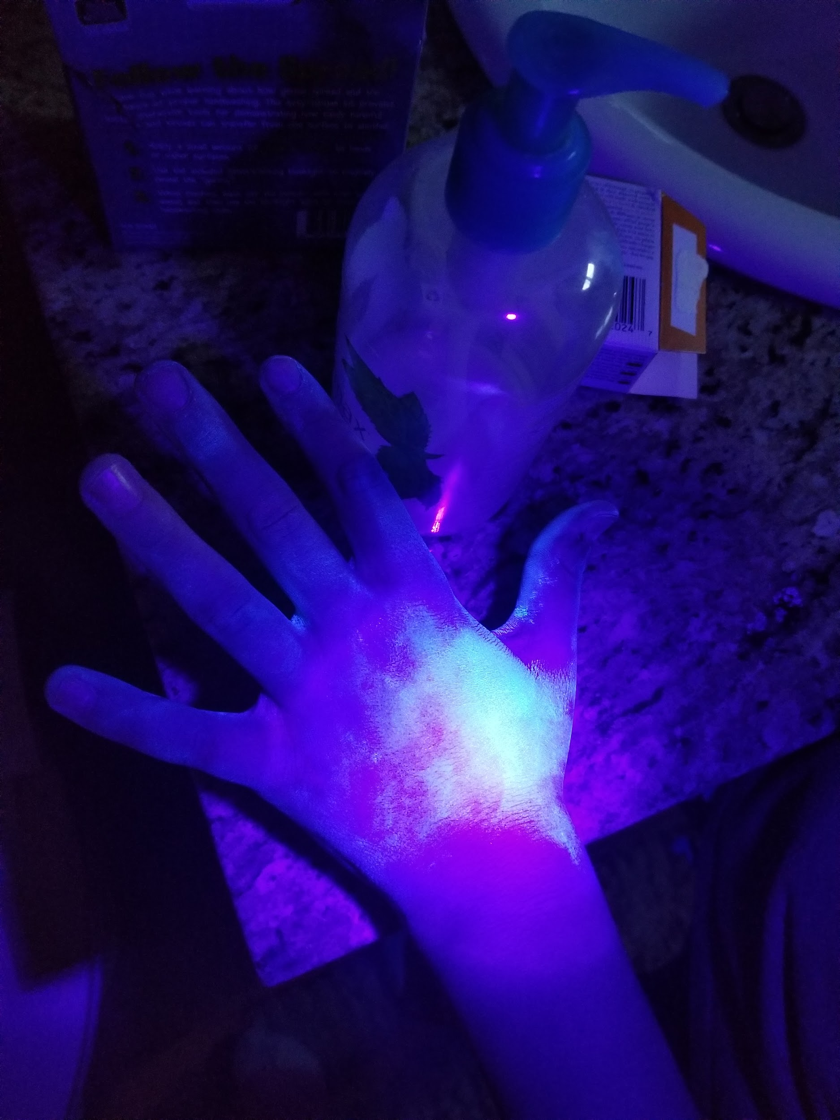
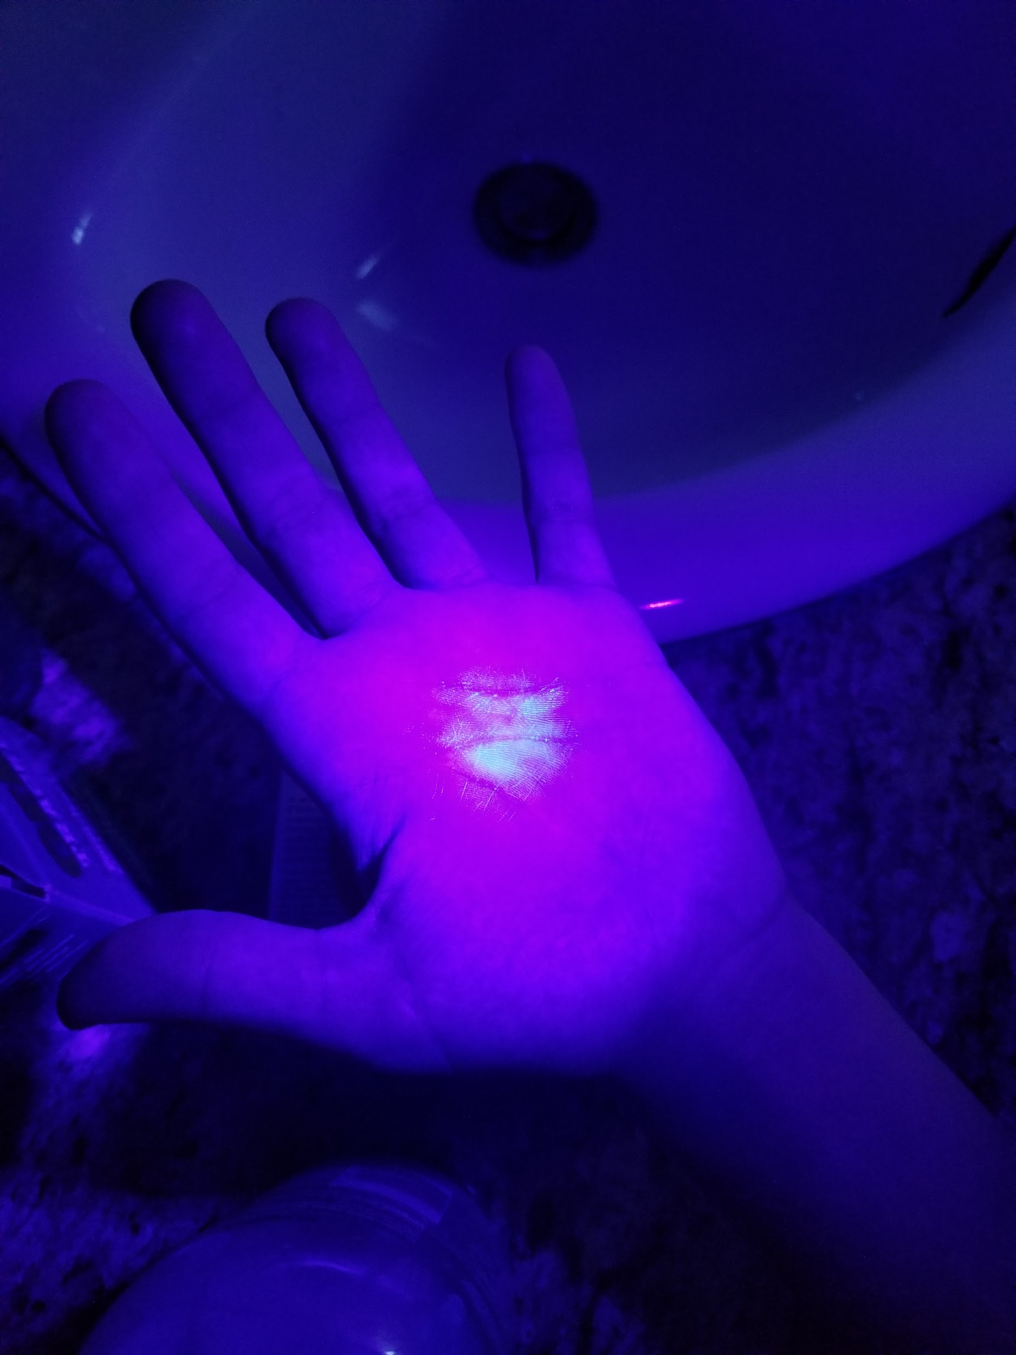
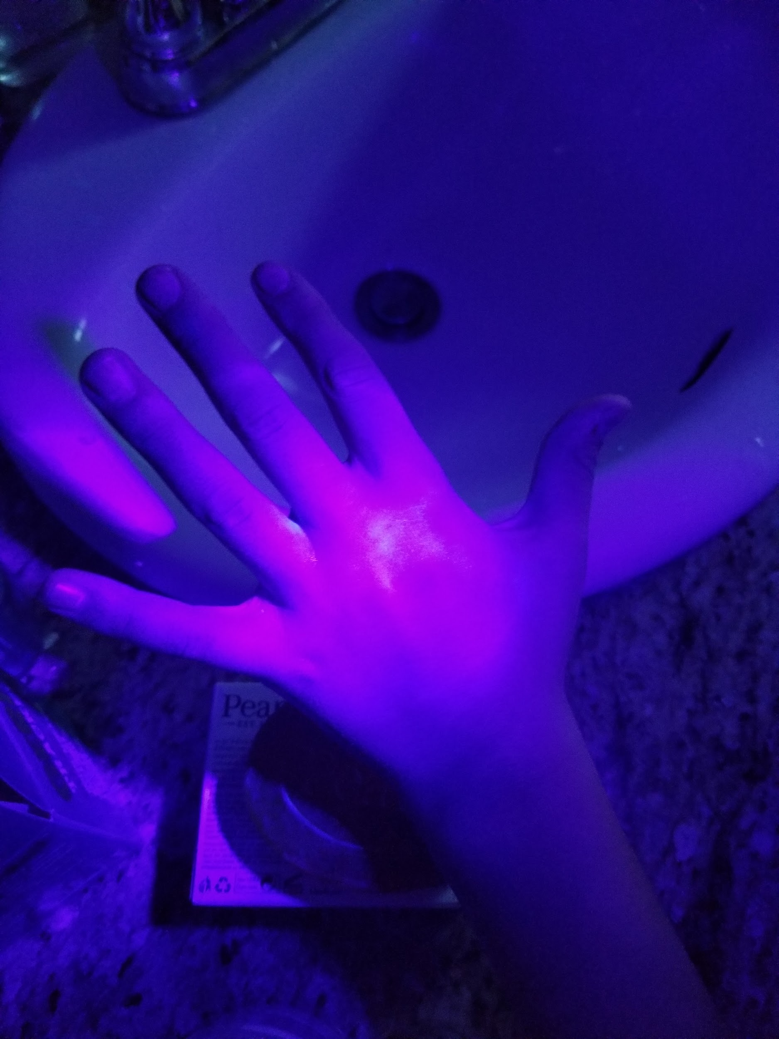
Observations Bar Soap (Test 2)
Palm before washing
Back of hand before washing
Palm after washing
Back of hand after washing

Slide 15
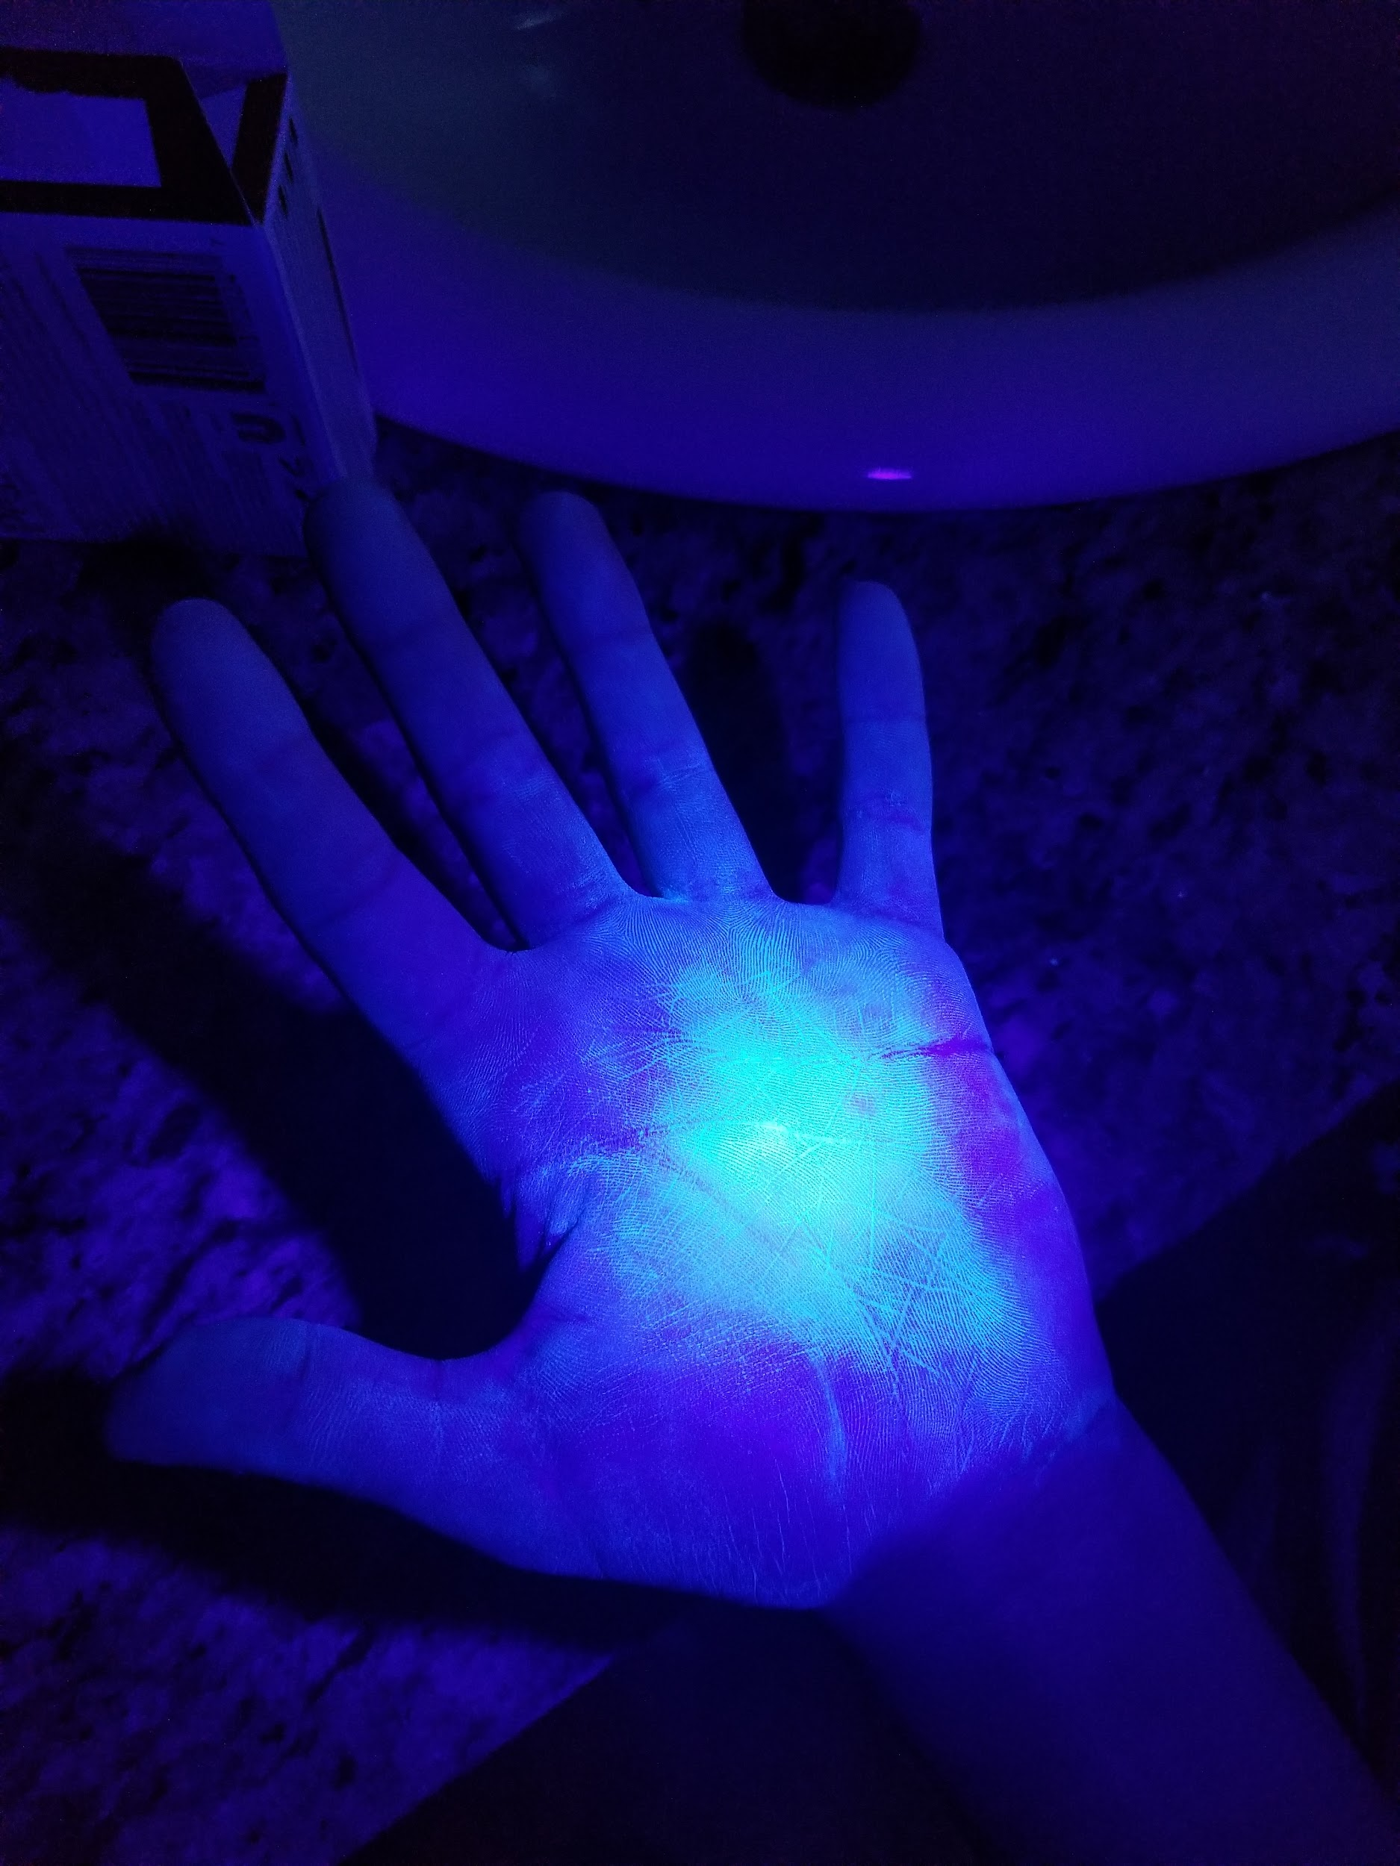
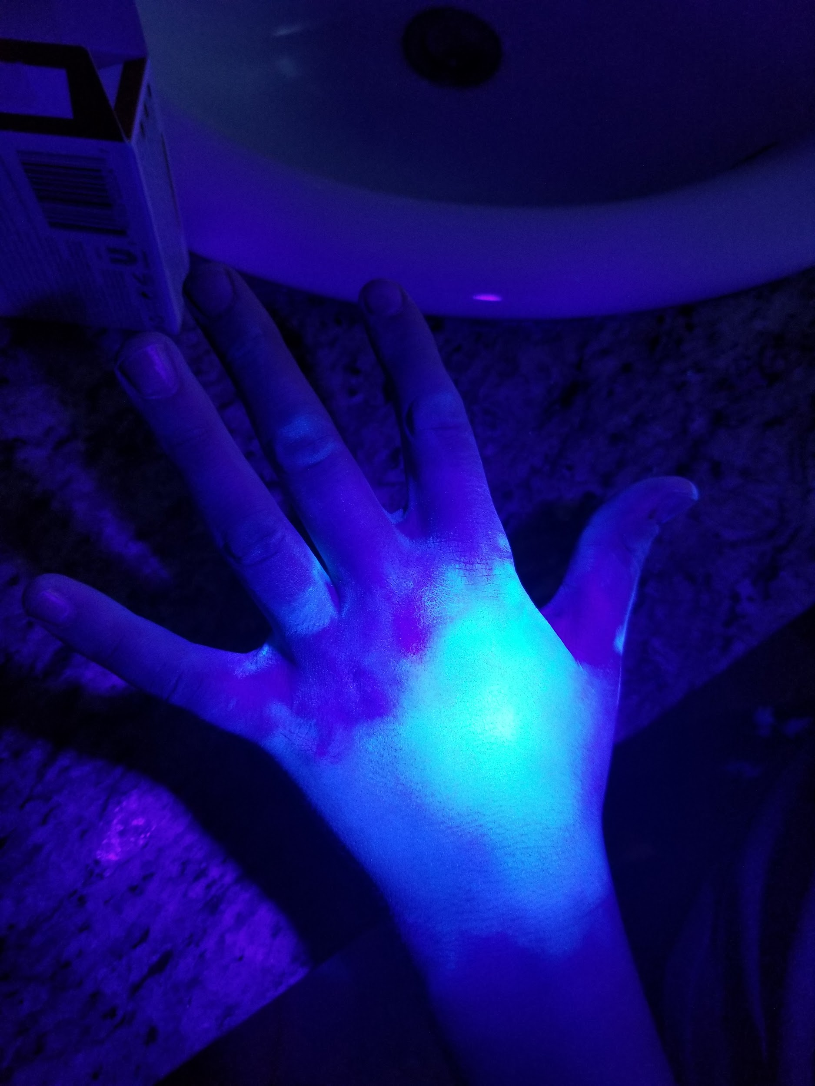
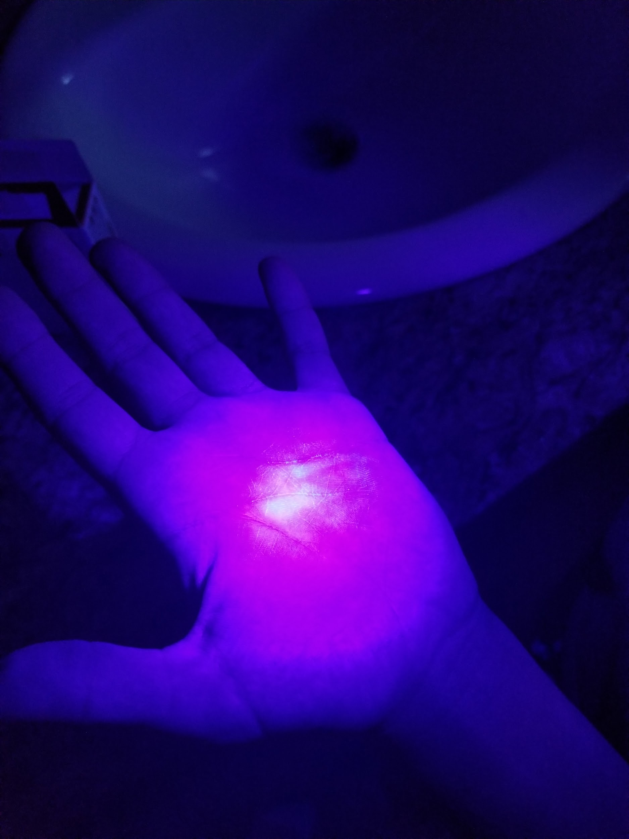
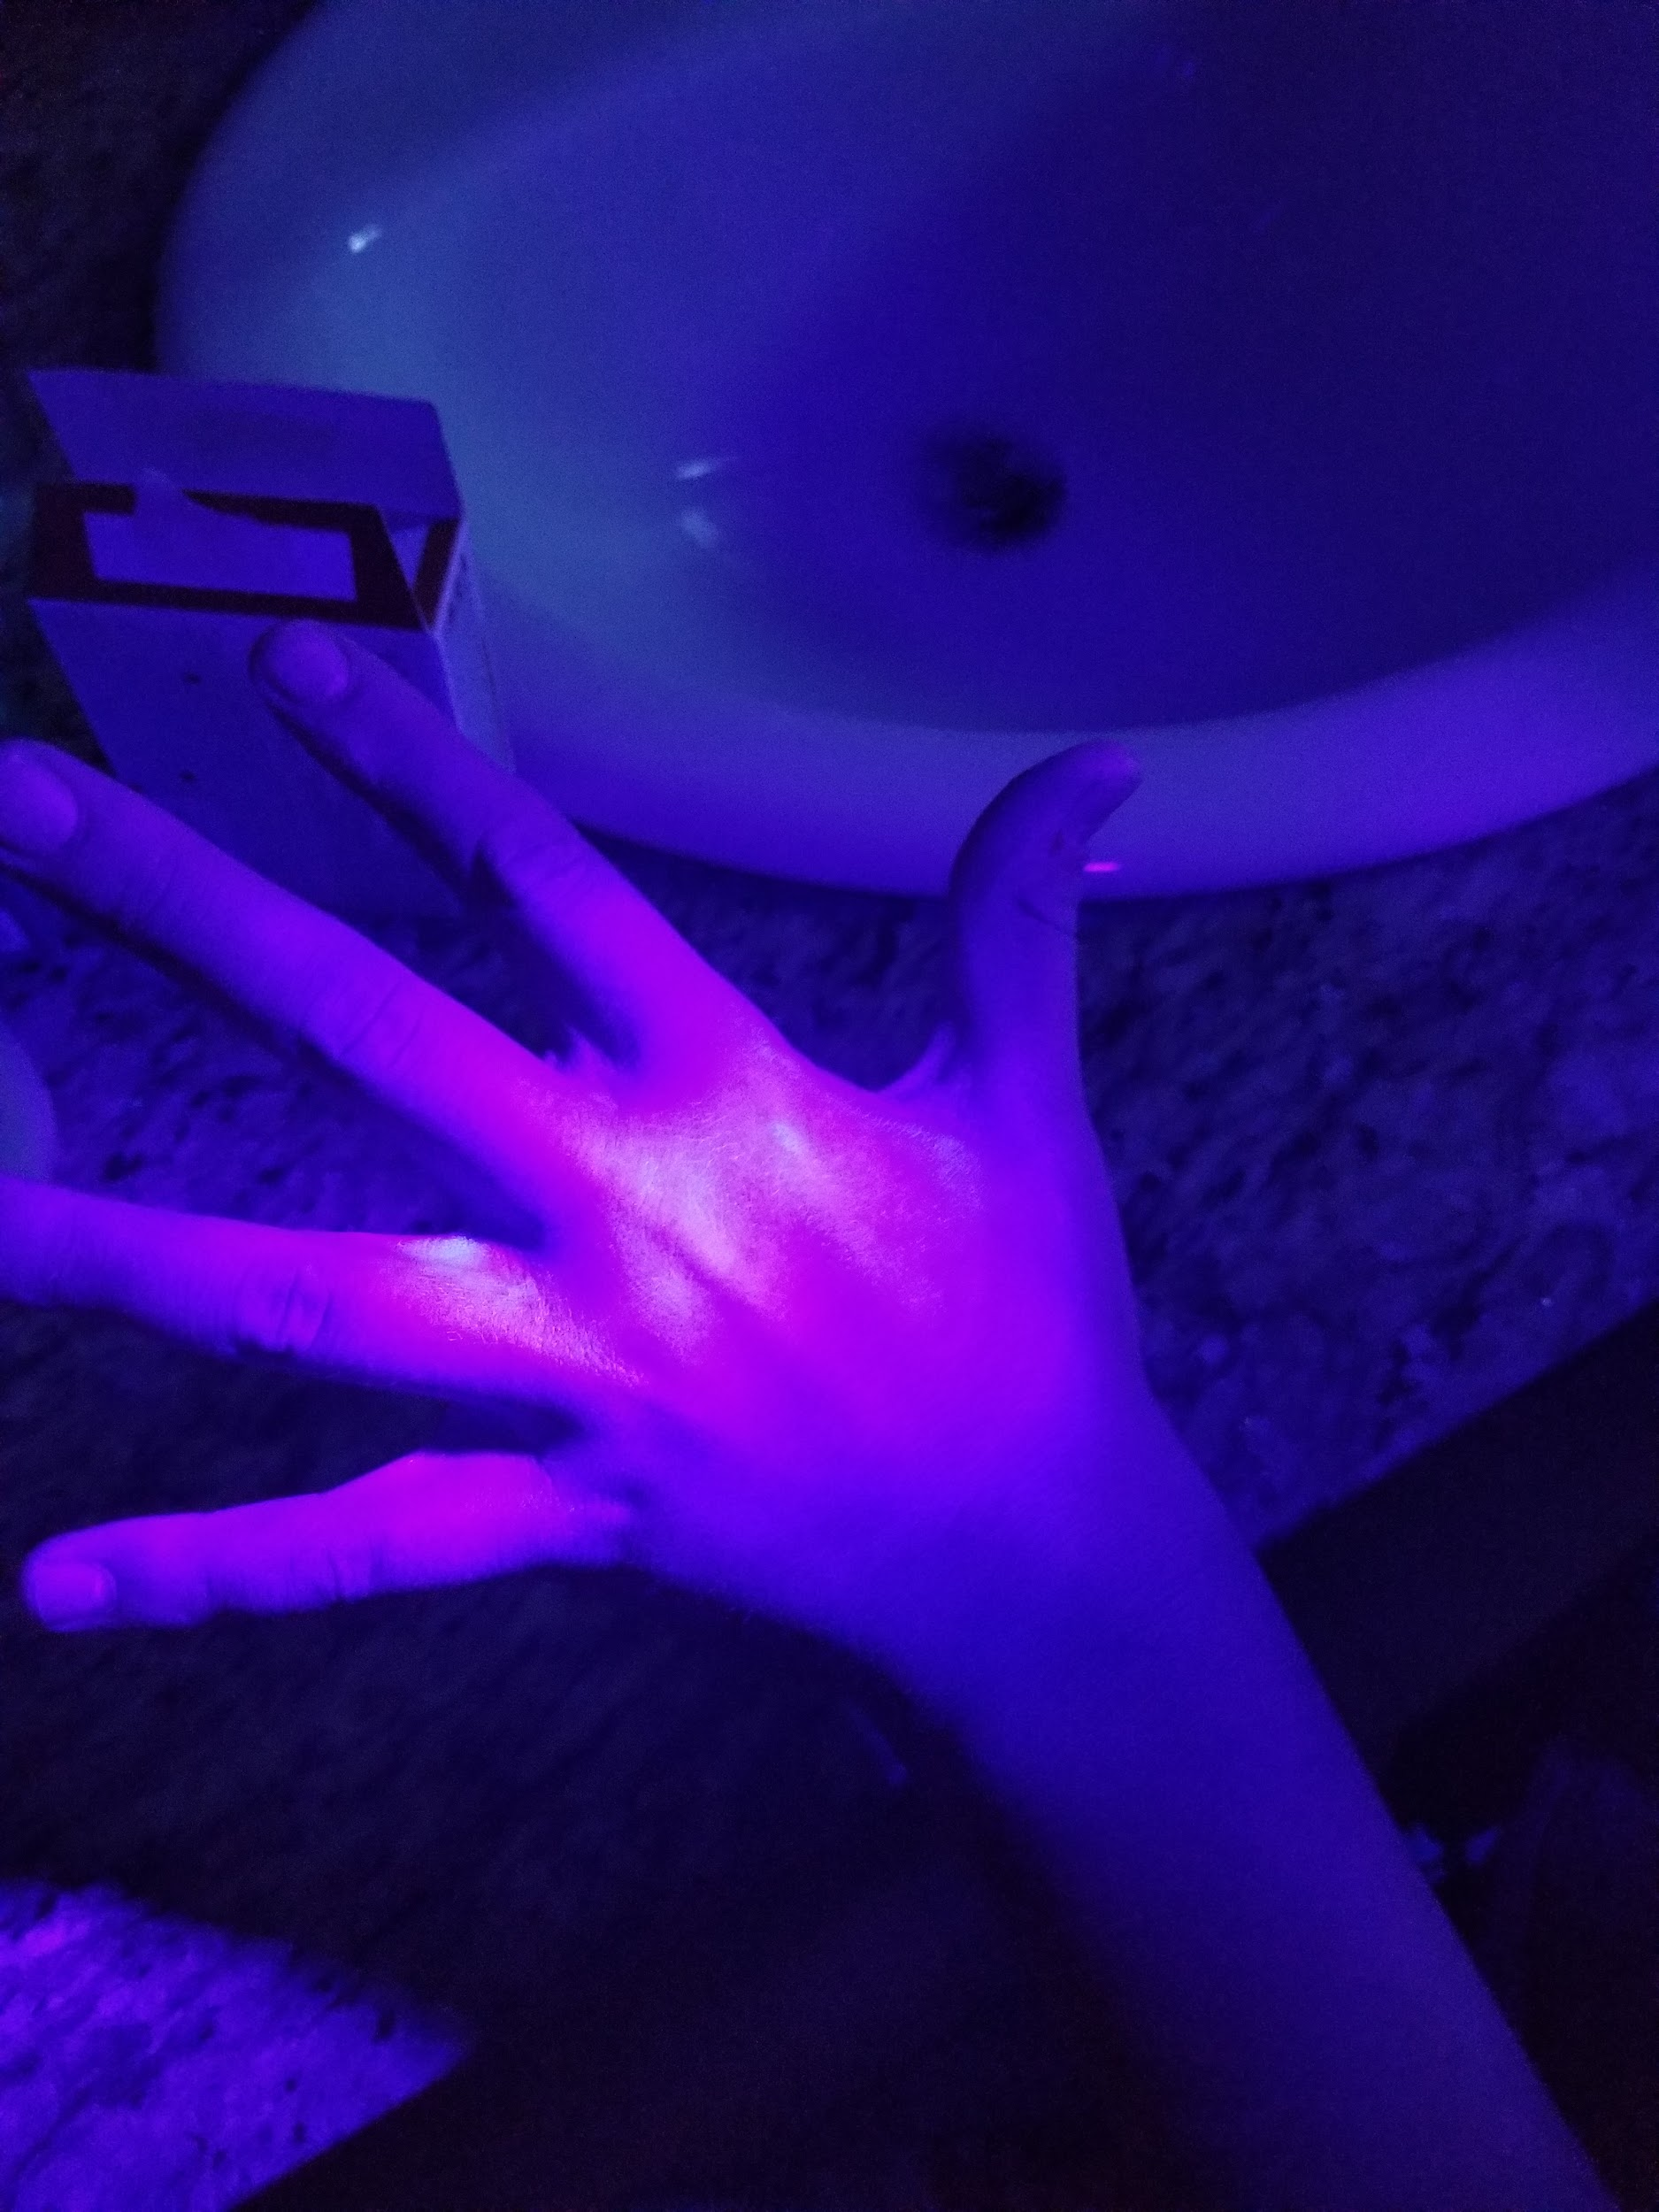
Observations Liquid Soap (Test 2)
Palm before washing
Back of hand before washing
Palm after washing
Back of hand after washing

Slide 16
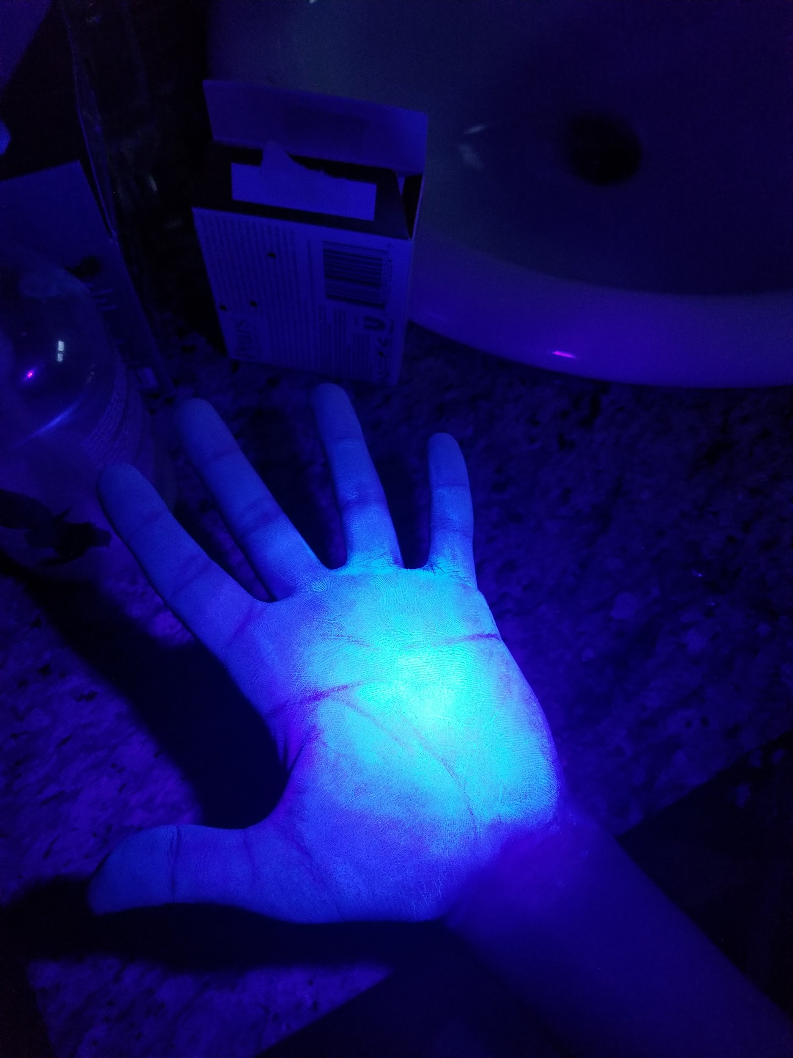
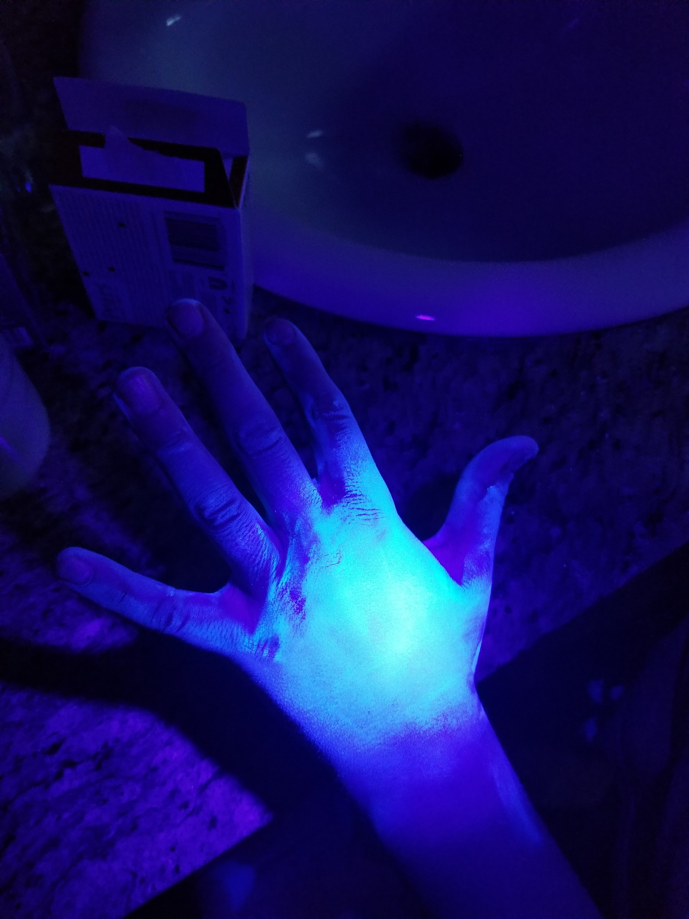
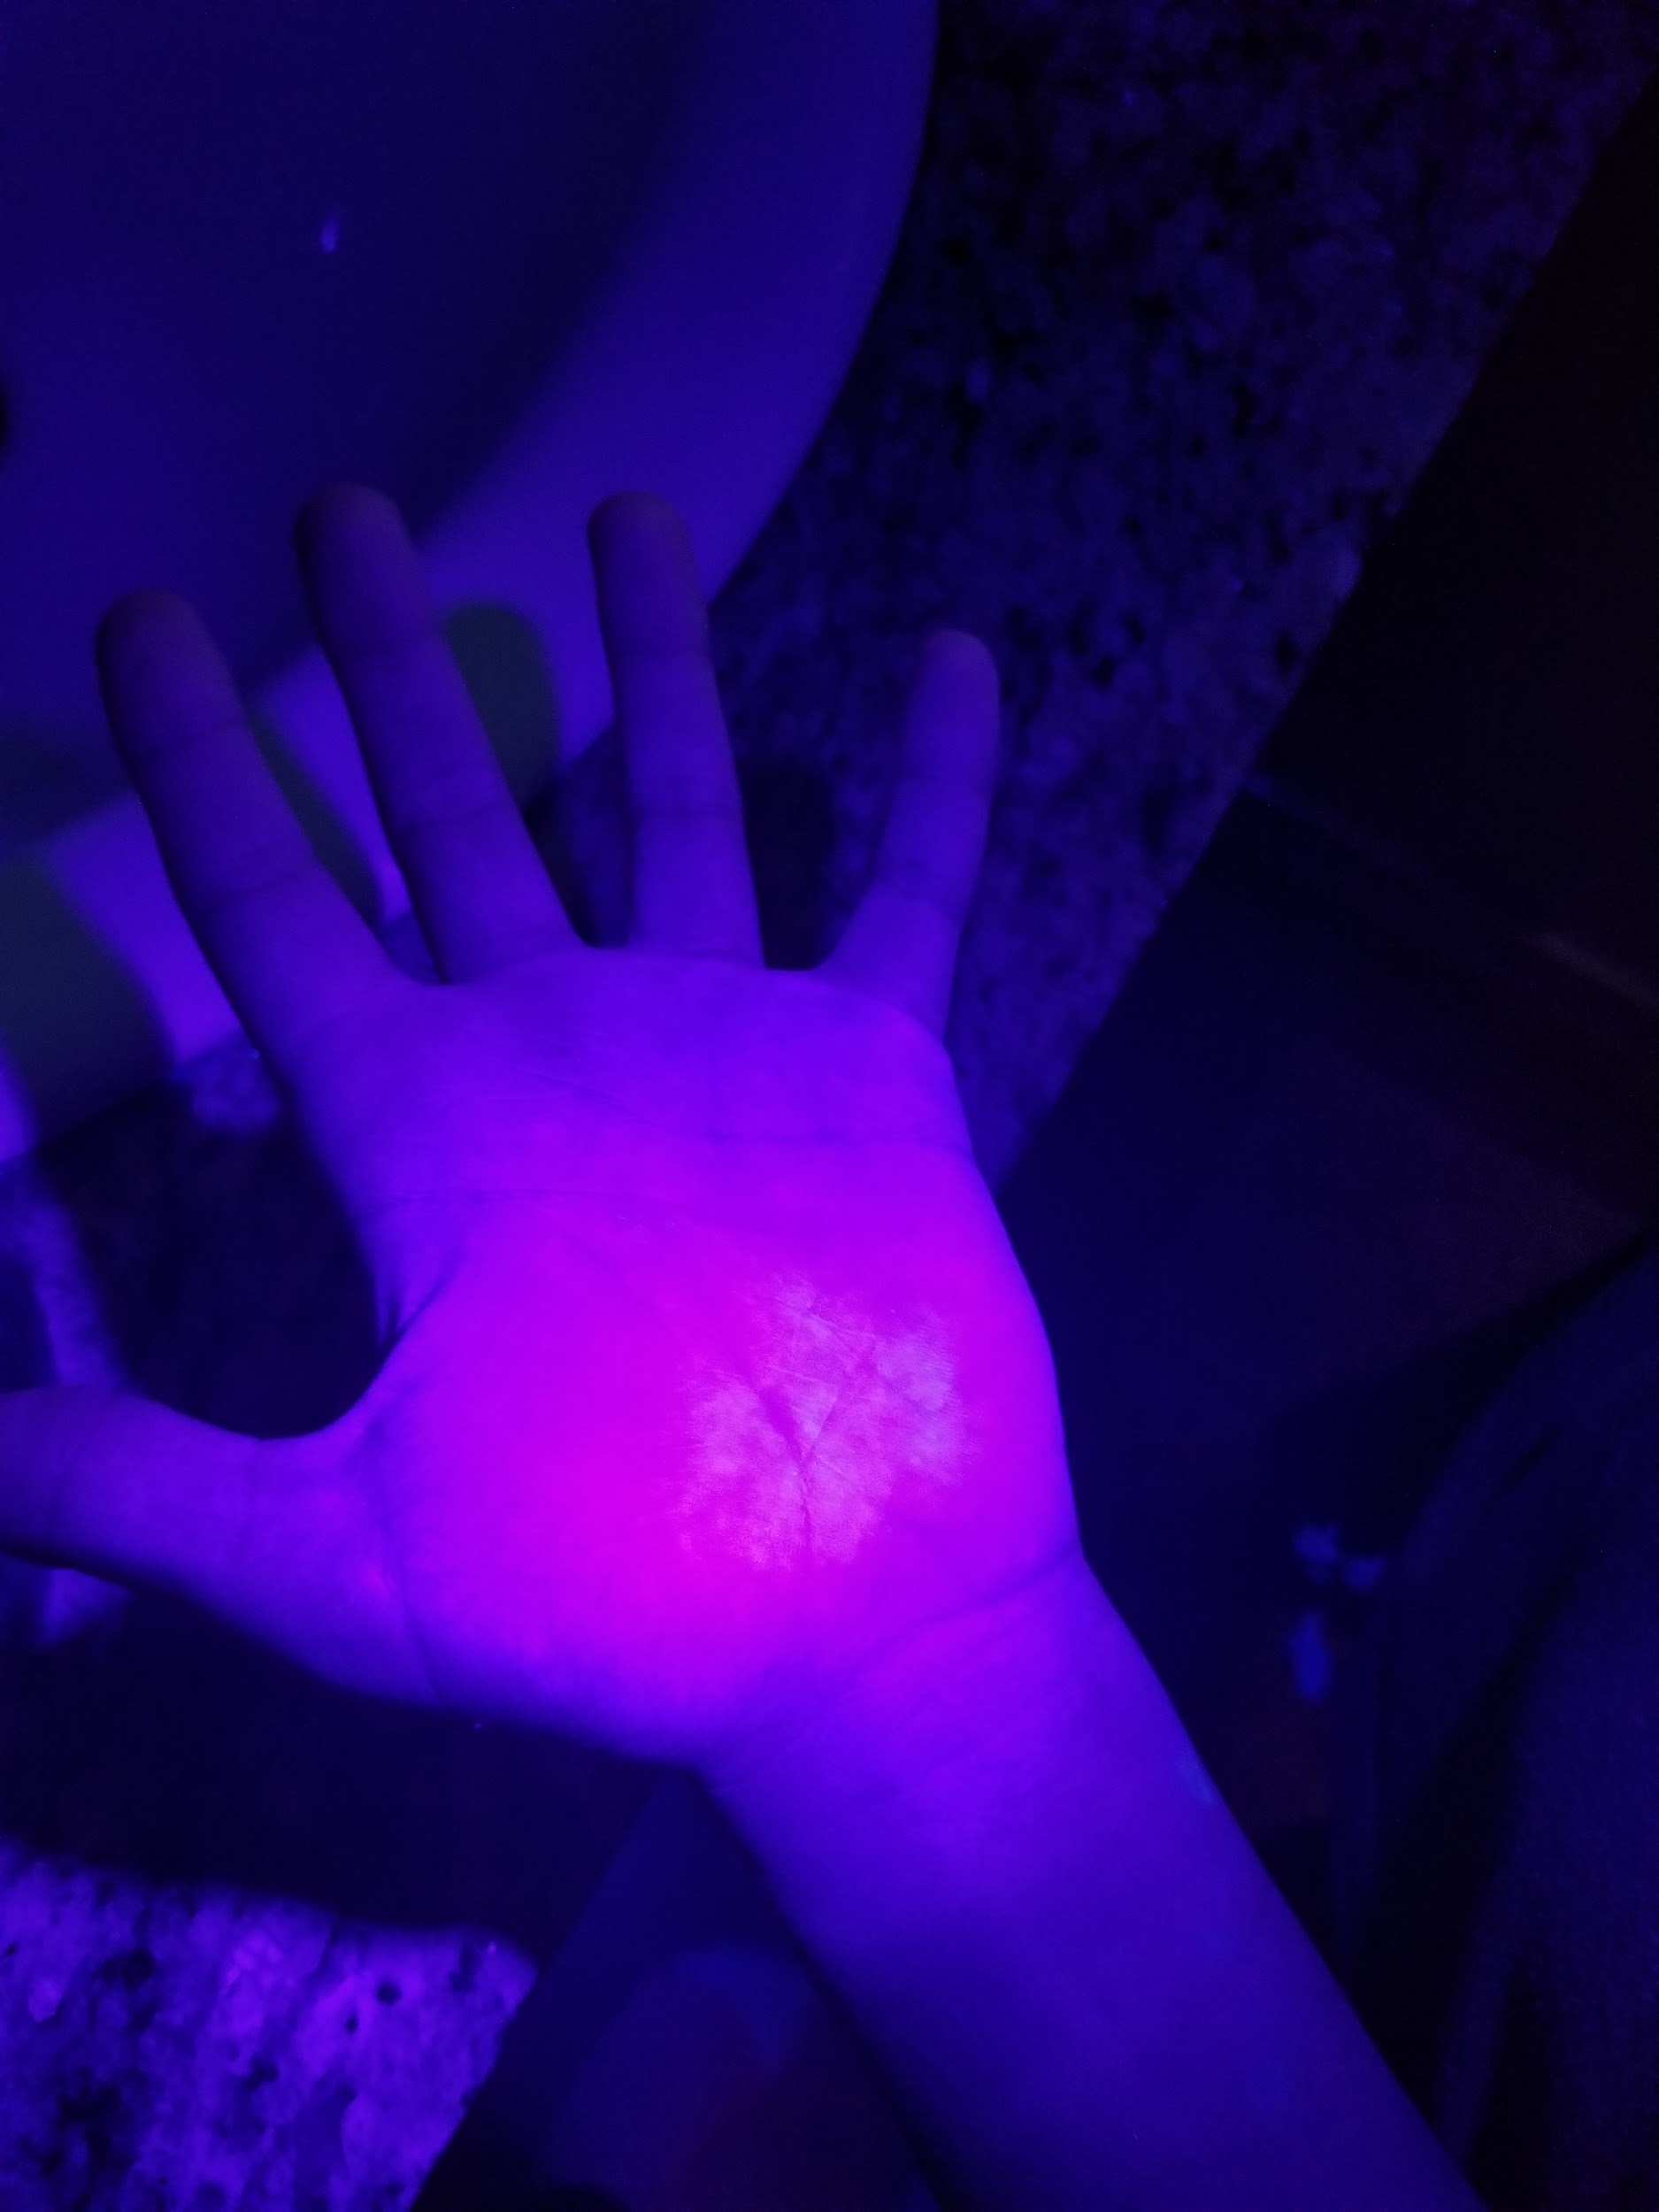
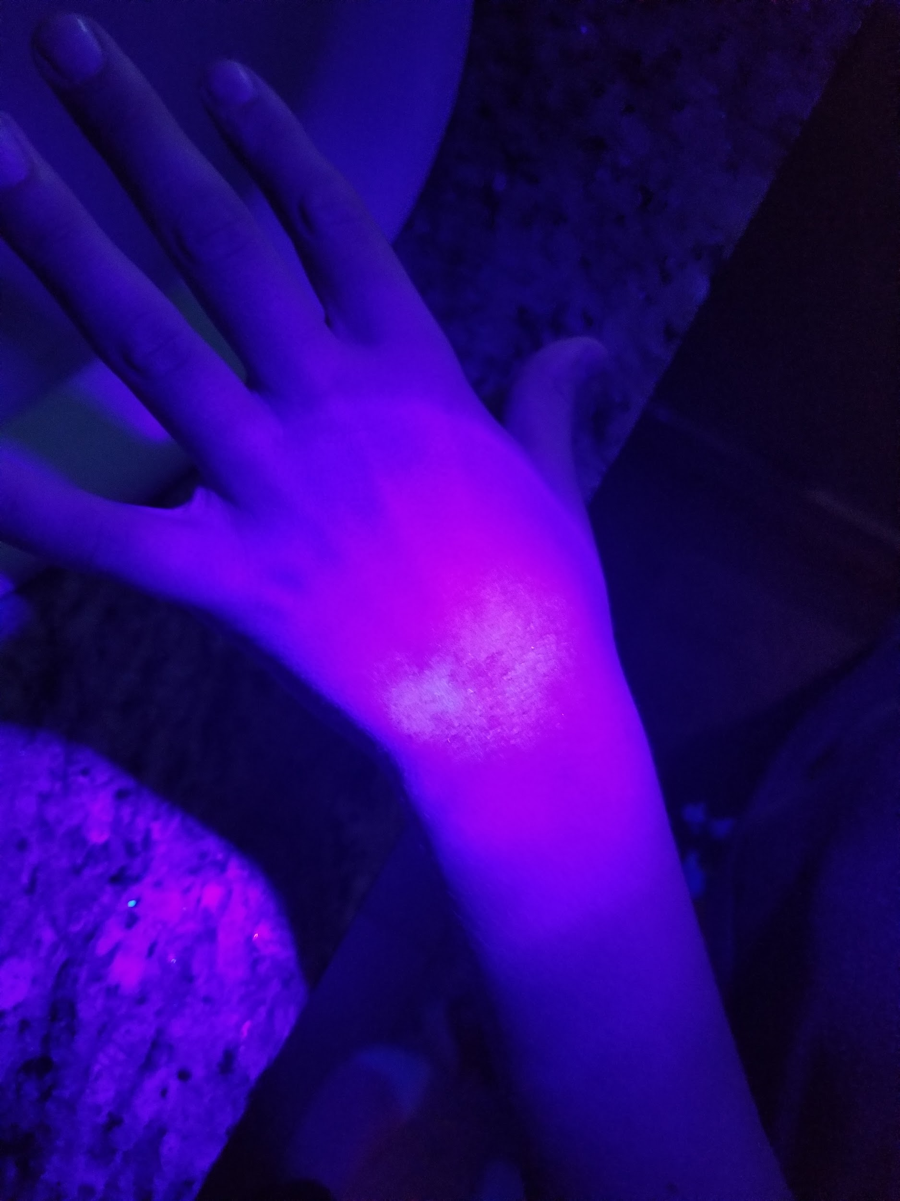
Observations Foam Soap (Test 2)
Palm before washing
Back of hand before washing
Palm after washing
Back of hand after washing

Slide 17
Observations Test 2
When I used bar soap, there was still a little bit of bacteria on my palm and there was still some near my thumb. There was also a bit of bacteria in my nails, mainly my pointer finger and ring finger nails.
When I used liquid soap, there was some bacteria on my palm and some in between my fingers. This time there was no bacteria in my nails, but there was some on the back of my hand.
When I used foam soap, there was really no bacteria on my hands except for a really little bit in my nails. The bottom of my palm also had a little bit of bacteria.

Slide 18
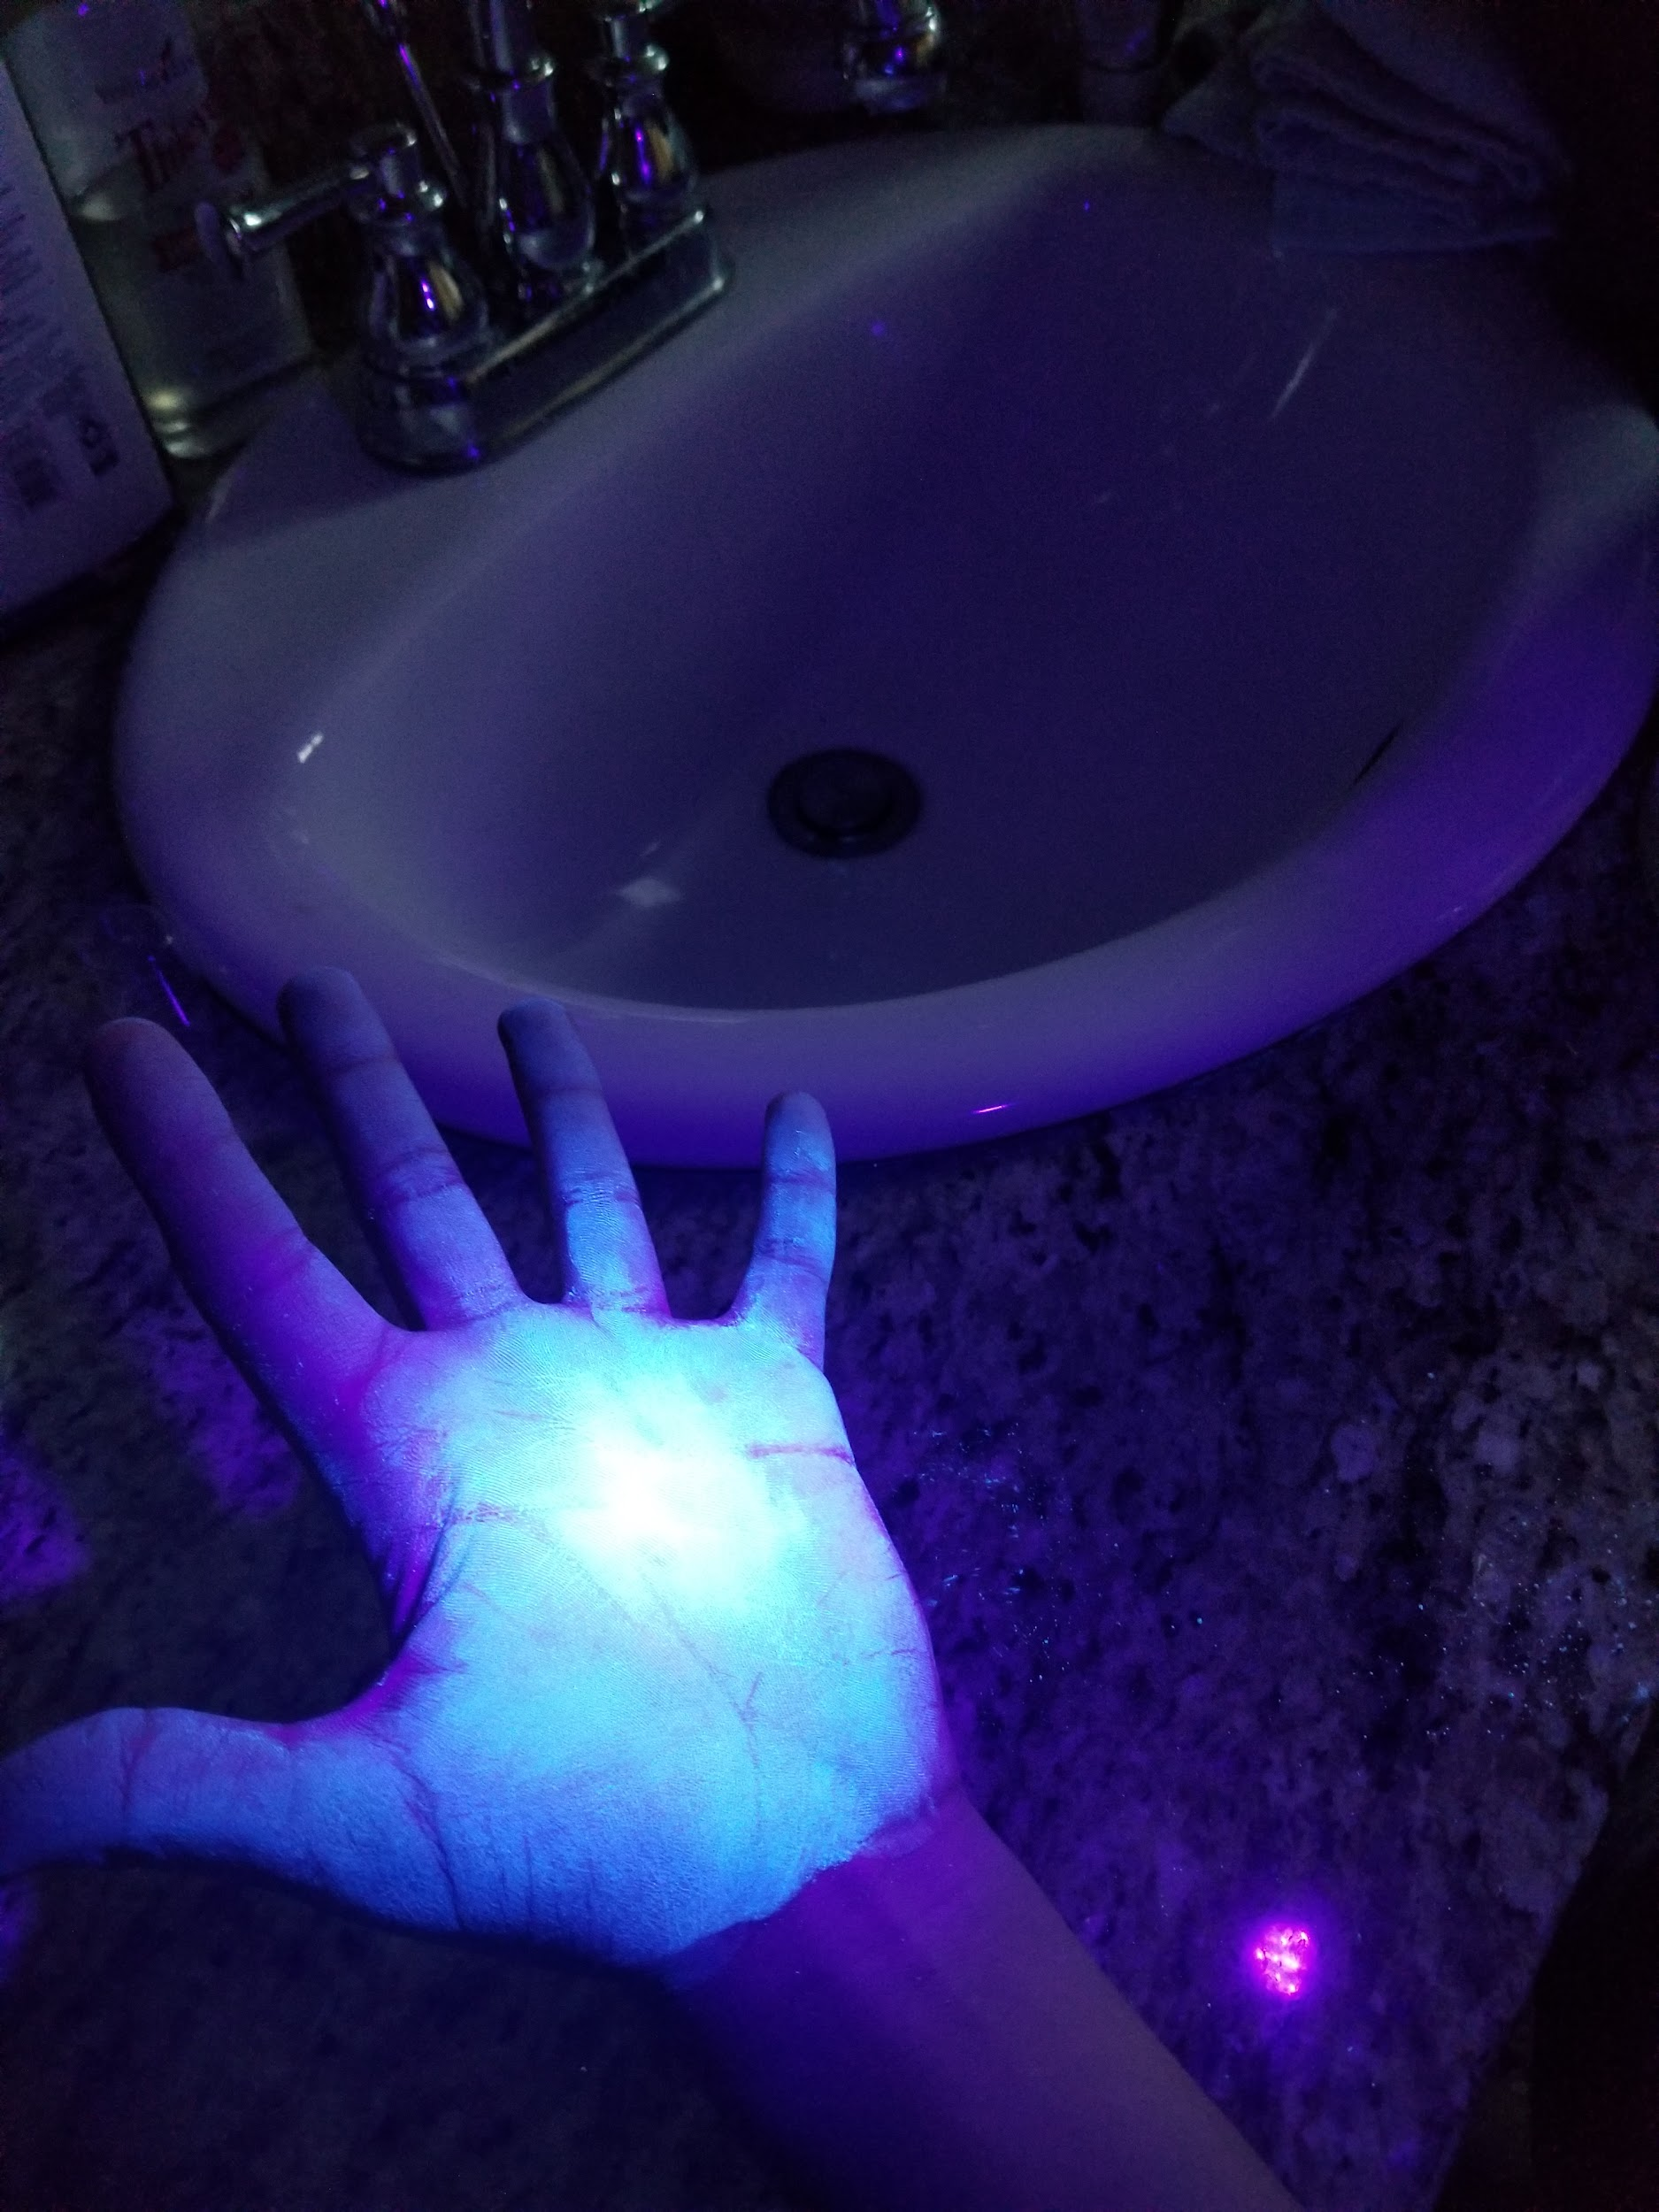
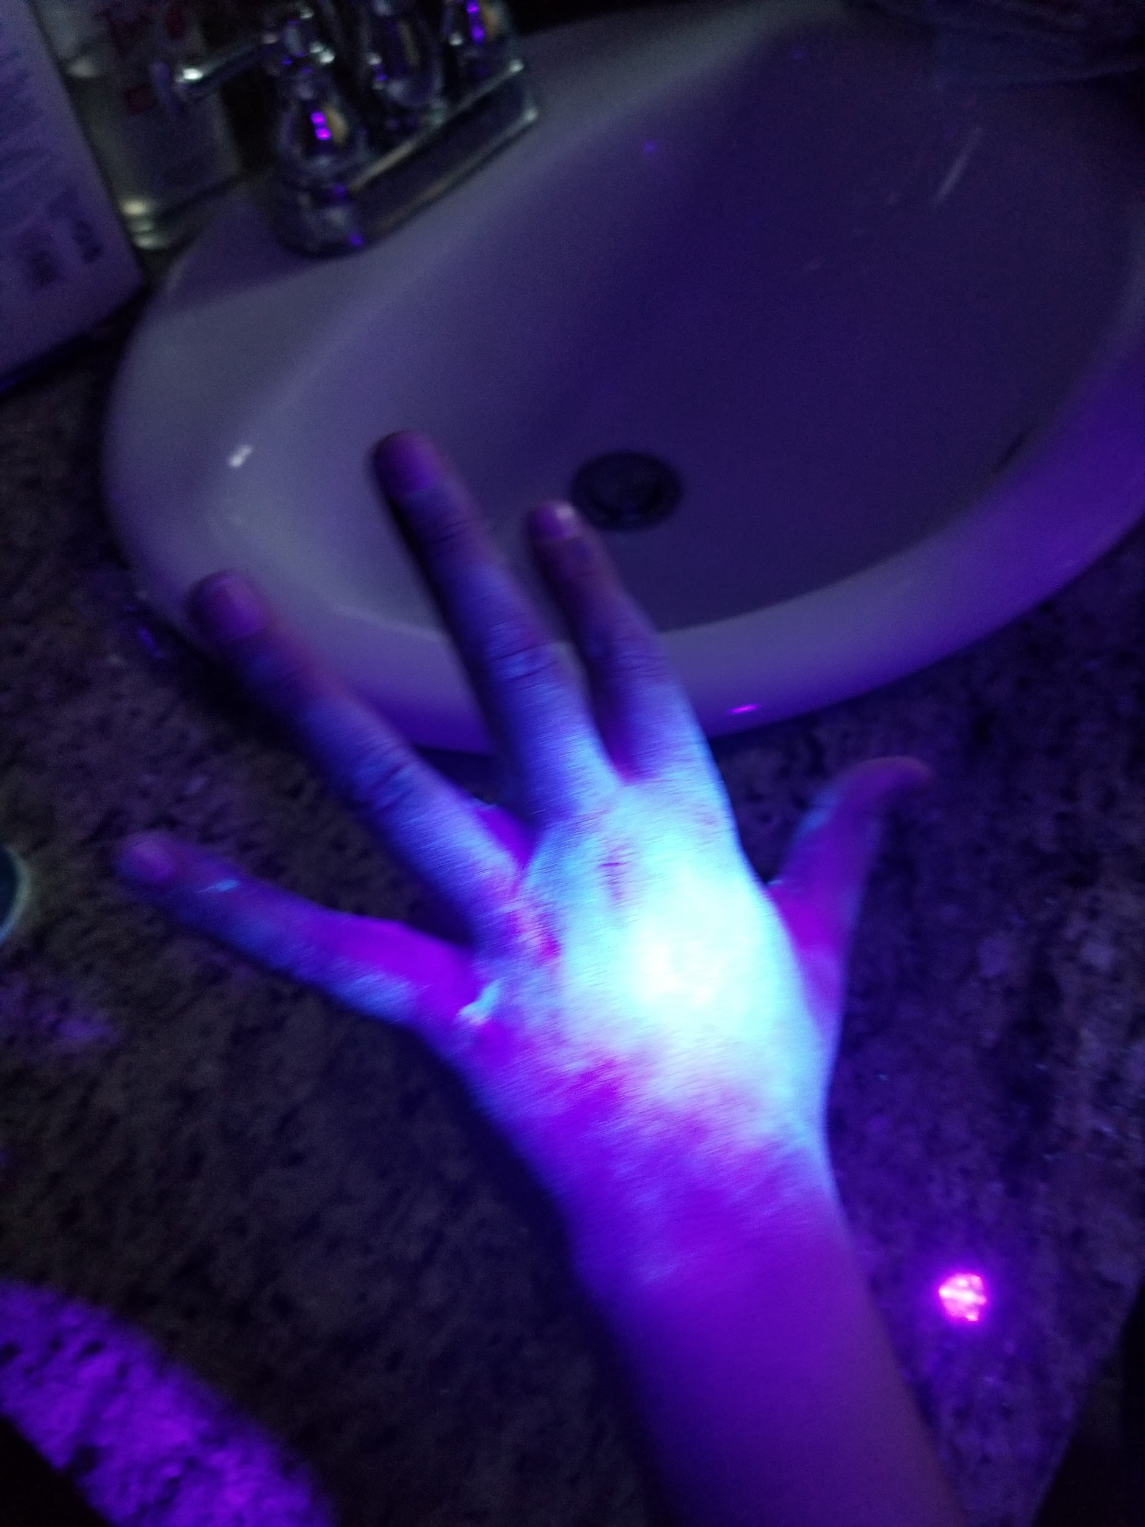
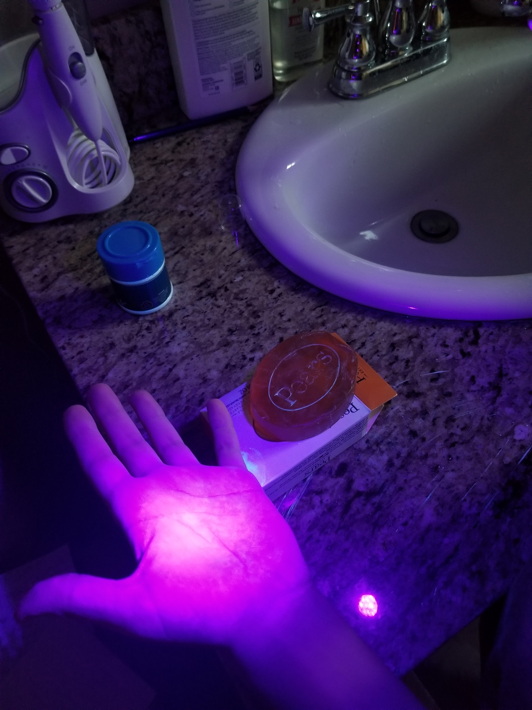
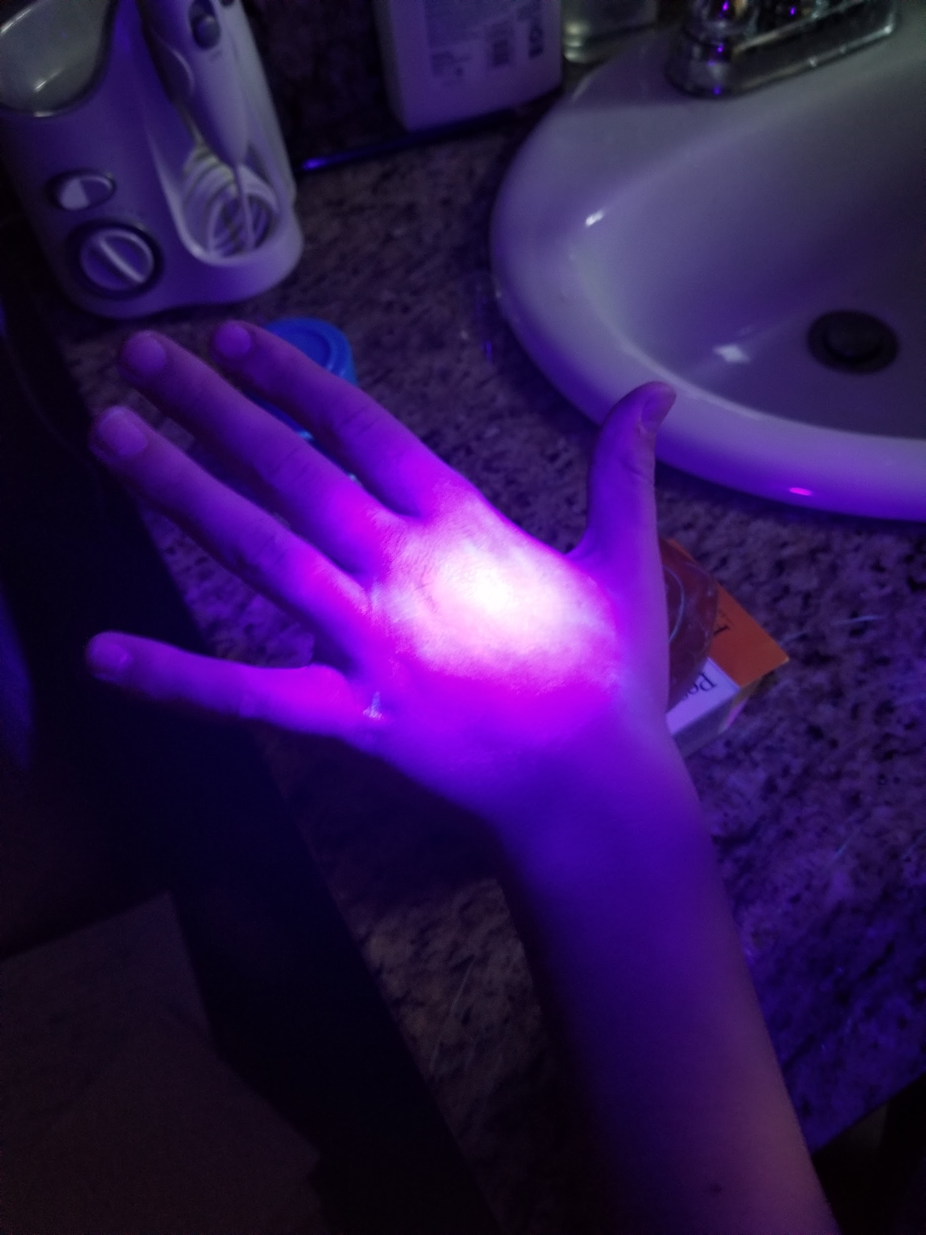
Observations Bar Soap (Test 3)
Palm before washing
Back of hand before washing washing
Palm after washing
Back of hand after washing

Slide 19
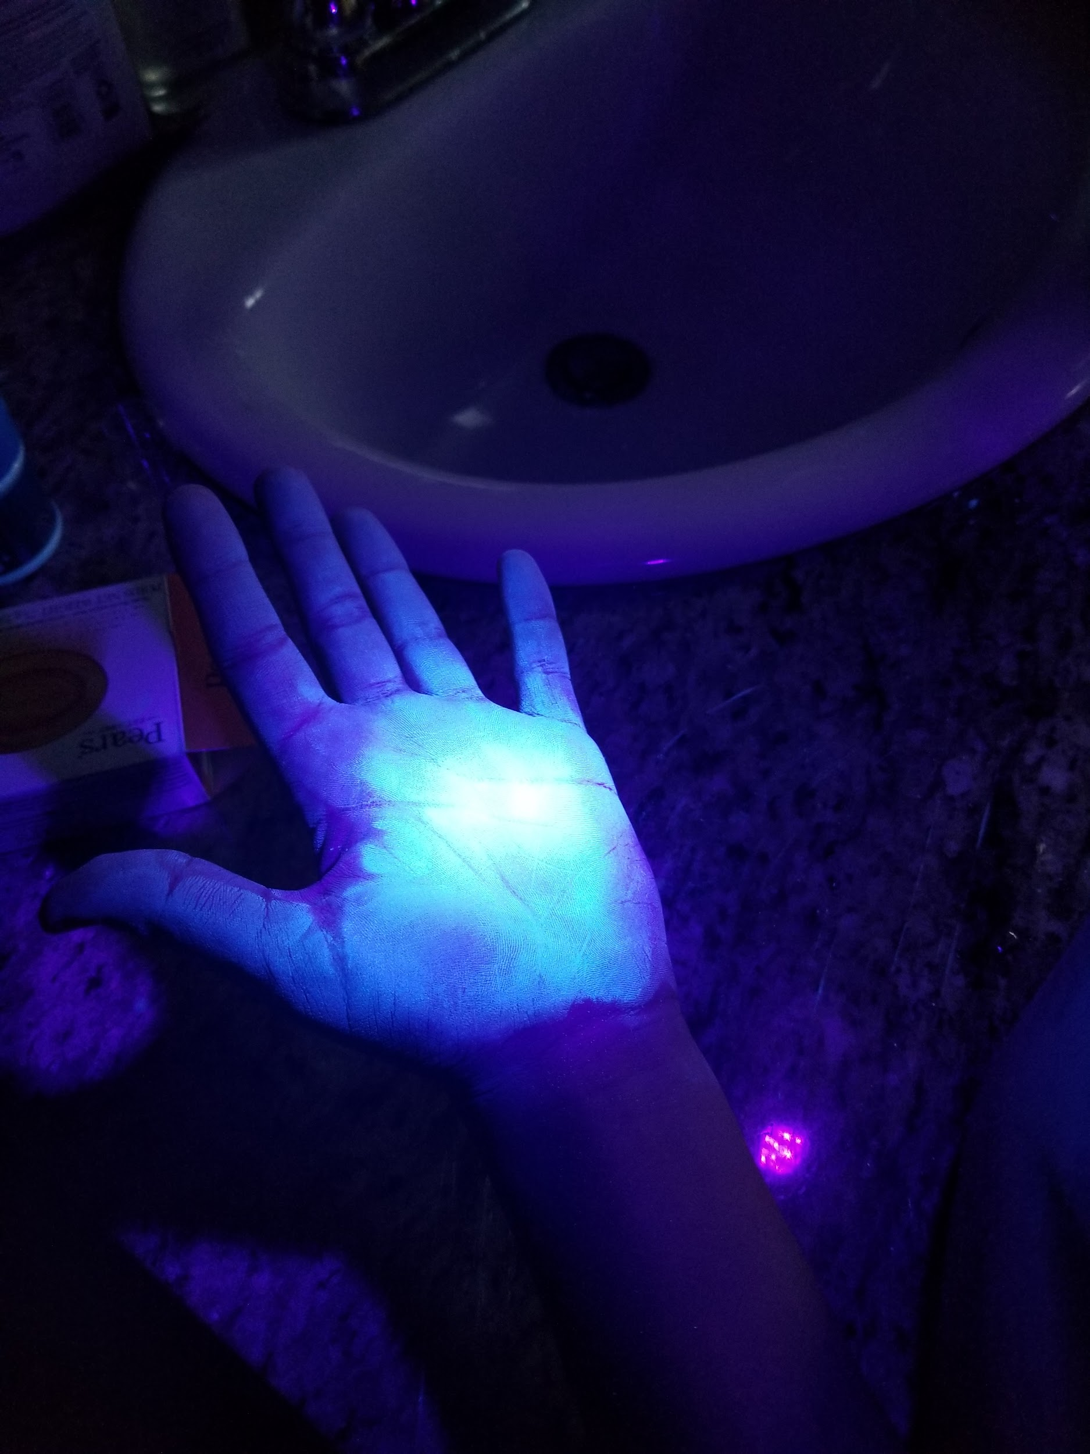
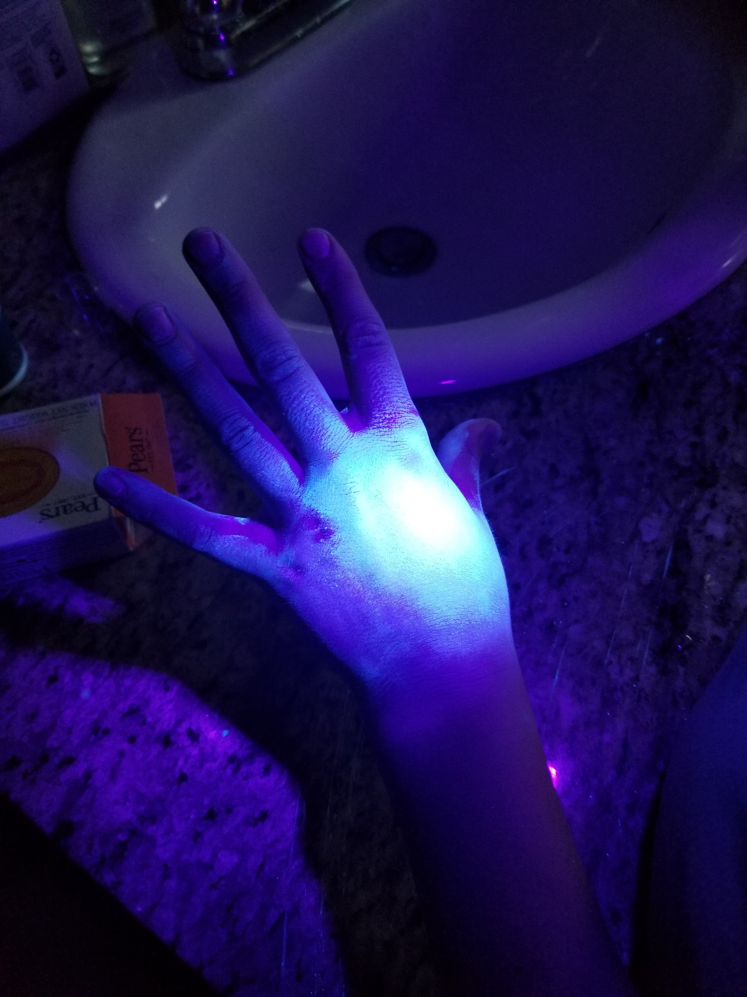
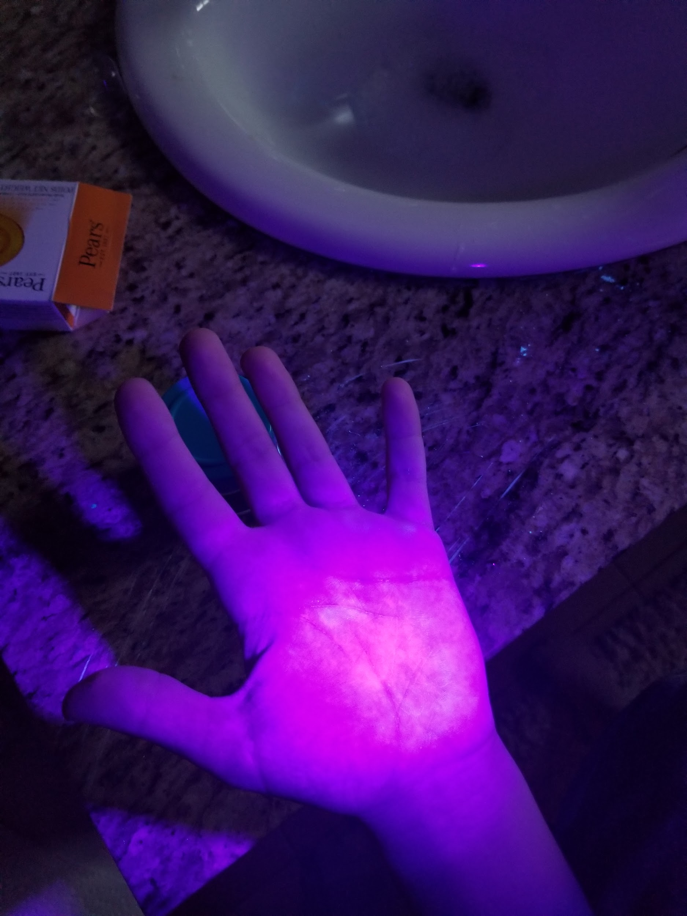
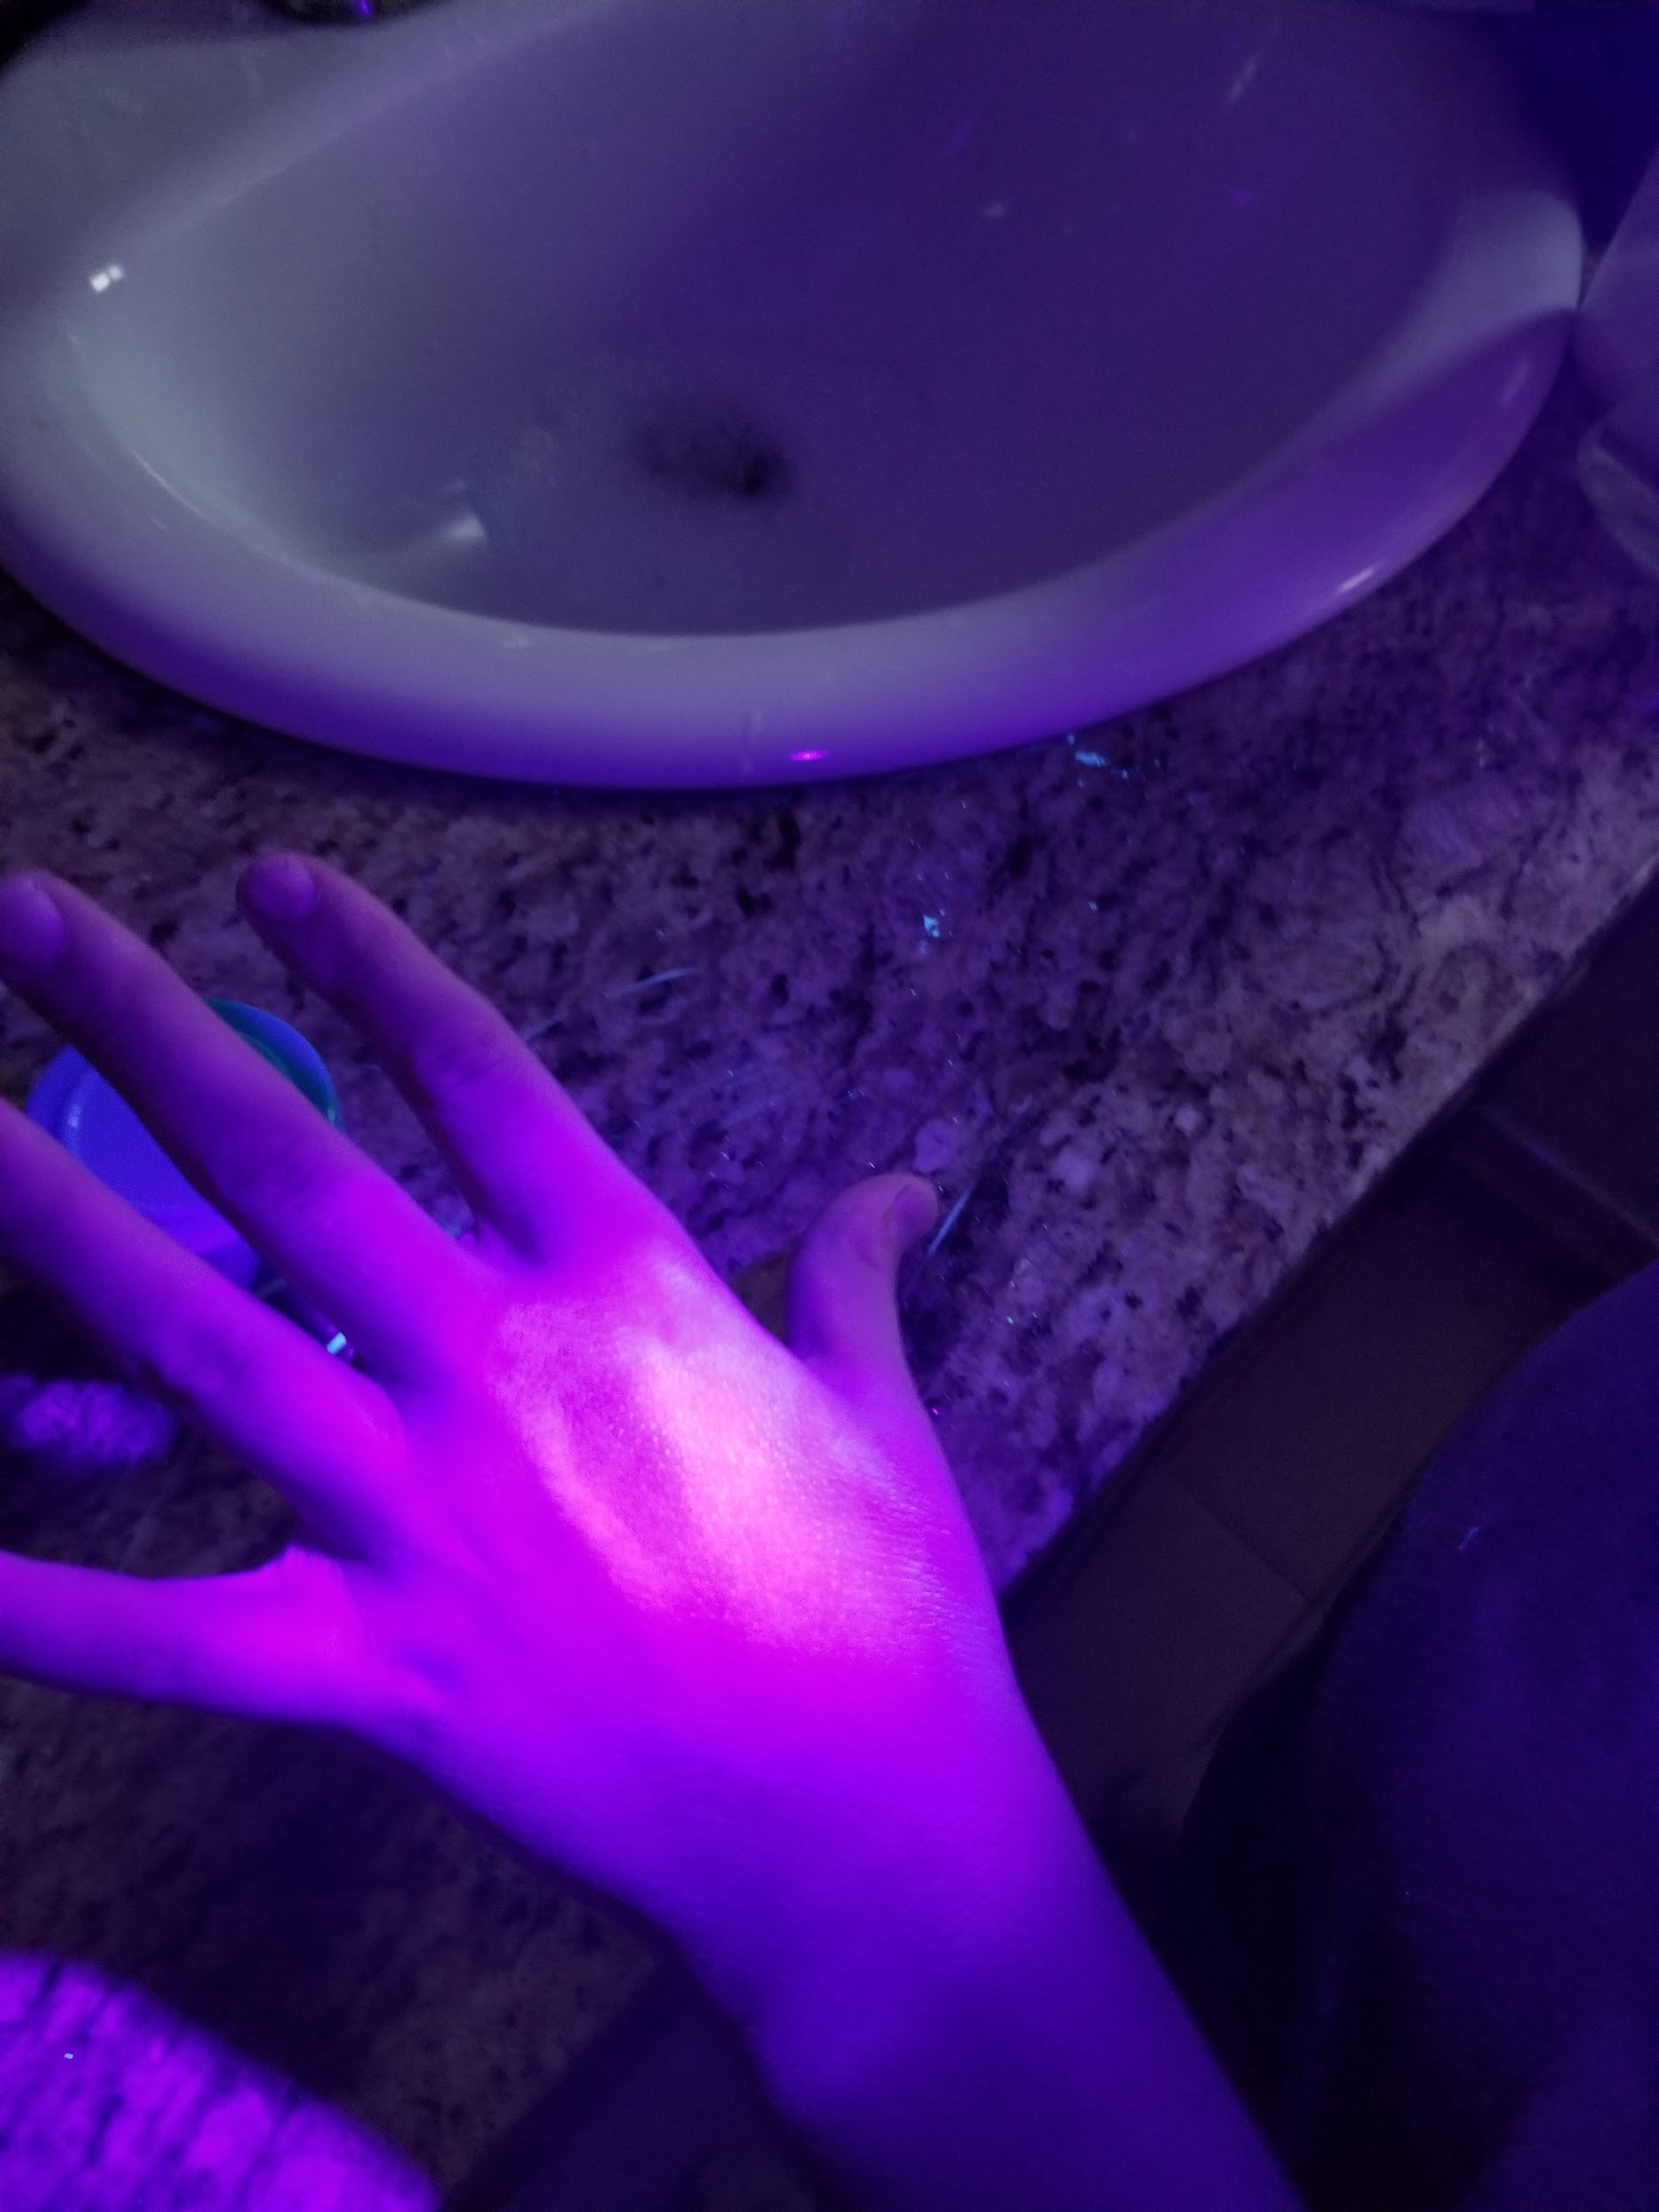
Observations Liquid Soap (Test 3)
Palm before washing
Back of hand before washing
Palm after washing
Back of hand after washing

Slide 20
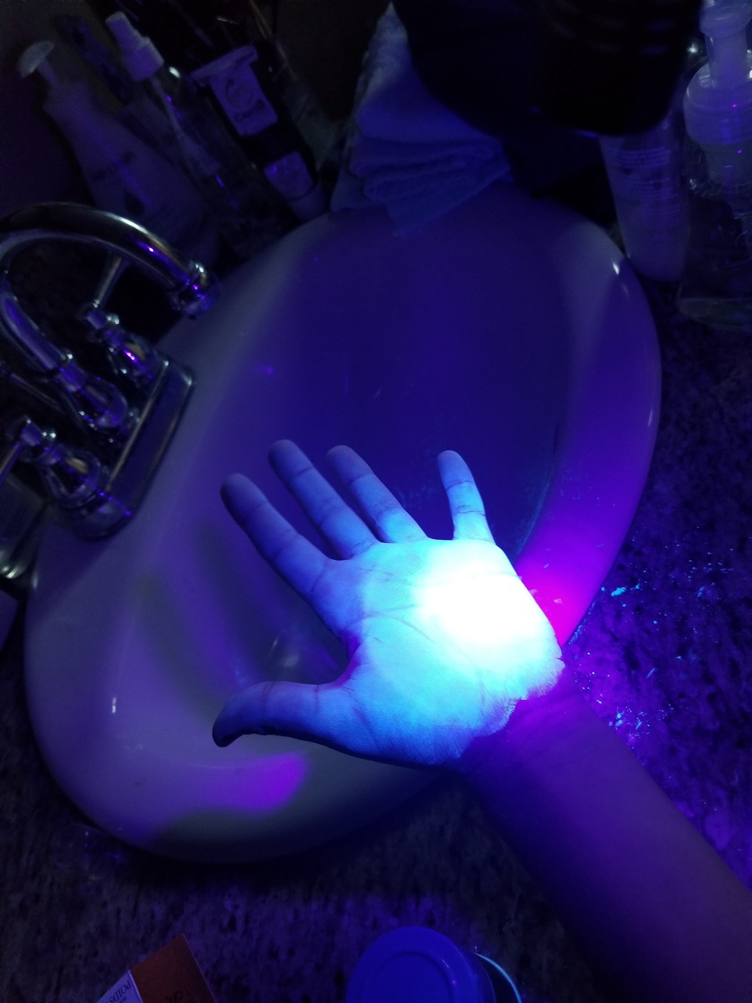
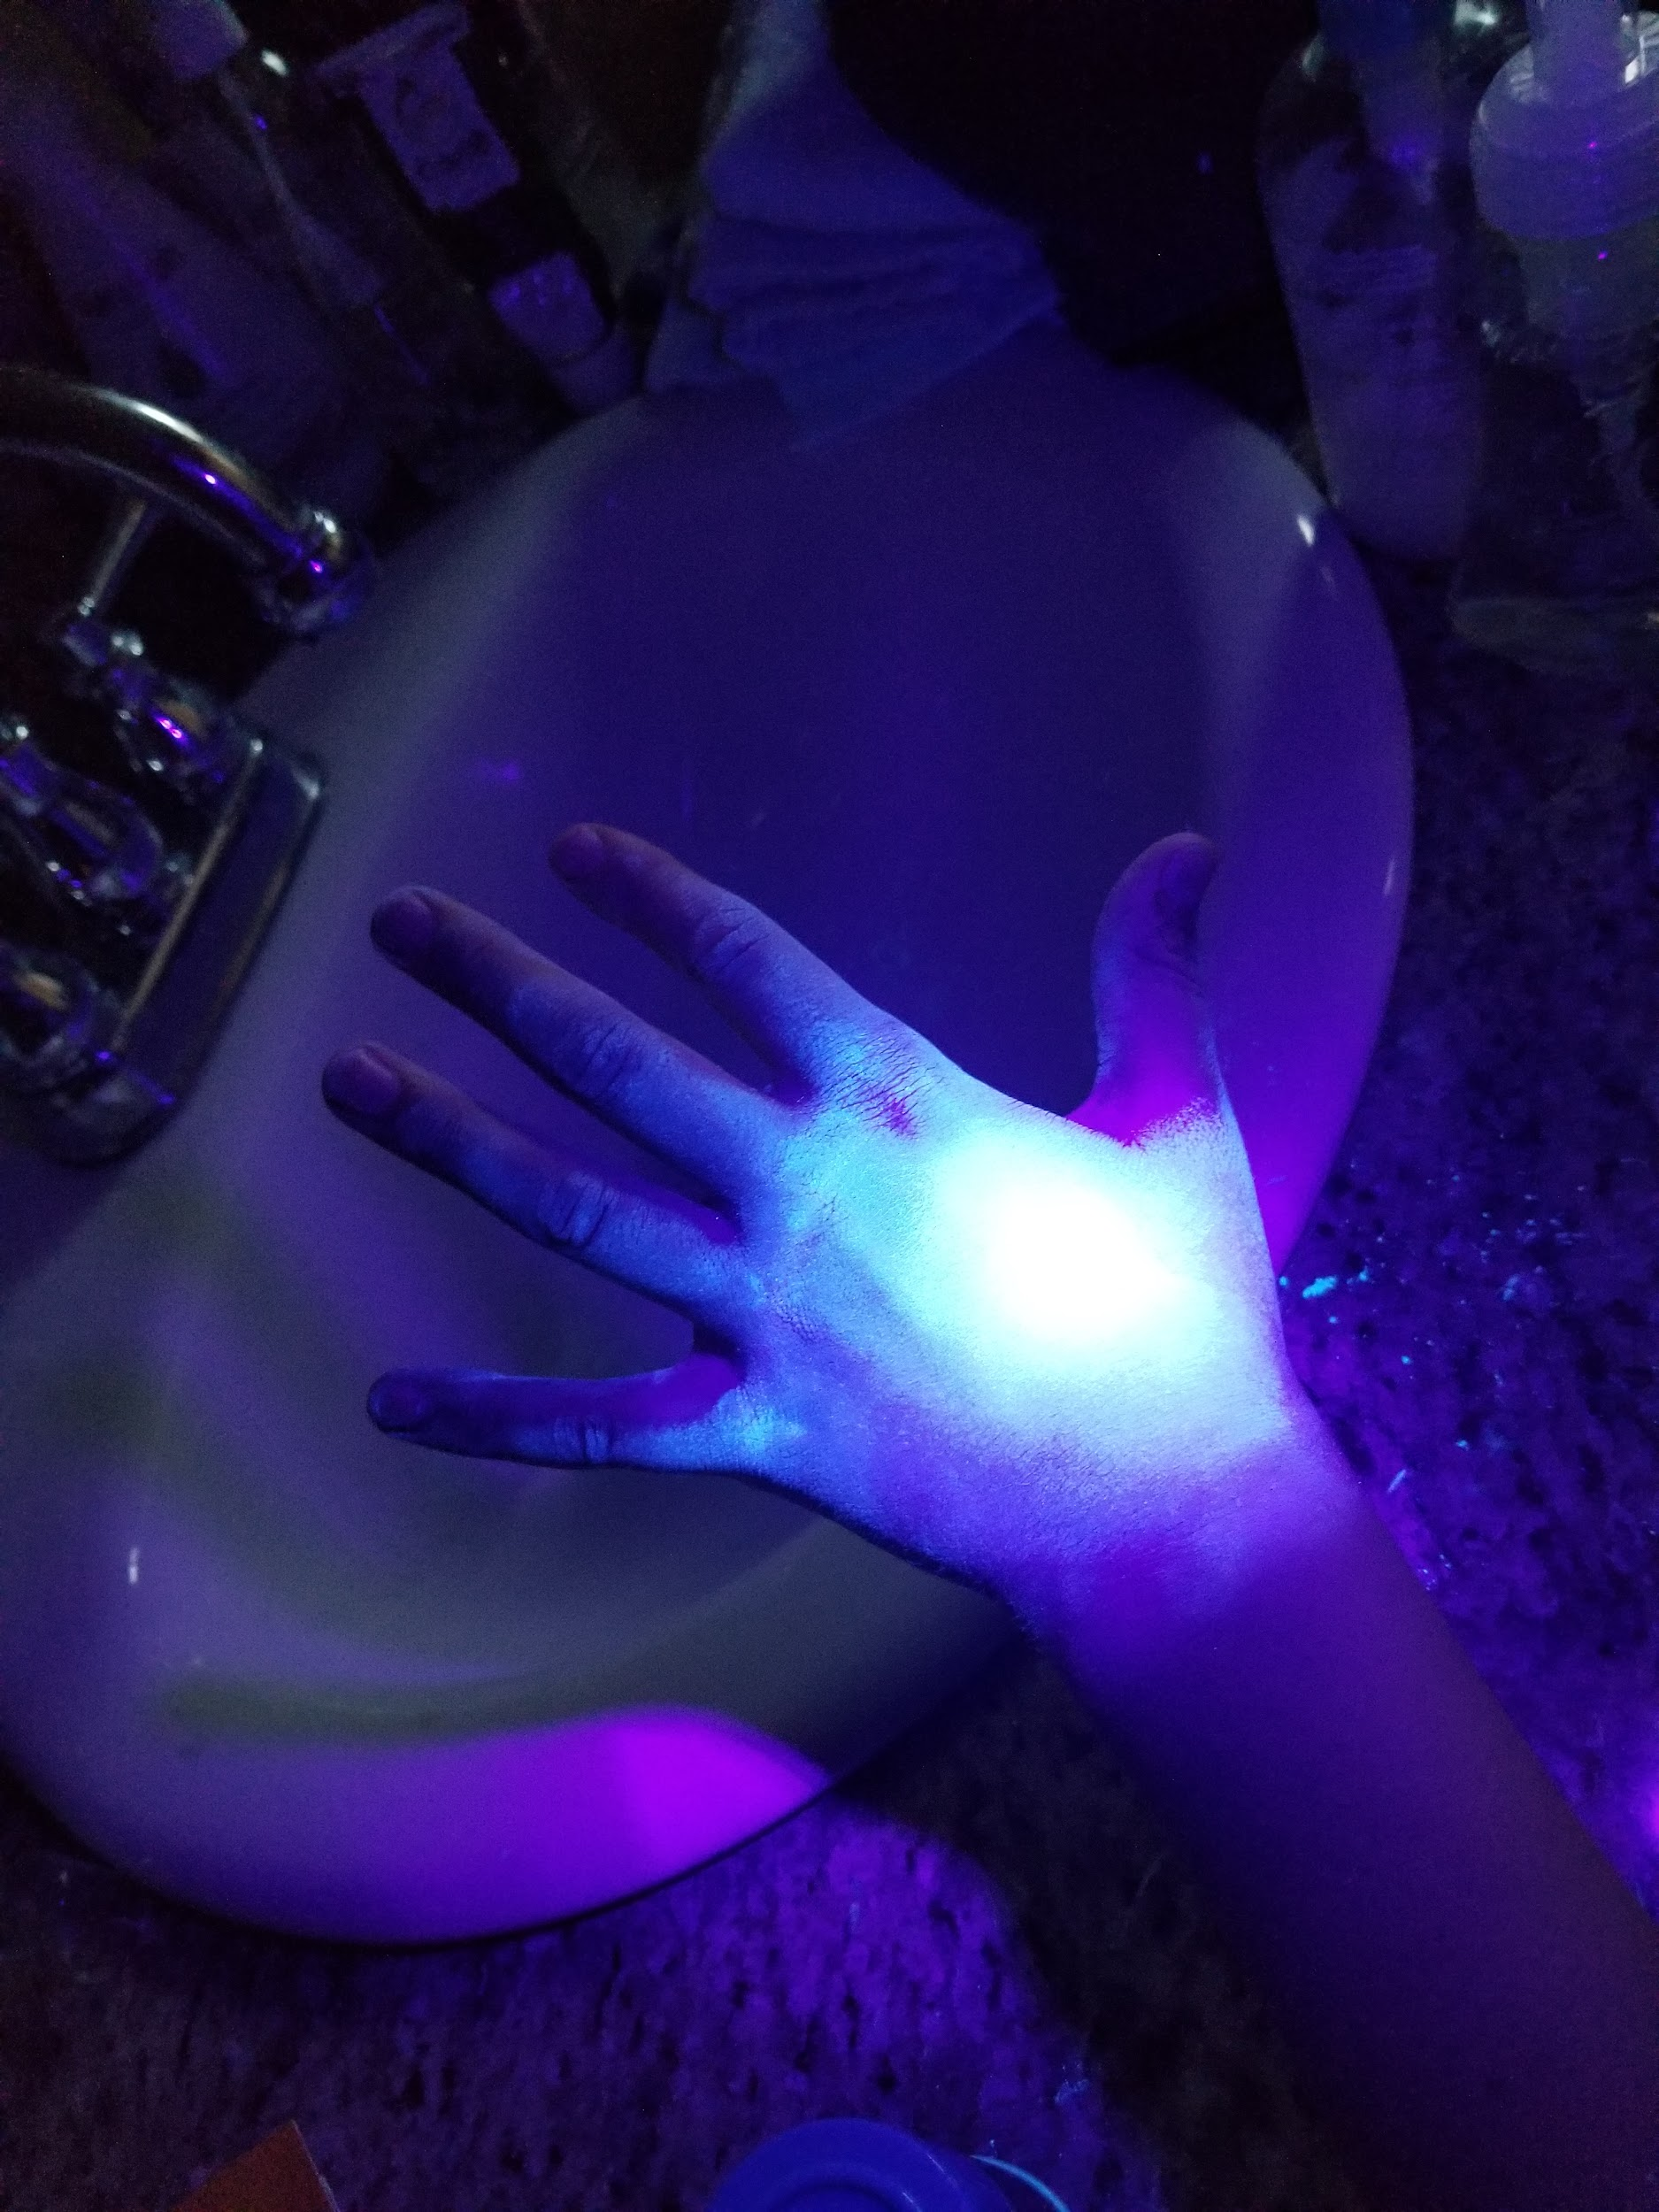
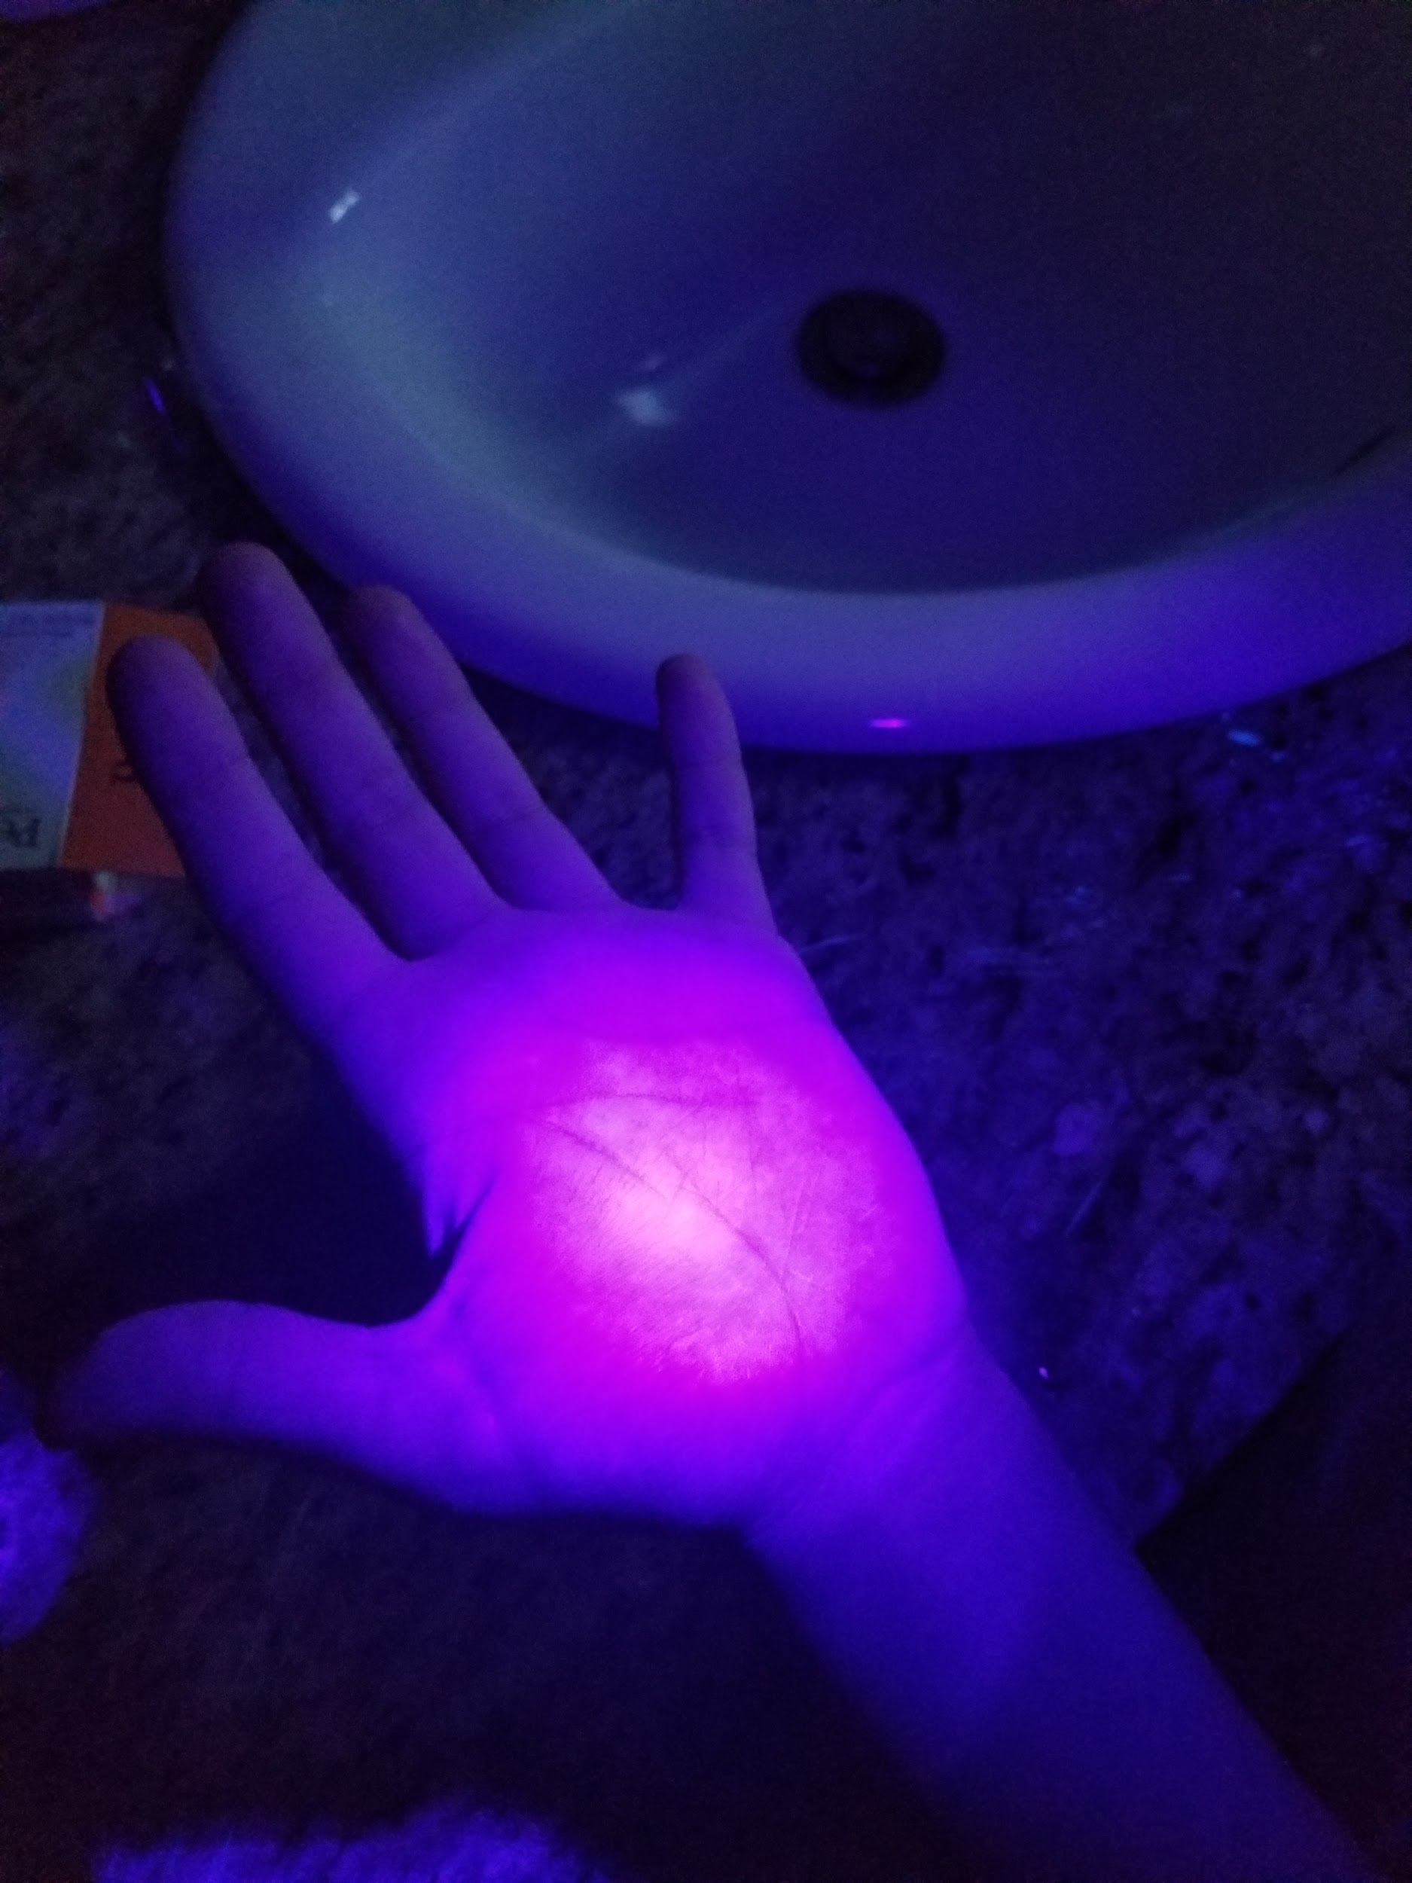
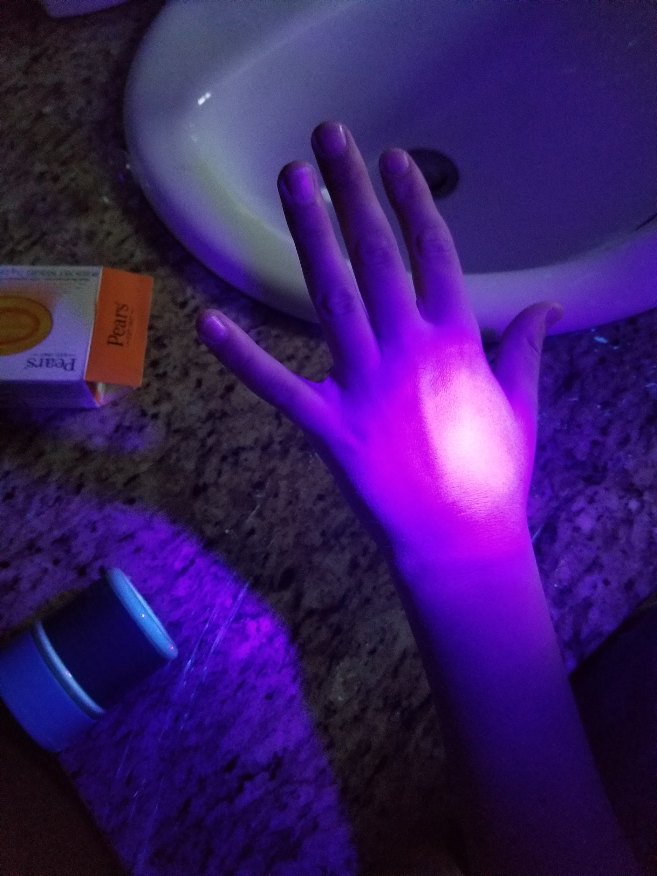
Observations Foam Soap (Test 3)
Palm before washing
Back of hand before washing
Palm after washing
Back of hand after washing

Slide 21
observations
observations

Slide 22
Observations test 3
When I used bar soap, there was still a little bit of bacteria on the back of my hand and some on my palm. My nails also had a little bit of bacteria.
When I used liquid soap, there was some noticeable bacteria in my nails after washing my hands. There was also some left on my palm.
When I used foam soap, there was basically no bacteria left on the skin. But there was some still under my nails.

Slide 23
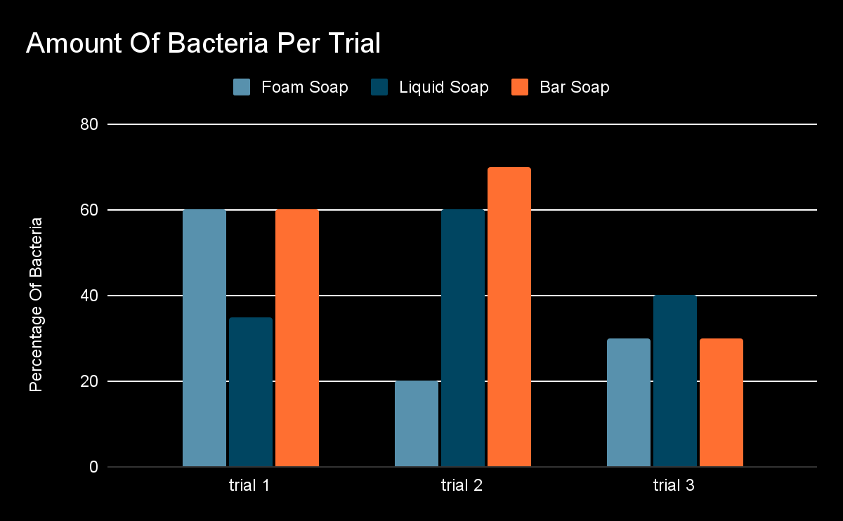

Slide 24
Analysis of Results
The trials and data collected visually told us that foam soap had the least bacteria percentage left on my hands after I washed them. I learned that bar soap is the worst soap in households because it had the most bacteria on my hands after I washed them 3 times. I noticed that Foam soap had the most lather than Liquid and Bar soap. The more lather there was, the more bacteria came off my hand. Another thing I noticed was that foam soap got the most bacteria out of the crevasses of my hands compared to Liquid soap and Bar soap. Bar soap had the most bacteria left in the crevasses because Bar soap is big, and it is hard to get it in the crevasses of my hand.

Slide 25
Conclusion
My hypothesis was incorrect because I predicted that liquid soap would get the most bacteria off my hands but liquid soap did not get the most bacteria off my hands. Foam soap was the soap that got the most bacteria off my hands and Bar soap was the soap that had the most bacteria left after washing. Bar soap did the worst I think because Bar soap is big and it is hard to get the soap in between your fingers but with liquid and foam soap you can easily get in in between your fingers. Foam soap won I think because when you do one squirt on your hand it comes out in a bigger portion and Liquid soap comes in a not so big portion and Bar soap you just rub it on your hand.

Slide 26
Real World Application
This will affect the real world because if your household is out of soap and you are wondering which soap is the best, you now know that foam soap cleans off the most bacteria. Another thing is if you are the manager of a hotel or any public building, you now know to buy foam soap instead of bar soap or liquid soap. Even though foam soap is the most expensive out of the three, it does the best job with cleaning your hands. Most of the time, public places choose to buy the cheaper soap which is bar soap, but it doesn’t do a great job at getting germs off your hands. If you are immune compromised or get sick easily, this helps you know what soap to use to keep your hands the cleanest. To prevent the spread of disease, infection, and illness, you should always wash your hands before you eat and touch your face. When you use the right soap/foam soap you could be preventing diseases like salmonella, E coli, covid 19, and colds. By using foam soap and being clean, you can keep yourself and others from getting sick.

Slide 27
Sources of Error
Some sources of errors include:
The distance that the black light was held from my hand (Closer to hand you could see more bacteria and further away you could see less)
I had to estimate the numbers on my graph because I didn’t take proper measurements of the bacteria before and after
The speed the water was running onto my hands was a little different each time I washed my hands
I did one drop of glow powder which could have had more or less of it each time

Slide 28
Next Questions
Will the different brands of soap affect how much bacteria comes off your hands?
If I added 2 squirts of foam and liquid soap would it affect how much bacteria came off my hands?
Would the different temperature affect the amount of bacteria that came off my hands?
If I put my hands under the sink water for more time would it affect the amount of bacteria came off my hands?
If I put the black light closer to hand would it expose more bacteria on my hands.
Would the more expensive soap affect the amount that is still on your hand and off your hand.
If i measured exactly one tsp instead of one shake would one shake have more than one tsp or would one tsp have more than one shake?

Slide 29
Bibliography
Brentpoint Company (Feb 21, 2022)
https://allportablesinks.com/blogs/news/different-soap-types-and-their-uses#:~:text=Liquid%20hand%20soap%20is%20the,homes%20and%20businesses%20for%20handwashing
English Soap Company (2024)
https://theenglishsoapcompany.com/how-does-soap-work/
Wikipedia (Jan 21, 2024)
https://en.wikipedia.org/wiki/Potassium_hydroxide
Kerrieanne Lischka (Jan 13, 2023)
https://honeydownfarm.com/blogs/goat-farm-blog/unlock-the-secrets-of-soap-making-with-the-best-oils-for-bar-soap#:~:text=Castor%20oil%20is%20a%20great,and%20provides%20a%20creamy%20lather.

Slide 30
Bibliography
Better Health (May 25, 2021) https://www.betterhealth.vic.gov.au/health/conditionsandtreatments/handwashing-why-its-important
CHOC (Aug 18, 2022) https://health.choc.org/why-is-my-child-always-sick-a-pediatrician-answers-your-questions/#:~:text=It%20is%20very%20common%20for,colds%20or%20illnesses%20per%20year.

